Slide 1
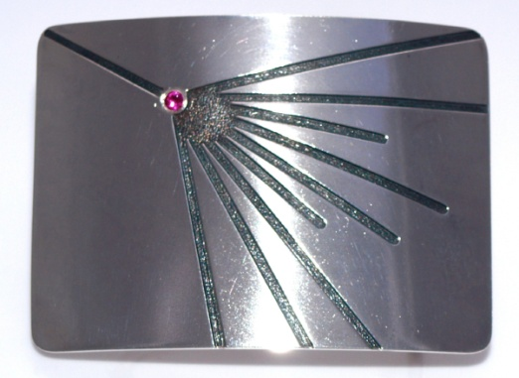
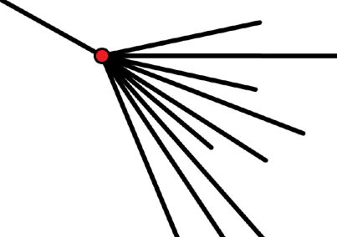
Interplay between Particle and Astroparticle Physics
QMUL: August 2014
Results from the Pierre Auger Observatory
Alan Watson*
University of Leeds, UK
*Talk given on behalf of Auger Collaboration
Thanks to many colleagues for slides and advice
~ 400 people from 17 countries

Slide 2
Overview:
Auger Observatory and Telescope Array
UHECR Energy Spectrum
Mass Composition (nuclei only)
Data-mismatches with Particle Physics
Summary
(No discussion of anisotropy or astrophysical implications,
p-p cross-section at 57 TeV or of photon or neutrino searches
....................................................)

Slide 3
Flux of Cosmic Rays
1 particle m⁻² s⁻¹
Air-showers
25 decades
in intensity
‘Knee’
1 particle m⁻² per year
Ankle
1 particle km⁻² per year
S Swordy
(Univ. Chicago)
LHC
11 Decades
in Energy

Slide 4
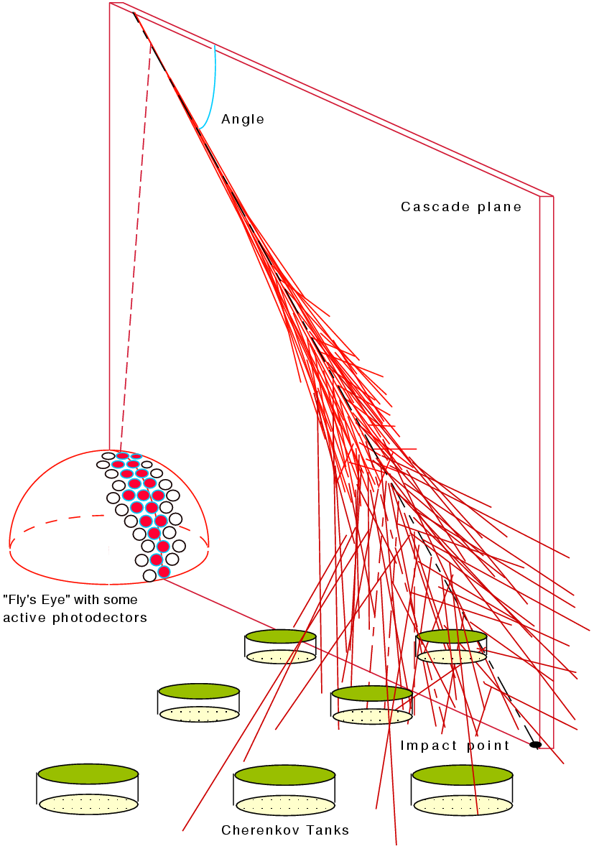
Schematic of Air-Shower Detection
The design of the Pierre Auger Observatory married these two
well-established techniques
→ the ‘HYBRID’ technique
Fluorescence →
25 km²
Arrays of water- → Cherenkov detectors
11
Enrique Zas

Slide 5
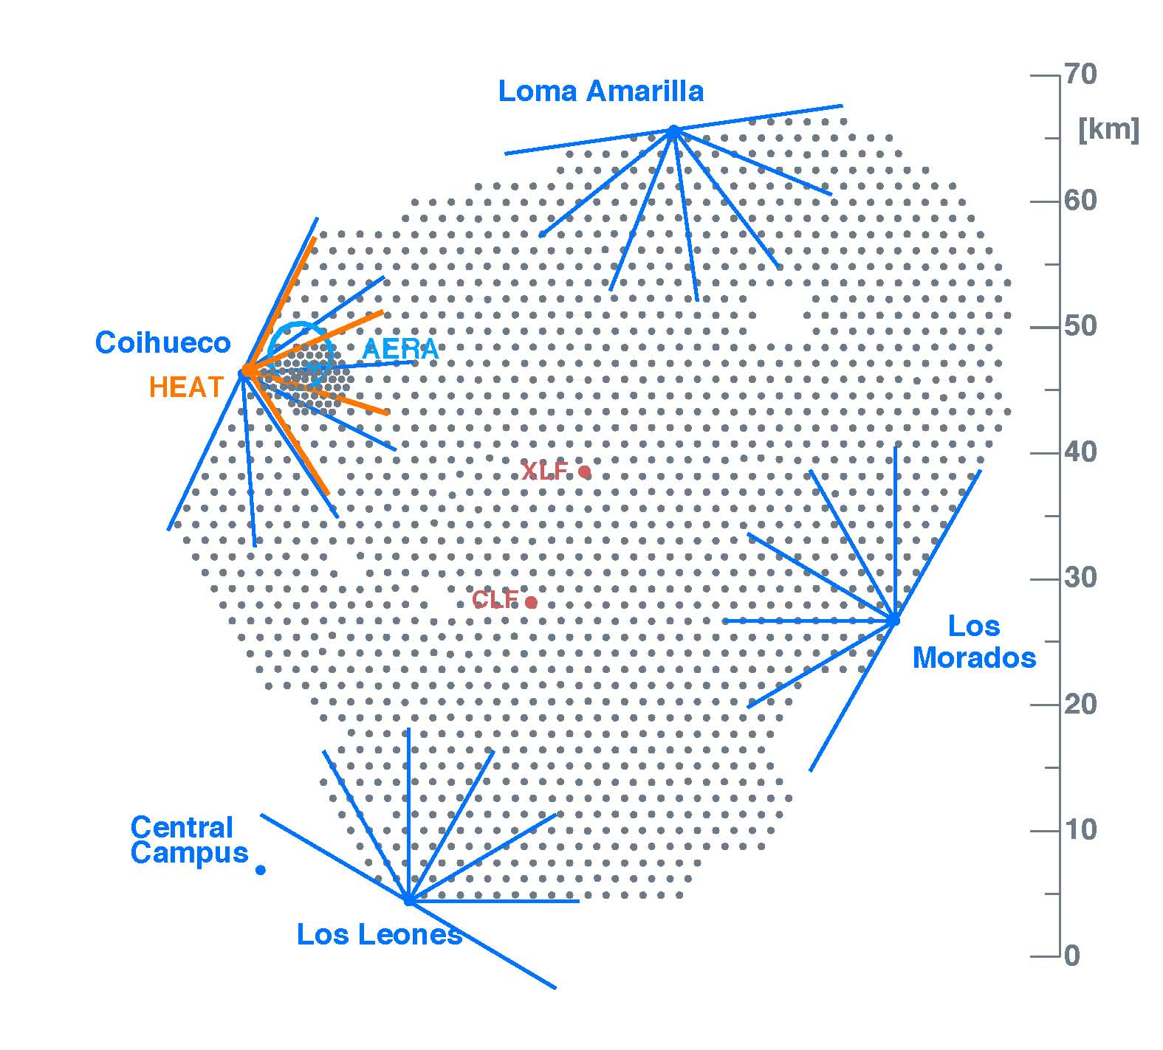
Pierre Auger Observatory
35.1 – 35.2° S at 1400 m asl
1600 10 m² x 1.2 m
water-Cherenkov detectors
on 1500 m grid
49 more on 750 m grid
27 Fluorescence detectors
in 5 buildings
~ 400 scientists (PhD and students)

Slide 6
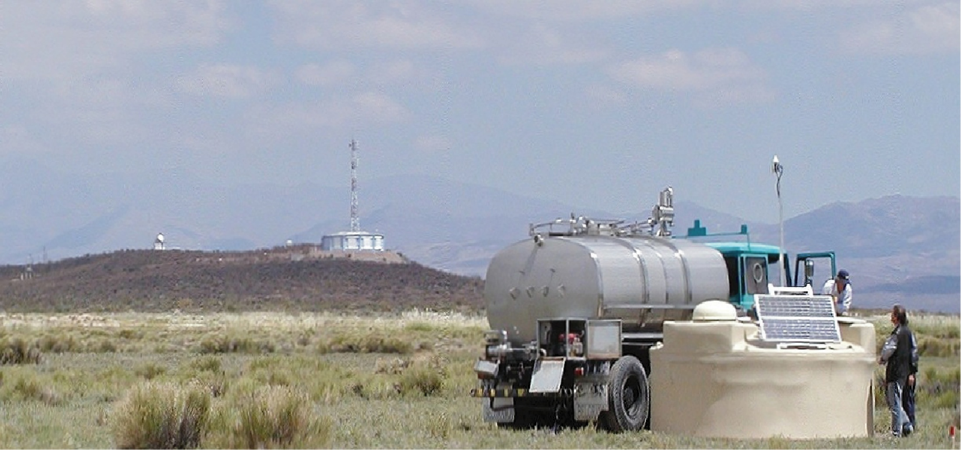
GPS Receiver
and radio transmission
Fluorescence
Detector site

Slide 7
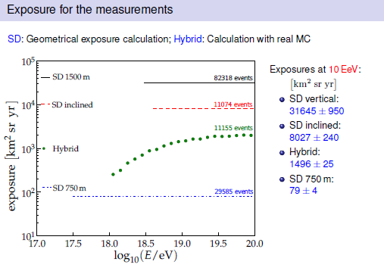
θ < 60⁰
TA
Telescope Array and HiRes
TA 4580 km² sr yr
14787 events above 10^{18.2} eV
HiRes 3650 km² sr yr
307 events above 10¹⁹ eV
The high statistics from Auger allow good
understanding of systematic uncertainties
- also a much larger collaboration

Slide 8
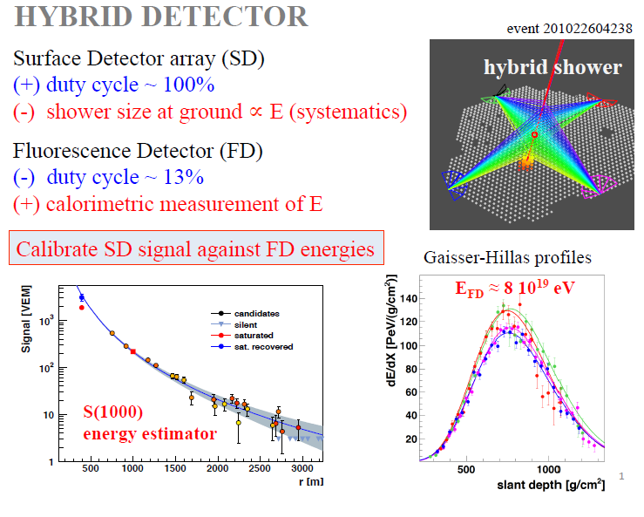
cf: S(800) in case of TA

Slide 9
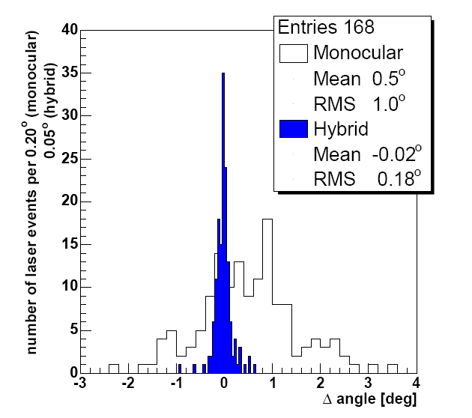
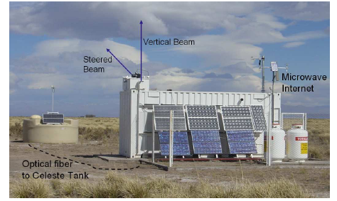
Angular Resolution checked using Central Laser Facility
355 nm, frequency tripled, YAG laser,
giving < 7 mJ per pulse: GZK energy
Mono/hybrid rms 1.0°/0.18°

Slide 10
Some Longitudinal Profiles measured with Auger
1000 g cm⁻² = 1 Atmosphere ~ 1000 mb
E = (ε₀/X₀) ∫ N_{e}(x) dx = (2.27 MeV) ∫ N_{e}(x) dx
Excluding ‘invisible energy’

Slide 11
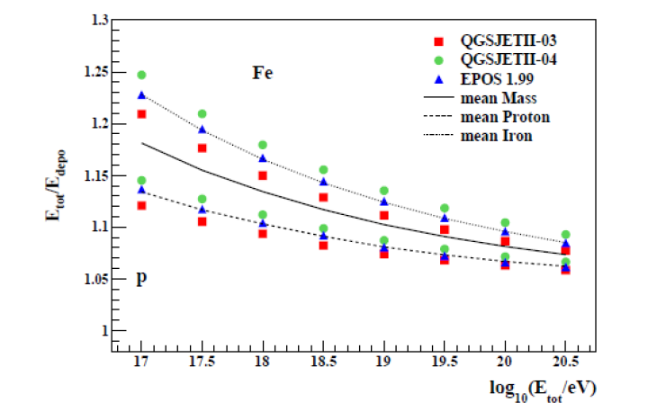
Correction for Invisible Energy (muons and neutrinos mainly)

Slide 12
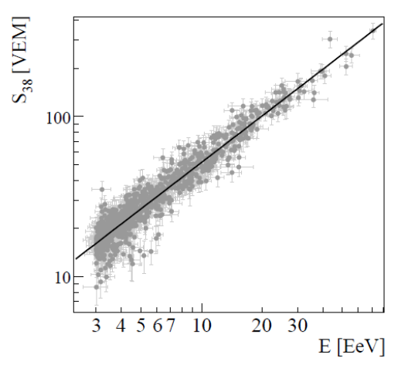
(S(1000) at 38° to Energy) conversion curve

Slide 13
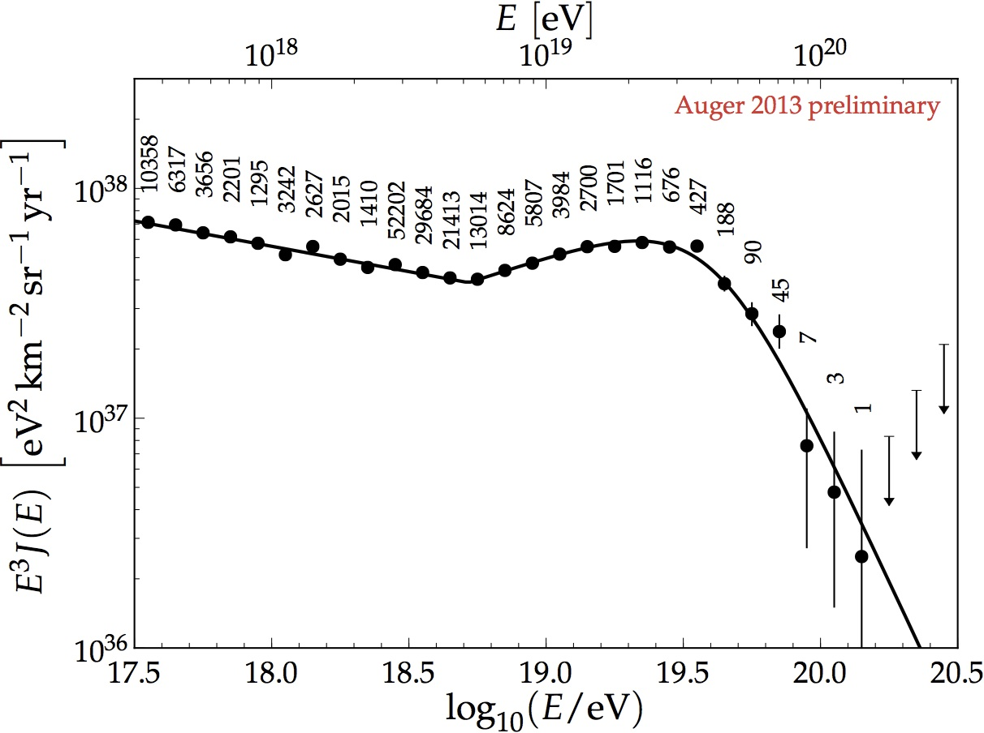
~ 175,000 events
~ 11000 > 10 EeV
Greisen-Zatsepin-Kuz’min – GZK effect - (1966)
γ_{2.7 K} + p → Δ⁺ → n + π⁺ or p + πº
and
γ_{IR/2.7 K} + A → (A – 1) + n
Sources must lie within ~ 100 – 200 Mpc

Slide 14
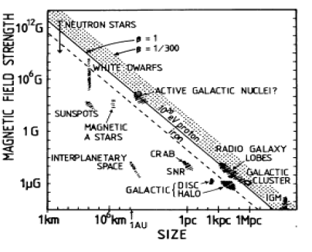
Or does the steepening mark the limit that the accelerators can reach?
E_{max} = kZeBRβc
k < 1
Hillas 1984
ARAA
B vs R
B
R

Slide 15
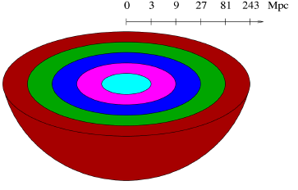
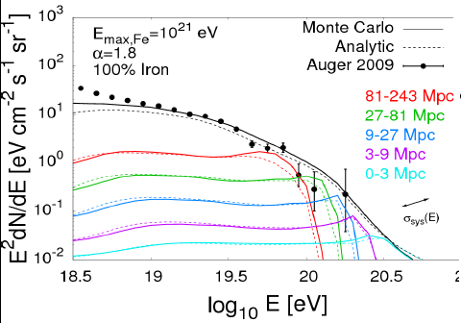
Taylor, arXiv:1107.2055

Slide 16
So crucial question is
“What is the mass of the cosmic ray primaries
at the highest energies?”
Answer is dependent on unknown hadronic interaction
physics at energies up to ~ 30 times CM energy at LHC
In particular, cross-section, inelasticity and multiplicity
Here is an important link between particle physics and
astroparticle physics

Slide 17
How we try to infer the variation of mass with energy
X_{max}
photons
< 1% above 10 EeV
protons
Data
Fe
dX_{max}/log E = elongation rate
Energy per nucleon is crucial
Need to assume a model
log (Energy)

Slide 18
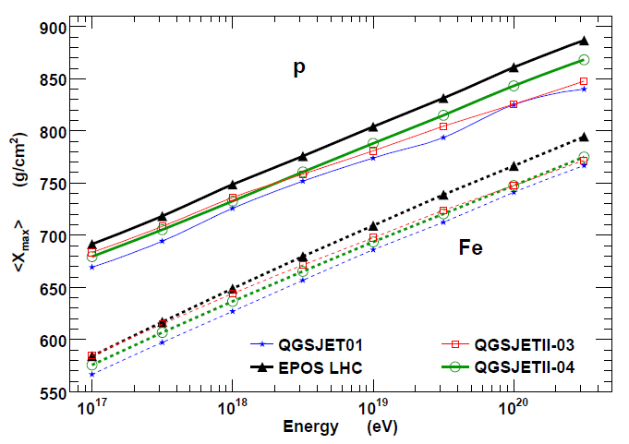
X_{max} vs log E is model dependent
~ 30 g cm⁻²
Tanguy Pierog

Slide 19
Some Longitudinal Profiles measured with Auger
1000 g cm⁻² = 1 Atmosphere ~ 1000 mb
rms uncertainty in X_{max} < 20 g cm⁻² from stereo-measurements

Slide 20
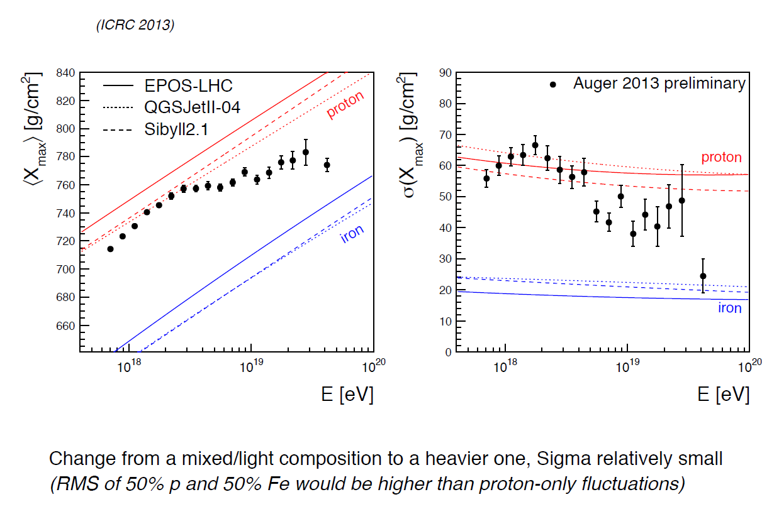
20 g cm⁻²
3 EeV x 26

Slide 21
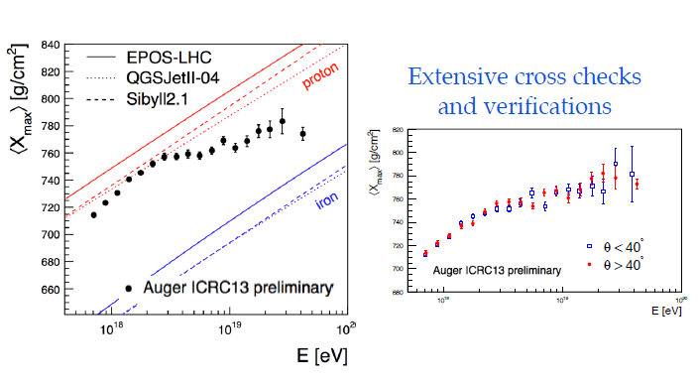
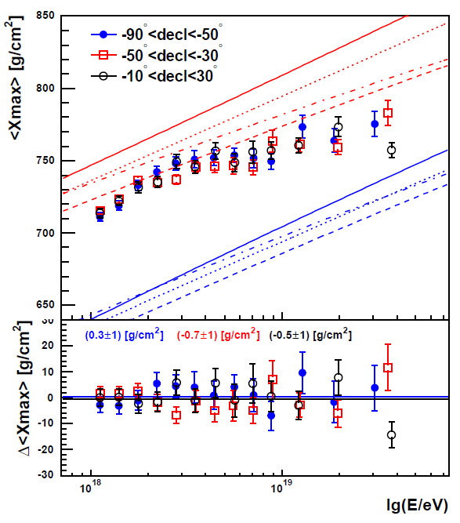
Extensive Cross-checks and
Verifications
Zenith and declination
dependencies
For detailed discussion of method see paper by de Souza at Rio ICRC and
forthcoming detailed paper to be submitted shortly

Slide 22
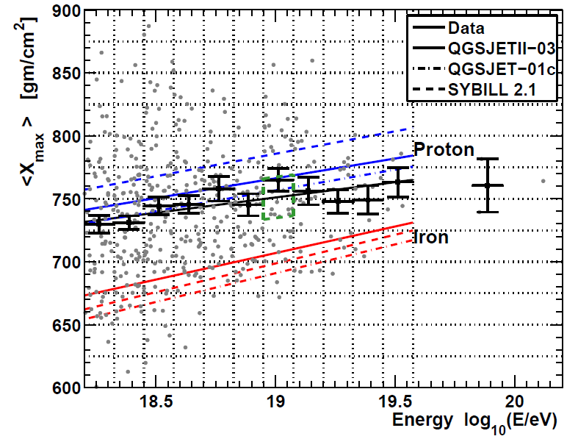
Recent Result from TA: arXiv 1408.1726
822 events

Slide 23
3 EeV x 26
Auger: ~ 20,000 events, TA: 822

Slide 24
Tanguy Pierog

Slide 25
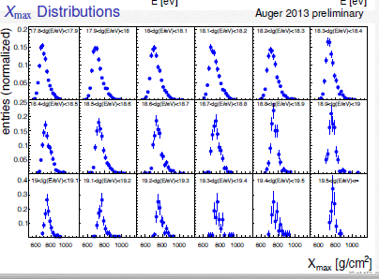
The latest version of the Auger Analysis based on ~ 20,000 events
3768
37

Slide 26
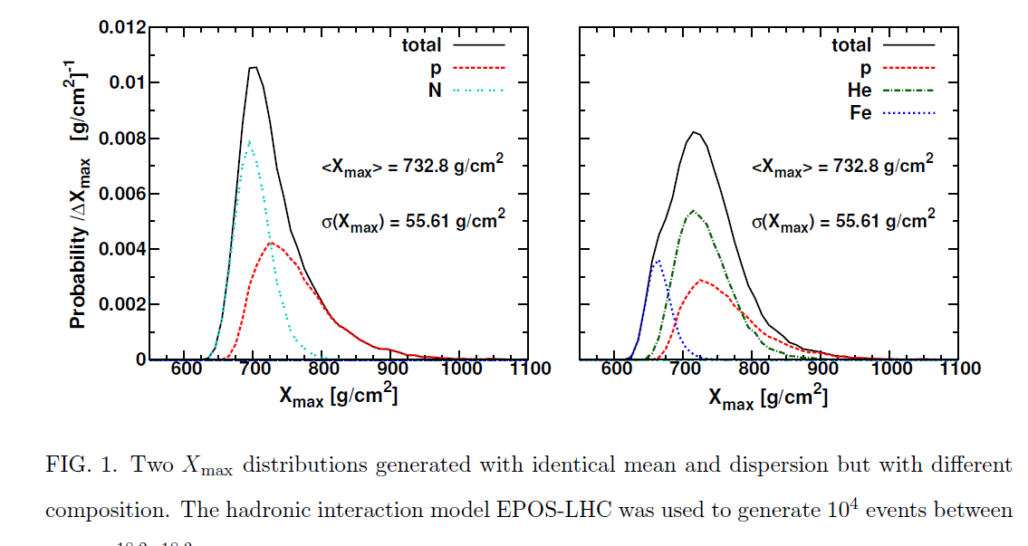
Detailed study of X_{max} distributions are required

Slide 27
Composition extracted is dependent on models used
Papers describing Auger measurements and detailed interpretation
of X_{max} distributions are in advanced state of preparation
Some (qualitative) highlights:-
A proton/iron mix cannot explain the data at any energy
Around 1 EeV, relatively large fraction of protons (>50%) for all
models tried, and helium ~ 10% (relevant for cross-section studies)
Above 10 EeV, ~ 20% protons with negligible iron
until highest energies
Light nuclei (He, N) appear to be required
BUT ALL CONCLUSIONS ARE MODEL DEPENDENT!

Slide 28
Hadronic Interactions
Some demonstrations of problems

Slide 29
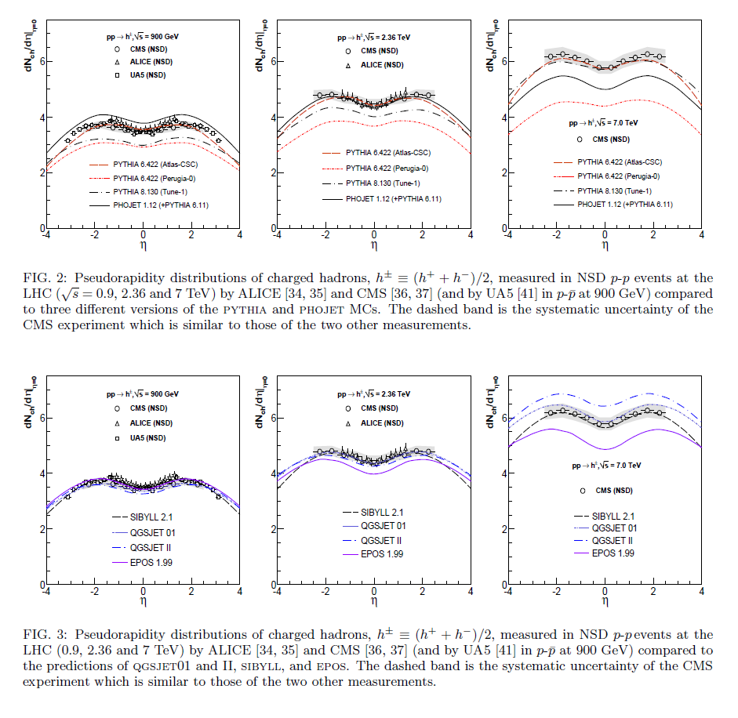
d’Enterria, Engel, Pierog, Ostapchenko and Werner (2011)

Slide 30
Problems with models at high energies and large angles where muon number
in showers can be measured can be fairly readily explained
Summary of following papers:-
Inclined Reconstruction: JCAP 08 019 2014
Inclined Muon Number: arXiv 1408.1421
MPD paper: Phys Rev D 90 (2014) 012012

Slide 31
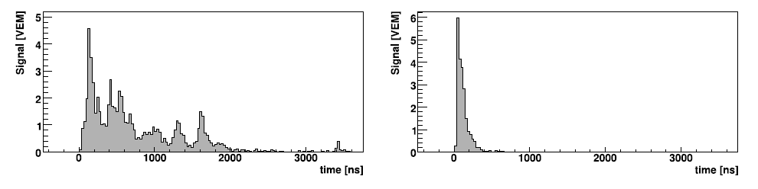
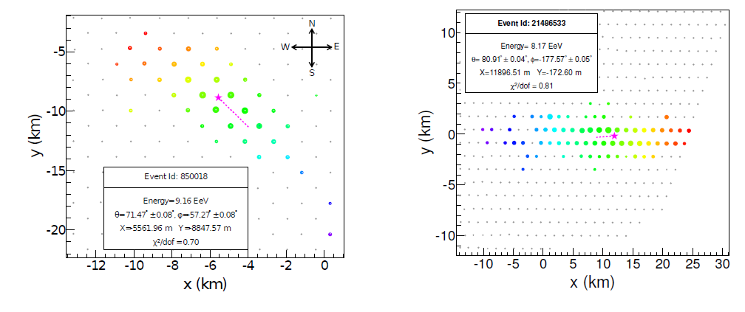
Characteristics of inclined showers I: Measuring the number of muons
1 km, 22°
1 km, 80°: ~ 5000 g cm⁻²
37 stations
69 stations

Slide 32
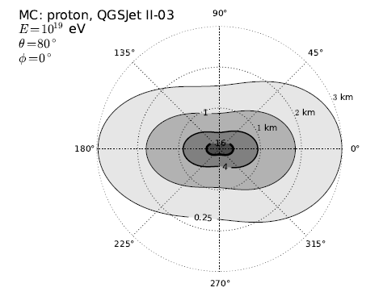

Slide 33
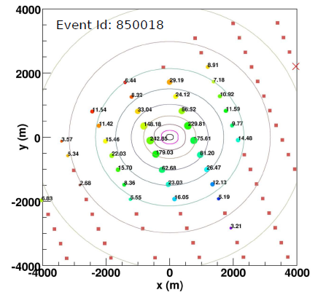
37 stations
71°
54 EeV
Fit made to density
distribution
Energy measured
with ~20 % accuracy

Slide 34
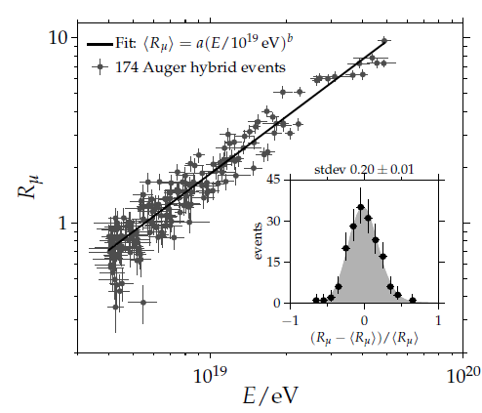

Slide 35
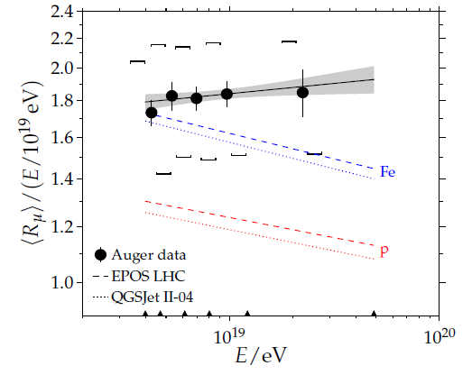
Muon numbers predicted by models are under-estimated
by 30 to 80% (20% systematic)

Slide 36
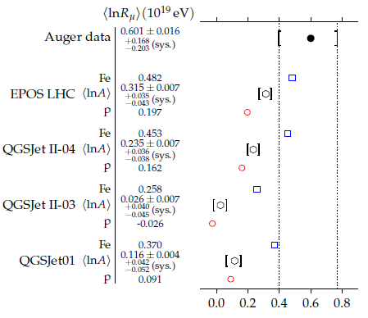

Slide 37
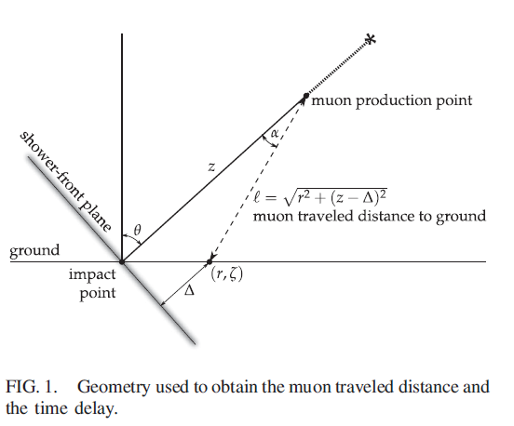
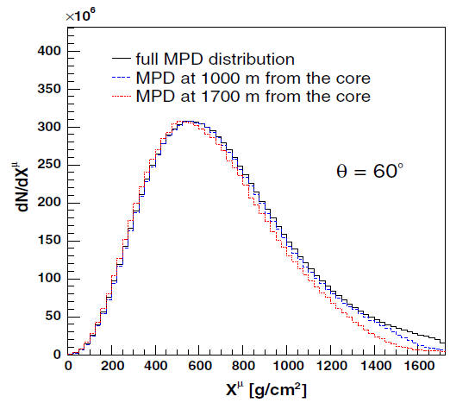
Second method of testing models:
Muon Production Depth (MPD)
log (E/eV) = 19.5

Slide 38
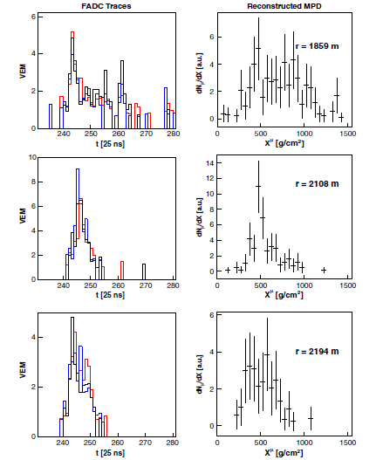
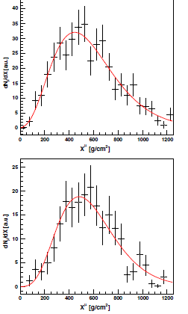
91 EeV
33 EeV

Slide 39
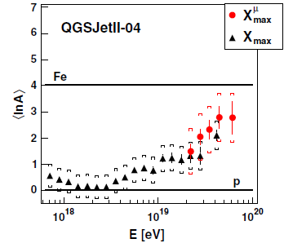
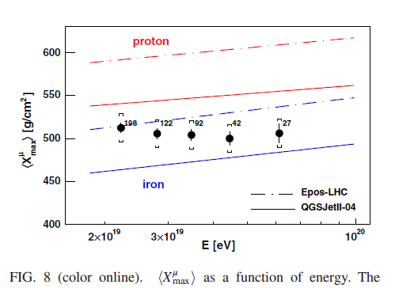
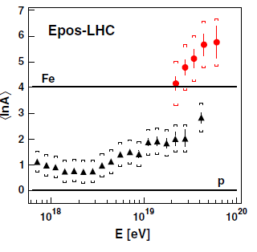

Slide 40
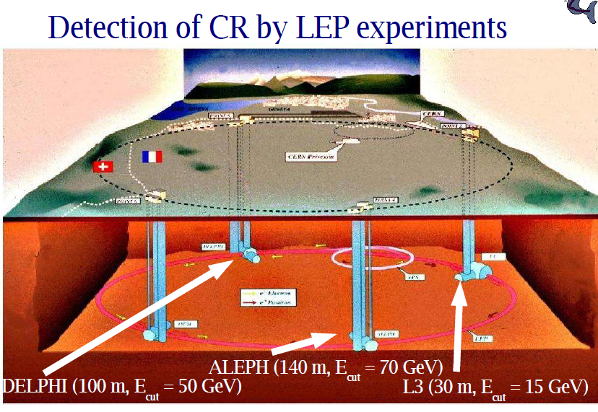
Is muon problem similar to what was seen at LEP?

Slide 41
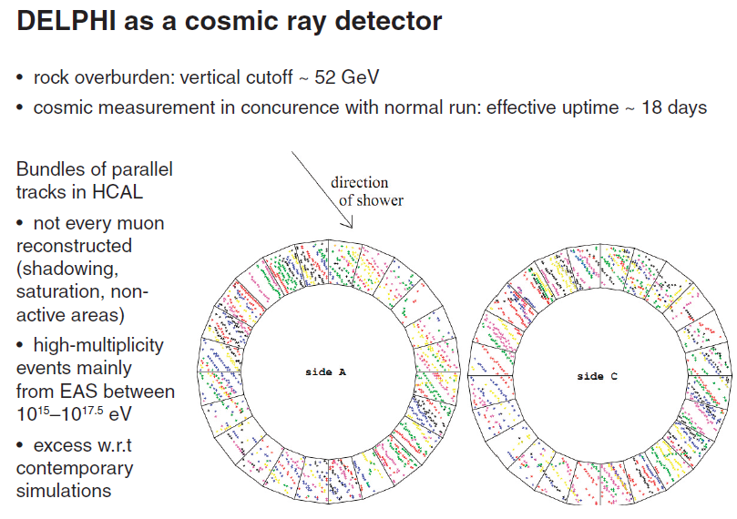

Slide 42
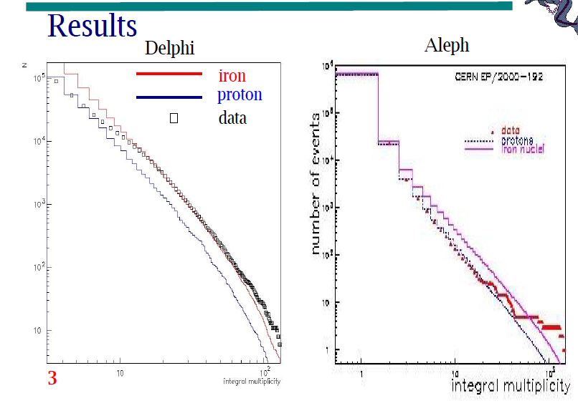

Slide 43
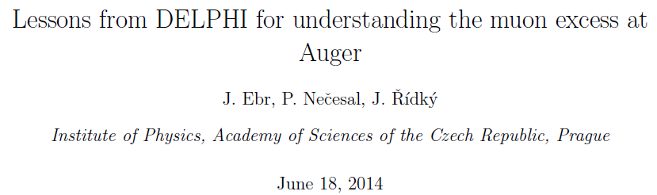
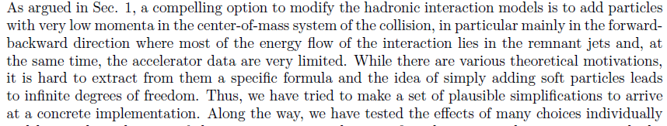
Auger Collaboration Note

Slide 44
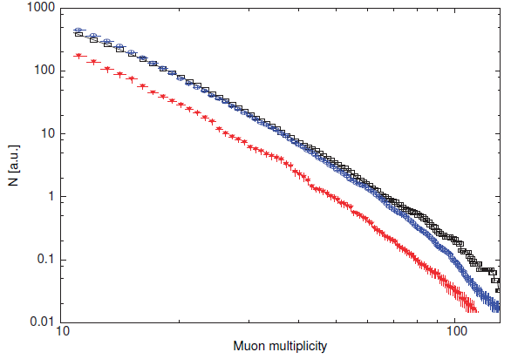
Red: protons
Blue: iron
Black: DELPHI data

Slide 45
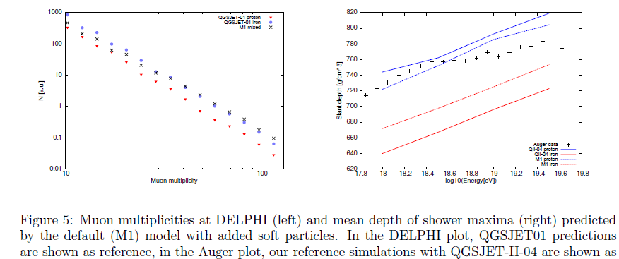
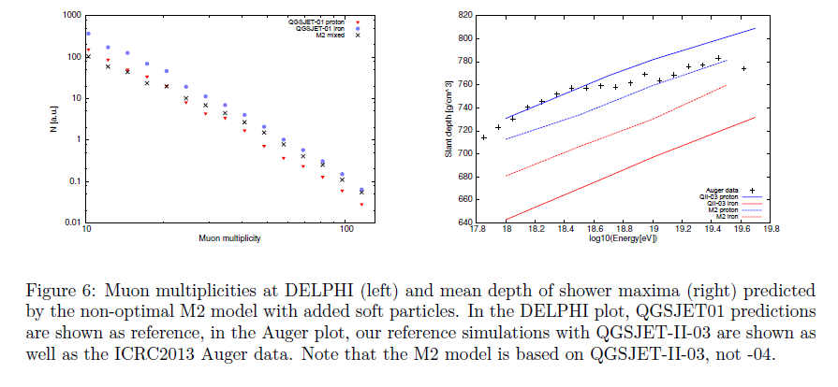

Slide 46
Conclusions:-
There is a steepening in the cosmic ray spectrum above ~ 40 EeV
Whether this is a source signature or the GZK-effect is unclear
There is evidence that the mean mass of UHECR increases with
energy
Helium and Nitrogen are important constituents of UHECR
Supports the view that the spectral steepening is a source effect
BUT: there are problems with the extrapolation of models to
the highest energies: TOO FEW MUONS ARE PREDICTED

Slide 47
Back Up Slides

Slide 48
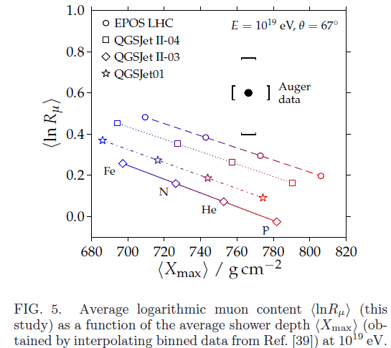

Slide 49
Arrival Direction Distributions

Slide 50
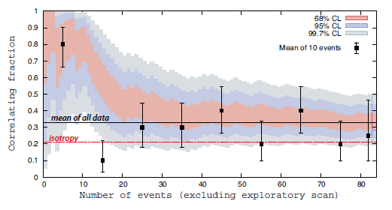
Events above 50 EeV
New results from TA do not contradict this effect

Slide 51
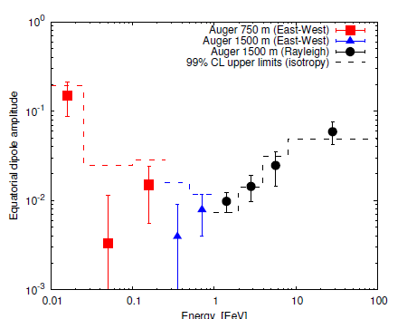
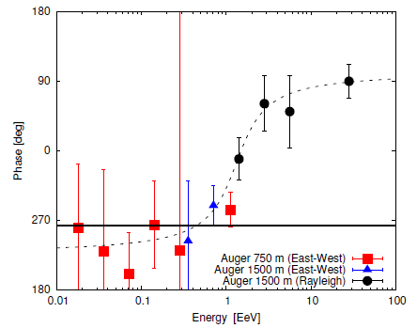
Amplitudes and Phases from Auger

Slide 52
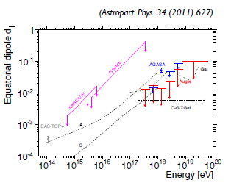
A and S:
Candia et al. 2003
Gal:
Calvez et al. 20110
C-G Xgal:
Kachelreiss and Serpico
2006

Slide 53

Telescope Array
Properties:-
Latitude = 39.3° N at 1400 m
507 x 3 m² scintillators
on 1200 m square grid
Overlooked by 3 FDs
Relatively easy deployment by
helicopter and runs well
However
Small area ~ 700 km²
(built to check AGASA)
Thin scintillators limit declination
band studied
Little prospect of muon identification
~ 120 collaborators from Japan, US, Belgium, South Korea and Russia

Slide 54



Telescope
Array
TA and Auger are what are now called ‘Hybrid Detectors’

Slide 55


log E X_{max}
19.2 – 19.4 42.9 ± 5.1 g cm⁻²
19.2 – 19.3 40.4 ± 6.3 g cm⁻²
19.3 – 19.4 46.9 ± 7.0 g cm⁻²
Corresponding Pull:-
(42.9 – 28.9)/√(4.5² + 5.1²) = 2.1 sigma
Drawing 71 events (2010) from 194 events (2013) give RMS < 28.9 g cm⁻² at 3.1%
Also there is a trials factor
2010
Analysis by Michael Unger

Slide 56


Slide 57


Slide 58

Towards the Energy Spectrum

Slide 59


