Slide 1
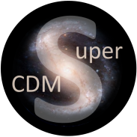
SuperCDMS
From Soudan to SNOLAB
Wolfgang Rau
Queen’s University

Slide 2
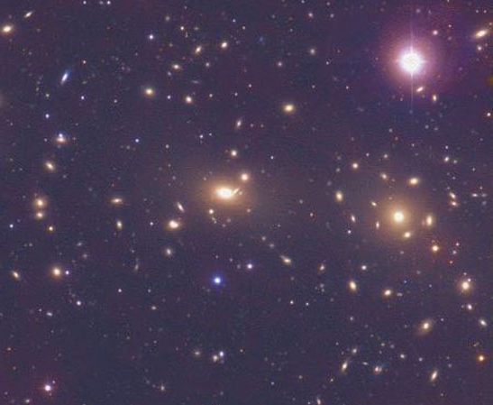
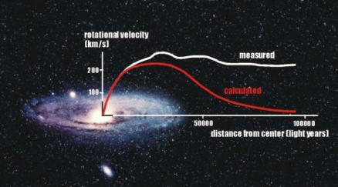
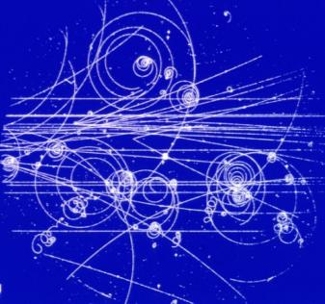
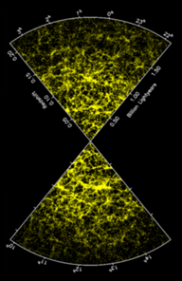
Dark Matter
Not observed in accelerator experiments:
Massive
Here, but not yet observed in nature: Weakly interacting
WIMP
(Weakly Interacting Massive Particle)
Predicted by SUSY: Neutralino
Universal extra dimensions:
Kaluza-Klein particles
Interaction with ordinary matter:
Nuclear Recoils
(most backgrounds:
electron recoils)
Large scale
structure of the Universe:
Slowly moving (‘cold’)

Slide 3
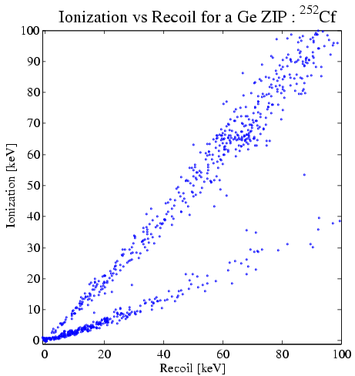
SuperCDMS Technology
Thermal
bath
Thermal coupling
Phonon signal (single crystal):
measures energy deposition
Ionization signal (semiconductor):
quenched for nuclear recoils
(lower signal efficiency)
Combination:
efficient rejection of electron recoil background
Phonon sensor
+
+
+
+
+
+
+
+
+
+
e
+
-
n
-
-
-
-
-
-
-
-
-
Target
-
Phonon signal
Electron recoils
from β’s and γ’s
Ionization energy [keV eeq]
Electron recoil (ER)
Nuclear recoil (NR)
Nuclear recoils
from neutrons
Charge signal
Phonon energy [keV]

Slide 4
Neganov-Luke Phonons
-
In Vacuum
+
-
Electron gains kinetic energy
(E = q · V → 1 eV for 1 V potential)
-
In Matter
+
Deposited energy in crystal lattice:
Neganov-Luke phonons
∝ V, # charges
-
Luke phonons mix charge and phonon signal → reduced discrimination
Apply high voltage → large final phonon signal, measures charge!!
ER much more amplified than NR
→ gain in threshold; dilute background from ER

Slide 5
Background dilution with Luke Effect
Electron Recoil Spectrum
Nuclear Recoil Spectrum
Number of Counts
Energy

Slide 6
CDMS History
1998 - 2002
CDMS @ SUF
6 detectors
1 kg Ge (30 kgd )
σ < 3.5e-42 cm²
CDMS II @ Soudan
30 detectors
~4 kg Ge (400 kgd)
σ < 2e-44 cm²
SUF, 10 mwe
2003 - 2009
2009 - 2014
SuperCDMS @ Soudan
15 (bigger) detectors
~9 kg Ge (~2000 kgd)
σ < few e-45 cm²
Soudan, 2000 mwe
exposures are
after all cuts!
SuperCDMS @ SNOLAB
O (50) detectors
Ge / Si, including HV
σ ≈ e-46 cm²
2017?
SNOLAB, 6000 mwe

Slide 7
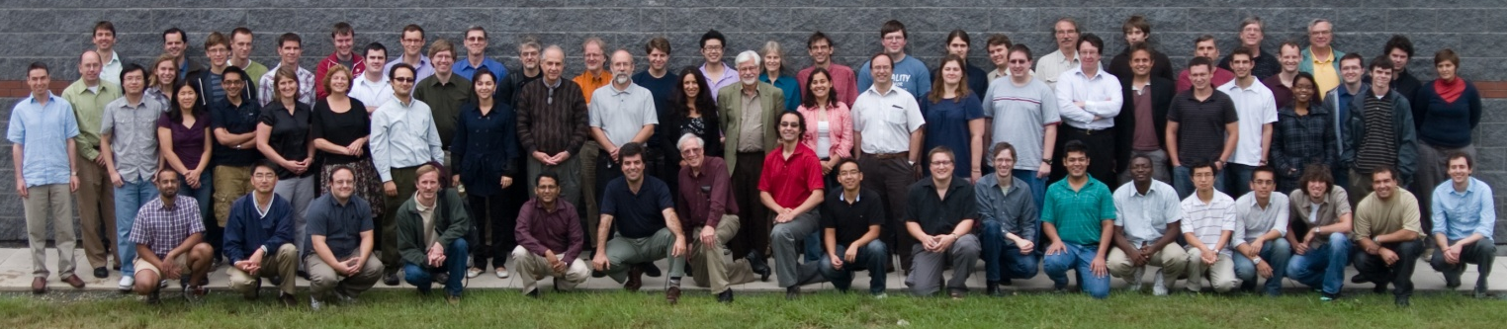
SuperCDMS Collaboration
California Institute of Technology CNRS/LPN Fermi National Accelerator Laboratory
NIST Massachusetts Institute of Technology PNNL Queen’s University
Santa Clara University SLAC/KIPAC Southern Methodist University
South Dakota School of Mines & Technology Stanford University Texas A&M
Universidad Atónoma de Madrid University of British Columbia
University of California, Berkeley University of Colorado Denver
University of Evansville University of Florida University of Minnesota
University of South Dakota

Slide 8
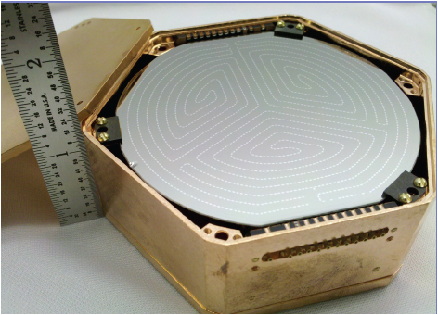
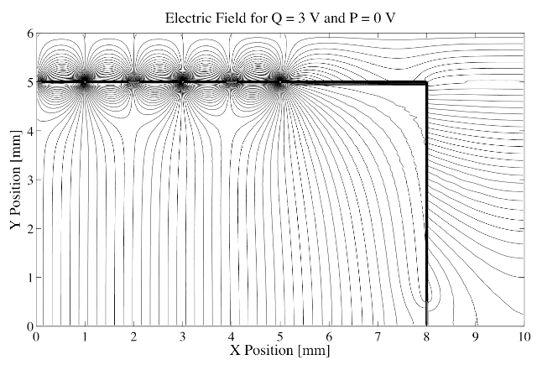
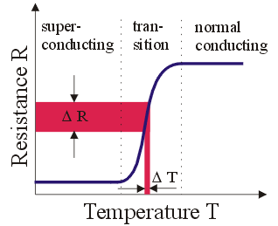
Implementation
+2 V
0 V
0 V
Basic configuration
CDMSlite configuration
Electric field calculation
-2 V
0 V
-69 V
Germanium single crystals (620 g modules)
Thermal readout: superconducting phase transition sensor (TES); T_{c} = 50 – 100 mK
Charge readout: Al electrode; interleaved with phonon sensors
Low bias voltage (4 V) in regular operation
One detector: ~70 V for some time

Slide 9
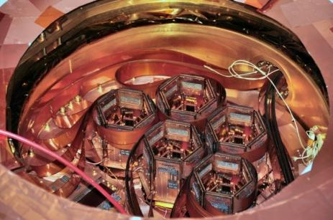
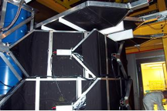
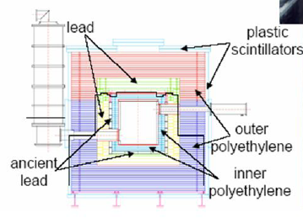
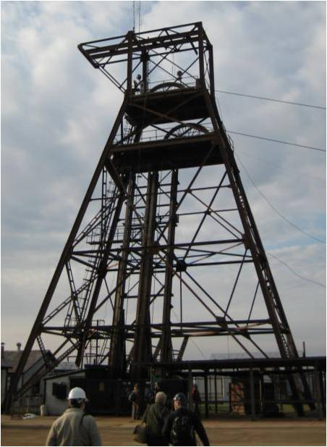
Implementation (CDMS setup)
Stack detectors (3) to mount (“tower”)
5 towers deployed in cryostat (~9 kg Ge)
Shielded with PE (for neutrons), Pb (gammas) and muon veto (cosmic radiation)
Located at Soudan Underground Lab (Minnesota) to shield from cosmic radiation

Slide 10
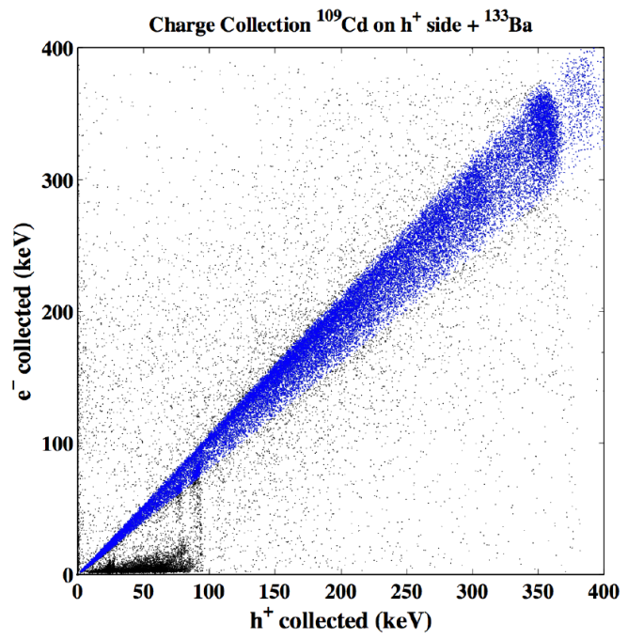
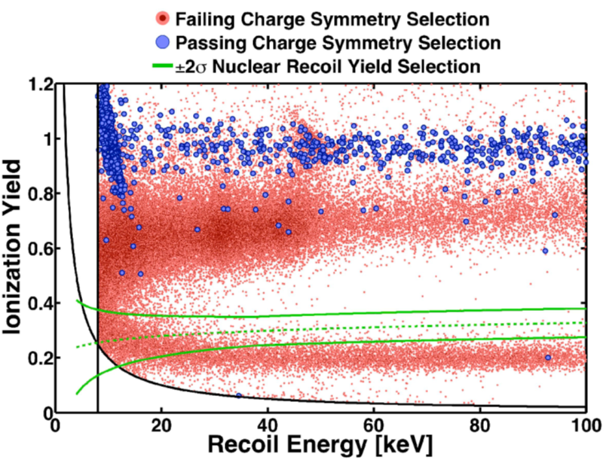
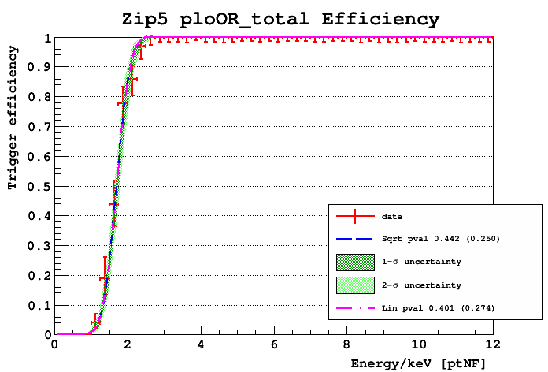
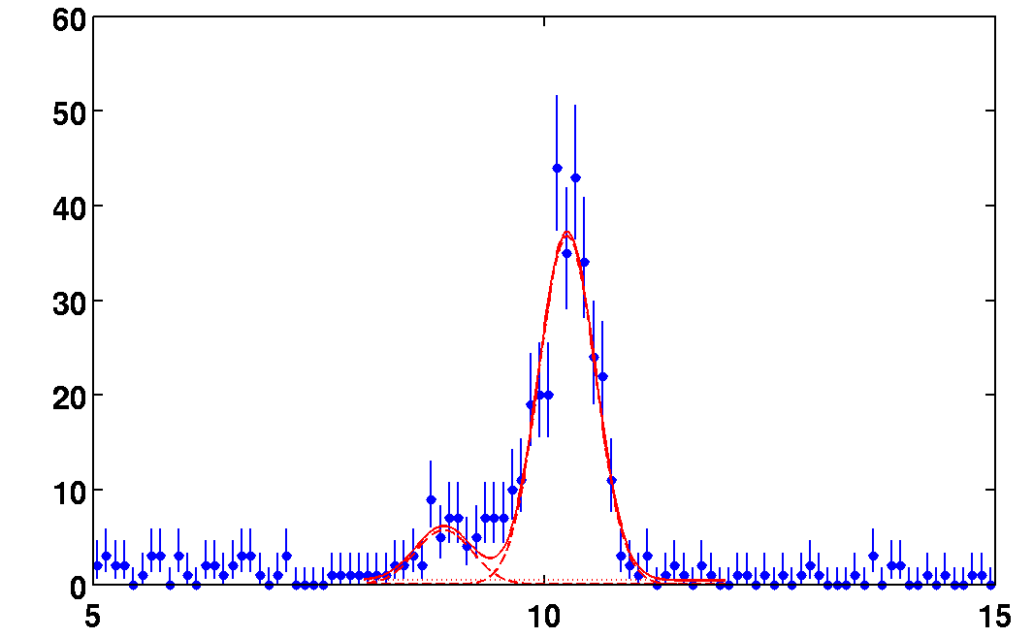
Detector Performance
²¹⁰Pb source
Surface events
65,000 betas
0 events leakage
15,000 surface NRs
1.0
Trigger Efficiency (good detector)
Sample of low background gamma data
10.3 keV (Ge)
0.5
Events per bin
cosmogenic
activation
0.0
0
2
4
6
8
10
12
Recoil Energy [keVee]
Total Phonon Energy [keV]

Slide 11
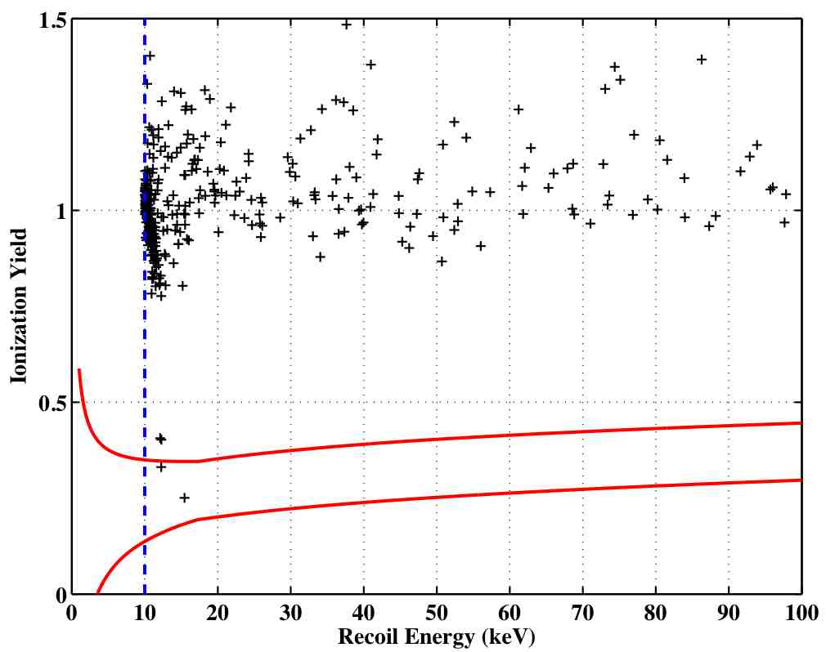
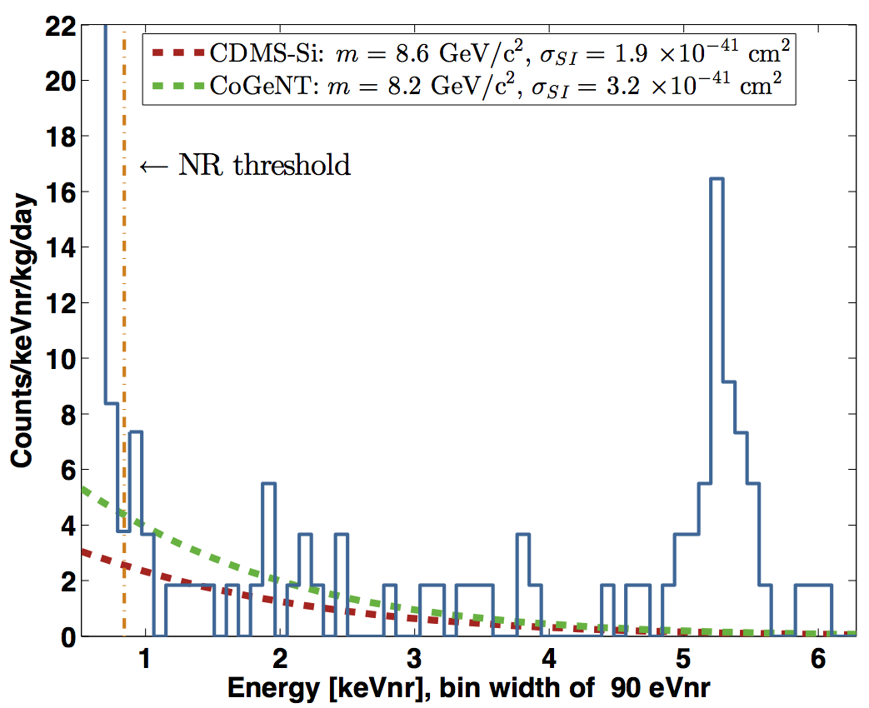
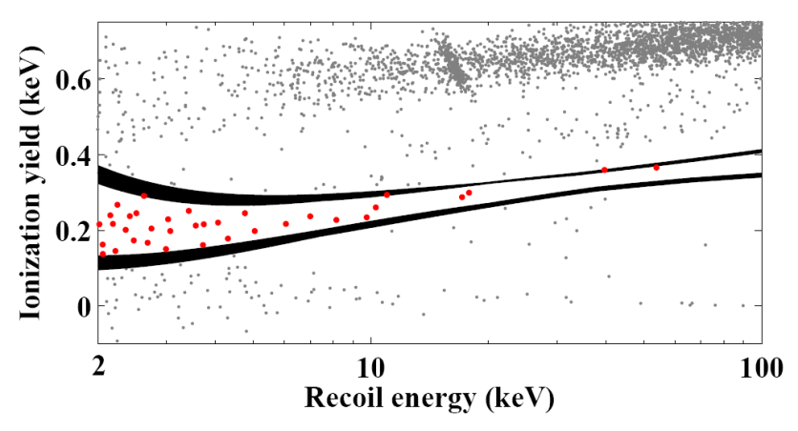
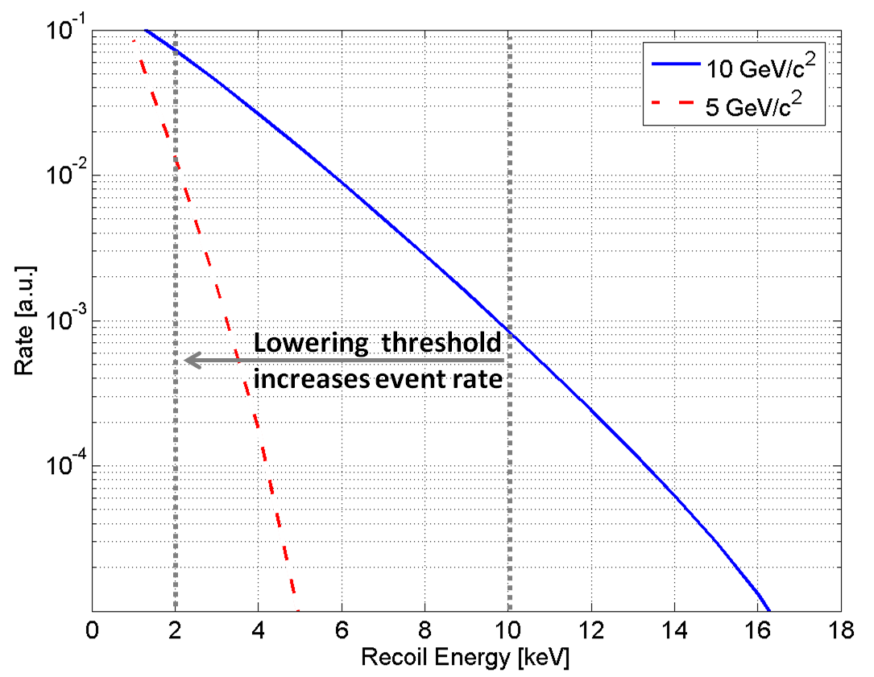
Past Analysis Approaches
“Classic” CDMS approach: minimize expected BG (<1 for data set under analysis) → threshold ~10 keV
(E_{recoil}: use Q signal for Luke correction)
Low-threshold extension: strongly rising WIMP spectrum at low E
→ improved sensitivity in spite of BG
(no surface event discrimination; E_{NR}: Luke correction based on mean yield)
CDMSlite: no discrimination, but even lower threshold; BG diluted
(E_{NR}: based on Lindhard model)
~200 kgd after cuts
~6 kgd after cuts
~100 kgd after cuts

Slide 12
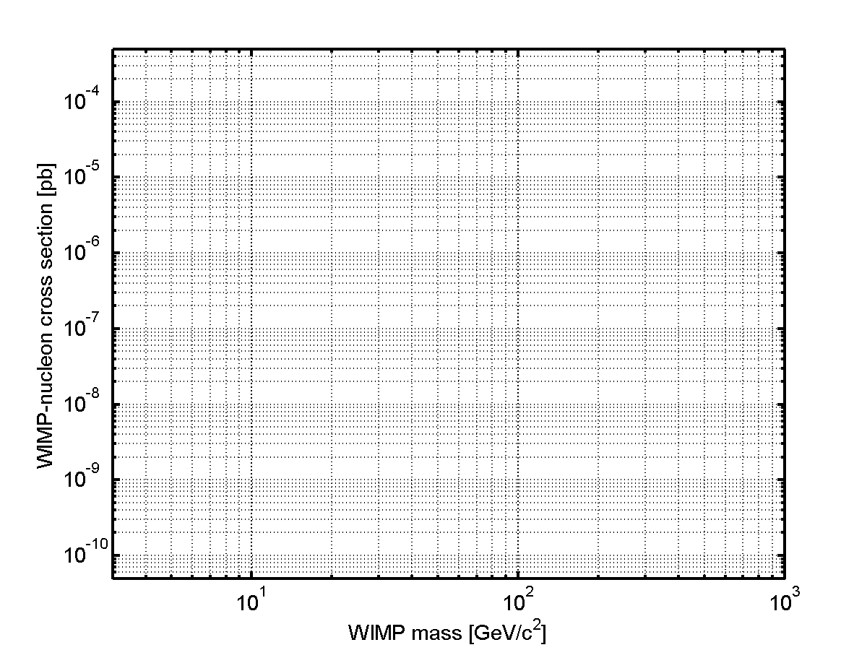
Results – before 2014
PICASSO 2012
CDMS low threshold 2011
CDMSlite
2013
CDMS Si
2013
DAMA 2000
CDMS Si
2013
XENON 10
S2 (2011)
CRESST
2011
CoGeNT
EDELWEISS II 2011
SuperCDMS low threshold 2014
CDMS
2010
XENON 100
2012
⁸B
LUX 2013

Slide 13
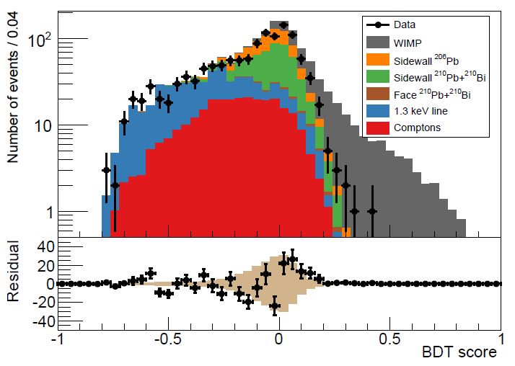
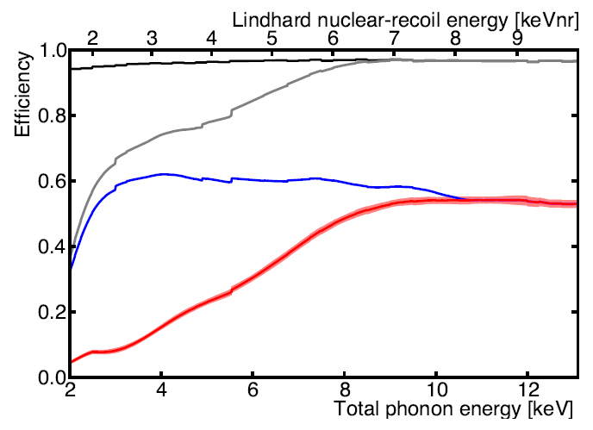
SuperCDMS Soudan – Latest Data
Low-threshold method, but now with:
Surface event rejection with charge signal (interleaved electrodes) AND phonon signal (sensors on top and bottom!)
Edge event rejection with charge signal (was available in CDMS) AND phonon signal (new sensor layout)
New Analysis method for improved efficiency (Boosted Decision Tree)
Background model to train BDT (cosmogenics, ²¹⁰Pb chain): MC to get distributions; use scaled pulses + real noise to generate `events’ (gammas for BG, neutrons for signal)
Optimize tree for different WIMP masses (5, 7, 10, 15 GeV/c²)
BG model only for BDT training; efficiency measured with neutrons
Data Quality
Trigger Efficiency
All before BDT (e.g.
singles, veto,
charge fid.
vol.)
BDT (phonon and charge
ampl., phonon fiducial volume)

Slide 14
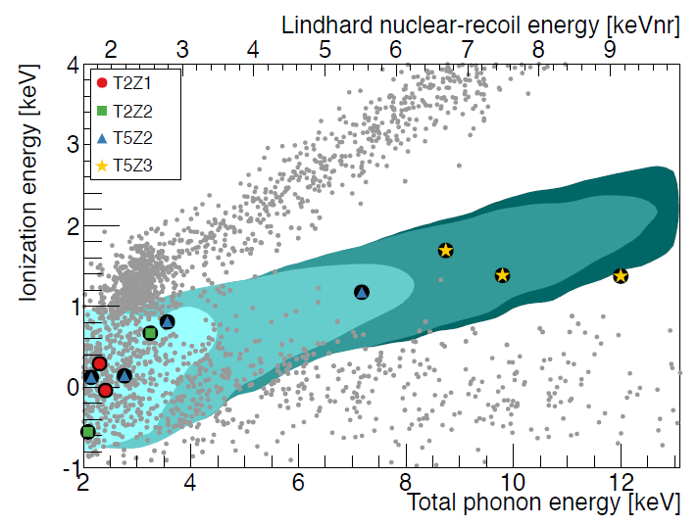
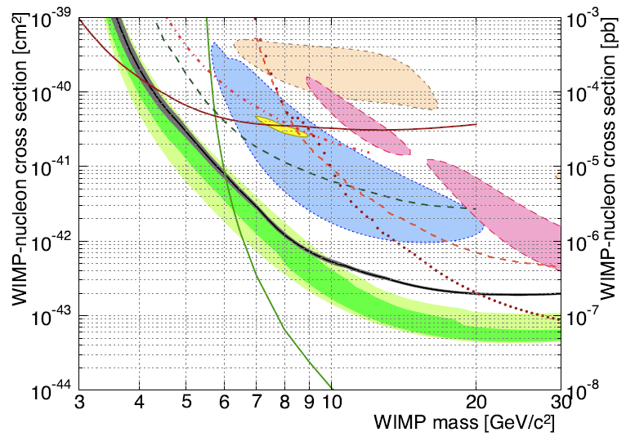
SuperCDMS Soudan – Results and Future
BG model predicts ~6 events – BUT: difficult to make good prediction in this low energy range → only set upper limit
“Open box”: observed 11 events
3 highest energy events in detector with shorted outer charge channel
CDMSlite
CRESST
Probe new parameter space between
4 and 6 GeV/c²
Incompatible with CoGeNT interpretation as NR signal from WIMPs
Lux
DM search concluded recently (sensitivity limitation expected from cosmogenics)
Standard (high threshold) analysis in progress / additional CDMSlite data collected
Systematic studies until spring 2015

Slide 15
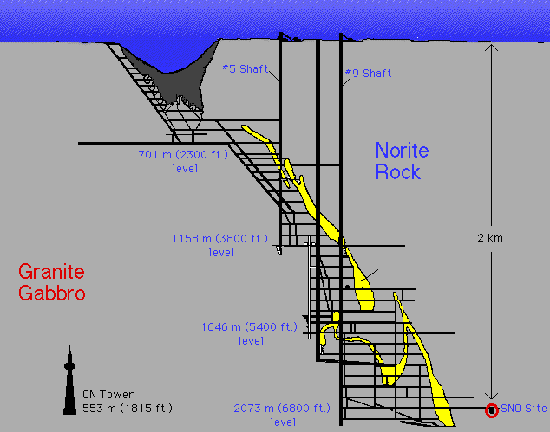
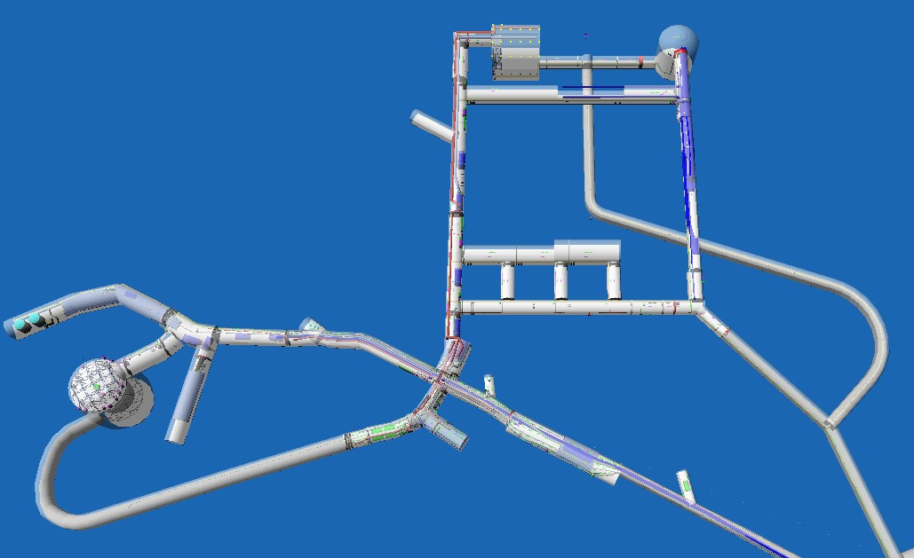

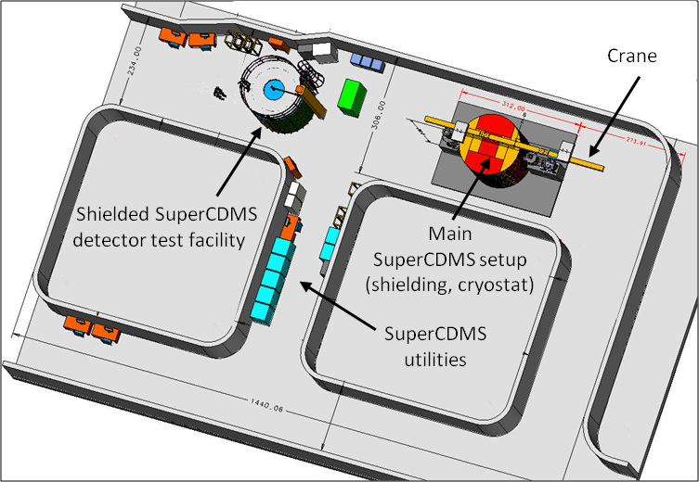
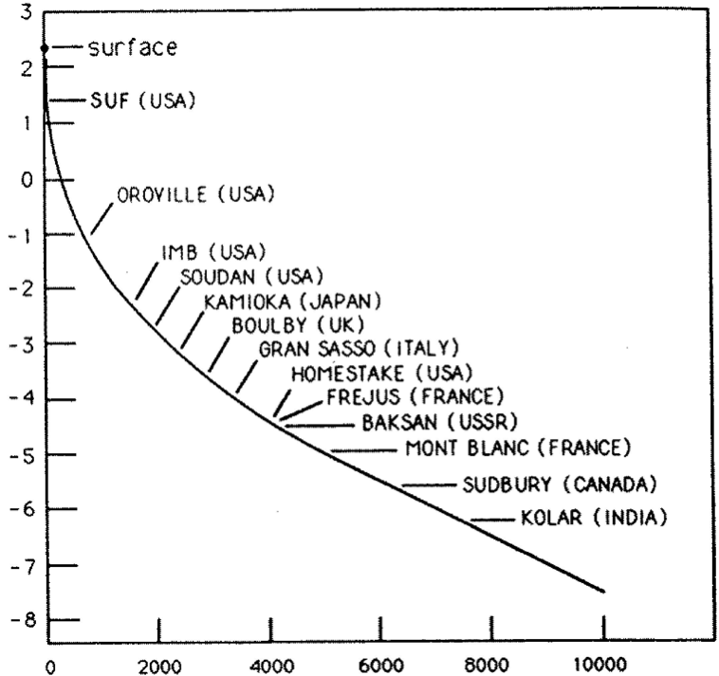
Dark Matter Search at SNOLAB
DEAP 3600,
MiniCLEAN
DAMIC
(DEAP-1)
SuperCDMS
COUPP / PICO
PICASSO-II
log (Muon flux [m⁻²s⁻¹])
Shileding [mwe]

Slide 16
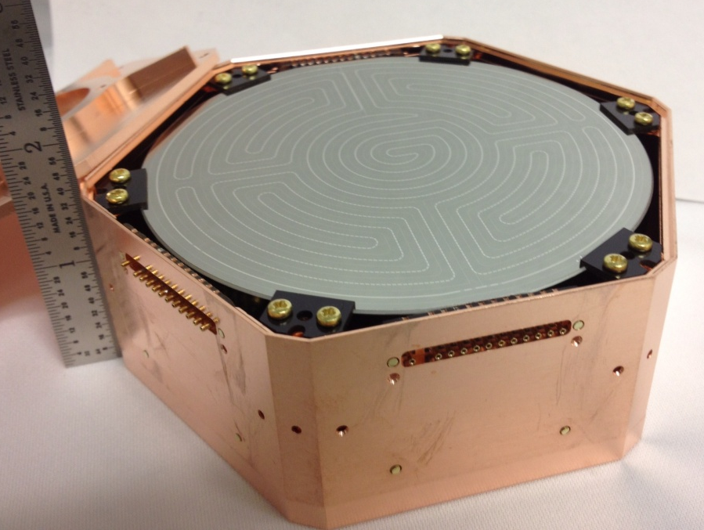
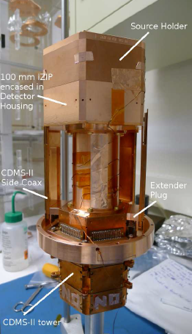
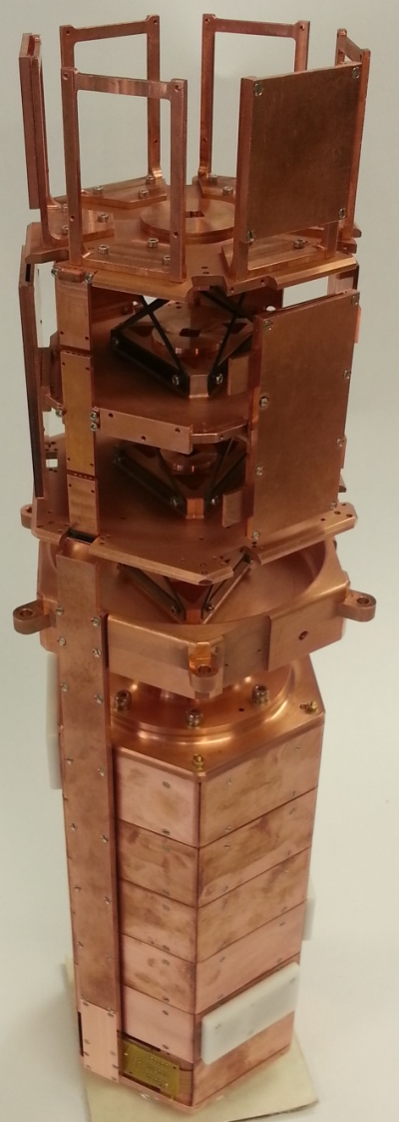
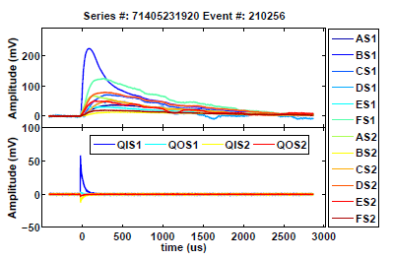
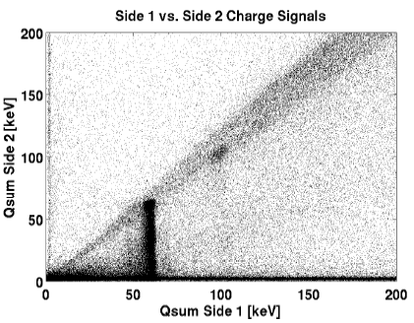
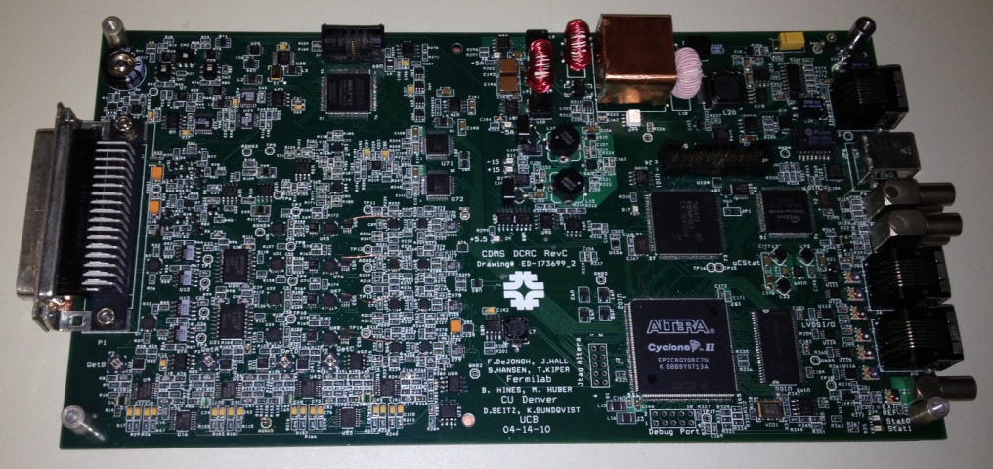
SuperCDMS at SNOLAB R&D
Larger modules (1.4 kg Ge/0.6 kg Si)
First prototypes are being tested using existing hardware
Mechanical prototype for new tower exists
Developing dedicated HV detectors
New SQUIDs for improved phonon performance (from NIST, USA)
New low noise charge amplifier (HEMTs from CNRS/LPN, France)
Compactified readout electronics (one 3U board / det. replaces 2 9U boards and digitizer)
DAQ: MIDAS based (UBC/TRIUMF)
100 mm iZIP:
33 mm high, 100 mm ∅
1.4 kg Ge / 600 g Si

Slide 17
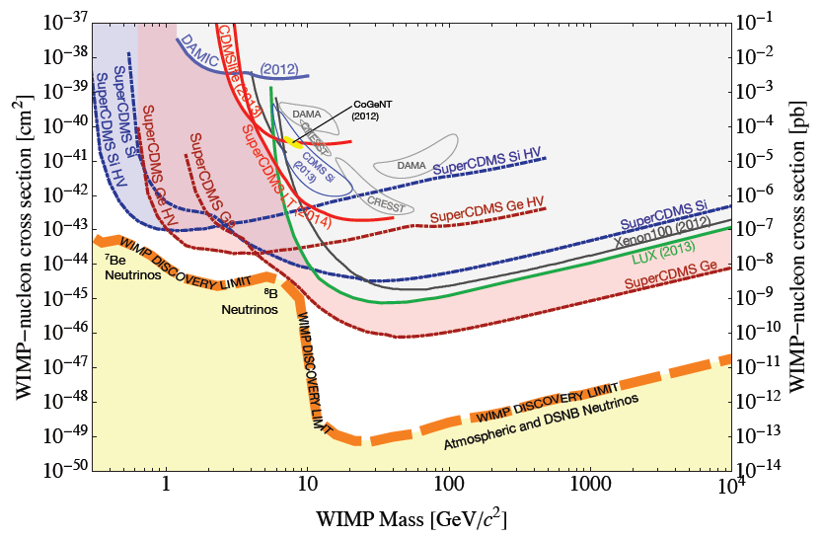
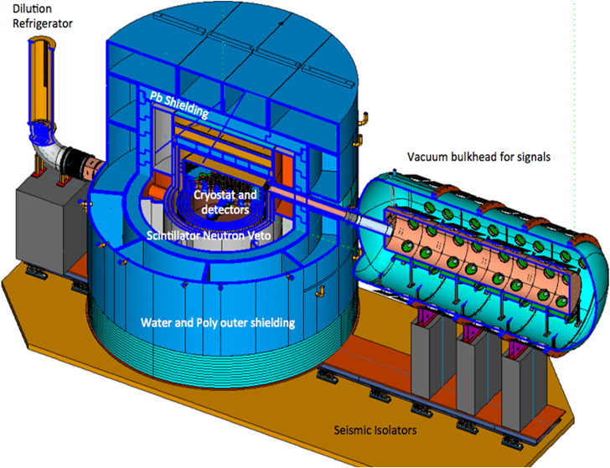
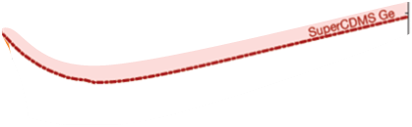
SuperCDMS at SNOLAB
Setup holds up to ~400 kg detectors
Planned shielding includes neutron veto detector
CRESST
(2014)
Initial payload includes mix of standard and HV detectors (Ge, potentially some Si)
Room for significant additional payload e.g. from EURECA (CRESST, EDELWEISS) or advanced HV dets.
Funding: Selected by DOE/NSF as one of two “G2” WIMP search experiments
Total project cost: ~$25-30 M, including $3.4M from Canada
Schedule depends on funding profile - ~2 years construction once money flows

Slide 18
Conclusion
Cryogenic Detectors have been providing world leading WIMP sensitivity since more than a decade
iZIP design greatly improves surface event discrimination
Together with improved analysis technique: gain in low-mass sensitivity
CDMSlite: very low threshold capability (no discrimination)
Going forward: SuperCDMS SNOLAB will go forward as “G2” project
Focus on low-mass sensitivity
Reach solar neutrino background
Discussions with EURECA about joining forces

