Slide 1
Jupyter on STFC Cloud
By Alexander Dibbo, Jacob Ward, David Fairbrother

Slide 2
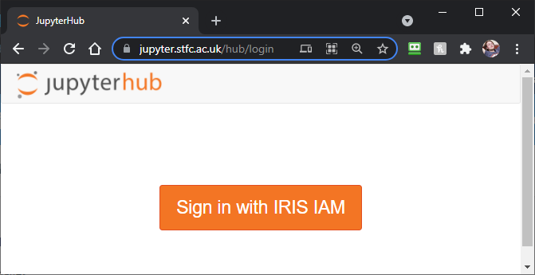
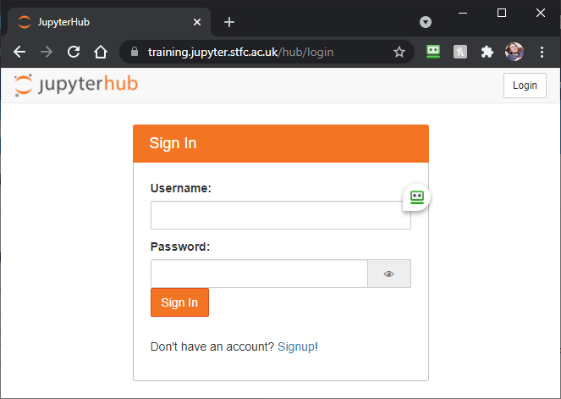
Jupyterhub
For the last few years there has been a strong desire for a generic Jupyter infrastructure within STFC and IRIS
This has been especially true for training courses.
2 infrastructures: - 1 with IRIS IAM login
https://jupyter.stfc.ac.uk
1 with local credential login (for training courses)
https://training.jupyter.stfc.ac.uk
Image © STFC John Dawson
Notes:
PLEASE DELETE/REPLACE PHOTO CREDIT IF CHANGING THE IMAGE.

Slide 3
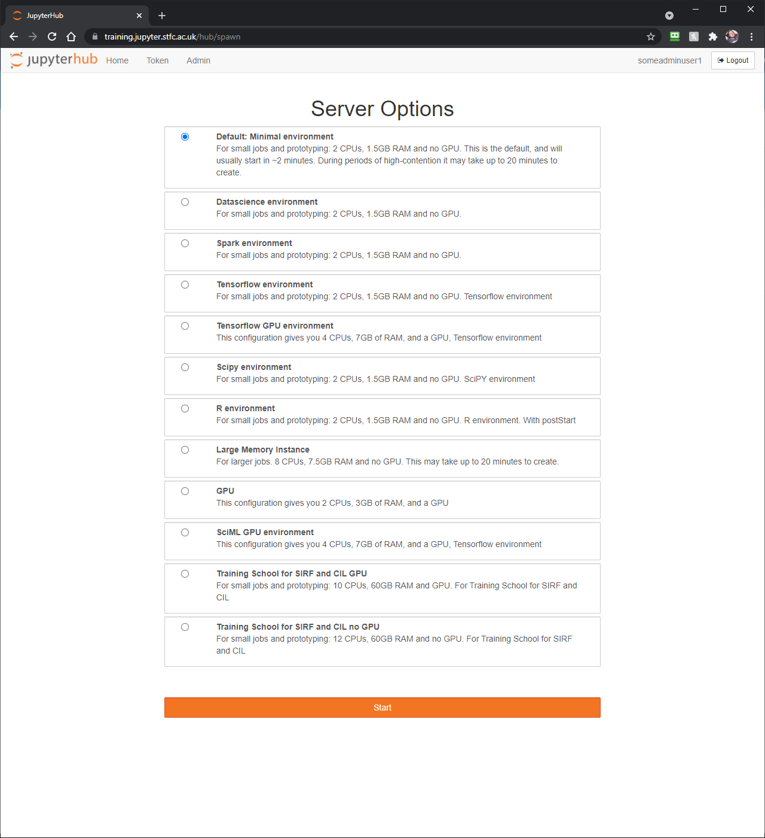
Deployment
Deployment done by David Fairbrother – a graduate from ISIS
Based on the work done by IRIS DA project
Deployed on top of OpenStack Magnum
CPU and GPU support
All standard jupyter environments supported
Also customised environments
Users get 10GB of storage
Shared storage available for training materials on training deployment.
Config available at https://github.com/stfc/ansible-jupyter
Environment image config: https://github.com/stfc/cloud-docker-images

Slide 4
Use so far
Minimal use of the IAM login instance so far
3 Training courses for SIRF/CIL with GPUs
120 on first course
30 on second
60 on third
Screenshot showing tomography of a Kinder Egg (I think)
Upcoming training courses:
SciML – several courses at 30-40 trainees each with GPUs
Hartree centre – several courses at ~25 trainees each

Slide 5
Live demo
Facebook: Science and Technology Facilities Council
Twitter:@STFC_matters
YouTube: Science and Technology Facilities Council

Slide 6
Future work
Document image customisation process
Test and document use of other storage with jupyter
Docker image build system to make environment customisation easier
Provide linux environments with sudo for linux training.
Provide a linux environment with OpenStack commandline tools/sdk
Investigate jupyter-desktop for disposable desktops

Slide 7
Questions
Facebook: Science and Technology Facilities Council
Twitter:@STFC_matters
YouTube: Science and Technology Facilities Council

