Slide 1
Welcome to Daresbury
7 Dec 2021
Massimo Noro
Director Business Development, Daresbury

Slide 2
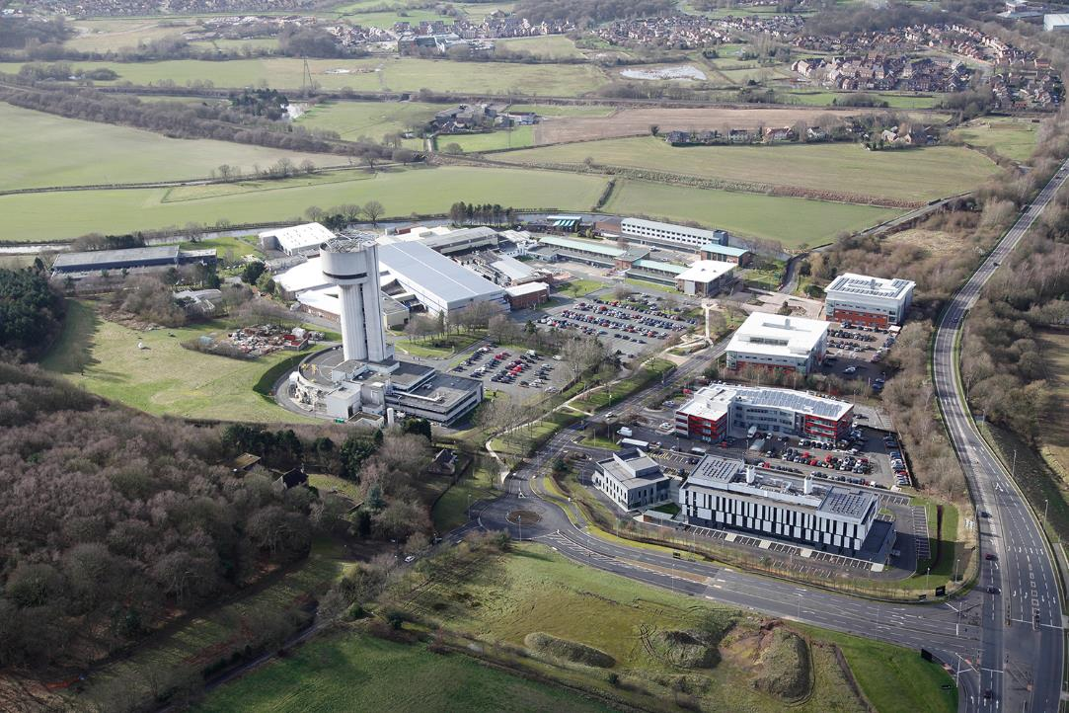

Slide 3
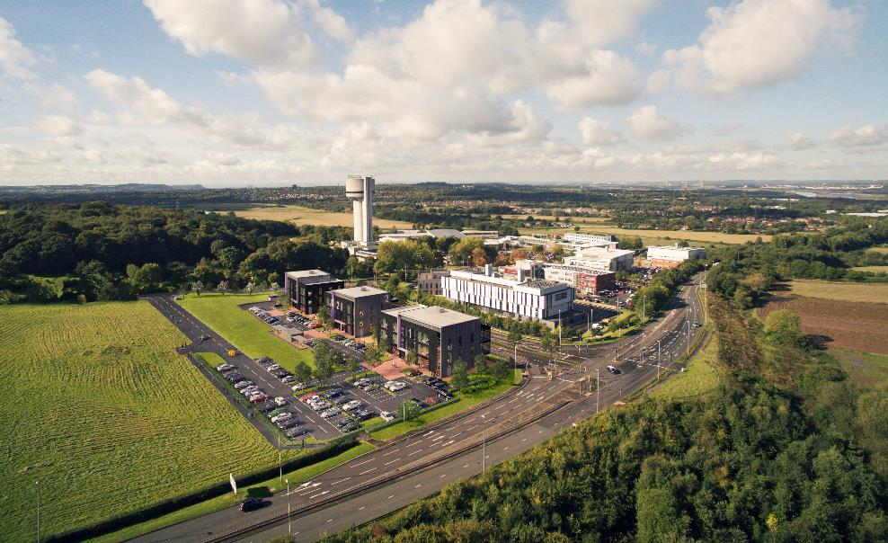
A National Science and Innovation Campus
Recognised location for national centres of innovation, research and development
Part of UKRI, direct link to BEIS
Only UKRI site in the North of England
Multi-way partnerships and collaborations
Well-established ecosystem spanning Universities, businesses of all scales across multiple sectors, regional and national government

Slide 4
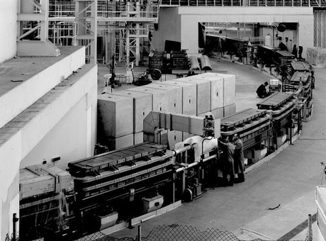
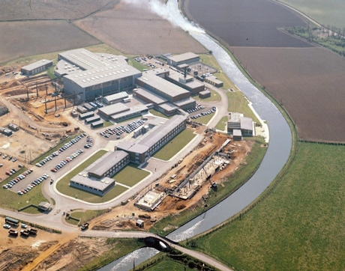
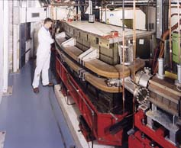
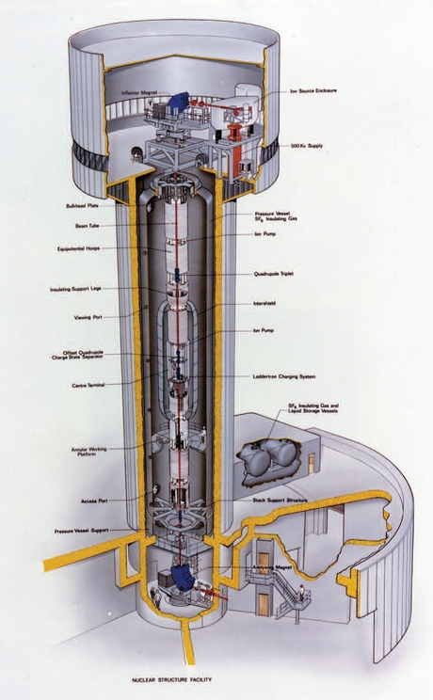
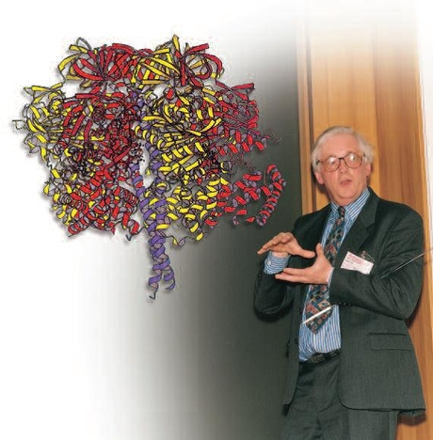
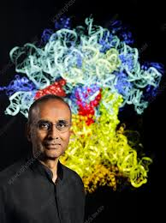
Heritage on Particle Accelerators
Established in 1962 as an accelerator lab to host NINA a 5 GeV electron synchrotron, then replaced by the Synchrotron Radiation Source SRS
The Tower was built in the late 1970s to host a Van der Graaff accelerator for nuclear physics
1997 Nobel Prize in Chemistry, for solving the structure of the F1 ATPase enzyme - Sir John Walker
2009 Nobel Prize in Chemistry, for the structure and function of the Ribosome - Sir Venki Ramakrishnan

Slide 5
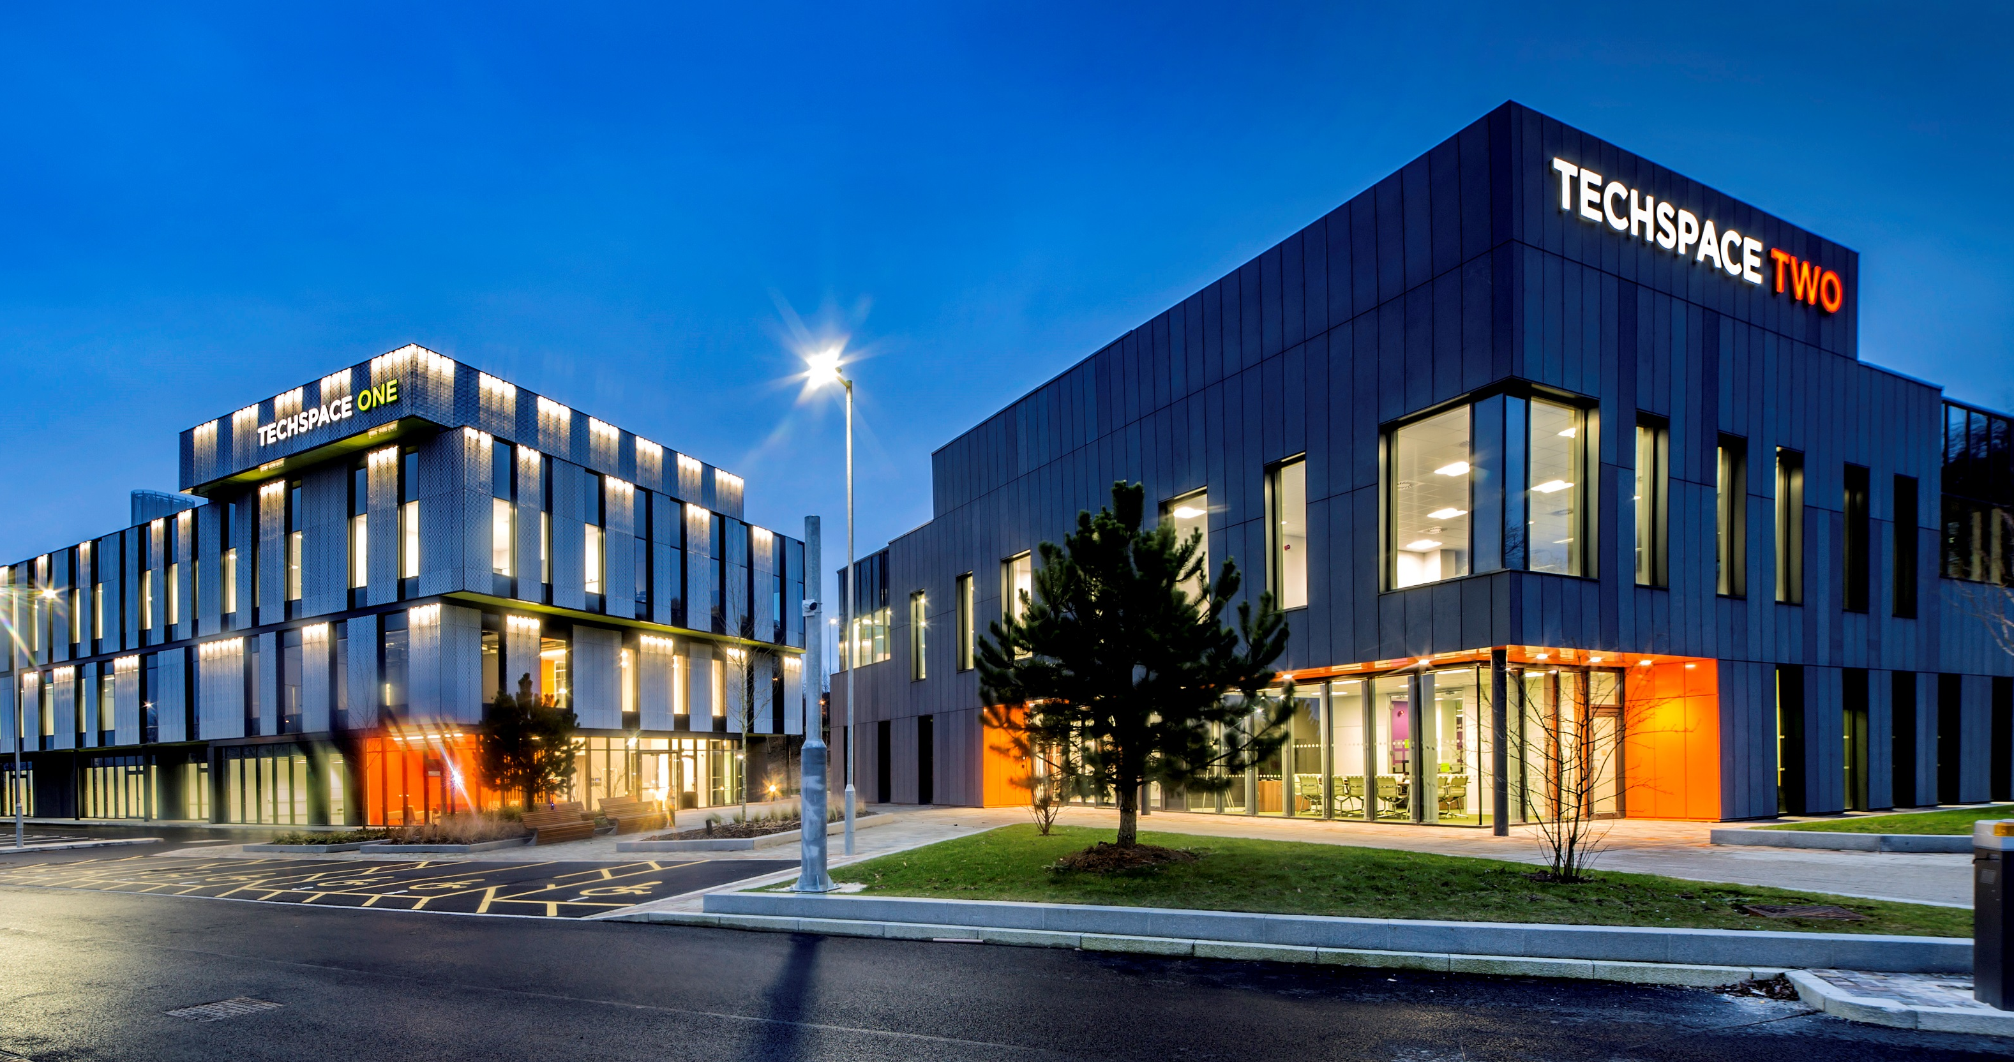
Campus Companies
Over 150 high-tech companies, 1,500 high value jobs
IBM, Hitachi, Atos & Croda
~20% international companies
Sector focus:
Digital
Advanced Engineering & Materials
Biomedical/Healthcare
Academic Collaborations:
Super STEM
Cockcroft Institute
Sales growth – 25-30% pa
5% company failure rate
70% companies collaborate on campus
Image © STFC John Dawson

Slide 6
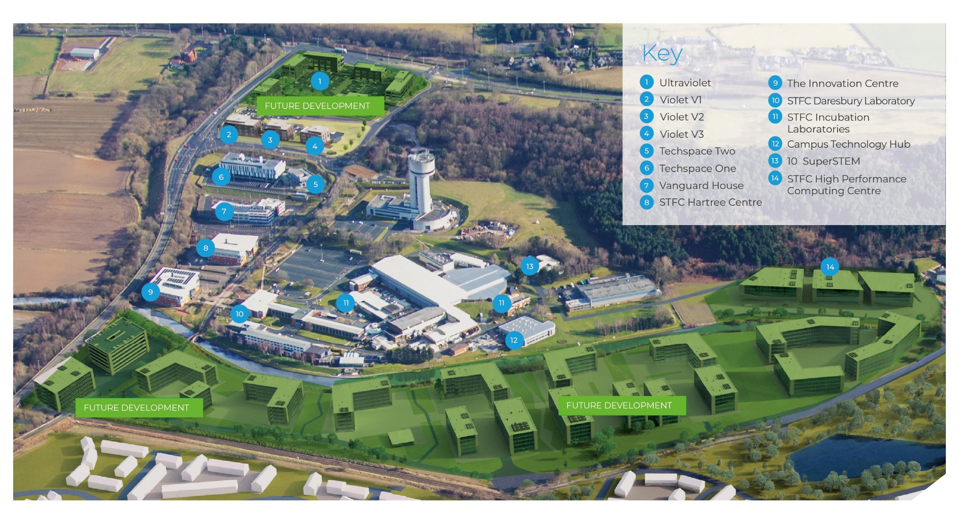
Masterplan
Enterprise Zone
Long-term vision to further develop the International campus
>700,000 sq ft of development
Circa 10,000 people working in science, technology & innovation
Notes:
Mention key campus stats here – 150 companies, 1600 people, high growth (25-30% pa), collaborative

Slide 7
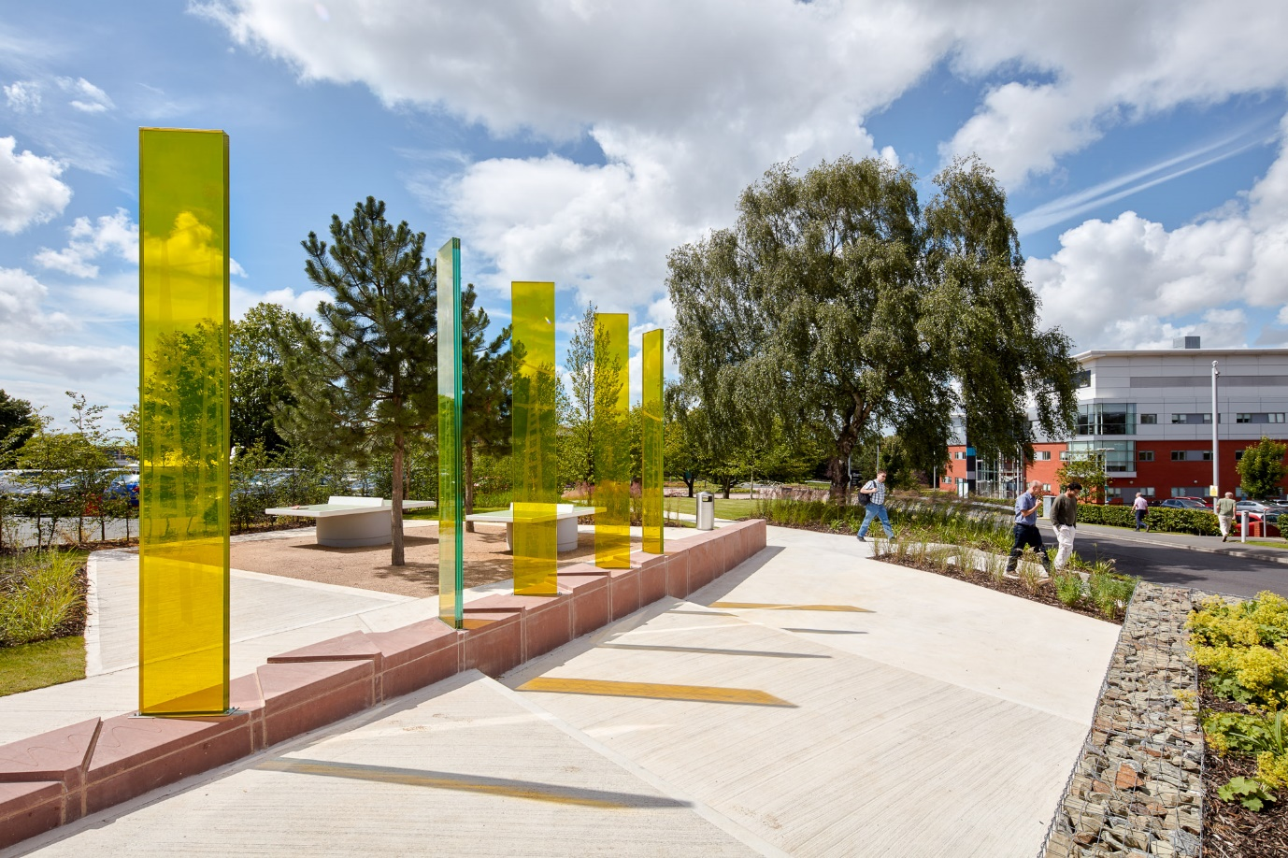
Summary
Deep expertise in applied technologies
Reach into whole UK Research and Innovation ecosystem
National campus with scalable space for
science facilities
growing technology companies
Strong focus on skills to attract, develop & retain the best talent
Notes:
1st bullet – applied technologies = hardware and software

