Slide 1
Looking ahead:
EPAC and data management
Stephen Dann (Central Laser Facility)

Slide 2
Two sides of the CLF
Lasers for Science
High-Power Lasers
Artemis
8 mJ in 30 fs
1 kHz
Gemini
12 J in 30 fs
1 shot per 20 s
I am here
Ultra
Time-resolved spectroscopy
Vulcan
400 J in 400 fs
1 shot per 20 minutes
Octopus
Advanced imaging facility
Notes:
Last year: Dan Rolfe of Octopus
Now: look at the other side of the CLF: HPL
Two facilities: Gemini and Vulcan. Mostly 5-6 week experiments with academic users.
Both have low repetition rates, so small amounts of data

Slide 3

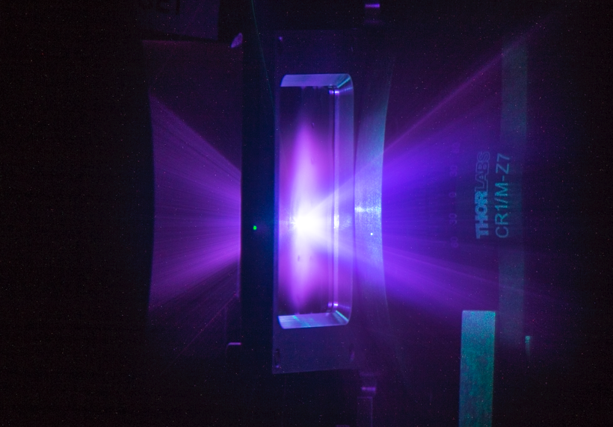

Imaging with high-power lasers
Multi-modal
– electrons, x-rays, ions, neutrons, terahertz
Bright
– up to 10¹² particles/photons per pulse
Ultra-short pulse
– of order femtoseconds - picoseconds
Small source size
–as small as a few μm
Notes:
One key application
Use laser to generate other types of radiation; use that to image samples
Other facilities exist, but laser-driven sources have some key benefits:
Multiple types of radiation (reconfigurable or multi-modal)
Small source size for coherent imaging
Short pulse for temporal resolution

Slide 4
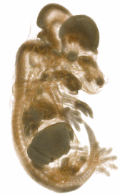
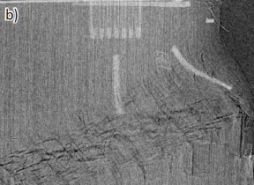
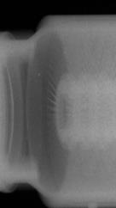
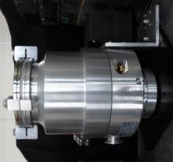
Imaging at the CLF
Phase contrast imaging
Flash radiography
X-ray CT with Betatron radiation
Promising results
Low repetition rates
Busy experiment schedule
No dedicated equipment
Notes:
Already have results from Gemini (and Vulcan), but hard to compete with other sources, so…

Slide 5
Extreme Photonics Application Centre (EPAC)
Funded by UK government strategic priorities fund
Facility exploiting CLF’s proprietary DiPOLE technology for academic, industry and security users
D100 laser pumping a Ti:S amplifier, with an OPCPA front-end
30 J, 30 fs, 10 Hz
Online in 2024
😲
Notes:
EPAC is a new £80M facility, currently under construction.
Looks like a bigger Gemini, but there’s a stronger focus on needs of industrial users
Key benefits over Gemini:
Higher repetition rate
Larger experimental areas
Streamlined experiments

Slide 6
Dealing with big(ger) data
Acquisition and display
  On-premises hardware
  2-5 GB/s
Storage and analysis
  Collaboration with Scientific Computing Department
  Tape library
  Ceph cluster
  STFC cloud
Data access through common RAL platform:
  ISIS
  Diamond Light Source
  Central Laser Facility
Gemini: 2 TB / year
EPAC: 1 PB / year?
Notes:
Higher rep rate brings new challenges: 200 times as much data?
Add new detectors and more efficient use of experimental time and the difference is even bigger
DAQ handled on-site: expect 2-5 GB/s when fully operational
Data storage and analysis uses h/w and s/w from the STFC Scientific Computing Department

Slide 7
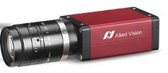
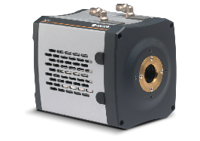
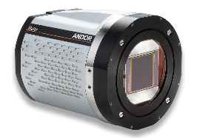
Data Sources
Only a small fraction of laser diagnostics data will be saved
Laser diagnostics
~0.5 MB images
>100 cameras?
PIC
Time
Radiation diagnostics
~10 MB images
~3 cameras
Main detectors
~30 MB images
~4 cameras
PIC
PIC
Cameras shown are representative examples
Notes:
Most data: images
Lots of laser diagnostics, but no need to save most of that data
Radiation diagnostics monitor performance of radiation generation
Main detectors are used for actual imaging process – experimental data
Diagnostics more of interest to facility and some academic users

Slide 8
Experimental data volumes
Current estimates for 10 Hz operation
Diagnostics
Laser
400 MB/s
Radiation
300 MB/s
Even larger detectors are possible
Main detectors: 1.2 GB/s
Total: 1.9 GB/s
10 Gb/s (for scale)
Notes:
Imaging detectors make up most of the data, due to sheer size
Could throw away other data: won’t help much

Slide 9
External data flows
Laser diagnostics
~10 TB/year
OperationsGateway
Long-term data storage for facility operations
Radiation diagnostics
Subsample
“Interesting” data is kept
Laser diagnostics
3 PB/year
1 PB/year
Data archive
Long-term data storage for experiments
Radiation diagnostics
Main detectors
“Boring” data is discarded
Notes:
Some diagnostic data is kept long-term for facility staff.
We can subsample this to keep data volumes manageable
Data for facility users is biggest challenge. Need curation by humans.
Example data rates:
3 PB/year produces
Only 1 PB/year can be kept
Users will need to choose which data to keep

Slide 10
Data Storage and Analysis
New data
EPAC
Scientific Computing Department
To HPC?
Tape archive
(long-term storage)
Ceph cluster
(live data storage)
Data Analysis as a Service
(cloud-based analysis platform)
Not pictured: data cataloguing and access
Notes:
Experimental data kept on SCD h/w.
Basic idea: Ceph cluster for data in-use, moved automatically to tape archive
Data restored from tape when needed
Data can be analysed directly in the cloud
Might also connect to HPC (e.g. SCARF)

Slide 11
Data analysis
Experiment data
CPU
Preinstalled software
Image processing tools
Scientific libraries
Special-purpose analysis packages
Tomography reconstruction
  Use GPUs!
Software
Analysis data
RAM
GPU
Advanced CT methods
Iterative
Multi-modal
Higher-dimensional (e.g. time or energy resolved)
User’s browser
https://www.scd.stfc.ac.uk/Pages/Dynamic-Infrastructure-Group.aspx
Notes:
VM in cloud provides access to compute hardware, data, and preinstalled software
Developed by Dynamic Infrastructure Group at RAL and used by ISIS and (parts of) CLF
Advanced CT reconstruction techniques need big GPUs: data set (typically) needs to fit in VRAM, and lots of system RAM needed too
Some types of CT (parallel-beam) are easy to split up into subproblems, but cone-beam and regularisation make that more difficult.
2k^3 reconstruction requires 32 GiB RAM with single-precision float

Slide 12
Thank you

