Slide 1
IRIS IAM IRIS Activities and Community reports
2021 IRIS Collaboration Meeting
Tom Dack
thomas.dack@stfc.ac.uk

Slide 2
IRIS IAM Background
IRIS requires core elements to operate as a coherent community:
Policy and Trust Framework
Identity Management – this is IRIS IAM
Resource Accounting
Monitoring
IRIS IAM is coordinated as part of DRTS
Distributed Research Trust and Security
STFC centre of excellence in distributed cybersecurity
IRIS IAM is represented & active within international identity management community - Observer in AEGIS, active participant in FIM4R
Operational Security
Trust and policy
DRTS
Identity Management
Information Security Management
Notes:
Significant opportunities
Increased effectiveness
Funding opportunities
Growing sphere of influence
Support of Digital Research Infrastructure program
Strengthen work in STFC, project nationally
AARC Engagement Group for InfrastructureS

Slide 3
The IRIS IAM
Aims of the IRIS IAM:
Provide users with a consistent authentication experience across IRIS services
Provide science communities & services with centralized authorization, through group management capability
Utilizes the INDIGO IAM application, developed by INFN Italy
Originally developed as part of the INDIGO Datacloud Horizon2020 project
For more info, check out the IAM Documentation: https://indigo-iam.github.io/v/current/docs/

Slide 4
Current Status of the IRIS IAM
Production standard service based on AARC blueprint
Primary authentication a number of IRIS services, including Accounting Portal, IRIS DynaFed (Storage), MISP Security Portal and OpenStack Clouds
Primary means of authorization for IRIS Users within the SCD Cloud
Small team supporting the service development and operations
Currently looking to expand effort in order to better serve community
Close liaison with IRIS Policy and Trust Framework
Ensure that the IAM follows collaboration polices and policies reflect what is possible
Organized and Hosted User’s Workshops for INDIGO IAM in Jan’21 and Nov’21

Slide 5
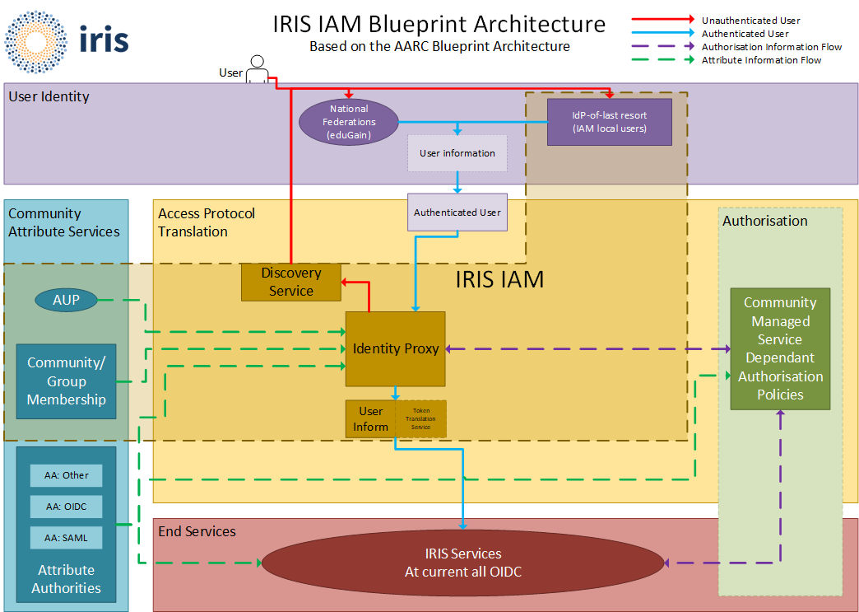
IRIS IAM: AARC Blueprint based
Federated Identities via eduGAIN
SIRTFI compliant with REFEDS status asserted
GÉANT COC compliant

Slide 6
Challenges
How to provide access to services which operate only over command line
OAuth Device Code PAM with Group Authorization
Assurance for users who do not have an eduGAIN IdP
Using the IRIS IAM as an IdP-of-last-resort
Community and Client Buy In
The service is in production and serves some IRIS communities
Slow uptake from others – have a good service, but how to convince people it’s better than what they’ve got
Improved Service Resilience

Slide 7
SSH access via IAM
PAM Module - Initially forked by Will Furnell, recent changes by Jens Jensen
https://github.com/stfc/pam_oauth2_device
Fork of https://github.com/ICS-MU/pam_oauth2_device
No client side software needed
Integrates well with IRIS IAM & Openstack
Currently working with DiRAC sites for testing
No special/custom SSH server required

Slide 8
Assurance for IDP-less users
There are a number of communities in IRIS which do not operate IdPs
Investigating using the IRIS IAM as an IdP-of-last-resort through provisioning of local (non-eduGAIN) accounts
Issue: How do you guarantee assurance for accounts made in this manner?
Account referrals and vetting from known and trusted community representatives
Dedicated community IAM instances
Community Management policy currently being developed for IRIS

Slide 9
Improved Service Resilience
Identity Proxy availability should never block access to connected services
Plan to move containerised service to K8 in the New Year
Discussions underway on how best to operate service database in a manner which does not rely on STFC network
Cross IRIS-site Galera Cluster or commercial cloud solutions seem most promising, discussions with SCD Database services planned

Slide 10
Next Steps
Integration of more IRIS services and communities
Including continued focus on Command Line services
Next steps of working with DiRAC after PAM testing
Continued improvements to service resilience
Look to continue to support development of INDIGO IAM directly where possible
Look to increasing IAM team to second full-time staff member where possible
Adoption and Migration of INDIGO IAM 2.0 when available
Improved multi-tenancy support through KeyCloak

Slide 11
Notes:
The abstract pattern can be removed or repositioned if required. Be careful to ‘Send to Back’ so that it does not obscure any important information.

