Slide 1

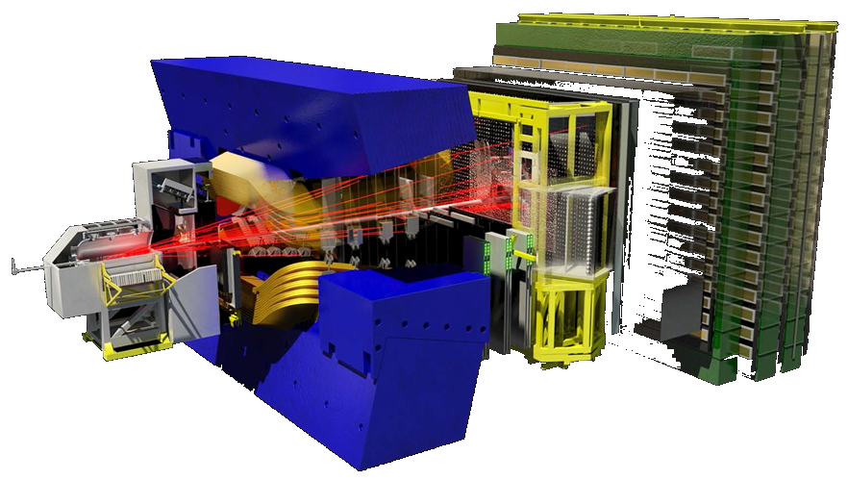

The LHCb upgrade
Burkhard Schmidt, CERN
on behalf of the LHCb Collaboration

Slide 2
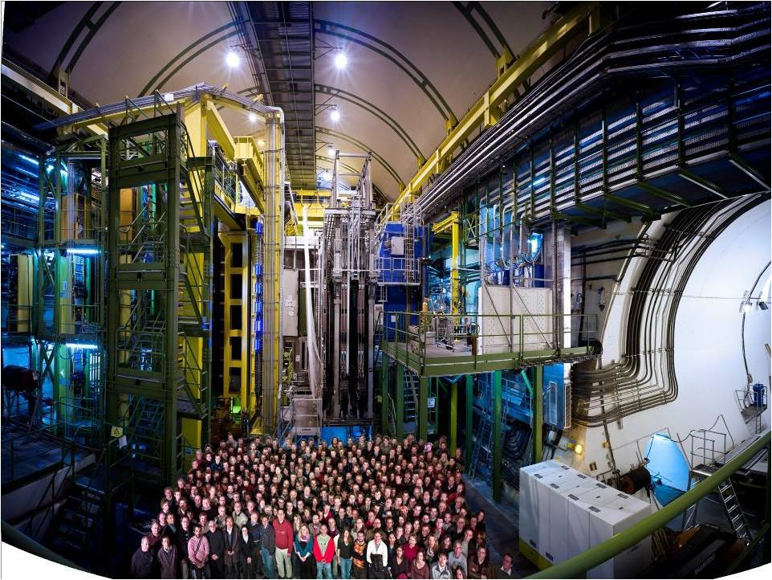
Overview
LHCb Collaboration
~900 physicists
64 universities
16 countries
Introduction to LHCb
LHCb upgrade
  Physics Motivation
  Trigger upgrade
  Detector upgrade
    Vertexing and tracking
    Particle Identification
Conclusions

Slide 3
Introduction
LHCb is a high precision experiment devoted to the search for New Physics (NP) beyond the Standard Model (SM)
Study CP violation and rare decays in the b and c-quark sectors
Search for deviations from the SM due to virtual contributions of new heavy particles in loop diagrams
Sensitive to new particles above the TeV scale not accessible to direct searches
RICH detectors
K/π/p separation
Vertex Detector
reconstruct vertices
decay time resolution: 45 fs
IP resolution: 20 μm
Muon system
μ identification
Tracking system
momentum resolution
Δp/p = 0.4%–0.6%
Calorimeters
energy measurement
e/γ identification
Dipole Magnet
bending power: 4 Tm

Slide 4
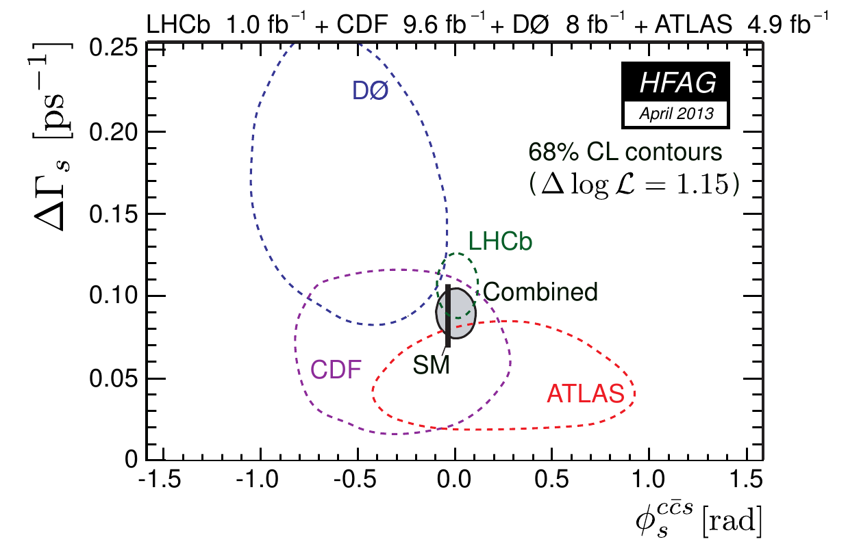
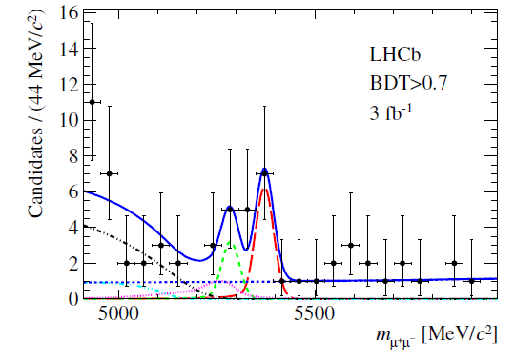
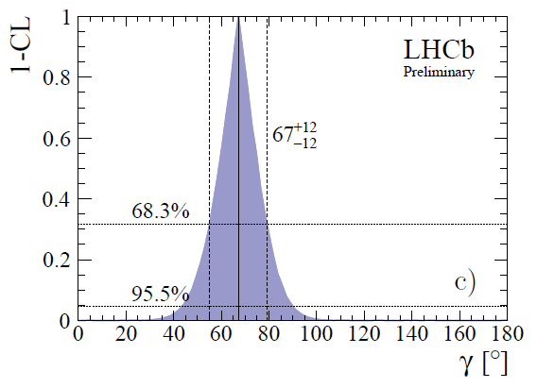
Some highlights of LHCb results
B_{S}⁰ → µ⁺µ ̶
PRD 87 (2013) 112010
PRL 111 (2013) 101805
Φ_{s} = 0.01 ± 0.07(stat) ± 0.01(syst)
1 fb⁻¹
LHCb-CONF-2013-006
JHEP 1308 (2013) 131
γ = (67.2±12.0)°
B⁰ → K*⁰μ⁺μ⁻
from B→DK
q₀² = 4.9 ± 0.9 GeV²/c⁴
Notes:
CP violating phase φs in Bs mixing
Zero crossing point of the Fwd Bwd asymmetry in B0→K*μ+μ- decays.

Slide 5
Motivation for the LHCb upgrade
Present experimental status:
flavour changing processes are consistent with the CKM mechanism
large sources of flavour symmetry breaking are excluded at the TeV scale
the flavour structure of NP would be very peculiar at the TeV scale (MFV)
Why is the LHCb upgrade important:
measurable deviations from the SM are still expected, but should be small
need to go to high precision measurements to probe clean observables
→ LHCb upgrade essential to increase statistical precision significantly
Quark flavour physics main component, but physics program includes also:
  Lepton flavour physics
  Electroweak physics
  Exotic searches, proton-ion physics
→ Reinforce LHCb as general purpose forward detector

Slide 6


LHCb upgrade
CERN-LHCC-2011-001
CERN-LHCC-2012-007

Slide 7
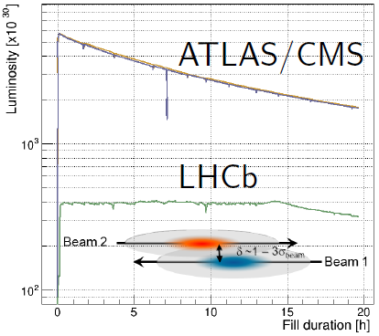
Expected luminosity evolution
2011 2012 2013 2014 2015 2016 2017 2018 2019 2020 2021 2022 2023 2024 2025 2026
LHC Run I LS1 LHC Run II LS 2 LHC Run III LS3 LHC Run IV
pp runs with LHC splice pp runs with LHC injector pp runs with HL-LHC prep
- 50ns bunch spacing consoli- - 25ns bunch spacing, upgrade - 25ns b.spacing GPD phase 2
- E_{CM} 7TeV and 8 TeV dation - E_{CM} 13 TeV LHCb - E_{CM} 14 TeV upgrades
LHCb L~4x10³²/cm²/s LHCb L>4x10³²/cm²/s upgrade L > 1x10³³/cm²/s L=2x10³³/cm²/s
LHCb ∫L ~3/fb LHCb ∫L >5/fb LHCb ∫L > 15/fb ∫L > 23/fb
LHCb up to 2018 → ~ 8 fb⁻¹:
find or rule-out large sources of flavour symmetry breaking at the TeV scale
~
LHCb upgrade → ≥ 50 fb⁻¹:
increase precision on quark flavour physics observables
aim at experimental sensitivities comparable to theoretical uncertainties

Slide 8
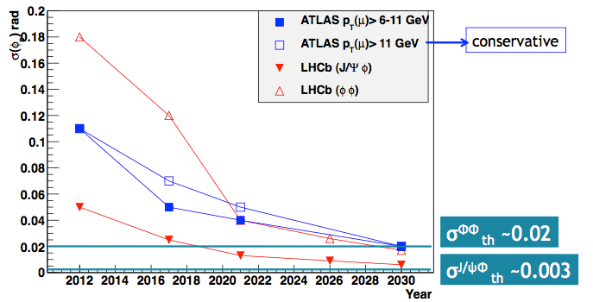
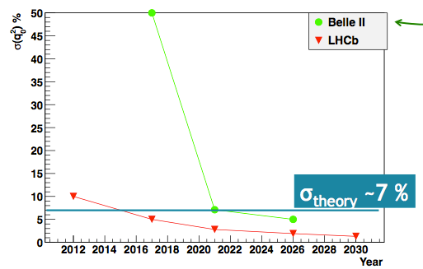
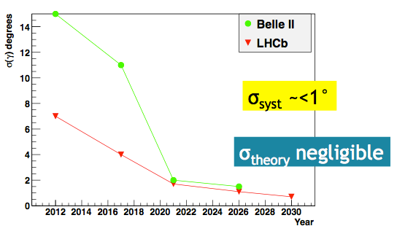
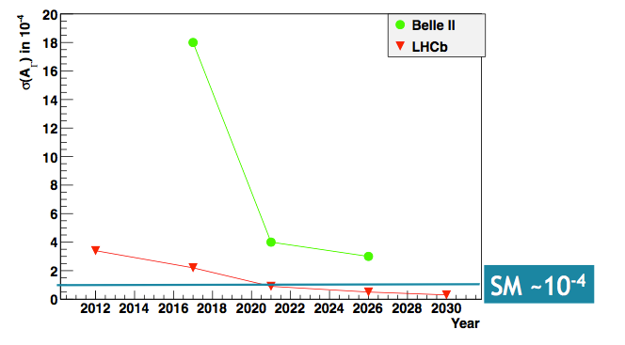
LHCb upgrade - expected precision
B_{s} mixing phase 𝜙_{s}
q₀ from B→K*ll
CKM angle 𝛾 from trees
From M.H. Schune, ECFA HL-LHC 2013 workshop
A_{𝛤}: CPV in charm

Slide 9
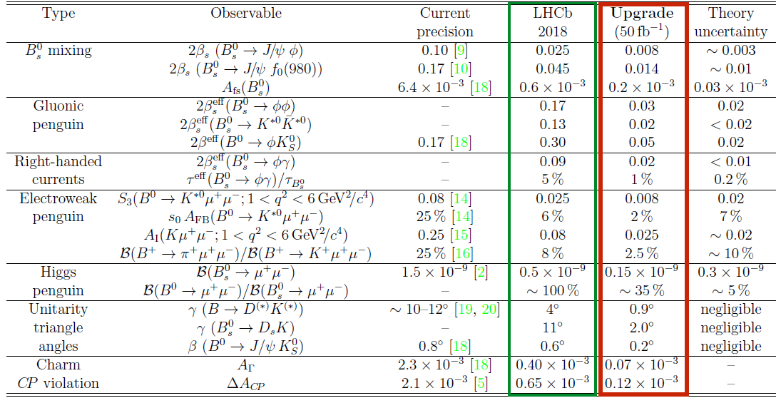
LHCb statistical sensitivity to flavour observables
Framework TDR for the LHCb Upgrade
CERN-LHCC-2012-007
Getting close to the theoretical uncertainties 8 fb⁻¹ up to 2018
≥ 50 fb⁻¹ for the upgrade
Notes:
Expected statistical uncertainties on a few selected physics channels before and after the upgrade, compared to theory.
CP violating observables, rare decays and fundamental parameters of the CKM unitary triangle.

Slide 10
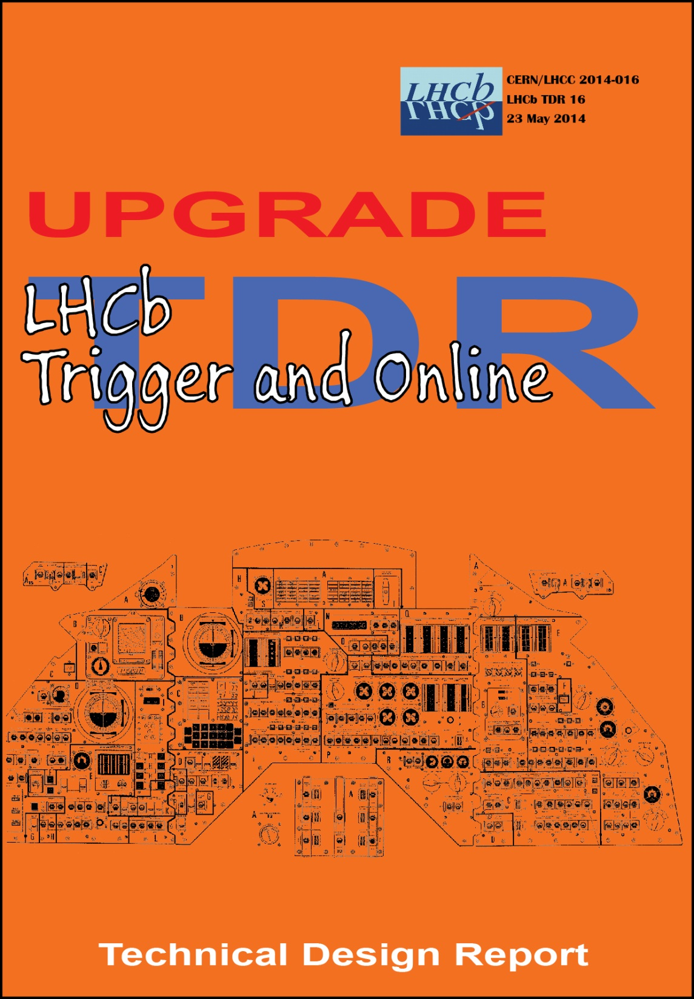
Trigger upgrade
CERN-LHCC-2014-016

Slide 11
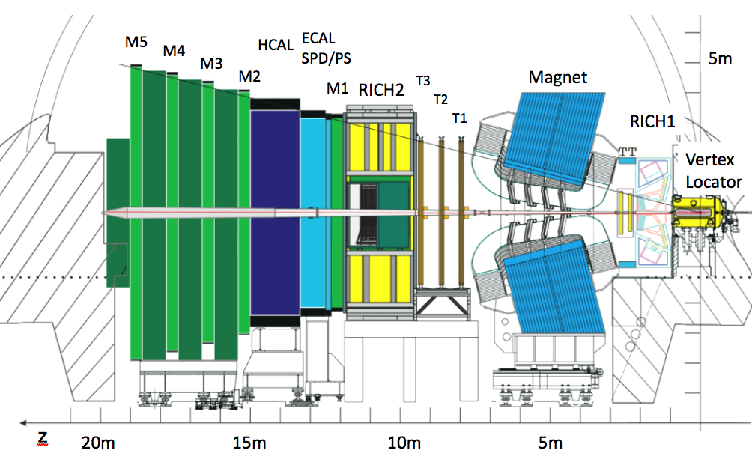
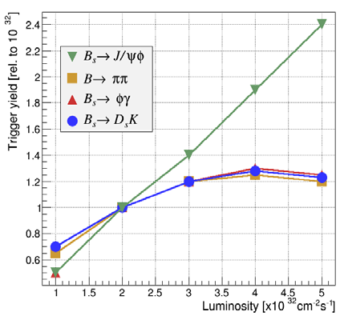
LHCb Trigger – Limitations
Final states with muons
→ Linear gain
Hadronic final states
→ Yield flattens out ---
→ Must raise p_{T} cut to
stay within 1 MHz
readout limit
To profit of a luminosity of 10³³cm⁻²s⁻¹, information has to be introduced that is more discriminating than E_{T}.
LHCb 2012
40 MHz
L0
μ
L0
had
L0
e, γ
Level -0
hardware
Max 1 MHz
Partial reconstruction
HLT1
30 kHz
Global reconstruction
High-Level Trigger
Inclusive selections
μ, μ+track, μμ, topological, charm, ϕ
software
Upgrade strategy:
40MHz readout rate
Fully software trigger
20kHz output rate
HLT2
& Exclusive selections
3-5 kHz
Storage: event size ~60kB

Slide 12
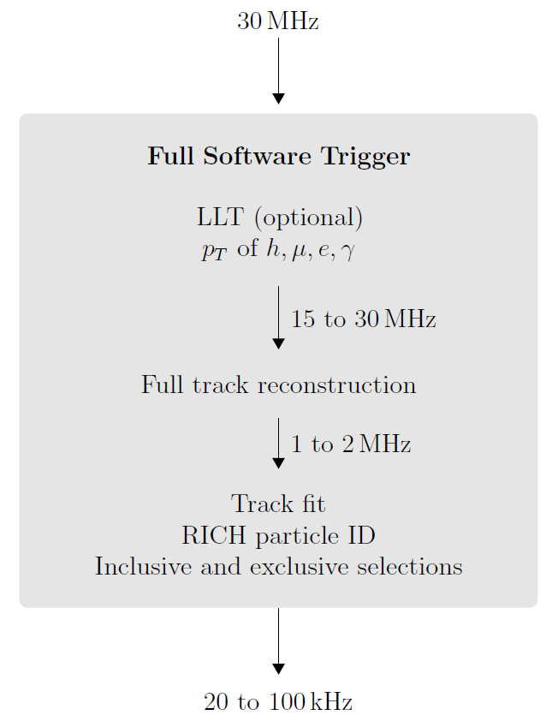
LHCb Trigger Upgrade
30 MHz inelastic collision rate
Effect on luminosity and signal yields
1/fb
LLT (optional)
(15 to) 30 MHz
upgrade
(1 to) 2 MHz
to storage
Run I
Run II
Run III
Run IV
run an efficient and selective software trigger with access to the full detector information at every 25 ns bunch crossing
→
increase luminosity and signal yields
Notes:
Output rate 2-10 GB/s (20-100kHz)

Slide 13
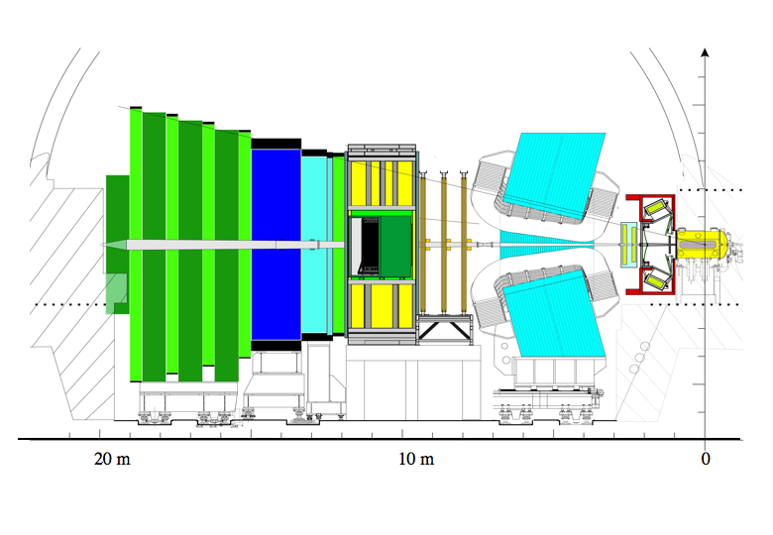
Detector upgrade to 40 MHz R/O
upgrade ALL sub-systems to 40 MHz Front-End (FE) electronics
replace complete sub-systems with embedded FE electronics
adapt sub-systems to increased occupancies due to higher luminosity
keep excellent performance of sub-systems with 5 times higher luminosity
Muon System
Replace ODE
RICH Detectors:
Replace photodetectors and change RICH1 optics
IP
New VELO
(Vertex Locator)
New Tracking System
Calorimeters
Replace R/O
0 10 m 20 m

Slide 14

Vertex Detector Upgrade
Present detector and its performance
Detector upgrade
Expected Performance
CERN-LHCC-2013-021

Slide 15
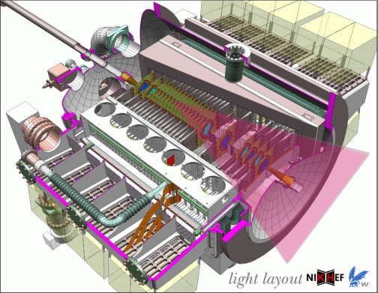
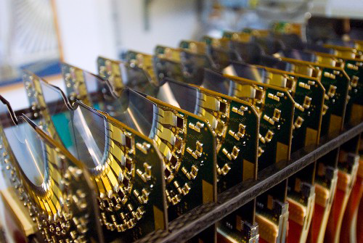
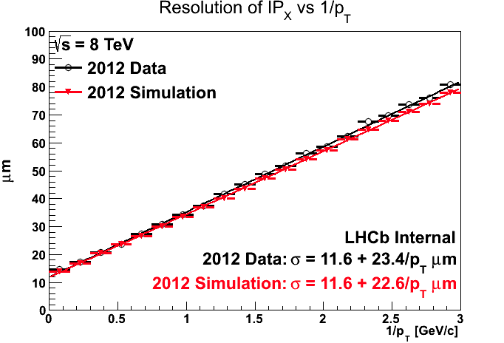
Current VErtex LOcator
Two retractable halves
5.5 mm from beam when closed
3o mm during injection
Operates in secondary vacuum
300 μm Al-foils separate detector from beam
21 R/ Φ modules per half
Silicon micro-strip sensors
Pitch 38-101 μm
Impact Parameter resolution (in x)

Slide 16
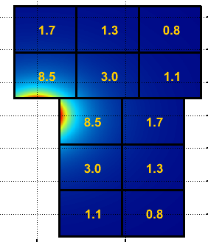
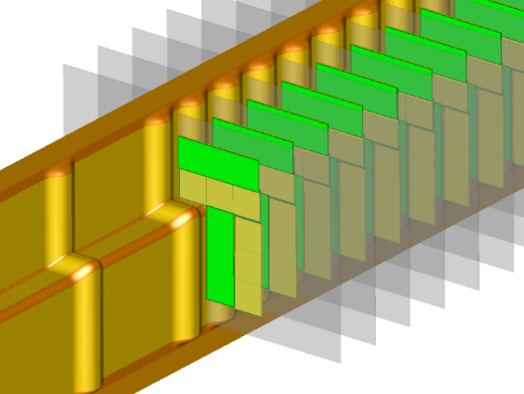
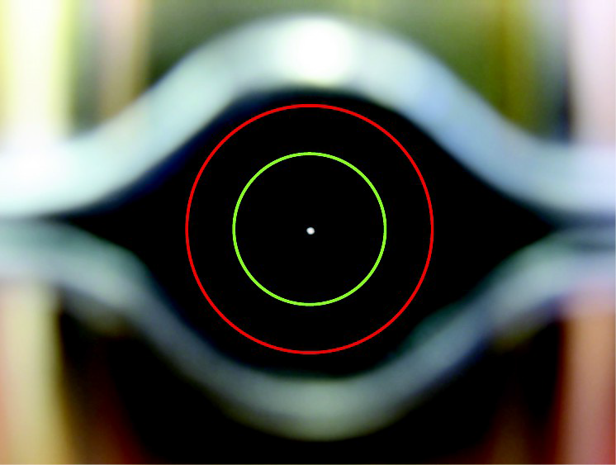
VELO upgrade
Upgrade challenge:
withstand increased radiation
(highly non-uniform radiation of up to 8∙10¹⁵ n_{eq}/cm² for 50 fb⁻¹)
handle high data volume
keep (improve) current performance
  lower materiel budget
  enlarge acceptance
tracks/chip/event at L=2∙10³³ cm⁻²s⁻¹
Technical choices :
55x55 µm² pixel sensors with micro channel CO₂ cooling
40 MHz VELOPIX (evolution of TIMEPIX 3, Medipix)
130 nm technology to sustain ~400 MRad in 10 years
replace RF-foil between detector and beam vacuum
  reduce thickness from 300 μm → ≤ 250 μm
move closer to the beam
  reduce inner aperture from 5.5 mm → 3.5 mm
current inner aperture 5.5 mm
RF-foil
new aperture 3.5 mm
Notes:
8.5 tracks/chip/event correspond to a data-rate of 15 Gbit/s (no buffering).

Slide 17
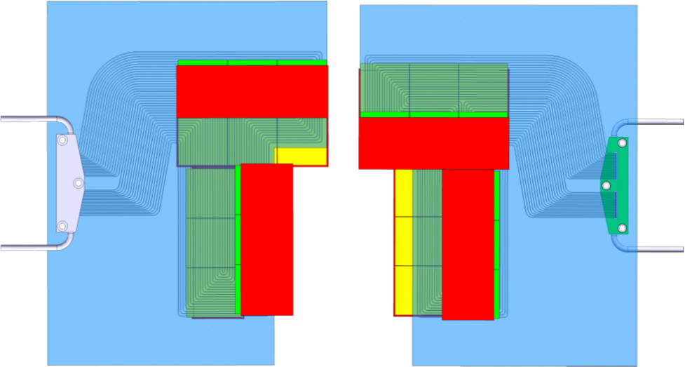
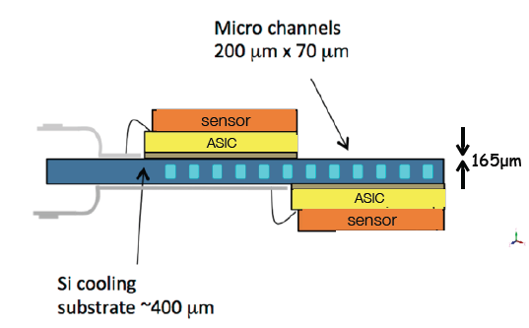
VELO upgrade
Upgrade challenge:
withstand increased radiation
(highly non-uniform radiation of up to 8∙10¹⁵ n_{eq}/cm² for 50 fb⁻¹)
handle high data volume
keep (improve) current performance
  lower materiel budget
  enlarge acceptance
Micro channel cooling substrate
Sensors
(front, back, bonds)
tracks/chip/event at L=2∙10³³ cm⁻²s⁻¹
Technical choices :
55x55 µm² pixel sensors with micro channel CO₂ cooling
40 MHz VELOPIX (evolution of TIMEPIX 3, Medipix)
130 nm technology to sustain ~400 MRad in 10 years
replace RF-foil between detector and beam vacuum
  reduce thickness from 300 μm → ≤ 250 μm
move closer to the beam
  reduce inner aperture from 5.5 mm → 3.5 mm
RF-foil

Slide 18
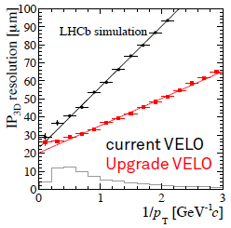
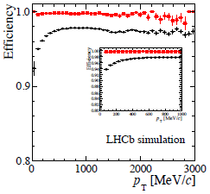
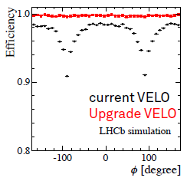
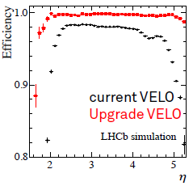
VELO upgrade performance
better impact parameter resolution due to reduced material budget
reduced ghost rate
improved efficiency over p_{T}, 𝜙, 𝜂
3D IP resolution at
L = 2∙10³³ cm⁻²s⁻¹
note: full GEANT Monte Carlo with standard LHCb simulation framework

Slide 19
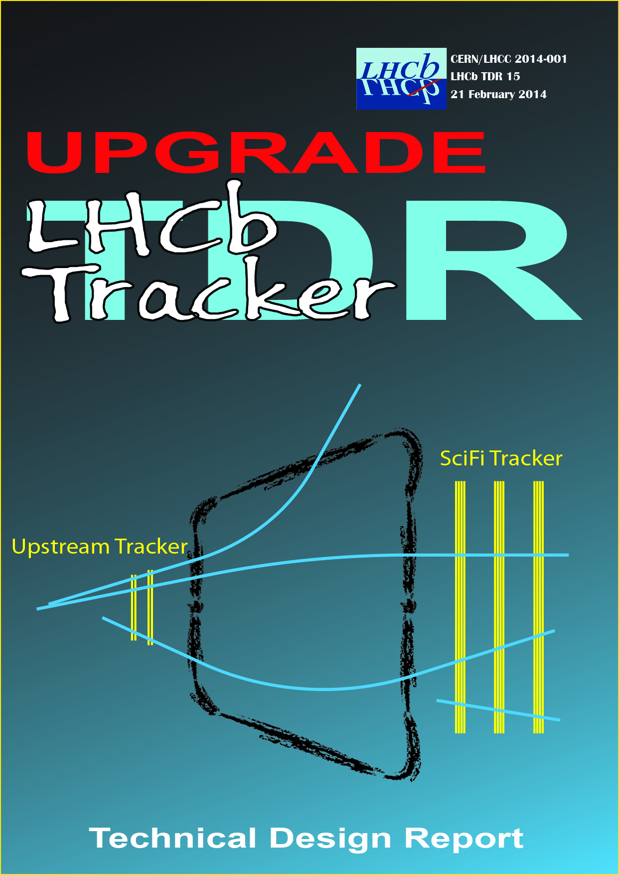
Tracker Upgrade
Upstream Tracker
Scintillating Fibre
Tracker
CERN-LHCC-2014-001

Slide 20
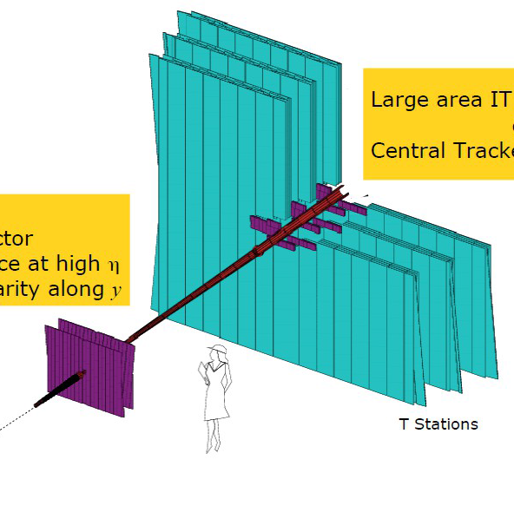
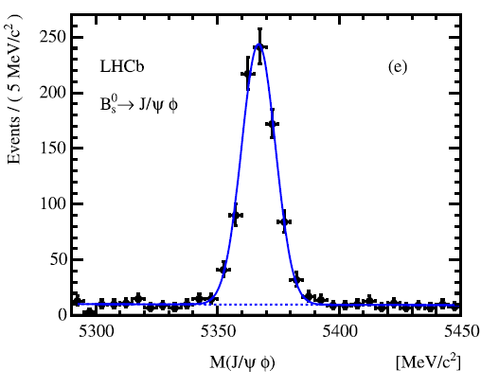
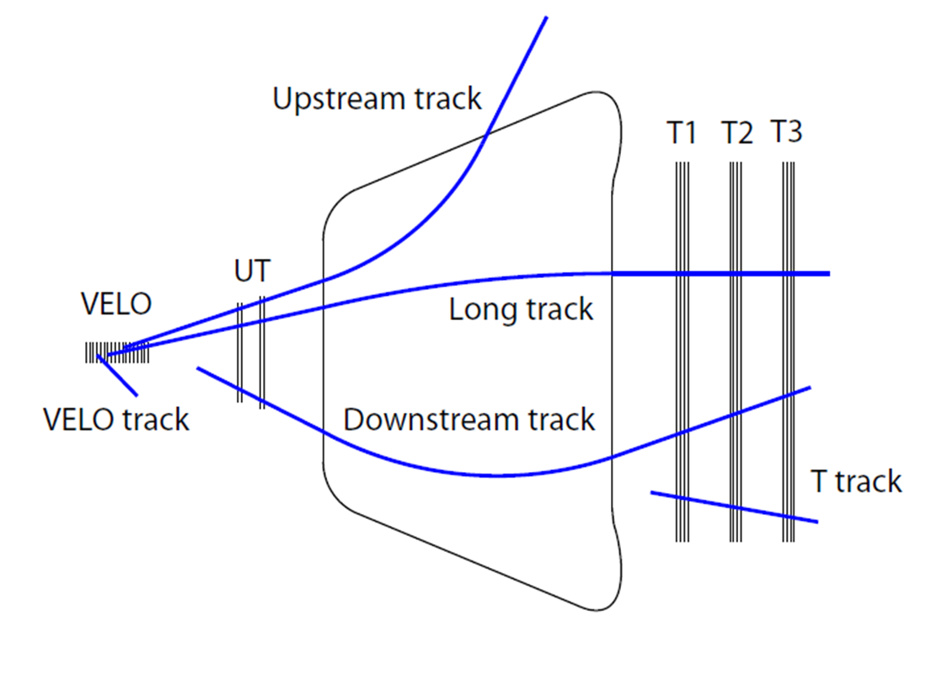
Present Tracking System
excellent mass resolution
very low background, comparable to e⁺e⁻ machines
world’s best mass measurements [PLB 708 (2012) 241]
Outer
Tracker
TT silicon
IT silicon
OT straw tubes
Trigger
Tracker
Inner
Tracker
σ = 7 MeV/c²
T-stations
TT

Slide 21
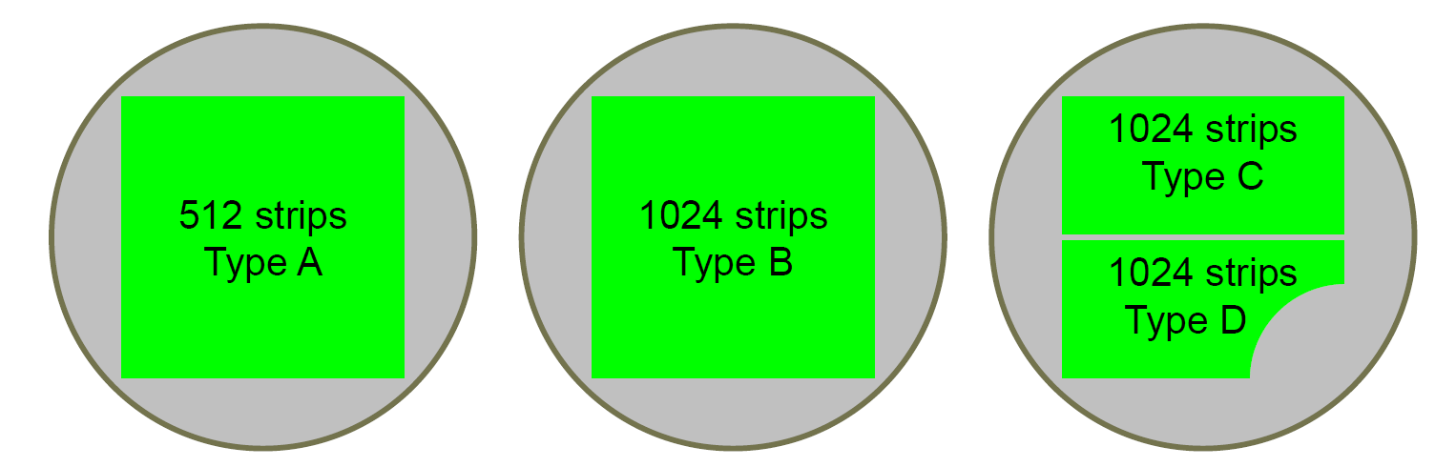
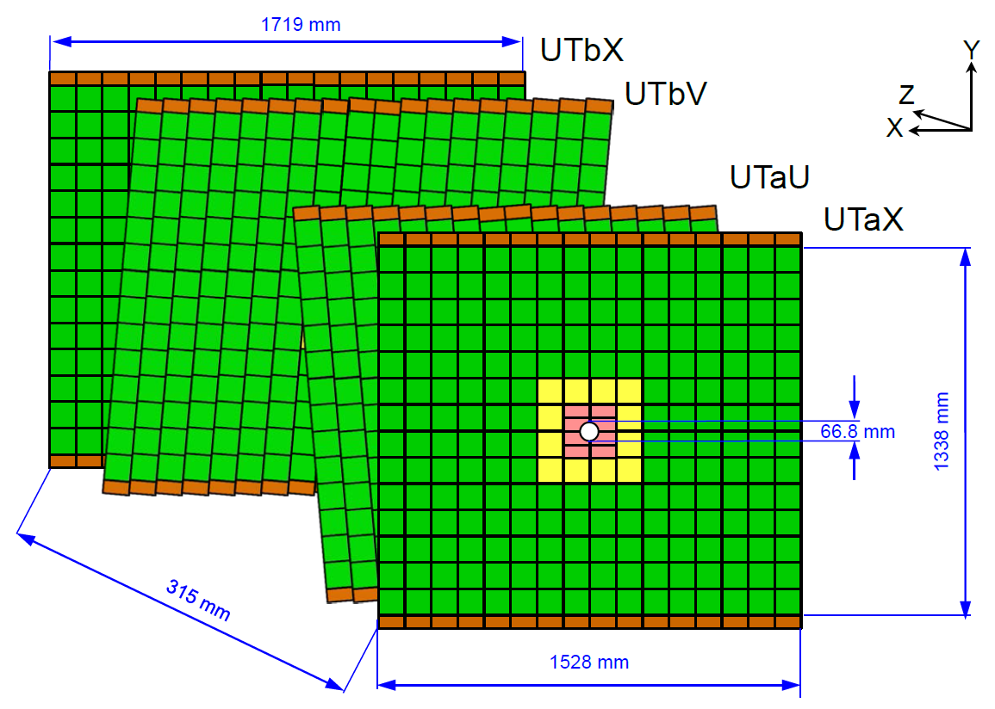
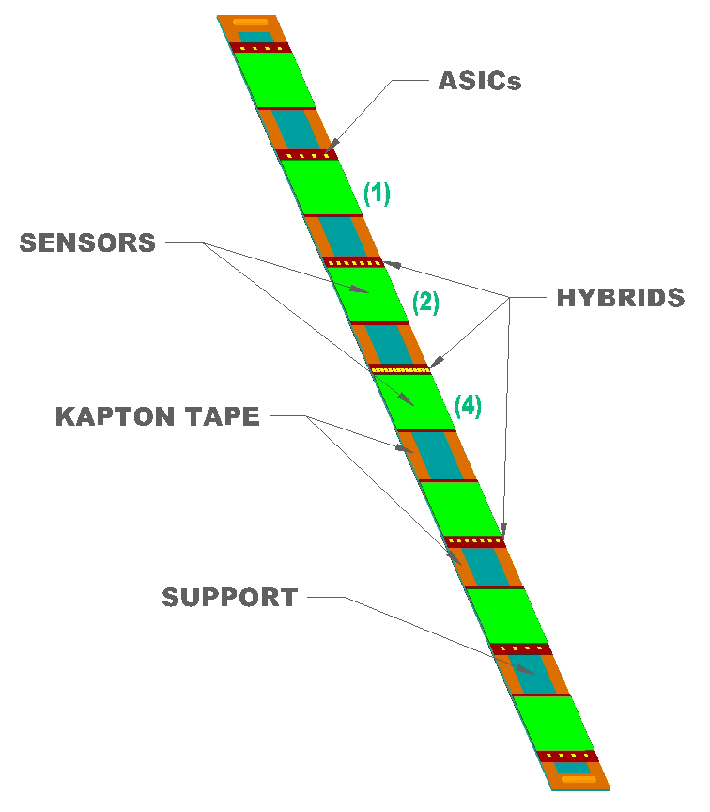
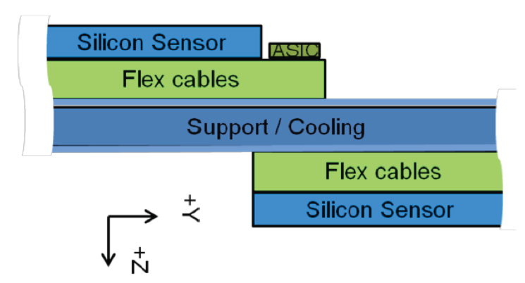
TT upgrade: Upstream Tracker (UT)
silicon strip detector
adapt segmentation to varying occupancies (out → in-side):
outer
middle
inner
98 → 49 mm long strips
190 → 95 µm pitch
p⁺-in-n → n⁺-in-p
40MHz silicon strip R/O → SALT chip
GBT
KAPTON TAPE
SUPPORT
GBT
40MHz silicon strip R/O → SALT chip

Slide 22
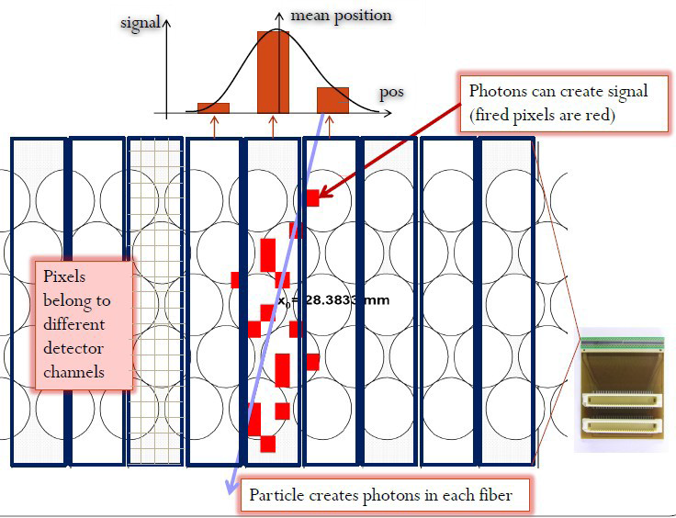
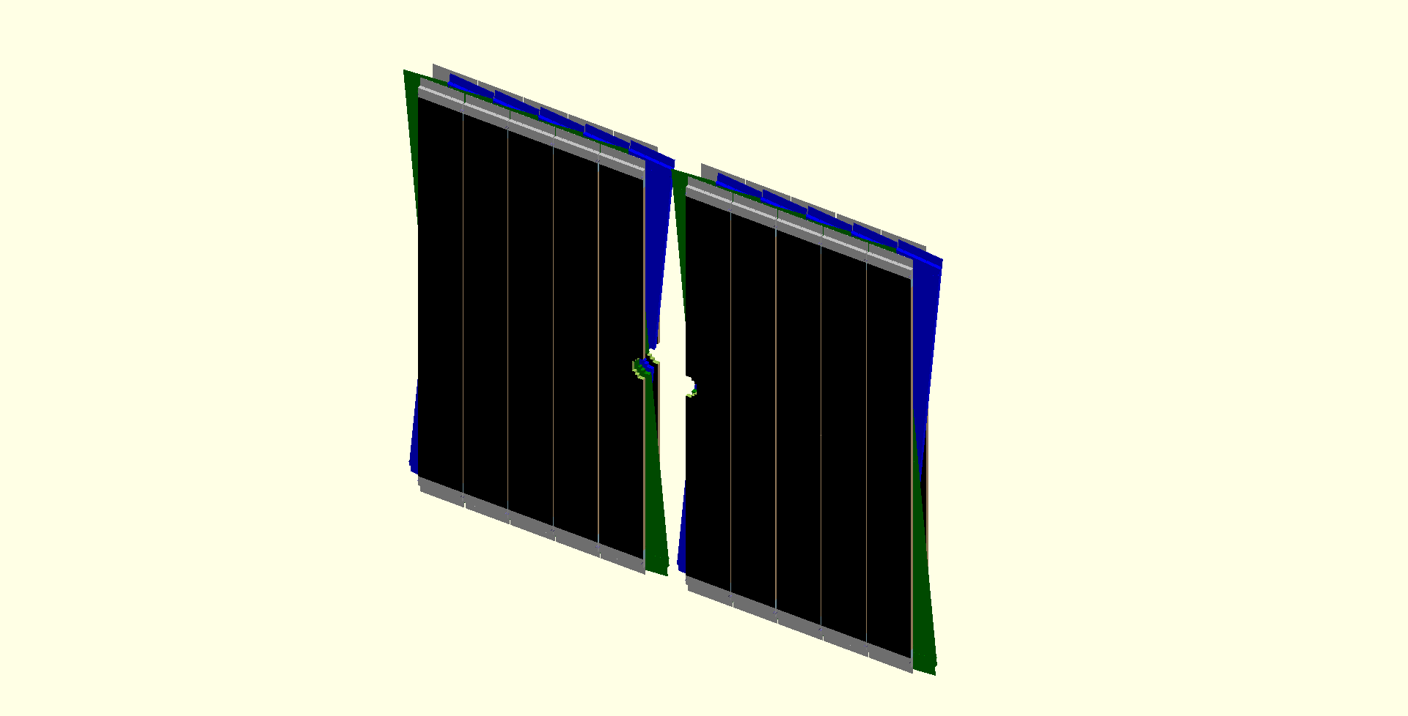
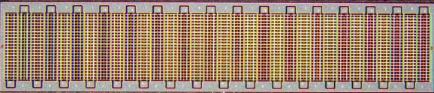
T-stations upgrade: Fibre Tracker
3 stations of X-U-V-X (±5º stereo angle) scintillating fibre planes
every plane made of 5 layers of Ø=250 µm fibres, 2.5 m long
40 MHz readout and Silicon PMs at periphery
Scint.-fibre mat (5-6 layers)
SiPM readout
2 x ~ 2.5 m
fibre ends
mirrored
1.25 mm
R/O by dedicated 128 ch. 40 MHz PACIFIC chip
3 thresholds (2 bits)
sum threshold (FPGA)
SiPM readout
1 SiPM channel
SiPM array
2 x ~3 m
Benefits of SciFi concept:
a single technology to operate
uniform material budget
SiPM + infrastructure outside accept.
x-position resolution of 50 – 75 µm
fast pattern recognition for HLT
Challenges: radiation environment
ionization damage to fibres → tested ok
neutron damage to SiPM → operate at -40ºC
large size – high precision, O(10’000 km) of fibres
Notes:
Photons create signal, fired pixels are red

Slide 23
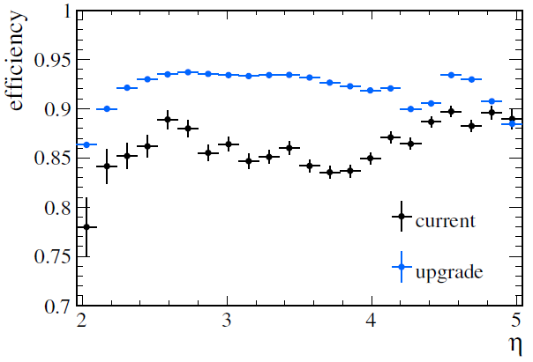
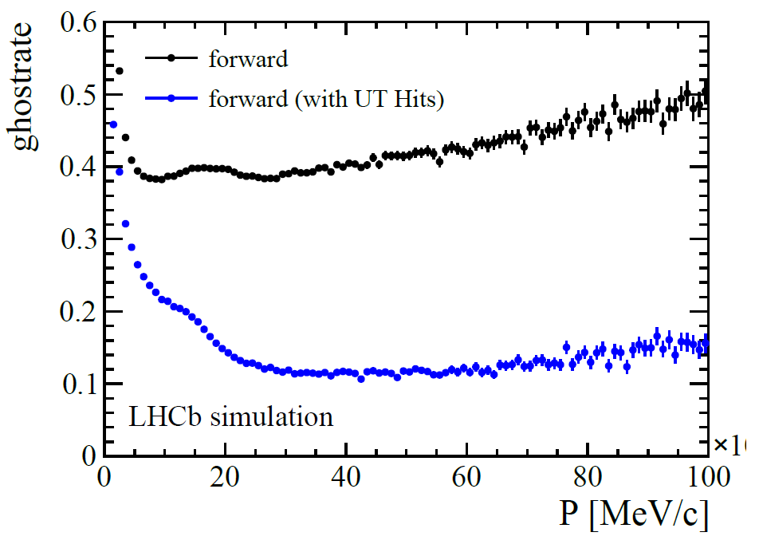
Tracking performance
Efficiency for B_{s} → ΦΦ events:
upgrade conditions,
current and upgraded T-stations
Ghost rate for B_{s} → ΦΦ events:
long tracks without UT and
with UT (≥ 3hits)
OT
IT
SciFi
without UT
with UT
improve tracking performance at upgrade luminosity with Fibre Tracker
reduce significantly the ghost rate using the Upstream Tracker information
Notes:
Left plot illustrates the superior performance of the SciFi Tracker compared to the OT.
Adding UT hits has the advantage that the momentum resolution improves significantly.
Moreover, the requirement to have at least three UT hits reduces the ghost rate while keeping the efficiency.

Slide 24
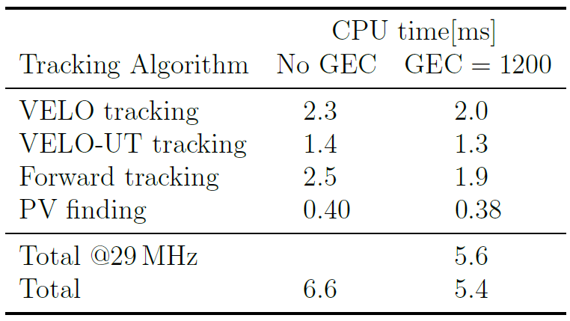
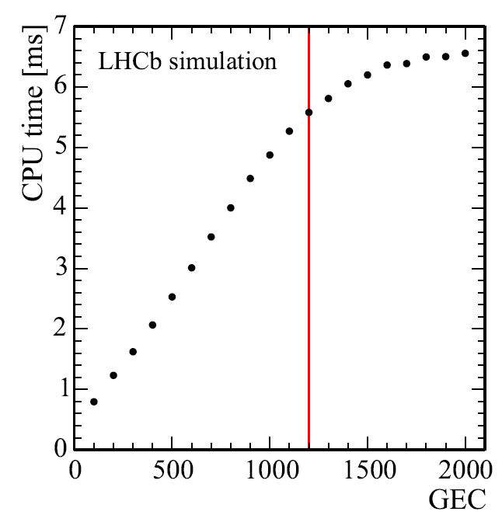
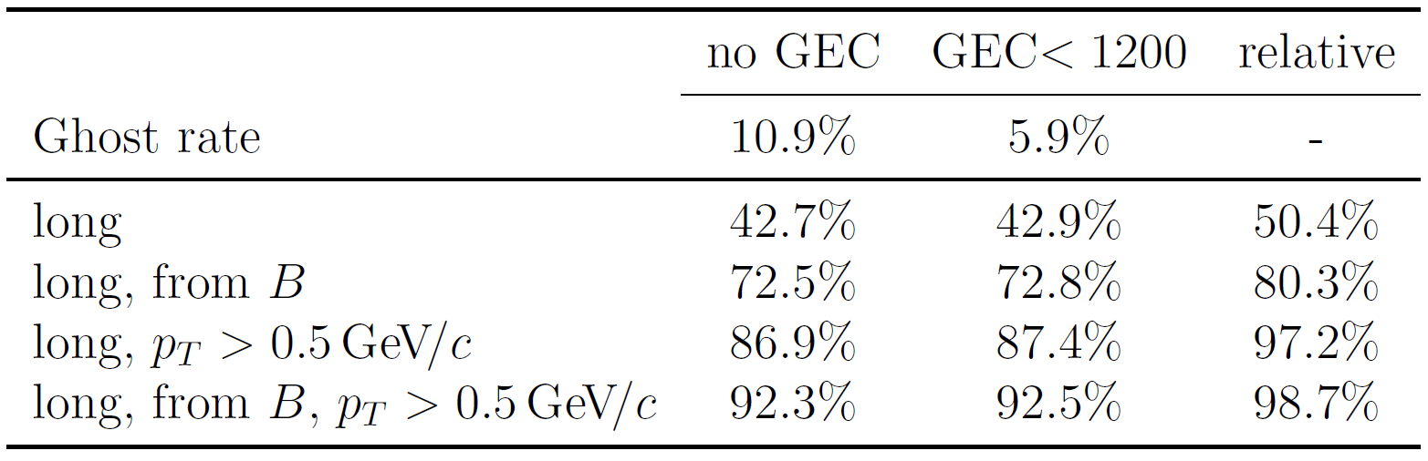
Tracking algorithm for the Trigger
Expected CPU budget with upgraded Event Filter Farm:
~13 ms (10 x current CPU farm)
Performance of HLT tracking with upgraded VELO, UT and FT:
GEC (Global Event Cut) → multiplicity cut to remove pathological events (e.g. hit multiplicity of sub-detector)
ms
→ leaves ~ 6-7 ms for a trigger decision
→ high efficiency (even with GEC)
Notes:
Bottom table: track finding efficiencies.
B-daughter tracks have pT more than 500MeV.
Relative means relative to offline.

Slide 25

Particle Identification Upgrade
RICH
Calorimeter
Muon System
CERN-LHCC-2013-001

Slide 26
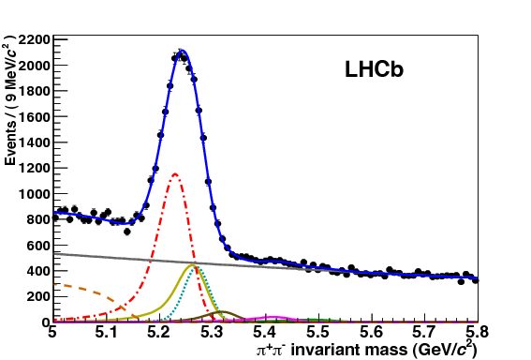
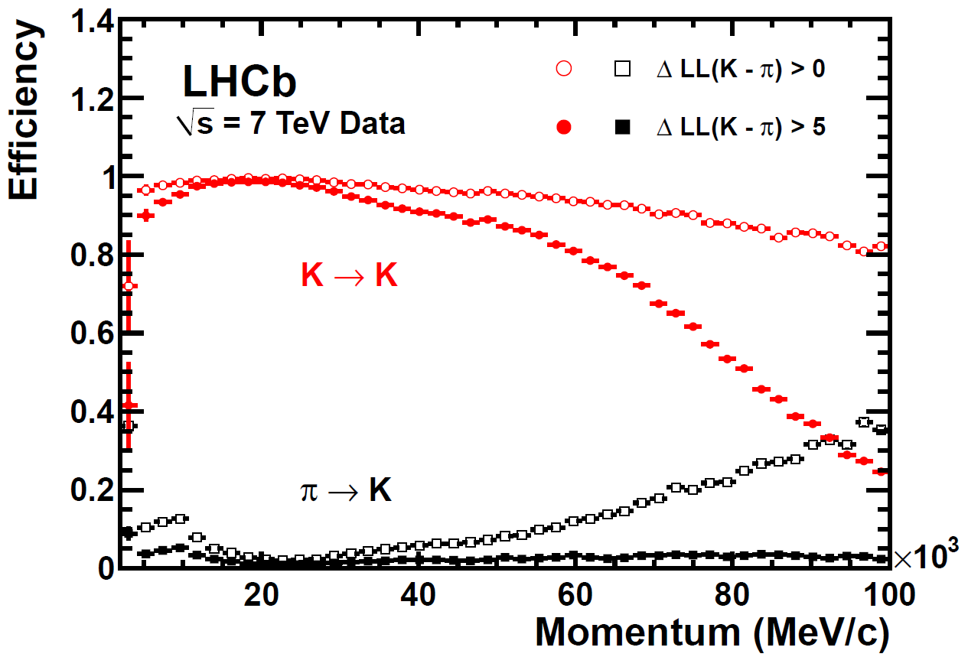
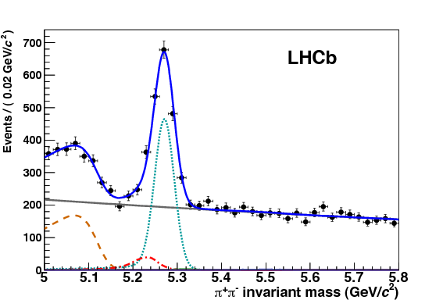
Particle ID with RICH
Efficient particle ID of π, K, p essential for selecting rare beauty and charm decays
B⁰ → h⁺ h⁻
K-identification and π-misidentification efficiencies vs. particle momentum
B_{d}⁰ → π⁺ π⁻
particle identification of 2 π
BR(B→π⁺π⁻) = 5 x 10⁻⁶ !
B_{d}⁰ → π⁺ π⁻
Eur. Phys. J. C (2013) 73:2431
Notes:
Invariant mass distribution for B →h+h− decays in the LHCb data before the use of the RICH information (top), and after applying RICH particle identification (bottom).
The signal under study is the decay B0 → π+π−, represented by the turquoise dotted line.
The contributions from different b-hadron decay modes (B0 → Kπ red dashed-dotted line, B0 → 3-body orange dashed-dashed line, Bs →KK yellow line, Bs →Kπ brown line, Ʌb →pK purple line, Ʌb → pπ green line), are eliminated by positive identification of pions, kaons and protons and only the signal and two background contributions remain visible in the plot on the right. The grey solid line is the combinatorial background.

Slide 27
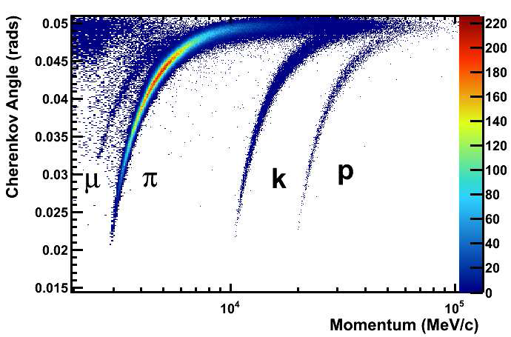
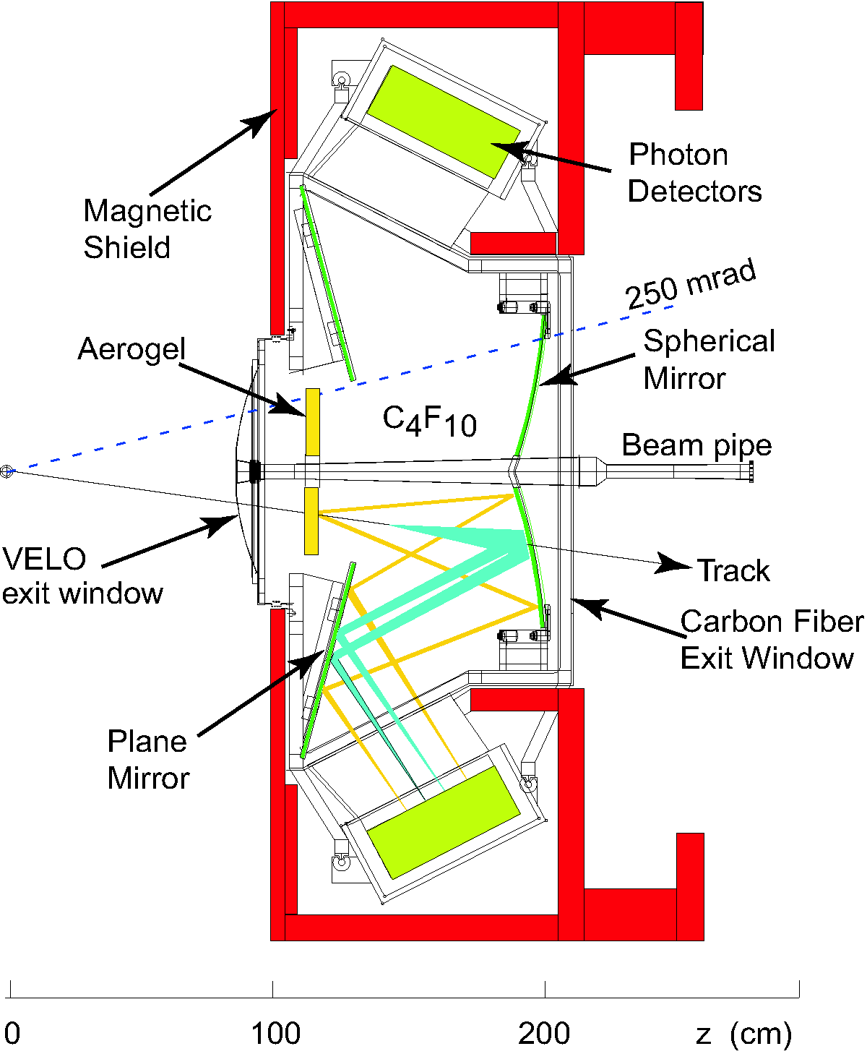
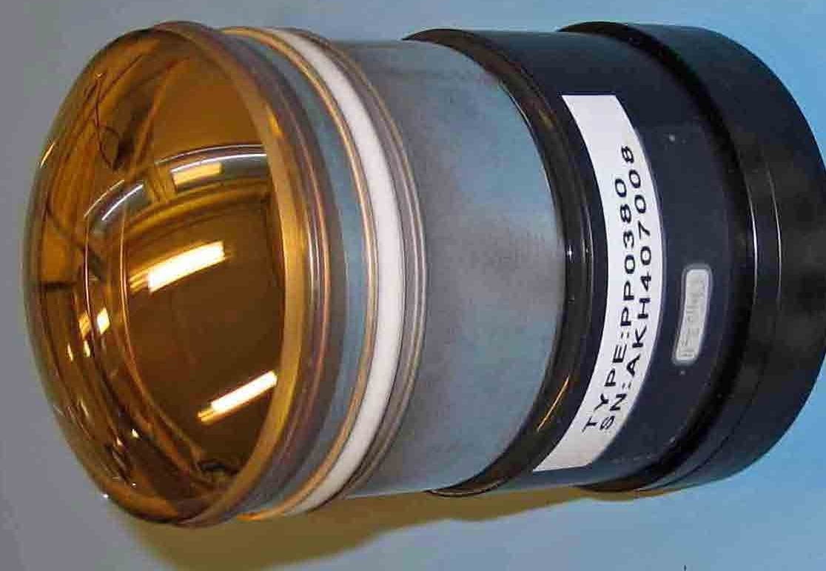


Present RICH 1
Particles traversing radiator produce Cherenkov light rings on an array of HPDs located outside the acceptance
RICH 1
C₄F₁₀
Eur. Phys. J. C (2013) 73:2431
Hybrid Photon Detector
photon detectors
with embedded 1 MHz R/O chip
plane mirror
HPDs
spherical mirror
Notes:
Reconstructed Cherenkov angle as a function of track momentum in the C4F10 radiator

Slide 28



RICH upgrade
optimise RICH1 optics
Luminosity of 2∙10³³ cm⁻²s⁻¹ → adapt to high occupancies
aerogel radiator removed
modify optics of RICH1 to spread out Cherenkov rings (optimise gas enclosure without modifying B-shield)
current
40 MHz readout → replace HPDs due to embedded FE
64 ch. multi-anode PMTs (baseline)
40 MHz Front-End: CLARO chip (or MAROC)
Prototype of photo-detector readout module
upgrade
64 ch. MaPMT

Slide 29

Performance RICH upgrade
as function of luminosity
Current RICH1
2∙10³² cm⁻²s⁻¹
10∙10³² cm⁻²s⁻¹
20∙10³² cm⁻²s⁻¹
RICH1 upgrade
20∙10³² cm⁻²s⁻¹
Pion misidentification efficiency [%]
note:
full GEANT MC with standard LHCb simulation framework
Kaon identification efficiency [%]

Slide 30


Particle ID with Calorimeters
Calorimeters allow to reconstruct neutral hadrons
They provide an E_{T} measurement used in the LO trigger
Typical π⁰ mass resolution:
~7-10 MeV/c² (depending on
number of converted photons)
Radiative b→ s γ transitions:
Invariant mass resolution ~ 94 MeV/c²
dominated by ECAL energy resolution.
π⁰ → γγ
B⁰→K*γ
Nuclear Physics, Section B 867 (2013) 1
Notes:
The performance of high energy photon reconstruction is illustrated by the reconstructed B0 → Ko γ mass distribution.
The mass resolution obtained for this radiative decay, 93 MeV=c2 is dominated by the ECAL energy resolution.
Reproducing the resolution of data with simulation samples, this corresponds to an intrinsic resolution in the photon energy of around 2%.

Slide 31




Calorimeter upgrade
40 MHz readout electronics:
reduce photomultiplier gain
adopt electronics
Impact of pile-up on the energy /
position measurement:
Change the reconstruction and define
smaller clusters
Radiation damage on detectors:
Preshower and SPD removed
HCAL modules ok up to ~50 fb⁻¹
irradiation tests show that most exposed ECAL modules resist up to ~20 fb⁻¹ → LS3
Innermost ECAL modules around beam-pipe can be replaced

Slide 32



Particle ID with the Muon System
MWPC
Y_{1S}
Y_{nS} → µ⁺µ ̶
Y_{2S}
Y_{3S}
High detection efficiency: ε(μ) = (97.3±1.2)%
Low misidentification rates:
ε(p → µ) = (0.21 ± 0.05)%
ε(π→ µ) = (2.38 ± 0.02)%
ε(K→ µ) = (1.67 ± 0.06)%

Slide 33
Muon System upgrade
Modifications due to higher luminosity and 40 MHz readout:
  remove M1 due to too high occupancies
  additional shielding behind HCAL to reduce the rate in the inner region of M2
  keep on-detector electronics (CARIOCA); already at 40 MHz readout
  new off-detector electronics for an efficient readout via PCIe40 R/O boards
on-detector electronics
off-detector electronics

Slide 34
Summary and Conclusions
LHCb is producing world best measurements in the b- and c-quark sector due to its excellent detector performance.
By 2018 with ~8 fb⁻¹ LHCb will find or rule-out large sources of flavour symmetry breaking at the TeV scale.
The LHCb upgrade is mandatory to reach experimental precisions of the order of the theoretical uncertainties.
An efficient and selective software trigger with access to the full detector information at every 25 ns bunch crossing will allow to collect the necessary ≥50 fb⁻¹ within ~10 years.
The LHCb upgrade is fully approved, with the last TDR under review.
The detector upgrade to 40 MHz readout sustaining a levelled luminosity of 2 x 10³³ cm⁻²s⁻¹ at 25 ns bunch spacing is under preparation, to be operational at the beginning of 2020.

