Slide 1
CP Violation and Six Quark Model
2014/07/10
London
M. Kobayashi
KEK and JSPS

Slide 2
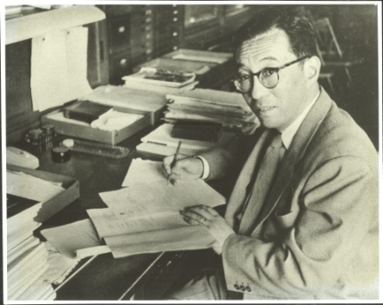
1956 Sakata
Sakata Model
All the hadrons are composite states of
: Fundamental Triplet
Courtesy of Sakata Memorial
Archival Library
Shoichi Sakata
1911-1970
It seems to me that the present state
of the theory of new particles is very
similar to that of the atomic nuclei 25
years ago.
Supposing that the similar situation
is realized at present, I proposed a compound
hypothesis for new unstable particles
to account for Nishijima-Gell-Mann's
rule.
1959 Ikeda, Ogawa, Ohnuki
U(3) symmetry of the Sakata Moel

Slide 3
Weak Interaction in the Sakata Model
Gamba, Marshak, Okubo
B-L Symmetry
1960 Maki, Nakagawa, Ohnuki, Sakata
Nagoya Model :

Slide 4
Discovery of Two Neutrinos
1962 Danby et al. PRL 9, 36 (1962)
Modification of Nagoya Model
1962 Katayama, Matumoto, Tanaka and Yamada
Progr. Theor. Phys. 28, 675 (1962)
1962 Maki, Nakagawa and Sakata
Progr. Theor. Phys. 28, 870 (1962)

Slide 5
Neutrino Mixing: Maki, Nakagawa, Sakata (MNS)
“Under what conditions should the parameter delta be determined?”
“It is tempting to suppose that the question mentioned above may be
closely connected with the problem of mu-e mass difference.”
Bare field:
2x2 mass matrices
Identify the mass eigenstates with

Slide 6
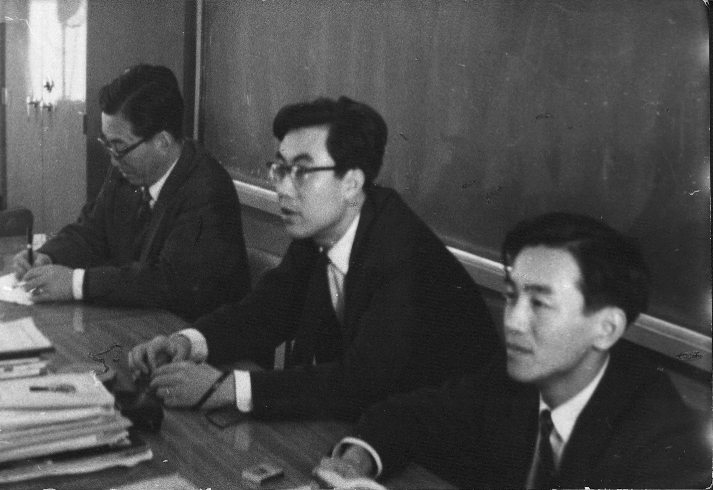
Courtesy of Sakata Memorial Archival Library
S. Sakata
1911-1970
Z. Maki
1929-2005
M. Nakagawa
1932-2001

Slide 7
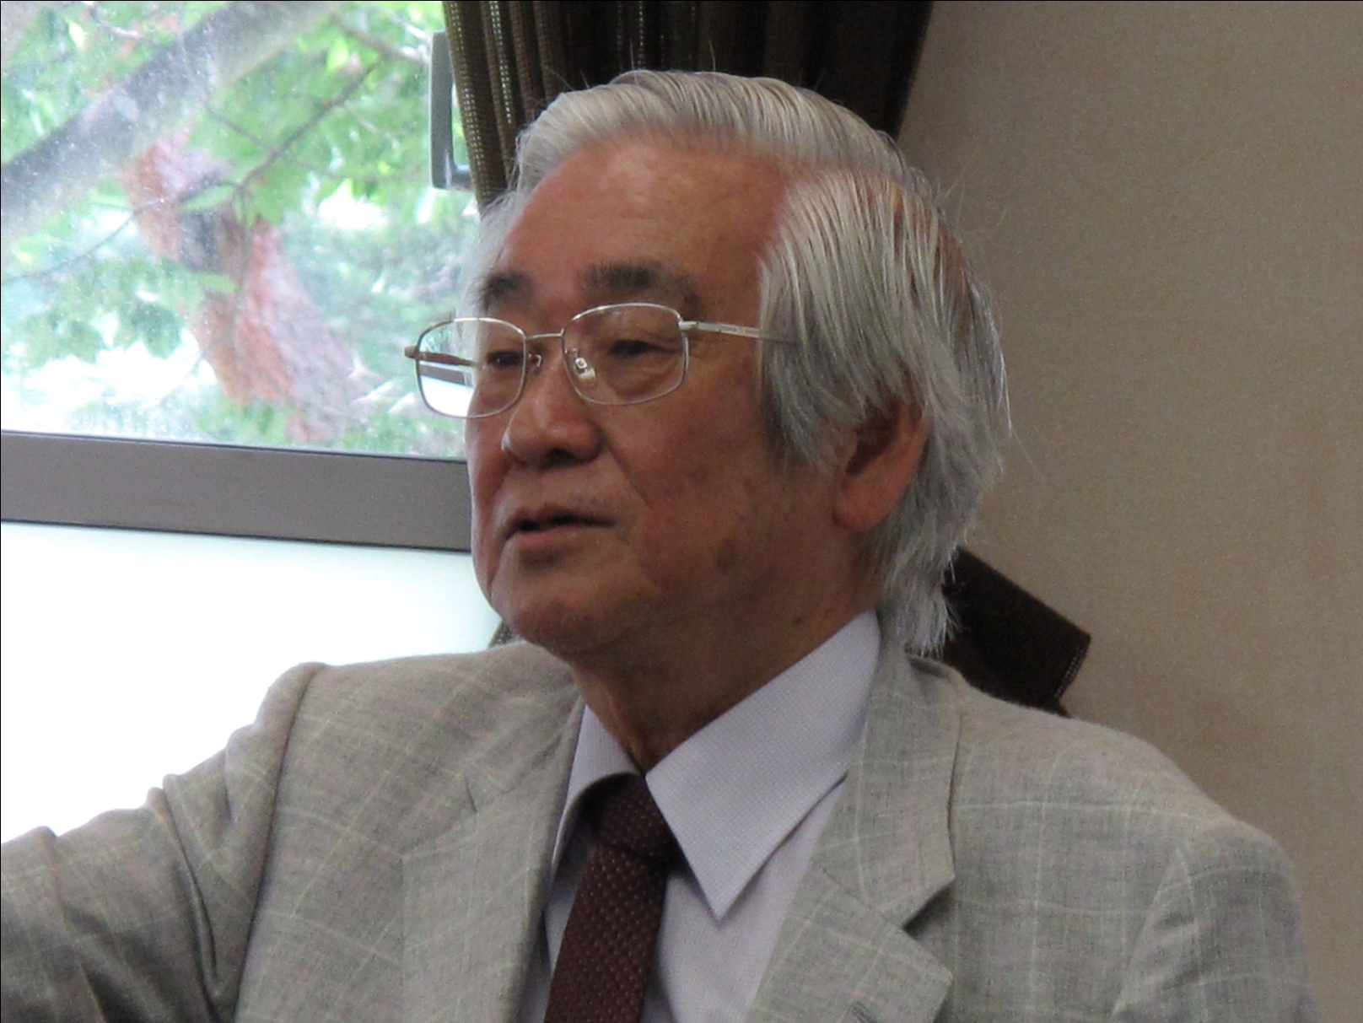
Makoto Kobayashi
1967 Graduate Course of Nagoya University
Ph.D. from Ngayoya University
Assistant Prof. of Kyoto University
Toshihide Maskawa
1962 Graduate Course of Nagoya University
Ph.D.
Pos. Doc. of Nagoya University
1970 Assistant Prof. of Kyoto University

Slide 8
1971 ‘t Hooft : Renormalization of Non-Abelian gauge theory
Renormalizable Electro-Weak Theory
(Weinberg-Salam-Glashow )
1973 Kobayashi, Maskawa
How to accommodate CP violation
What we found
Not possible with three or four quarks
Existence of unknown particles
A possible candidate is six-quark model

Slide 9
Flavor Mixing of 4-Quark Model
Redefinition of quark fields
No CP Violation
Generic CP transformation

Slide 10
6-Quark Model
9 - 5 = 3 + 1
U(3)
O(3):real
# of relative phases
Imaginary

Slide 11
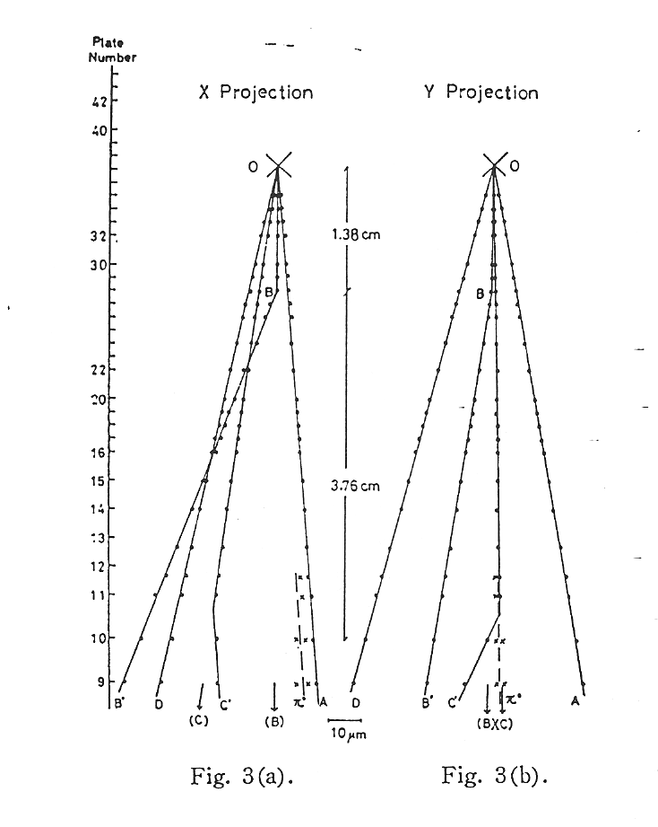
Discoveries of new particles
1973 Kobayashi, Maskawa
1974 Discovery of J/ψ particle ( c-quark )
1971 Niu et al.
Cosmic ray events
1975 Discovery of τ-lepton
1977 Discovery of Υ particle ( b-quark )
1995 Discovery of t-quark

Slide 12
Early Theoretical Papers
Pakvasa, Sugawara Phys.Rev. D14, 305 (1976)
Ellis, Gaillard, Nanopilos Nucl.Phys. B109, 213 (1976)
CP Violation in the Neutral Kaon
Dominant contribution to ε is from box diagrams:

Slide 13
Direct CP Violation in K_{L} Decay
rules out the Superweak Model
Experimemts
Lattice QCD Calculation
Final results are not available yet

Slide 14
Time dependent CP asymmetry in B-decays
Carter, Sanda Phys.Rev.Lett. 45, 952 (1980);
Phys.Rev. D23, 1567(1981)
Asymmetric B-factory
at KEK and SLAC

Slide 15
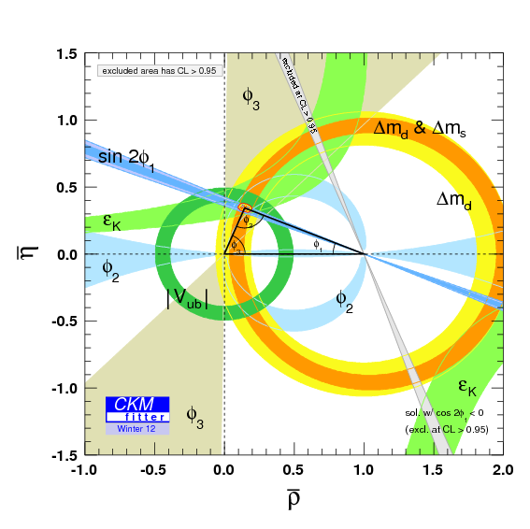
CKMfitter Group (J. Charles et al.), Eur. Phys. J. C41, 1-131 (2005) [hep-ph/0406184], updated results and plots available at: http://ckmfitter.in2p3.fr

Slide 16
Matter dominant Universe
1967 Sakharov
Baryon number non-conservation
C and CP violation
Out of thermal equilibrium
sphaleron process
V-A, flavor mixing
1st order phase transition
Standard Model meets three conditions
Detailed analysis shows that the effect is too weak
New source of CP violation

Slide 17
Present status of CP violation
The standard model explains CP violation
in both K-mesons and B-mesons
The standard model, however, cannot explain
the matter dominance of the Universe.
There will be yet unknown particles and unknown
CP violating interactions.

