Slide 1

Physics Highlights
of
(mainly) on CP Violation
(with some history)
Physics Highlights
of
Physics Highlights
of
(mainly) on CP Violation
David Hitlin
Caltech
Fifty Years of CP Violation
Queen Mary, University of London
July 10, 2014

Slide 2
The situation in the mid ’80’s
In 1981 Bigi and Sanda showed that a measurement of CP violation in B⁰ meson decay to CP eigenstates could be clearly interpreted, without theoretical uncertainties due to hadronic structure, directly in terms of CKM parameters
The prospect of a clean CPV measurement in B⁰ decays was exciting; perhaps the Standard Model prediction of the strength of CP violation would fail
With the observation in ’83 of a long B meson lifetime by Mark II and MAC and in ’87 of substantial B_{d} mixing by ARGUS and UA1, it became clear that one could actually contemplate measuring CP-violating asymmetries in
B⁰ meson decays
Doing so would require flavor-tagging a B meson and then distinguishing
mixed from unmixed decays, which could be done using B’s produced in
e⁺e⁻ annihilation or in hadronic collisions
However, in e⁺e⁻ ~10⁷-10⁸ pairs would be needed, a 2 to 3 order of magnitude increase in the then-existing data sample
Exploiting the quantum correlations of pairs produced in ϒ(4S) decays in e⁺e⁻ seemed like a particularly elegant approach, but separating the decays was difficult, as the B⁰ lifetime in the laboratory corresponds to a distance of 19μm
Thus making this measurement required not only an asymmetric energy *
e⁺e⁻ collider of unprecedented luminosity, but also a detector with excellent vertex and exclusive state reconstruction

Slide 3
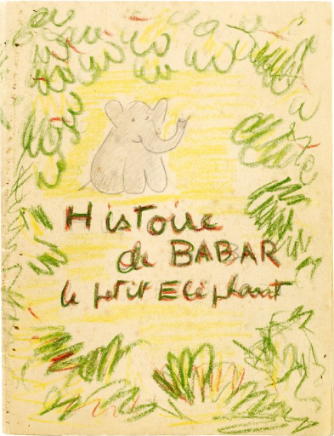

Histoire de BABAR
Jonathan Dorfan has told you the
story of PEP-II
I will briefly describe our early
efforts to find a way to measure
CP violation in B decay, how the
BABAR collaboration came together,
and built a detector capable of
measuring CP violation at PEP-II
I will then survey a selection
of BABAR’s important physics
results pertaining (mostly) to
CP violation
BABAR currently has 538
publications in refereed journals,
6 more submitted for publication,
and many analyses ongoing

Slide 4
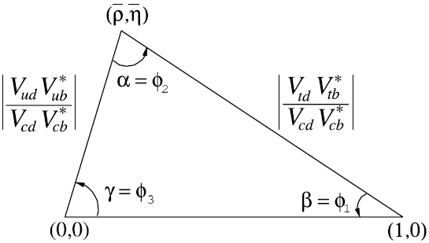
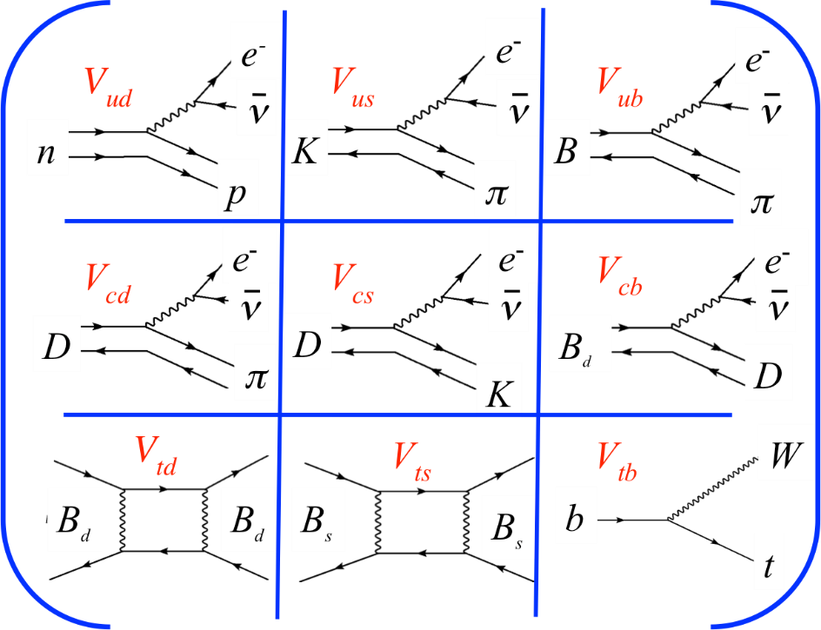
The CKM Matrix
d s b
There are six unitarity conditions:
one has sides of comparable length
u
c
t
V_{CKM} =

Slide 5
The Wolfenstein parametrization
The Unitarity Triangle

Slide 6
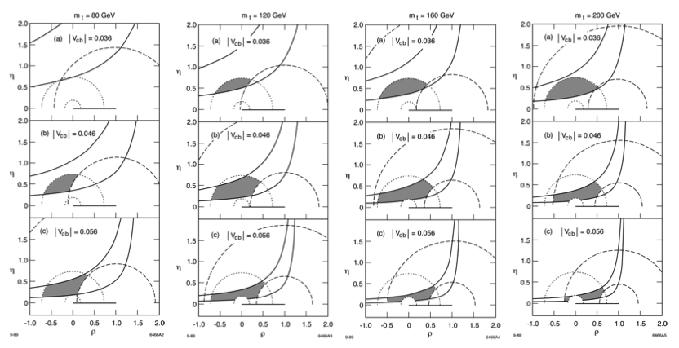
The unitarity triangle construction clearly illustrated the Standard Model tests that would be made possible with a measurement of CP-violating quantities in the B meson system, but which triangle?
The top quark mass was not known.
Dib, Dunietz, Gilman and Nir 1989

Slide 7
Measuring CP violation at the
are produced in pairs in a coherent L=1 state
Decay + mixing
There are four time distributions
The CP asymmetry is
The CP asymmetry is

Slide 8
Overview of the analysis
Reconstruct exclusive B decays to
CP eigenstates and flavor eigenstates
and tag the flavor of the other B decay
e⁺ e⁻
Measure Δ z between B_{CP} and B_{tag} to determine the
signed time difference Δ t between the decays
Determine the resolution function for Δ z

Slide 9
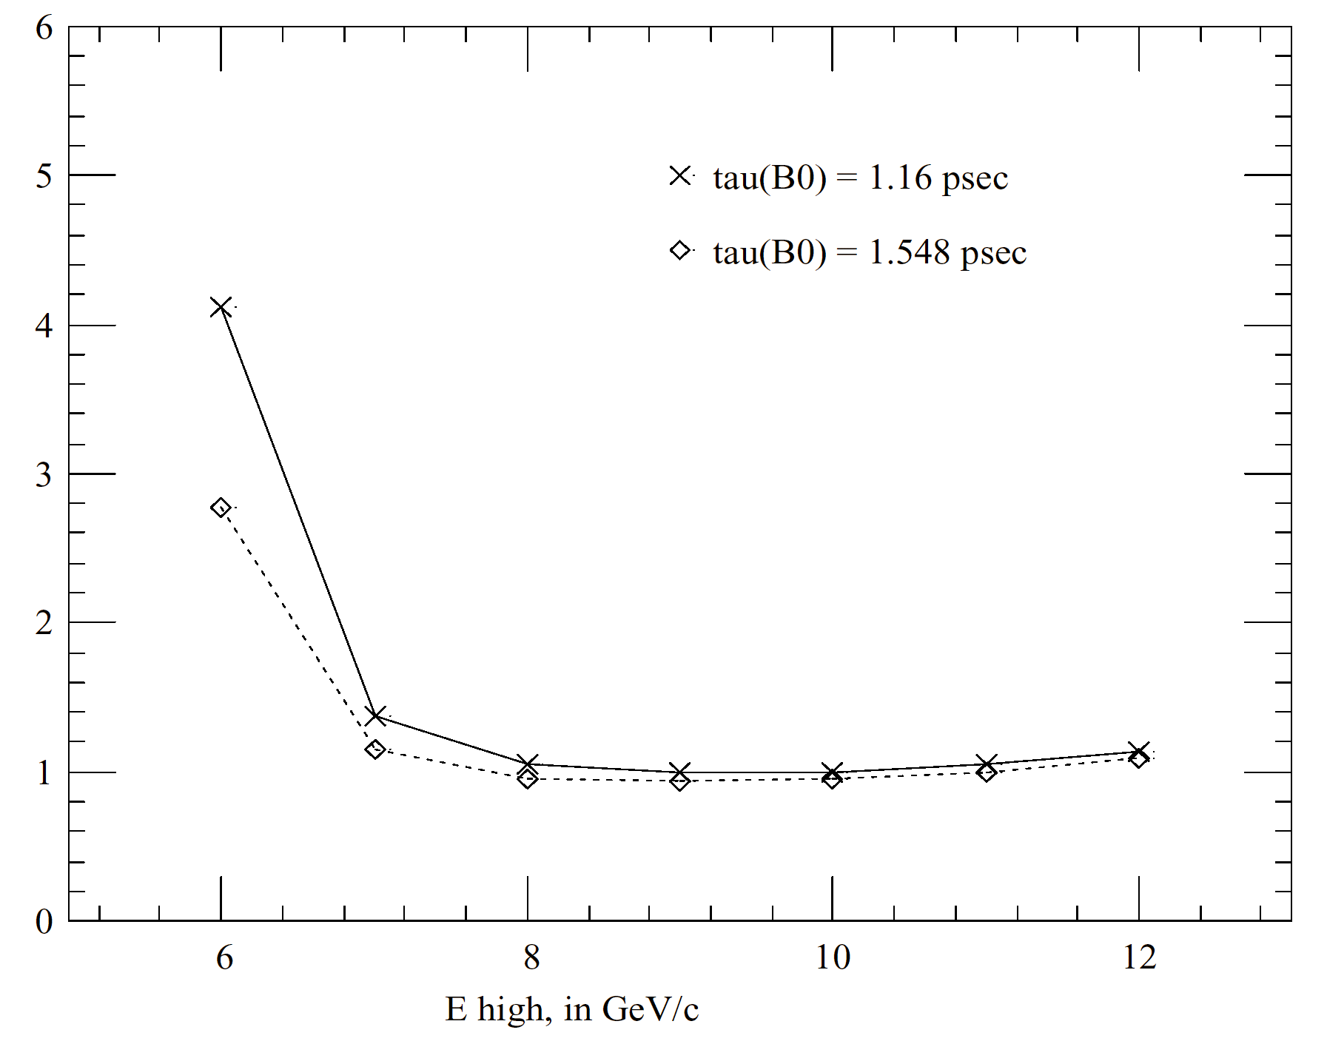
sin2β efficiency in B⁰→J/yK_{S} versus E_{beam}(HER)
Normalized luminosity degradation factor
Normalized to
9 on 3.1 GeV
βγ_{cm}=0.56
KEK-B
PEP-II
S. Wagner

Slide 10
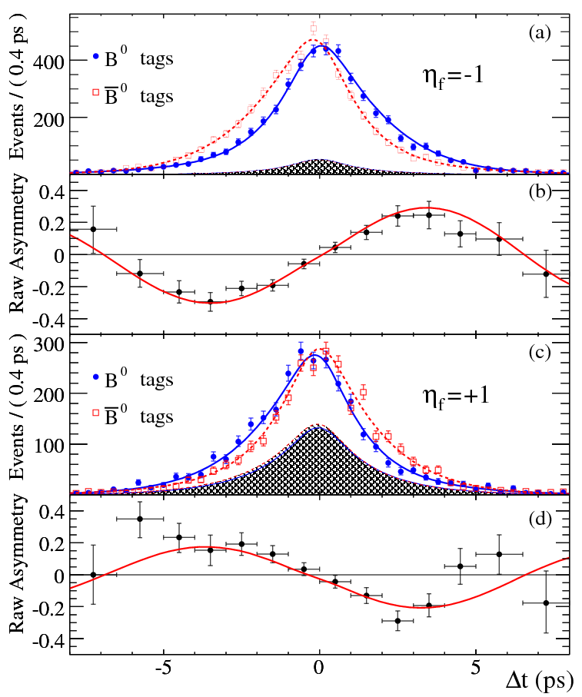
Measuring CP violation at the

Slide 11
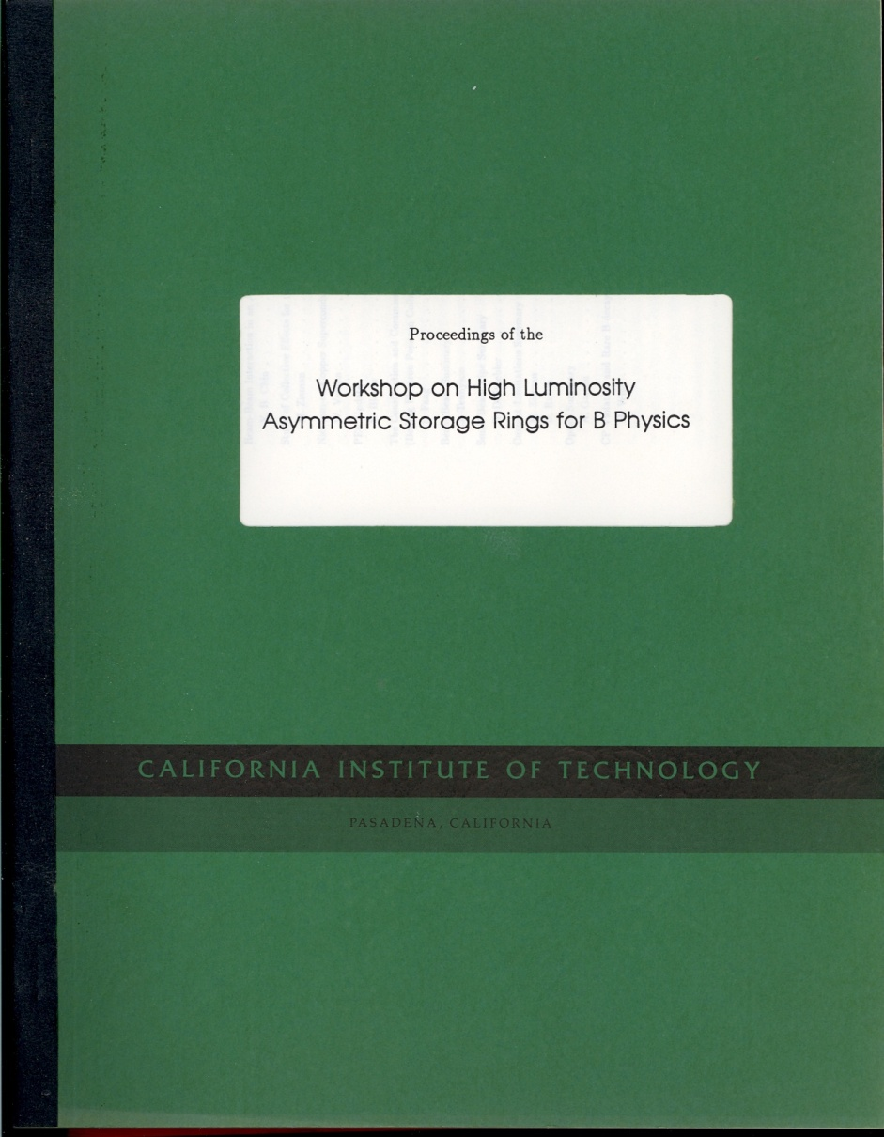
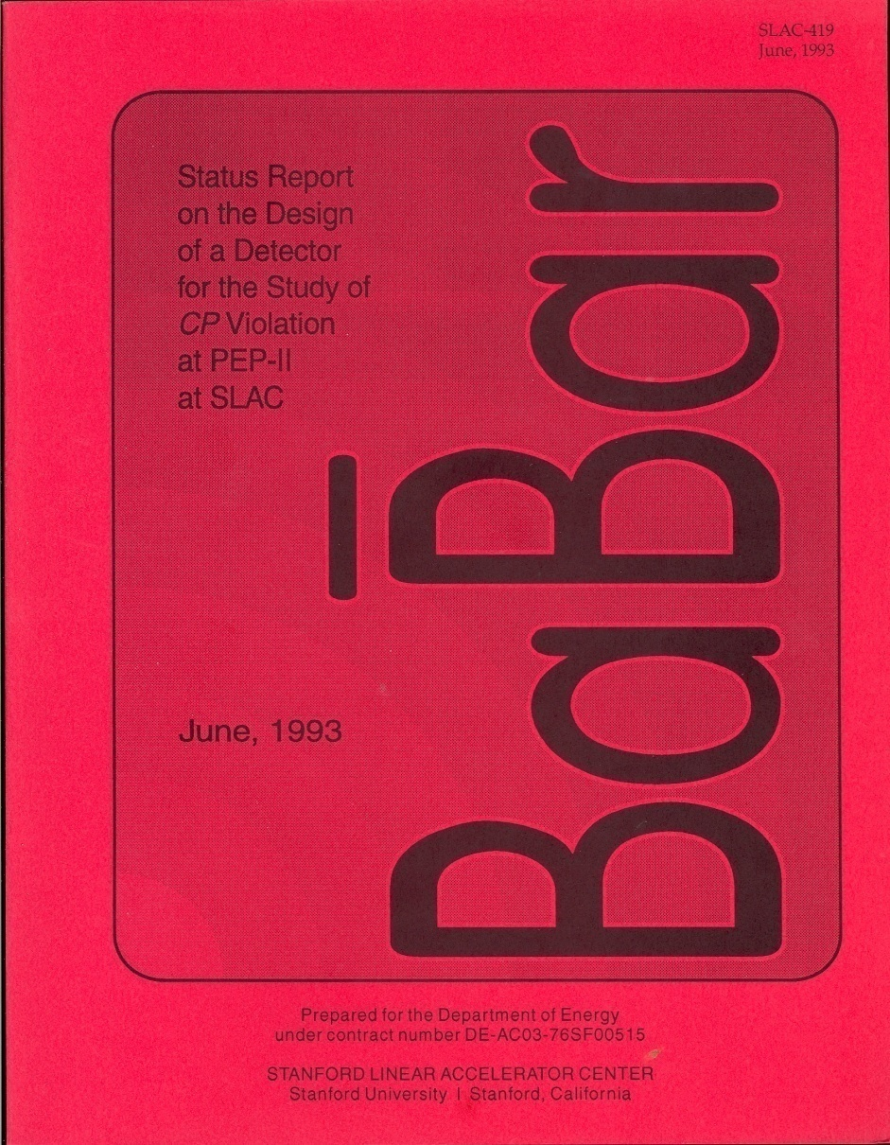
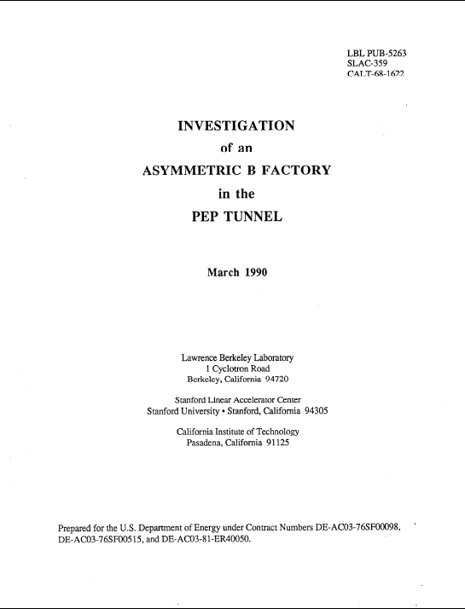
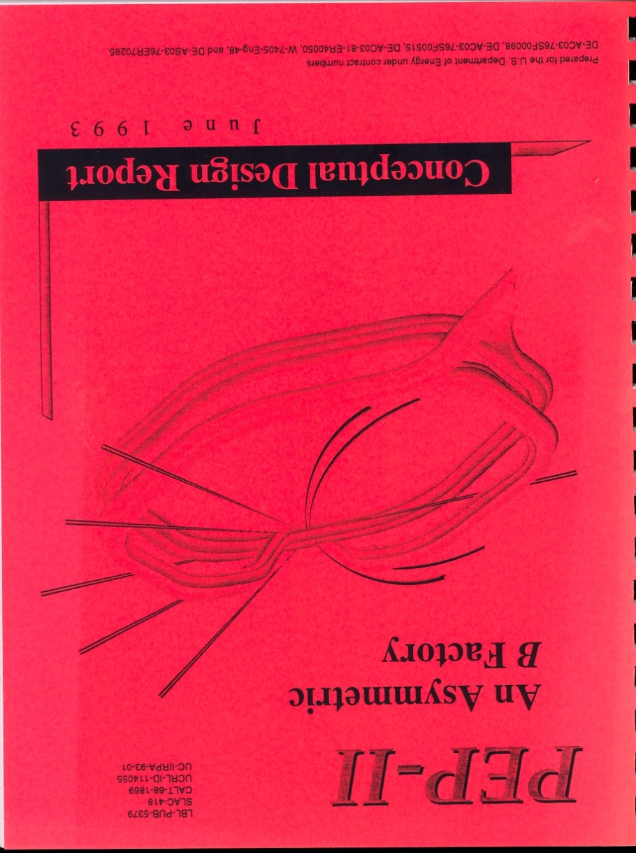
More than two pages (c.f. Cronin)

Slide 12
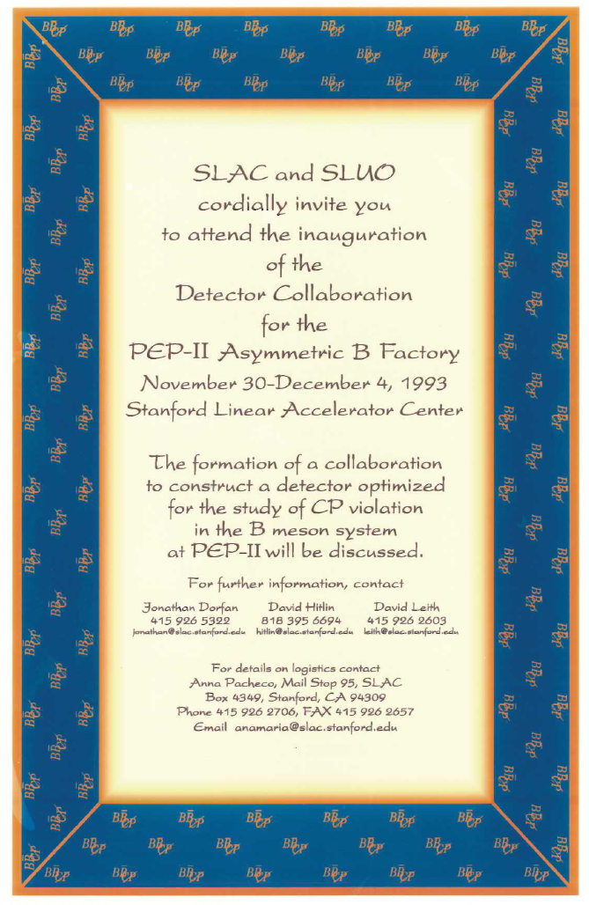

Slide 13
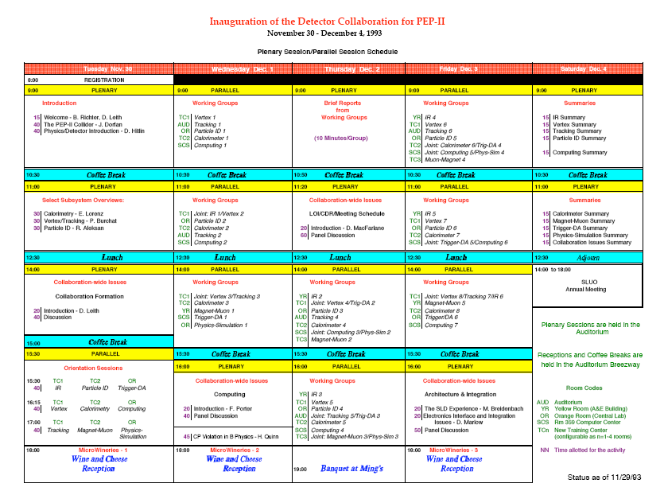
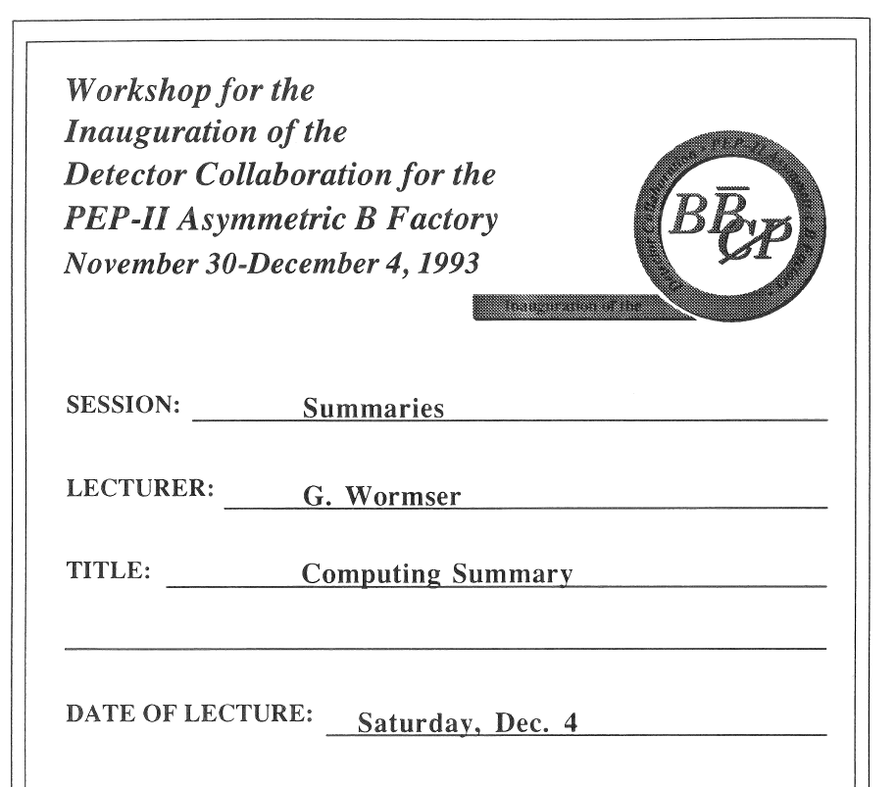

Slide 14
How BABAR got its name
The first use of the name was in 1990, spelled as (not an acronym)
In 1992 the question of copyright was raised and we asked the SLAC™
Business Office to make inquiries
In the Fall of 1993 I wrote to Laurent de Brunhoff extolling the virtues of
CP violation measurements in the meson system and the importance of investigating the origin of the matter-antimatter asymmetry
He did not answer directly, but in December, 1993 I received a call from Nelvana, which held the licensing rights to Babar, offering a five year, renewable, royalty-free license for use of the Babar name and images
The SLAC™ Business Office then concluded a formal agreement
With the new initiative to form a detector collaboration for a detector for
PEP-II it seemed wise to have the new group choose its own name
An email vote was organized, with John Fry as Election Commissioner, and the name chosen by the proto-Collaboration Council, on May 12, 1994, was BABAR, with capitalization and relative letter size subsequently decided upon by the Interim Steering Committee:
\def\babar{\mbox{\slshape B\kern-0.1em{\smaller A}\kern-0.1em B\kern-0.1em{\smaller A\kern-0.2em R}}}

Slide 15


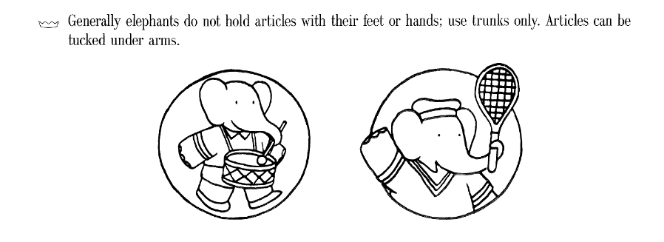
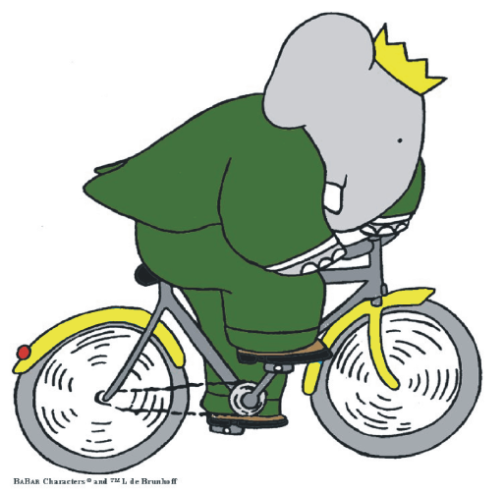

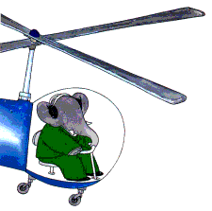

The license for the BABAR name and logo came with rules:

Slide 16
The BABAR Collaboration
10 Countries
77 Institutions
485 Collaborators
USA [33/244]
California Institute of Technology
UC, Davis
UC, Irvine
UC, Los Angeles
UC, San Diego
UC, Santa Barbara
UC, Santa Cruz
U of Cincinnati
U of Colorado
Colorado State
U of Iowa
Iowa State U
LBNL
LLNL
U of Louisville
U of Maryland
U of Massachusetts, Amherst
MIT
U of Mississippi
Mount Holyoke College
Northern Kentucky U
U of Notre Dame
ORNL/Y-12
U of Pennsylvania
Prairie View A&M
Princeton
Rutgers
SLAC
U of South Carolina
Stanford U
U of Texas at Dallas
Vanderbilt
U of Wisconsin
Italy [13/72]
INFN, Bari and U di Bari
INFN, Ferrara
Lab. Nazionali di Frascati dell' INFN
INFN, Genova and U di Genova
INFN, Milano and U di Milano
INFN, Napoli and U di Napoli
INFN, Padova
U di Pavia
INFN, Pisa, U di Pisa & Scuola Normale
INFN, Roma and U "La Sapienza"
INFN, Superiore di Sanita', Roma
INFN, Torino and U di Torino
INFN, Trieste and U di Trieste
Norway [1/1]
U of Bergen
Russia [2/28]
Budker Institute, Novosibirsk
JINR, Dubna
United Kingdom [10/42]
U of Bristol
Brunel University
U of Edinburgh
U of Lancaster
U of Liverpool
Imperial College
Queen Mary & Westfield College
Royal Holloway & Bedford New College
U of Manchester
Rutherford Appleton Laboratory
Taiwan [1/3]
Academia Sinica
October 1995
Canada [7/25]
U of British Columbia
Carleton U and CRPP
McGill U
U de Montréal
TRIUMF
U of Victoria
York U
China [4/19]
Beijing Glass Research Inst.
Inst. of High Energy Physics, Beijing
Shanghai Inst. of Ceramics (SICCAS)
Tsinghua U, Beijing
France [5/44]
LAPP, Annecy
LAL Orsay
LPNHE des Universités Paris 6/7
Ecole Polytechnique
CEA, DAPNIA, CE-Saclay
Germany [1/7]
Technische U Dresden

Slide 17
BABAR Collaboration Membership
August 30, 1995
eventually >600

Slide 19
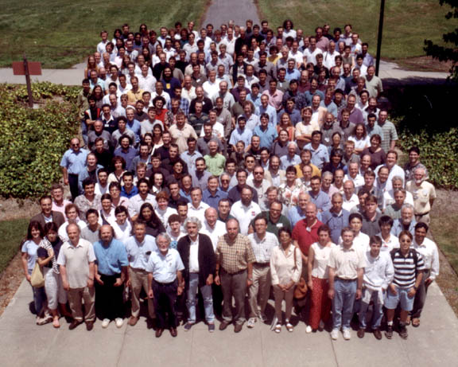

Slide 20
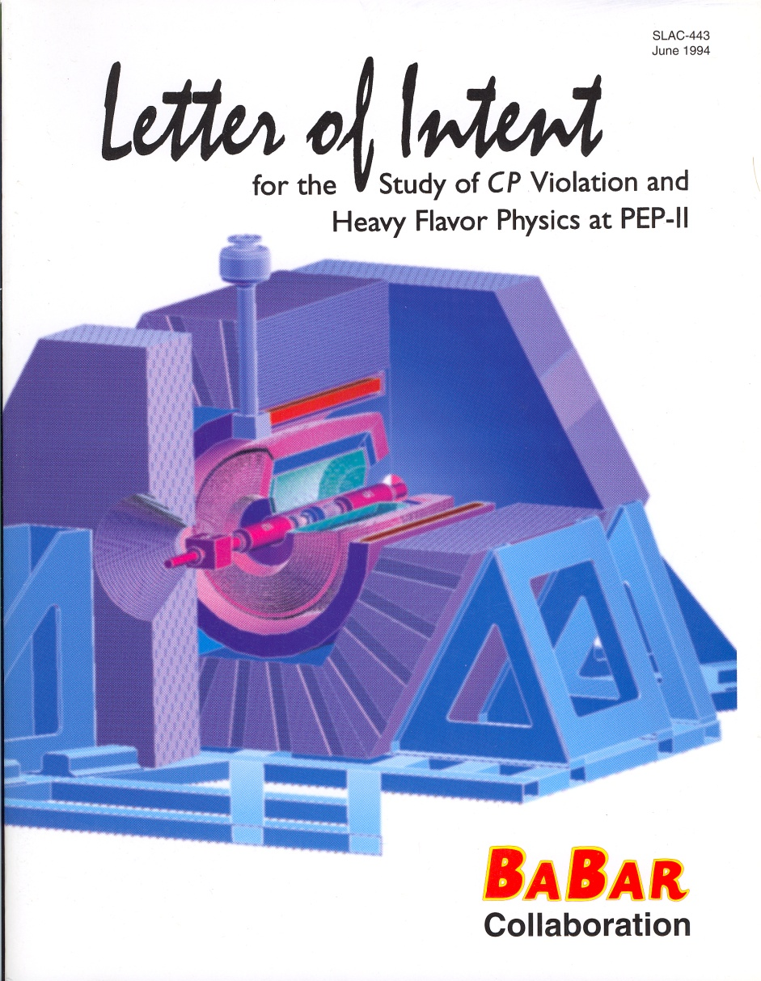
Add the LOI (June 94) and the TDR (March 95)

Slide 21
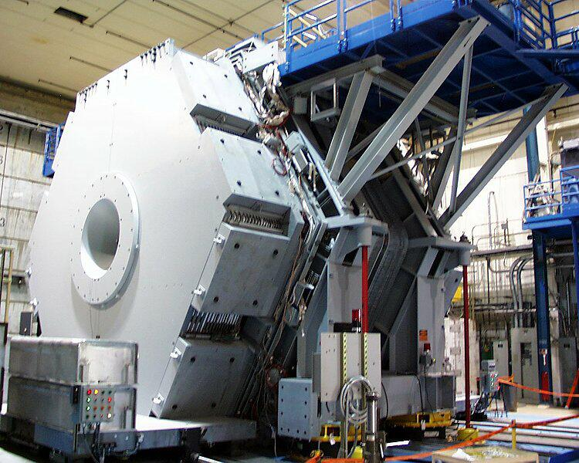

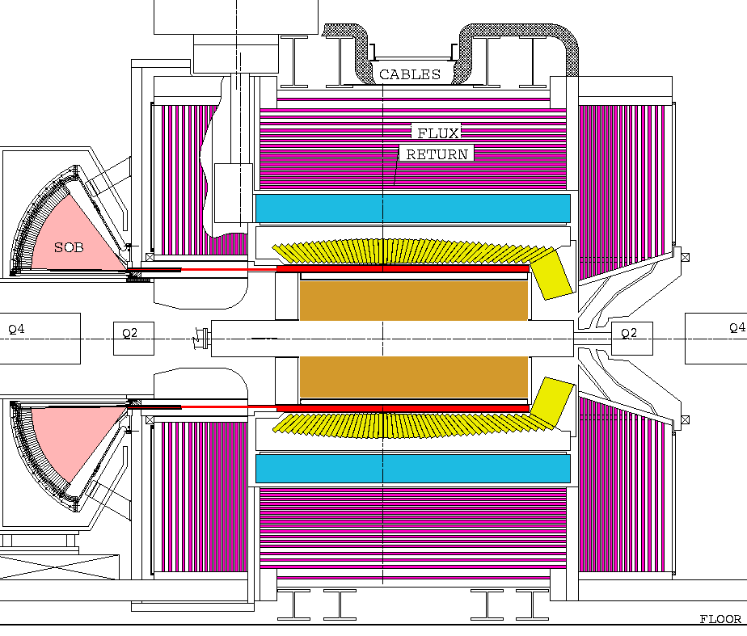

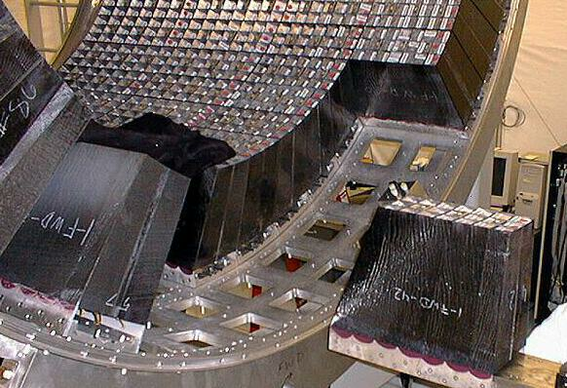





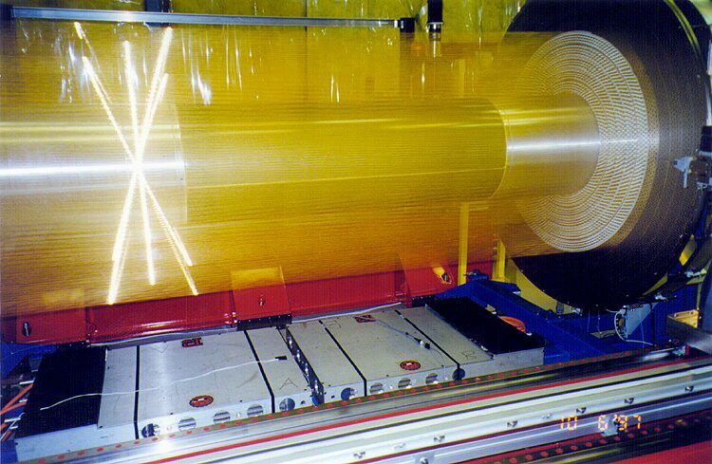



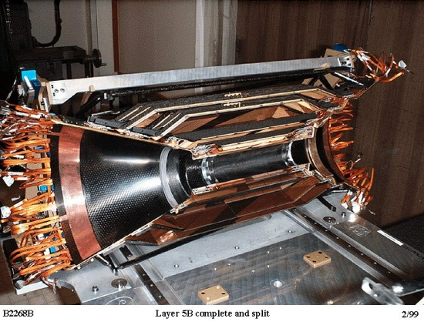

The BABAR Detector
1m
Si Vertex-Tracker, Drift Chamber,
DIRC (Cherenkov), CsI-Calorimeter,
Superconducting Coil, Iron Yoke + RPCs/LSTs

Slide 22
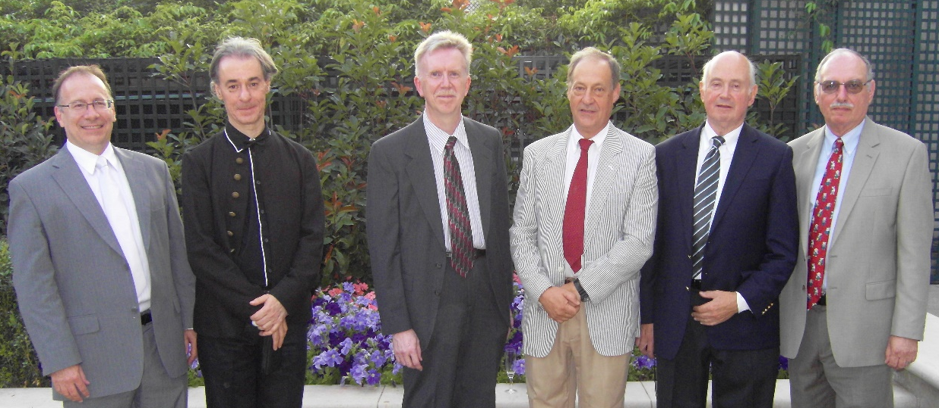
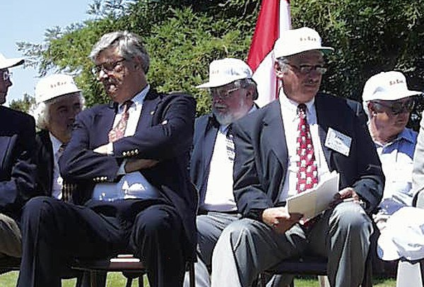
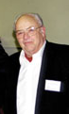
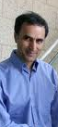
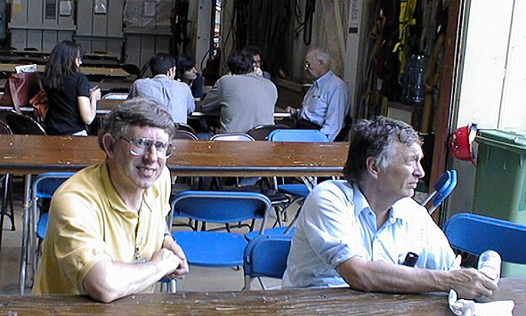
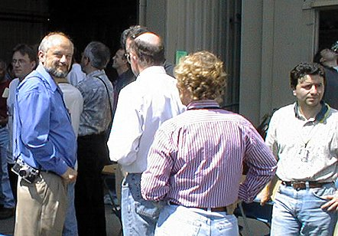
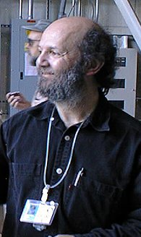
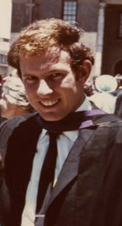
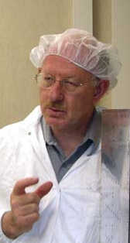
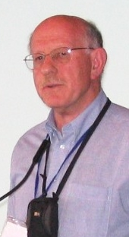
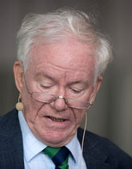
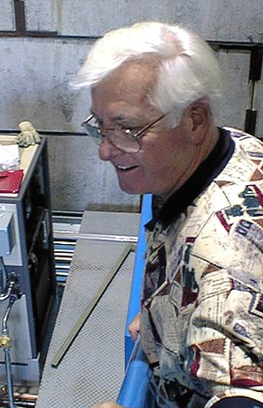
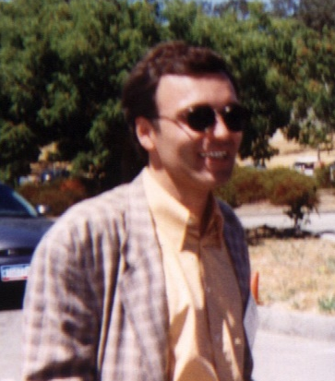
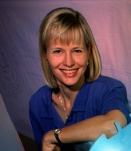
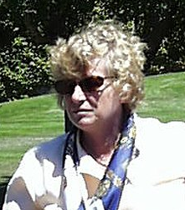
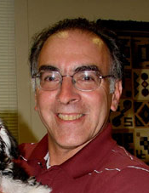
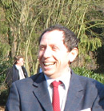
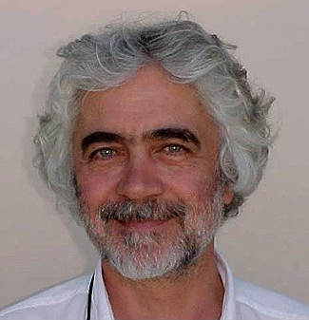

Slide 23

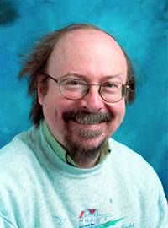
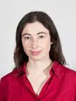
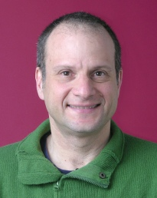
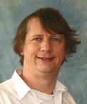
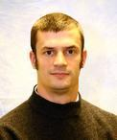

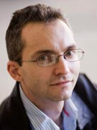
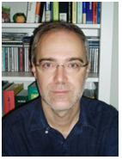
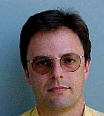
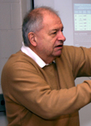


Slide 24


We should avail ourselves of the new EU rules on Google privacy

Slide 25

Preparing to do physics – four additional workshops

Slide 26


Slide 27

After a plenary discussion at the Padova Collaboration Meeting in 1997
BABAR committed to employing blind analysis techniques, becoming one of
the first major experiments to do so
We also pioneered the use of sophisticated maximum likelihood and
multivariate techniques that enabled us to extract maximum information from
the data in an unbiased manner

Slide 28
CPV-related physics goals
Our initial goal was to measure sin2β, i.e., to find evidence for
CP violation in the interference of mixing and decay in the B meson system
We then made those measurements needed to over-constrain the
Unitarity Triangle
  This required measurements of V_{ub}, V_{cb}, Δm_{d}, and t_{B},
  as well as sin2α and γ
  We were also able to resolve trigonometric ambiguities
We were able to exploit other features of the entangled state
to observe T violation in particle decay
As the data sample increased, it became possible to investigate rare inclusive and exclusive penguin-dominated decays and to search for CPV in these decays, in which physics beyond the Standard Model is most likely to be observable

Slide 29




Slide 30



1989
Eons ago
in the parking lot of the Stanford Park Hotel
A bet was made between
Professor David Hitlin
of the
California Institute of Technology
and
Professor Bruce Winstein
of the
University of Chicago.
These esteemed scholars bet
One Case of Chateau Lynch-Bages
that a three standard deviation signal of
CP violation would be seen in
B meson decay by the end of the millennium.
Professor Hitlin took the affirmative side.
Performing my duty,
Professor Robert Siemann
Stanford Linear Accelerator Center
Year of the b quark
discovery

Slide 31

Chronology of
sin2β measurements
sin2β

Slide 32


Resolution of the sin2β trigonometric ambiguity
There are several techniques for resolving the four-fold ambiguity in β that results from measuring sin2β
  Time-dependent angular analysis of B⁰→ J/ψK^{*0} decay
  Time-dependent Dalitz plot analysis of B⁰→ D^{(*)0}[K_{S}⁰π⁺π⁻]h⁰ decay
  Time-dependent CP asymmetry in B⁰→ D^{*+}D^{*-}K_{S}⁰ decay

Slide 33




Sin2α using B⁰ → ππ
Penguin amplitude is significant (P/T ~ 0.3), and has a different weak phase
“penguin
pollution”
+
S_{ππ} ∝ sin2α_{eff} = sin2(α + δ )
Determine δ using isospin analysis (Gronau & London, PRL 65, 3381 (1990))

Slide 34

sin 2α using B → ππ, ρρ, ρπ
ρπ and ρρ decays can also be used to measure sin2α
B → ρρ is a VV decay, requiring a separate isospin analysis for each polarization amplitude
  longitudinal polarization is dominant (> 90%)
Penguin contribution in B→ρρ is small

Slide 35



γ from B⁻→D^{(*)}K⁻ decays
Rates of B±→D ^{(*)} K± decays are sensitive to
γ through the interference of b→c and b→u transitions
  Need states accessible to D^{(*)0} and D^{(*)0}
Several neutral D ^{(*)} final states investigated by B factories and CDF
GLW : CP eigenstates (ππ, KK, etc.)
Gronau & London, PLB 253, 483 (1991);
Gronau & Wyler, PLB 265, 172 (1991)
ADS: Flavor DCSD states (Kπ)
Atwood, Dunietz, & Soni, PRL 78, 3257 (1997),
Atwood, Dunietz, & Soni, PRD 63, 036005 (2001)
GGSZ: 3-body decays (K_{S}ππ, K_{S}KK)
Giri, Grossman, Soffer, & Zupan, PRD 68, 054018 (2003)
Bondar, PRD 70, 072003 (2004)

Slide 36

Global CKM Fit
Consistency of angles
Consistency of angles and sides from global fit

Slide 37




Further unitarity triangle tests
All measurements
Tree-dominated measurements
Loop (mixing)-dominated measurements
CP-violating measurements

Slide 38

A full CKM fit with the Scan Method
|V_{ub}|/|V_{cb}|
Parameter (95% CL range) | Full fit
ρ | 0.058—0.191
η | 0.314—0.406
β [^{ο}] | 19.0—25.8
α [^{ο}] | 81.1—93.3
γ [^{ο}] | 62.8—79.8
No assumptions as to the
distribution of theory uncertainties
G. Eigen, G.P. Dubois-Felsmann, D.G. Hitlin, F.C. Porter
Phys. Rev. D89, 033004 (2014)

Slide 39
CKM matrix unitarity
PDG review fits
Row and column
unitarity
The Jarkskog invariant

Slide 40
Eight different transitions related by different symmetries
These transitions are related by CP, T and CPT
Each transition represents a distinct set of events
Analysis consists of comparing the t dependence of the transitions related by the various transitions
Not all independent – show results for six
The transition is characterized by
T-reversed transition is , characterized by
If T were a good symmetry, and would be equal.
We can quantify the size of T violation by
The are similar expressions for, e.g.,
In the Standard Model

Slide 41







T Violation
Measure 4 T-violating asymmetries,
e.g.
all asymmetries show the expected
asymmetry
14σ significance other results are
consistent with CP violation and
CPT invariance
PRL 109, 211901 (2012)
PRL 109, 211901 (2012)

Slide 42


Probes of new physics
In the Standard Model we expect the same value for “sin2β ” in
modes, but different SUSY models
can produce different asymmetries
Since the penguin modes have branching fractions one or two orders
of magnitude less than tree modes, a great deal of luminosity is
required to make these measurements to meaningful precision
~
W ⁻ H ⁻ χ ⁻ g, χ⁰
~
b u,c,t s
b u,c,t s
~
~
~
~
~
b u,c,t s
b d,s,b s

Slide 43


No sign yet of new physics in CPV in exclusive B decays

Slide 44


Slide 45
Direct CPV in b→sγ: limits on Im(C_{8g}/C_{7γ})
For the sum of exclusive decays, the CP asymmetry is defined by
The SM predictions yield -0.6% < A_{CP} (X_{s}γ) <2.8%
With 16 exclusive modes using 471×10⁶ BB events measure
The difference for charged and neutral B decays is
ΔA_{CP}(B→X_{s}γ) depends on C_{7γ} and C_{8g}
In the SM, C₇^{eff} and C₈^{eff} are real →ΔA_{CP} (X_{s}γ)=0
  This may be modified by new physics contributions
arXiv:1406.0534
M. Benzke, S. J. Lee, M. Neubert and G. Paz, Phys. Rev. Lett. 106, 141801 (2011).

Slide 46



Direct CPV in b→sγ: limits on Im(C_{8g}/C_{7γ})
This is the first ΔA_{CP} (X_{s}γ) measurement and the first constraint on the
ratio of Wilson coefficients C₈^{eff}/C₇^{eff} for new physics in this process
CL
CL
Notes:
C7gamma electromagnetic dipole, C8g chromomagnetic dipole

Slide 47
Conclusions
BABAR has been a remarkably productive experiment
  We established the CKM phase as the source of CP violation by measuring sin2β
  We measured the other Unitarity Triangle angles α and γ, as well as determining the sides through V_{ub}, V_{cb} , τ_{B} and Δm_{d}, allowing a probing series of overconstrained tests of the CKM paradigm
  We have measured T violation in particle decays and made
  sensitive CPT tests
  We have, through CPV and rare decay studies, made sensitive searches for new physics in the flavor sector, providing quite stringent constraints
  I didn’t even attempt to discuss the major successes in the study of charm meson mixing, onia, QCD, τ decays…..
Perhaps not a bad quarter century’s work

Slide 48
* (from page 2)
Karl Berkelman [Mod. Phys. Lett. A10,165 (1995)] showed that it is possible to measure sin2β using produced in Υ(4S) decay at rest, i.e., at a symmetric e⁺e⁻ collider
  A non-zero value of Δy, that is, a vertical displacement of the difference between two vertices in the vertical direction, implies a
  non-zero value of Δt, i.e., CP violation
  With CESR/CLEO parameters, the sensitivity to sin2β is worse than that of BABAR by a factor of ~3.3 i.e., an order of magnitude more integrated luminosity is required
  This was looked at for SuperB, which had a reduced asymmetry and a much smaller beam size. In this regime, the sensitivity advantage of the asymmetry was only 50-75%
David Hitlin BABAR Physics Fifty Years of CP Violation July 10, 2014

