Slide 1
Searching for Shackleton’s Vessel Endurance in the numbers
Robin G. Stuart

Slide 2
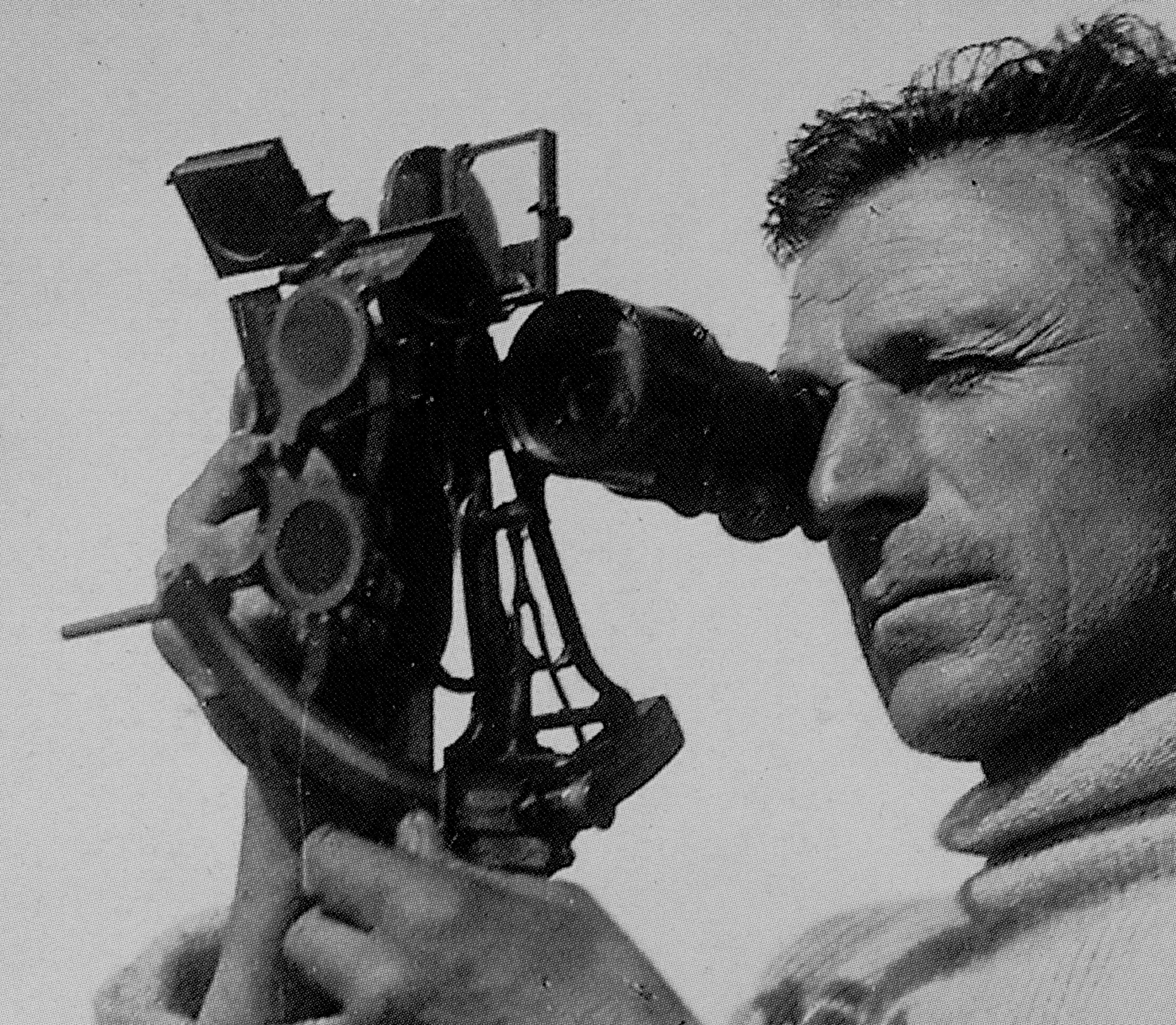
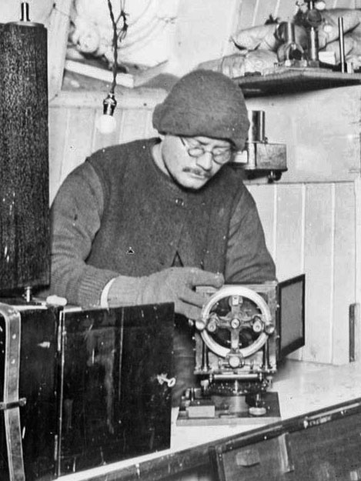
Imperial Trans-Antarctic Expedition 1914
Planned transcontinental march from Vahsel Bay on Weddell Sea to Ross Sea via South Pole
Sir Ernest Shackleton
Expedition Leader
Captain Frank Worsley
Captain of Endurance
Reginald James
Expedition Physicist

Slide 3
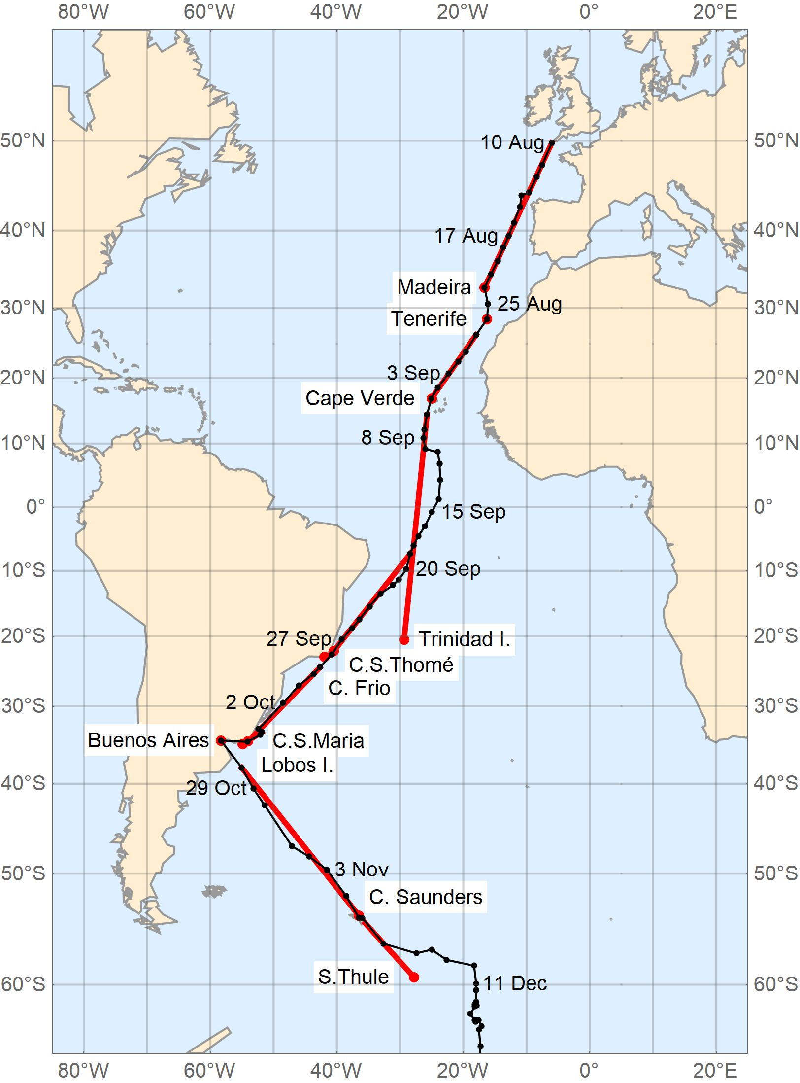
Imperial Trans-Antarctic Expedition Timeline
8 Aug | 1914 |  | Departed Plymouth
3 Oct |  |  | Longitude by sounding. Latitude 31°39′S. Depth 55 fathoms
9 Oct |  |  | Arrived Buenos Aires
24 Oct |  |  | Rated Chronometers
5 Dec |  |  | Departed Grytviken, South Georgia
11 Dec |  |  | Ice encountered
19 Jan | 1915 |  | Endurance "Fast in pack“ (Worsley)
24 Jun |  |  | Begin series of lunar occultation timings for GMT
27 Oct |  |  | Endurance abandoned. "Men & dogs sleep on floe" (Worsley)
21 Nov |  |  | Endurance sinks. “at 5pm she went down by the head.” (Shackleton)
9 Apr | 1916 |  | Boats launched
15 Apr |  |  | Land on Elephant Island
24 Apr |  |  | Shackleton, Worsley and 4 others depart in James Caird
10 May |  |  | Land in King Haakon Bay on south coast of South Georgia
19 May |  |  | Trek across South Georgia to reach Stromness Whaling Station
30 Aug |  |  | Remainder of crew rescued from Elephant Island
Bergman and Stuart. Records of the Canterbury Museum 33 (2019) 5–22.

Slide 4
Search for the Wreck of Endurance
Captain Frank Worsley’s original workbook and log in Canterbury Museum, Christchurch, New Zealand
Contents transcribed and labelled. Calculations replicated
Bergman, Huxtable, Morris and Stuart Navigation of the James Caird on the Shackleton Expedition. Records of the Canterbury Museum 32 (2018) 23–66.
Bergman and Stuart Navigation of the Shackleton Expedition on the Weddell Sea Pack Ice. Records of the Canterbury Museum 32 (2018) 67–98.
Weddell Sea Expedition announces plans to search for Endurance in early 2019
Log position 68°39′30″S 52°26′30″W believed accurate to ½ a mile

Slide 5
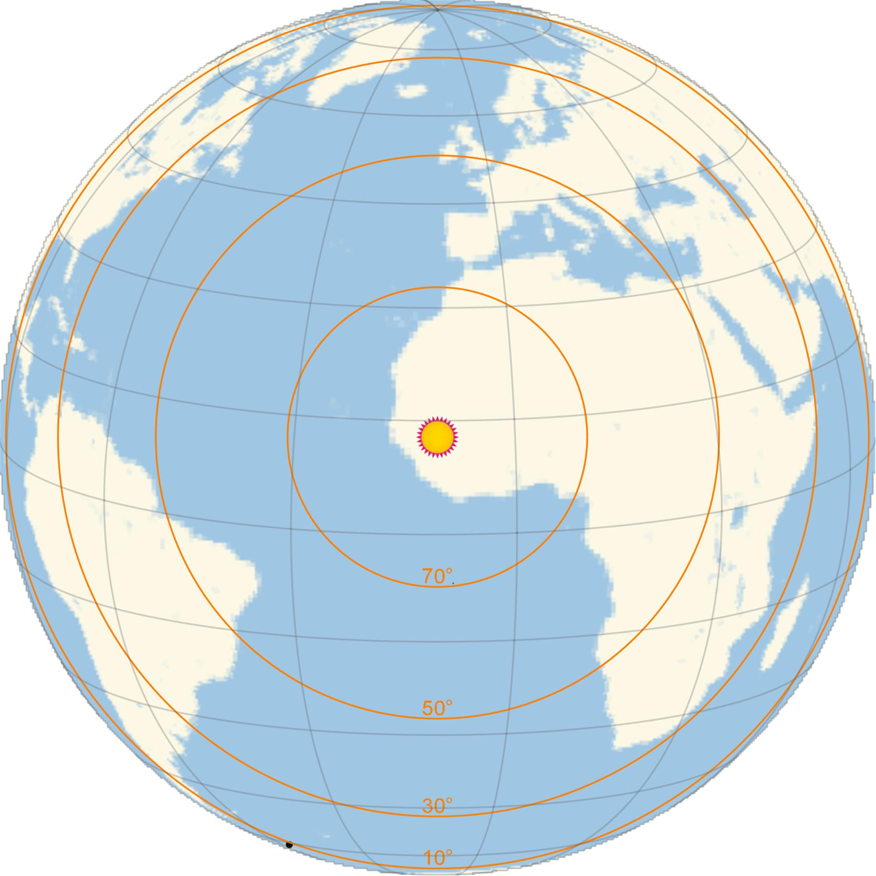
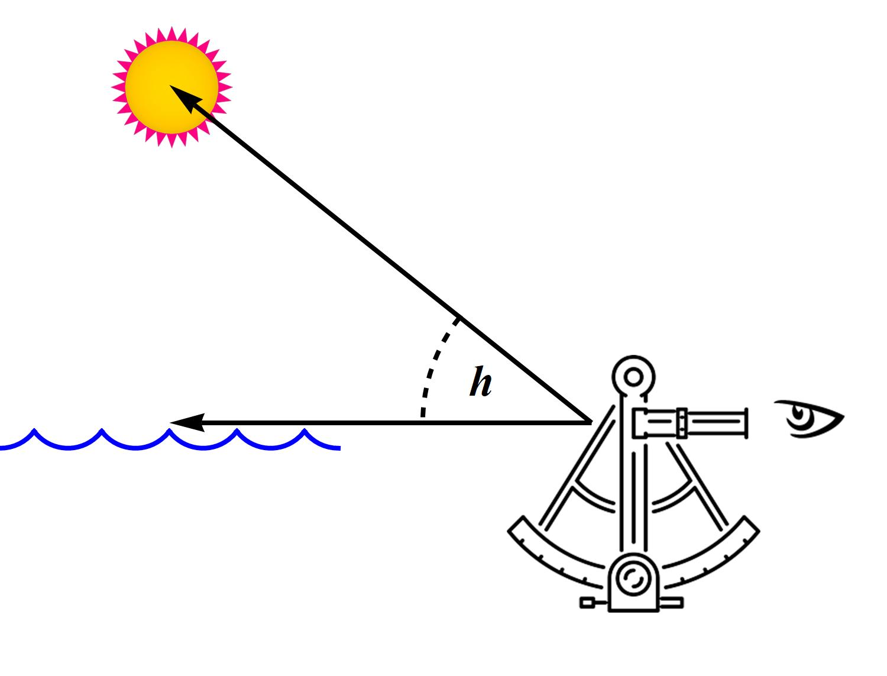
Celestial Navigation
24 April 1916 12^{h} 40^{m} 01^{s} GMT
Geographic Position (GP) of the Sun 12°51.5′N 10°28.4′W
Sextant sight of altitude above sea horizon places observer on a Circle of Position (CoP)
• Locally a Line of Position (LoP)
• 1 arc minute subtends 1 nautical mile (NM) at Earth’s Surface
• Distance from GP = 60×(90° − h°) NM
Corrections applied for
• Dip of Horizon • Refraction
Semi-diameter (Sun, Moon) • Parallax (Sun, Moon, Venus, Mars)
Augmentation (Moon)
Ellipsoidal figure of Earth included in definition of latitude
Worsley measured Sun’s altitude as 8°21½′ from Elephant Island

Slide 6
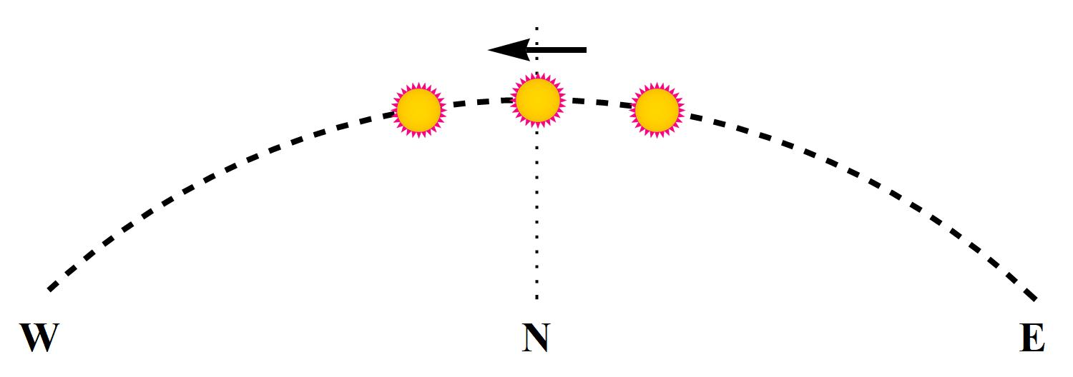
Noon Sight for Latitude
Measure Sun’s maximum altitude, h_{max}, crossing the meridian at noon
Gives latitude by simple arithmetic

Slide 7
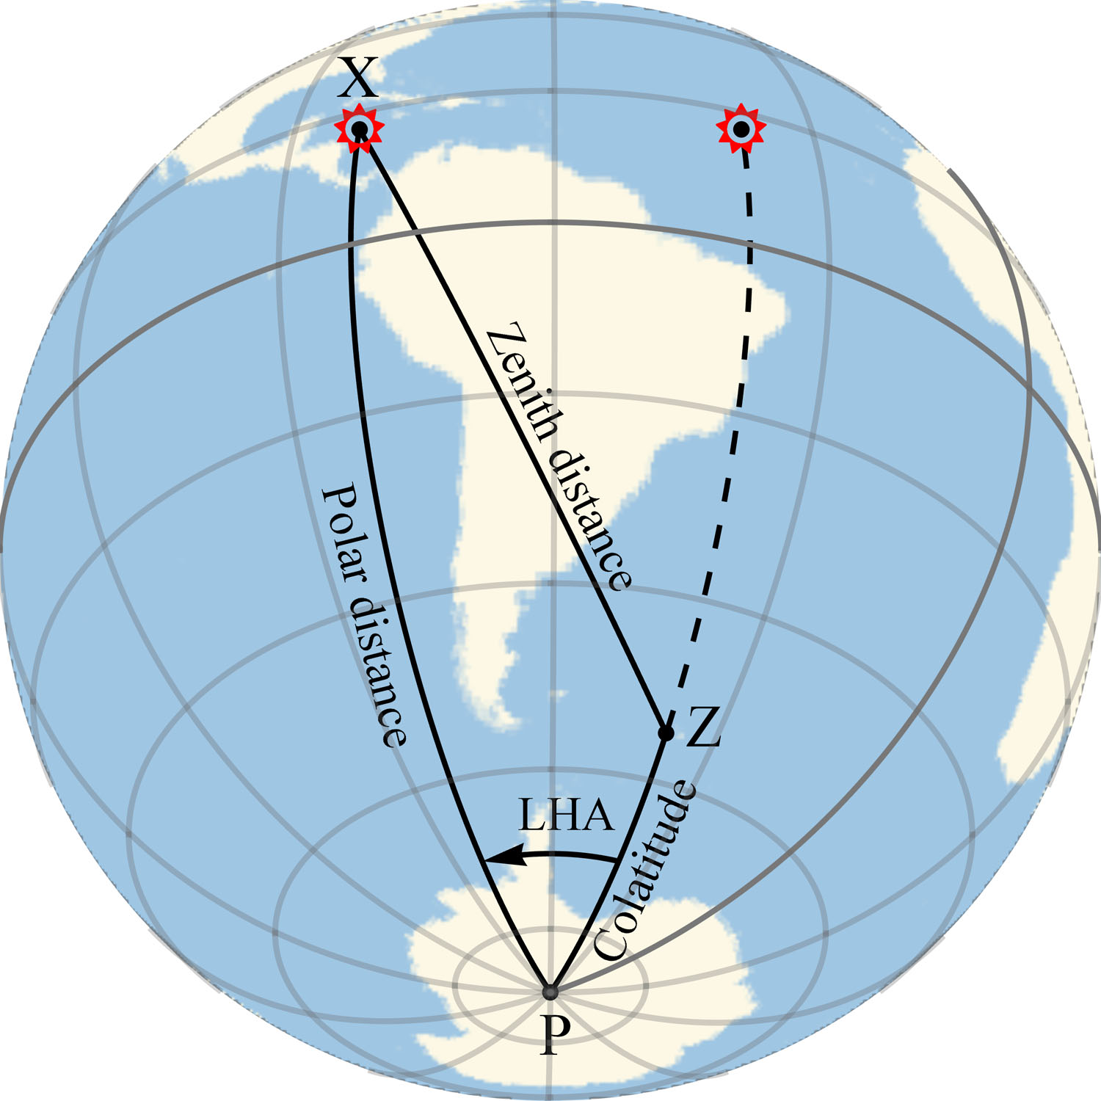
Time Sight for Local Mean Time
Sun’s Local Hour Angle (LHA) ≡ Local Apparent Time (LAT)
time a sundial would show
obtained by calculation
Polar distance of Sun (≡ declination) from Nautical Almanac
Latitude by dead reckoning
no dependence if Sun is due east or west
Sextant sight of altitude gives zenith distance
Local Mean Time (LMT) = LAT − Equation of Time
Formulas optimized for manual evaluation with logarithms
Rearranged to
Time sight from James Caird nearing South Georgia 7 May 1916

Slide 8
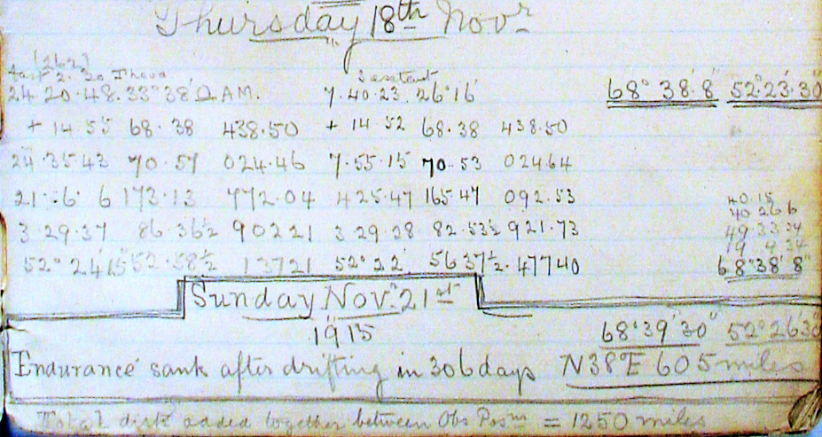
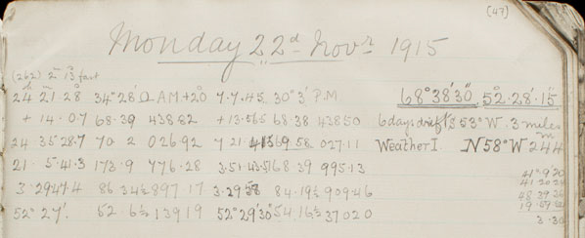
Logbook Entries
No sights recorded from 19−21 November
The noon sight reduction for 22 November contains an arithmetic error
Observed altitude of the Sun's lower limb | 41 | ° | 9 | ′ | 20 | ″
True altitude of the Sun's centre | 41 |  | 20 |  | 24
Sun's true zenith distance | 48 |  | 39 |  | 36
Sun's declination | 19 |  | 59 |  | 54 | S
Latitude |  |  | 3 |  | 30
Correct noon latitude of Ocean Camp is 68°39′30″
1 NM further to the south
1.2 NM SE offset from Ocean Camp to site of sinking
“…our camp is roughly 2 m NW of the position of the ship...” (Worsley 10 Nov)
“…there was our poor ship a mile and a half away breathing her last” (Orde-Lees 21 Nov)
Positions fixed 19 hours after the sinking!

Slide 9
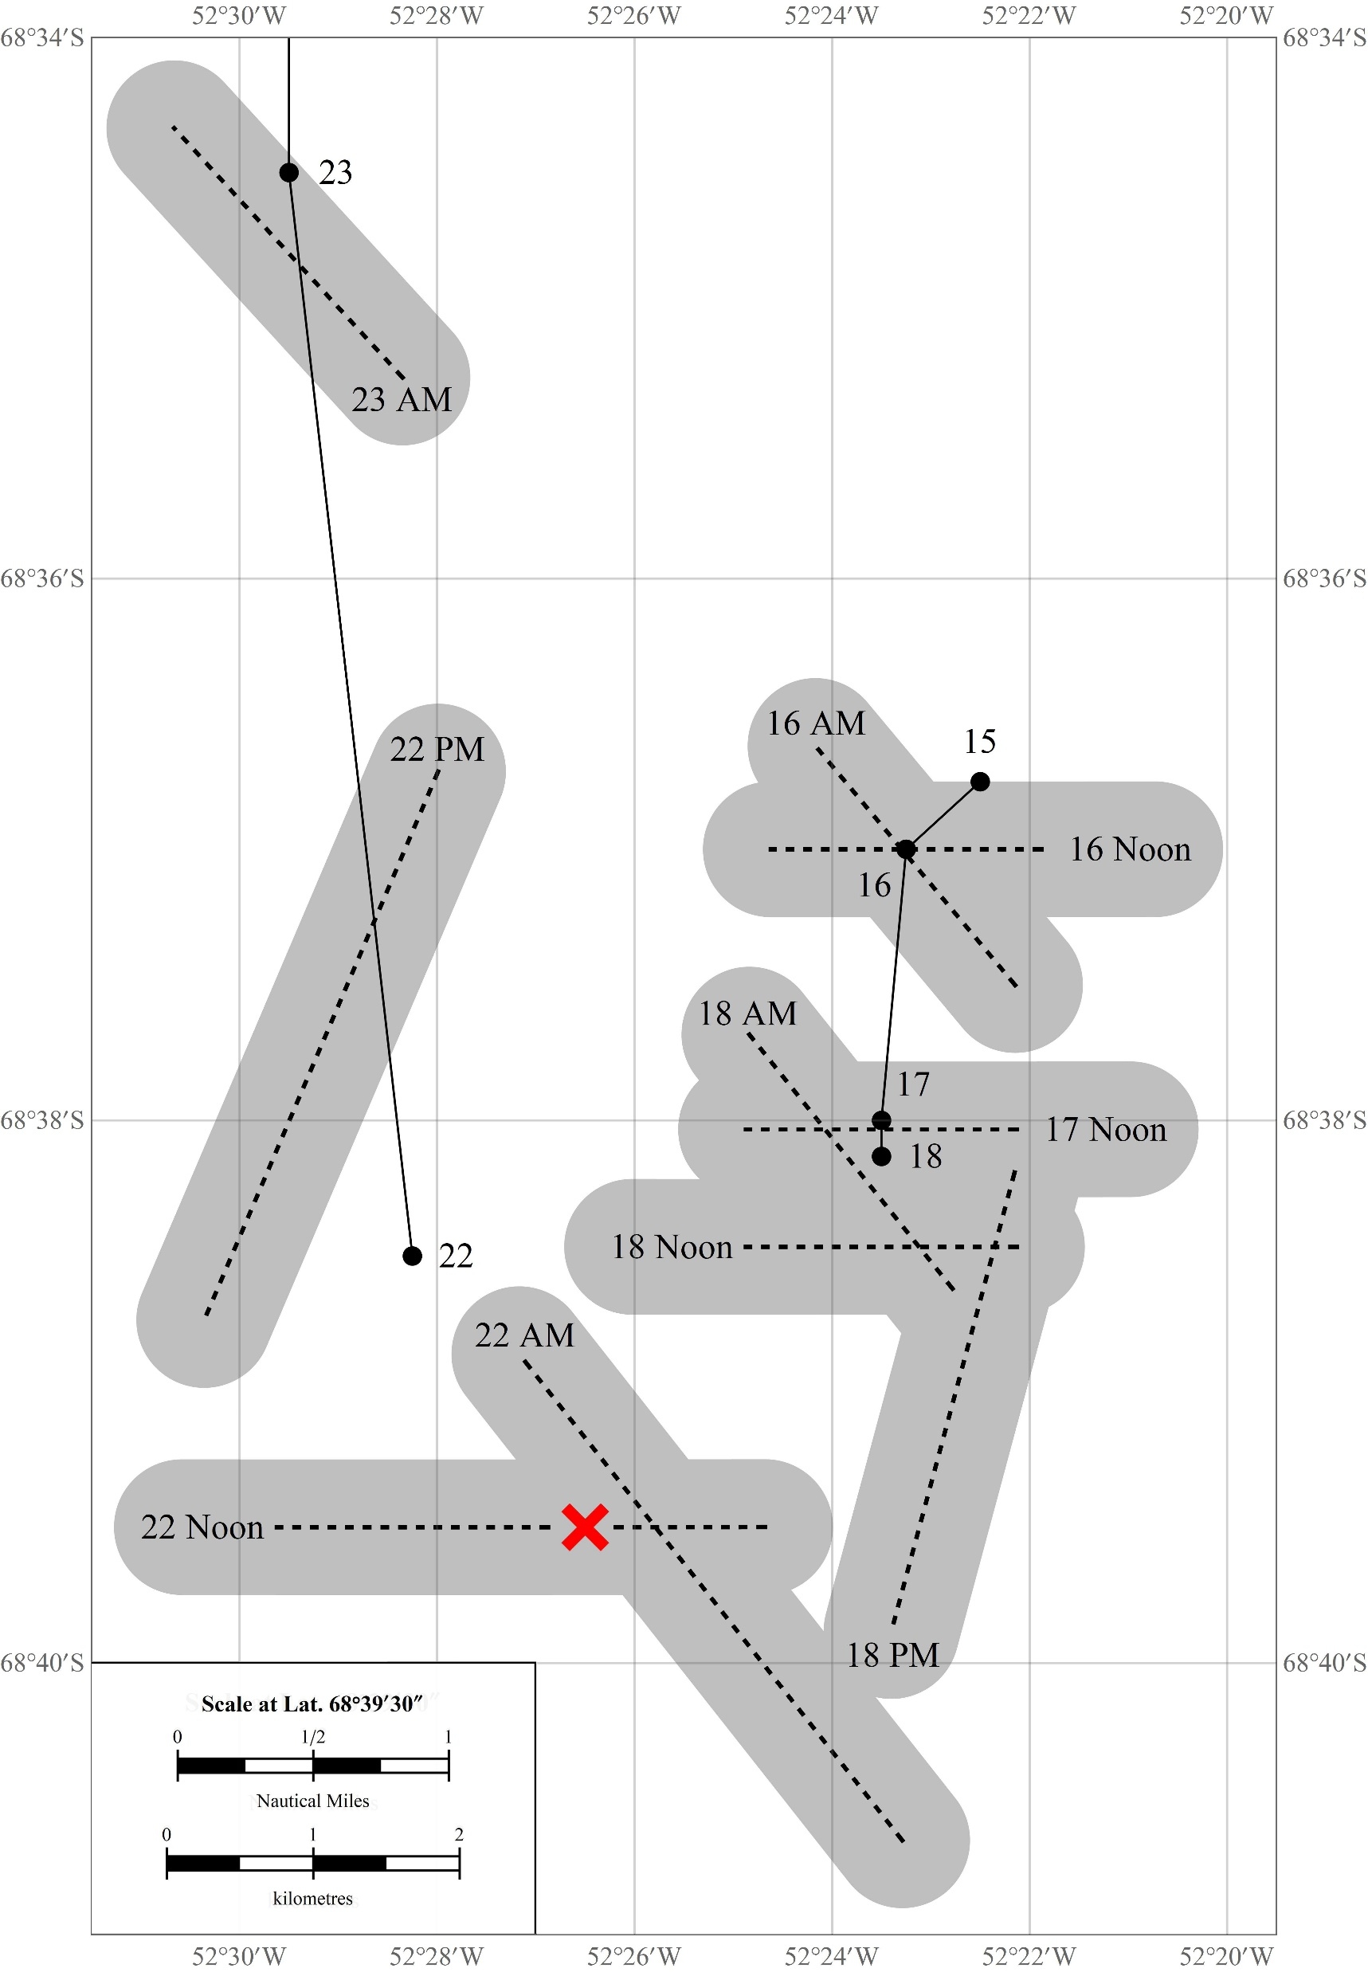
Lines of Position
Ocean Camp LoPs plotted from sights as recorded in the log
Grey bands are ½ NM wide
noon positions as recorded in log
× Position of Endurance as recorded in log
AM and PM time sights for longitude not taken at optimal time
Position depends on estimated or assumed latitude
Rapid drift north between noon sights of 22 and 23 November
Some westward drift over 22 November – net easterly wind
21 November
“… a SSE fair wind all day” and “The wind veered later to the west, and the sun came out at 9 p.m.” (Shackleton)
“wind S. to S.W. increasing about 6pm” (Orde-Lees)
22 November
“A moderate southerly wind also bodes well, if maintained though our "position" today showed that as yet we were neither north nor west of where we were three days ago; but we have been unable to get a "sight" since then & may have made some southing in the meantime” (Orde-Lees)
Bergman and Stuart. Journal of Navigation 72 (2019) 257−268

Slide 10
Conclusion for Latitude
The position reported in the log for the sinking of Endurance is based on an offset of the noon position of Ocean Camp the following day
19 hours after sinking − nearest time at which a full fix was available
Reduction of noon sight contains an arithmetic error pushing the true position 1NM to the south
Steady wind from the south
 Wreck lies to the south of the log position by up to 5.5NM
Bergman and Stuart, On the Location of Shackleton’s Vessel Endurance. Journal of Navigation 72 (2019) 257–268.

Slide 11
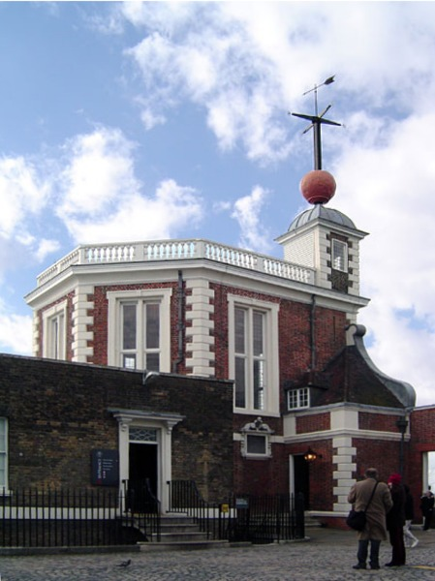
Longitude and Chronometers
Longitude, λ, is the difference between GMT and Local Mean Time (LMT)
λ = LMT − GMT
1 hour difference = 15° longitude
LMT found by time sight
GMT read from the chronometer
Endurance started with 24 chronometers
Unaccounted for chronometer errors shift all LoPs east or west
Chronometers require regular rating for
Chronometer error (CE) - minutes and seconds fast or slow
Chronometer rate (CR) - seconds gaining or losing per day
GMT can be determined
From longitude of known location and measured LMT
Set from time ball drop at 1pm
Timing lunar occultations

Slide 12
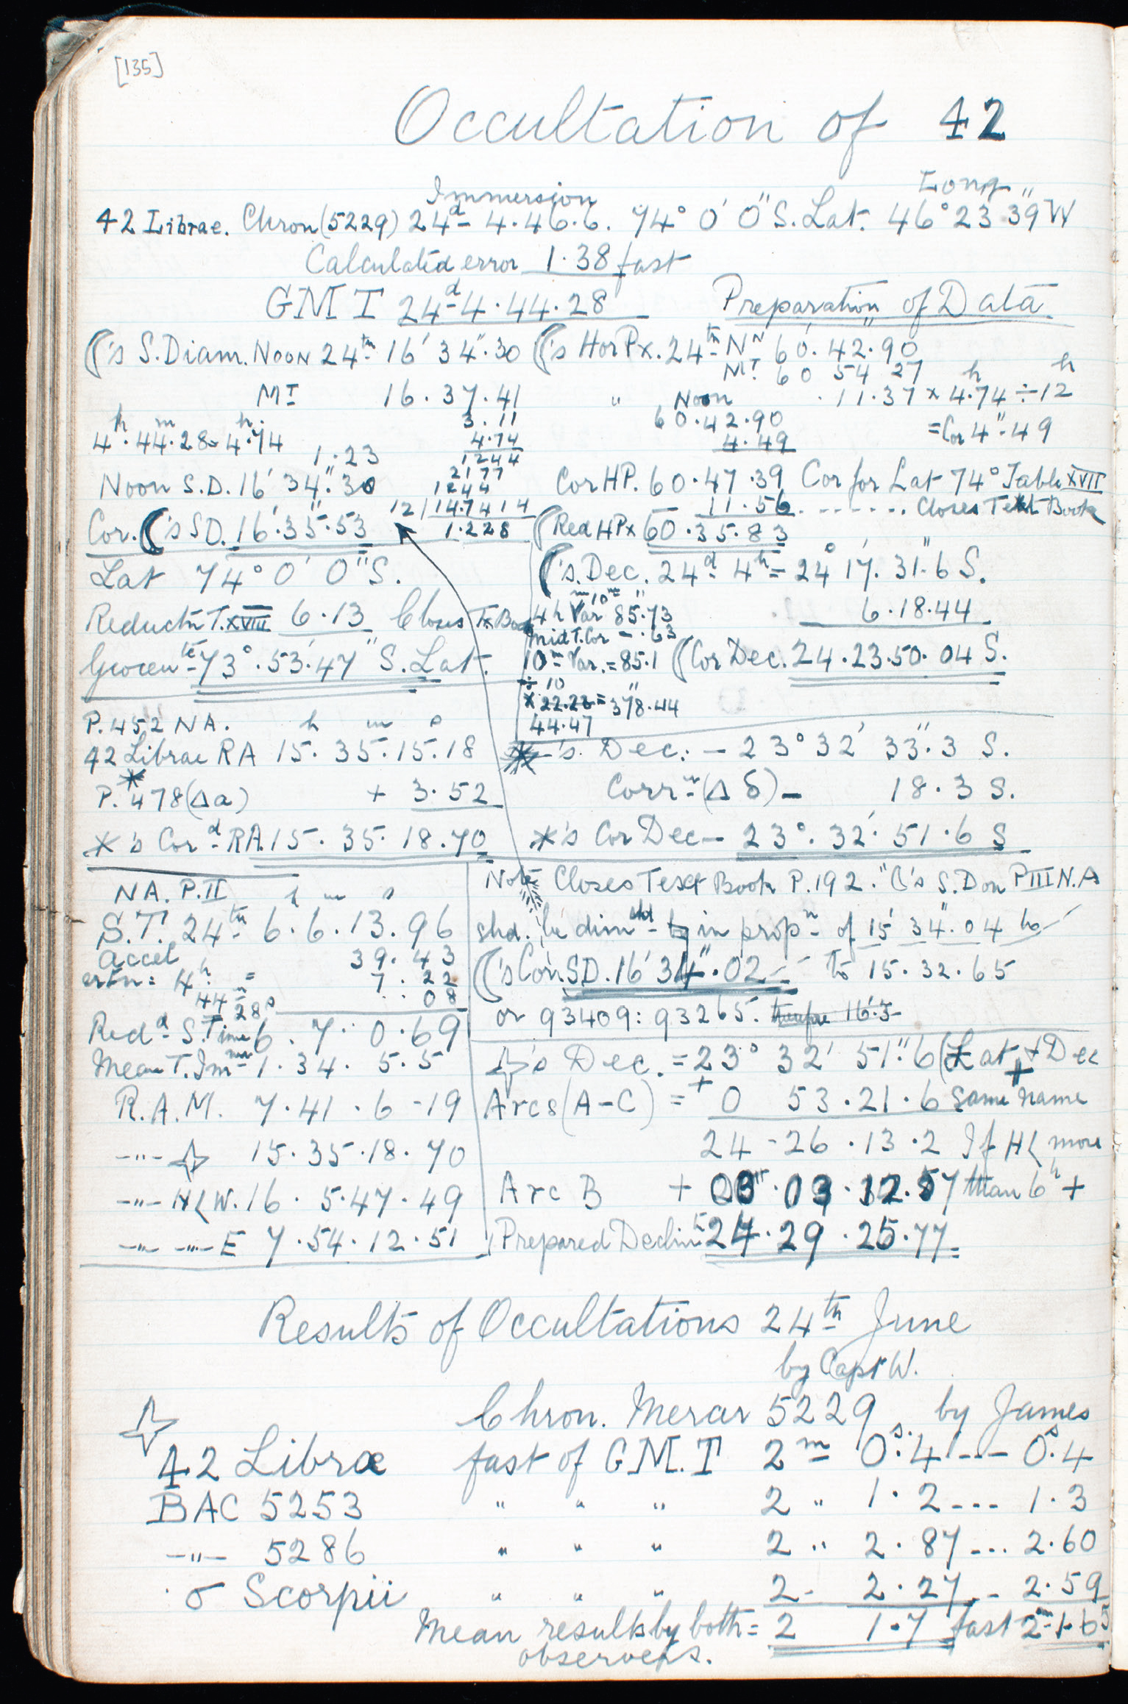
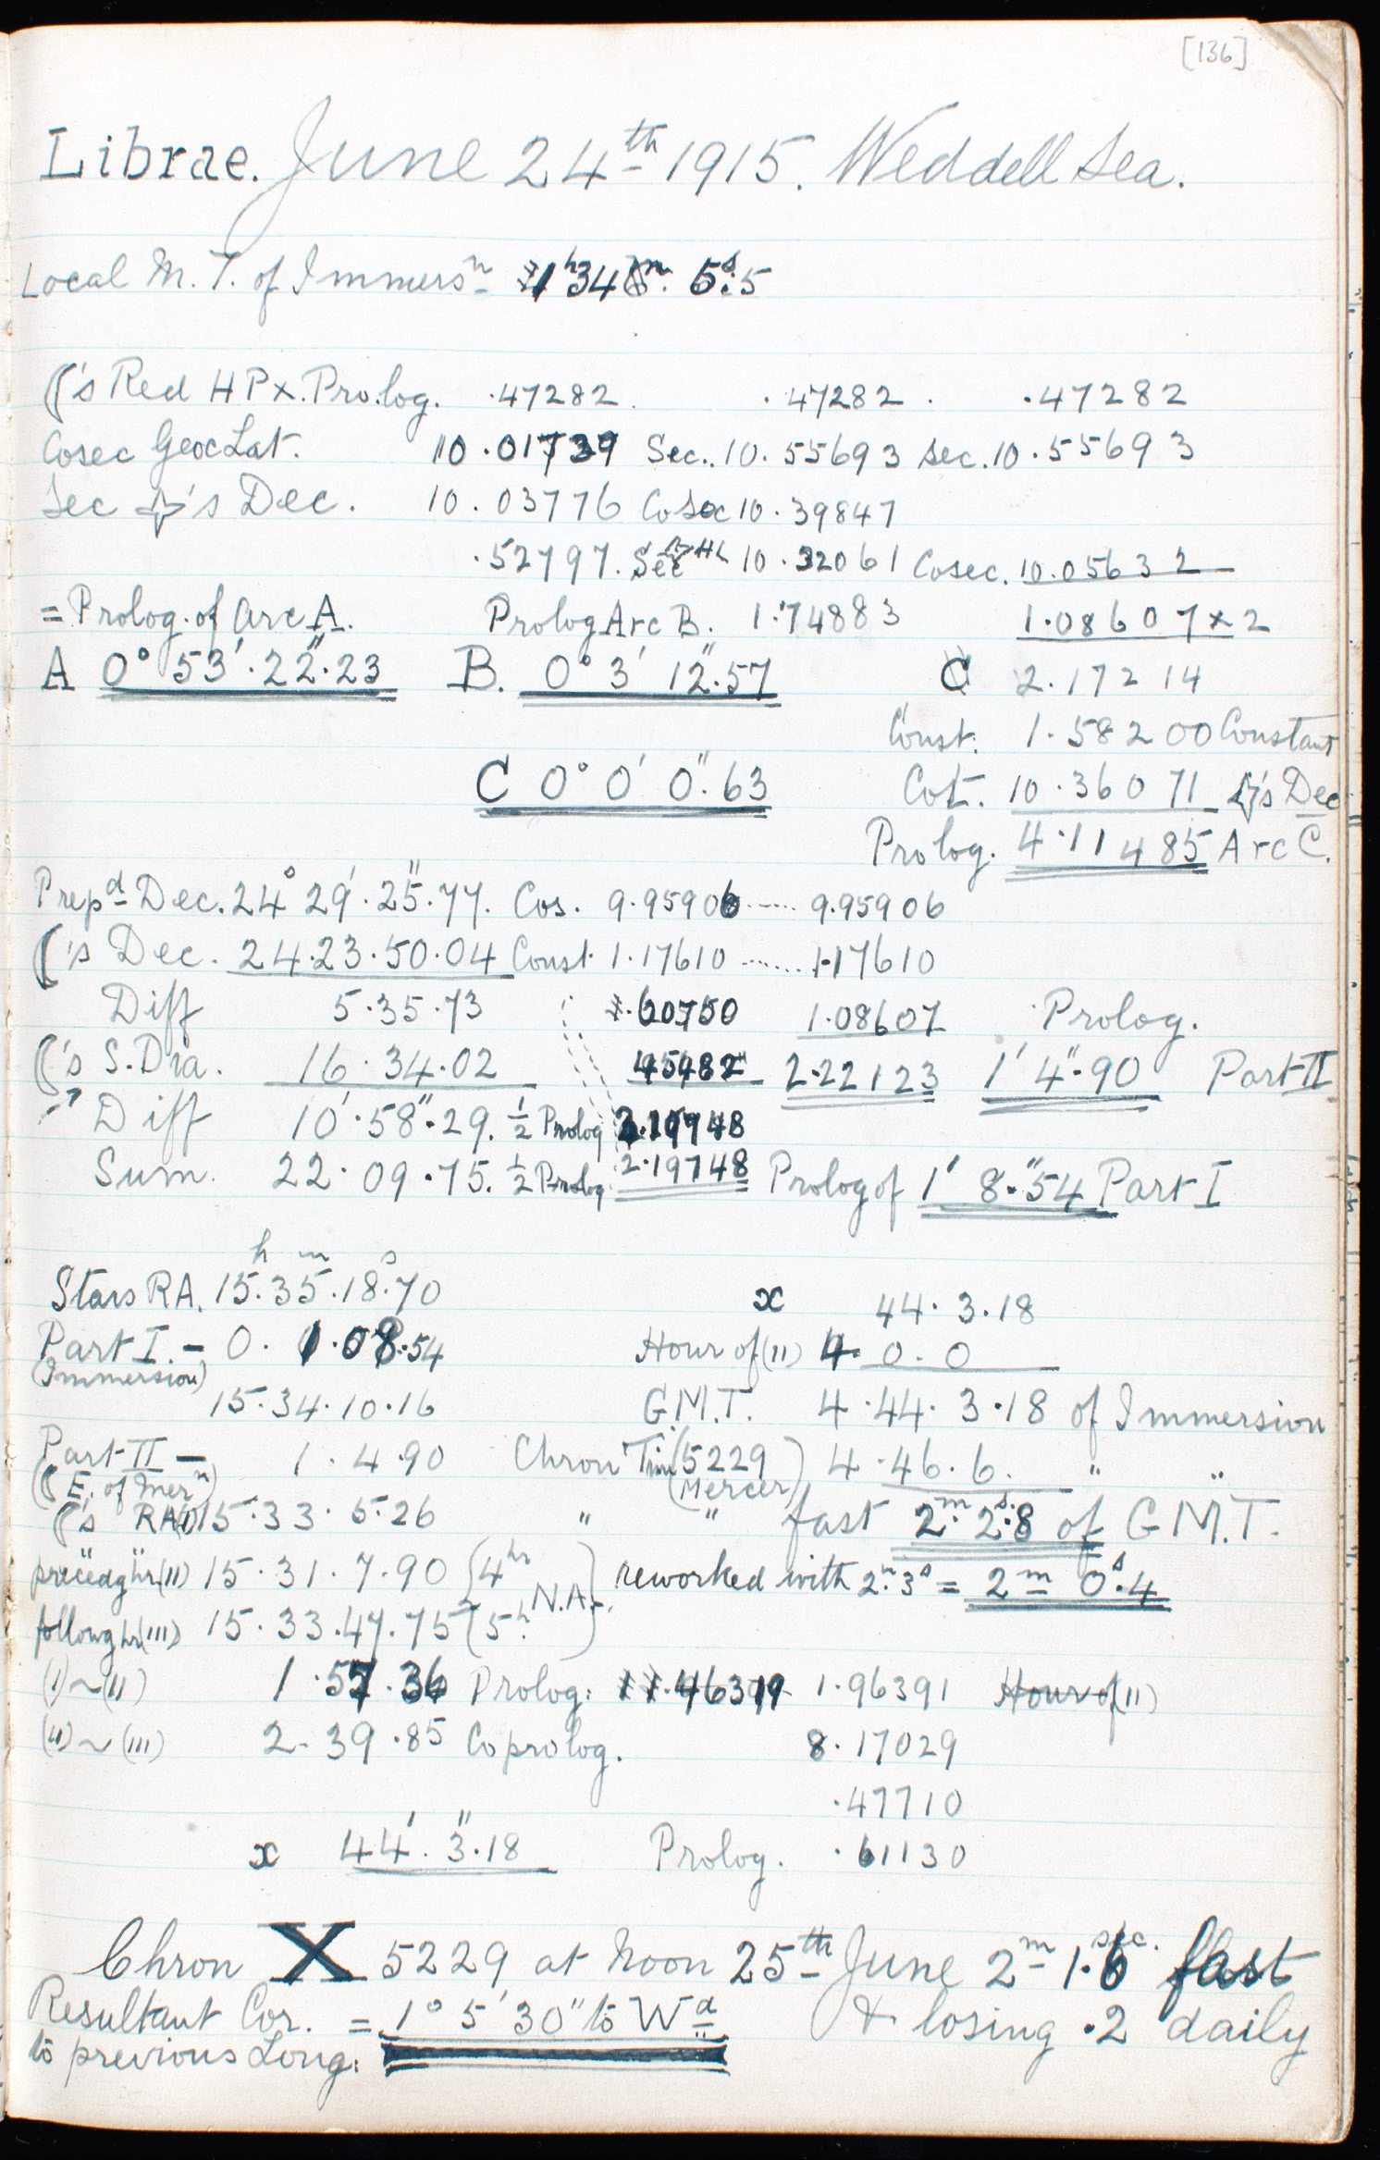
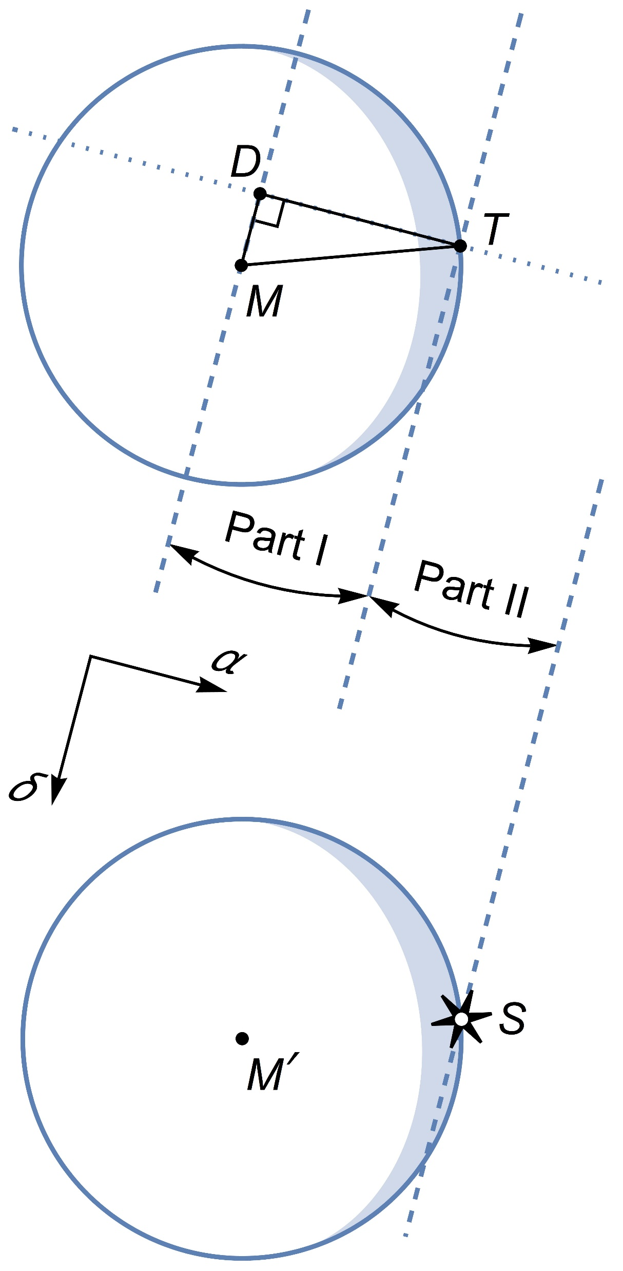
Lunar Occultations
10 occultations timed and reduced
24 June − 15 September 1915
Input latitude and LMT of immersion
Compute Moon’s geocentric R.A.
hence GMT
Replicated calculations
Raper’s Method (1840) accurately applied
Canterbury Museum 2001.177.1, pages 135-136

Slide 13
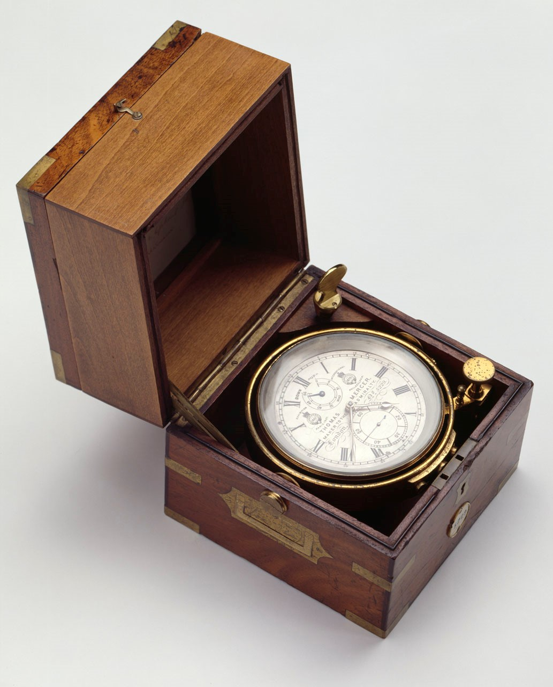
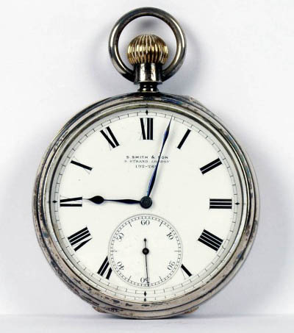
The Chronometers
Mercer 5229 (Chronometer X)
The working chronometer aboard Endurance
Kept in temperature controlled environment
Could not be maintained camping on ice
Would become erratic
Now at National Maritime Museum, Greenwich
Smith 192/262
Working chronometer at least from 2 November 1915 onward
“I carried… the chronometer…slung around my neck by lampwick, inside my sweater, to keep it warm” (Worsley)
Similar chronometers given to Hudson and Wild
Now at Scott Polar Research Institute, Cambridge
How did the Smith 192/262 drift from 2 to 22 November?

Slide 14
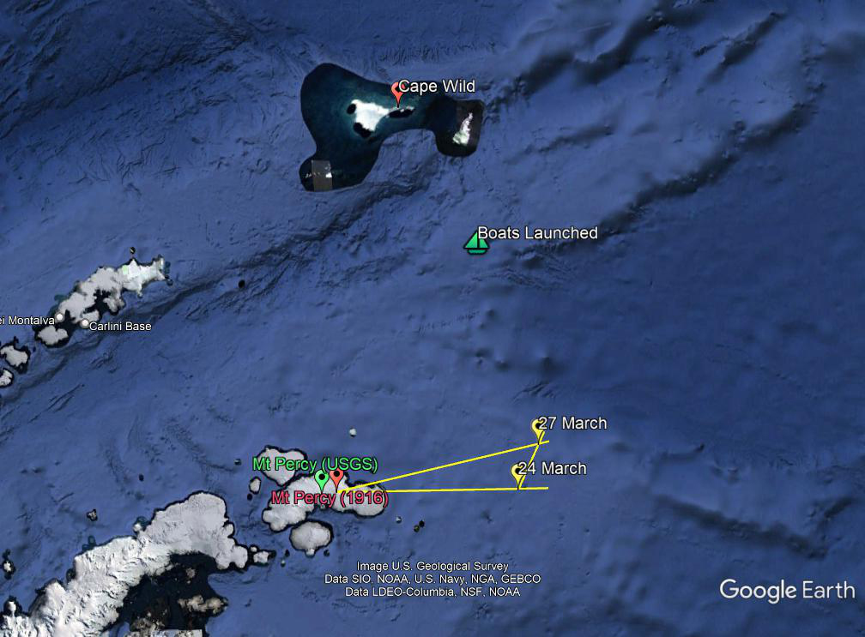
Triangulation on Mount Percy
Compass bearings taken on Mount Percy as ice drifts north
Distance found graphically
Chart in Nordenskjöld “evidently only intended for the general public thus not the close accuracy of [position] for Mt Percy necessary to correct [chronometer]” and consequently “will not allow any change to [chronometer] in [the] meantime.”
True position as known today is 11′ further west of chart
24 March, 1916 − CE 2^{m}16^{s} slower than expected

Slide 15
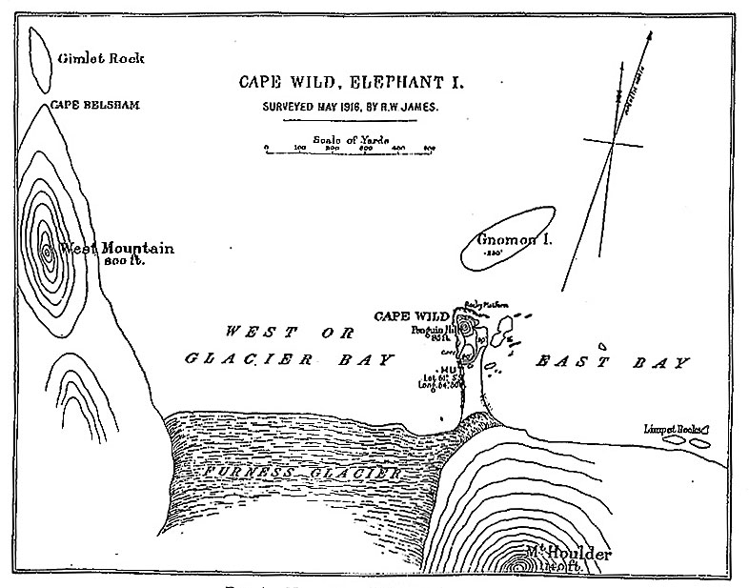
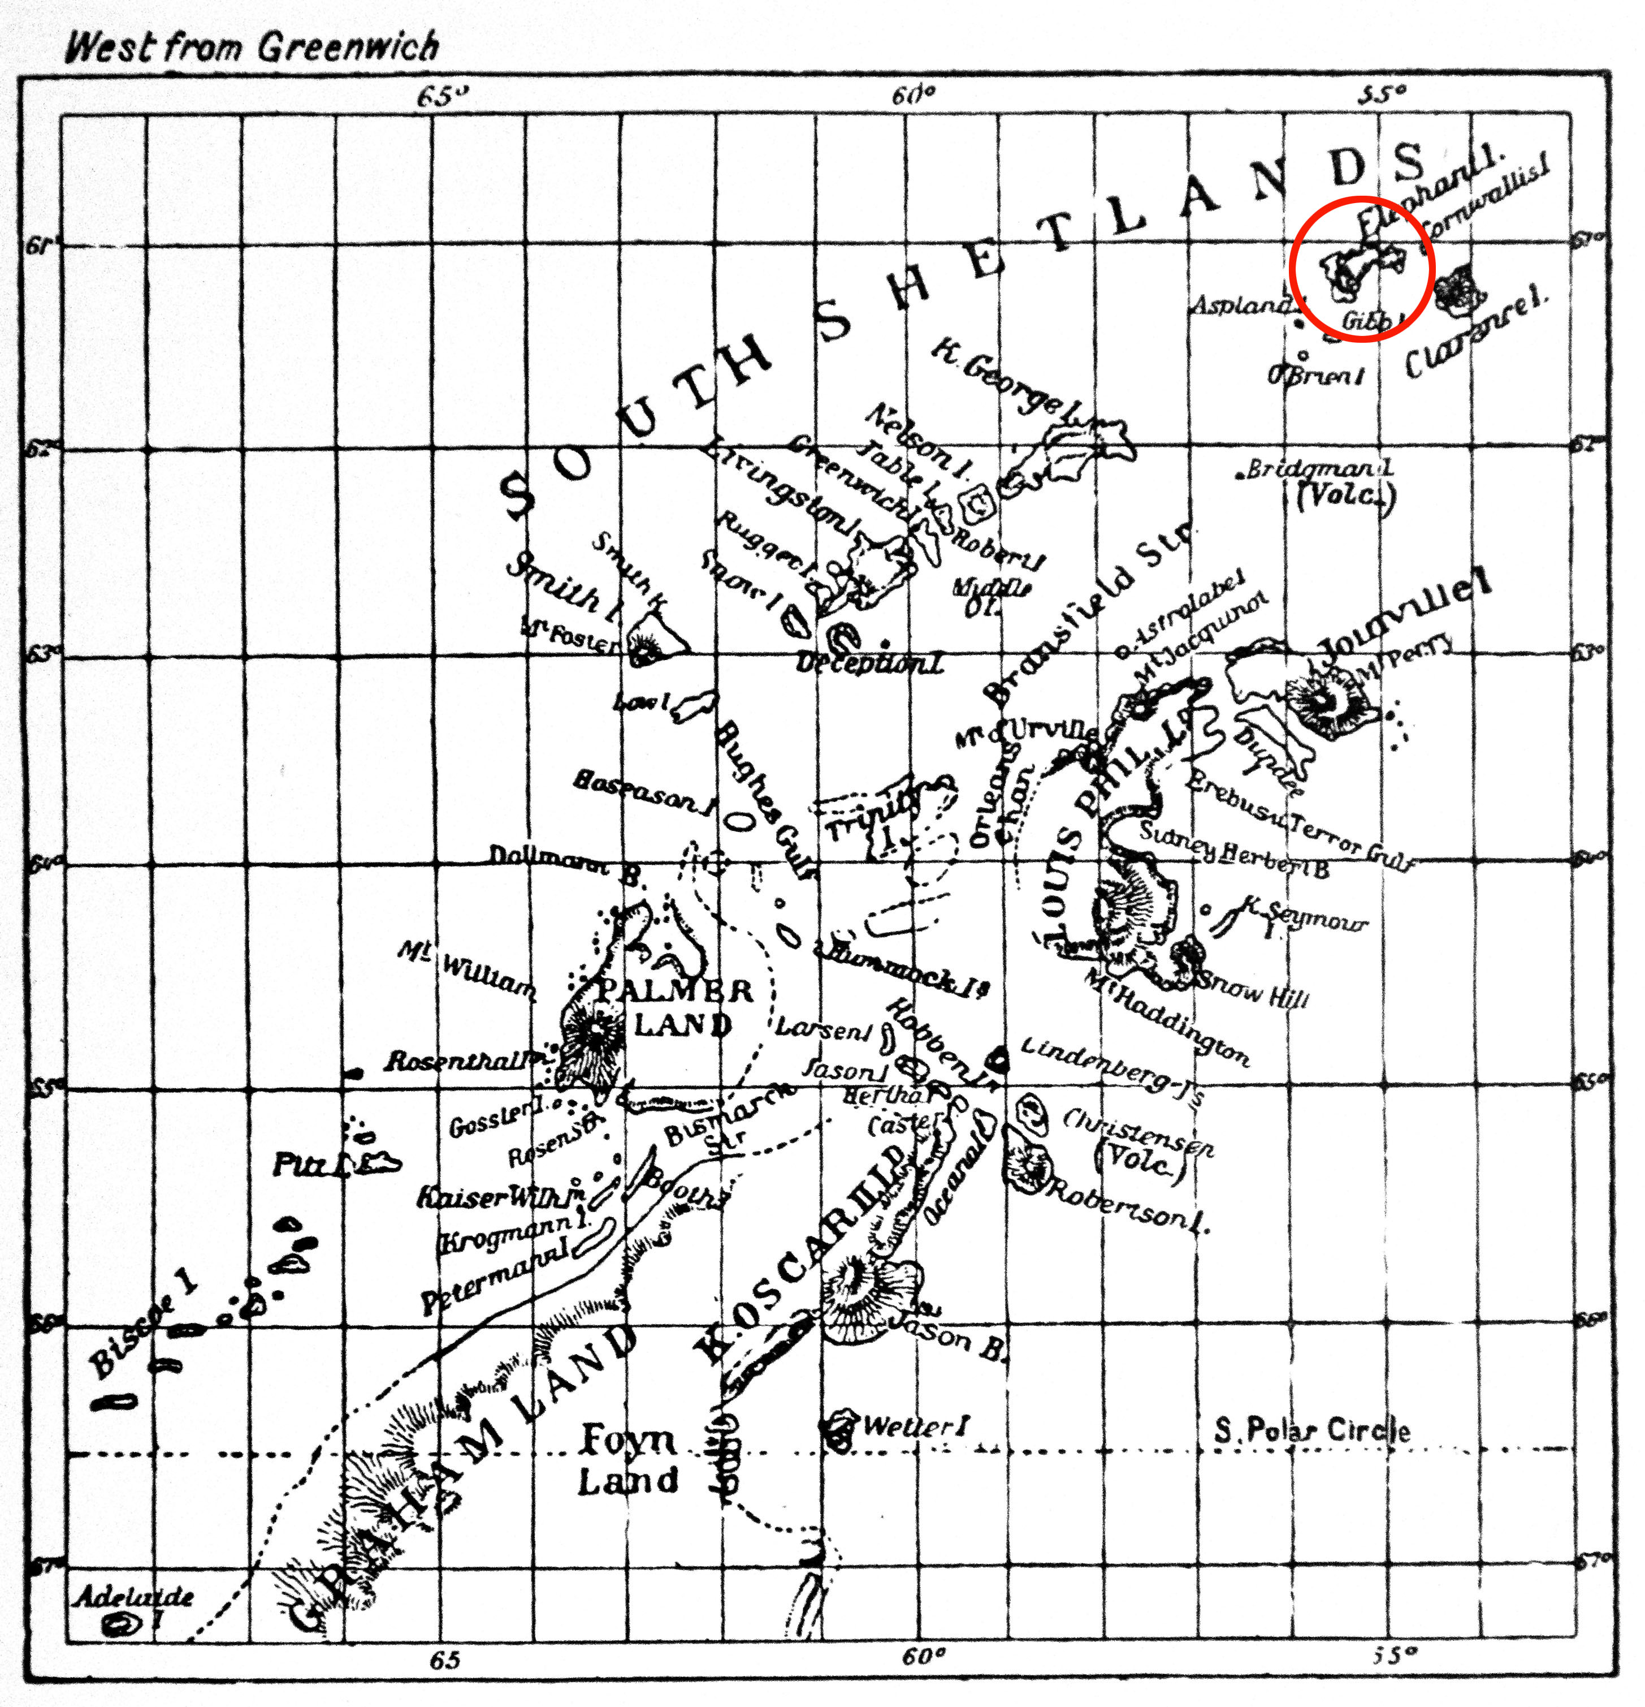
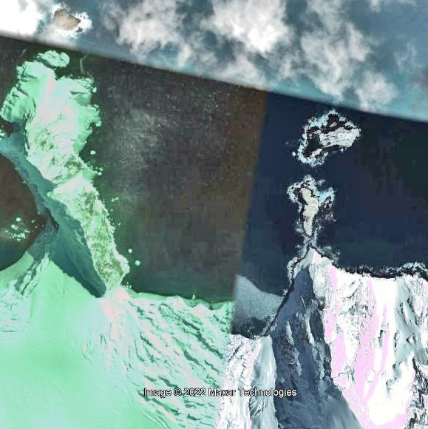
Elephant Island Time Sight
Map of Cape Wild showing location of hut (Wordie 1921)
Google Earth view of Point Wild
Chart of South Shetland Islands used to determine position of Cape Wild
(Nordenskjöld and Andersson 1905)
Position narrowly constrained at 61°6′S 54°51′30″W
24 April 1916 − time sight CE 2^{m}25^{s} slower than expected
Worsley allows “1minute+4sec more slow” as longitude of Cape Belsham “only approx. known to us”
Introduces roughly 10NM westerly bias and avoids overshooting South Georgia to the east
Position on sighting South Georgia “about 20^{mls} of distance further astern than obs.^{n} showed”
Worsley’s position for Cape Belsham correct to 2¼ NM

Slide 16
Conclusion for Longitude
Tendency to underestimate how slow the chronometers were running pushes true position to the west of log
Date when Smith 192/262 became working chronometer unknown
Long term trends may not reflect short term variation
Variable east-west wind component introduces additional uncertainty
Based on CE wreck lies to the west of the log position by up 5.9′ of longitude (2.2 NM)
Westward drift pushes position back to the east
Weddell Sea Expedition 2019
Reached log position of sinking
Contact lost with (untethered) Underwater Autonomous Vehicle

Slide 17
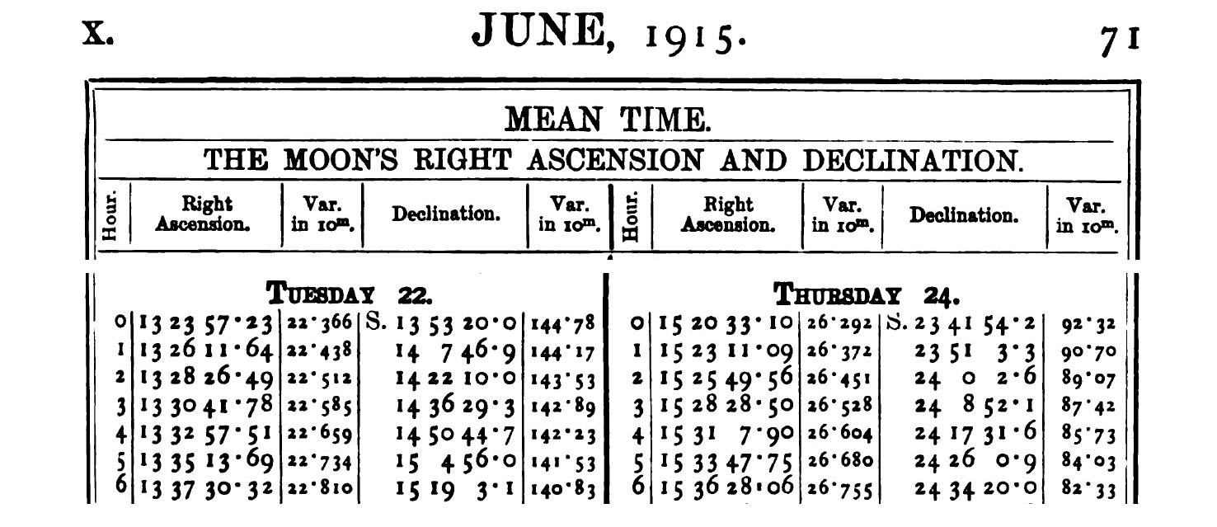
Systematic Errors in the Nautical Almanac
David Mearns (Blue Water Recoveries) discovered unpublished paper in Scott Polar Research Institute archives
Physicist Reginald James and A. C. Crommelin (Greenwich Observatory) corrected positions using observations
New CE from occultations roughly 20 seconds faster
Pushes true position to the east of log positions
Accuracy to which Moon’s position is quoted to does not reflect accuracy to which it could be calculated

Slide 18
Occultations – Modern Reanalysis
Moon’s position computed with JPL model DE430
Nautical Almanac positions lag by 0.9^{s} in right ascension
1.7″ root-mean-square difference in declination
Star positions and proper motions from Hipparcos Catalogue
Average difference 1.3″; maximum 3.7″
A Ophiuchi observed on 23 July and 15 September 1915
Binary with two equal components
Position angle 184.1°and separation 4.24″ required
23 July: A star occulted first − B star 0.15 seconds later
15 September: B star occulted first − A star 4.25 seconds later
Linear regression of corrected CE against occultation time
(Skyfield 2019ascl.soft07024R)
 | CR (s/day) gaining | R²
Worsley | 0.347 | 0.901
Worsley (DE430) | 0.365 | 0.992
James | 0.343 | 0.925
James (DE430) | 0.365 | 0.992
Crommelin | 0.271 | 0.863
Modern Moon and star positions
give a better fit and larger CR

Slide 19
New conclusion for Longitude
Tendency to underestimate how slow the chronometers were running pushes true position to the west of log
Unaccounted for CE of 29.8 seconds fast pushes true position to the east of log
Date when Smith 192/262 became working chronometer unknown
Long term trends may not reflect short term variation
Variable east-west wind component introduces additional uncertainty
Based on CE wreck lies to the east of the log position by up 2.4′ of longitude (0.9 NM)
Average 0.13 knot westward drift (uncertain) could push position 2.6 NM further east

Slide 20
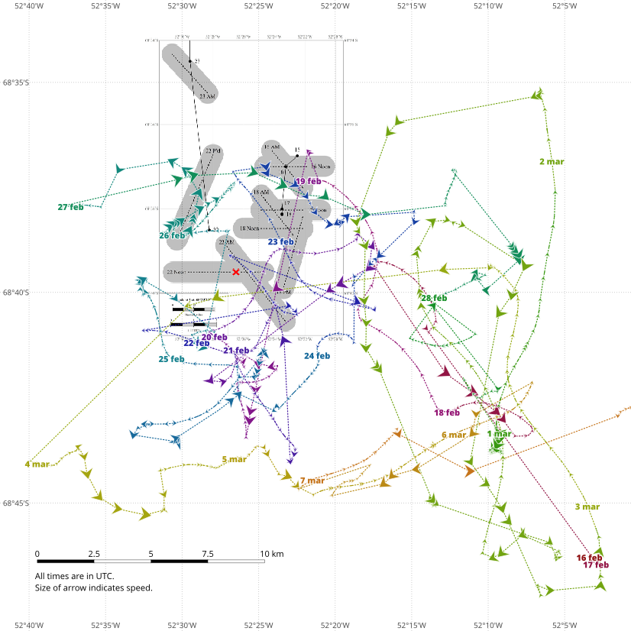
Endurance22 Search
In 2021 Endurance22 team announces new search
SARB Sabretooth tethered drones
Helicopter for possible ice camp
New results written up
submitted to Journal of Navigation 29 July, 2021
http://fer3.com/arc/imgx/OccultationCEPreprint.pdf
Ice breaker SA Agulhas II departs Cape Town 5 February, 2022
Search permit until 10 March
Endurance found 5 March 2022
Exact location as yet undisclosed
Ship’s AIS data suggests location of wreck is consistent with predictions
4 mile difference from log position is not a reflection of Worsley’s navigational skills
© Matus Tejiscak

