Slide 1
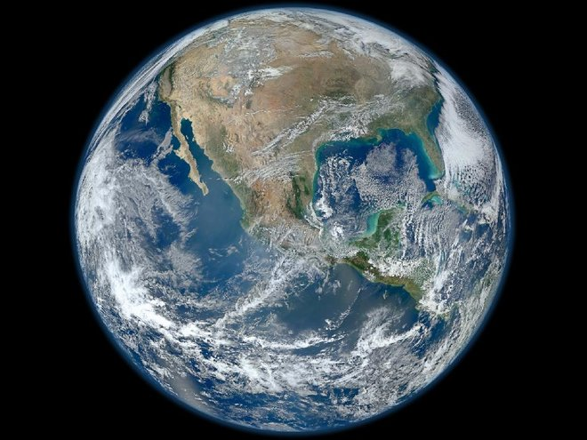
The Climate Emergency: can Particle Physics ever be sustainable?
Véronique Boisvert (b. 329.7 CO2 ppm)
@VBoisvertRHULPP
5th October 2022 (415.9 CO2 ppm)

Slide 2

Outline
The climate emergency
CO2e emissions & solutions from:
  Accelerators (construction/operation)
  Detectors
  Computing
  Rest (travel, conferences, buildings, etc.)
Possible recommendations
Disclaimer:
  I’m not a climate/energy scientist!
  My research is on ATLAS, so energy frontier bias!

Slide 3
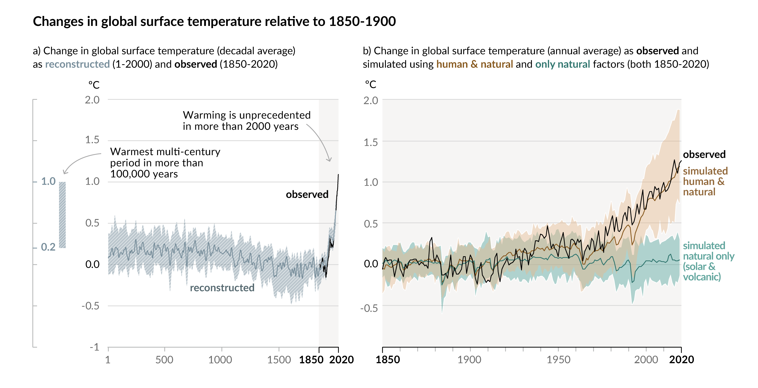
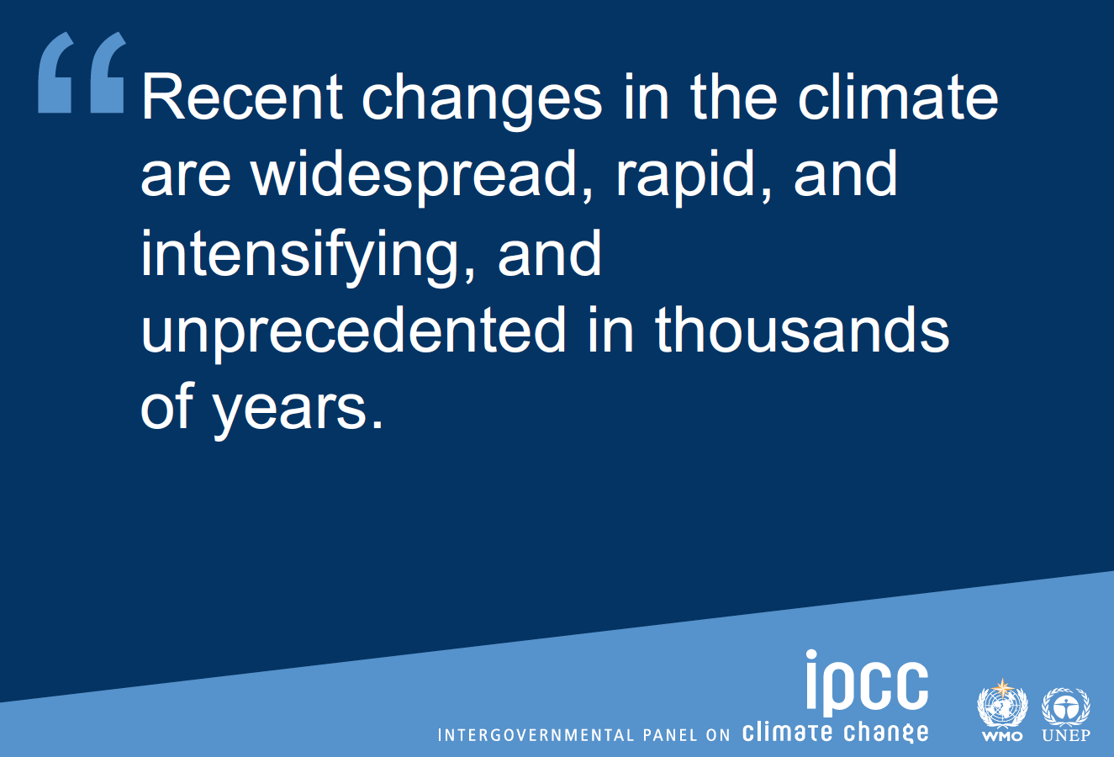
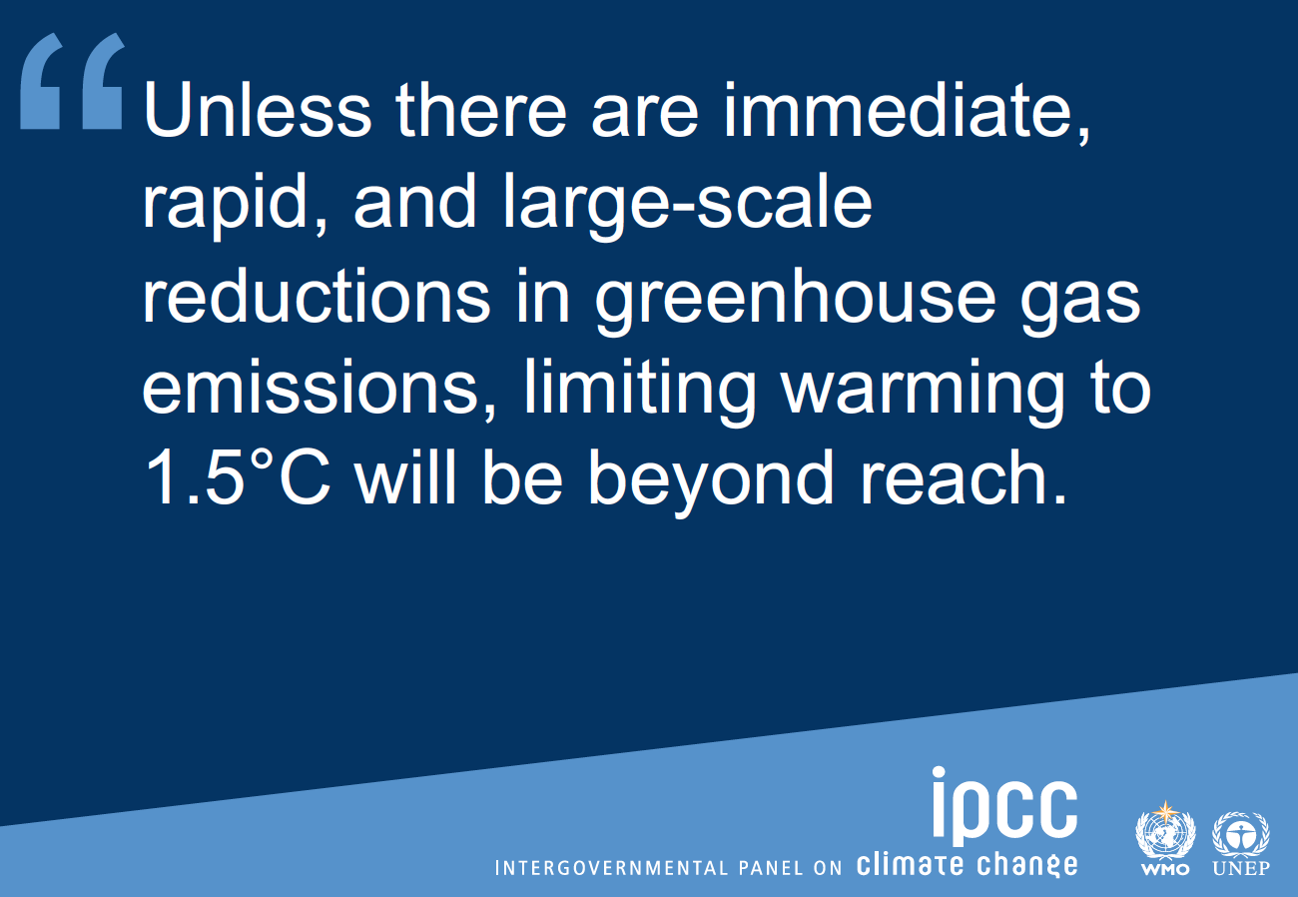
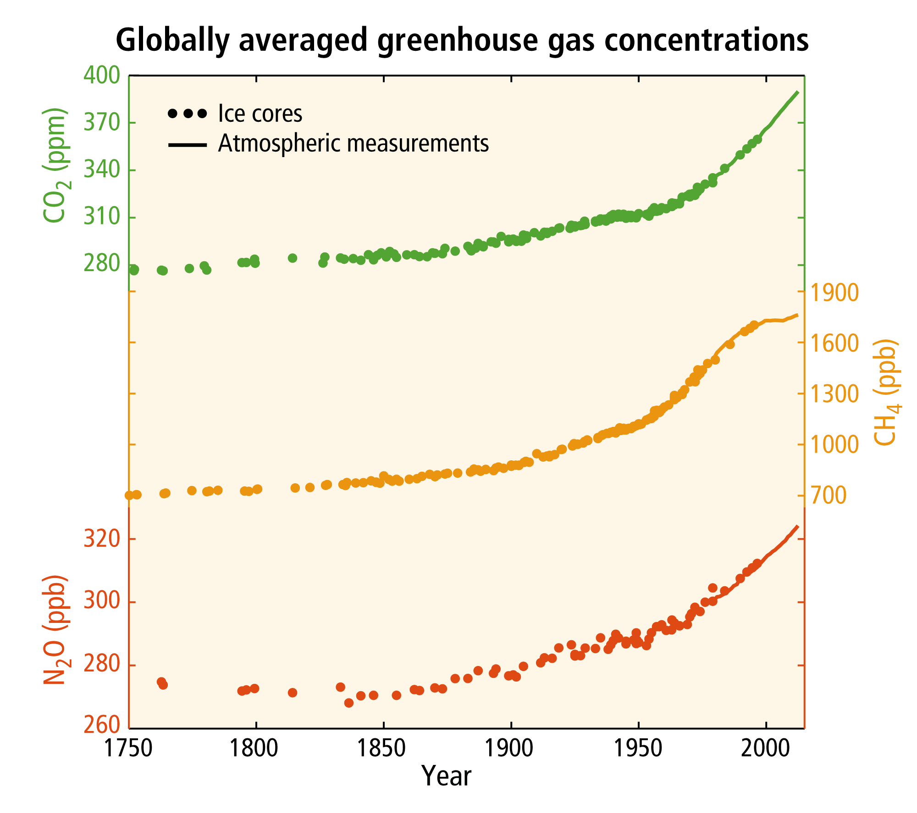
Climate Change: an emergency
IPCC AR6
IPCC AR5

Slide 4
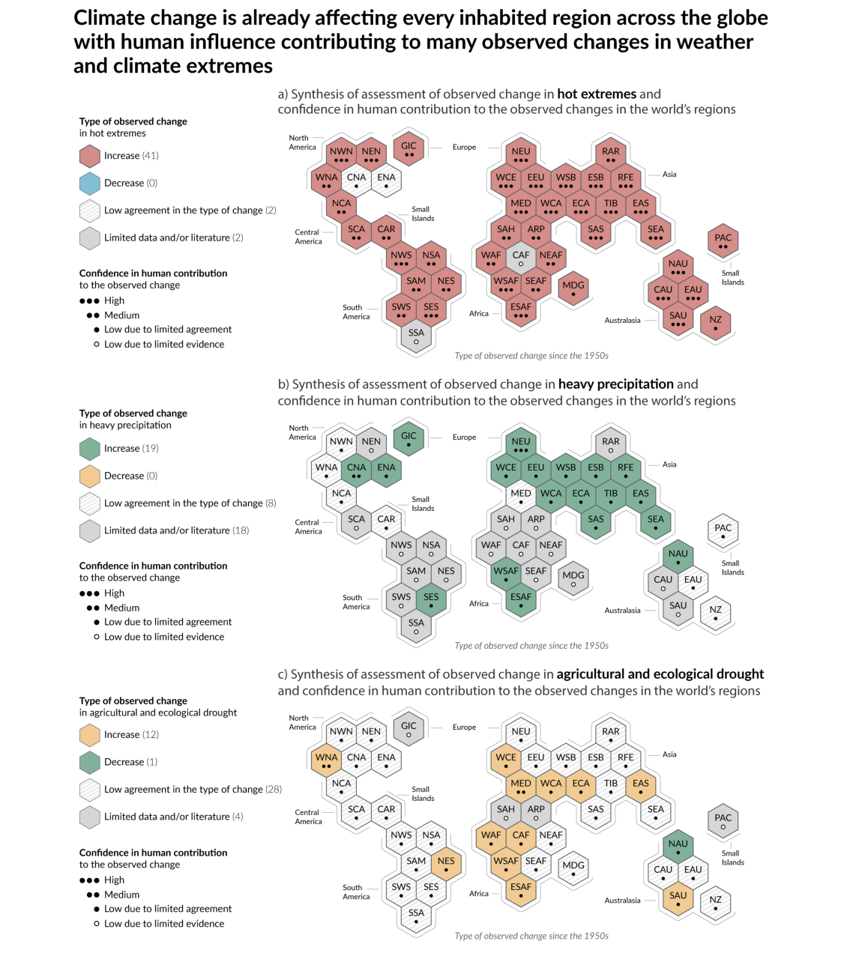
Climate Change: an emergency
IPCC AR6

Slide 5
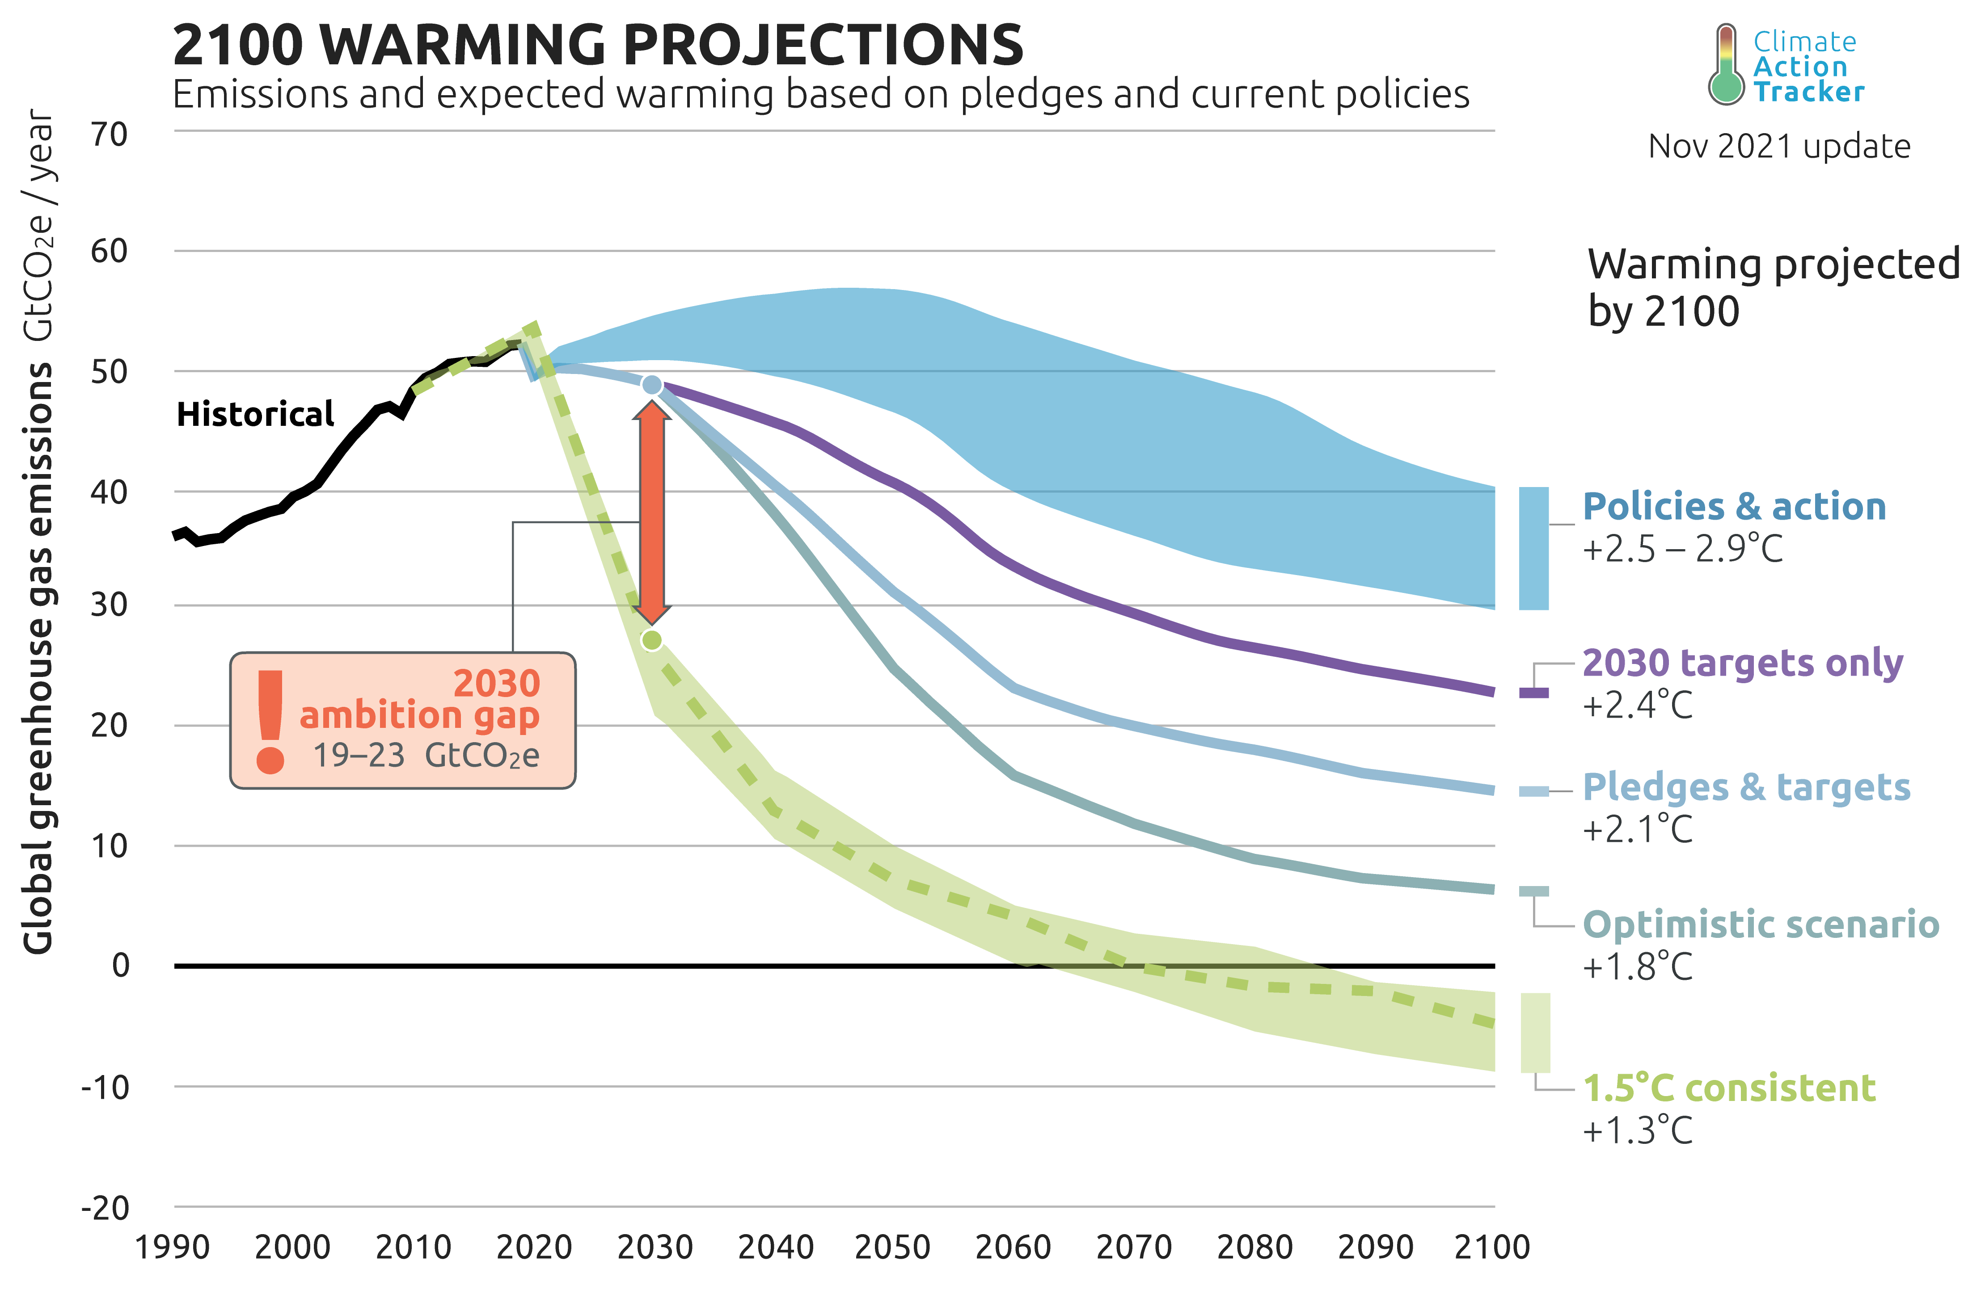
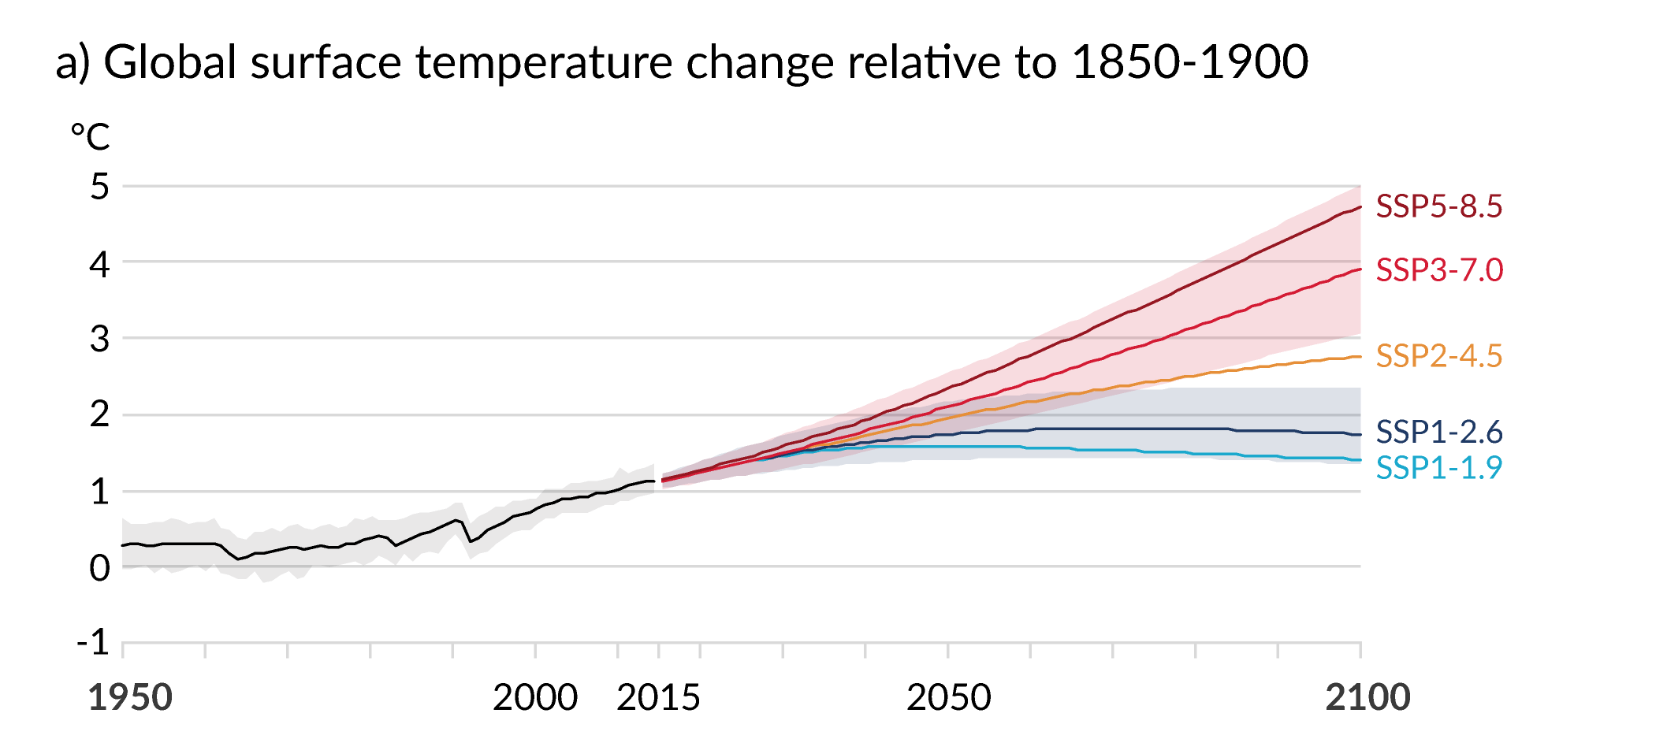
Climate Change: an emergency
UK parliament first to approve a motion to declare an “environment and climate emergency” on 1st May 2019
Of the top 10 GHG emitters, only Japan, Canada and the EU have legally binding target of “net zero emissions by 2050 (2045)”
  The pandemic was a blip (lessons)
IPCC 2015 Paris agreement: aim to stay “below 2℃” so focus on 1.5 ℃
  NDC: Countries make pledges for how to achieve this (and then increase those pledges over time)
  Climate Action Tracker: “With all target pledges, including those made in Glasgow, global greenhouse gas emissions in 2030 will still be around twice as high as necessary for the 1.5 ℃ limit.
IPCC AR6
Ice ages: ~ -5℃
+4℃: civilization breakdown…

Slide 6
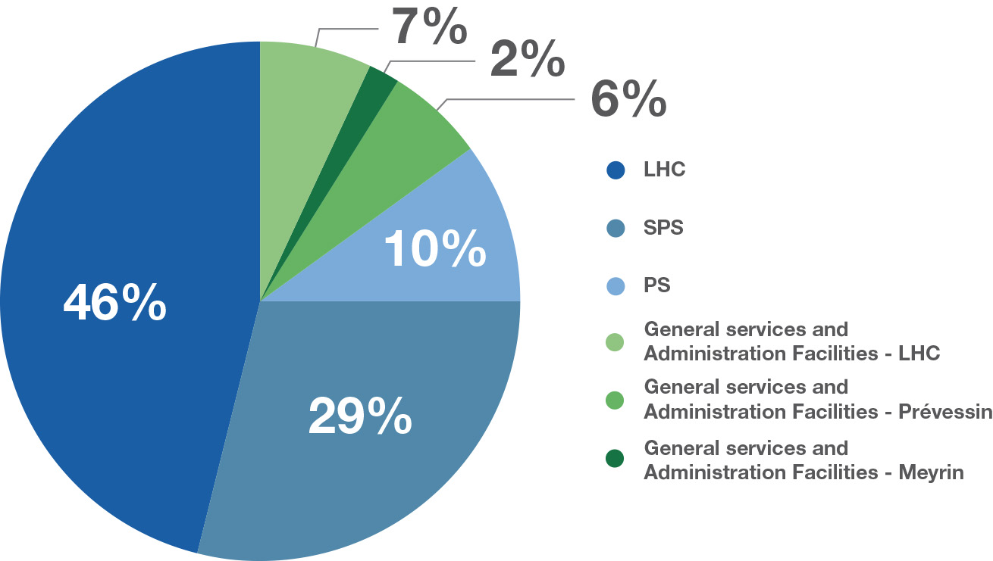
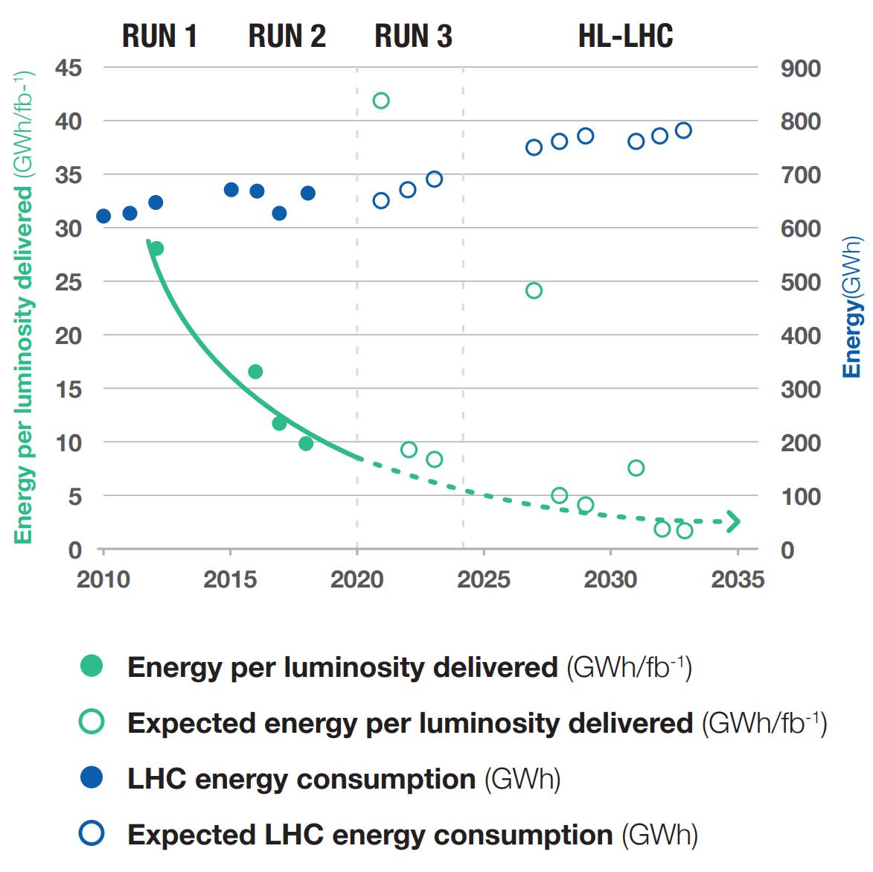
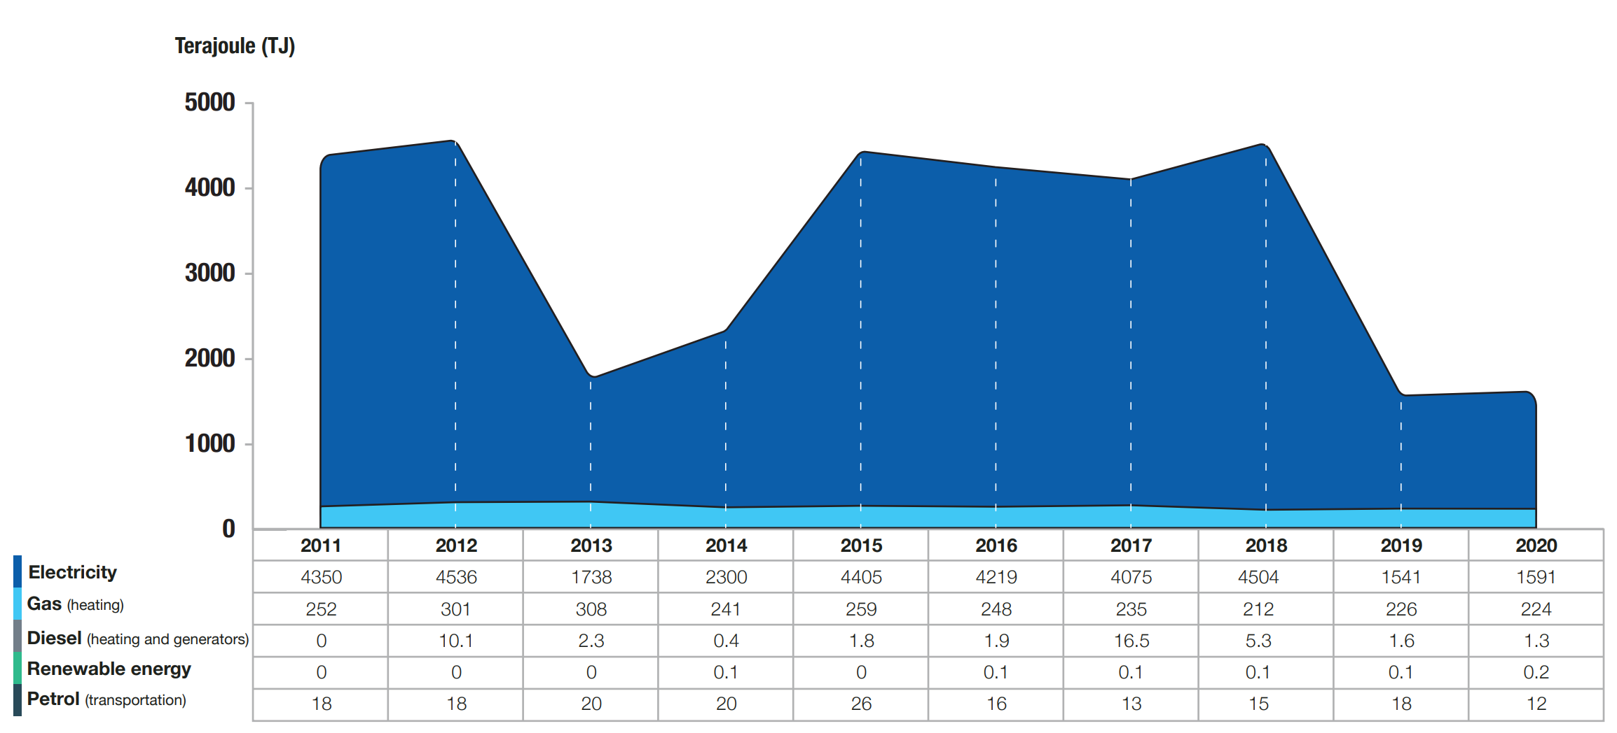
Emissions from accelerators: operations
CERN now releases Environment reports (1st: 2017-18, 2nd: 2019-20)
CERN peak power: ~180 MW (~ 1/3 of Geneva)
Per year: ~ 1.2 TWh (~ 2% of Switzerland, 0.03% of Europe)
LHC: ~55% of CERN’s E consumption
Electricity mainly comes from France: 88% carbon free (2017)
Electrical power distribution 2018

Slide 7

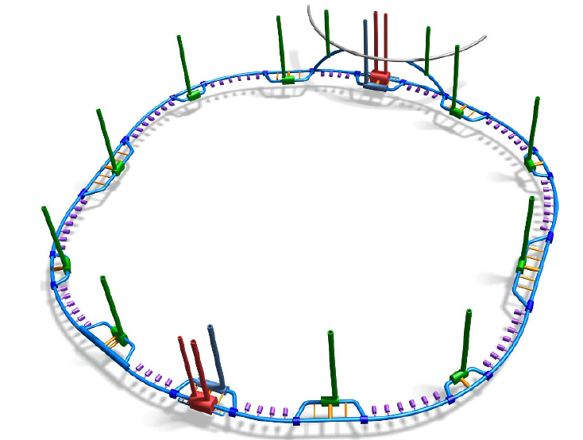
Emissions from accelerators: construction
Potential future of energy frontier: FCC (ee then hh)
Civil engineering:
  Machine tunnel: one of the longest tunnels in the world: 97.75 km in circumference
  8 km of bypass tunnels
  18 shafts
  12 large caverns
  12 new surface sites
  Excavation: 9 million cubic metres of spoil (mixture of marls and sandstone)
  New roads

Slide 8
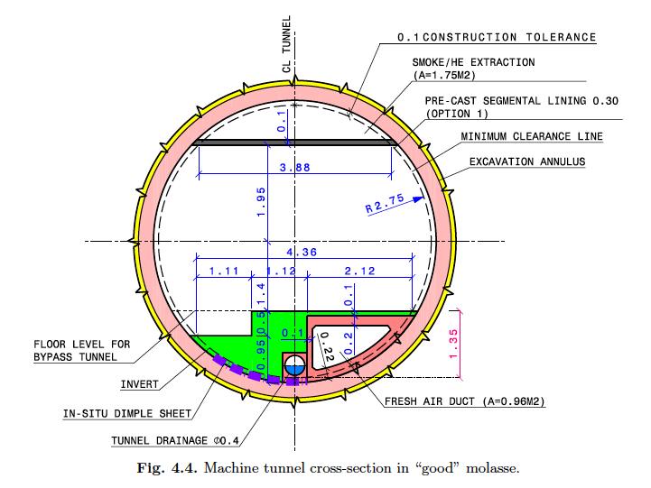
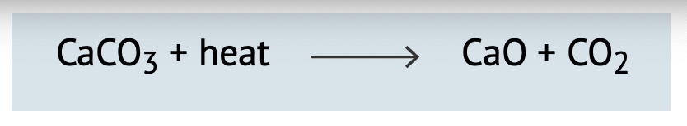
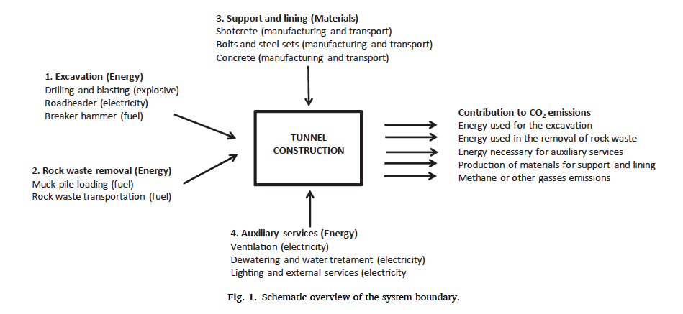
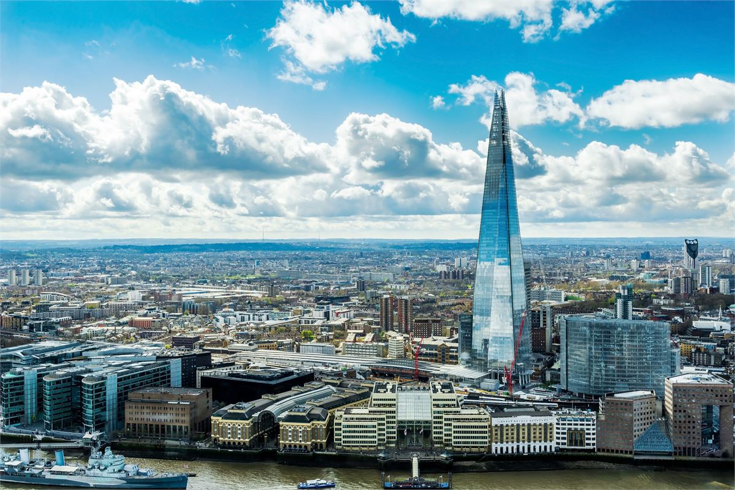
Emissions from accelerators: construction
Concrete needed for the tunnel, which means (Portland) cement!
Half of emissions from Portland clinker (ref)
Ken Bloom and my rough calculation:
  ~260k tonnes of CO2 emissions
Paper on emissions from road tunnels:
  Lowest estimate: ~500k tonnes CO2 emissions
Comparison: Using report for CO2e for construction of buildings: = building 8 London Shards!
1.4% of CH CO2e emissions (2016)
Plant 6 million trees!

Slide 9
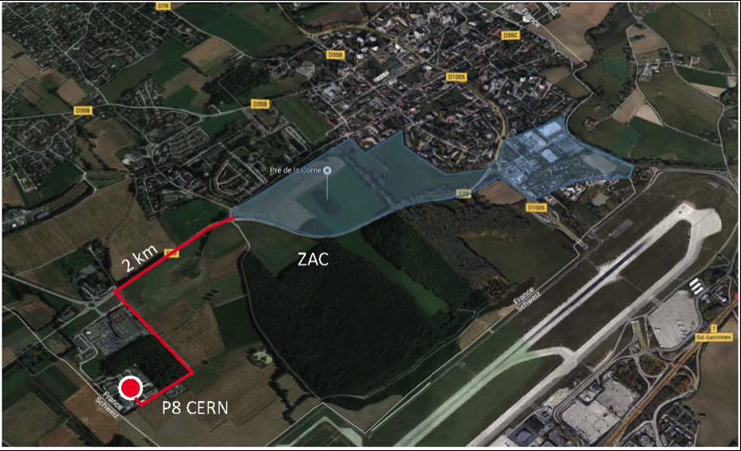
Emissions from accelerators: solutions
District heating:
  From 2022 hot water from LHC cooling at Point 8 will heat 8000 homes in Ferney-Voltaire, CERN also looking at Point 2 and 5, and Point 1 could heat CERN building on Meyrin site
Since 2011 series of workshops: Energy for Sustainable Science at Research Infrastructures, 6th one: September 2022 at ESRF
  Seems very Europe-centric
Long-standing R&D in lowering accelerator power requirements
  Eg Energy-Recovery in a Laser-Driven Plasma Wakefield Acceleration

Slide 10
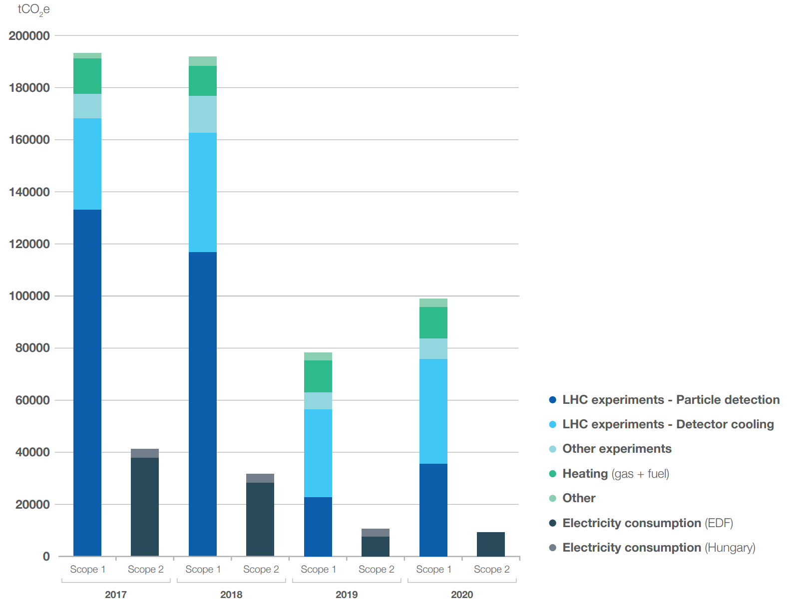
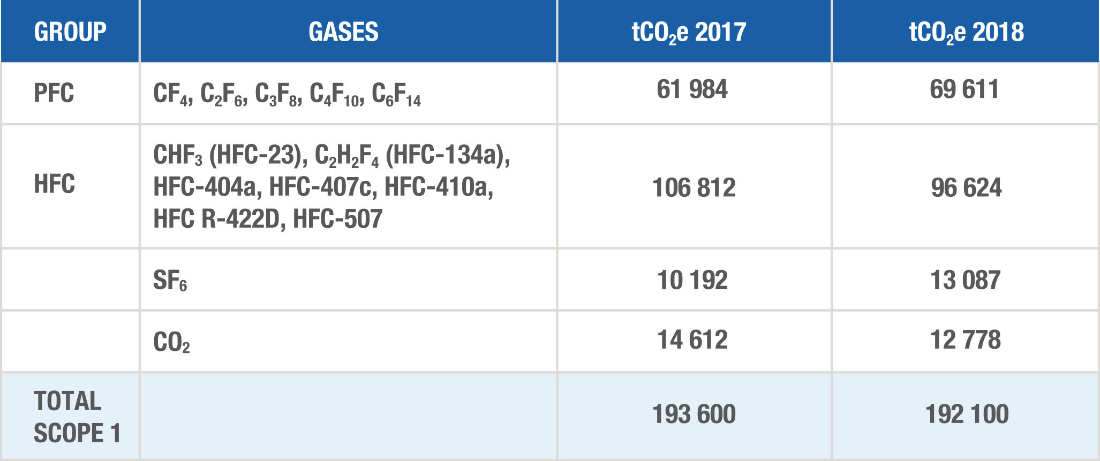
Emissions from detectors
Dominant CO2e emissions from CERN: gases used in experiments!
Scope 1: direct emissions from organization/vehicles etc.
Scope 2: indirect emissions from electricity generation, heating, etc.
Scope 3: all other indirect emissions, upstream and downstream (business travel, personnel commutes, catering, etc.)
CERN environmental report 2017-18

Slide 11
Emissions from detectors
Particle detection
SF6, HFCs and PFCs: particle detection
HFCs and PFCs: detector cooling
HFCs: air conditioning systems
SF6: also used for electrical insulation in power supply systems
Gas recirculation is 90%
Notes:
RPC: Resistive Place Chambers: Trigger chambers: pairs of parallel plastic plates at an electric potential difference, separated by a gas volume, CSC: Cathode Strip Chambers: precision chambers: composed of copper strips crossed by arrays of wires in a gas mixture.

Slide 12
Emissions from detectors
Beatrice Mandelli, CERN Gas Systems

Slide 13
Emissions from detectors: solutions
2020: CERN launched a working group on managing F-gases, with representatives from the departments concerned and the large LHC experiments. The group looked at issues such as the implementation of a centralised F-gas procurement policy, leak detection, replacement alternatives, training courses for personnel handling F-gases, and improving traceability and reporting.

Slide 14
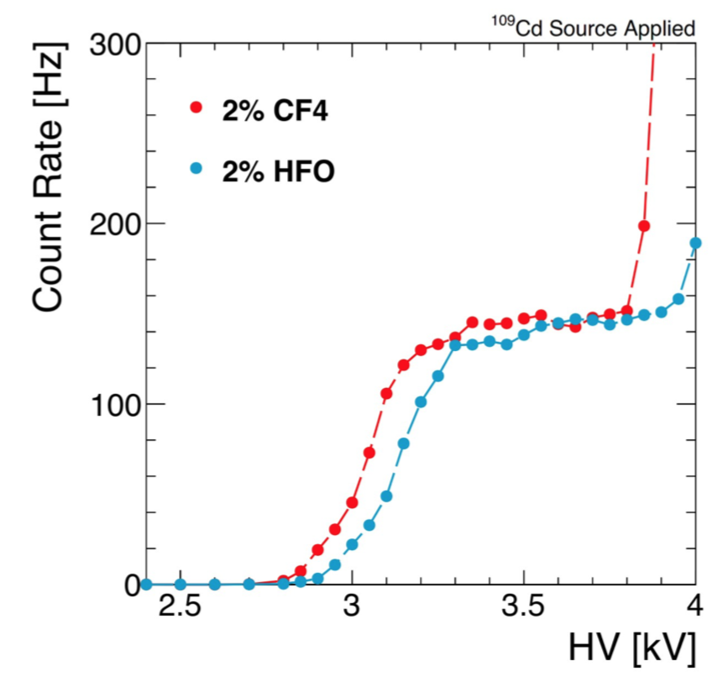
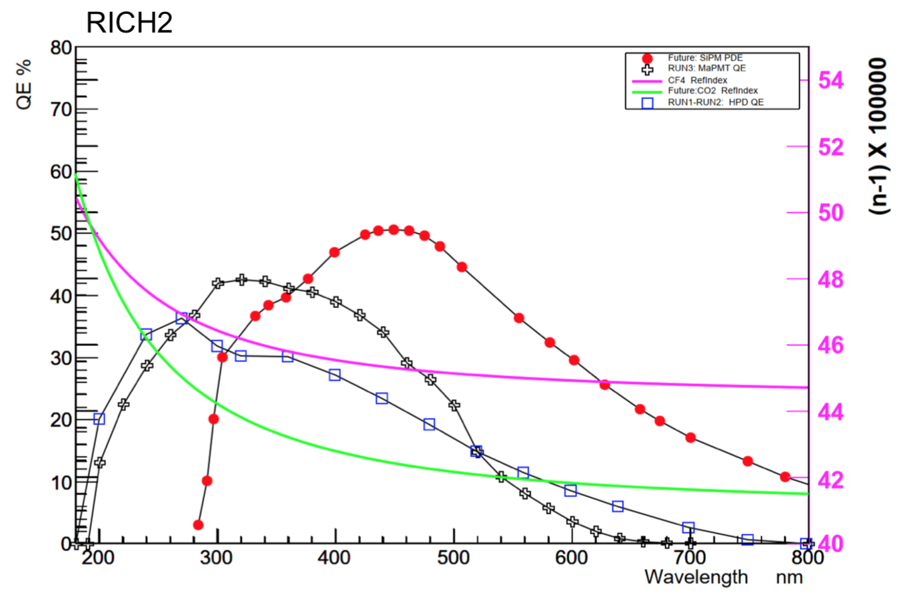
Emissions from detectors: solutions
Presented at DPF 2019
Alternative gas example: replace CF4
CF4 prevents ageing, improves timing resolution and is a scintillator
CMS CSC: currently 10% CF4
  Reduce concentration to 5%
  Replace with CF3l or HFO1234ze
LHCb RICH studies:
  CF4 or C4F10 used for good refractive index
  Could replace C4F10 with C4H10 but flammable
  Replace CF4 with CO2: under study
  Use of SiPM to reduce the chromatic error and increase the yield
S. Easo and O. Ullaland
Beatrice Mandelli, CERN Gas Systems

Slide 15
Emissions from detectors: solutions

Slide 16
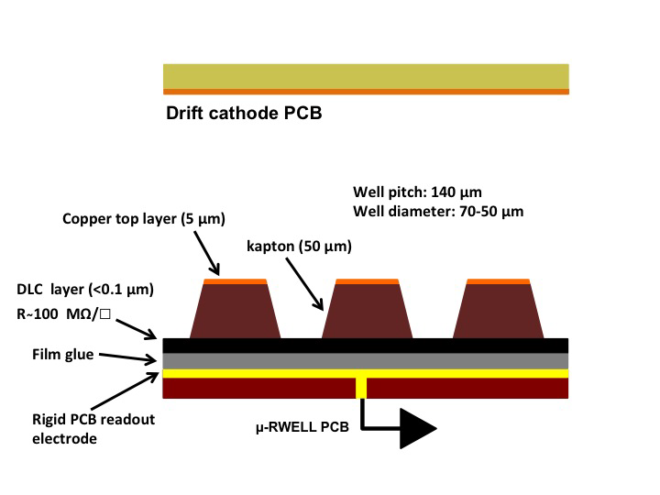
Emissions from detectors: solutions
FCC-ee CDR
FCC-ee detectors:
CLD (similar to CLIC): RPCs for the muon detector
IDEA: large drift chamber (similar to KLOE and MEG2) containing He:iC4H10 90:10, iC4H10 GWP: ~3, for muon: large area μ-Rwell chambers, also use 10% iC4H10
Crucial to do R&D in finding replacements or ensure 100% leak-free and 100% recirculation
G. Bencivenni et al 2017 JINST 12 C06027

Slide 17
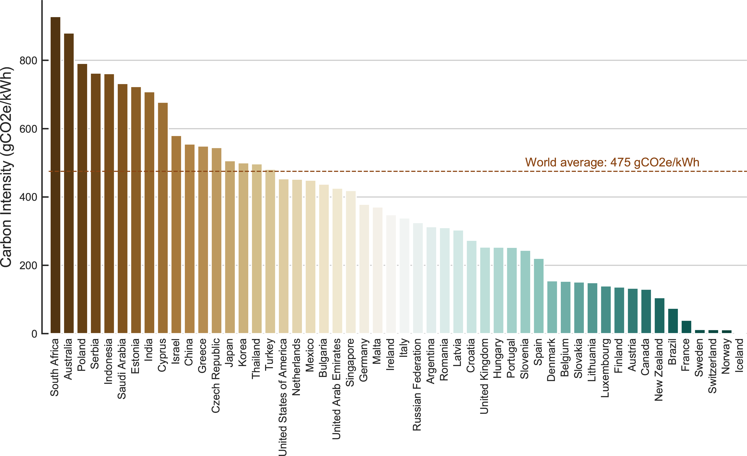
Emissions from Computing
Global IT sector could be 2-6% of global CO2e emissions, growing to 20% by 2030
70% from data centres and communication networks
HEP uses Grid centres all over the world, yet emissions from electricity vary wildly
Solutions:
  Choose sites with green electricity…
  Green500 list
  Optimize your code ;-)
Far future (2040):
  All OECD electricity grids will be fully green…
  …. But huge demand for electricity

Slide 18
Emissions from FNAL
In the US, DOE requirements to report yearly on environmental impacts including emissions
REC: Renewable Energy Certificates
2019 FNAL Environment Report

Slide 19
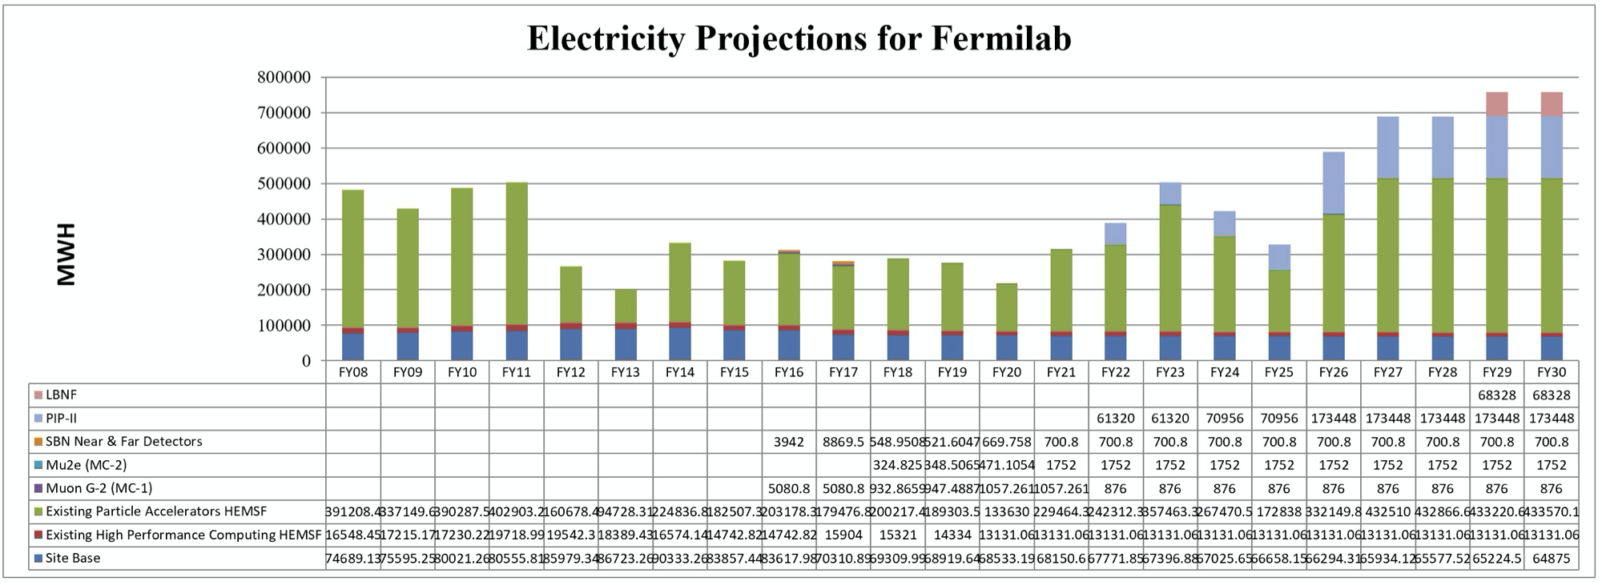
Emissions from FNAL
Notes:
PIP-II: Proton Improvement Plan for neutrino beam for DUNE, LBNF: Long Baseline Neutrino Facility, HEMSF: High Energy Mission Specific Facilities.

Slide 20
Emissions from Universities
Heating/cooling + hot water + light/appliances = 40% of energy consumption of a UK citizen
Not only helps Climate, but is cheaper to run
B Corporations certification
Green Labs: “research labs consume 10 times more energy and 4 times more water than office spaces”, green lab certification, LEAF
Remaining carbon budget:
(50% chance of staying < 1.5℃) 460 GtCO2
Per year per person: 2.2t

Slide 21
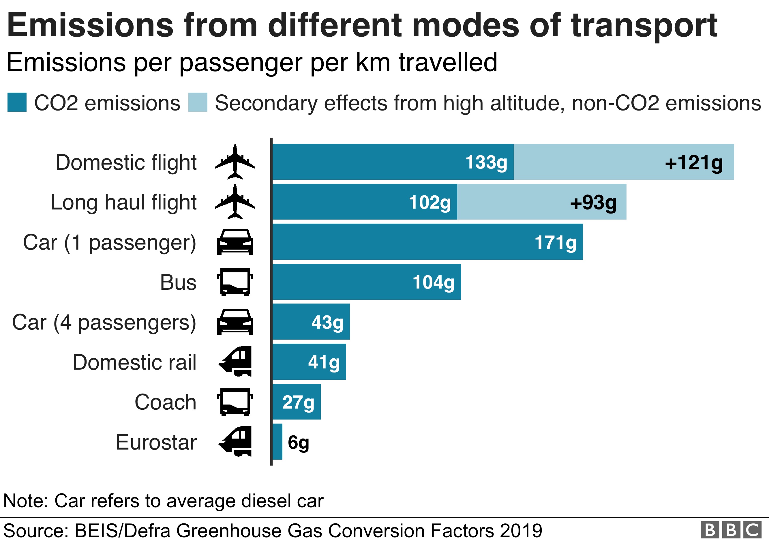
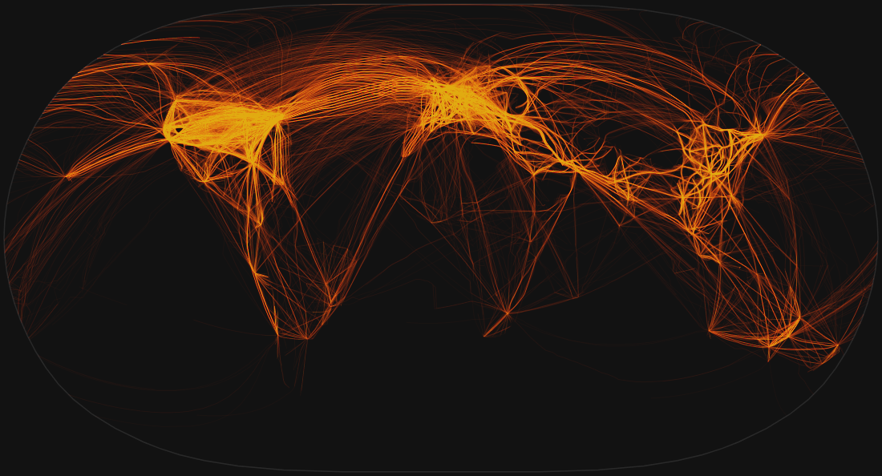
Emissions from Travel
Commuting, conferences, etc.
A nearly carbon-neutral conference model
Although aviation is 2.4% (2018) of global emissions (more than Australia or Italy or France!), rate of growth is large and carbon neutral flights long way off (CO₂ emissions increased by 32% from 2013-2018)
Environmental groups calling for frequent flyers levy since eg in 2015 only 12% of people in England took 3 flights or more!
Carbon offsetting as short term mitigation? controversial
One day in May 2019: 162,637 take offs recorded
Notes:
2014 D of Transport survey: 15% of UK people take 70% of flights

Slide 22
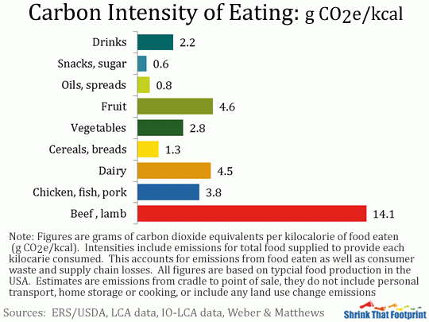
Emissions from food
  IPCC report in August on Land Usage
  How about migrating our PP catering (meetings, conf, workshops) in that direction?
Pre-pandemic

Slide 23
Possible recommendations

Slide 24
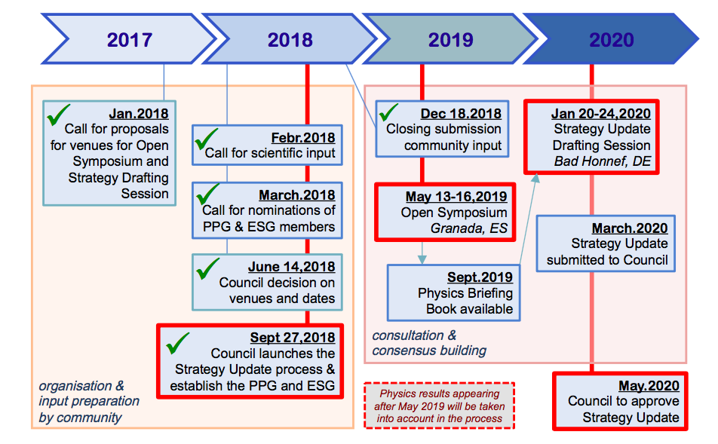
European Strategy Update
“The Strategy is due to be updated by May 2020 to guide the direction of the field to the mid-2020s and beyond.”

Slide 25
Input to the ESU
VB (RHUL)
Cham Ghag (UCL)
Francesco Spano (RHUL)
David Waters (UCL)
CERN Courier article
ECFA group of early career researchers asked to give input to European Strategy, document released which includes statements supporting the environmental sustainability of the field

Slide 26
Input to the ESU: recommendations
Recommendation 1:
  As part of their grant-giving process, European laboratories and funding agencies should include criteria evaluating the energy efficiency and carbon footprint of particle physics proposals, and should expect to see evidence that energy consumption has been properly estimated and minimised.
Recommendation 2:
  Any design of a major particle physics experiment should consider plans for reduction of energy consumption, increased energy efficiency, energy recovery and carbon offset mechanisms. Similarly, any design for new buildings associated with particle physics research should consider the highest building and energy efficiency standards.
Recommendation 3:
  European laboratories should invest in the development and affordable deployment of next-generation digital meeting spaces including virtual reality (VR) tools in order to minimize the need for frequent travelling to the laboratory, thereby minimizing the travel carbon and energy footprint of their users.

Slide 27
Outcome
European Strategy Update web site

Slide 28
Outcome
a) The energy efficiency of present and future accelerators, and of computing facilities, is and should remain an area requiring constant attention. Travel also represents an environmental challenge, due to the international nature of the field. The environmental impact of particle physics activities should continue to be carefully studied and minimised. A detailed plan for the minimisation of environmental impact and for the saving and re-use of energy should be part of the approval process for any major project. Alternatives to travel should be explored and encouraged.

Slide 29

Community Engagement Frontier: TG07 Environmental & Societal Impacts
Coordinators: VB, Ken Bloom (U of Nebraska), Mike Headley (SDSTA-SURF)
White papers due 15th March, Community meeting in Seattle in July, then feeds into P5 roadmap

Slide 30
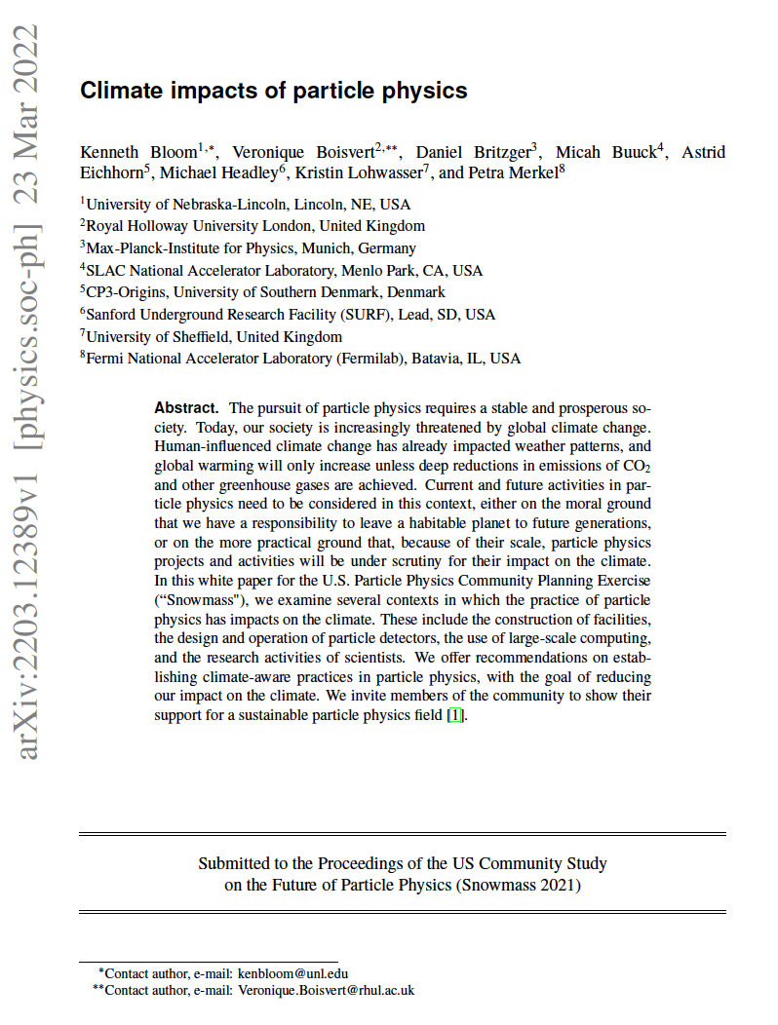

Slide 31
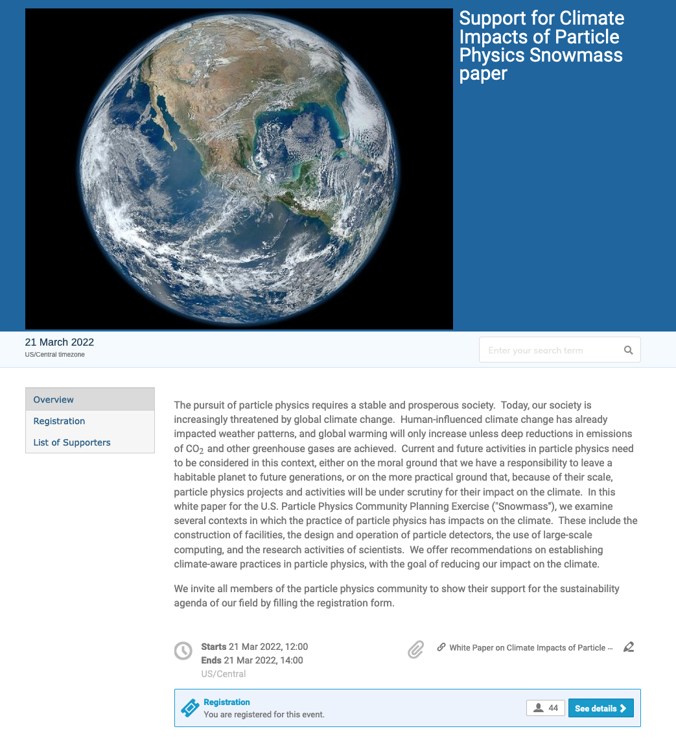
Show support!
https://indico.fnal.gov/event/53795/

Slide 32
Additional recommendations
PP researchers need to be informed about the climate emergency
Accounting of CO2e emissions in particle physics should follow some common standards and get reported clearly to stakeholders
Particular attention to gas detectors
Costing of future experiments need to take into account of the climate policy context:
  Net zero commitments
  Demand on electricity grids
  Possible carbon taxes, etc.
Monitor emissions from universities/labs, travel, catering
Be visible to our colleagues and society about our actions in that area
Directly contribute to the energy/climate field

Slide 33
Recommendations
New experiments and facility construction projects should report on their planned emissions and energy usage as part of their environmental assessment
Review across all international laboratories to ascertain whether emissions are reported clearly and in a standardized way
Take steps to mitigate impact on climate change by setting concrete reduction goals and defining pathways to reaching them
  spend a portion of research time on directly tackling challenges related to climate change

Slide 34
Recommendations
Minimize the travel emissions of users
Long-term projects should consider the evolving social and economic context
Actively engage in learning about the climate emergency and about the climate impact of particle-physics research
Promote and publicize their actions surrounding the climate emergency to the general public and other scientific communities
Engage with the broader international community to collectively reduce emissions

Slide 35

Discussion/Questions
The Climate Emergency: can Particle Physics ever be sustainable?

Slide 36
Back up

Slide 37
Carbon footprint of PP researchers
Flying!
  15% of E consumption for an average UK citizen
  Particle Physicists fly a lot (esp. seniors)! Let’s say, per year:
    8 European trips (eg use from London to Zurich): 8 x 148 Kg CO2: 1184 Kg CO2
    1 overseas trip (eg use from London to NYC): 986 Kg CO2
    Total: 2170 Kg CO2: ~87 countries where the average citizen emits less CO2 in a year (incl. India, Morocco, Peru, Colombia)!
    Using: Guardian calculator
  A nearly carbon-neutral conference model

Slide 38
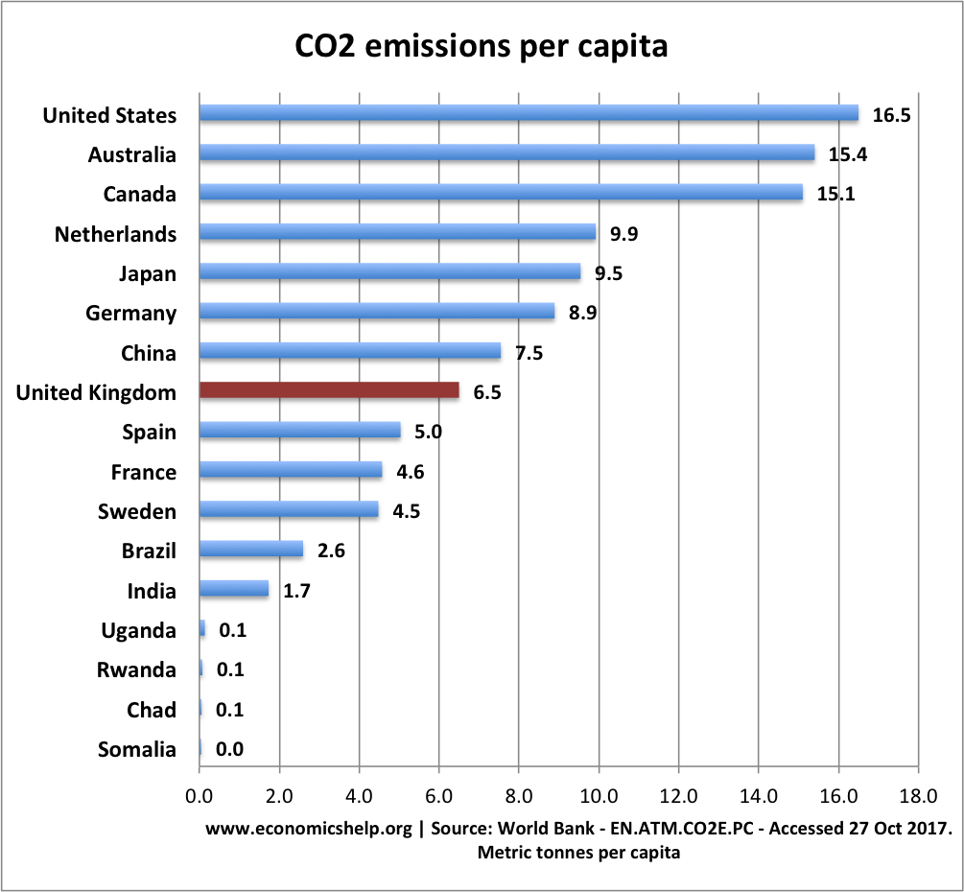
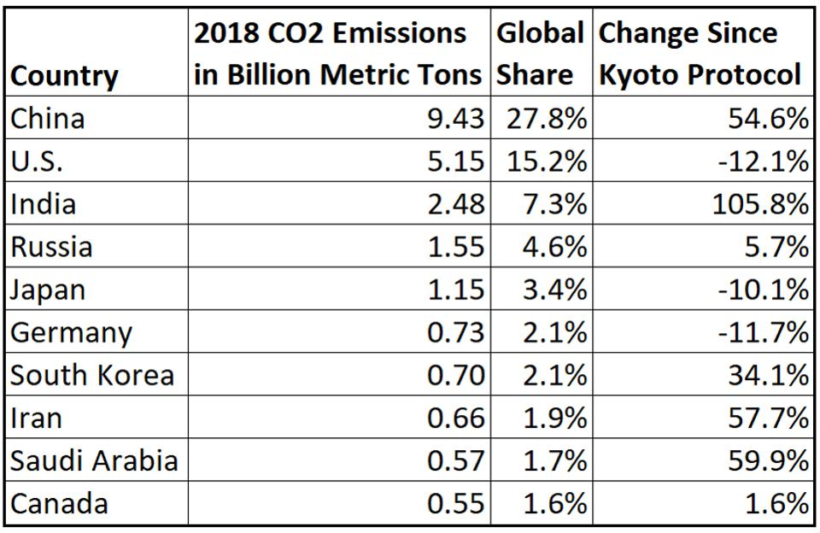
List of top CO₂ emitters
Economicshelp.org
Forbes

Slide 39
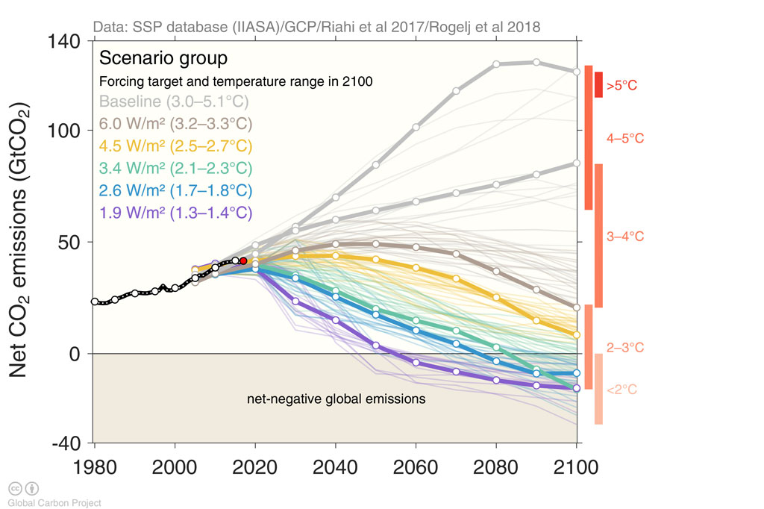
Emissions pathway

Slide 40
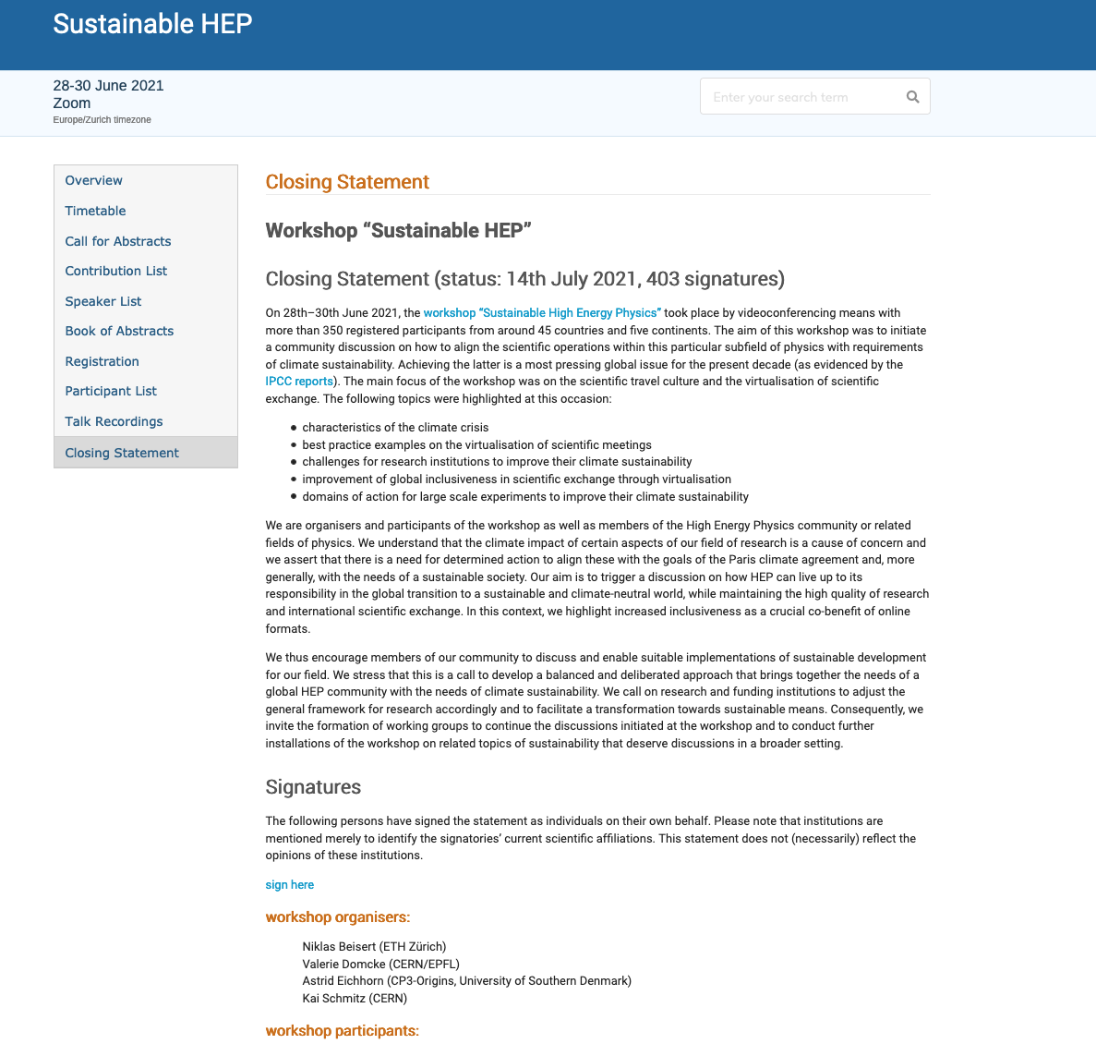
Also: white paper for Australian Astronomy: “The imperative to reduce carbon emissions in astronomy”

