Slide 1
IRIS IAM Update
Status and Current Plans for 2023
Tom Dack,
STFC Scientific Computing
Notes:
The abstract pattern can be removed or repositioned if required. Be careful to ‘Send to Back’ so that it does not obscure any important information.

Slide 2
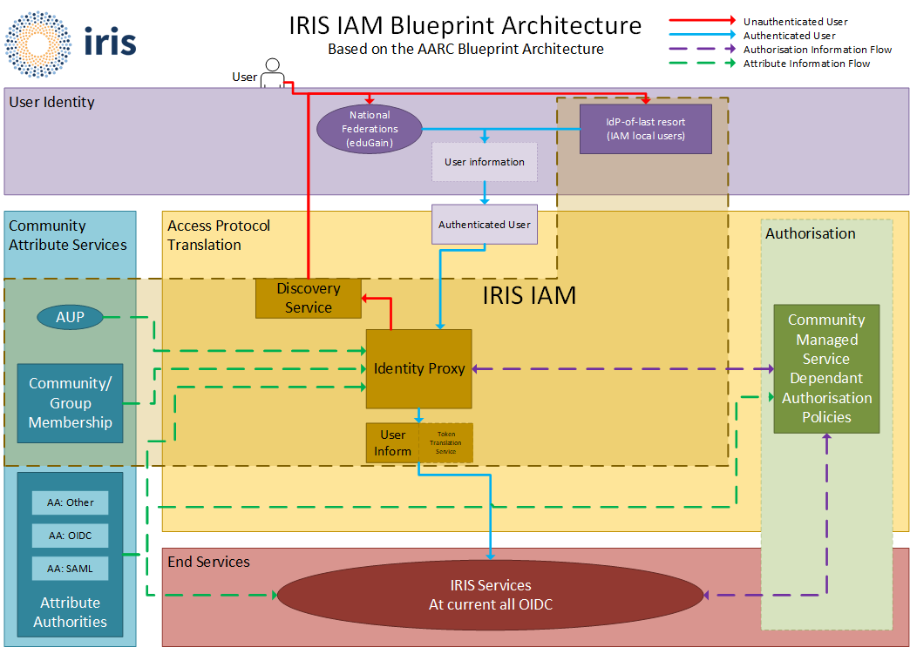
INDIGO IAM and the AARC Blueprint Architecture for Infrastructures
Authentication and Authorisation for Research and Collaboration (AARC)

Slide 3
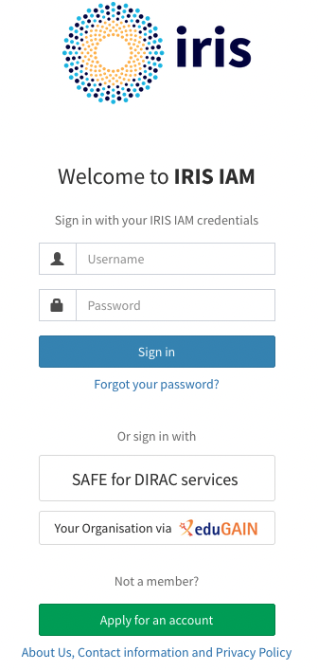
Current Status of the IRIS IAM
Primary authentication and authorization for IRIS services, including Accounting Portals, GocDB, and OpenStack Clouds
Close liaison with IRIS Policy and Trust Framework
Ensure that the IAM follows collaboration polices and policies reflect what is possible
Community policy and risk assessments
PAM module for authenticating with IAM for SSH
Improved operational support
Now managed as part of STFC GridTools on-duty rota, alongside APEL and GocDB

Slide 4
What Next for IRIS IAM?
High Availability – a priority for IRIS
Planned deployment of distributed high availability database – digital asset funding for March to coincide with a STFC graduate placement
Similar work underway within the WLCG context – INDIGO IAM team has development work planned to support, planned for IAM v1.9.0 - https://github.com/indigo-iam/iam/projects/10#card-86093149

Slide 5
What Next for IRIS IAM?
Improved Group Delegation – working with the INDIGO IAM development team to prioritise
Existing implementation allows for delegating approval flow
Would like to delegate full management, on the release schedule for IAM v1.8.1 - https://github.com/indigo-iam/iam/issues/531

Slide 6
Further Goals for 2023
Ongoing recruitment for Software Developer role within GridTools
Time split between IAM, APEL and GocDB
IAM work to drive IRIS priorities for INDIGO IAM development
AAI training resources
Looking to align with IRIS Security training plans

Slide 7
Science and Technology Facilities Council
@STFC_matters
Science and Technology Facilities Council
Notes:
The abstract pattern can be removed or repositioned if required. Be careful to ‘Send to Back’ so that it does not obscure any important information.

