Slide 1
APEL Accounting
Development Plans
Adrian Coveney
IRIS Collaboration Meeting
05 December 2023

Slide 2
Outline
IRIS Accounting Dashboard
Grid Tools Team update
Recent work
Development plans
Other bits

Slide 3
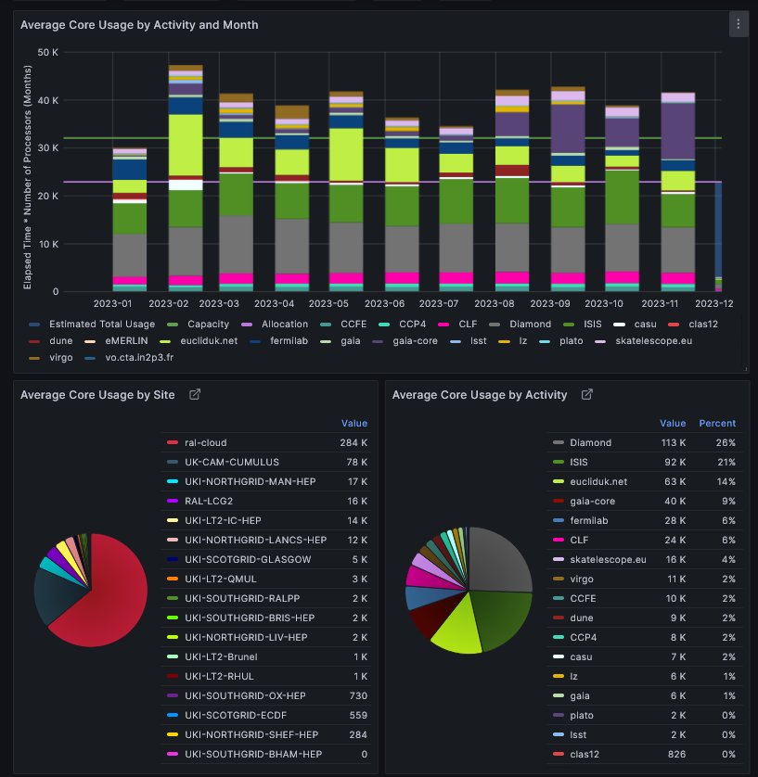
IRIS Accounting Dashboard
Compute resource accounting system for IRIS
Dedicated Accounting Repository using MariaDB with APEL schemas and software, plus an IRIS-specific layer
Bespoke Grafana dashboard to explore the data

Slide 4
Grid Tools Team update
Services we run and develop
APEL accounting
GOCDB topology database
IRIS IAM
We deliver to IRIS and a number of EU and other projects
On-duty rota
Has particularly improved response for IAM requests
New people
Dedicated developer
Graduate trainee (6 months)
New developer starting in January
Apprentice starting in April (6 months)

Slide 5
Recent work
Dashboard developments
Smaller interface and help page improvements
New activities added to Dashboard
Month length fix (to be deployed)
Input from Deniza invaluable in guiding development
Working through list of issues raised (e.g. month length, normalisation)

Slide 6
Development plan
(Very) Basic normalisation
Outline plan agreed for a simple method of normalisation of Providers with a baseline CPU to allow for better (but not perfect) apples to apples comparisons
Will be previewed in the pre-production dashboard early next year for feedback as it will likely significantly change the apparent usage
Just the start of a conversation about benchmarking and normalisation
Cloud GPU and storage space accounting
While there’s been development in the background, nothing yet deployed
Will make a proposal for IRIS effort in this area so we can deploy next year

Slide 7
Other bits
GOCDB
Plan to use GOCDB as the source of truth for who’s publishing for which Provider
Helpdesk
Looking at migration to Atlassian JIRA Service Management for IRIS user support for Grid Tools
Will hopefully overlap with plans for a central IRIS helpdesk

Slide 8
Thank you
GGUS: APEL client & Accounting Repository
Email: apel-admins@stfc.ac.uk

