Slide 1
ARM (and other non-x86 architectures?) @ Glasgow
Sam Skipsey (he/they)
[work mostly by Emanuele Simili, some by Dan Protopopescu + Dwayne Spiteri]

Slide 2
NetZero (“Why Do We Care”)
Capture
NetZero
Offset
Scope-2: Indirect emission of CO₂ due to power used.
Scope-3: (Embodied) CO₂ emitted during the manufacture of hardware.
Reduce Scope-2
Reduce Volume
Reduce Scope-3
Software
Buy Lower Scope-3 HW
Reduce Power
Greener Power
Techniques
Hardware Lifetime
Newer Hardware
Supply Choice
Precision
Hardware Choice
Hardware Choice
Usage Pattern
Usage Pattern
Some of these things are not under direct site control.
Lower PUE
This talk
Benchmark Hardware
Measure Power Use
Life-Cycle Assessment
Carbon Inventory
Carbon Model
Carbon Allocation
(This slide from David Britton’s CHEP plenary)
Measure + Model + Monitor → Moderate

Slide 3
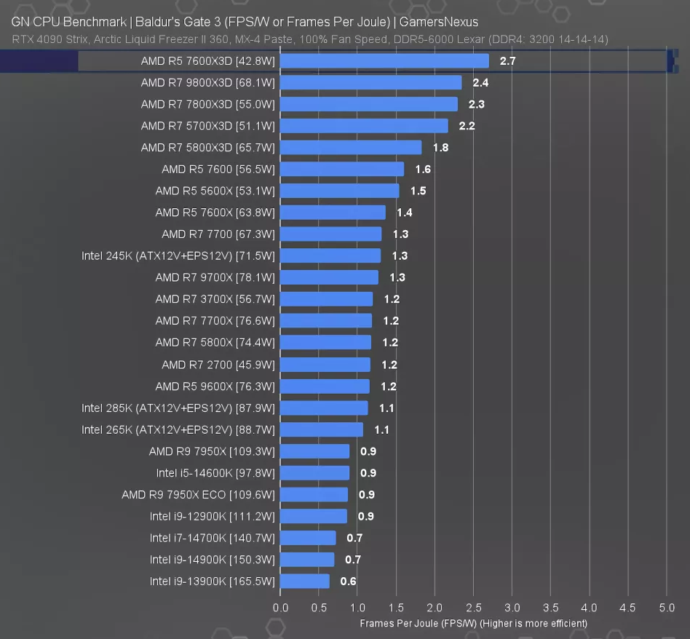
History (2)
GamerNexus comparison of Desktop x86 energy efficiency
(https://gamersnexus.net/cpus/best-cpus-2024-intel-vs-amd-gaming-production-budget-efficiency)
In 2014, CMS and LHCb both looked at ARM as an alternative arch… and found it was more power efficient (but not powerful enough)
In 2020, the first ARM machine entered the top 500, at the top!
(and Apple announced they were switching to ARM for new MacBooks)
Scaling for x86 also slowing (and Intel being comprehensively outperformed by AMD)
Condensed from
David Abdurachmanov et al 2014 J. Phys.: Conf. Ser. 523 012009
Type | (Events/min)/core | (Events/min)/watt
Exynos442 Prime (ARM) | 1.14 | 1.14
Dual Xeon L5520 | 3.50 | 0.23
Dual Xeon E5-2630L | 3.33 | 0.33

Slide 4
Top 500 over time…
ARM

Slide 5
ARM at Glasgow
Technology adoption often requires a “first mover” to invest in a technology sufficiently to allow validation
In 2021, Glasgow began evaluating energy efficiency in its existing and potential CPU estate – led by Emanuele Simili
We also managed to get Ampere Altra test machines for initial evaluation of ARM energy efficiency…
Since then, we’ve invested in significant ARM CPU estate (more later), and continued to evaluate new x86 and ARM CPUs…

Slide 6
Benchmarks + Machines
Node Type | Node CPU
2*Xeon | 2 * Intel XEON 10-Core CPU E5-2630 v4
Milano | AMD EPYC 7643 48-Core Processor
2*Milano+GPU | 2 * AMD EPYC 7443 24-Core Processor + 2* NVIDIA A100 PCIe 80GB
2*Roma | 2 * AMD EPYC 7452 32-Core Processor
2*Milano | 2 * AMD EPYC 7513 32-Core Processor
2*Bergamo | 2 * AMD EPYC 9754 128-Core Processor
2*Genoa | 2 * AMD EPYC 9654 96-Core Processor
Siena | AMD EPYC 8534P 64-Core Processor
Q80 | Ampere Altra Q80-30
Max28 | Ampere Altra Max M128-28
Max30 | Ampere Altra Max M128-30
Grace | NVidia Grace 144-Core 480GB DDR5
AmperOne | AmpereOne 192-Core
2*Q80 | 2 * Ampere Altra Q80-30
Single Benchmark | Threading | Lang
JetReconstruction.jl + FastJet | Single (SIMD) | Julia + C++
Composite Benchmark
HEPSCORE | Multi/whole node | C++, Python

Slide 7
HEPSCORE
HEPSCORE is a composite benchmark, a statistical average of 9 sub-workloads representing “typical” WLCG tasks, across the 4 WLCG experiments.
It is developed by the HEPiX Benchmarking Working Group – see https://arxiv.org/abs/2306.08118 - and is now the official unit for WLCG resource pledges.
We are interested in the Power Efficiency – the HEPSCORE / Watt – which is equivalent to the number of Joules per Event for event-oriented workflows.
We measure the 75-95 quantile average power, as a robust estimation of power consumption under load.

Slide 8
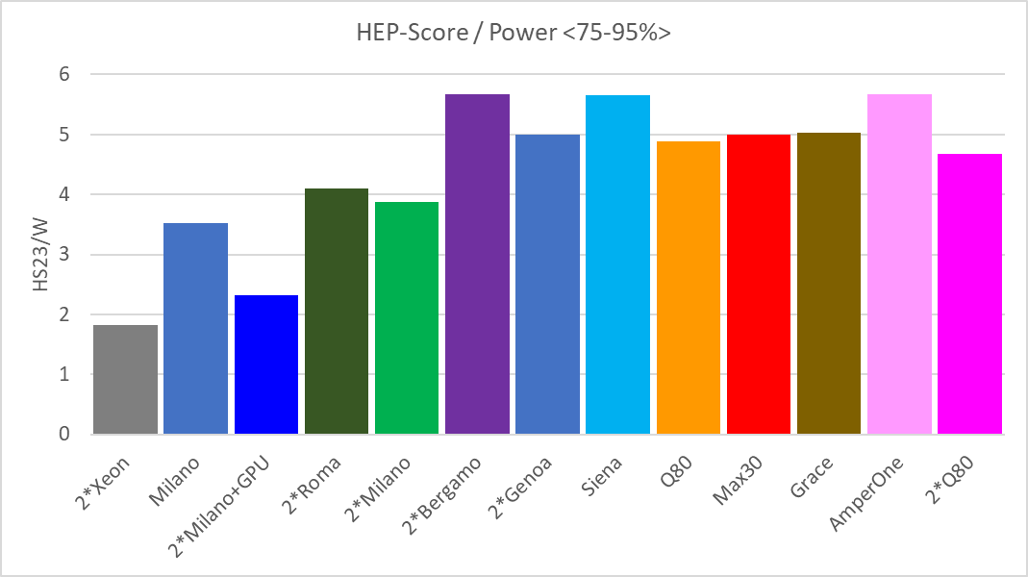
HEPscore/Watt
Using the new FoM (75-95% quantile average), we measure performance per watt as:
New this week,
thanks to BIOS IT
AmpereOne result may be an underestimate – other work suggests large pages (64k) may improve performance further.
We were testing with conventional 4k pages.
2022
2023
2024
2024
2022
2017
2022
2022
2020
2022
2023
2023
2024
*
AMD x86
ARM
Notes:
(*) but, this is not the whole story: each machine runs at its highest frequency (conservative governor), and frequency directly affects power usage.
See next slide !

Slide 9
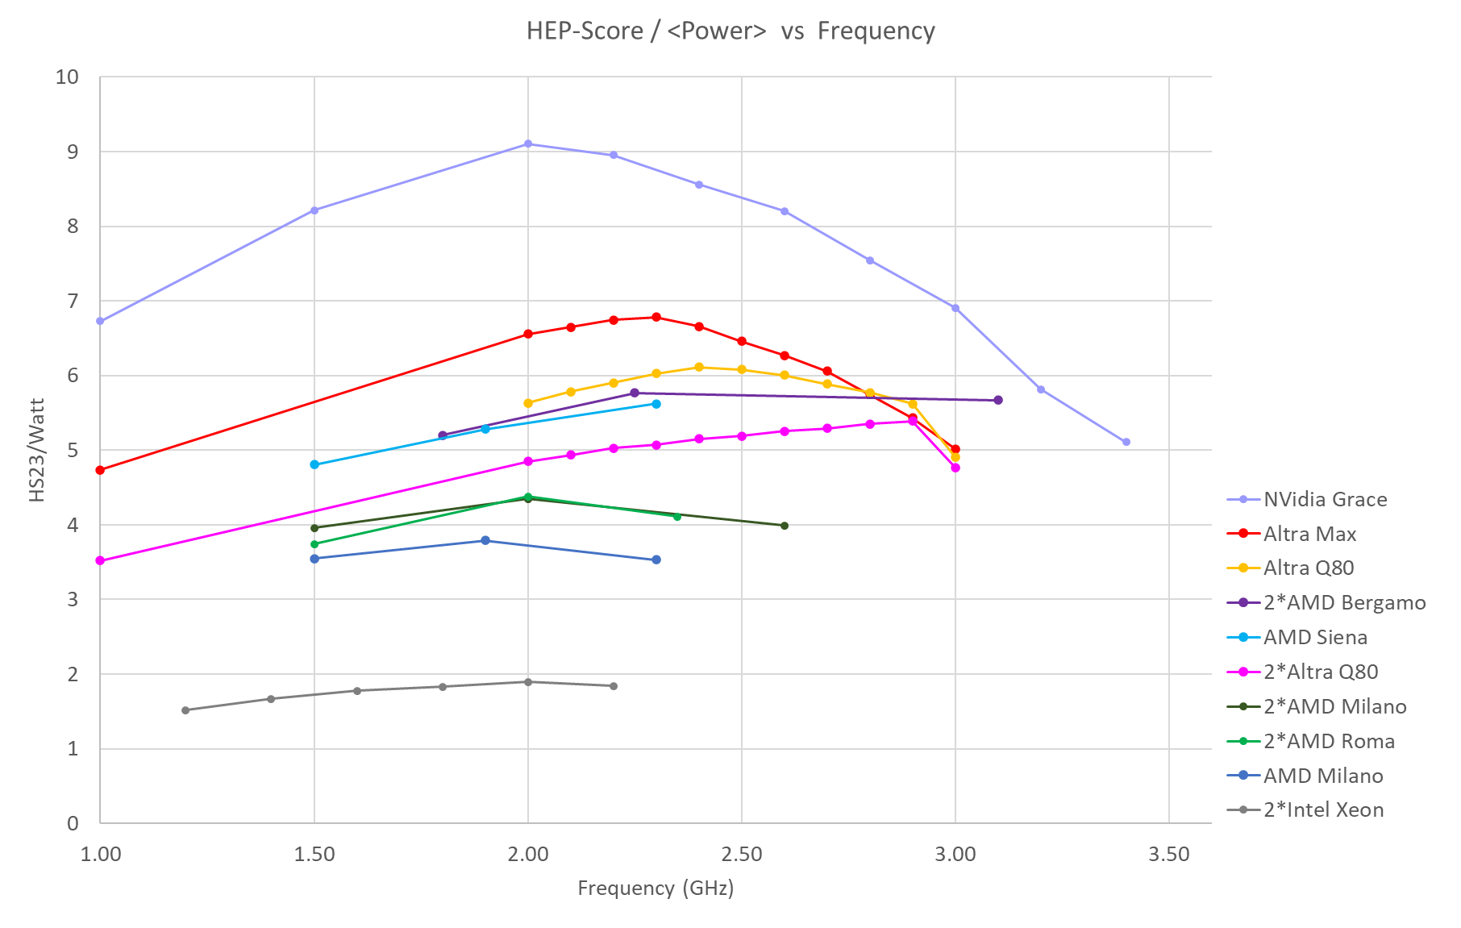
Frequency Scan
CPU power draw is not linear on clock speed.
Underclocking a CPU changes its energy efficiency…
2.80
Notes:
(!) see performance/watt of Max vs Grace …
NOTE: the x coordinate shows the nominal frequency, i.e., the frequency that has been set via ‘cpupower frequency-set’.
This does not always stay constant during the run, especially x86 have a high frequency turbo mode that is switched on/off depending on load.

Slide 10
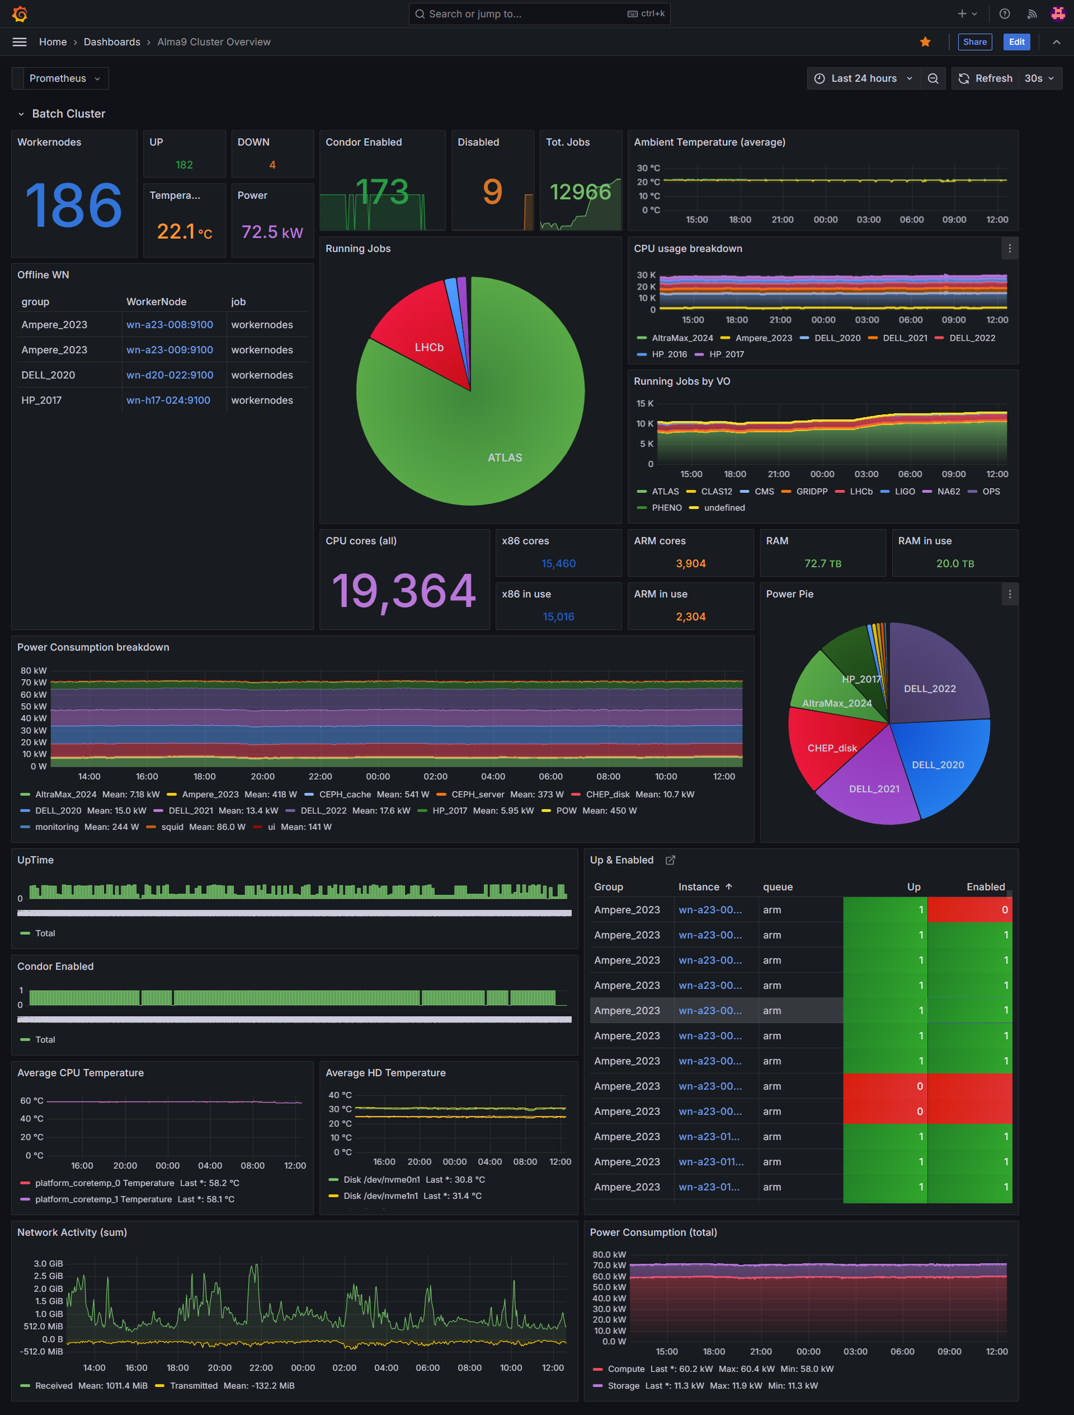
Heterogeneous Compute Cluster @ ScotGrid
We provide ARM resources at the our WLCG Tier2 cluster within our standard ARC-CE endpoints.
~15k cores (ht)
jobs
x86 queue
wn_x86
wn_x86
wn_x86
wn_x86
ce01.gla.scotgrid.ac.uk
wn_x86
wn_x86
wn_x86
wn_x86
ce02.gla.scotgrid.ac.uk
Job manager
wn_x86
ce03.gla.scotgrid.ac.uk
~4k cores
ce04.gla.scotgrid.ac.uk
ARM queue
wn_ARM
wn_ARM
wn_ARM
wn_ARM
wn_ARM
wn_ARM
wn_ARM
At the moment, ARM resources are mainly used by ATLAS… but anyone who wants to use them can submit jobs to the ARM queue.
Please let us know if you are interested!
Notes:
ScotGrid Glasgow Compute Cluster

Slide 11
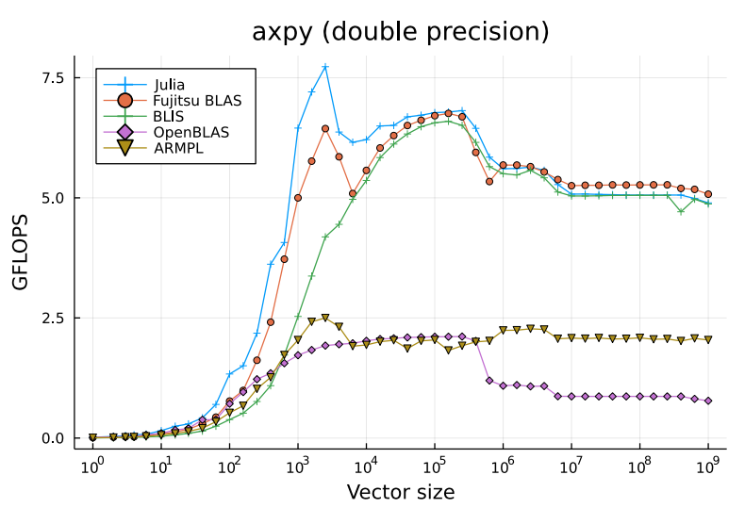
Julia Benchmarks
FastJet is a well-known & optimised “jet clustering” library for HEP, in C++ . It operates on an event – consisting of many (n) trajectories – and provides methods for outputting “jets”, clusters of associated trajectories. This is computationally complex, especially as n increases.
JetReconstruction.jl is an implementation in Julia of (an increasing number) of FastJet’s algorithms, as a demonstrator for Julia as a useful language for HEP.
Partly inspired by
“Productivity meets Performance: Julia on A64FX”
Mosè Giordano, Milan Klöwer, Valentin Churavy
arXiv:2207.12762v1 [cs.DC] 26 Jul 2022
Another Fugaku powered ARM performance paper,
with Julia!
Relative performance of programming languages can change based on architecture – due to differences in the efficiency of their compilers targeting different instruction sets, and due to differences in how well the language itself maps to architectural tradeoffs (for ex. memory ordering models, SIMD width…)

Slide 12
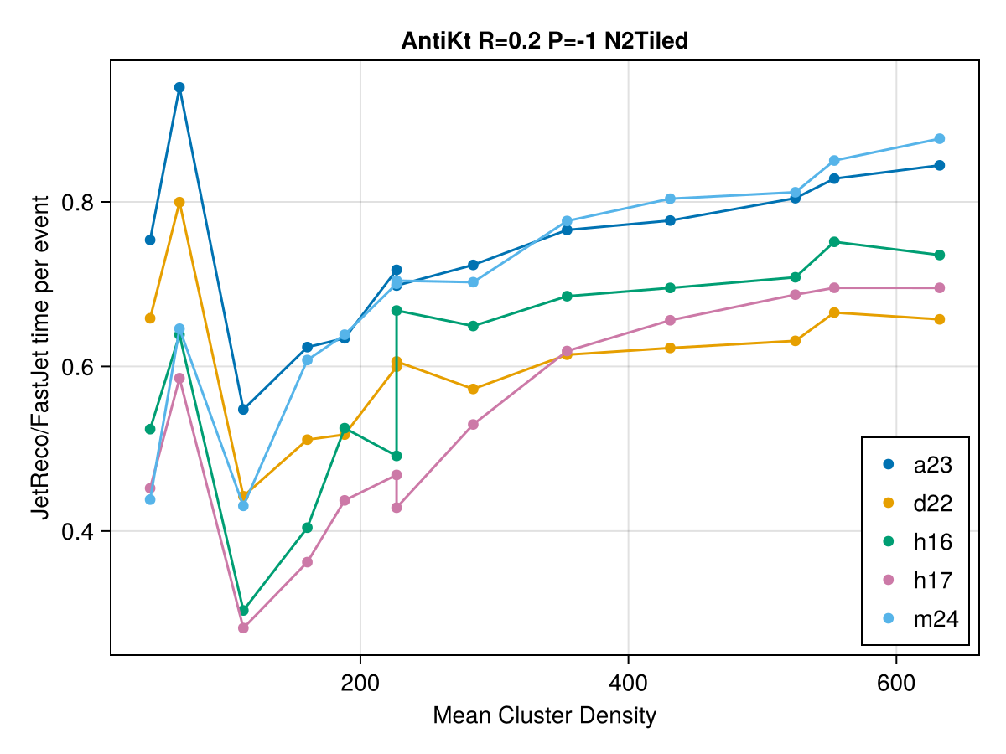
Julia Results
ARM
Julia implementations are faster than C++
On both x86 and ARM
But there are significant differences in the degree…
ARM

Slide 13
The future?
At present, ATLAS allow pledging of 50% of their CPU resources as ARM at a site.
Glasgow has a significant ARM estate – which was also used to validate ATLAS workloads to allow the above.
ARM offerings were initially more energy efficient than (all) x86
Now (AMD) x86 is in a competitive cycle with ARM providers
This is good for us, as there is now pressure on both sides to improve.
We remain interested in any other challengers – RISC-V is not there yet…
…but both China and Europe have interest in developing it as a competitor.

Slide 14
Questions?

Slide 15
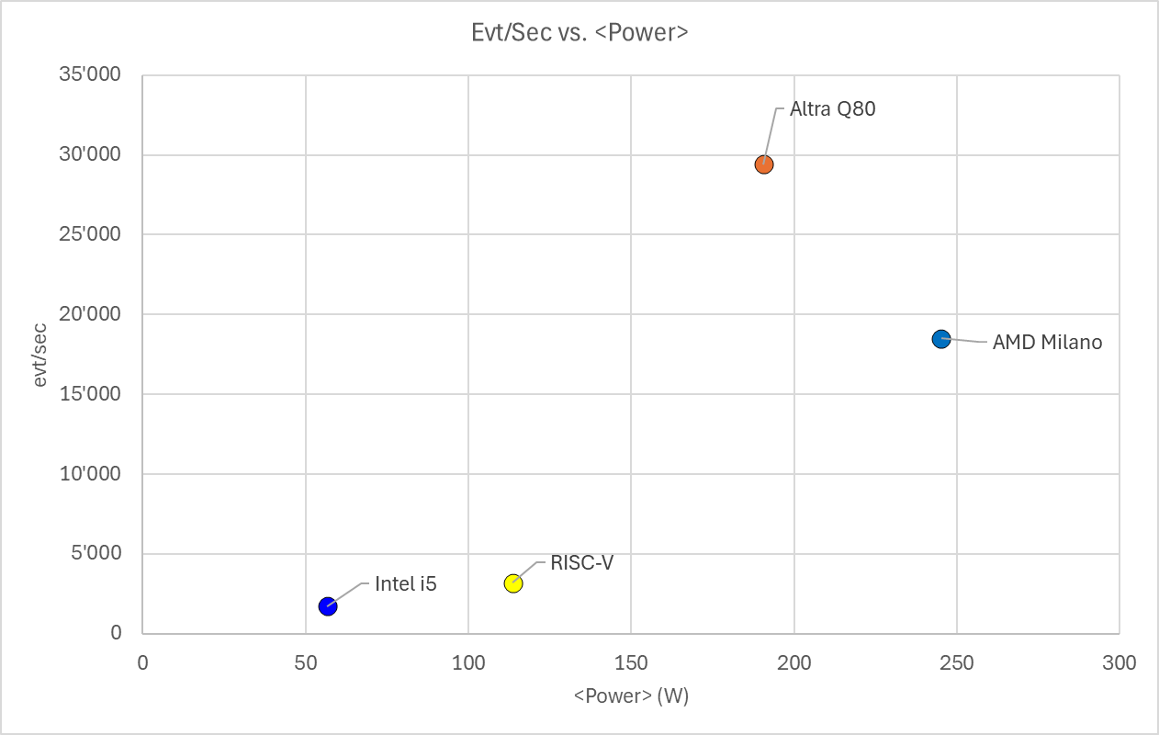
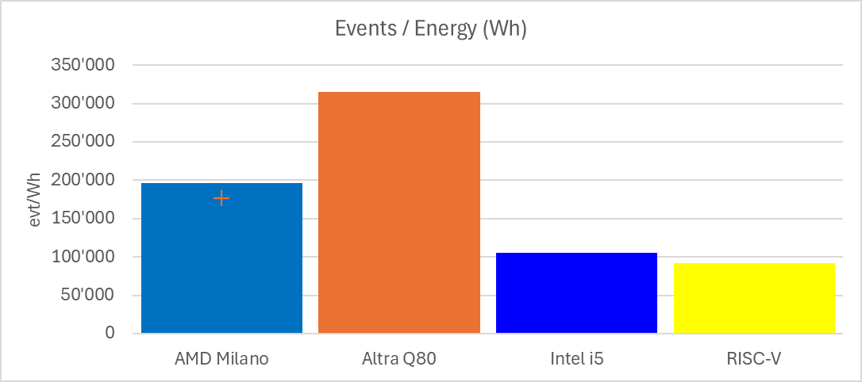
Preliminary look at RISC-V
Milk-V Pioneer
~2.5k € from China
128 GB RAM, 64 cores desktop-class PC
As the standard HEP benchmarks are not available on RISC-V, we used standard Geant4 detector simulation on the RISC-V and other 3 types of hardware (desktop i5, AMD EPYC and ARM Ampere Q80).
Notes:
RISC-V will improve!
Already comparable to a mid-range x86 from 2017
Will soon become comparable with ARM
We wish to have a test-suite ready to follow the evolution …

Slide 16
Questions?

