Slide 1
How Jisc is supporting End to end network monitoring with
on the Janet network
Chris Walker (Jisc)
Duncan Rand, Raul Lopes, Tim Chown (Jisc)
IRIS Collaboration meeting 3rd December 2024

Slide 2
Jisc’s network performance test facilities
Open to our members, and their collaborators, to use
perfSONAR
10G (Slough) and 100G (London)
Mesh and archive
Iperf and ethr
10G - (100G on request)
10G data transfer node (DTN) for application-oriented disk-to-disk tests (100G coming)
All facilities
IPv4/IPv6
Jumbo frames (MTU=9000)
TCP-BBRv3
See https://www.jisc.ac.uk/guides/using-the-janet-network-performance-test-facilities
Email netperf@jisc.ac.uk for any assistance or advice

Slide 3
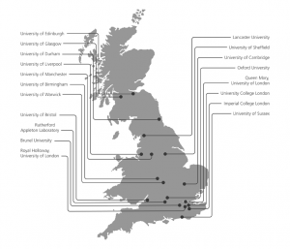
perfSONAR network monitoring
Matrix of tests
Jisc (https://ps-mesh.perf.ja.net/grafana/)
Mesh configuration
Visualisation / archive of results
Bandwidth (automated iperf ~6hrs)
One way Latency
Packet loss
Traceroute

Slide 4
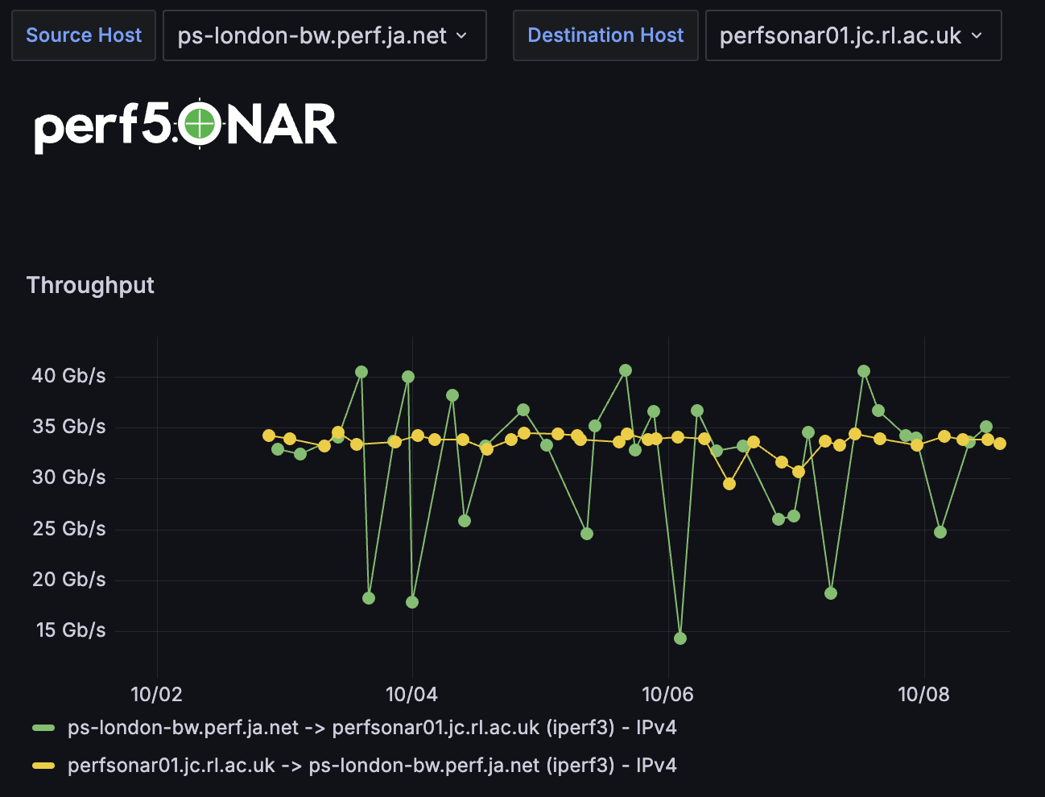
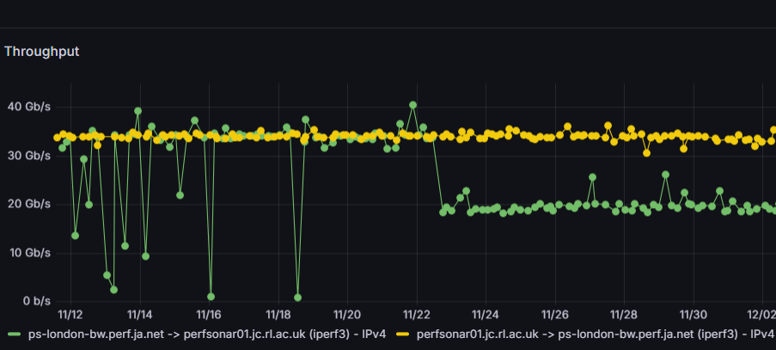
Performance Example 1
ps-london (100G) to a RAL Jasmin/SKA node
See here.
Excellent single stream performance (Top)
RAL -> London steady
London -> RAL less stable
Performance testing (Bottom)
Drop due to testing
Net.core.optmem_max= 1M

Slide 5
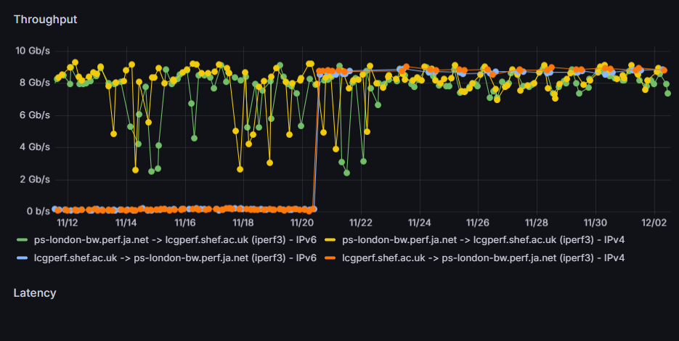
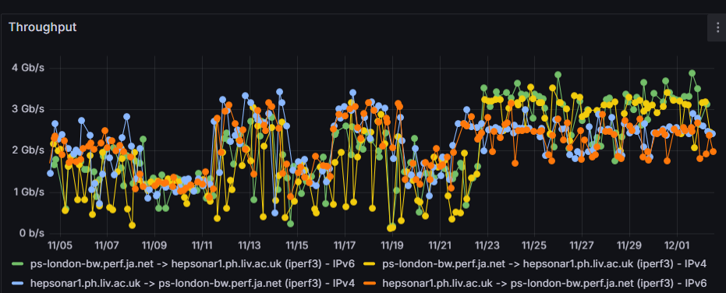
Performance Examples 2
Sheffield
To: 9Gb/s
From: 0.1Gb/s
Issue: Asymm routing
Liverpool
~1-2Gb/s
Issue: Asymm routing

Slide 6
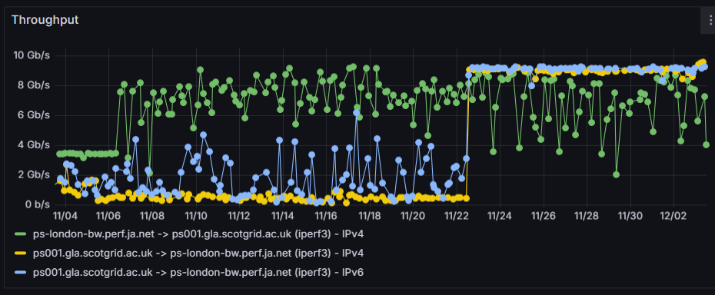
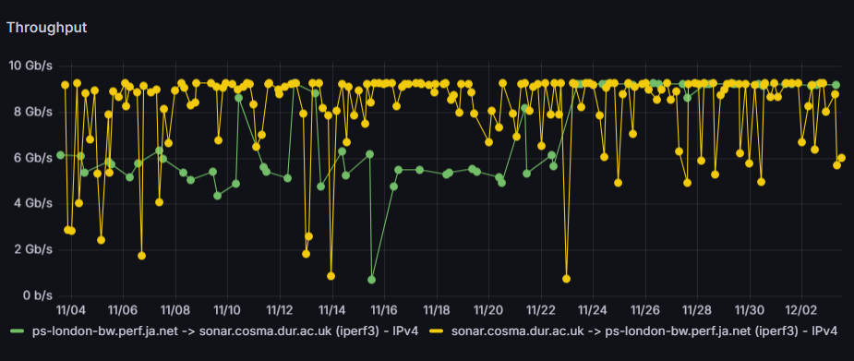
Performance Examples 3
Glasgow
To: good
From bad
Routing
Durham
~10Gb/s
Improvement to with detuning of 100Gbit transmission

Slide 7
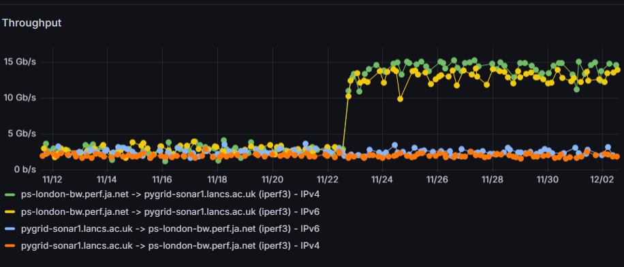
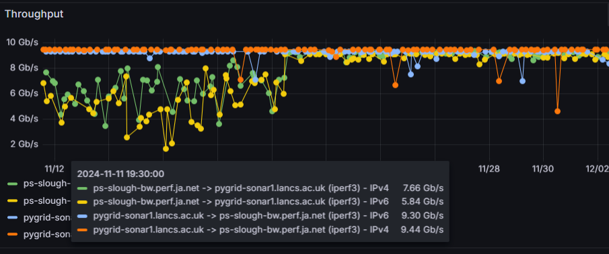
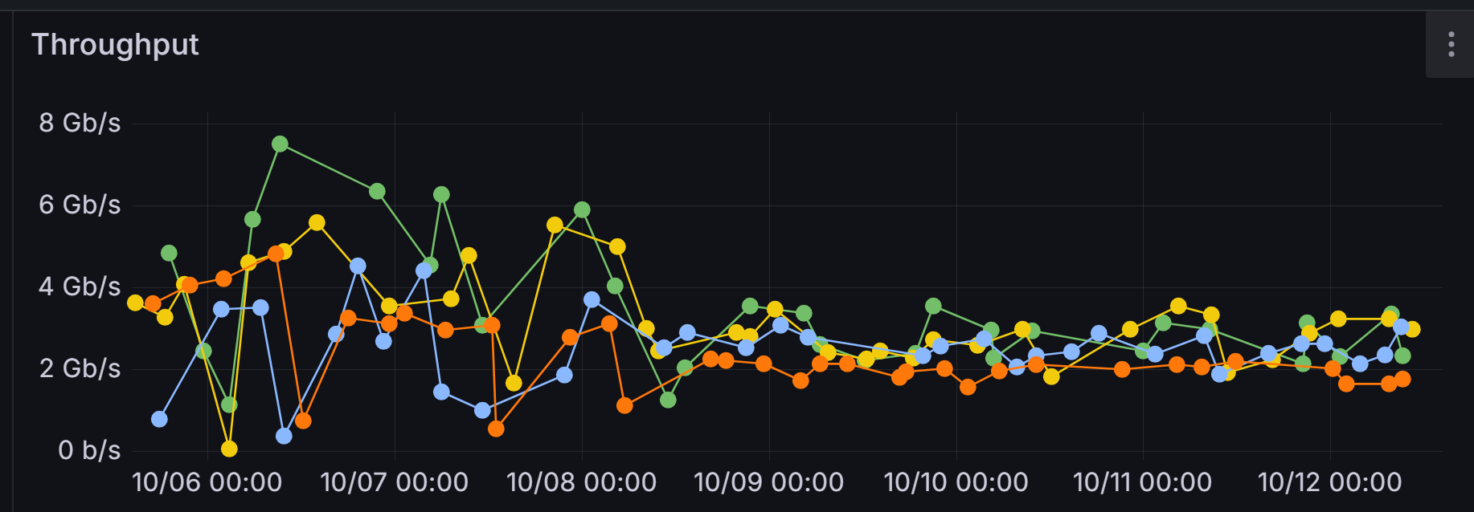
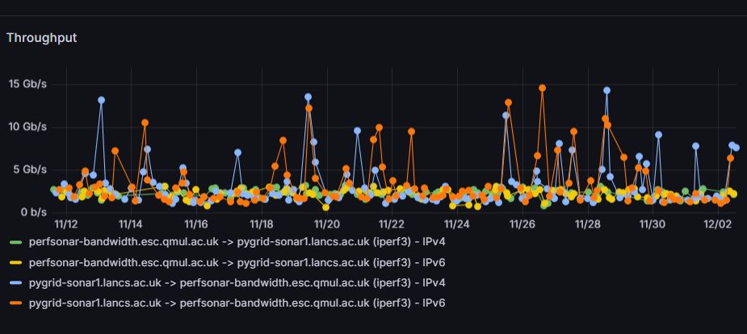
Performance 4
Lancaster
100G link causes performance decrease (below L) but why?
100G Jisc node detuned (Top R) increase 3->15 Gb/s (Top R)
10G Jisc node ~10Gb/s (Mid R)
100G QMUL ~3Gb/s (Bottom R)

Slide 8
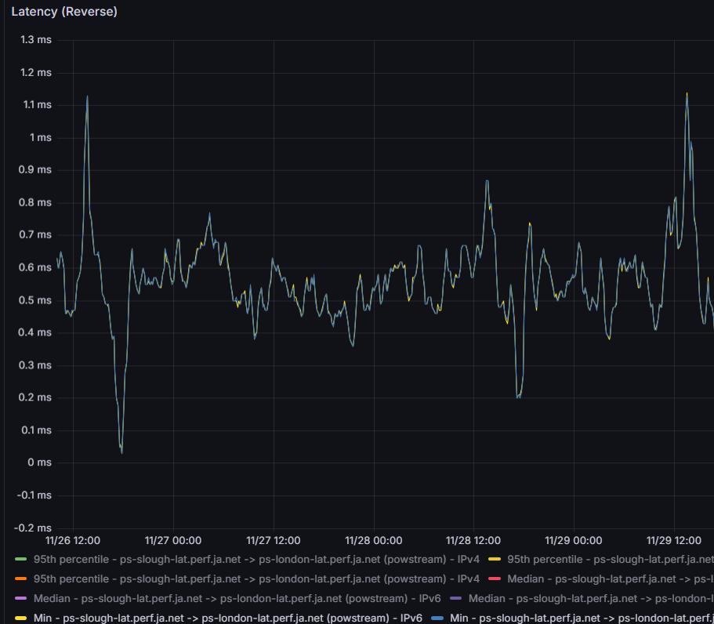
Joining the Jisc Mesh
How?
e-mail netperf@jisc.ac.uk and ask
psconfig remote add https://ds2-london.perf.ja.net/psconfig/ds2-psconfig.json
Why?
Measure network performance end to end.
Facilitates debugging
Found and fixed various issues
Jisc has helped to correct
Asymmetric routing
TCP tuning
IPv6 config, DNS config

Slide 9
Christopher J. Walker
Christopher.Walker@jisc.ac.uk
netperf@jisc.ac.uk

