Slide 1
Sustainable Computing
Prof Jonathan Hays
NetDRIVE Meeting
Queen Mary University of London, 18th February 2025

Slide 2
Sustainable, adj.
Capable of being maintained or continued at a certain level or rate
Computing, n.
The action or practice of using computers, esp, as a professional or expert; the activity operation of an electronic computer
Source: Oxford English Dictionary

Slide 3
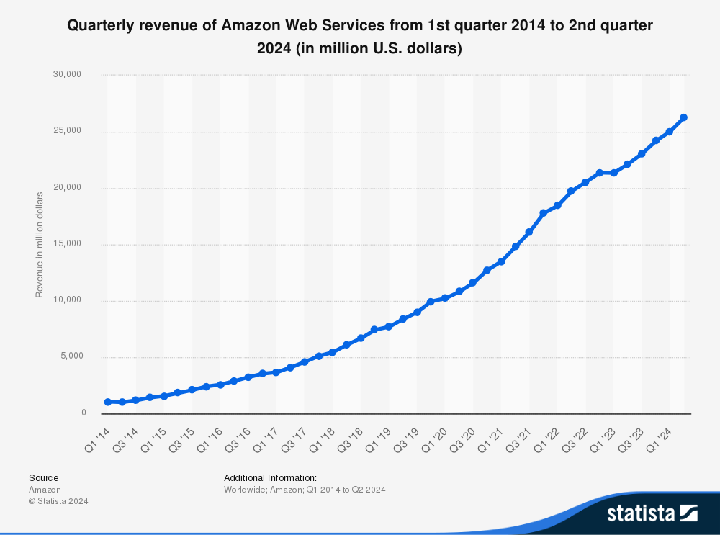
Sustainable, adj.
Capable of being maintained or continued at a certain level or rate

Slide 4
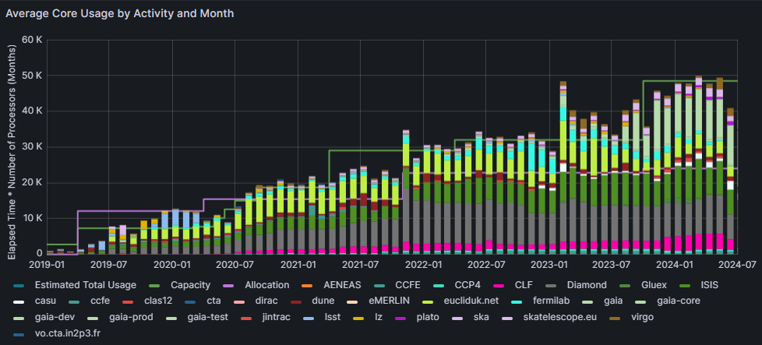
Sustainable, adj.
Capable of being maintained or continued at a certain level or rate
STFC IRIS CPU Usage 2019-2024

Slide 5
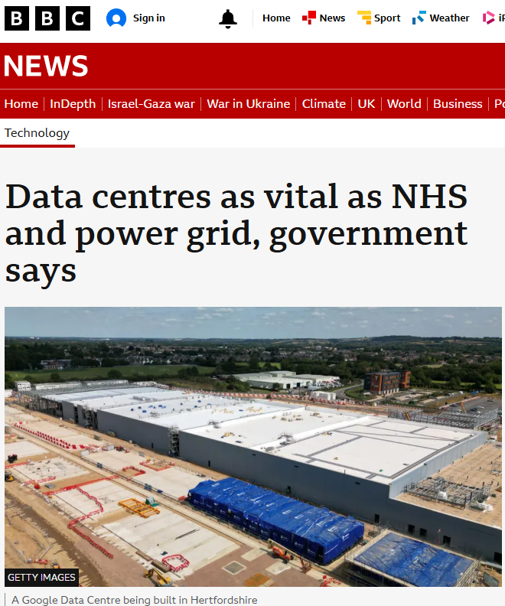
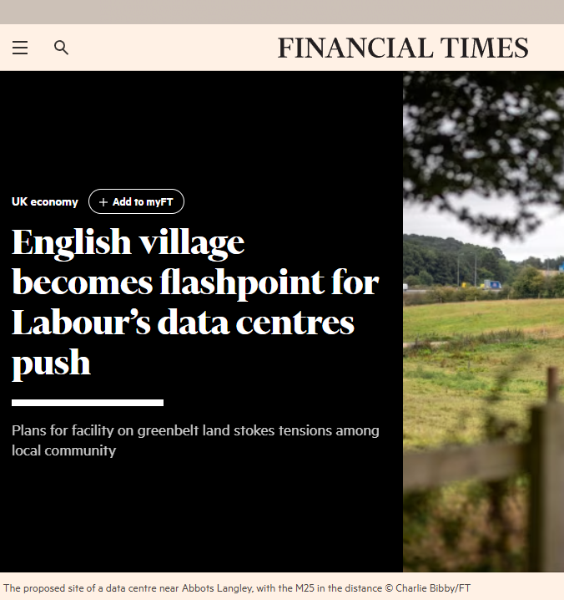
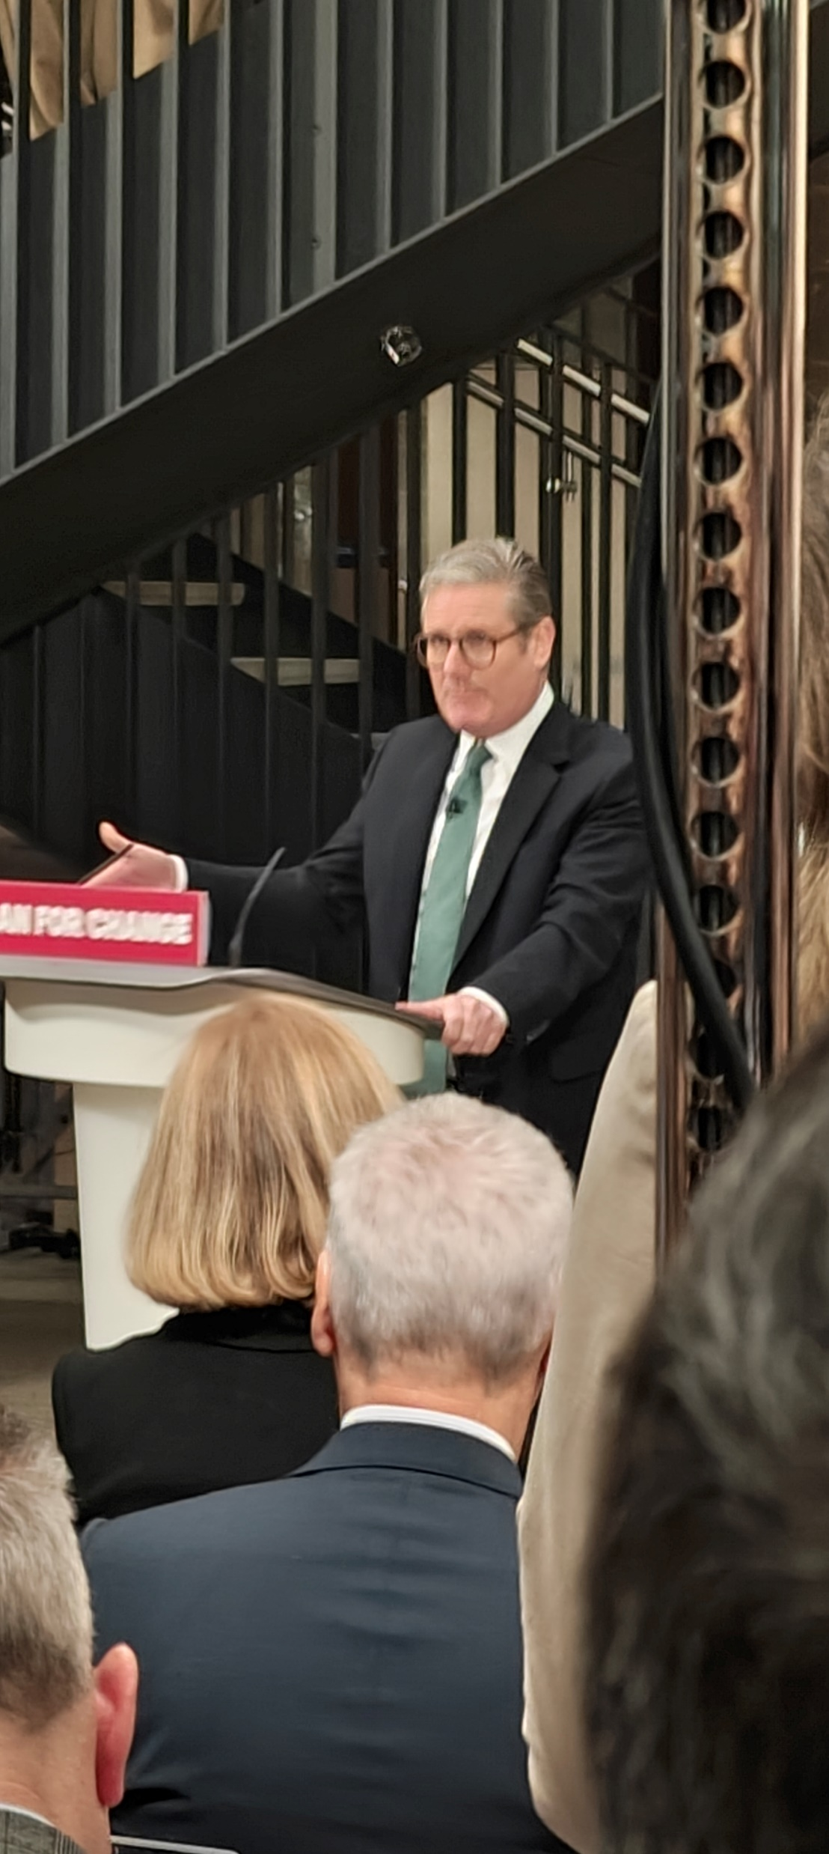
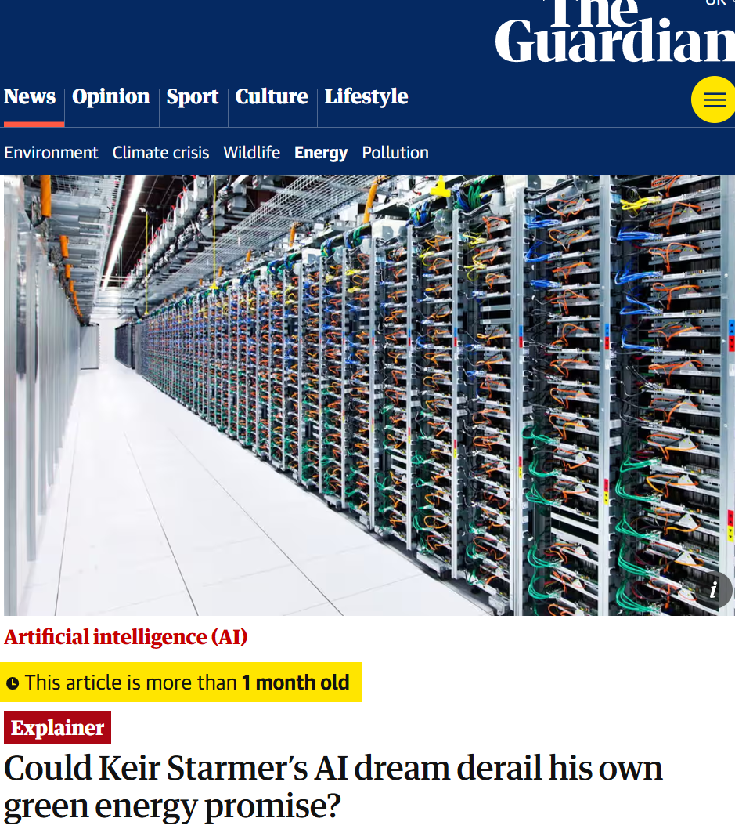
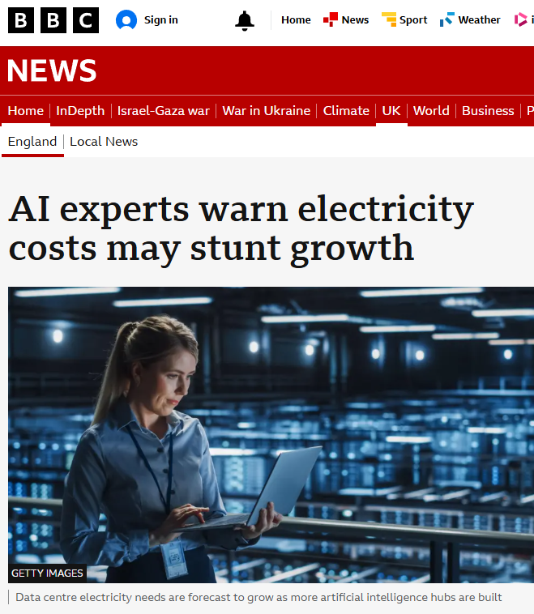
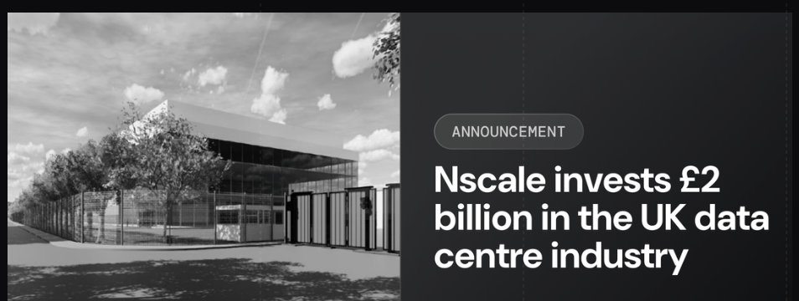
Sustainable, adj.
Capable of being maintained or continued at a certain level or rate
Sustainable?

Slide 6
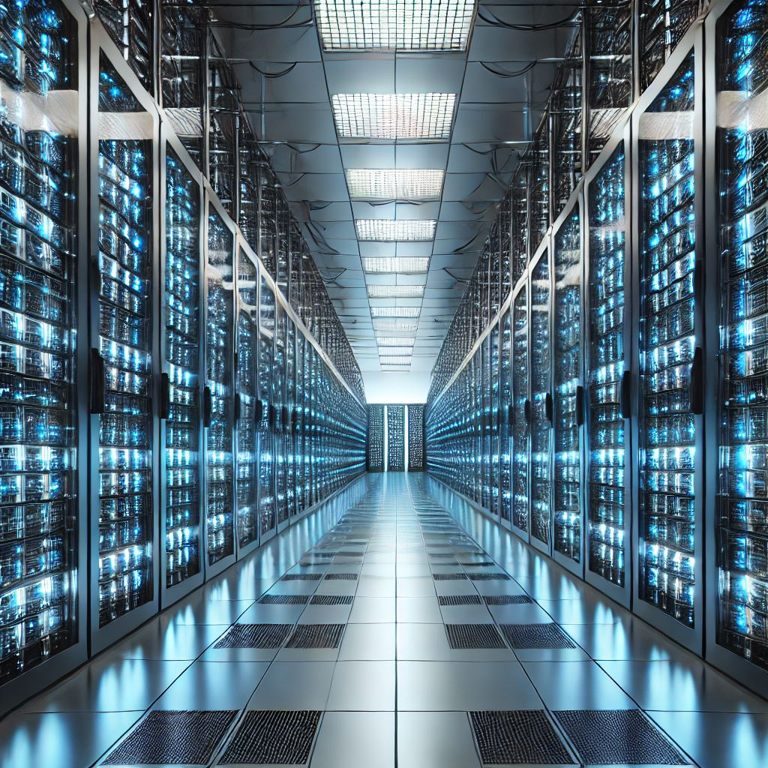
Accelerating demand for compute creates challenges
£
Skills
Power
Carbon emissions
Cost
Water Usage
Waste

Slide 7
Accelerating demand for compute creates challenges
More efficient use of resources
– federation, pooling, mixed-access models, heterogeneous infrastructure
Improved financial modelling and planning
Joined-up approach to funding assessment, award, and oversight
£
Rising demand for compute to achieve science goals
Diminishing improvements in raw compute power over time
Cost

Slide 8
Accelerating demand for compute creates challenges
New technologies
Increasing scale of deployments
New techniques and algorithms
Larger pool of skilled people
Improved incentives and recognition
More training opportunities
Skills

Slide 9
Accelerating demand for compute creates challenges
Increased grid capacity
Grid improvements
Hardware improvements
Renewables
Smart scheduling
More compute
More cooling
Power

Slide 10
Accelerating demand for compute creates challenges
Data centre improvements
Data centre siting
Tightened environmental requirements
Increased cooling requirements
Water abstraction and waste
Water Usage

Slide 11
Accelerating demand for compute creates challenges
Reuse and recycling of systems and components
Increased lifecycles
Reuse and recycling of systems and components
Increased lifecycles
Waste

Slide 12
Accelerating demand for compute creates challenges
Green procurement
Renewable energy
Efficient usage
Improved algorithms
Improved architectures
More hardware
More electricity
More cooling
Carbon emissions

Slide 13
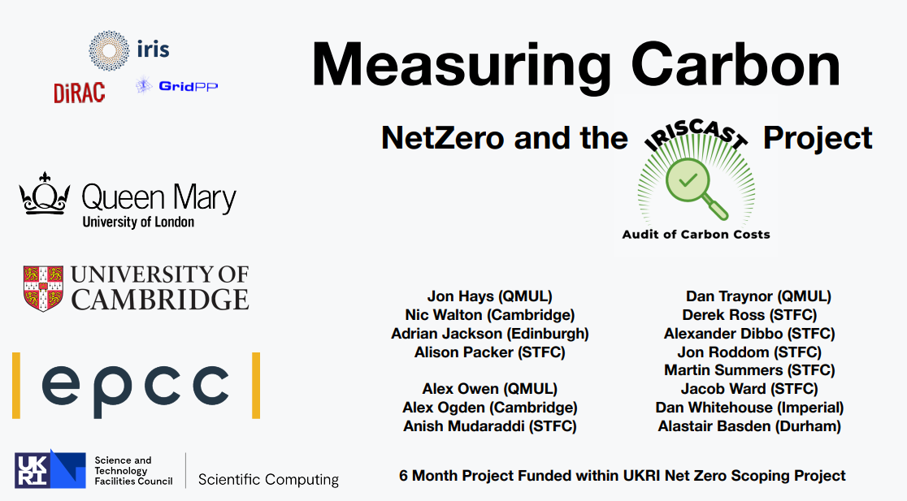
UKRI DRI NetZero: IRISCAST
Attempt to build a picture of carbon “costs” across a distributed set of heterogenous infrastructures
Learn by doing
Document the challenges and gaps to generate requirements and recommendations
https://doi.org/10.5281/zenodo.7692451
https://doi.org/10.5281/zenodo.8199984

Slide 14
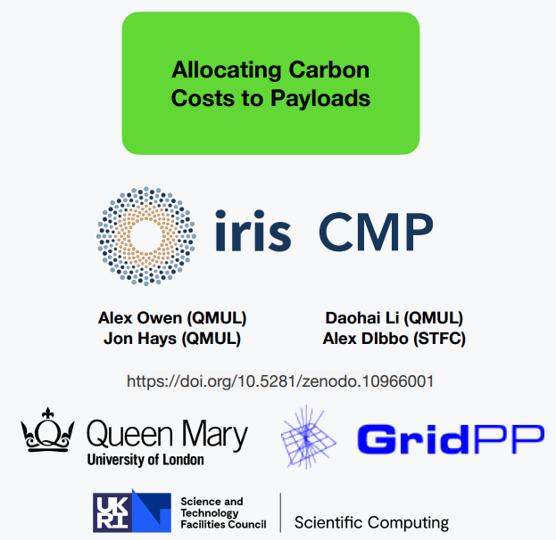
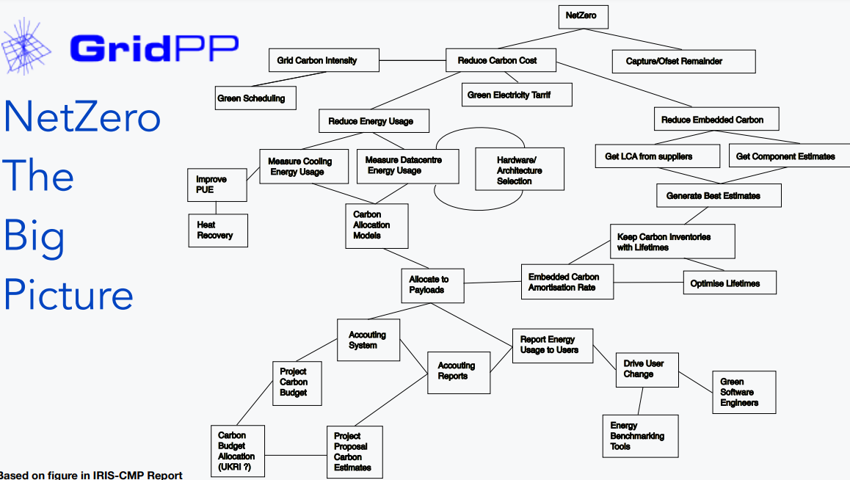
IRIS: IRIS-CMP
Take job level measurements on live systems
Develop and evaluate two simple models of carbon accounting suitable for both grid computing and cloud infrastructures
Key conclusions
Keep it simple
Gather widely – use wisely
Think like an accountant not a scientist!

Slide 15
GridPP: The 4 ‘M’s
Model
Data centre digital twinning
Carbon accounting
Carbon reporting
Alternative architectures
Mitigate
Measure
Monitor
https://indico.cern.ch/event/1297834/contributions/5509064/
https://indico.cern.ch/event/1377701/contributions/5902267/

Slide 16
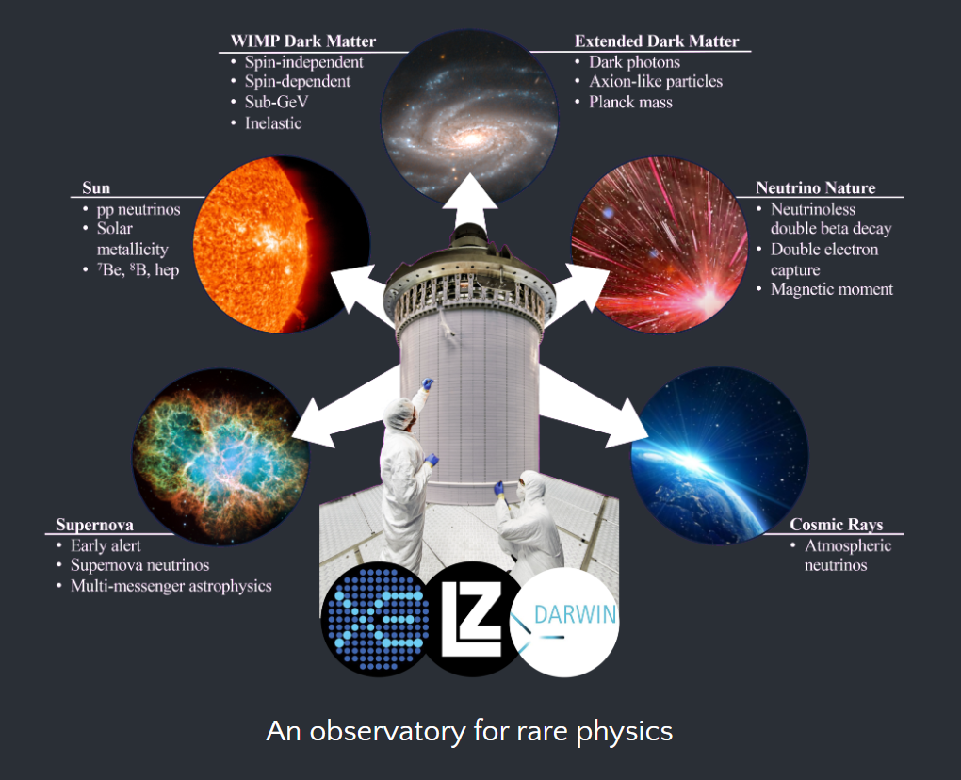
XLZD : Sustainable Dark Matter
UKRI Infrastructure fund preliminary activity
WP8: Environmental Sustainability
Most sustainable experiment possible while achieving our scientific goals
Achieve carbon neutrality in operations
Create a legacy for future experiments

Slide 17
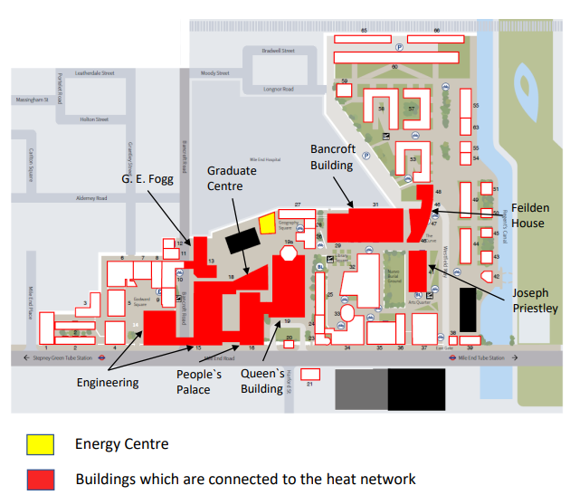
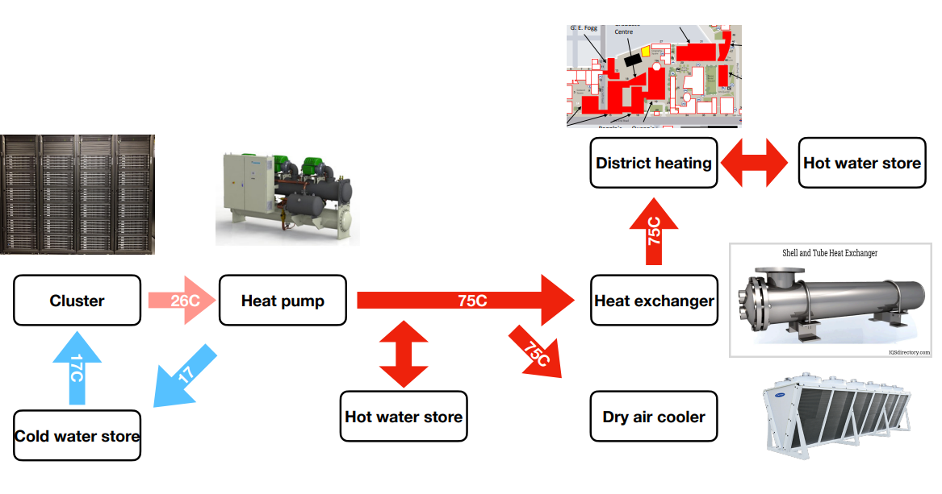
QMUL: Data Centre Upgrade

Slide 18
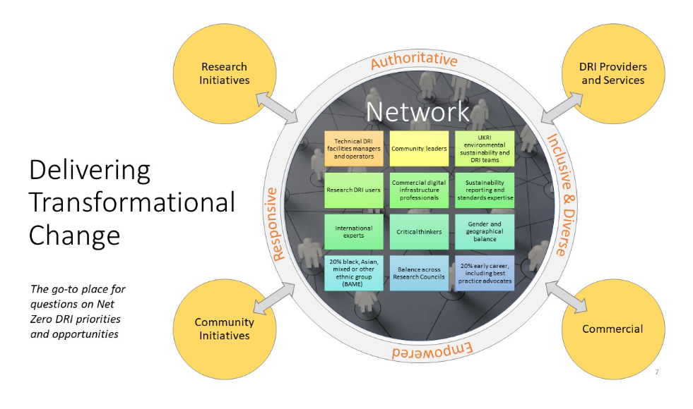
UKRI DRI NetZero: NetDRIVE
The challenges are tough
Change is hard
There’s lots to do
Let’s get on with it!

