Slide 1



Tracking the carbon cost of numerical optimization algorithms
Jess Huntley
Mathematical Research Software Engineer, STFC
jessica.huntley@stfc.ac.uk

Slide 2
Session Outline
Why should we track carbon cost of software?
How can we track carbon?
Adding an energy usage table to FitBenchmarking
Insights and next steps

Slide 3
Why track software carbon emissions?
We are facing a climate emergency
IT sector was estimated to account for 2-6% of global carbon emissions in 2020, could increase to 20% by 2030 [1].
Currently limited information on the carbon cost of computational research

Slide 4
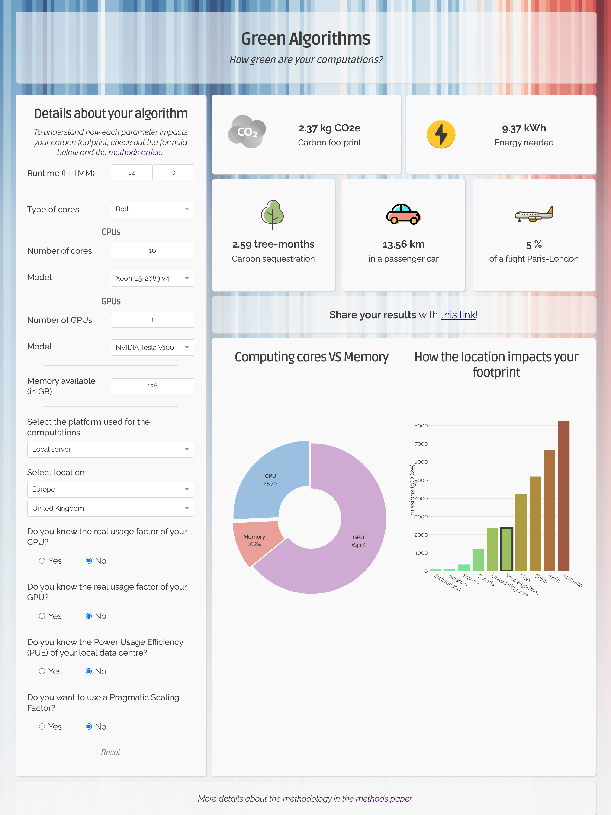


How to track carbon emissions?
[3]
[4]
[2]

Slide 5

FitBenchmarking
Open-source Python package
Compares how different nonlinear least squares solvers perform on various fitting problems.
Supported by ALC funding
  Centre of expertise in scientific software with primary objective of maximising the scientific impact of STFC’s facilities.

Slide 6
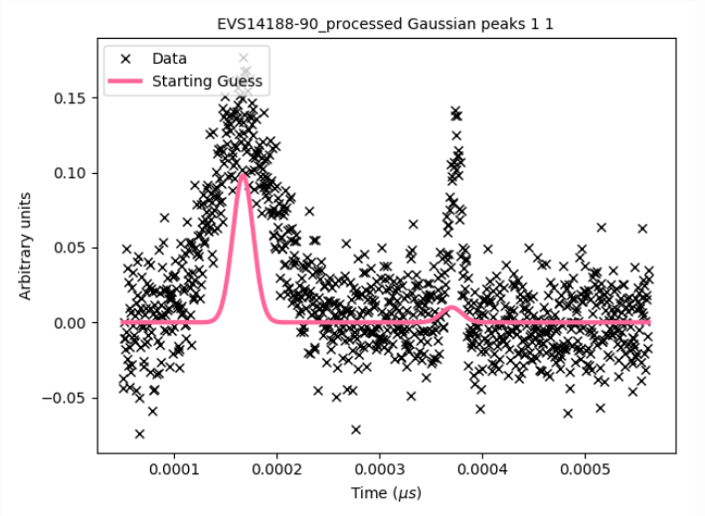
Example workflow

Slide 7
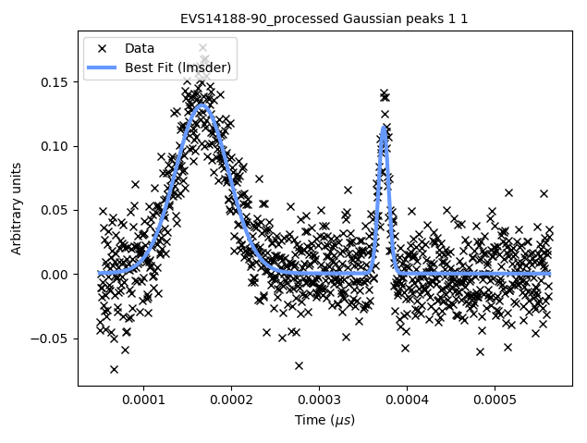
Example workflow

Slide 8
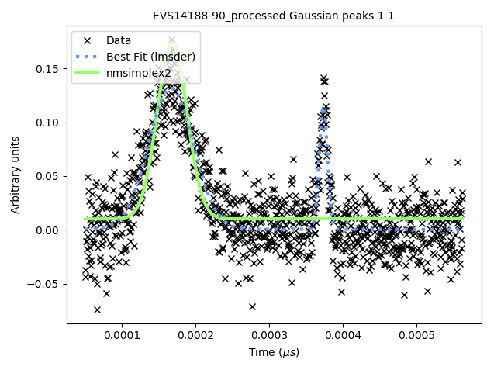
Example workflow

Slide 9
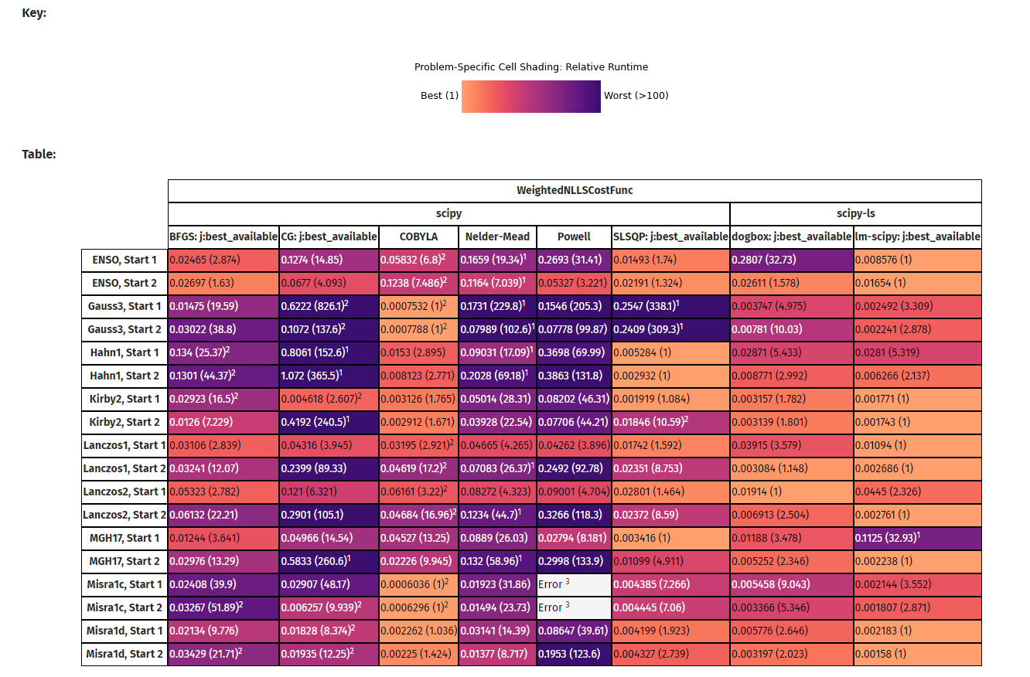
Existing results table metrics

Slide 10
Adding the energy usage table
Used CodeCarbon to embed energy usage tracking into FitBenchmarking – initially reported carbon emissions, but this is not a consistent metric
Only tracking energy usage for call to fitting function – explicit object used but was slow initially…

Slide 11
Implementation Pitfalls
For Windows, obtaining an accurate measurement relies on using a deprecated tool
On Linux, root access required to change permissions of Intel RAPL files
Fallback mode estimates energy usage based on runtime, so not very useful for FitBenchmarking users!

Slide 12
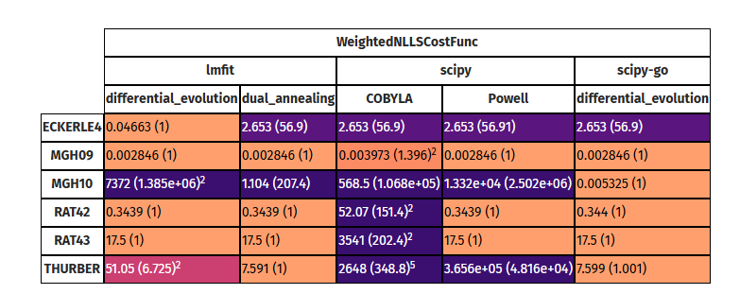
Accuracy

Slide 13
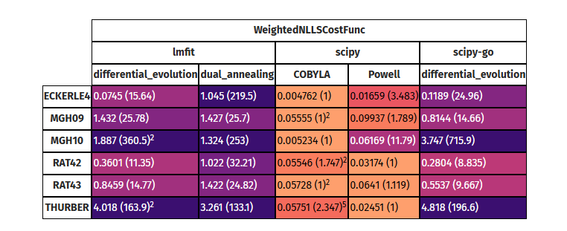
Runtime

Slide 14
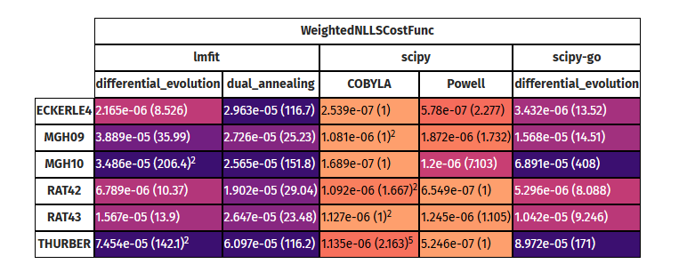
Energy usage

Slide 15
Relationship between energy and runtime
Van Kempen et al [5] claim that energy and runtime are directly proportional – independent of choice of programming language.
One of the contributors to power draw is the number of active cores
  In their experiments, aggressively parallelizing programs was almost always an energy efficient choice.

Slide 16
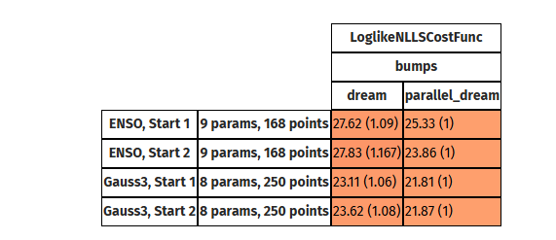
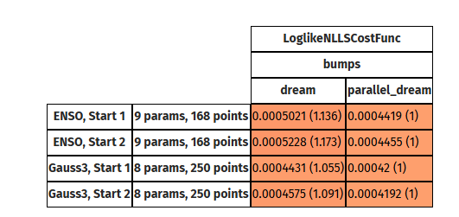
Is running in parallel more efficient?
Runtime
Energy

Slide 17
How does an emissions table help users?
Carbon budgeting
Raise awareness
Motivation for developers to produce more carbon efficient solvers

Slide 18
Next steps
Add examples section to documentation to include case studies
Improve results table outputs so energy usage can be directly compared to other metrics
Investigate trade-off between energy usage and number of cores

Slide 19


jessica.huntley@stfc.ac.uk
scd.stfc.ac.uk
@SciComp_STFC

Slide 20
References
[1] Copenhagen Centre on Energy Efficiency. Greenhouse gas emissions in the ICT sector: Trends and methodologies [Internet]. 2020. Available from: https://c2e2.unepdtu.org/wp-content/uploads/sites/3/2020/03/greenhouse-gas-emissions-in-the-ict-sector.pdf
[2] Lannelongue, L., Grealey, J., Inouye, M., Green Algorithms: Quantifying the Carbon Footprint of Computation. Adv. Sci. 2021, 2100707. https://doi.org/10.1002/advs.202100707
[3] Benoit Courty, ‘mlco2/codecarbon: v2.6.0’. Zenodo, Aug. 09, 2024. doi: 10.5281/zenodo.13286710.
[4] https://www.green-algorithms.org/GA4HPC/
[5] Van Kempen, N. et al. It’s Not Easy Being Green: On the Energy Efficiency of Programming Languages, https://arxiv.org/abs/2410.05460

