Slide 1
ADHD in girls and women across the life span
Jessica Agnew-Blais Queen Mary University London
j.agnew-blais@qmul.ac.uk
Notes:
Today I will talk about

Slide 2
Today
Background on ADHD
Gender and ADHD
ADHD in times of hormonal change
Throughout I will highlight ongoing research being conducted by my lab
Notes:
Today I will start with a bit of background about ADHD, and then discuss gender and ADHD and why it’s important to consider the two looking over the life course. Then I will focus in on ADHD in times of hormonal change for women, which includes puberty, menstruation, pregnancy and the postnatal period and then perimenopause and menopause. Throughout I will highlight some of the ongoing research of my lab at Queen Mary, which recently received funding from the Medical Research Council in the UK to look at these questions.

Slide 3
Background
Inattention:
Easily distracted
Not listening when spoken to
Forgetful in daily activities
Hyperactivity/impulsivity:
Talks excessively
Fidgets with or taps hands or squirms in seat
Unable to play or take part in activities quietly
Results in impairment
Pervasive (occurs in multiple settings)
Notes:
Just briefly, ADHD is characterized by symptoms of inattention, like being easily distracted or not listening, and symptoms of impulsivity/hyperactivity, like fidgeting.

Slide 4
ADHD and neurodiversity
Note on neurodiversity
An extreme of a continuum in the population
ADHD from a neurodiversity perspective:
ADHD symptoms
“…variations in brain structure and function, which lead to ways of thinking and behaving that are different from most people in society... Any impairment experienced by neurodiverse people occurs, not as an intrinsic part of a disorder, but because there is a mismatch between their ways of thinking and behaving and their environments”
Sonuga-Barke & Thapar 2021
Notes:
I want to make a pause here to make a note about ADHD in the context of neurodiversity. Firstly, ADHD isn’t really a binary thing, that some people simply have ADHD and some people dont. ADHD traits lie on a continuum in the population, and people who meet diagnostic criteria for ADHD are those who are on the more extreme end of this continuous spectrum of traits.
And while the word DISORDER is part of the acronym describing this condition, I want to contextualise this from this neurodiversity perspective using a quote from a very nice editorial from Edmund Sonuga Barke and Anita Thapar, who note that ADHD represents variations…So I just want to set this as context and note that when I use the word ADHD or talk about ADHD and impairment, I am thinking of it in this neurodiversity framework.

Slide 5
Gender and ADHD in childhood
ADHD diagnosis has a strong male preponderance
16:1-3:1 male:female gender ratio
At least 2 broad (not mutually exclusive!) explanations:
True higher risk in males (female protective effect)
Underdiagnosis among girls
Young 2020, Novik 2006
Notes:
One very characteristics aspect of ADHD is its strong male preponderance.

Slide 6
Note on language about sex/gender
The vast majority of research on this topic is not-specific about sex vs gender
Some what I will talk about will have to do with sex (i.e. biological) factors, e.g. related to menstrual cycles
Some will be more to do with gender (i.e. social) factors, e.g. cultural expectations about how girls ‘should’ act
My aim is to be as inclusive as possible– when talking about biological processes like the menstrual cycle, I mean all people with menstrual cycles (or menopause, etc).
When talking about gender, I mean people who present as female
Notes:
But first I just want to make another note on language here… the vaaaaast majority of research on gender and ADHD does not distinguish between sex and gender.
Some of what I will talk about today will have to do with sex, so biological sex and here im talking about processes related to hormones for example like menstrual cycles

Slide 7
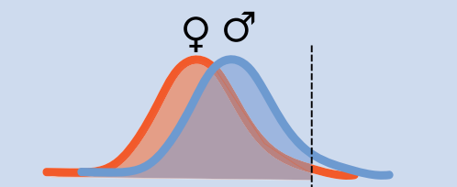
Is ADHD more prevalent in boys?
Female protective effect:
Hypothesizes that female individuals are resilient to developing ADHD
If this were the case:
Girls with ADHD undergo greater exposure to etiological factors than males in order to develop ADHD
Require a higher burden of risk factors to develop ADHD
Liability to ADHD
Wigdor 2022
Notes:
The female protective effect hypotheszes that basically, women are more resilient to developing ADHD

Slide 8
Female protective effect?
Supportive evidence
↑ risk of ADHD in 1st degree relatives of girls/women with ADHD compared with males
i.e. families of affected girls have a genetic burden
Contradictory evidence
Not all studies find ↑ risk of ADHD in 1st degree relatives of affected female individuals compared with affected males
Study in large (n>50k) cohort in Sweden found no higher ADHD polygenic risk score amongst girls vs boys with ADHD
Rutter 2003, Martin 2018

Slide 9
Underdiagnosis in girls
Gender ratio varies from 16:1 in some clinical cohorts to 3:1-2:1 in population-based cohorts
This difference in clinical sex ratio and population-based cohorts suggests referral bias
→ Girls are being missed
Young 2020, Novik 2006

Slide 10
Underdiagnosis in girls
Historical bias of ADHD as a disorder affecting boys among clinicians, teachers and parents
Clinicians
Parents & teachers
Study presenting clinical vignettes with identical behaviours but the gender of the patient varying
Clinicians 2x more likely to diagnose boys than girls based on identical clinical information (Bruchmuller 2012)
Evidence parents and teachers rate boys as more hyperactive even when objective indicators rated them similarly
Study used the Classroom Observation Code used to rate ADHD behaviours by blinded classroom assessors
Parent & teacher ratings significantly higher for males than females even when ratings by assessor did not differ by sex (Meyer 2020)

Slide 11
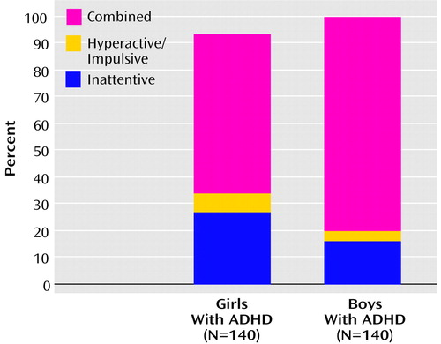
Underdiagnosis among girls
Many (not all) studies find girls are more likely to have predominantly inattentive versus hyperactive symptoms
Teachers less likely to raise as a potential problem inattention symptoms vs combined type ADHD
Teachers particularly important as they may initiate referral for diagnosis raising concerns about a child’s behaviour
Biederman 2002, Moldavsky 2012, Sayal 2006

Slide 12
Underdiagnosis among girls
ADHD symptom description reflects more “male” behaviours
Many early studies of ADHD that helped establish the ADHD criteria included all boys or had extremely small female subsamples
DSM-IV criteria for ADHD are based primarily on observations of males and the DSM-5 field studies included a greater percentage of males
Thus, the ADHD symptom description may itself be biases towards a more “male” presentation
E.g. physical overactivity vs excessive talkativeness
Lahey 1994, Barkley 2002, Clarke 2013, Mowlem 2019

Slide 13
Underdiagnosis among girls
Some studies find girls with ADHD are less likely to exhibit co-morbid disruptive behaviours (Gaub 1997)
Boys more likely to have comorbid conduct disorder
Boys exhibiting higher levels of externalizing behaviour
More recent findings on this are inconsistent:
Several studies (Graetz 2005, Levy 2005, Bauermeister 2007) find no difference in the rates of disruptive disorders between girls and boys

Slide 14
Underdiagnosis among girls
Girls more likely to exhibit ‘prosocial’ behaviour
Study comparing boys and girls who met diagnostic criteria for ADHD to those with high levels of ADHD symptoms, but no ADHD diagnosis
What other elements (impairment, other behavioural problems) associated with diagnosis?
In the presence of positive social behaviour, girls’ symptoms may be ‘masked’ making them appear less impaired, which could reduce the likelihood of girls with ADHD symptoms being referred
Mowlem 2019
Notes:
There is also the possibility that girls are less likely to be diagnoses due to their exhibiting more “prosocial” behaviour

Slide 15
Implications of underdiagnosis among girls
Women diagnosed at later ages
Incidence peaked earlier in boys than girls in ADHD (8 vs 17 years of age)
Already have more comorbidities:
Study from Stockholm finds women presenting with ADHD have significantly more comorbid anxiety, mood and substance use disorders compared to men
Anecdotally, this is something women talked about a lot
Receiving diagnosis of anxiety, depression, etc prior to ADHD diagnosis in adulthood
Feeling derailed in their lives, especially around schooling, due to missed diagnosis in childhood
“I think of how much I could have done if it had been caught earlier”
Dalsgaard 2019, Skoglund 2023

Slide 16
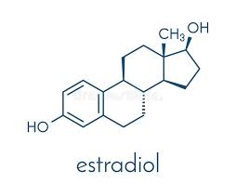
Sex hormones and ADHD
Aim 2: “As I Hit Puberty, It All Came Melting Down“
Because of this historical under-recognition of ADHD in girls and women, female-specific factors have been under-researched
Strong biological rationale linking estrogen and ADHD:
Dopamine a key neurotransmitter associated with ADHD
Stimulant medication acts by reducing dopamine reuptake
Estrogen can affect dopamine availability
Overall estrogen appears to have a facilitating effect on dopaminergic neurotransmission
Drops in estrogen (e.g. premenstrually) could result in lower dopamine availability
Much of this research comes from animal models (rats)
Barth et al 2015
Notes:
Estrogen plays a role in dopamine availability:
When levels of estrogen drop (premenstrually), dopamine becomes less available
ADHD has been linked to dopamine dysfunction
Blocking dopamine reuptake is a central mechanism of action of stimulant medication

Slide 17
Hormonal change and ADHD

Slide 18
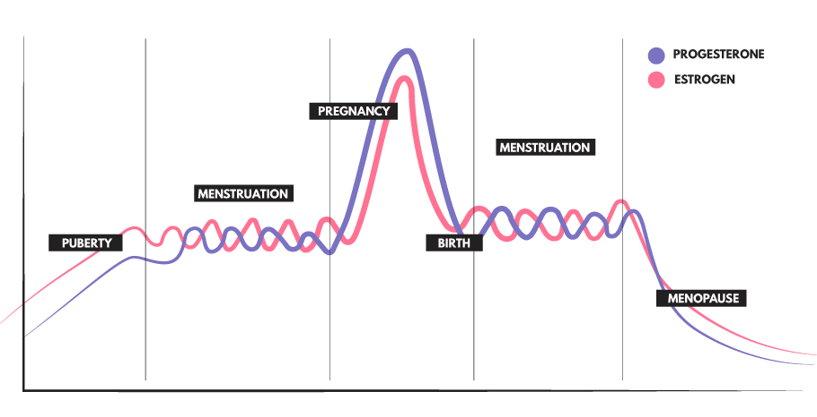
Puberty
“As I hit puberty, it all came melting down”
Notes:
With that in mind, we can go through the evidence on ADHD and these different times of hormonal transition.
I really became interested in this topic based on what women we’re talking about, so I will begin each section with a For each, I will start each a quote from women with ADHD who I interviewed in design my new research.
So one woman said, in thinking back on her life, as I hit puberty, it all came melting down

Slide 19
Puberty
Aim 2: “As I Hit Puberty, It All Came Melting Down“
Time of significant hormonal change
Increase in estradiol, which is responsible for developing secondary sexual characteristics
Time of significant neurological change
The structure of the prefrontal cortex undergoes significant development
Time of significant educational, social and emotional change
Notes:
Puberty is a time of transition in many areas of life, characterized by significant hormonal changes as the rise in gonadotropins stimulates the ovaries to produce estradiol, which is responsible for developing secondary sexual characteristics.
It is also a time of significant neurological change, as the structure of the prefrontal cortex in particular is undergoing significant development.
It is also a time of significant educational, social and emotional change.
And of course these things are interlinked processes

Slide 20
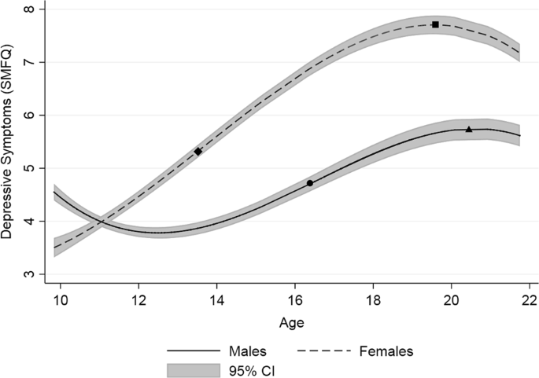
Adolescence and mental health
Aim 2: “As I Hit Puberty, It All Came Melting Down“
Puberty is associated with onset of mental health problems in girls, especially depression:
In childhood, the prevalence of depression is similar in boys and girls but around the age of 12-13, incidence increases sharply in females
Millennium cohort study find by age 14, 1 in 4 girls have high levels of depressive symptoms
Compared to 1 in 9 boys, despite similar levels at age 11
Hankin 1998, Patalay 2017, Kwong 2019
Notes:
Many studies have found that puberty is associated with onset of mental health problems in girls, especially evident for depression
In childhood, the prevalence of depression is similar in boys and girls, but around age 12, the incidence in girls sharply increases, and will remain much higher for girls and women for many years
This increase is so stark that the Millennium cohort study in the UK finds that by age 14, 1 in 4 grils have high levels of depressive symptoms, compared to 1 in 9 boys, despite levels being similar at age 11.
So this points to puberty as a really high risk period for poor mental health for girls

Slide 21
Adolescence and ADHD
Why do we think adolescence might be particularly important for girls and ADHD?
In childhood, ADHD diagnosis has a strong male preponderance
16:1-3:1 male:female gender ratio
By adulthood, the gender ratio equalizes, and ADHD diagnoses are 50% male, 50% female
Puberty/adolescence may represent a key transition point in ADHD among girls
Hinshaw et al 2022
Notes:
Why do we think adolescence might be a particularly important time for ADHD symptoms in girl
That persistence is not associated with gender is also

Slide 22
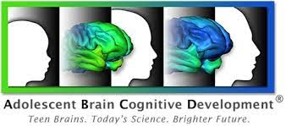
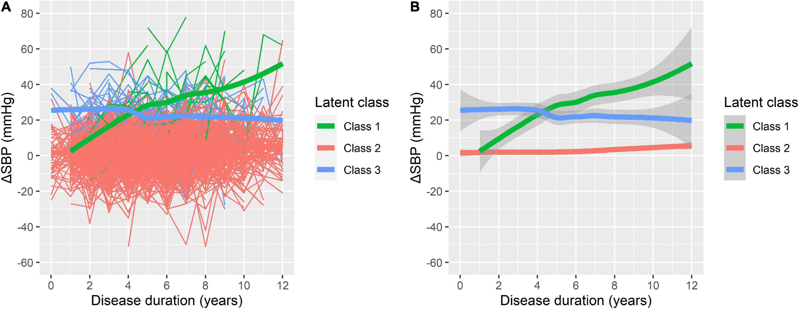
ADHD and puberty
New research study using a cohort from the US that follows children from age 9/10 to most recently 12/13 with:
Yearly ADHD symptom assessment
Questions on pubertal stage by parents and adolescents
Biological assessments of hormonal levels
Research questions:
(1) Is there a subgroup of girls with increasing ADHD symptoms in adolescence?
(2) Is pubertal onset associated with ADHD symptom change in girls?
Notes:
This influx of women into the adhd population could occur for a couple, not mututally exclusive, reasons

Slide 23
Menstruation
“I’ve taken my meds, why can I not focus on things when last week I could…”

Slide 24
Menstrual cycle
Beginning of cycle characterised by low estrogen and progesterone
Followed by a steep preovulatory increase in estrogen and sharp drop post ovulation
Then both estrogen and progesterone rise in the luteal phase then drop sharply premenstrually
Drops in estrogen may affect dopamine availability
Could exacerbate ADHD symptoms and compromise medication effectiveness
Notes:
The menstrual cycle is characterized by changes in certain hormones, aagain including

Slide 25
Menstrual cycle hormonal fluctuations
Premenstrual Dysphoric Disorder (PMDD)
Mood and behavioural changes that occur in the few days prior to menstruation that are so severe they interfere with personal and professional relationships
Affects between 3-9% of menstruating women
Not caused by different levels of hormones, per se, but by differential sensitivity to these hormones
Studies of the post-natal period and post-initiation of hormonal contraception suggest women with ADHD might have higher rates of hormonal sensitivity
DSM-5, Backstrom 2003, Schmidt 1998, Lundin 2023, Andersson 2023
Notes:
One of the ways in which the menstrual cycle most clearly affects mental health is premenstrual dysphoric disorder, which is mood and

Slide 26
ADHD and PMDD
Online study of 715 women with and without ADHD
ADHD:
Self-reported clinical diagnosis (n=102)
ADHD scale-based ADHD (n=229)
Non-ADHD reference group (n=305)
PMDD measured via the Premenstrual Symptoms Screening Tool (PSST)
31.4% among participants self-reporting a clinical ADHD diagnosis
41.1% among ADHD scale-based ADHD participants
9.8% among non-ADHD reference group

Slide 27
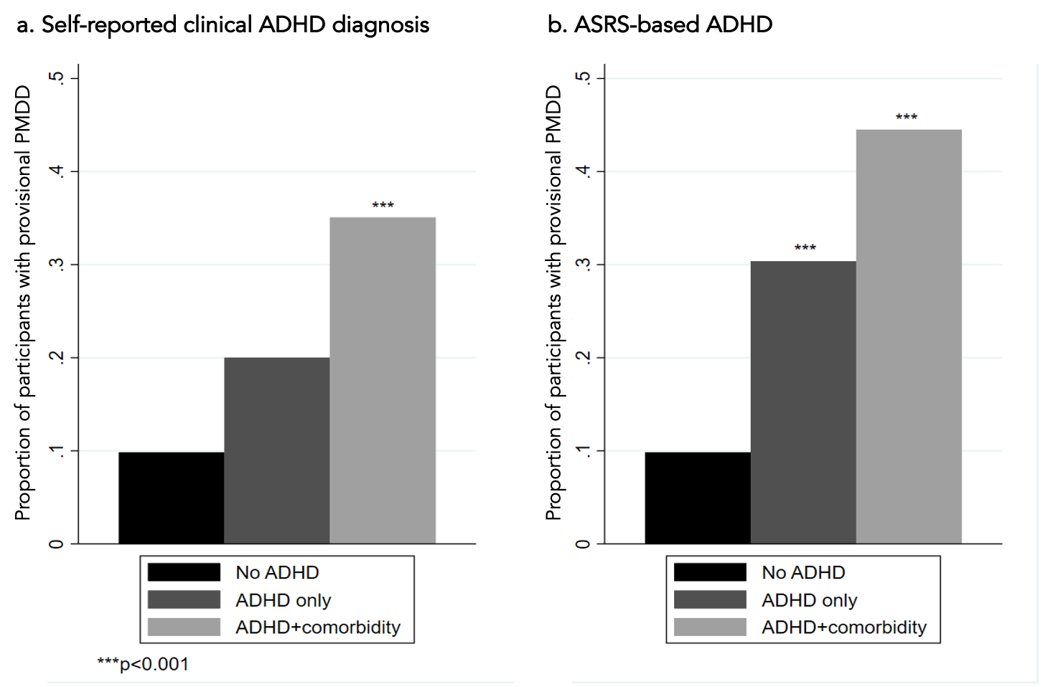
ADHD and PMDD

Slide 28
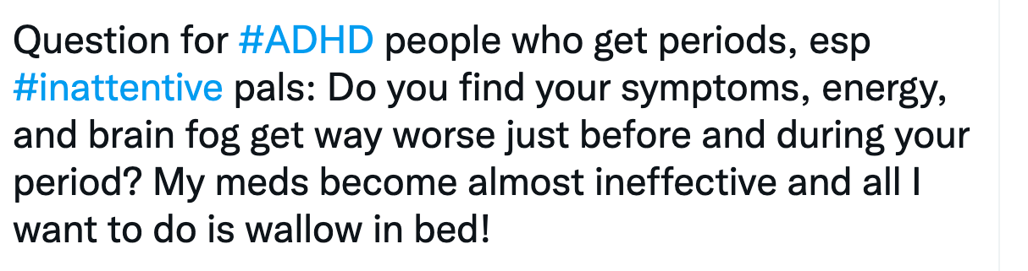
Hormonal fluctuations on women’s ADHD symptoms
Clinical and anecdotal evidence for some role of hormonal fluctuation in ADHD symptom expression for women with ADHD
Women discuss their symptoms getting worse premenstrually, medication being less effective during this time
Notes:
Moving on from PMDD and thinking about changes in *ADHD* across the menstrual cycle

Slide 29
Measuring Adult ADHD and Menstruation (MAAM) Study
To address this gap in the research we have funding for the MAAM study
Research questions:
Are different cycle phases associated with changes in ADHD symptoms and functioning among women with ADHD?
Are changes in hormone levels across the menstrual cycle among women with ADHD are associated with the effectiveness of ADHD medication?
Do sleep and physical activity mediate the association between hormonal changes and ADHD symptoms/functioning among women with ADHD?
https://www.adhdlifelab.com/maam-study
Notes:
We are going to examine this question in a study that was recently funded by the UK medical research council. In this study, we will prospectively follow

Slide 30
Measuring Adult ADHD and Menstruation (MAAM) Study
https://www.adhdlifelab.com/maam-study
Notes:
We are going to examine this question in a study that was recently funded by the UK medical research council. In this study, we will prospectively follow

Slide 31
Menstrual cycle hormonal fluctuations and ADHD
Impact:
Provide quantitative evidence regarding symptom change across the menstrual cycle
A better understanding of the effect of menstrual cycle for women with ADHD may help them better anticipate/plan for symptom exacerbation
If ADHD medication is less effective in certain cycle phases, this may suggest a benefit to increasing dose during these phases
If sleep and physical activity are key mediators, interventions could focus on improving these areas to mitigate hormonal effects

Slide 32
“My friends and I are going through perimenopause, and my friends with ADHD… we just struggle more”
“The scatter of my memory is just on a different level… I thought I had early onset Alzheimer’s”

Slide 33
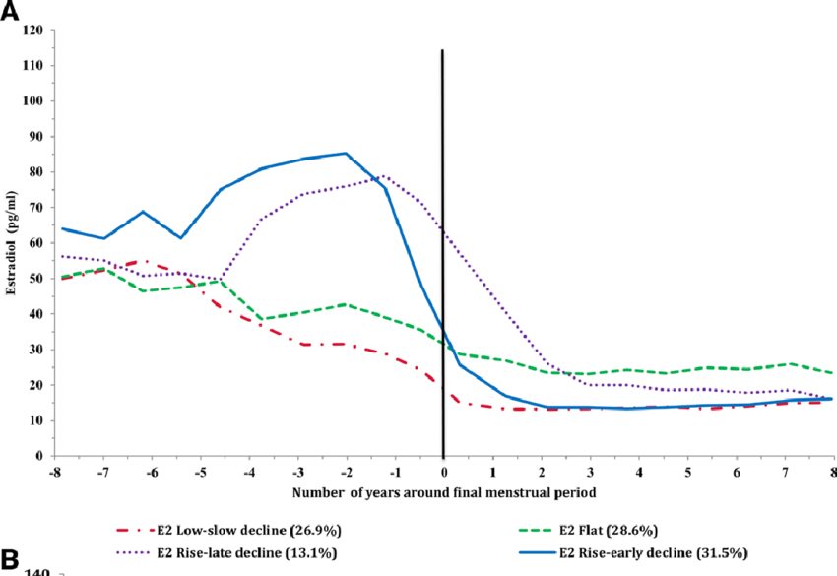
Perimenopause/menopause
The transition to menopause can occur over a 10–15 year period (around age 40-44)
Early in perimenopause, menstrual cycles are typically more frequent and characterized by more hormonal extreme fluctuations
Later in the menopausal transition, cycles become unpredictable and decrease in number exposing women to progressively longer periods of estrogen withdrawal
Morrison 2006, Santoro 1996, Deecher 2008, Khoudary 2020

Slide 34
Perimenopause/menopause
This is an area of huge concern for women with ADHD
Currently forming a PPI group of women with ADHD in the menopausal transition who will inform on several PhD projects, including:
Qualitative interviews with women with ADHD about their experiences of the menopausal transition
Analysis of data from the US-based SWAN cohort examining how women with high genetic risk for ADHD experience menopause
Survey study comparing women with ADHD to those without a diagnosis on symptoms and experience of menopause

Slide 35
In conclusion
Times of hormonal transition may particularly affect women with ADHD
We have many more questions than answers about how hormones affect women with ADHD (and women in general!)
Women are asking us to answer these questions and we need to listen

Slide 36
Thank you for listening! Questions?
Ways to keep in touch:
adhdlifelab.com
j.agnew-blais@qmul.ac.uk
agnewblais.bsky.social

