Slide 1
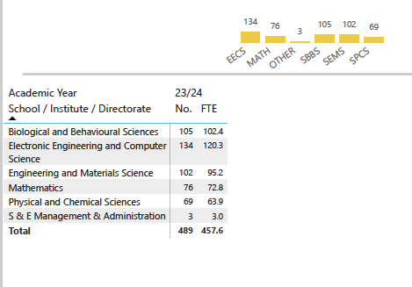
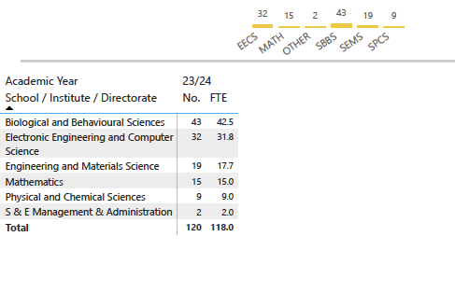
S&E academic staff
Female Academic Staff
S&E female PS: 68%
S&E female professors: 12.5%
S&E female academics: 24.5%
S&E female PGR: 36%
S&E female UG: 42%
EECS: 23.8%
SMS: 19.7%
SBBS: 40.9%
SEMS: 18.6%
SPCS: 13%

