Slide 1
IRIS 10th Birthday (Nearly?)
Andrew Sansum
1st June 2025

Slide 2
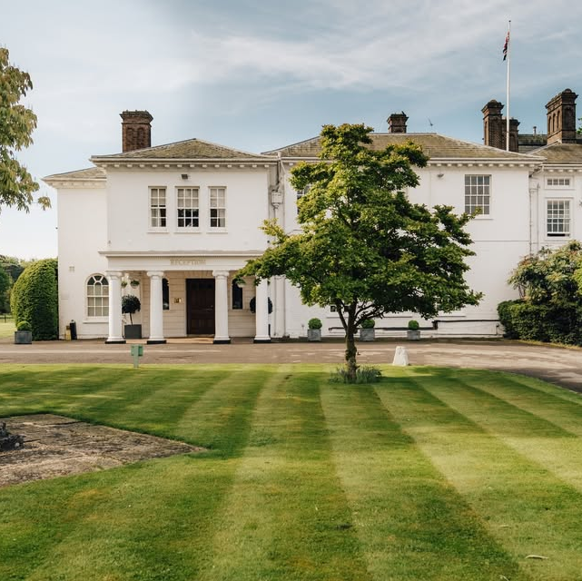
UK-T0 Meeting: – 20th October 2015
Community Organised
Milton House hotel, Abingdon
55 attendees
Prepare for Spending review outcome (Chancellor's speech in November)
Working Together
Requirements Capture
Who would use a “”UKT0”
What was needed

Slide 3
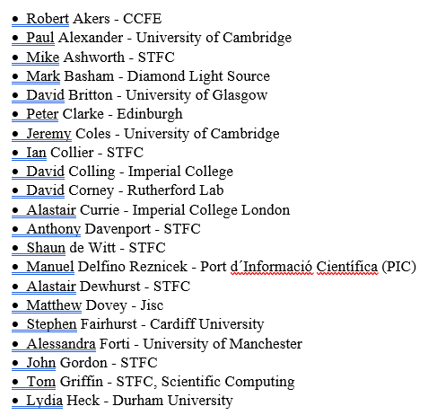
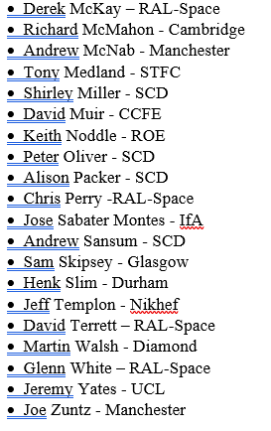
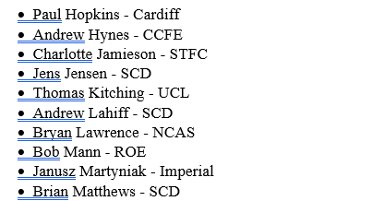
UKT0 – 2015 Attendees

Slide 4
Talks:
Science Community requirements --→
Tools and technologies
Grid Computing
Data Transfer
Cloud Computing
Services
Batch Farms and Cloud
Data Management
Astronomy Data Management
Software Distribution
AAI

Slide 5
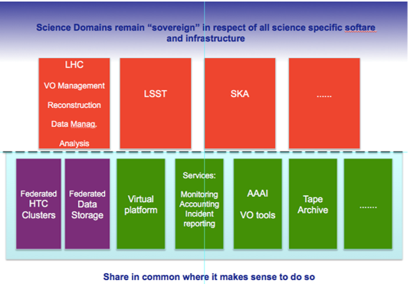
UK-T0 2015 Proposition
A simplistic picture is shown below to illustrate the UKT0 “proposition”. There was broad agreement on the spirit embodied by this. The important principles are:
To migrate things below the dotted line to shared infrastructure where it makes sense to do so.
To recognise that bespoke elements are often needed within individual infrastructures and therefore the activities decide what remains above the line.

Slide 6
UKT0 2015 Meeting - Actions
Develop a case for UKT0 – Prepare for CSR
Monthly meeting and UKT0 Email list
Begin to share CPU between activities with clear and present problem (EUCLID, LOFAR, LSST)
Understand “the cloud”
CHANGE the NAME!!

Slide 7
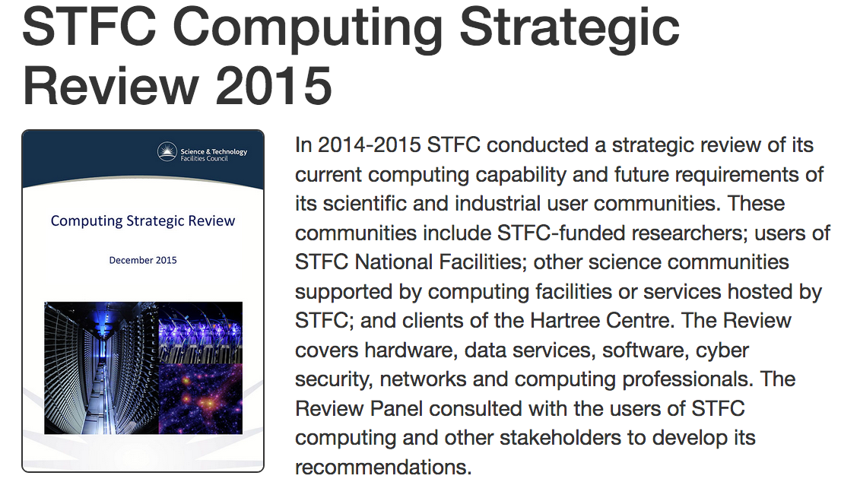
18 December 2015: STFC Computing Strategic Review 2015
“All STFC programme areas anticipate an order of magnitude increase over the next five years in data volumes, with implications for requirements for computing hardware, storage and network bandwidth. Meeting this challenge is essential to ensure the UK can continue to produce world leading science, but in the current financial climate it is clear there will be funding limitations. Long-term planning will be critical, as will more efficient use of resources.
The scientific disciplines supported by STFC should work more closely together to find ways of sharing computing
infrastructure, with new projects encouraged to make use of existing expertise and infrastructure. “
The data processing, analysis and event simulation requirements of particle physics, astronomy and nuclear physics (PPAN) researchers, Facilities users and others require advanced High Throughput Computing facilities. By co-operating across organisational and project boundaries to make UKT0 a reality it will be possible to ensure the consolidation of computing resources and provide HTC access in a cost effective manner.

Slide 8
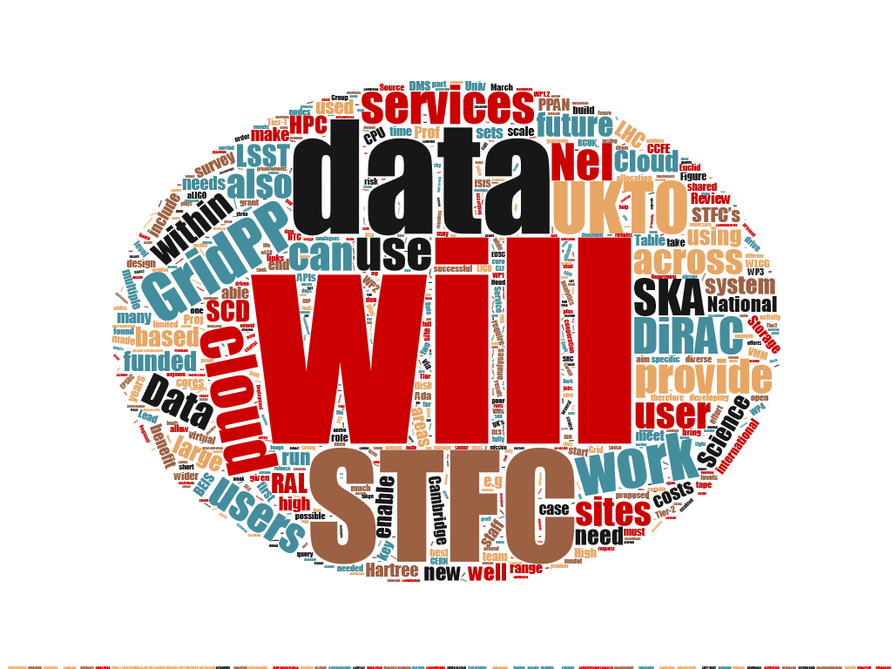
UKT0 – 2017 eInfrastructure Award
Awarded £1.5M for STFC eInfrastructure in Dec 2017
£1.2M for hardware for “under-supported” communities (Edinburgh/Manchester/RAL)
£300k for digital assets for facilities users and federated OpenStack development (RAL and Cambridge)
To deliver additional CPU and Storage resources aimed at STFC supported communities with little or no compute resource
To support the ADA Lovelace Centre
To deliver enhancements to OpenStack
To deploy a high performance database archive testbed
To move STFC nearer towards a UK NeI

Slide 9
2018 Business Case £16M (£4M x 4 Years)
“eInfrastructure for the exploitation of the UK National Facilities and STFC Frontier Science programmes”
4.This case proposes the minimal investment needed to maintain capability through replacement of components, to begin to respond to the increased data volumes from existing science and innovation programmes, to prepare for exploitation of the highest priority opportunities presented by new investments, and ensure coherence with the development of the National eInfrastructure.
5. The proposal is for £16M profiled equally over 4 years to augment the existing eInfrastructure by procuring additional i) HTC compute capacity ii) storage capacity and iii) digital assets. This proposal complements, and is coordinated with, that requesting additional HPC capacity for the DiRAC component of the STFC eInfrastructure.

Slide 10
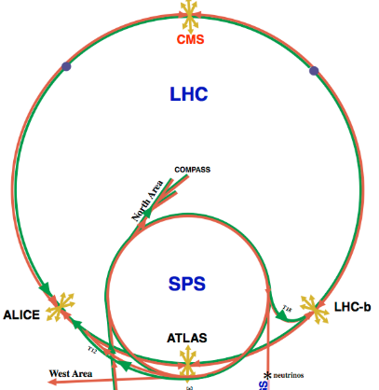
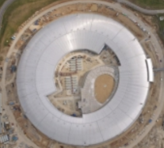
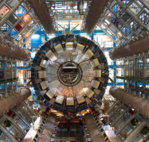
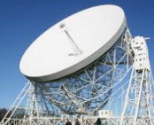
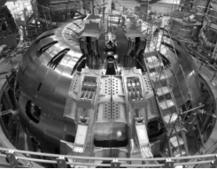
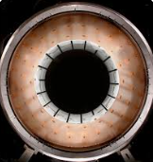
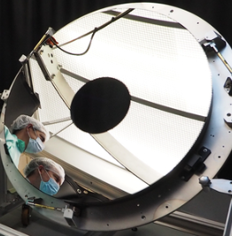
Name Change – Thursday 10th May 2018
Finally – the hardest bit!!!!!!!
Approx 2.5 years after agreeing we needed to change the name
After complex selection process
UKT0→ IRIS

Slide 11
Next Meeting – Proposed Theme - IMPACT
After 10 years – a good moment to reflect on what we have achieved
Many of our community have been part of IRIS since 2015
Many projects which were planned and discussed in 2015 are now operational.
It would be valuable to capture and record what IRIS has achieved over 10 years

