Slide 1



STFC Update
Tom Griffin, Director, Scientific Computing
1st July 2025
Notes:
To edit the background image, select ‘Format’ from the PowerPoint menu and ‘Slide Background’ from the drop-down menu. Within the new list of options that appears on the right of the screen, select the ‘File’ button under ‘Insert picture from’ and select your image from your file browser. Please remove or amend the image credit if you are using a different image to the one provided.

Slide 2
Digital Teams in STFC
STFC Programmes
George Madden - Associate Director, Skills and DRI
Katherine Rooke - Head of Programmes – DRI
Sarah Garlick - Senior Programme Manager, DRI
STFC National Laboratories
Tom Griffin - Director, Scientific Computing Department
Justin O’Byrne - Deputy Director for Digital Research

Slide 3
Computing Advisory Panel - CAP
Members
Anne Trefethen, University of Oxford (Chair)
Robert Beswick, University of Manchester
Tony Cass, CERN
Luigi Del Debbio, University of Edinburgh
Carmen Domene, University of Bath
Alejandra Gonzalez-Beltran, UKAEA
Biagio Lucini, Queen Mary University of London
Sri Sri Perangur, Just Eat Takeaway
Andrew Richards, Imperial College
Bruno Silva, Amazon Web Services
Filippo Spiga, Nvidia Corporation
Alessio Spurio Mancini, Royal Holloway
Viv Kendon, Strathclyde University
Attendees at open sessions
Mark Wilkinson, DiRAC
Jonathan Hays, IRIS
Tom Griffin, STFC – Scientific Computing
Kate Royse, STFC – Hartree
Michael Cuthbert, STFC - NQCC
John Ginever, STFC – Digital Infrastructure
Also attending from STFC
Nicky Bladen-Hovell
Sarah Garlick
George Madden
Justin O’Byrne
Katherine Rooke

Slide 4
CAP ToR – Purpose
The purpose of the Computing Advisory Panel (CAP) is to advise the STFC Executive on the strategy and management of requirements for Digital Research Infrastructure (DRI) activities and any related issues and opportunities, including but not limited to, high performance and high throughput computing, data and data storage, security, data network, skills and people in support of the STFC science and facilities programme.
The CAP will act as an ‘expert and critical friend’ in computing to provide a link between both the Particle Physics, Astronomy, and Nuclear Physics (PPAN) Science Board and the Facilities and Laboratories Science Board, while providing independent advice and reporting to STFC’s Executive Board around issues and opportunities relating to DRI within STFC and UKRI (where relevant).
Alongside the evolving role of IRIS in collating and scrutinising STFC’s PPAN and facilities/labs DRI requirements, CAP will also review and validate the outputs of IRIS. This will be done on an annual basis.
DRAFT

Slide 5
CAP ToR - Remit
The current status of Digital Research Infrastructure (DRI), how it operates within UKRI, with a specific focus on STFC, and potential future requirements of and opportunities for Digital Research Infrastructure (DRI), including (but not limited to) computing resources, data handling and storage, software, as well as associated skills development and career pathways for the science communities, facilities and programmes supported by STFC.
Future potential strategies, frameworks and plans to coordinate scientific computing provision across STFC and UKRI (where relevant), and coordinating DRI, and High-Performance Computing (HPC) developments across UKRI and other relevant national and international activities. CAP should also comment on how STFC fits within the broader national and international context.
The development of STFC's requirements for next generation computing facilities working across STFC and UKRI as well as understanding international opportunities.
DRI priorities for funding and mechanisms across STFC and beyond, to support the highest quality, high impact programmes.
The wider DRI funding context, potential new funding and in-kind routes (access to other communities, benefits and barriers), mechanisms to mitigate constraints and demands, including international routes for compute access.
DRAFT

Slide 6
CAP ToR - Remit
Opportunities for dissemination and synergies with other programmes, and to explore areas of leadership and scenarios in driving development within DRI across STFC.
Future or emerging opportunities in area such as AI, ML and Quantum Computing in the context of the DRI portfolio, including gaps and opportunities to upskill individuals on these emerging fields.
Opportunities and challenges to improve Environmental Sustainability of and within the DRI landscape, including energy consumption taking account of UKRI and STFC goals together with government targets for net zero. This include, advise STFC on how efficiencies might be driven in DRI operations across its projects and research areas.
Technical developments and trends in industry, including potential collaborative partnerships and knowledge exchange.
Requirements, opportunities and challenges for data protection, and the ethical collection and use of data and advise on best practice where applicable.
The CAP will be asked to review and advise on computing resources allocation processes and outcomes for STFC projects, activities and facilities.
DRAFT

Slide 7

UKRI DRI Update
Notes:
The abstract pattern can be removed or repositioned if required. Be careful to ‘Send to Back’ so that it does not obscure any important information.

Slide 8
How we invest in Infrastructure
From large (£100m’s) to small (£10k+), from buildings and facilities, to knowledge resources, digital and estates functions, through:
R&I Infrastructure Budgets within UKRI
WCL - Research Councils
£1,070M
Calls and allocations to universities and institutes
Direct allocations to Research Councils and Research England
Project
Funding
Infrastructure Fund
£481M
Proposals from councils
Digital Research Infrastructure
£129M
Decarbonising UKRI-owned operations
UKRPIF £129M
Proposals from universities
International Subscriptions¹
£145M
International science projects
Carbon Zero Fund £48M
Proposals from councils
WCL – Formula Capital
£679M
Allocated to universities
(and others)
Major Projects
£175M
Ad Hoc approved by ExCo/ DSIT/ HMG
For this SR period
(22/23 – 24/25)
¹Includes resource funding.
UKRPIF = UK Research Partnership Investment Fund
WCL = World Class Labs

Slide 9




UKRI’s Digital Research Infrastructure Programme
A globally competitive Digital Research Infrastructure (DRI) is essential for the UK to support cutting-edge research and innovation. The DRI Programme aims to drive the competitiveness of the UK’s researchers and innovators by greater adoption of cutting-edge digital techniques across all communities of practice.
We support the system of large-scale compute and data infrastructures, software, networks, tooling and skilled DRI professionals.
Our vision is a coherent state-of-the-art national Digital Research Infrastructure (DRI) that will seamlessly connect researchers and innovators to the computers, data, tools, techniques and skills that underpin the most ambitious and creative research
Interconnected DRI
Human DRI
FAIR DRI
Sustainable DRI

Slide 10

Interconnected DRI
We aim to break down silos and promote collaboration within the DRI landscape by creating a more interconnected, open, inclusive,
and user-friendly infrastructure. This involves fostering community engagement, promoting the creation of federated infrastructure and ensuring that DRI funding addresses the technical challenges of operating across disciplines.

Slide 11

Human DRI
We understand that DRI starts with the people that build, maintain, and upgrade it. By recognising their crucial role within DRI, promoting their careers, and supporting their professional development, we aim to foster a supportive culture and ensure a skilled and diverse DRI workforce.

Slide 12

FAIR DRI
We will ensure that research infrastructure is easily accessible, interoperable, and reusable by driving adoption of the FAIR principles, enhancing research efficiency, and fostering a more collaborative research environment.

Slide 13

Sustainable DRI
We focus on ensuring the long-term health of DRI by addressing efficiency, security, environmental and financial challenges to create
a sustainable DRI ecosystem.

Slide 14


Our vision and approach for DRI
Our Vision
Our Approach
The DRI ecosystem includes large-scale computing, data storage, facilities, software, networks, skilled DRI professionals, and other components. Working across UKRI, we will evolve existing infrastructures to support new communities of practice and, subject to funding, by investing in new capabilities.
A coherent state-of-the-art national Digital Research Infrastructure (DRI) that will seamlessly connect researchers and innovators to the computers, data, tools, techniques and skills that underpin the most ambitious and creative research

Slide 15






Summary of Phase 2 Portfolio
National Computational Research Services
Software for future Large-scale compute
Federated Data Services
To deliver aspects of the DRI strategy relating to data infrastructure and implementation of FAIR.
Ensuring the UK has the compute services to facilitate the ambitions of our R&I community.
Creation of a mission-led software programme for large-scale accelerated computing.
Total for FY 24/25
Total for FY 24/25
Total for FY 24/25
£29.2M
£13.5M
£6M
Supporting DRI Professionals
Software, Networks, Security and Net Zero
Ensuring the UK has the skills base to deliver effective world-leading research and innovation.
Secure access and connectivity, and software as an infrastructure and UKRI net zero ambitions.
Total for FY 24/25
Total for FY 24/25
£8.2M
£6.61M

Slide 16
UKRI, STFC, and the Spending Review
Notes:
The abstract pattern can be removed or repositioned if required. Be careful to ‘Send to Back’ so that it does not obscure any important information.

Slide 17
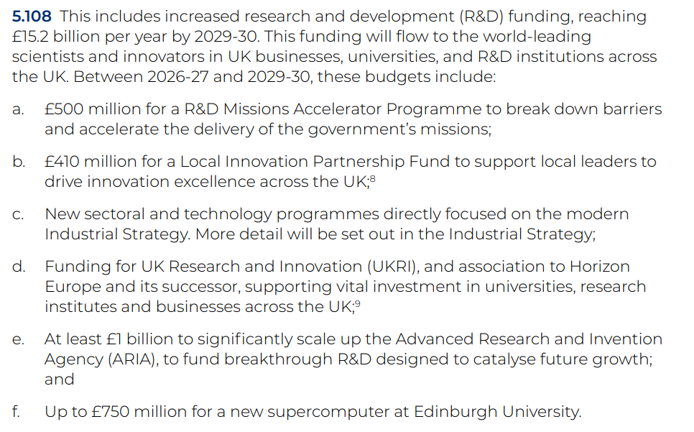
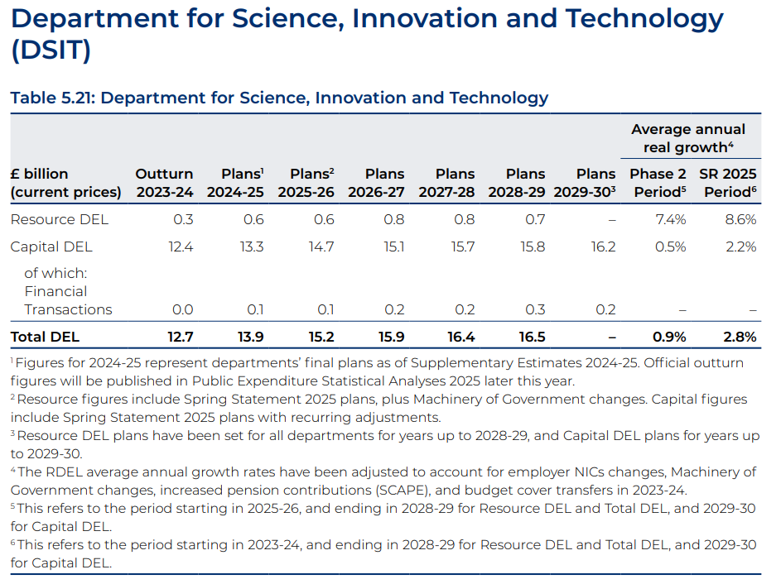
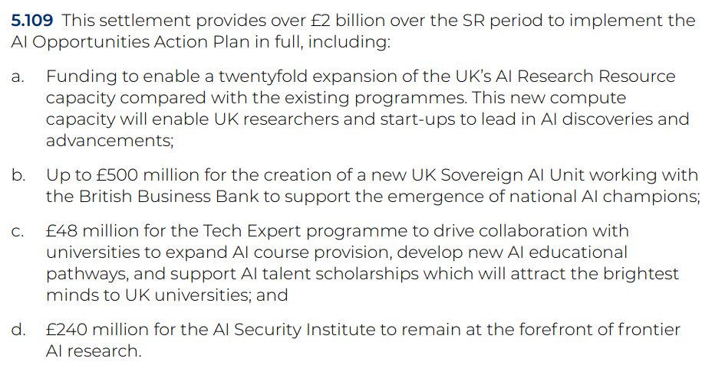
UKRI, STFC, and the Spending Review

Slide 18
UKRI, STFC, and the Spending Review
No UKRI budget yet
No STFC budget yet
Science Boards, Council, and Executive Board reviewing all STFC activities and programmes – ‘prioritization’
There are likely to be very significant pressures on STFC budgets
Clearly acknowledged that compute is a non-optional part of science activities
IRIS collated numbers fed into this process – thank you

Slide 19

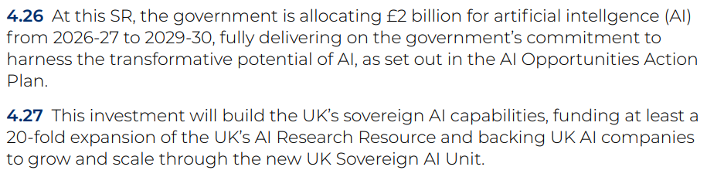
£750m for a new supercomputer….
UKRI Project – STFC engagement through Katherine, Sarah, Mark, Tom
DSIT-led Compute Plan/Strategy
Identified need for a diverse set of compute systems

Slide 20
So……
Notes:
The abstract pattern can be removed or repositioned if required. Be careful to ‘Send to Back’ so that it does not obscure any important information.

Slide 21
Maximise our use of UKRI and national resources
STFC’s budget is not likely to allow us to do everything we want to - we cannot provision compute for all our needs*
What do we / STFC need to do to effectively use national services?
What do those services need to look like?**
What will not be able to use national services? (and why not?)
How/where can we target mission-focused and AI funding?
*has this ever been the case? **IRIS is part of these diverse national services

Slide 22
Maximise efficiency
Reduce hardware, cost and carbon!
What changes can we make in workflows or services?
What investment is required to do this?
Where are the opportunities in software/pipelines/AI?
Carbon budgeting is coming

Slide 23
Summary
Uncertain times – for at least another few months
IRIS is part of the solution
We need to (visibly) demonstrate efficiency savings
We need to make the case for investment to support this
  There will be opportunities, but maybe not through traditional STFC routes

Slide 24


Notes:
The abstract pattern can be removed or repositioned if required. Be careful to ‘Send to Back’ so that it does not obscure any important information.

