Slide 1

Minimizing Idle Resources on the Ada Platform (DAaaS)
Adam Laverack
Notes:
Credit to Jeremy for some of the slides

Slide 2
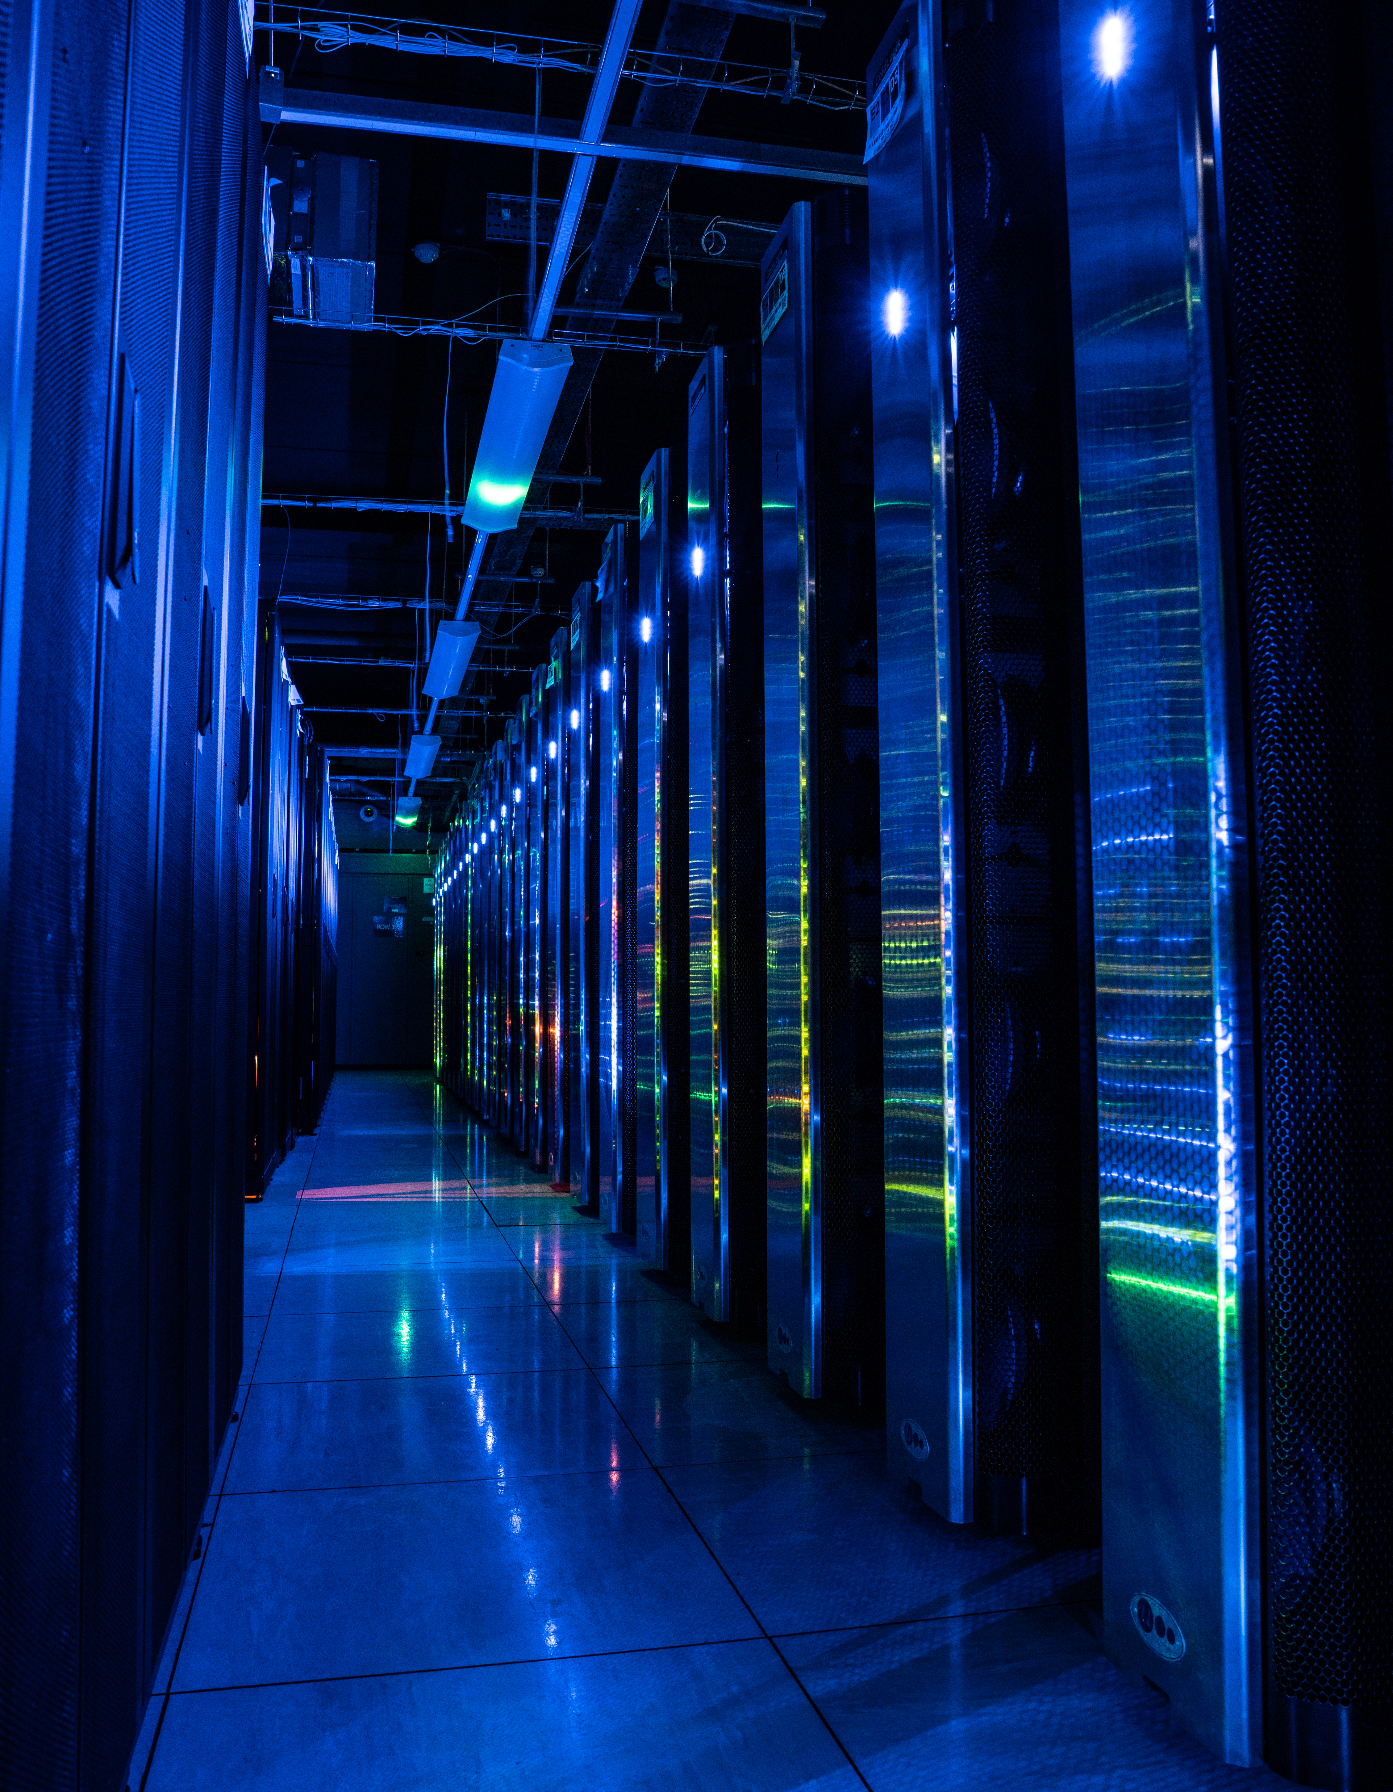



DAaaS Group
STFC Scientific Computing
Ada is run by the DAaaS group
  Team of 10 developers
  Running for over 6 years
  Supporting STFC Facilities:
    ISIS Neutron and Muon Spallation Source
    Central Laser Facility (CLF)
  Dedicated training platform released in 2023
Support address: supportanalysis@stfc.ac.uk
Notes:
Part of Scientific Computing, Platforms and Services Theme.
6 long term staff, and a variety of early careers staff rotating in and out of the group
Officially in production from spring 2019
Focused on supporting experiment data analysis both during and after the experiment

Slide 3
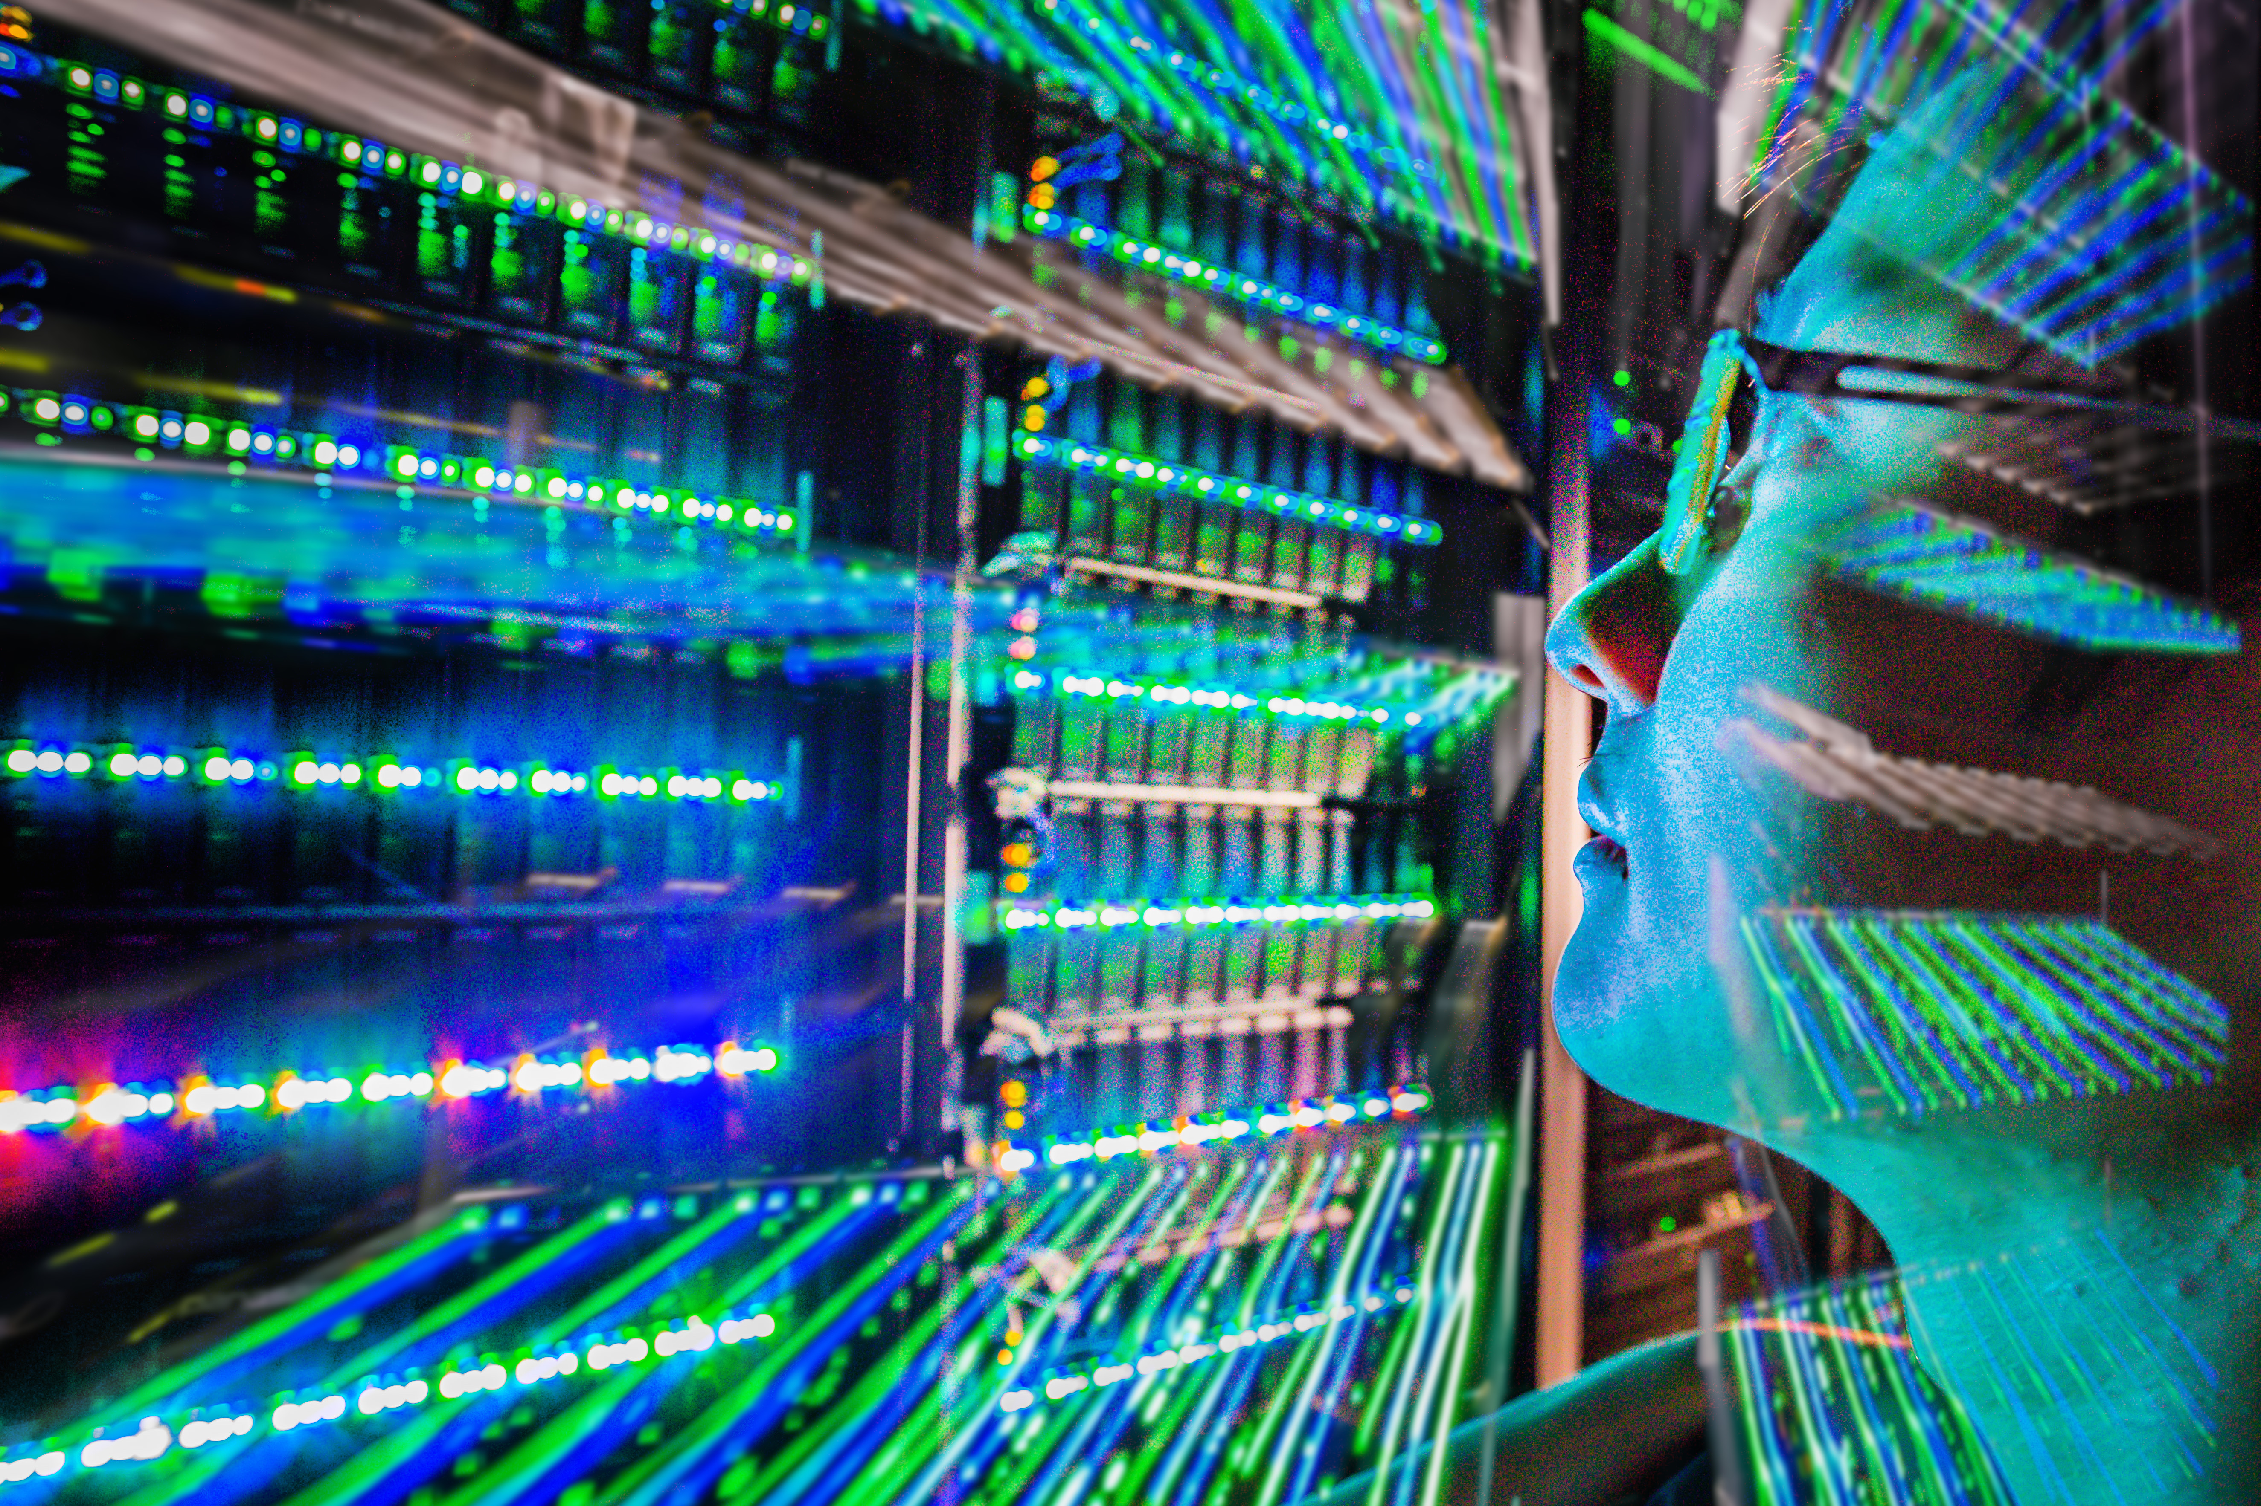


What is Ada?
Previously known as DAaaS (Data Analysis as a Service)
Remote data analysis
It brings together the data, software and compute resources for a variety of scientific workflows
  >1PB data stored
  >100 scientific software applications available
  15,000 CPUs, 50TB RAM, 100 GPU cards
In summary:
  A handful of clicks gets a user a remote desktop to a computer with everything they need readily available
Notes:
In practice this means that a handful of clicks gets a user a remote desktop connection in their browser to a preconfigured computer with access to all their experiment data and the software they need to process and analyse it.

Slide 4
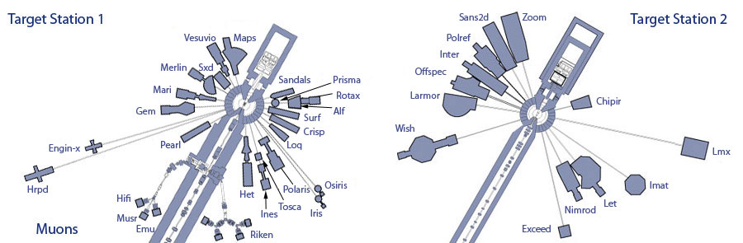
Labs (with ISIS as an example)

Slide 5
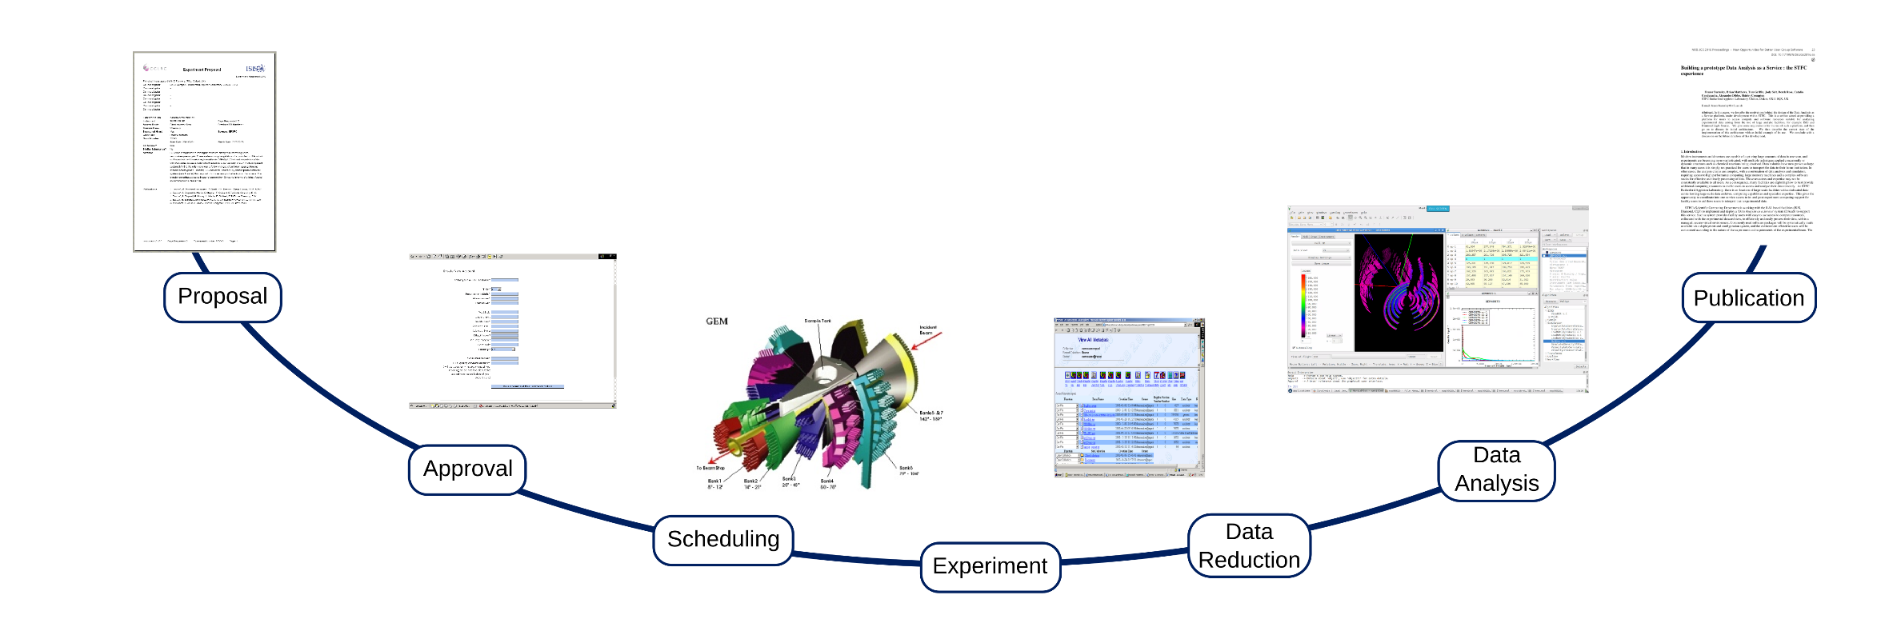
Experiment Life Cycle
Notes:
Experiment lifecycle: Users will come on site for a short time (maybe 2 days) then never come back.
Lots of people visit the facilities each year, this may be the only big experiment they ever do (PhD students)
Once they leave, they have 3 problems. They need to access their data which is stored at RAL behind the site firewall
They need compute
They need an environment to analyze their data

Slide 6
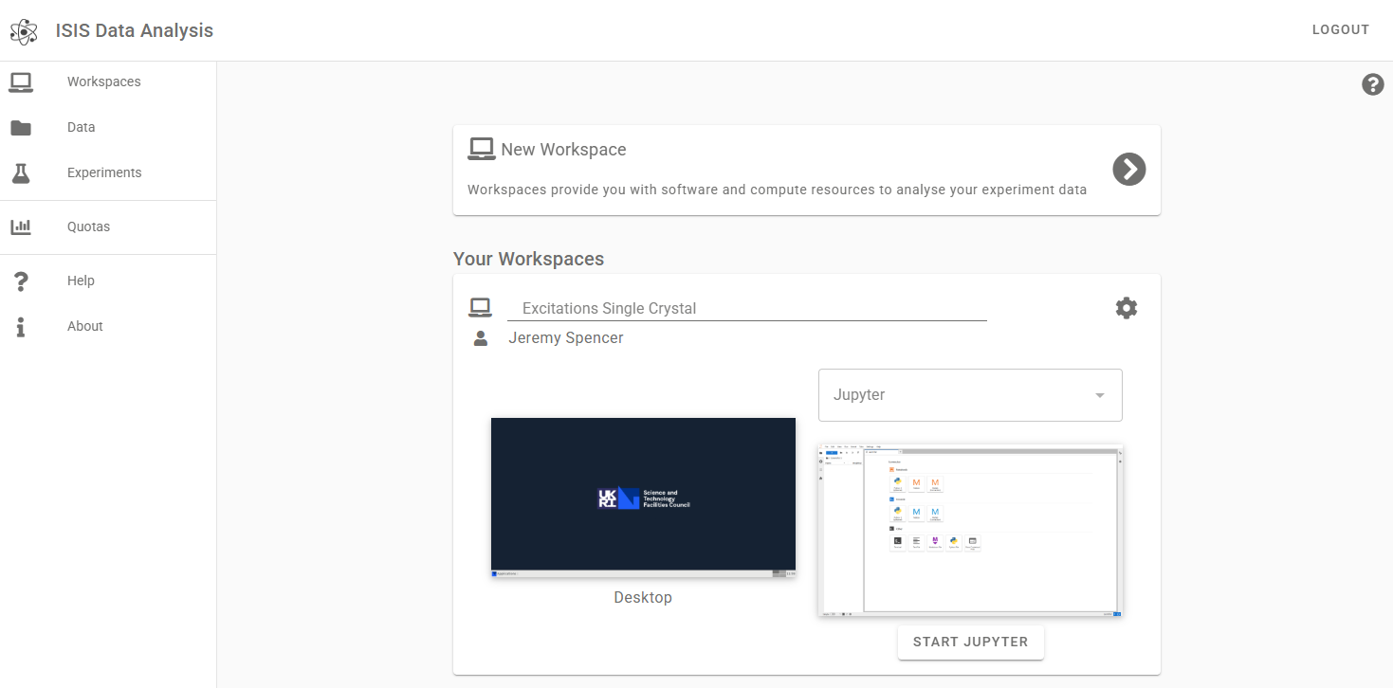
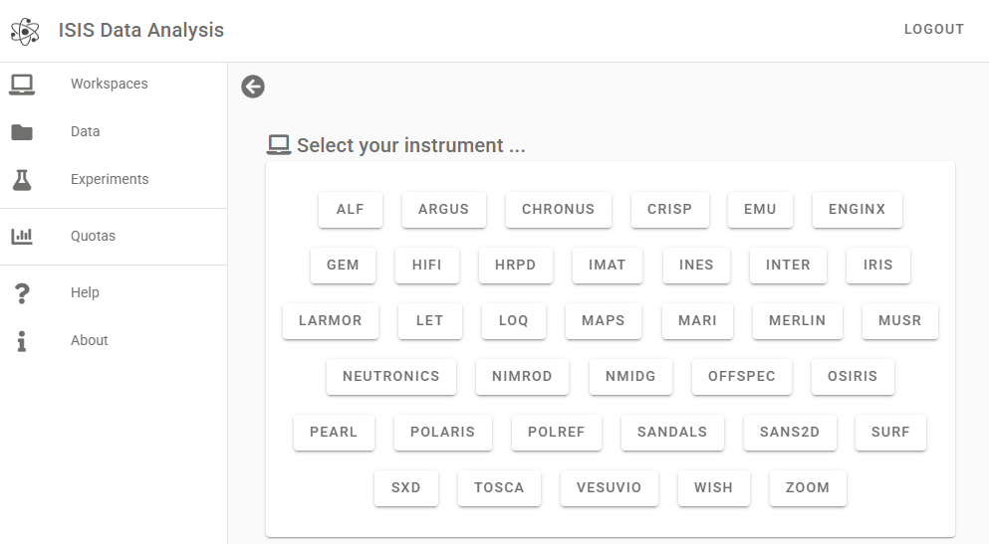

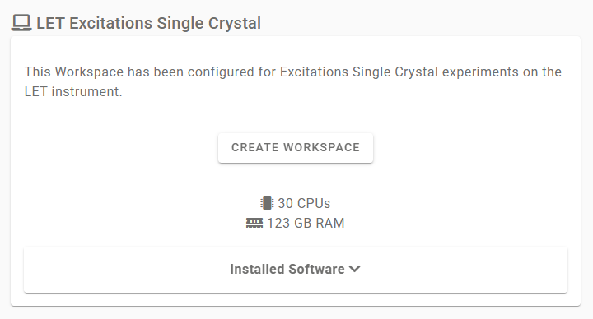
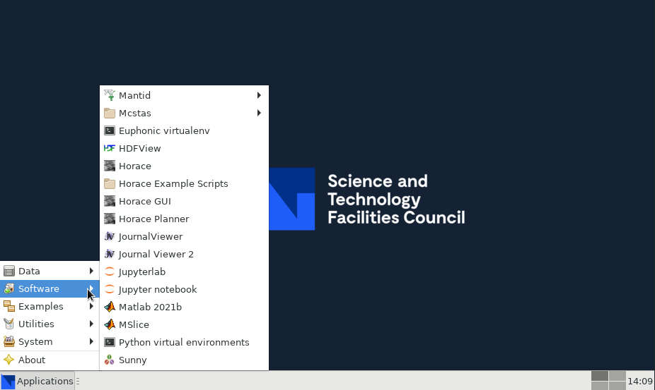
Workspaces
Notes:
They can log into our website with their UO credentials and claim a workspace
Access to data, compute, analysis environment

Slide 7
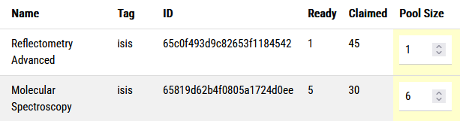
Workspace pools
A workspace is a STFC Cloud VM configured with Ansible
To prevent users having to wait, we create pools of prebuilt workspaces
Also hides build failures and provides a buffer
Notes:
Workspaces take 30-60 minutes to build from scratch

Slide 8
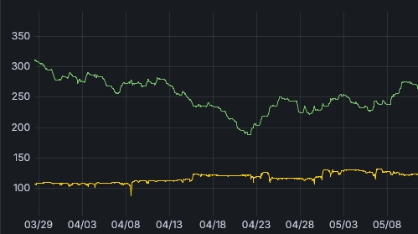
Downsides of pools
Workspaces in pools are idle
Roughly 30% of all workspaces are in the pool at any given time
Claimed workspaces (in use)
Ready workspaces (in pool/idle)

Slide 9
Trade-offs between build systems
Do entire build procedure when user claims workspace
+ No idle VMs
Takes a long time to claim a workspace
Builds can fail, bad user experience
Do entire build procedure in advance
+ User instantly gets workspace on claim
+ User experiences no build failures
+ Buffer of built workspaces
- Lots of idle VMs

Slide 10
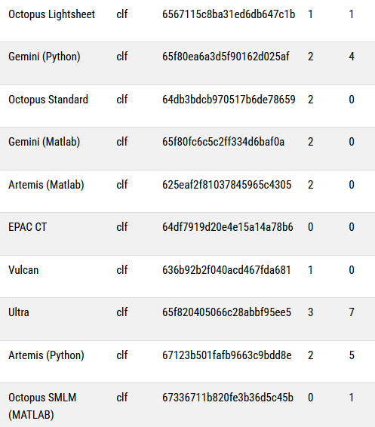
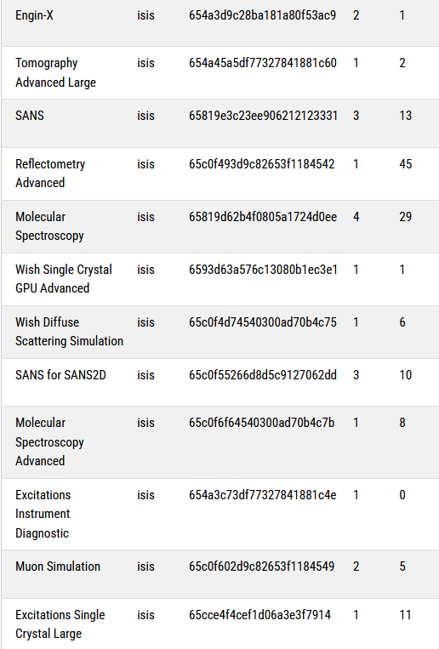
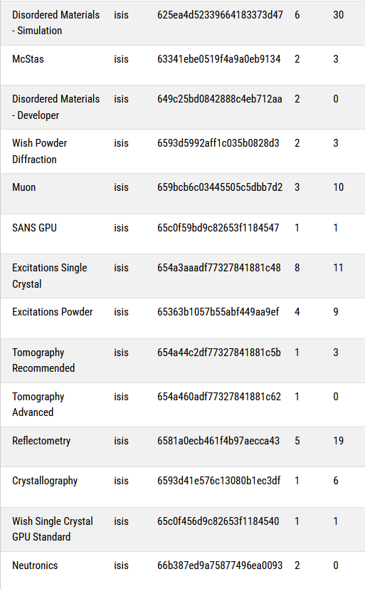
Currently at one extreme
Currently all workspace configuration is done before claim
Each variation in configuration requires its own pool
2 pools might have the same hardware but slightly different software selection
42 ISIS & CLF pools plus training courses
…

Slide 11
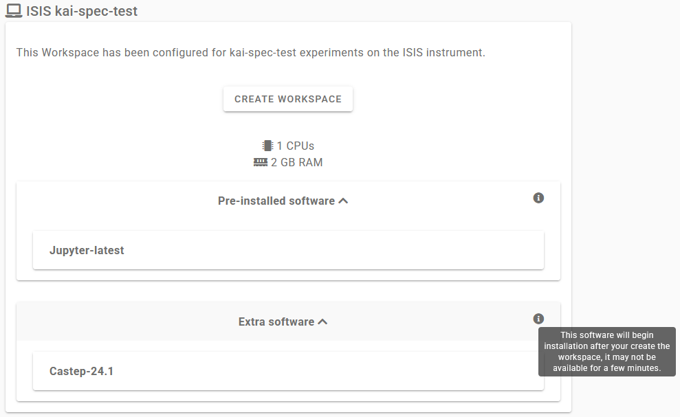
Moving towards a middle ground
Do common configuration before claim
Deploy an API server on workspaces to allow extra software install on claim
Result: much fewer pools, one for each hardware level
Image credit: Kai Horimoto

Slide 12
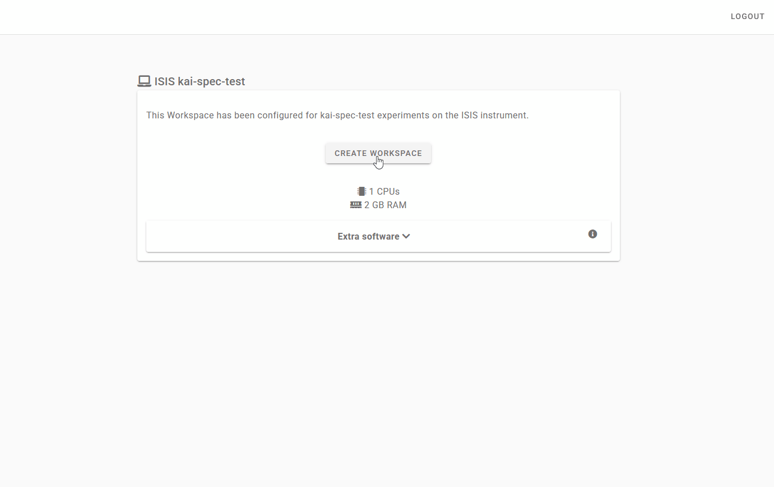
Progress so far
Development work largely complete
Will need to ensure that user experience is not degraded
Deployment to come over next 6 months
Image credit: Kai Horimoto

Slide 13


sc.stfc.ac.uk

Slide 14



