Slide 1
IRIS Security
IRIS Collaboration meeting, Durham,
July 1st 2025
David Crooks
david.crooks@stfc.ac.uk
On behalf of the IRIS Security Team
Notes:
The abstract pattern can be removed or repositioned if required. Be careful to ‘Send to Back’ so that it does not obscure any important information.

Slide 2
Landscape
Broad status the same: high, persistent risk
Considerable focus on compliance → Risk
Organisational focus
IRIS Collaboration meeting, July 2025

Slide 3
IRIS Security Team
From last time:
Focus on “professionalisation” of IRIS Security Team towards IRIS CSIRT
RFC 2350 + SIM3
Expectations for Computer Security Incident Response
Work is ongoing, focused on RFC 2350
Structural elements of a CSIRT
IRIS Collaboration meeting, July 2025

Slide 4
Security Handbooks
More recent work focuses on underpinning “security checklist” for sites, stemming from work for GridPP
Partly following longstanding appetite for “security baseline” from sites
Focus on using existing work and materials but identify key elements for our environment
Propose to extend this to IRIS
“Living document”, mature over time
Linked to local policies and procedures
Also an RFC for security handbooks!
RFC2196
Some obvious technology anachronisms, but useful basis
IRIS Collaboration meeting, July 2025

Slide 5
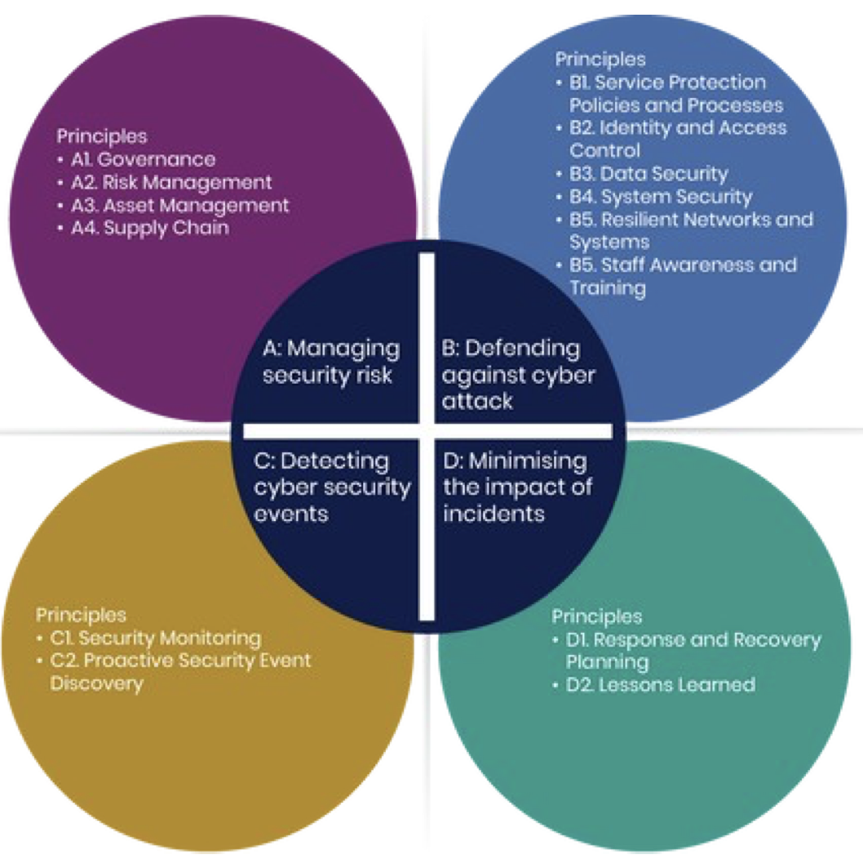
Cybersecurity reviews
Potential for many organisations to be undergoing cybersecurity reviews at this time
In DRI context, drive to focus on NCSC Cyber Assessment Framework (CAF) as “lingua franca”
Which sites are undergoing such activity?
IRIS Collaboration meeting, July 2025

Slide 6
Tier1 CAF outcomes [1]
Tier1 CAF assessment now complete, including both internal and external assessments
One conclusion: a full assessment, with over 200 indicators of good practice, is a heavyweight process: up to months of 20%-50% FTE for assessment team
IRIS Collaboration meeting, July 2025

Slide 7
Tier1 CAF outcomes [2]
Broad outcomes from external assessors fall into
Topics which may be specific to research environment
Specific work for Tier1
Work best focused at higher level
IRIS Collaboration meeting, July 2025

Slide 8
Cybersecurity Governance
Focus on higher level
Processes for governance, risk management and assurance
Likely to be common thread
Ongoing process to identify most effective approach
IRIS Collaboration meeting, July 2025

Slide 9
Cybersecurity Governance for Infrastructures
What does this look like at an infrastructure level?
Focus of work this summer under the aegis of DRI Cybersecurity
Invitation for infrastructures/participating organisations to perform lightweight CAF assessment (contributing outcome level, not full assessment)
Followed by in-depth workshops to dig into Objective A: Governance and Risk Management
IRIS Collaboration meeting, July 2025

Slide 10
CAF Objective A
Governance
Risk Management
Asset Management + Supply Chain
Focus on this area as everything else follows from this
Intended outcomes from this work:
Understand current posture
Identify steps to improve
Continued understanding of needs in research computing context
IRIS Collaboration meeting, July 2025

Slide 11
DRI Cybersecurity Workshop
Next DRI Cybersecurity Workshop: 17/18 July, hosted in Bristol
Registrations now open
Focus on governance, risk and policy
Kick-off workshop for CAF A work
Overall DRI Cybersecurity focus on Governance, risk, and skills and training
Build long-term planning to improve overall posture
IRIS Collaboration meeting, July 2025

Slide 12
Skills and Training
Alongside governance and risk, for me one of the most important activities with long-term impact
Recent experiences: Thematic CERN School on Computing (Security)
First run in 2022
Third iteration this year, April 6-12
Hosted by STFC at Cosener’s House
Same structure as other thematic schools
5 days, mix of lectures and exercises
Tutors from EGI CSIRT, CERN and STFC
IRIS Collaboration meeting, July 2025

Slide 13
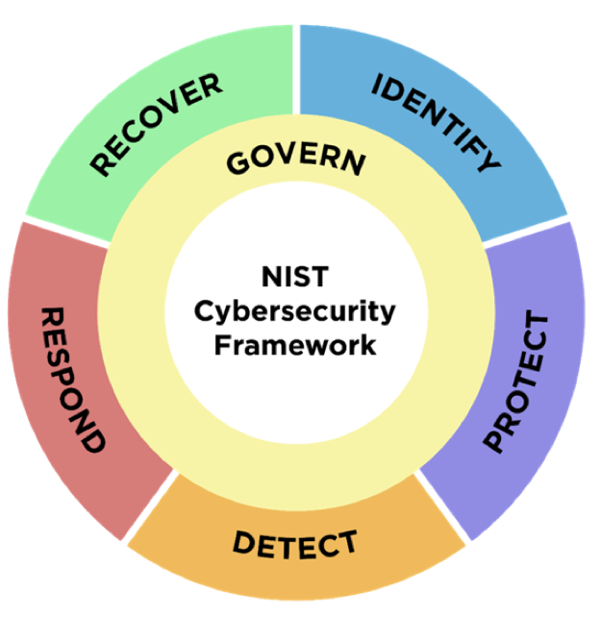
CERN School on Security
Aimed at system managers expected to work with security in their day-to-day role
As opposed to cybersecurity professionals – but typically have a small number of these as well
Cover security lifecycle of a service
Risk management
Security architecture
AAI
Logging and Traceability
Virtualisation + cloud security
Container security
Vulnerability management
Application security
Security Operations Centres
Security operations
Incident response management
Forensics
Incident response exercise
IRIS Collaboration meeting, July 2025

Slide 14
Types of training: IRIS
In person training very effective in delivering broad curriculum
And team building within cohort
Impossible to scale this
How do we approach this for IRIS?
Approaches + Identify key topics
Continue discussion tomorrow
Identify additional external training
IRIS Collaboration meeting, July 2025

Slide 15
Upcoming topics: policy
Setting a flag for the future: IRIS does have a current set of security policies: www.iris.ac.uk/security
Clear from earlier discussions that not everyone is aware of these – but also we’re approaching the point at which a review would make sense
See also contemporaneous work in EGI/WLCG scope + AARC TREE
More on this soon
IRIS Collaboration meeting, July 2025

Slide 16
Upcoming topics: operational security
Focus on monitoring across IRIS
Site/organisation level
Part of IRIS CSIRT work: what would benefit from coordinated activity
Next SOC Hackathon: Bucharest, 15-17 September
Remote attendance possible
Identify where we could encourage additional IRIS/GridPP/DiRAC work in this area
Potential focus this time on growing toolset
Talk to David afterwards
Software vulnerability risk assessments
EGI Software Vulnerability group looking at future developments
Very important for IRIS/DRI scopes to best understand how to contribute to this work
IRIS Collaboration meeting, July 2025

Slide 17
Summary
In a continued high risk environment, security governance and risk management are key areas for development
Understand impact for IRIS: engage with broader DRI activities
Skills and training vital additional strand
IRIS Collaboration meeting, July 2025

Slide 18
Science and Technology Facilities Council
@STFC_Matters
Science and Technology Facilities Council
Notes:
The abstract pattern can be removed or repositioned if required. Be careful to ‘Send to Back’ so that it does not obscure any important information.

Slide 19
Notes:
The abstract pattern can be removed or repositioned if required. Be careful to ‘Send to Back’ so that it does not obscure any important information.

