Slide 1
Getting the best out of Jisc's Janet network
Christopher J. Walker

Slide 2
Overview
Janet Upgrades
Optical upgrades
Core Network upgrades
Network Performance
Testing tools
perfSONAR

Slide 3
Janet Upgrades
Optical backbone (Ciena)
Deployed 12 years ago
100G with 50GHz Channel width
88 channels (8.8 Tbps)
Fixed filters
C band (1550nm)
Upgrade to colourless add/drop
Wavelength Selective Switches (WSS) -> Flexgrid (done)
DWDM (to do)
Will give 400G /800G capability (75 GHz) – 23 Tbps

Slide 4
Janet Upgrades
Routers
Core router upgrade
Next couple of years
400/800G likely
Coherent optics?
Southern network to go to 1.6 Tb (4*400G or 2*800G)
Significantly less power

Slide 5
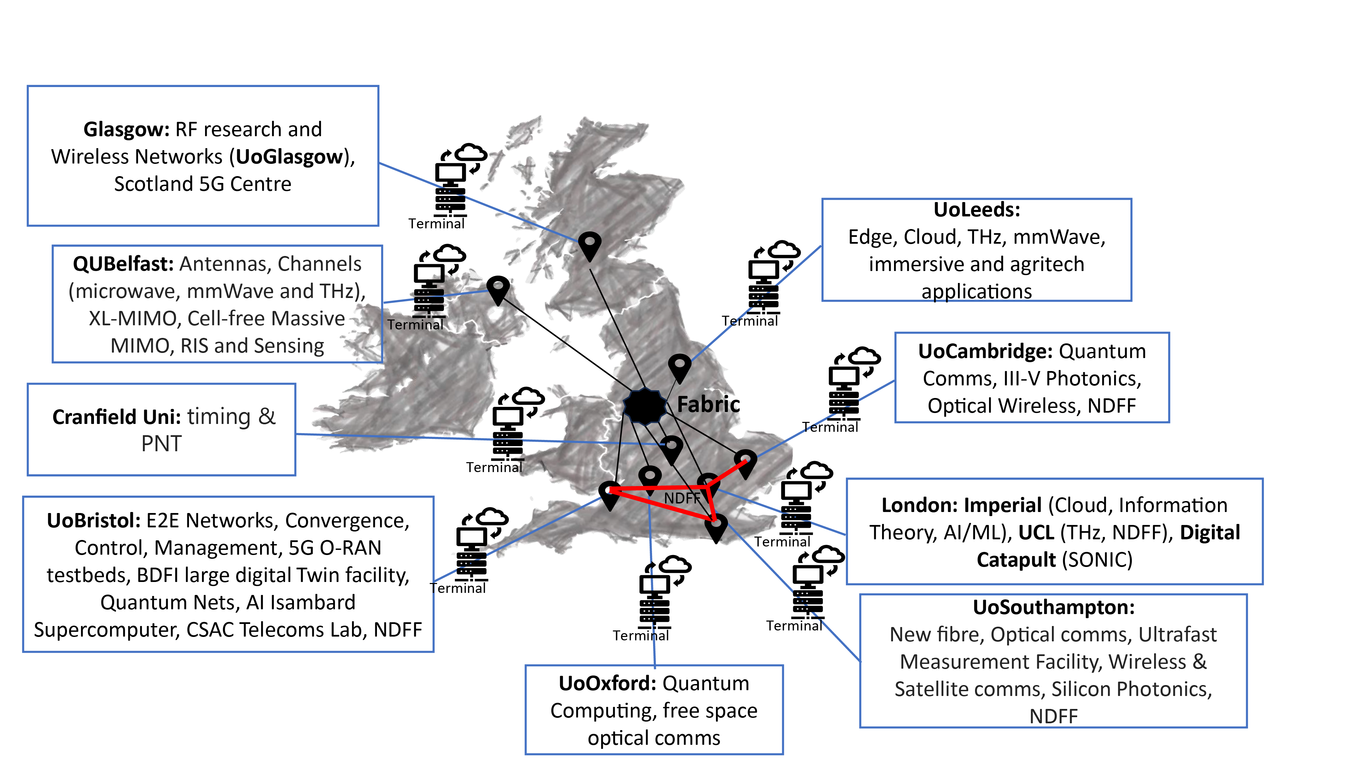
Joiner – Telecoms research and NDFF
Joiner - Layer 2 overlay network
Federated testbed for telecom ecosystem research, fostering sharing of experimental resources and introducing new technologies.
Dublin node being added (with HEANet)
National Dark Fibre Facility (NDFF)
Fibre for photonics/quantum etc

Slide 6
Global links
Geant (European NRENs)
Submitted EuroHPC hyperconnectivity bid (EU27) for Terrabit connectivity
Global R&E Networks (GREN)
Optimised for low loss – for large science flows

Slide 7
Thoughts
What does this unlock
Potential capability
Move data to compute
On demand
Real time
Location of compute
Move compute rather than electricity
Storage federation
Can’t get faster than the speed of light (in glass)
Time / frequency services
Fibre Sensing

Slide 8
Network performance test facilities - Jisc
Slough and London
IPv4/IPv6
9000 MTU
Iperf (iperf2/3)
RIPE Atlas Anchor
100Gbit Data Transfer Node
Delivered on Monday
Installation soon
Globus
What else do people want?

Slide 9
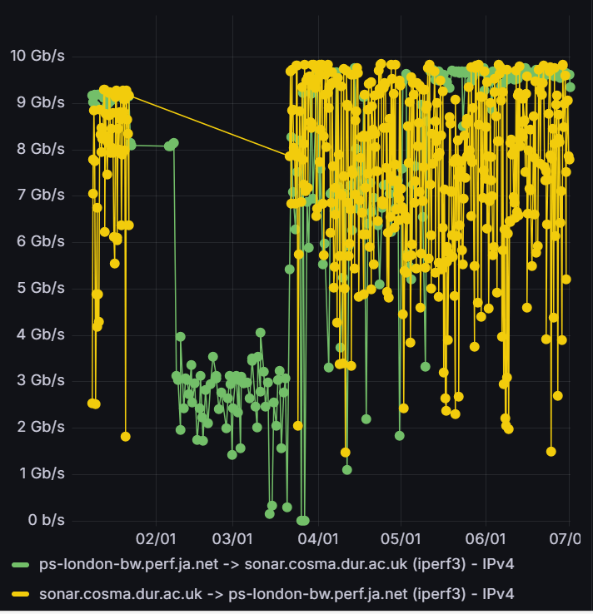
perfSONAR
HPC mesh
netperf@jisc.ac.uk to join
Latency/bandwidth monitoring

Slide 10
perfSONAR
Custom Dashboards
XLZD mesh
Time Synchronisation mesh

Slide 11
Jumbo Frames
Jumbo Frames = MTU=9000
Durham requested Jumbo Frames
“Writing the tickets took longer than the change” (Jisc colleague)
Jumbo frames across campus took longer.
perfSONAR shows a (small) difference
Capped by link (single stream max 10Gbit)
Globus
TBC

Slide 12
perfSONAR
Time Synchronisation
Chrony.conf changes:
server ntp5.ja.net minpoll 5 maxpoll 5 iburst
# Previously default minpoll/maxpoll 6
lock_all
Sysconfig: vm.swappiness from 60 to 1

Slide 13
Jisc Communities
Research network engineering (RNE) community group – Jisc
Digital research community group – Jisc
Networkshop community group – Jisc *NEW*
Cyber security community group - Jisc

Slide 14
Christopher J. Walker
Research Support Senior Manager
Christopher.Walker@jisc.ac.uk

