Slide 1
Evaluating performance and power consumption of bulk Ceph storage configurations
Tom Byrne
STFC SCD Storage architect
Storage Infrastructure Group Leader

Slide 2
Agenda
Background
Testing setup and methodology
Initial performance findings
Initial power efficiency findings
Summary, next steps

Slide 3
Background
Introduction, what are we trying to do here?

Slide 4
Background: Introduction
In Storage Infrastructure, we run Ceph clusters with a range of storage densities and performances
Our clusters provide shared services to multiple user groups, which leads to challenges optimising storage for all access patterns
This is particularly true on Deneb and Arided, our cloud CephFS clusters
Deneb started off with 4TB HDDs, but now uses 8TB HDDs, which provides a mix of affordable capacity with ‘enough’ performance for the general-purpose use we see.
Arided uses ~4TB flash devices, providing performance for exciting usage patterns, albeit at a much higher cost
We’re always cautious about increasing HDD size on Deneb
Larger HDDs generally provide less performance-per-TB
HDD + wide geometry EC CephFS clusters are always in peril of running out of HDD IOPS (particularly read ops)
Our cautiousness places a limit on rack density, power consumption, and £/TB
Cluster | Description
Deneb | HDD based CephFS storage with EC data pools, supports ISIS, CLF, RFI and other IRIS users
Arided | Flash based CephFS storage with replicated data pools for STFC cloud users, user provisioned shares via manilla

Slide 5
Background: An opportunity
In 2024, STFC procured three types of hardware for our two STFC Cloud CephFS clusters with funding from IRIS, UKSRC (SKA) and STFC
The ‘Regular Deneb’ was a normal refresh for the cluster, replacing aging out hardware and increasing capacity
The ‘Dense’ specifications are significantly denser compared to the existing clusters hardware and were bought to evaluate suitability of these denser formats
(they may not be fit for purpose in the named cluster, although we will have use for them somewhere, e.g. Dense Deneb for UKSRC bulk storage)
Specification | Nodes | Data devices | Capacity | £/usable TB* | Funded by | Notes
Regular Deneb | 10 | 24 x 8TB HDD | 2.0PB | 106 | IRIS | All specs have single 100GbE networking RAM and CPU aimed at capacity HDD storage has ~5% NVMe for metadata
Dense Deneb | 5 | 24 x 22TB HDD | 2.7PB | 63 | UKSRC
Dense Arided | 6 | 24 x 15TB TLC NVMe | 2.1PB | 258 | UKSRC & STFC
* Cost for servers only, Assuming 8+3 EC pool and 20% administrative headroom, including VAT

Slide 6
Hardware!
6 x Dense Arided
10 x Regular Deneb
5 x Dense Deneb

Slide 7
Background: Evolutionary dead ends?
In the changing world of storage hardware, when does a midsize HDD based solution make sense?
Let’s evaluate the suitability of the current Deneb hardware vs…
a denser HDD solution – can it provide enough performance while being meaningfully cheaper, smaller, more power efficient?
a large NVMe based solution – can we quantify the performance benefits? Are their other benefits?
Also, an opportunity to evaluate EC vs replicated on dense Flash configurations – to guide Arided evolution

Slide 8
Testing
Setup, methodology

Slide 9
Testing: Setup
ID TYPE NAME
-26 1.72705 root regular-deneb
-29 0.19189 host sn248
-31 0 host sn249
-33 0.19189 host sn250
-35 0.19189 host sn251
-37 0.19189 host sn252
-39 0.19189 host sn253
-41 0.19189 host sn255
-43 0.19189 host sn256
-45 0.19189 host sn258
-47 0.19189 host sn260
-25 2.01489 root dense-arided
-49 0.33582 host arided-sn161
-51 0.33582 host arided-sn162
-53 0.33582 host arided-sn163
-55 0.33582 host arided-sn164
-57 0.33582 host arided-sn165
-59 0.33582 host arided-sn166
-23 2.39868 root dense-deneb
-13 0.47974 host sn246
-15 0.47974 host sn247
-21 0.47974 host sn254
-19 0.47974 host sn257
-17 0.47974 host sn259
-1 0.32042 root default
-11 0.11914 host sn118
-9 0.06976 host sn235
-3 0.04651 host sn53
-5 0.04651 host sn54
-7 0.03850 host sn55
All nodes added to a development cluster under separate CRUSH roots
Pools created on each hardware type
Targeting ~100 PGs in-use per OSD per pool
Single OSD per block device
Erasure coded m=8 k=3 pools, 32kB stripe width
Also, a 3-replica pool on the SSD hardware
A collection of scripts to:
Run benchmarks across a set of client nodes, targeting one pool
Collect and aggregate benchmark results
Collect power usage via ipmitool, telegraf, influx
Jupyter notebooks, Pandas, Seaborn for aggregation of benchmarking and power data and subsequent analysis

Slide 10
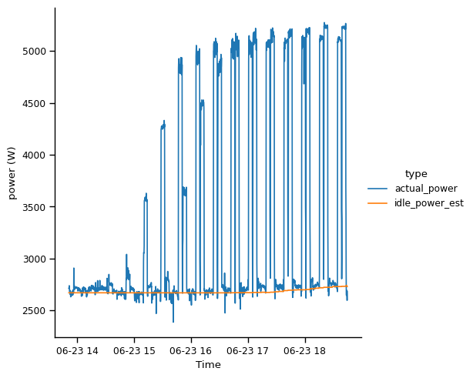
Testing: Methodology
Sweeps of benchmarking thread counts to find performance limits
Small and large block sizes to identify IOPS and BW limits (32K, 8M)
50:50 mixed reads and writes for now, more scenarios to follow
Estimate additional power draw over idle to allow power-per-performance measurements
IPMI measured power usage and estimated idle power during a benchmarking sweep of Dense Arided hardware

Slide 11
Before we continue…
This is a (slightly rushed) work in progress
I’m happy to present some results and draw some initial conclusions at this stage
I think it will have value to the community,
and I’m hoping for some feedback…
…but results are likely to change with further testing
And conclusions may change, especially if there’s a fundamental issue with the methodology or analysis!

Slide 12
Initial performance findings
IOPS and bandwidth, performance per capacity, performance per price

Slide 13
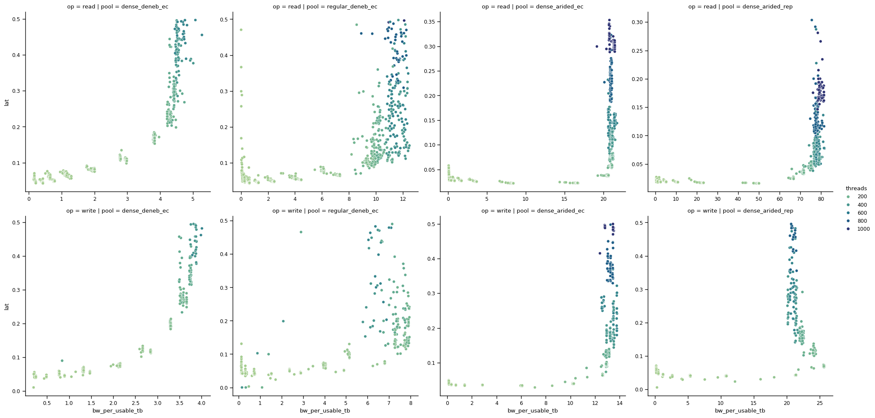
A taste of the data…
Average client operation latency (seconds) against client bandwidth (MBps per usable TB),
50:50 r/w mixed 8MB random IO operations,
exponential sweep (1 - 1024 client pairs)
Results not final!

Slide 14
Performance observations – Mixed workloads on EC
Results not final!
Normalising the max performance achieved on each configuration by usable PB, we can compare the solutions
HDD based solutions limited by HDDs in all cases
The large 22TB HDDs have very limited read IOPS per capacity, and the wide EC geometry does not help here
Dense Arided limited by networking in streaming benchmark, CPU in IOPS benchmark
The SSDs are essentially idling in both cases (400MB/s & 10k IOPS)

Slide 15
Replicated vs EC on flash
Results not final!
Bandwidth performance somewhat comparable
Replicated reads more efficient from a network standpoint as no inter-cluster transfer required
Replicated writes will be less efficient as more inter-cluster transfer required
For IOPS intensive workloads, still hard to beat replication on performance, even looking at performance per price/raw capacity.
These nodes were running out of CPU in the EC configuration, 7-8 more subops required for a client operation means lots more work to do
It would be interesting to see the impact of narrower EC geometries on this disparity

Slide 16
Performance, at what cost?
Results not final!
Cost per bandwidth is amusingly consistent
For bulk capacity with streaming workloads, HDDs still a viable (and cheap) option?
Cost per IOPS trends in the direction you would expect

Slide 17
Performance conclusions*
Meaningfully less IOPS (3x) performance available from Dense Deneb (22TB HDD) compared to Regular Deneb (8TB HDD)
It could be risky to use these in an EC CephFS cluster without well controlled client IO suited to larger block sizes
Meaningfully more BW (1.5x) and IOPS (10x) available from Dense Arided
Compelling option for future Deneb purchases
Replicated still has meaningful performance benefits over EC 8+3
* Subject to change!

Slide 18
Initial power findings
Idle power usage, power increase per performance

Slide 19
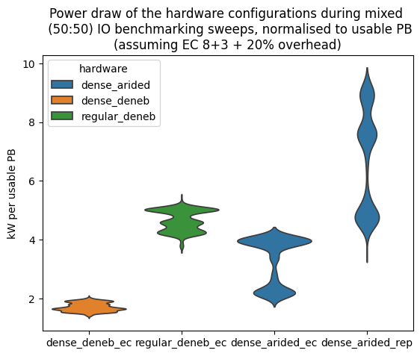
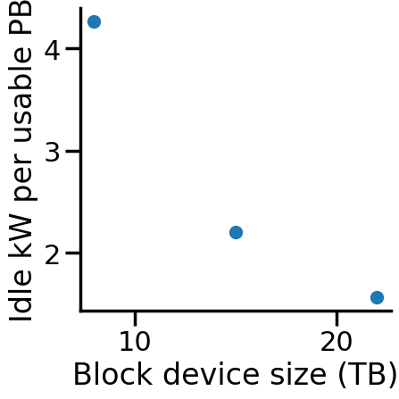
General observations
Results not final!
As expected, dense flash can consume significantly more power under load than dense HDD based solutions
However, the dense flash is surprisingly competitive at ‘idle’ power usages
Better than a similarly sized HDD solution?
 | Idle power usage (kW/PB usable) | Idle power cost per PB/year* | Perc. power increase seen over idle
Dense Deneb (EC) | 1.57 | £3438 | 21%
Dense Arided (EC) | 2.20 | £4818 | 80%
Regular Deneb (EC) | 4.26 | £9329 | 17%
Dense Arided (3 rep) | 4.76 | £10,424 | 87%
HDDs
SSD
Observations from a series of mixed IO workload sweeps
* Using a representative cost per kWh of 25p

Slide 20
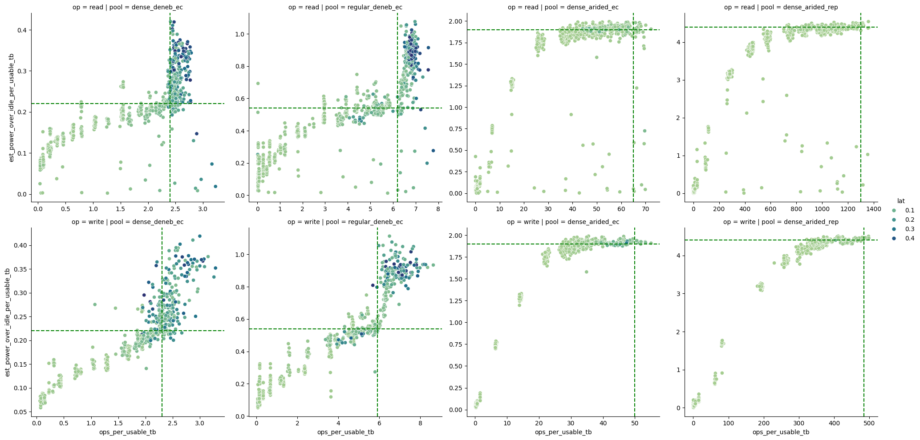
Estimated power above idle (watts per usable TB) against client bandwidth (MBps per usable TB)
50:50 r/w mixed 32KB random IO operations
exponential sweep (1 - 4096 client pairs)
Results not final!
We need to know cost per op per tb?
And power per ???

Slide 21
Power against performance
Results not final!
Taking the lowest power needed to achieve the max performance, we can compare the power needed to do GBps/kIOPS on each solution
The relationship between power and performance is interestingly non-linear, needs more investigation
The 3 hardware configurations are well matched for streaming power consumption with EC
The EC-on-flash solution is substantially more energy efficient for IOPS workloads, and the replicated-on-flash is more efficient again

Slide 22
Power conclusions*
Medium density HDD configuration seem to use significantly more power than dense HDD or SSD offerings at idle
As expected, more nodes = more power
Regular Deneb having over double the energy bill of the other EC configurations tested is a significant downside to the Medium density HDD (or Flash) configurations
Similar (normalised) power usage for streaming performance across all hardware
Not paying any more or less for performance, just pick the solution with the GBps/PB needed
* Subject to change!

Slide 23
Summary and next steps
Nearly there…

Slide 24
Next steps
Investigate effect of cluster fullness on power usage at rest, and performance
Investigate narrower erasure coding geometries impact on total available performance
70:30 R/W mixed tests
Investigate nonlinear relationships between power usage and performance
Estimate associated carbon costs of configurations
Embedded carbon per PB, associated carbon costs of power figures (Idle, power-per-performance)
Scientific rigour!

Slide 25
Summary*
The denser HDD based solution tested probably isn’t suitable for our current Deneb use-cases
But ideal for cheap, power efficient, streaming storage for use-cases that require large amount of online data
Factoring in the power reduction (0.5x) and performance benefits over Regular Deneb, it’s worth considering the Dense-Arided-style hardware as an evolution path for Deneb.
Price of now-current potential dense SSD specs (with 30TB+ drives and denser server form factors) should already be closing the price gap, although QLC performance not evaluated here.
Lots of benefits in moving to an equivalently priced flash solution for Deneb that uses a ~1/4th of the idle power and rack space, and provides ~5x the IOPS.
Replicated vs EC performance difference too large to overlook for Arided currently
Exploring narrower EC geometries may change this conclusion
* Subject to change!

Slide 26
Thanks for listening
Questions?

Slide 27
Results not final!

Slide 28
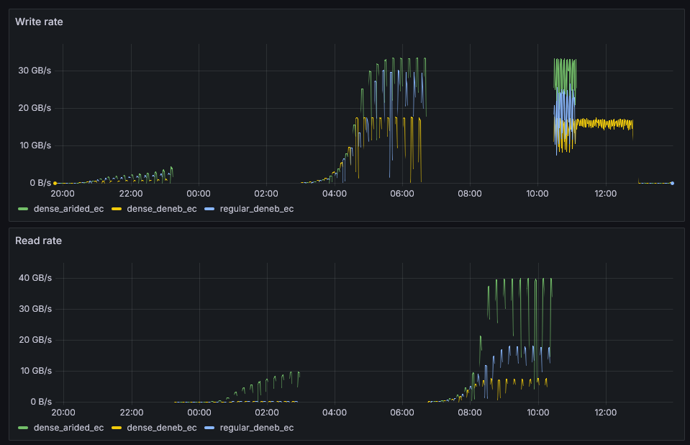
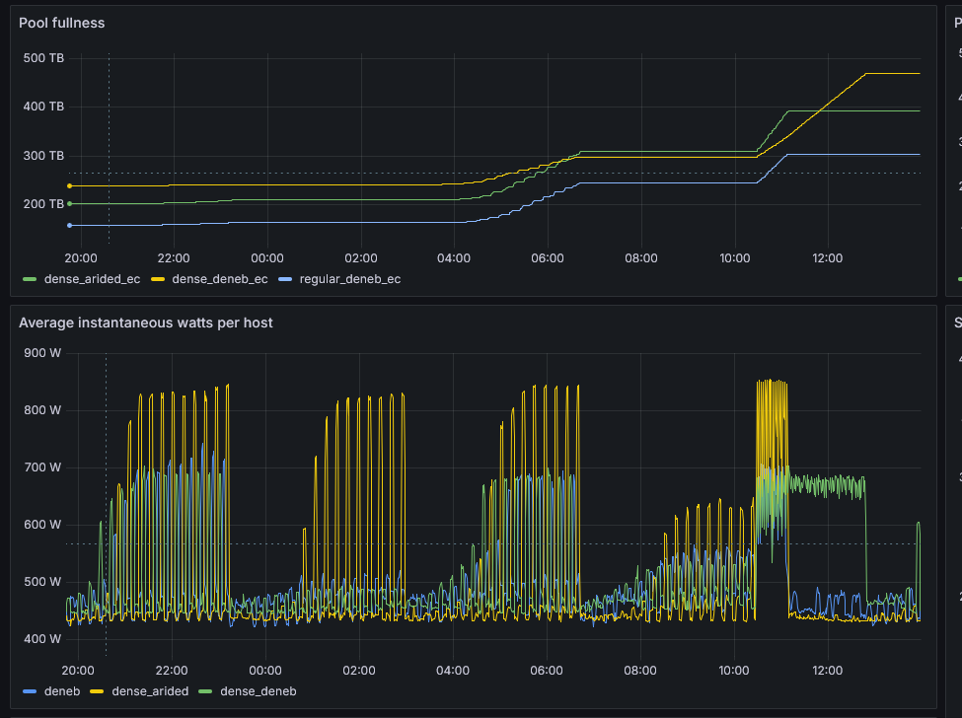
Testing: example run
8M write
sweep
10% fill
32K write
sweep
8M read
sweep
32K read
sweep

Slide 29
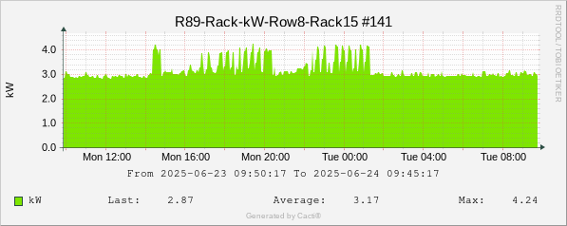
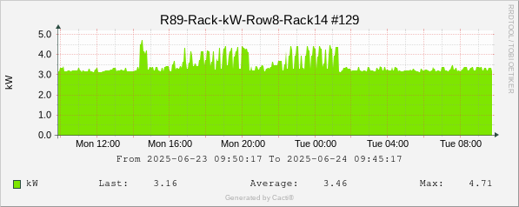
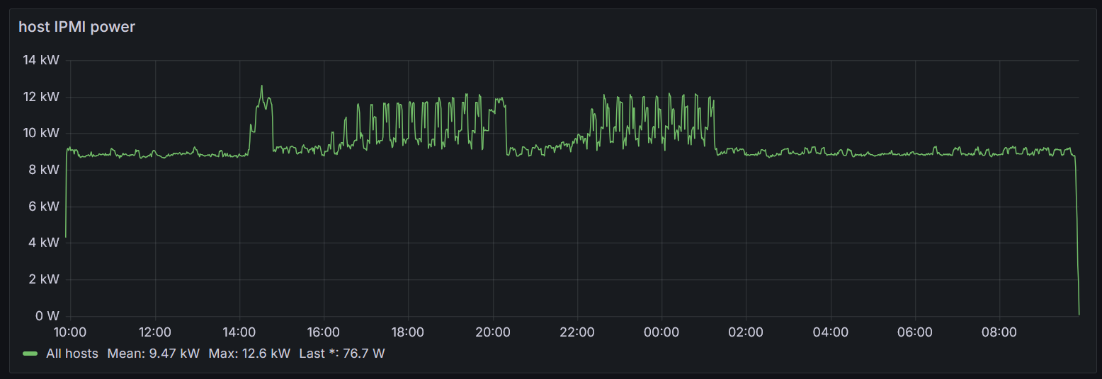
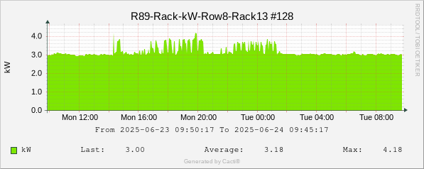
Validating host IPMI power consumption measurements
The sum of rack PDU readings consistently slightly higher than the sum of hosts IPMI readings
9.81kW vs 9.47kW average over the 24h period observed – 3.5% higher
13.13kW vs 12.6kW peak – 4.0% higher
IPMI power results reliable enough for this testing, but more rigorous validation required

Slide 30
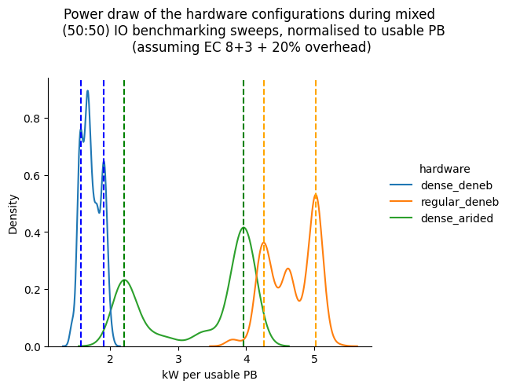
Power consumption

