Slide 1
Towards Efficient Workflows with STFC and CCP4 Cloud
Ville Uski, CCP4, STFC
IRIS collaboration meeting, 2nd July 2025

Slide 2
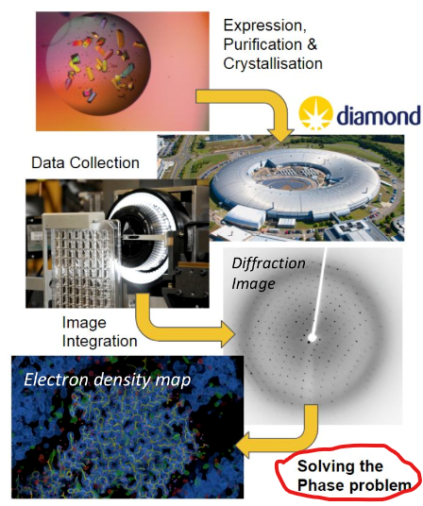
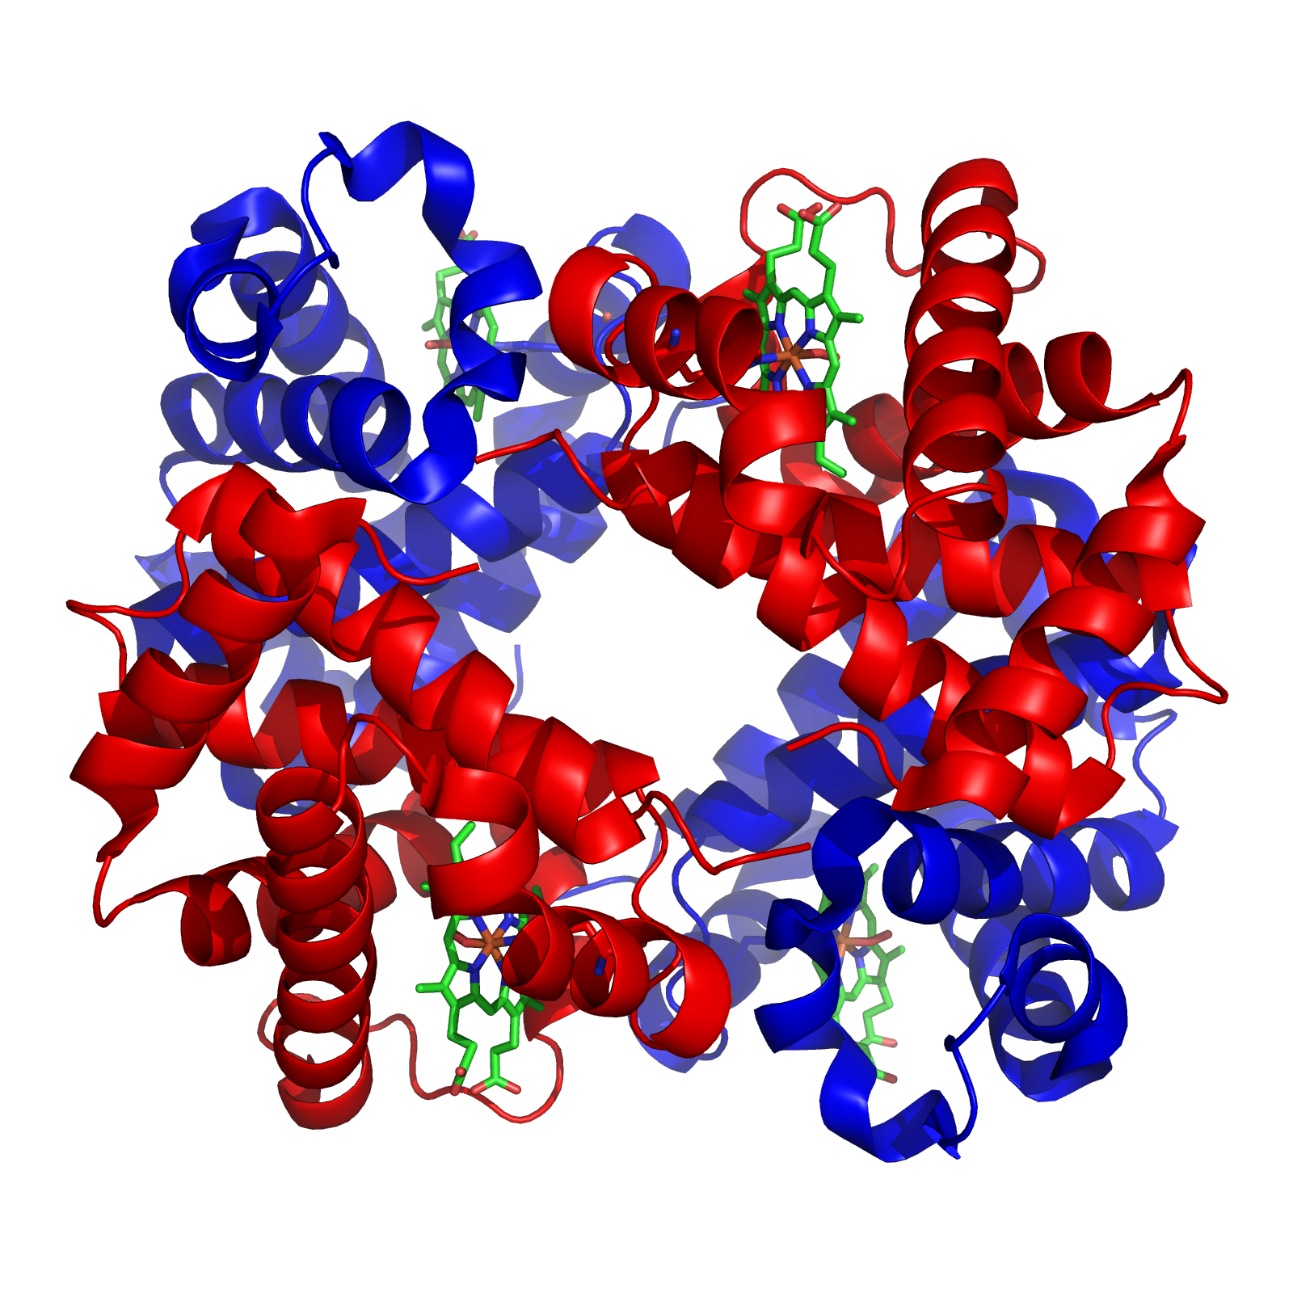
Macromolecular crystallography (MX)
the gold standard for determining 3D structures of proteins and other biological molecules.
enables insights into how proteins function, how drugs bind, and how to design better therapeutics.

Slide 3
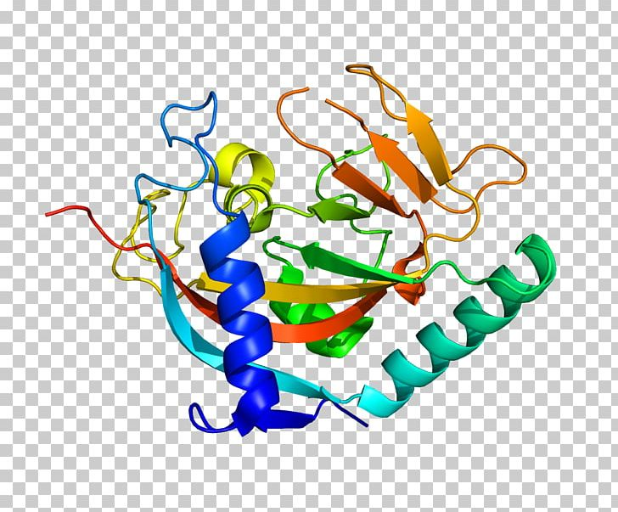
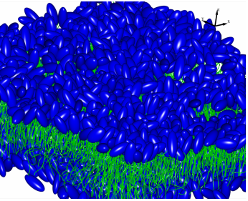
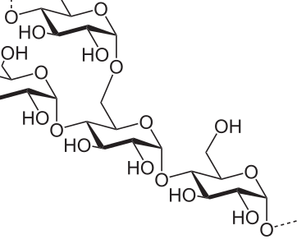
Software for Macromolecular X-Ray Crystallography since 1979
It is used for solving structures of macromolecules: proteins, carbohydrates, lipids, RNAs, DNAs.
Implement many complementary algorithms for all stages of the structure solution.
CCP4 is supported by the Biotechnology and Biological Sciences Research Council (BBSRC) and the industrial income.

Slide 4
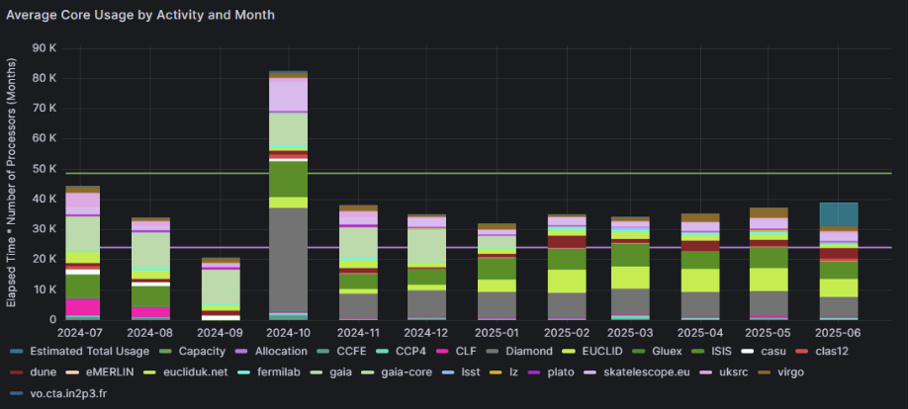

Slide 5
The Evolving Landscape of MX
AlphaFold and multi-crystal experiments have made structure prediction more accessible
But modern beamlines collect data faster than traditional software can handle
High throughput requires scalable, automated solutions.

Slide 6
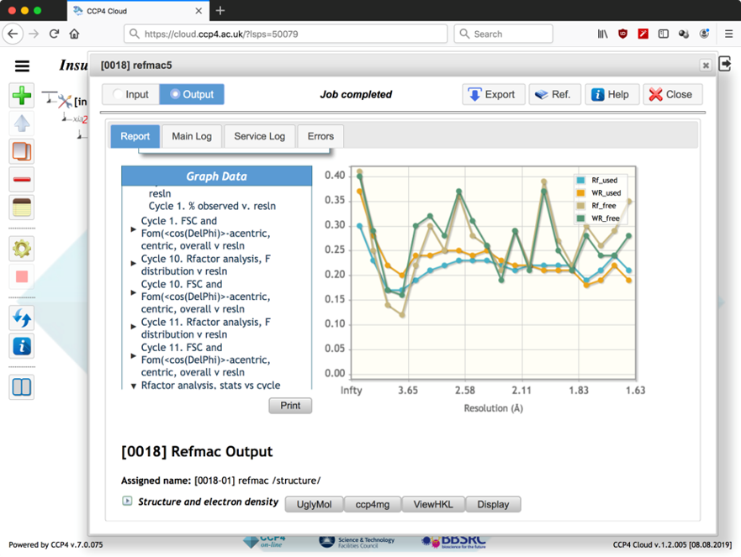
CCP4 Cloud
Web-based platform for solving macromolecular structures from X-ray data.
Built on CCP4 suite with cloud-native, automated workflows.
ccp4.cloud.ac.uk is an instance of CCP4 Cloud run by us

Slide 7
CCP4 Cloud: Number crunchers
When users start new tasks (or workflows) on the CCP4 Cloud front-end, tasks are sent to run on ‘number crunchers’.
NC’s are daemon processes on remote servers, submitting to a job scheduling system, such as Slurm.
cloud.ccp4.ac.uk uses several number crunchers
ccp4 servers
Virtual CPU cluster in STFC Cloud (RAL cloud)
Virtual GPU cluster in STFC Cloud

Slide 8
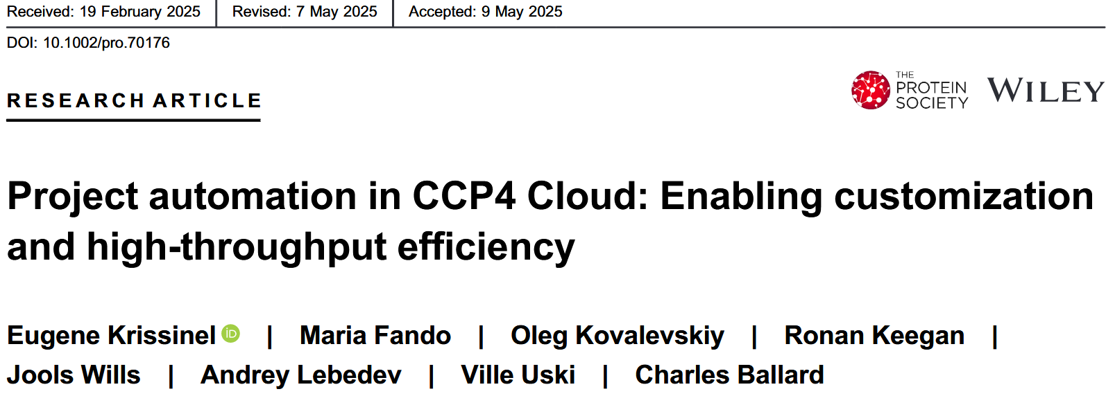
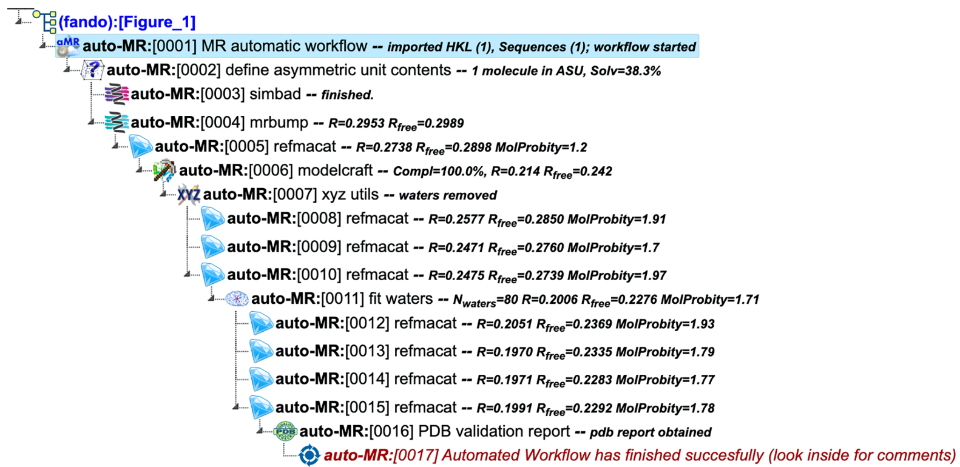
From Manual Pipelines to Automated Workflows
CCP4 Cloud features:
Predefined workflows for structure solution.
Custom workflows via WScript for tailored experiments.
Integration with beamlines and remote data collection.
Benefits:
Reduces manual intervention.
Enables reproducibility and scalability.
Supports both novice and expert users.

Slide 9
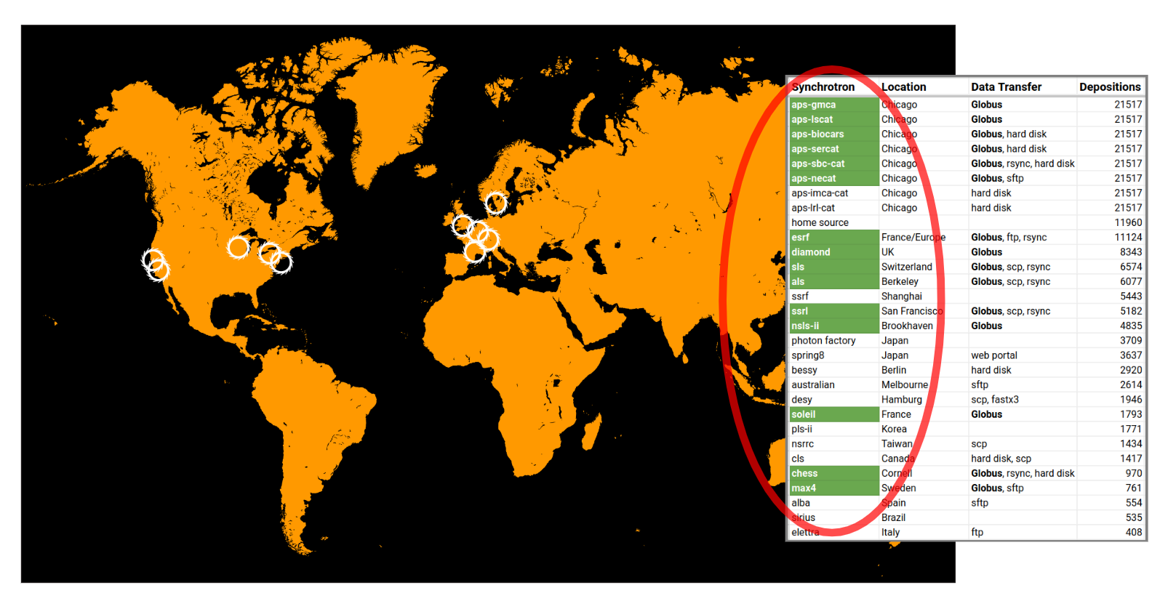
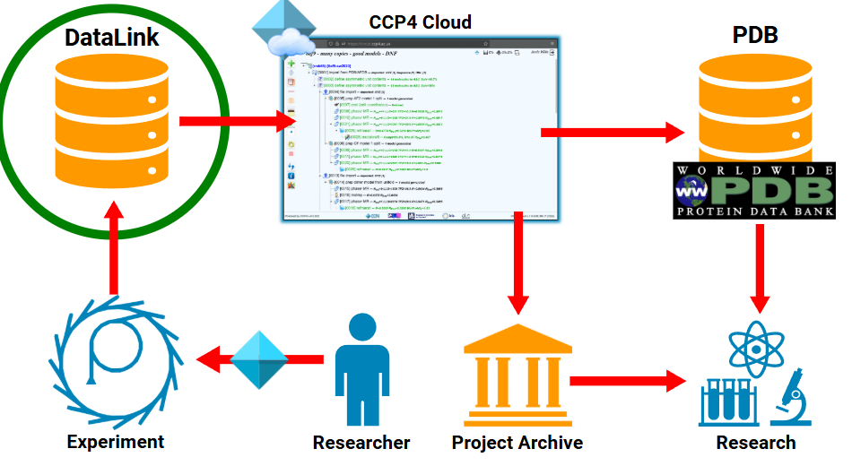
DataLink: Connecting data sources with CCP4 Cloud

Slide 10
Resource usage patterns
Peaks and idle times: Static cluster deployments often lead to either underutilization (wasted resources/cost) or insufficient capacity (jobs waiting)
Most tasks run fast but complex workflows can lead to serious number crunching
Motivation for dynamic resource allocation

Slide 11
ElastiCluster
github.com/elasticluster/elasticluster
from University of Zurich
creates ‘elastic’ HPC clusters of VMs on the cloud and configure them with Ansible.
INI-style configuration file to define cluster templates
Allows resizing, but this is slow and hard to automate

Slide 12
Auto-scaling with OpenStack Heat?
“Heat is the core orchestration engine in OpenStack that manages the lifecycle of cloud resources, including virtual machines.”
Heat templates define scaling policies that specify the conditions under which instances should be added or removed.
But it didn’t work.

Slide 13
Terraform
Packer
infrastructure-as-code tool from that enables the automation of infrastructure deployments and management
infrastructure-as-code tool that automates the creation of VM images

Slide 14
Slurm’s power saving parameters
ResumeProgram: Path to a custom script executed when Slurm needs to power up a cloud node.
SuspendProgram: Path to a custom script executed when Slurm decides an idle node can be powered down.
ResumeTimeout & SuspendTimeout: Maximum time Slurm waits for script completion/node readiness.
SuspendTime: Duration a node must be idle before Slurm considers it for suspension.

Slide 15
Auto-Scaling with Slurm and Terraform
‘Hybrid’ solution
Terraform to provision and configure static infrastructure in OpenStack
custom scripts that interact directly with OpenStack APIs for dynamic compute node management
Packer to create and update base compute node images with the latest CCP4 suite

Slide 16
Autoscaling Workflow
CCP4 Cloud submits a new task to a number cruncher
Slurm needs resources; it executes ResumeProgram
ResumeProgram calls the OpenStack Nova API to create node
OpenStack provisions the VM. cloud-init configures a Slurm compute node, which registers itself with slurmctld via scontrol update
Job execution
Job completion
Suspend trigger
Instance deletion

Slide 17
Current Status
CCP4 Cloud has implemented automated workflows and allow custom ones
DataLink is in production
Terraform-powered auto-scaling cluster still in ‘dev’ stage but looks promising

