Slide 1


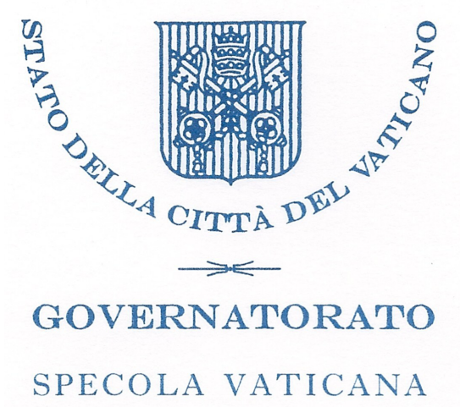

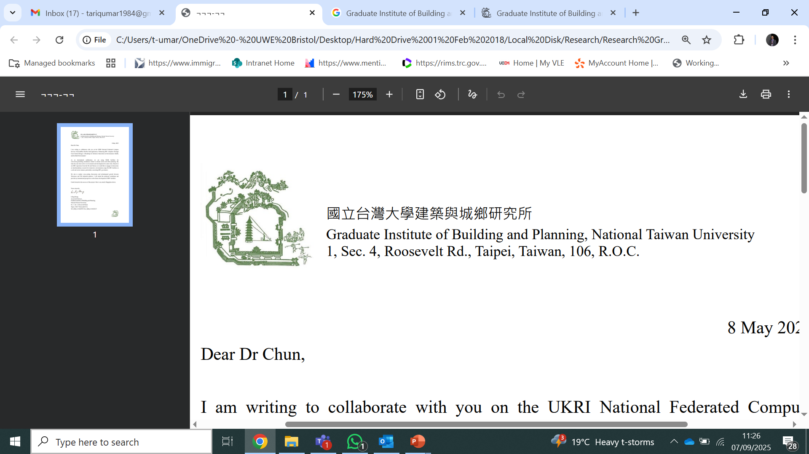


Autumn Conference
22-23 September 2025
Enhancing HPC Adoption Through User-Centred Design
A Roadmap for Inclusive Innovation in Environment, Health, and the Built Environment
Dr Tariq Umar
Imperial College London
Notes:
Good morning, I’m Dr. Tariq Umar from UWE Bristol, and today I’ll present our project: Enhancing HPC Adoption Through User-Centred Design.”
“This project is funded under the UKRI NFCS Flexible Funding call and focuses on making high-performance computing more inclusive, usable, and trusted across health, environment, and the built environment sectors.”

Slide 2
Why? (Motivation)
HPC powers climate modelling, healthcare analytics, infrastructure simulation.
Barriers remain:
- Complex access procedures
- Awareness & training gaps
- Trust, privacy & governance concerns
Many potential users are not yet engaging with HPC.
Motivation: Make HPC usable, trusted, and inclusive.
Notes:
“HPC powers breakthroughs in climate science, healthcare analytics, and infrastructure modelling.”
“But many communities still face barriers: complex access processes, limited awareness and training, and concerns about trust, privacy, and governance.”
“Our motivation is to bridge this gap—making HPC not just powerful, but also usable, trusted, and accessible for all sectors, not only for computational specialists.”

Slide 3
Project Aim and Objectives
Aim:
To make UK HPC more accessible, trusted, and inclusive
Co-design a user-centred roadmap for a national HPC federation
Directly aligned with NFCS NetworkPlus pillars: Community, Technology, Governance

Slide 4
Project Aim and Objectives
Objectives
1. Identify barriers to HPC access (Community & Governance)
2. Co-design roadmap for inclusive HPC federation (Cross-cutting)
3. Understand technical challenges post-access (Technology & Community)
4. Explore trust, safety, and governance across sectors (Governance & Community)

Slide 5
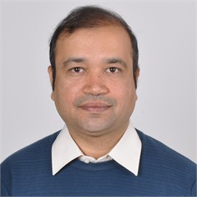
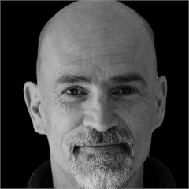
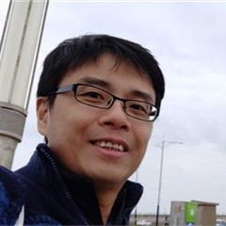
Project team
Dr Tariq Umar
https://people.uwe.ac.uk/Person/TariqUmar
Dr Kwok Chun
https://people.uwe.ac.uk/Person/KwokChun
Prof Jim Smith
https://people.uwe.ac.uk/Person/JamesSmith

Slide 6

Methodology:
Surveys → capture current barriers & needs
Workshops (NHS, construction, environment, international)
Focus groups → expert users
Facility visits & training → test practical onboarding packages

Slide 7

Who? (Stakeholders)
Process (delivery team):
- UWE Bristol (PI & Co-Is)
- Collaborators: Imperial, NTU Taiwan, Vatican Observatory, ITU Turkey, Coventry, Arcadis
Outcome (beneficiaries):
- NHS & health researchers
- Built environment & construction professionals
- Environmental scientists
- Industry partners
- Policymakers & funders
Notes:
“For the delivery process, we have a strong team at UWE Bristol with collaborators from Imperial College, NTU Taiwan, Vatican Observatory, ITU Turkey, Coventry University, and Arcadis Consulting.”
“For the outcomes, our beneficiaries are broad: NHS and healthcare researchers, construction and built environment professionals, environmental scientists, industry partners, and policymakers.”
“By bringing all these voices together, we ensure that the roadmap reflects real-world user needs across diverse communities.”

Slide 8
What? (Contributions)
By project end (July 2026):
- User-centred roadmap for national HPC federation
- Recommendations on access, usability, governance
- Personas & use cases for onboarding/training
Beyond project:
- Wider adoption pathways (NHS, construction, environment)
- Influence NFCS policy pillars
- Position UK in global HPC federations
Notes:
“By the end of the project, we’ll contribute to a user-centred roadmap for a national HPC federation.”
“We’ll provide recommendations on how to simplify access, improve usability, and ensure trusted governance models.”
“We’re also creating user personas and use cases that will directly inform training and onboarding.”
“Beyond the project, this work will open adoption pathways for NHS, environment, and construction communities, influence NFCS policy pillars, and position the UK as a leader in global HPC federations.”

Slide 9

Activities & Timeline
2025: Ethics approval, stakeholder survey, NHS & Built Env. workshops
Early 2026: Environmental sciences workshop, international engagement
Spring 2026: Focus groups, facility visits & training
Summer 2026: Final roadmap, recommendations, dissemination
Notes:
“The project runs from mid-2025 to July 2026.”“In 2025, we begin with ethics approval, stakeholder surveys, and the first workshops with NHS and built environment communities.”
“In early 2026, we’ll engage environmental scientists and international participants.”
“Spring 2026 will be dedicated to focus groups and facility visits with training activities.”“By summer 2026, we’ll finalise the roadmap, publish recommendations, and widely disseminate the findings.”

Slide 10
Expected Impact
Community: widen HPC participation (esp. underrepresented).
Technology: interoperable, user-friendly workflows.
Governance: trusted, secure collaboration models.
Long-term: UK leadership in international HPC federations.
Notes:
“Our work contributes directly to the NFCS pillars.”
“For Community, we’ll widen participation, particularly from underrepresented users.”
“For Technology, we’ll recommend interoperable, user-friendly workflows.”
“For Governance, we’ll propose transparent and secure models to foster collaboration.”
“In the long-term, this will position the UK as a leader in international HPC federations and ensure its competitiveness in global digital research infrastructure.”

Slide 11
Closing
Why? Inclusive HPC adoption matters.
Who? NHS, environment, construction, academia, industry, policy.
What? A roadmap shaping UK’s HPC future.
Notes:
“To summarise: Why? Because HPC adoption must be inclusive and trusted. Who? A diverse network of stakeholders from health, environment, construction, industry, and academia. What? A user-centred roadmap that will shape the future of the UK’s HPC federation.”
“This project is not only about technology—it’s about people, usability, and trust.”
“Thank you, and I welcome your questions.”

Slide 12
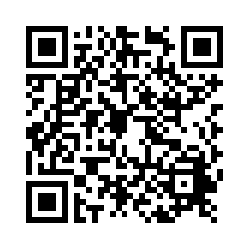
We need your help
We want to research to sider participants
Participate and share our survey

