Slide 1


Autumn Conference
22-23 September 2025
Federation of Compute and Infrastructures in the Arts and Humanities
Prof Karina Rodriguez Echavarria, Dr Myrsini Samaroudi
University of Brighton

Slide 2
Our aim is to engage with the A&H communities to collectively elicit requirements around federation within the current DRI A&H landscape to support the NFCS roadmap development

Slide 3


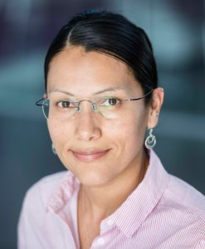
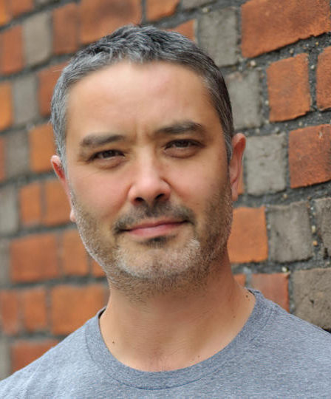
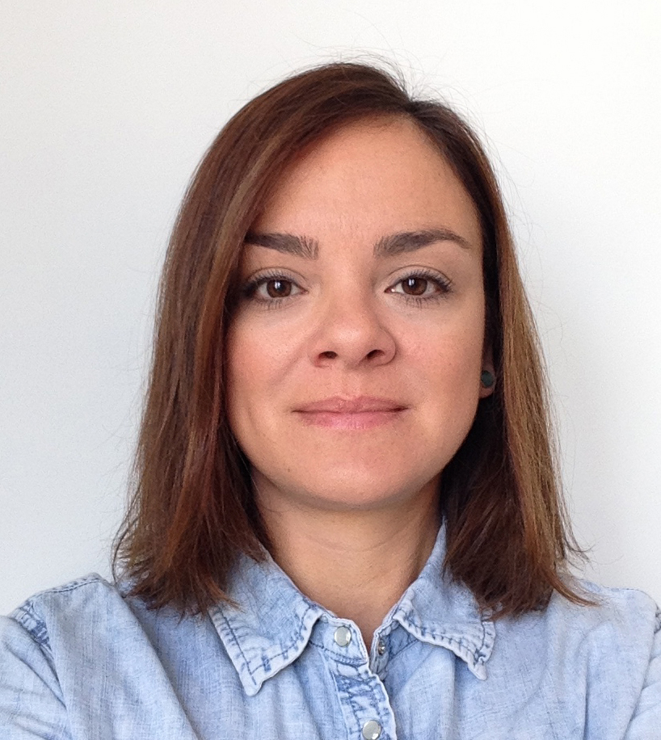


Project team
Dr Arianna Ciula
King’s College London
KDL
Matt Penn
King’s College London
eResearch
Prof. Karina Rodriguez Echavarria
University of Brighton
Neil Jakeman
King’s College London
KDL
Dr Myrsini Samaroudi
University of Brighton

Slide 4

Context
Builds on existing research and projects which produced insights about workflows, and practices.
Specific to the A&H research landscape.
      Challenges include the disciplinary culture of research, large-scale and complex data, and digital literacy.
      Some opportunities to explore data-driven workflows and AI-driven methods.

Slide 5

Core objectives
Elicit and validate federation requirements in A&H communities:
2. Collect feedback on the national strategic roadmap
Emerging federation-related ​user stories for workflows ​
​Skills gaps and opportunities for training and access of expertise ​

Slide 6
Activities
Pilot and launch the survey
Organise stakeholder event/s focusing on user stories and piloting training.
Close survey and analyse results
Design survey on key requirements for federation practices in the A&H
Stakeholder event(s)
Ethics approvals
Project starts
Project ends
September 2025
October 2026
December 2026
February 2026
June 2026
July 2026
Coordinate, document, and communicate evidence to roadmap informed by the A&H research landscape

Slide 7

Thank you

