Slide 1



Autumn Conference
22-23 September 2025
Federated Edge-HPC Architectures for AI workflows in Privacy-sensitive and Real-time Domains
Presenter: Dr Theodoros Spyridopoulos
Notes:
Federated Edge–HPC Architectures for AI Workflows in Privacy-Sensitive and Real-Time Domains

Slide 2
Project team
Project Lead
Dr Theodoros Spyridopoulos (Cardiff University)
Project Team Members
Prof Omer Rana (Cardiff University)
Prof. Rajiv Ranjan (Newcastle University)
Dr Varun Ojha (Newcastle University)
Dr Yinhao Li (Newcastle University)
Dr Dev Jha (Newcastle University)
Co-leads
Dr Tomasz Szydlo (Newcastle University)
Notes:
Computer Science & Informatics

Slide 3
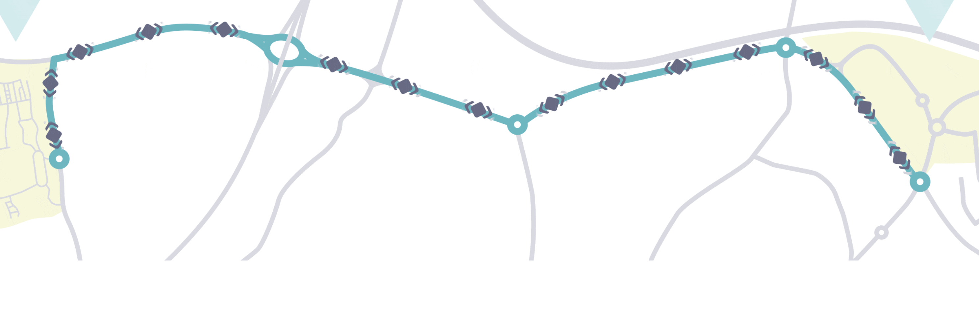
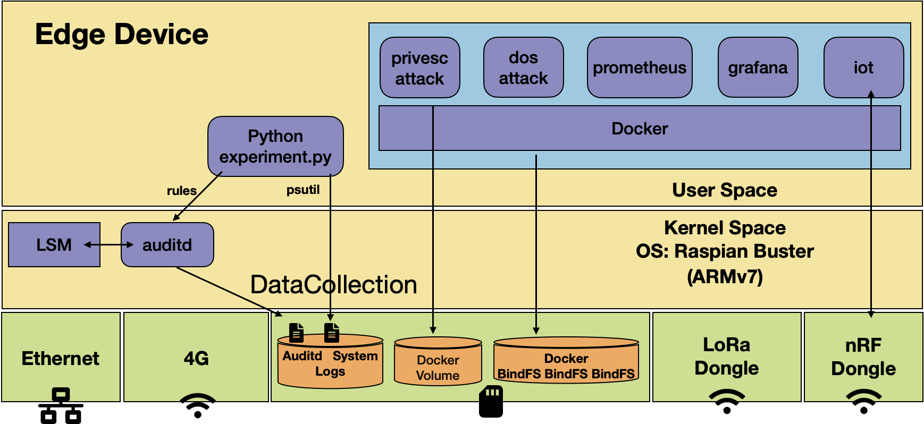
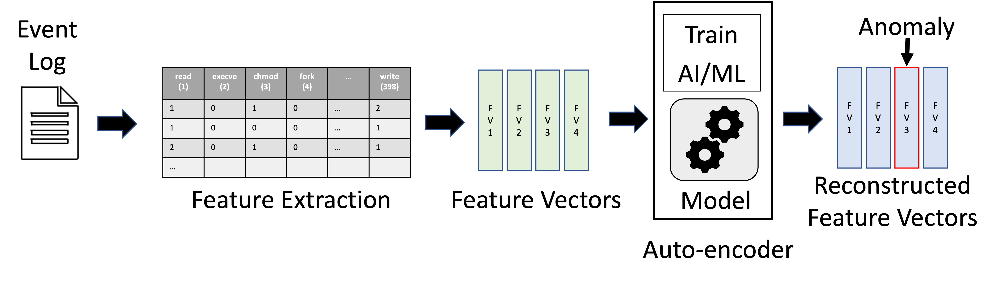
Motivation
SYNERGIA - Secure bY desigN End to end platfoRm for larGe scale resource constrained Iot Applications (£2.2M UKRI-funded, Nov 20 - Oct 22)
- Intrusion/Anomaly Detection at the IoT Edge Using Federated Learning
7.2 km road
Over 200 sensing nodes
100 Edge AI nodes
Low Confidence scored outputs sent to a human expert

Slide 4
Motivation
Real-time decision-making and privacy-preserving resource-heavy computation
Healthcare – Federating local TREs with HPC; Example: Synthetic data generated locally (e.g. at TRE level) used to train large models on HPC
Transport systems simulations – Federating local Digital Twins with HPC; Example: Localised combined higher-level Multi-agent simulations; Real-time traffic modelling (100K–500K vehicles)
HPC provides large-scale processing power; requires integration with local/edge infrastructure.
Can we use workflow tools (e.g. Pegasus) to design workflows on heterogeneous systems?
Need to explore feasibility of Edge–HPC federation.
Notes:
Trusted Research Environment – DARE UK

Slide 5
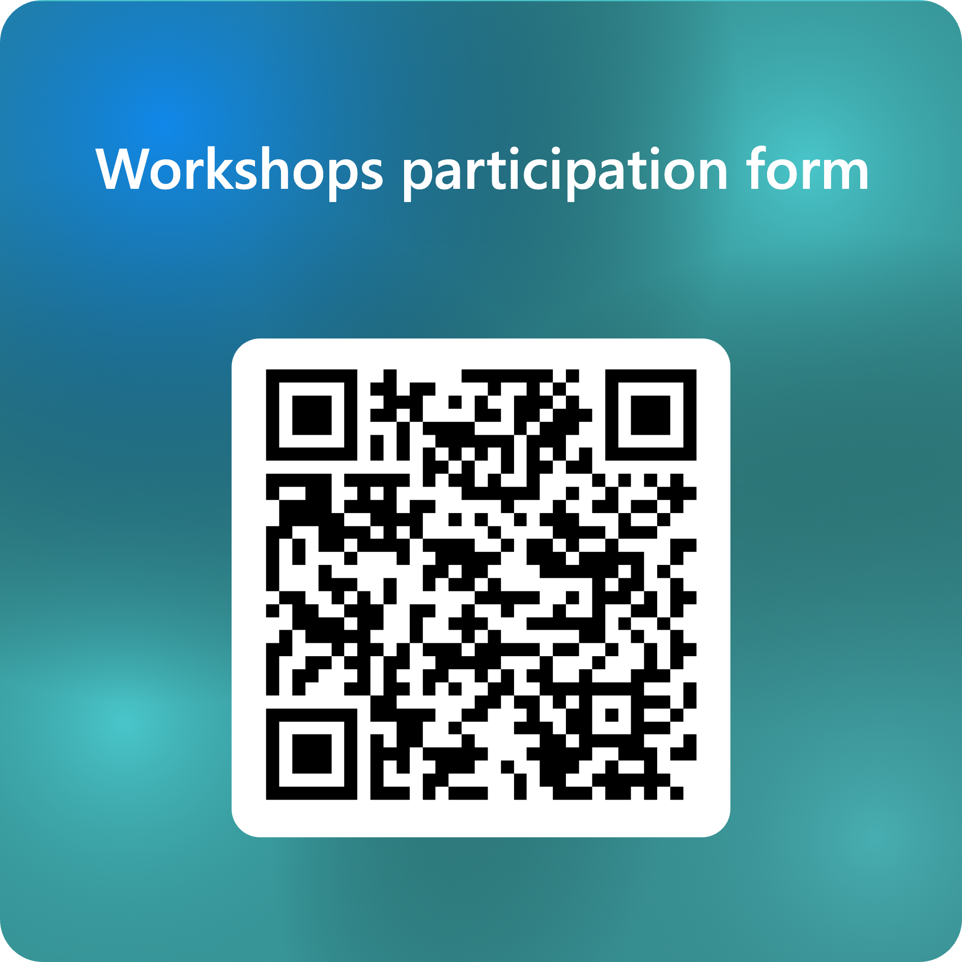
Aims
Evaluate federation between national HPC (Isambard AI) and local Edge infrastructures.
Build a user/stakeholder community in healthcare and transportation.
Develop and test workflows across the Edge–HPC continuum.
Identify technical and policy barriers to federation.

Slide 6
Pillars of the Project
Community Pillar
Engage healthcare & transport stakeholders ++ (Edge AI HUB partners, DARE UK projects etc.)
Generate user narratives to inform design.
Organise 3 workshops for co-design.
Technology Pillar
Build testbed integrating Edge and HPC (Cardiff and Newcastle Edge infrastructure; ISAMBARD AI)
Validate AI workflows across heterogeneous systems
Explore privacy-preserving and decentralised approaches.

Slide 7
Example Workflows
Edge: Privacy-preserving training (e.g. synthetic data generation).
HPC: High-performance model training on aggregated/synthetic data.
Edge/Endpoint: Model distillation for real-time inference on constrained devices.
Transform into a scientific workflow (Pegasus/Argo or similar workflow orchestrators) ready to be deployed on HPC/EDGE/Endpoint

Slide 8
Community Engagement Activities
3 workshops
Newcastle, Cardiff
November 2025*
January 2026
March 2026

Slide 9
Thank you

