Slide 1





Autumn Conference
22-23 September 2025
Federated AI Application Container Platform/Registry: a Feasibility Study
Frederic Brochu-Williams, University of Cambridge

Slide 2
Motivations

Slide 3
Motivations
AI applications are complex to install and setup.
Added complexity of specific hardware distribution (GPU/CPU) in HPC centres for processing -> management nightmare.
Our goal: to provide a curated, federated platform for established AI applications with built-in hardware detection and support for known data centres hardware distributions (DAWN, Isambard-AI), open-source to allow for future extensions (including research laptops).

Slide 4
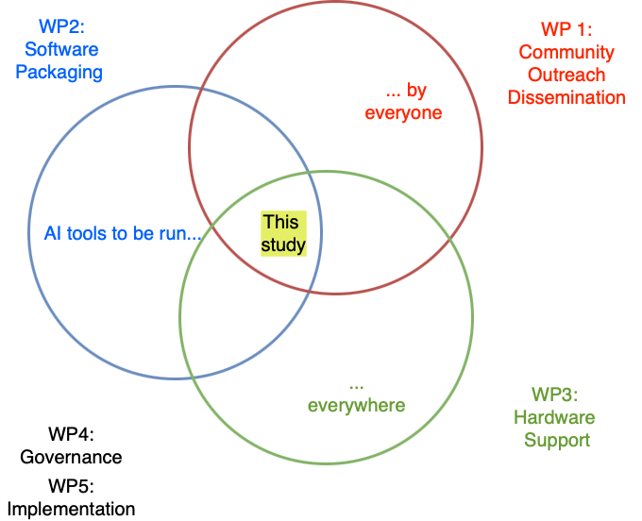
Introduction
Feasibility study: studying all 3 domains (User/ Tools/ Data Centre support) and maximising the overlap area.
Main deliverable: report on findings, possibly a prototype (stretch goal)
Although focusing on HPC running of AI apps, can look at AI apps running on laptops too.

Slide 5
Work Packages
WP1: Community/Technology Pillar. To assess the requirements of the UK AI research community through workshops and surveys.
WP2: Technology Pillar. To survey and evaluate the suitability of existing software packaging tools and platforms
WP3: Technology Pillar. To evaluate the key technical challenges in operating and managing a federated, hardware-optimised AI container service in Data Centres.
WP4: Governance Pillar. To investigate potential architectural and governance models for such a service
WP5: Synthesis Pillar. To produce a comprehensive feasibility report on the various findings of the previous WPs to directly inform the NFCS roadmaps.
WP6 (WP5 stretch goal): implement a limited prototype if time/resources and findings allow it.

Slide 6
Road map
Focused over 4 workshops:
1st workshop, introduction to the community, survey (WP1): satellite event on Day 2 of HPC-SIG meeting in Hartree, 23/10/2025.
2nd workshop, interim report on user requirements (WP1): UCL (Q4 2025-Q1 2026)
3rd workshop, report on Operation challenges (WP3) and Governance (WP4): Bristol, Isambard Day (if possible)
4th workshop, wrap-up: Cambridge.

Slide 7
Project team
Project Leads
Chris Edsall (Cambridge)
Project Team Members
Wojciech Turek (Cambridge)
Deepak Aggarwal (Cambridge)
Adam Walford (Cambridge)
Frederic Brochu-Williams (Cambridge)
Ethan Williams (Bristol)
Co-leads
Sylvie Da Graca Ramos (UCL)
Richard Gilham (Bristol)

