Slide 1



Autumn Conference
22-23 September 2025
ACCoRD – A Community for Contract Regulation for Data
Dr Claire Ellul
Dr Michelle Harricharan

Slide 2



Do not edit
How to change the design
Join at slido.com
#1719345
The Slido app must be installed on every computer you’re presenting from

Slide 3
Project team
Project Leads
Dr Michelle Harricharan
Dr Claire Ellul
Project Team Members
Dr Rahil Alipour
Katie Buntic
Dr James Wilson
UCL ARC – Advanced Research Computing Centre

Slide 4
A data contract defines how data is stored, managed, transferred and used
By working with stakeholders, ACCoRD will identify challenges, share best practices and create solutions to unblock data for UK research

Slide 5

Do not edit
How to change the design
What are the main issues and challenges that slow down the research data contracting process?
The Slido app must be installed on every computer you’re presenting from

Slide 6

Do not edit
How to change the design
In your experience, what is the average time in weeks for a research data contract to be created, agreed and signed?
The Slido app must be installed on every computer you’re presenting from

Slide 7

The Research Data Contracting Challenge
Contracting delays can have a serious impact on research progress
Due to ..
  Complex terminology
  Multiple stakeholders, with different:
    types of research data contracting experience
    disciplinary backgrounds
  The need to ensure compliance
  Other factors?
Generated with AI - September 15, 2025 - Microsoft. (2025) Copilot (GPT-4) [Large Language Model]
https://copilot.microsoft.com/

Slide 8

ACCoRD’s aims:
To deliver:
The evidence and roadmap needed to improve and standardize research data contracting
The community of stakeholders and practitioners who will take this work forwards

Slide 9

ACCoRD’s activities:
Delivered through:
A survey
5 workshops
Interviews
Community building
Image generated by Microsoft Copilot | Title: Visual Representation of 5 Workshops, Interviews, and a Survey | Created: 18 September 2025 | Free to use and modify

Slide 10
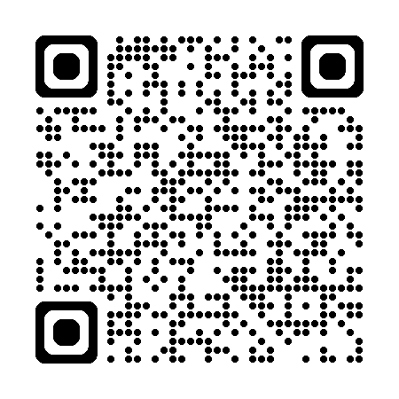
How you can help ..
Complete our Questionnaire
Stakeholder identification
Best practice
Challenges
Community formation
(Identifying topics for future ACCoRD workshops)
https://tinyurl.com/accord-survey-ucl

Slide 11
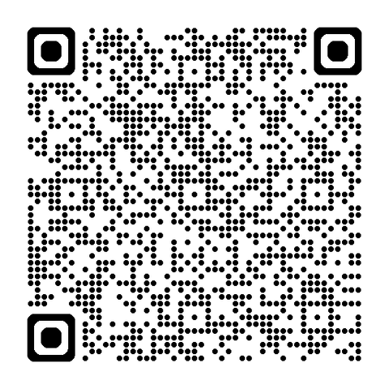
How you can help ..
Participate in our first workshop
Combining talks and break-out sessions
22nd October 2025
1.30pm – 5pm
London (10 minutes from Kings Cross)
https://tinyurl.com/accord-workshop

Slide 12
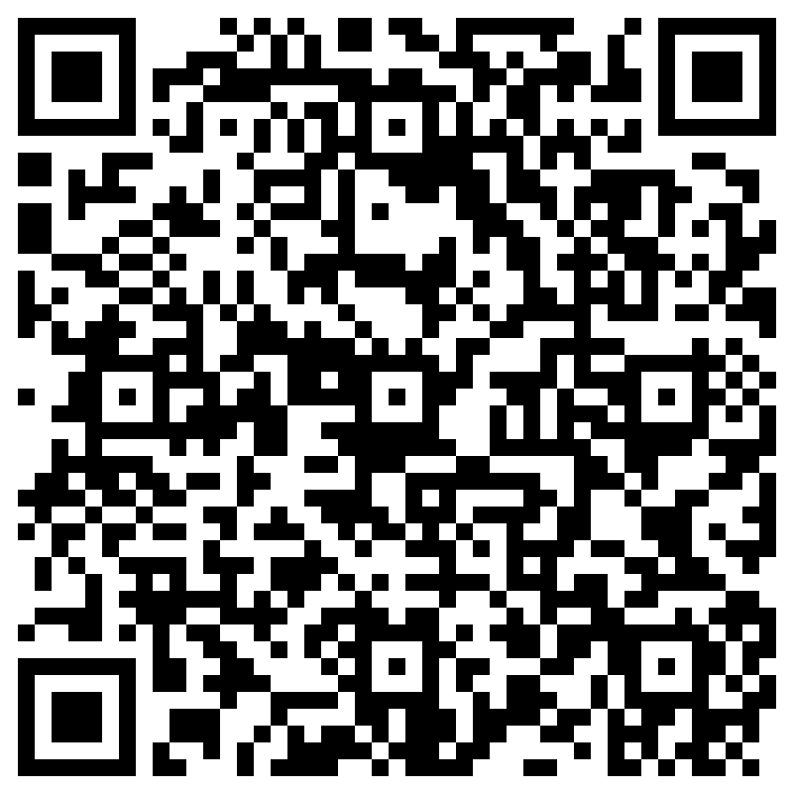
Join the Community
Sign up to join:
  The UCL ACCoRD Community (active until August 2026)
  The NCFS Network+ Research Data Contracts Community (from August 2026 onwards, but terms of reference will be explored as part of ACCoRD)
https://tinyurl.com/accord-community
Notes:
UCL ACCoRD Community
keep up to date with the project
make sure your voice and expertise is included in the evidence gathering process
develop the research data contracting framework based on our evidence

Slide 13
Do not edit
How to change the design
Who are the stakeholders/stakeholder groups who should be involved in our research data contracting discussions?
The Slido app must be installed on every computer you’re presenting from

