Slide 1



Autumn Conference
22-23 September 2025
Digital Skills in Arts and Humanities (DISKAH) Network
Prof Karina Rodriguez Echavarria
University of Brighton

Slide 2

DISKAH builds capacity and collaboration amongst Arts & Humanities researchers to harness DRI, promoting innovation through the adoption of computationally intensive data-driven methods.

Slide 3
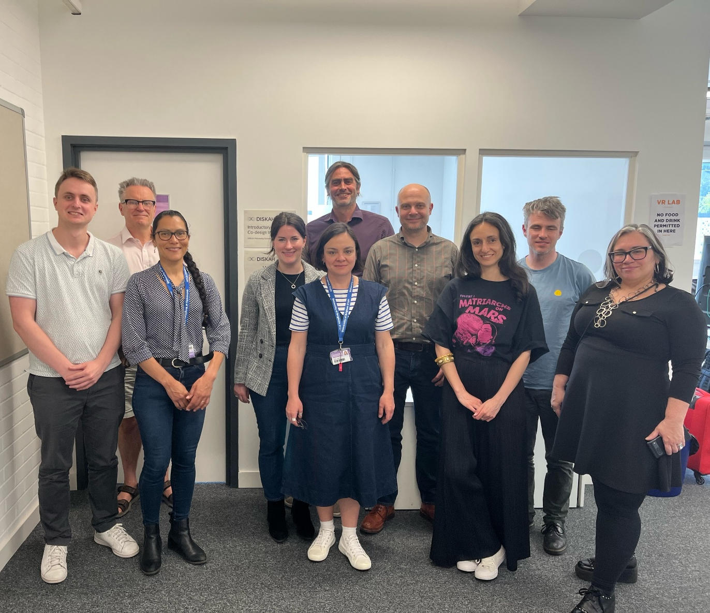
Funding details
Funded by UKRI-Science and Technology Facilities Council (STFC) as part of the Digital Research Infrastructure (DRI) Programme​​
November 2024 – March 2027
£599K co-investment​​
Aims to implement a UK-wide training fellowship program​me to build exemplary use-cases of use of DRI amongst the community.

Slide 4
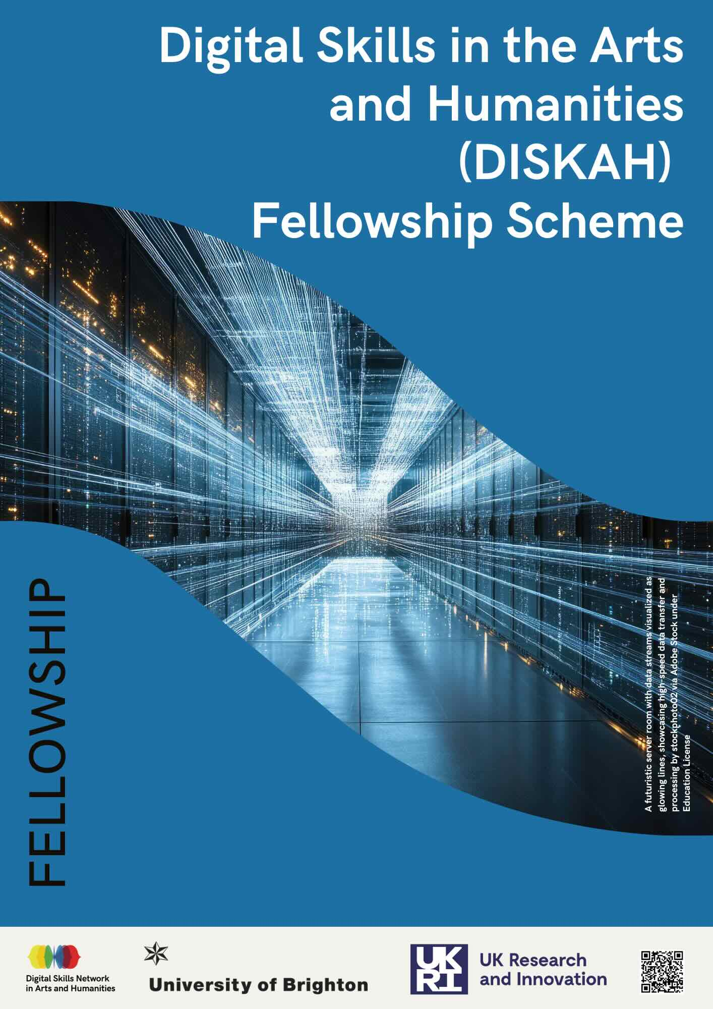

DISKAH Fellowships
Up to 12 fellows
Competitive call focusing on academics, RTPs and practitioners in HEI/IRO.​
165 funded hours, including activities:
- Professional development via training and hands-on learning (access to DRI).
- Networking
- Leadership

Slide 5
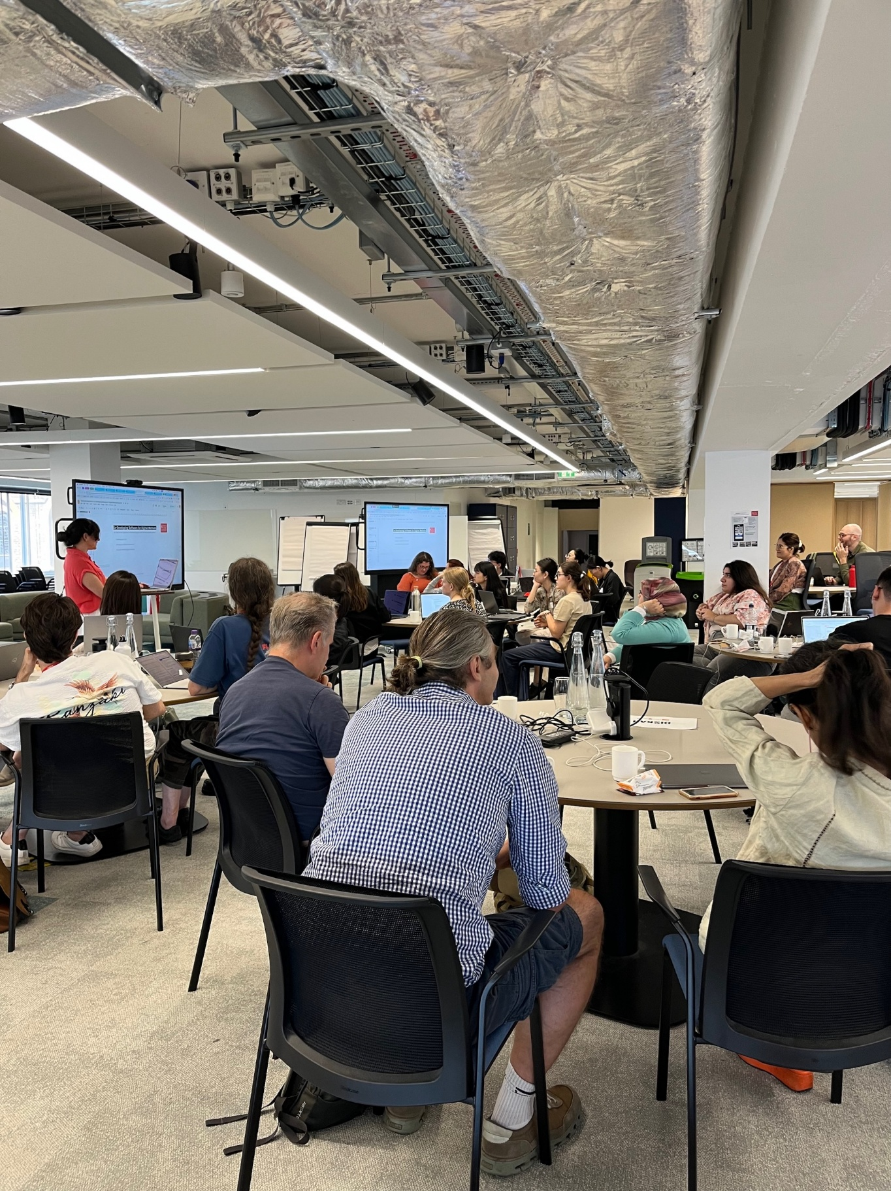
Activities & outputs
Co-designed the yearly programme, including the syllabus of DRI-skills
Training in relevant software research engineering skills.
Onboarded to Tier 2 HPC
Regular DRI drop-in sessions
In the following months, fellows will document use-cases of DRI, disseminate outputs and deliver training to their own communities.

Slide 6
DISKAH Projects
Texting Scarlatti - Dr Jasper van der Klis, Guildhall School of Music & Drama, London
Investigating 18th century manuscript transmission of Domenico Scarlatti's music by using phylogenetic tools
PolyGraphs - Prof Brian Ball, Northeastern University London
Simulations exploring network structure, information quality, and processing to inform debates on higher-order evidence and group belief
Technology for Handling and Improving Stubborn Text-Level Errors - Dr Jessica Witte,
University of Edinburgh
LLMs to improve the accuracy of complex OCR errors in historical digitised newspapers
Mobile Subjects, Contrapuntal Modernisms - Dr Maria Isabel (Maribel) Hidalgo Urbaneja,
University Arts London
Investigating entities from art history literature to study the circulation of artists from the decolonising world and their impact on the regional history of modern art
Shakespeare's Textual Variations - Prof Gabriel Egan, De Montfort University
Authorship attribution on Shakespeare's plays, using Information theory metrics to generate writing style profiles based on authors' most frequent words

Slide 7












DISKAH Network
7

Slide 8
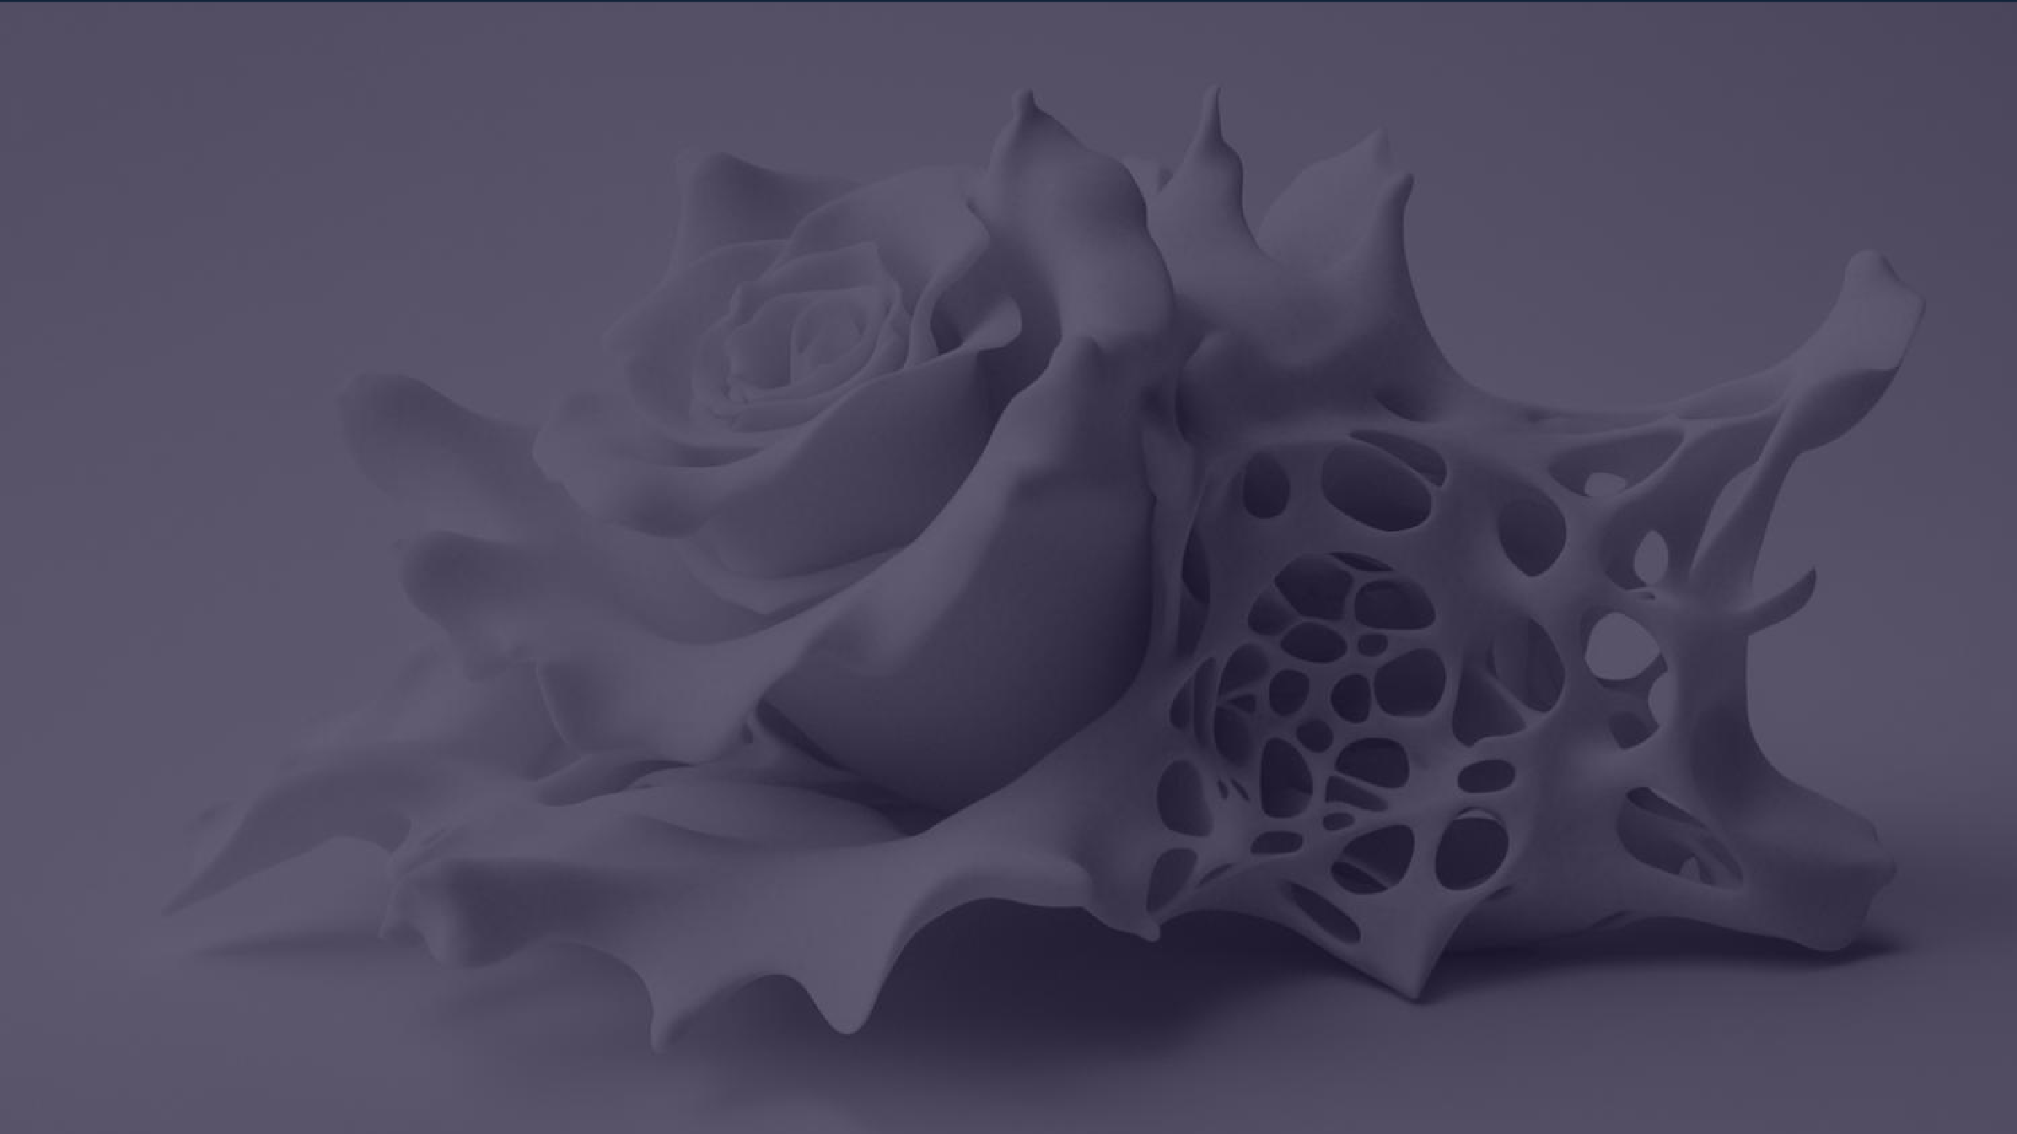
Thank you

