Slide 1


Autumn Meeting Introduction
September 2025
Prof. Jonathan Hays,
Queen Mary University of London

Slide 2
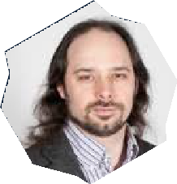
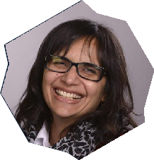
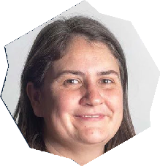
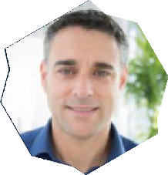
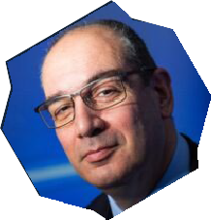
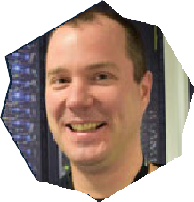
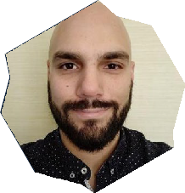
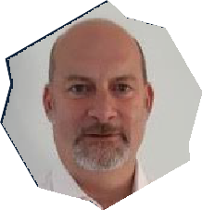
Project team
Project Leads
Prof. Jonathan Hays, QMUL
Dr. Sadaf Alam, University of Bristol
Project Team Members
Jeremy Yates, QMUL (Technical Coordinator)
Kieran Leach, QMUL (Technical Coordinator)
Rui Apostolo, University of Edinburgh EPCC (Community Engagement Officer)
David Meredith, STFC Hartree
John Masih, QMUL (Programme Manager)
Gemma Hopton, QMUL (Admin & Events Officer)
Co-leads
Jo Beech-Brandt, University of Edinburgh EPCC
Adrian Hines, STFC RAL
Vassil Alexandrov, STFC Hartree

Slide 3
Federated Research Network
Federation, noun
A country consisting of a group of individual states that have control over their own affairs but are controlled by a central government for national decisions, etc.
A group of clubs, trade unions, etc. that have joined together to form an organization
The act of forming a federation
(Oxford English Dictionary)
A Federated Research Network (FRN) is a decentralized system that enables multiple institutions, organizations, or researchers to collaborate while maintaining control over their own data and resources. Instead of centralizing data in one location, an FRN allows participants to share insights, models, or results without exposing raw data.
(ChatGPT)

Slide 4




Project Objectives
Produce a roadmap for federated provision of computational resources for all UKRIs communities
Scope the data storage needs for the federated service
Act as a DRI Network Plus by linking up with networking activities in other DRI workstreams

Slide 5
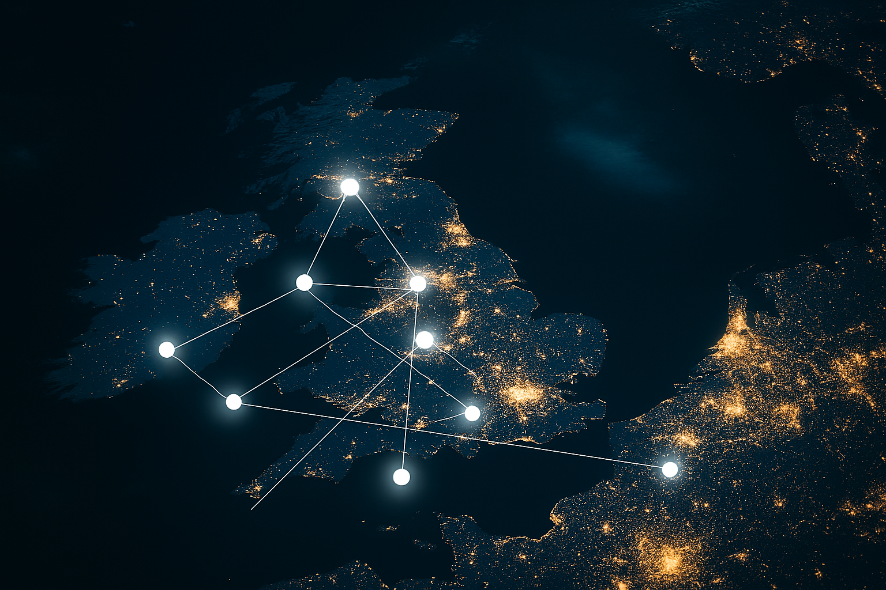
Project Objectives
Produce a roadmap for federated provision of computational resources for all UKRIs communities
Scope the data storage needs for the federated service
Act as a DRI Network Plus by linking up with networking activities in other DRI workstreams

Slide 6



Key principles
Decentralisation
Interoperability
Autonomy
Security and Privacy
Scalability

Slide 7




Three Pillars
Community
Technology
Policy

Slide 8


Community
Building communities
Engaging with Stakeholders
Identifying existing and emerging user stories
Establishing common nomenclature and standards

Slide 9

Technology
Gather the state-of-the-art and existing practice
Knowledge exchange
Evaluating potential technological components
Identifying core federation services

Slide 10

Policy
Identify existing and emerging governance and policy approaches
Identify policy requirements based on business cases and user stories
Develop outline policy framework

Slide 11

Community Engagement:
National Events
Workshops
Flexible Funding
Community Consultation
Roadmap Development
Evidence for Roadmap
Community Building
Roadmap

Slide 12

Flexible Funding
13 projects funded
Call for second round of funding now open
Deadline: 5th October
Projects to complete by July 2026 with value of up to £120k
Prioritising areas not well covered by existing projects

Slide 13
Flexible Funding
Second flexible funding call
Proposals must:
Demonstrate clear alignments with the pillars
Demonstrate clear and achievable objectives aligned with the goals of the Network Plus
Clearly justify all costs and how they support delivery
Demonstrate an appropriate level of cross-disciplinary engagement for the activity being proposed

Slide 14







Goals of this meeting
Build community and connections
Showcase newly funded projects
Build awareness of the NetworkPlus

