Slide 1
IRIS Federated Digital Research Infrastructure: an update
Prof. J. Hays, IRIS Science Director
IRIS Collaboration Meeting
13th January 2026

Slide 2

eInfrastructure for Research and Innovation for STFC
IRIS is a cooperative community bringing together STFC computing interests
Formed bottom up by science communities and compute providers
Works closely with STFC but run by the community

Slide 3
IRIS Activities
Build infrastructure
Build community
Invest in computing hardware
Coordinate
Support training
Support digital asset creation
Making the case for investment

Slide 4
IRIS Structure
Resource Scrutiny and Allocation Panel
Delivery Board
Technical Working Group
Resource Allocation
Strategy, Policy, Funding etc
Technical Coordination
Activities and Facilities
Other Partners
Providers

Slide 5

IRIS Structure: updated?
Resource Scrutiny and Allocation Panel
IRIS Project Adminstration
Delivery Board
Resource Allocation
IRIS Leadership and Delivery
Strategy, Policy, Oversight
Activities and Facilities
Technical Working Group
Technical Coordination
Other Partners
Providers
Computing Advisory Panel
Technical Review Panel
Technical Scrutiny

Slide 6





SCARF HPC cluster
SCD RAL
GridPP
DiRAC
RAL cloud
Imperial Cloud
CSD3 HPC cluster
IRIS Cloud?
Arcus cloud
Durham Cloud

Slide 7
RAL cloud
QMUL, Leicester, Lancaster
Pilot clouds
Imperial Cloud
IRIS Cloud
Arcus cloud
IRIS-CLD
New pilot project to explore potential and requirements for a distributed cloud for IRIS
Durham Cloud

Slide 8
Funding
2017:
  £1.5m Capital : £1m hardware, 0.5m digital assets
2018:
  £16m (4M / year over 4 years, 11M Hardware, 5M Digital Assets for National Facilities
2020:
  Capital injections ~ £6m : 3M capital for IRIS, 2M for LSST (Rubin Observatory), 1M for SKA
2021:
UKRI Digital Research Infrastructure funding ~ £2m 2022:
  STFC Capital funding £2.4m – anticipated recurrent over 3 years
  UKRI DRI funding – £3.5m additional funding in 22/23 + 23/24
  Additional capital supporting Astronomy programme £2.3m
2023:
  STFC Capital funding £2.4m
  UKRI DRI Phase 1b from 22/23 award - £400k
  UKRI DRI Phase 2 - £1.4m (£400k 23/24, £1m 24/25)
2024:
  STFC Capital funding £2.4m
  UKRI DRI Phase 2 - £1.2m
2025:
  STFC Capital funding £2.4m
  UKRI DRI £1m
2026:
  ???

Slide 9
IRIS Community
Technical Working Group
  Weekly meetings
    Technical discussions – presentations, showcases etc
    Operations reports
  Regular ad-hoc workshops as and when needed
    Wide range of topics from identity management, cloud computing, GPU usage, machine learning etc
Targeted at the IRIS community but open to all

Slide 10
Digital Asset Creation
Digital Assets
Essentially software (or similar) products (capitalizable) – with a defined end point or delivery of the asset
Additional track of funding “Other DA” programme available to full IRIS Community
Often infrastructure related but can also be closer to science
UKRI DRI funding also allows some non-capital projects
- can be used for R&D as well as asset production
Challenging funding environment the last two years has meant we have not funded DA projects for a little while

Slide 11
What IRIS is not…
IRIS is not a turn-key computing solution
IRIS currently has no direct resource funding for user support – some community support as “best effort”
IRIS can provide physical resources for groups who can make use of it –
Activities may need their own:
  Software frameworks
  Support staff
IRIS might not have the kind of hardware needed for every activity

Slide 12
Key challenges : Planning
Forward planning
  Continues to be a key challenge
  Driven mainly by funding uncertainties
    Causes extra work in scenario planning
    Increases delivery risk with respect to March 31st deadline
  Coherence across STFC
    Risk of shortfalls when projects are approved without funding for their compute
    “Right-sizing” of projects essential
    CAP may start to address this?
  Scope creep
    Risk of shortfalls when projects wish to expand scope of work

Slide 13
Key challenges : Provider Support
Providers paid in capital grants
  Supports purchase of hardware
  Associated MOU outlines hardware provision
Current model:
  4 year life-span for IRIS allocation purposes
    assuming typical 5 year life-span of equipment
  15% additional capital for hardware to be used at providers discretion (within some restrictions)
  Amounts to around 35% additional funding in-lieu of direct funding for non-capital costs

Slide 14
Key challenges : Provider Support
  Challenges:
  Use of pure capital funding present challenges to institutions
  Complicates negotiations around extending lifetime of equipment
  Ideal model (?):
  Multi-year operations grant for baseline operations
  Single-year capital grants to maintain or extend hardware
  But…
  FEC:
  paying non-equipment costs at 80% FEC breaks this model
  breaks the link between overhead carrying funding to do the science from the infrastructure costs to deliver it

Slide 15
Key challenges : Tensioning
From last Collab meeting…
Tensioning
  When resources insufficient some projects will not get their allocations
  Science is not tensioned by IRIS
    Science funding decisions made by STFC through its boards and panels
    No double jeopardy
  IRIS continues a policy of balancing shortfalls at each facility across all projects
    While maintaining a pragmatic approach of dialogue with all affected projects to find the best outcomes
  No mechanism exists to handle large shortfalls
    This necessarily needs to involve relevant STFC boards/panels etc
This may evolve as CAP finds its feet – channel of communication to Science Boards to address this?

Slide 16
Key challenges : Capacity, Resilience, Funding
Data centre space is filling up (non-uniformly)
Connection of specific workloads to specific sites presents a challenge with respect to resilience
Distributed cloud may be a partial solution
Need to better understand challenges, requirements, and use cases

Slide 17
Key challenges : Capacity, Resilience, Funding
 | 2024 Demand met [%] | 2025 Demand met before proc 2025 [%] | 2025 Demand met after proc 2025 [%] | 2026 Demand met [%] if proc 2025 successfull
CPU | 78.48% | 75.14% | 85.97% | 79.88%
GPU | 91.45% | 47.64% | 72.36% | 65.25%
Disk | 86.40% | 73.81% | 94.24% | 53.43%
Tape | 100.00% | 100.00% | 100.00% | 100.00%
Demand based on RSAP not actual usage
Typically, actual demand is slightly lower than RSAP demand
Gap for storage is worst case scenario – driven by one off large increase in potential demand – may not be realised
Gap is still worrying

Slide 18
Forward Look : strong headwinds
Funding remains a challenge
  Can’t see that improving in the short term
Governance Changes
  CAP is finding its feet but relationship with IRIS not yet completely defined
  How to adapt to changing demands and requirements?
STFC IT Transformation
  Implications for IRIS not yet evident but we have had input to the process
Rising prices
  Drive for AI is pushing up prices and lead-times in dramatic fashion – especially for memory and GPUs

Slide 19
Summary
IRIS is a federated cooperative community bringing together STFC (and beyond) computing interests
Bringing groups together
Building Infrastructure
Supporting Science
Lobbying for the future

Slide 20
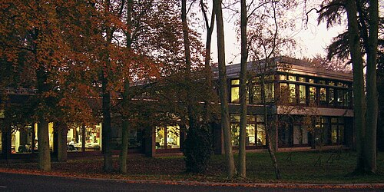
IRIS: A Decade of Discovery And Collaboration
We have a great set of talks celebrating a decade of successes and impact in a great location!

Slide 21
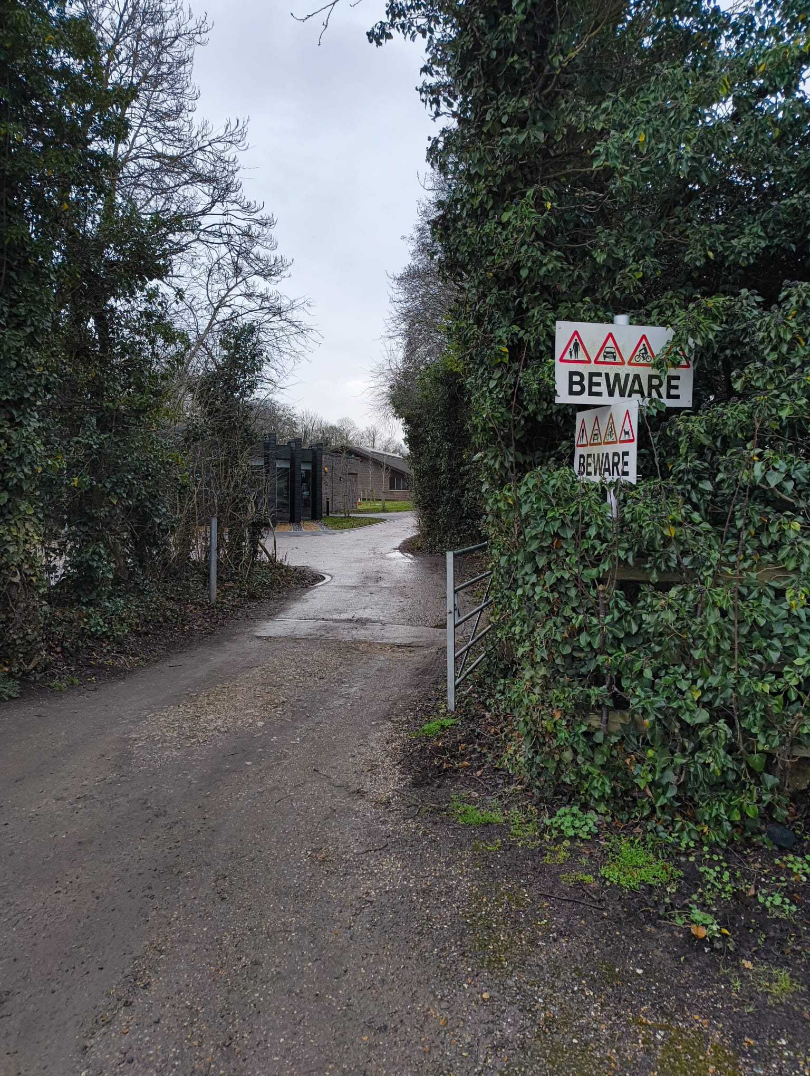
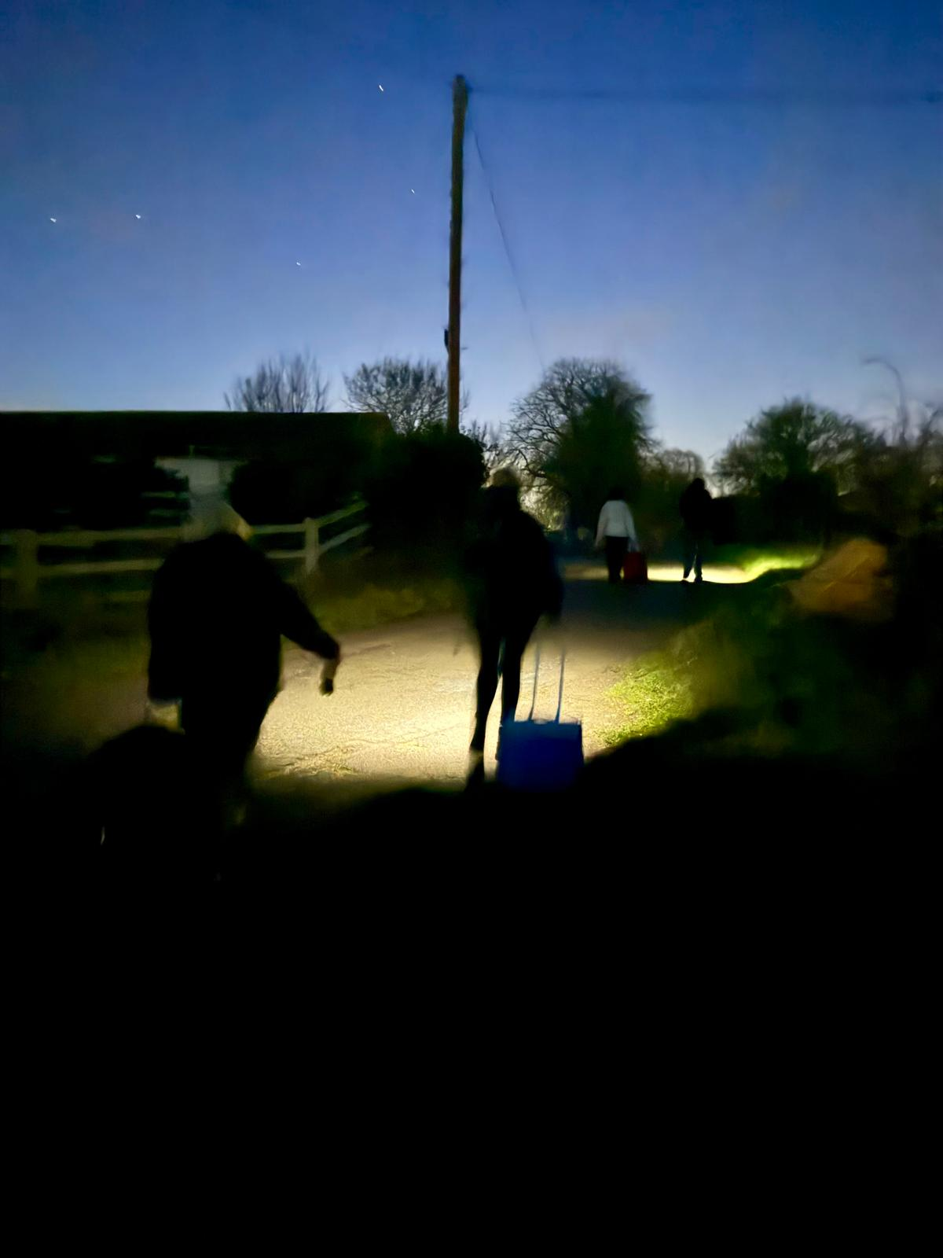
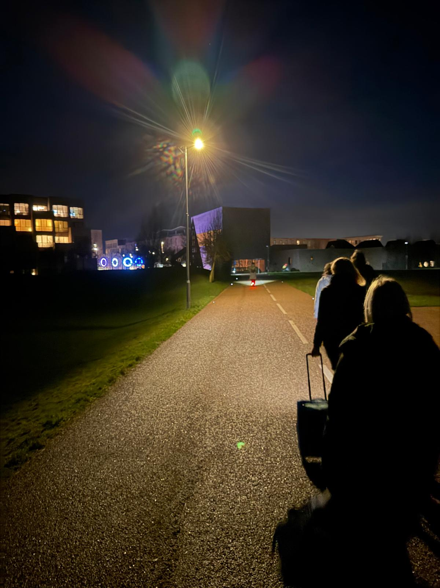
IRIS: A Decade of Discovery And Collaboration

Slide 22
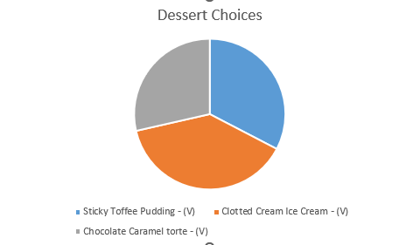
IRIS: A Decade of Discovery And Collaboration

