Slide 1



IRIS Security
IRIS Collaboration meeting, Cambridge,
January 13th 2026
David Crooks
david.crooks@stfc.ac.uk
On behalf of the IRIS Security Team
Notes:
The abstract pattern can be removed or repositioned if required. Be careful to ‘Send to Back’ so that it does not obscure any important information.

Slide 2
Landscape + overview
Broad status the same: high, persistent risk
Considerable focus on compliance → Risk
Organisational focus
Security team continuing to develop, no changes in the roster
IRIS Collaboration meeting, January 2026

Slide 3
Security Handbooks
First draft of site security handbook for GridPP – and potentially IRIS – has been completed and handed to Lancaster and Glasgow
Gain site feedback before broader distribution
Focus on key controls: likely to require some work especially in documentation
Not a full framework assessment, but hopefully useful in that regard
Recent addition was a maturity model: ultimate aim for level 2, but useful to note any 3s.
Level | Description
0 | Not known/not in place
1 | Known verbally
2 | Known and documented
3 | Known, documented and peer reviewed
IRIS Collaboration meeting, January 2026

Slide 4
Security Handbooks
Security contact
Central logging configuration
Asset management process
Network map including relation to central network
Access control structure, including local, site and organisational firewalls
Approach to system hardening
Patching process, noting applicable organisational policies
Local incident response and recovery procedure
Monitoring capabilities including local and organisational where relevant
Security documentation, processes, procedures lifecycle
IRIS Collaboration meeting, January 2026

Slide 5
Security Detection
Previously mentioned pDNSSOC as a tool to correlate DNS logs with threat intelligence
Now replaced by Unicor, maintained by Romain Wartel and the SAFER community
Ingests DNS logs or other JSON formatted records and correlates with MISP threat feeds
Builds alert notifications with context and sends to security teams
IRIS Collaboration meeting, January 2026

Slide 6

Unicor pilot
Focussed initially on GridPP, intention with core Tier 2s to implement Unicor as lightweight incident detection mechanism
Pilot underway at Lancaster
Goal here is not a unified regional Security Operations Centre, but contribution to the overall work of securing our organisations
Building relationships with central teams
IRIS Collaboration meeting, January 2026

Slide 7
DRI Update
Next DRI Cyber Security workshop now in planning stages – hopefully to be held in Edinburgh around April
Active planning now taking place around CAF workshops
NFCS N+ project underway to contribute cyber security elements to the overall roadmap
Likely to include additional workshops
Specific project on online cyber security training for research computing
Focus initially on induction style course, useful in different contexts
IRIS Collaboration meeting, January 2026

Slide 8
Skills and Training
Upcoming training events
ISGC, Taipei, March: additional track added to conference focused on security training (less directly relevant to IRIS, but part of overall training development)
Next Thematic CERN School on Computing will be held again at Cosener’s House in Abingdon
27th September to 3rd October (Sunday to Saturday, school M-F)
Should design an IRIS security training day this year
IRIS Collaboration meeting, January 2026

Slide 9
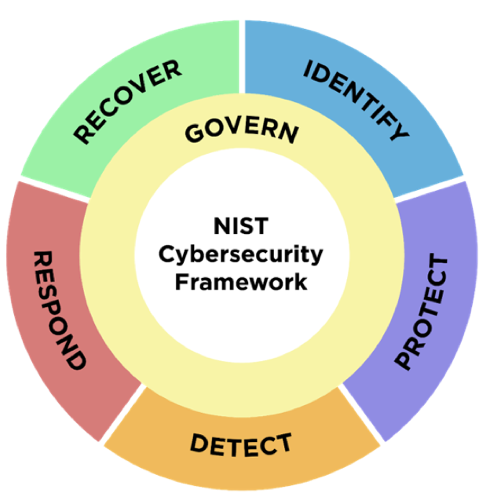
CERN School on Security
Aimed at system managers expected to work with security in their day-to-day role
As opposed to cybersecurity professionals – but typically have a small number of these as well
Cover security lifecycle of a service
Risk management
Security architecture
AAI
Logging and Traceability
Virtualisation + cloud security
Container security
Vulnerability management
Application security
Security Operations Centres
Security operations
Incident response management
Forensics
Incident response exercise
IRIS Collaboration meeting, January 2026

Slide 10
Policy
Mentioned policy in the summer; a review of our existing policies needs to be a focus for this year
https://www.iris.ac.uk/security/
Parallel work needed for EGI and WLCG
AARC TREE project (AARC and AARC 2 provided policy toolkit used by IRIS) almost complete
Experience from IRIS has greatly benefited that activity
IRIS Collaboration meeting, January 2026

Slide 11
Exercises
Something that has been discussed over the past few years
Compare and contrast with the EGI Service Security Challenges that run against the WLCG infrastructure every few years
Heavyweight, in depth activity
For IRIS, propose a lighter-weight approach, identifying a specific area to focus on in the first instance
Could include technical and pure tabletop elements
IRIS Collaboration meeting, January 2026

Slide 12
Summary
In a continued high risk environment, security governance and risk management are key areas for development
Understand impact for IRIS: engage with broader DRI activities
Skills and training vital additional strand
Need to plan IRIS security exercises
Upcoming work
Site Security Checklist work
Unicor pilot → Tier2 deployments
IRIS Collaboration meeting, January 2026

Slide 13






Science and Technology Facilities Council
@STFC_Matters
Science and Technology Facilities Council
Notes:
The abstract pattern can be removed or repositioned if required. Be careful to ‘Send to Back’ so that it does not obscure any important information.

Slide 14



Notes:
The abstract pattern can be removed or repositioned if required. Be careful to ‘Send to Back’ so that it does not obscure any important information.

