Slide 1

Outputs Are Great. Impact Gets Funded
Evidence it, or It Didn’t Happen
Deniza Chekrygina

Slide 2
What am I going to talk about?
Why we are talking about impact
What can be done
How we can approach this

Slide 3
IRIS strategy – a missing activity
IRIS should communicate successes to the stakeholders to justify funding
-"But this is a lot of work and we hardly have funding for stuff to support our actual objectives! "

Slide 4
Own context
We have a russian/soviet university culture saying
"Cначала ты работаешь на зачётку,а потом зачёткa работает на тебя“
(Build a strong academic record early, and later that reputation will help you)
To address concerns: This may be challenging at the outset, particularly given current funding and staffing constraints. However, once a clear process is in place and meaningful monitoring is embedded, it will become significantly easier and less resource-intensive over time.

Slide 5
Why

Slide 6
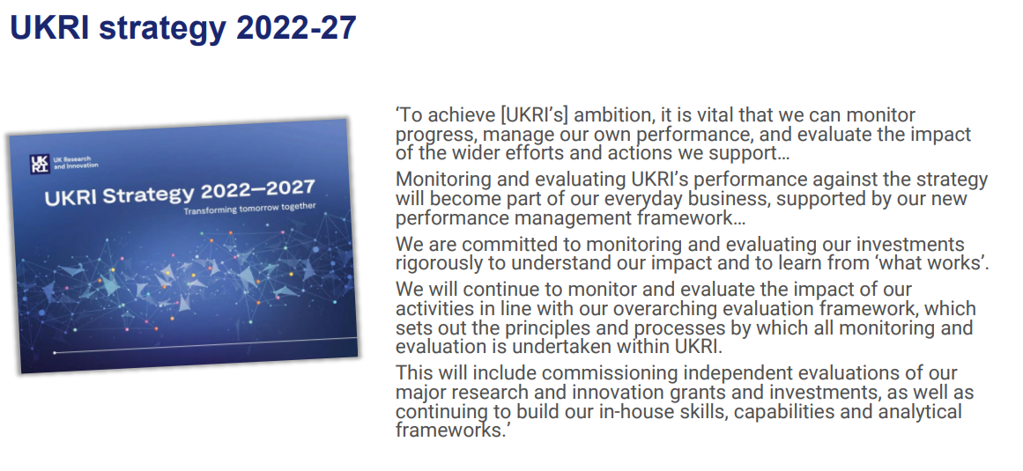
This is not something new!
Slide:Charlotte Glass,Head of Evaluation, STFC

Slide 7






Increasing need from DSIT to be able to prove the value of R&I…
UKRI will have new outcomes focused objectives
Evidence of Impact
Monitoring Data
Learning from M&E
Slide:Charlotte Glass,Head of Evaluation, STFC
Notes:
“While investing in ambitious and pioneering research, it is important for UKRI to understand how its work is providing a return on investment for taxpayers.”

Slide 8
What

Slide 9
M&E
Monitoring is the routine tracking of what you deliver and how well it runs. It uses regular data such as usage, programme performance, costs, and progress against milestones. It tells you what is happening now and whether delivery is on track.
Evaluation is a structured assessment of what changed and why. It uses monitoring data plus other evidence, such as user feedback, comparisons over time, or case studies. It tells you whether the work(intervention) led to the intended outcomes and what should change next.

Slide 10
M&E
Impact is the sustained, meaningful change that happens beyond the immediate delivery of a service or project. It sits at the far end of the chain.
Typical examples include:
research enabled that would not otherwise run,
faster time to results,
reduced operational risk,
better capability across communities,
cost avoided,
or measurable carbon effects.

Slide 11
How

Slide 12
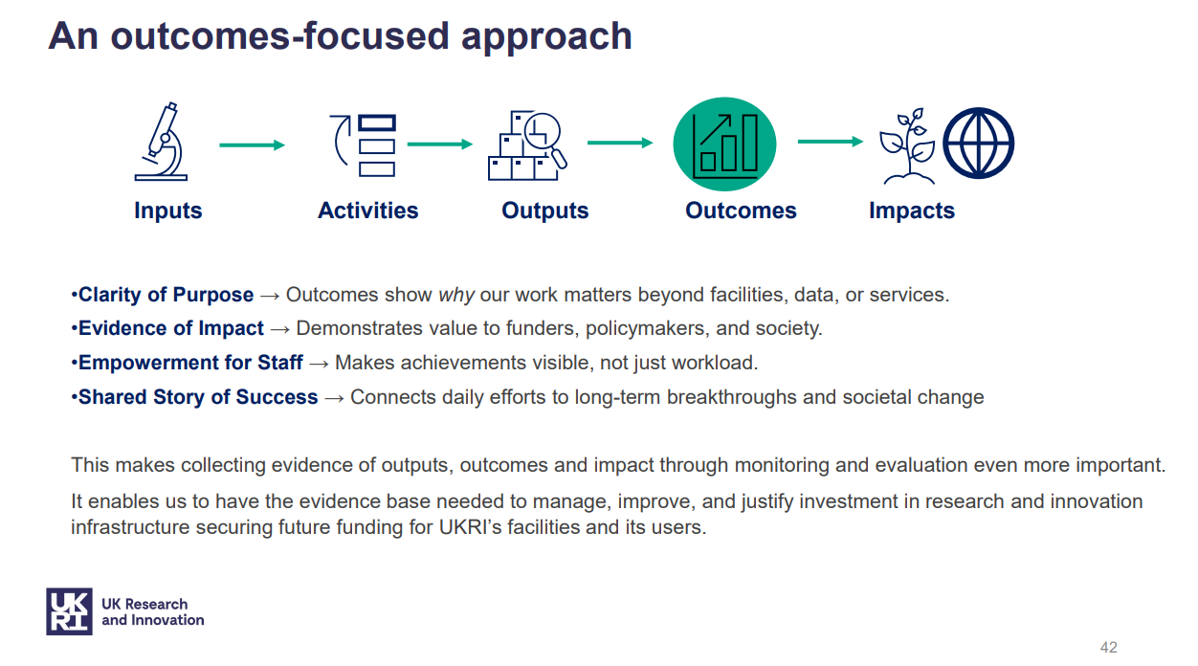
Funding
Infrastructure
Staff and Expertise Governance Structures Digital Tools Community Engagement
…
Resource monitoring and accounting
Accounting Reports
Usage Metrics Technical IAM Solutions
Technical Accounting Solutions Policies and Frameworks Digital Assets
…
Improved Decision-Making
Higher Trust Better Decisions on Purchases Reduced Misallocation
Enhanced Collaboration
…
Optimised Infrastructure Greater Public Value Environmental Sustainability
Economical Sustainability
Higher Scientific Output
UK Leadership in R&I
…
Slide:Charlotte Glass,Head of Evaluation, STFC

Slide 13
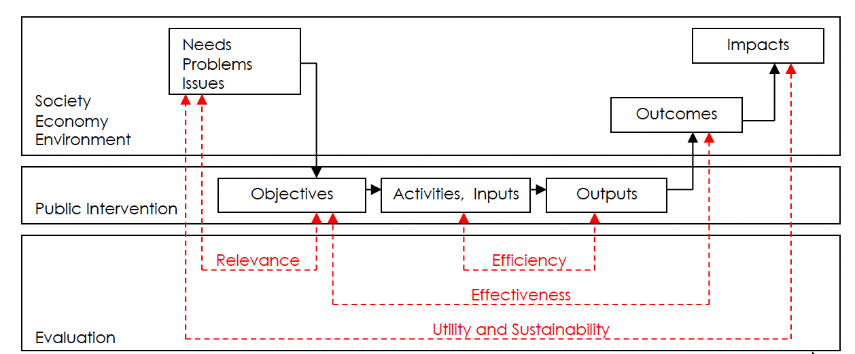
Theory-based evaluation = Logic model / theory of change provides framework for evaluative questions and evidence
Slide:Charlotte Glass,Head of Evaluation, STFC

Slide 14
Theory-based evaluation = Logic model also provides framework for understanding strength of attribution to realised benefits.
INFLUENCE
CONTRIBUTION
ATTRIBUTION
Inputs
Activities
Outputs
Outcomes
Impacts
Monitoring
Evaluation
Slide:Charlotte Glass,Head of Evaluation, STFC

Slide 15



Logic model is a communication tool and also a way of thinking

Slide 16
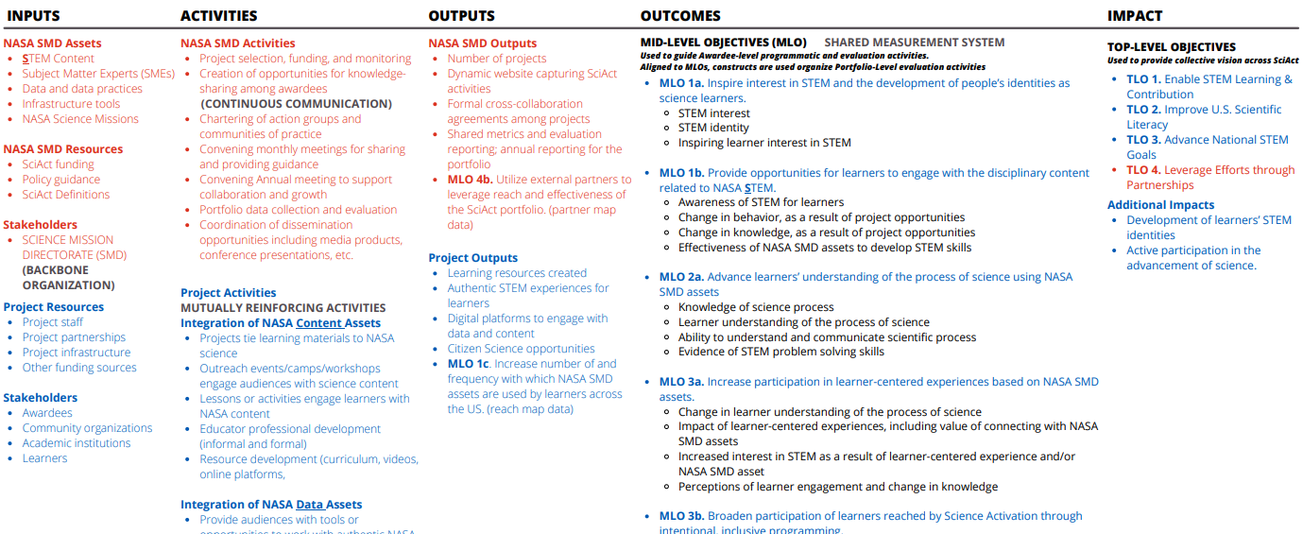
NASA Science Mission Directorate: Science Activation Program, Logic Model
https://science.nasa.gov/learn/logic-models/

Slide 17
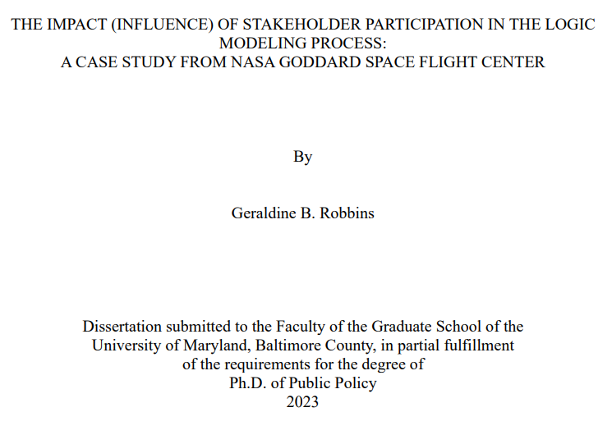
Other things to consider
Unsurprisingly stakeholder participation in the logic modelling:
Creates shared understanding and buy-in for what “success” means.
Makes evaluation credible and usable, so recommendations get implemented.
Aligns work across roles by translating goals into operational requirements.
https://ntrs.nasa.gov/api/citations/20230006043/downloads/20230006043.pdf

Slide 18
In summary logic models helps to:
Understand your program and what you are trying to achieve
Implement your value-centered service delivery approach
Effectively communicate to others what your program does and why
Identify the outcomes your program aims to achieve
Build consensus and a common understanding about your theory and assumptions
Make management and strategic decisions about the program
Plan your program evaluation and measure its effectiveness
Demonstrate to funders that you have strategically identified what resources and activities you need to achieve your goals.
Understand your program and what you are trying to achieve
Implement your value-centered service delivery approach
Effectively communicate to others what your program does and why
Identify the outcomes your program aims to achieve
Build consensus and a common understanding about your theory and assumptions
Make management and strategic decisions about the program
Plan your program evaluation and measure its effectiveness
Demonstrate to funders that you have strategically identified what resources and activities you need to achieve your goals.

Slide 19
What we are presently working on:
Applying the presented logic model to deliver its own impact evaluation with support from STFC M&E team
Making plans on setting the regular M&E process
What we want from you:
Your support in this process
Your input on outcomes and impact you consider the most important
Your contributions during this collaboration meeting and after to become part of the publication on impact sometime in Q1 FY2627, using quantitative data and user story data

Slide 20
To sum-up
Why we are talking about impact – internal and external factors
What can be done – Monitoring and Evaluation processes
How one might approach this – the Logic model
Thank you!

