Slide 1
LIGO and IRIS
Duncan Macleod | IRIS Collaboration Meeting | Jan 2026

Slide 2
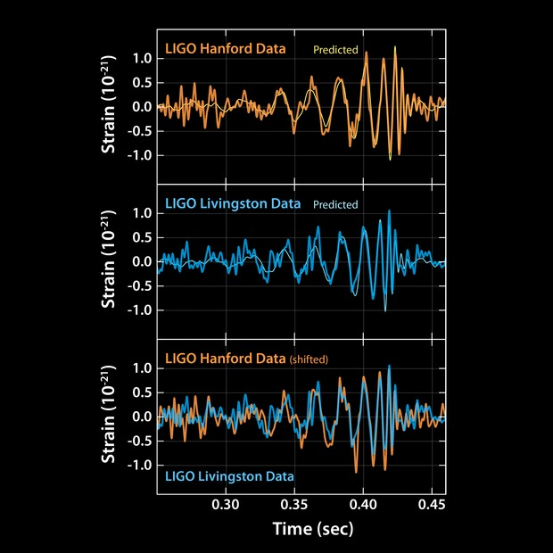
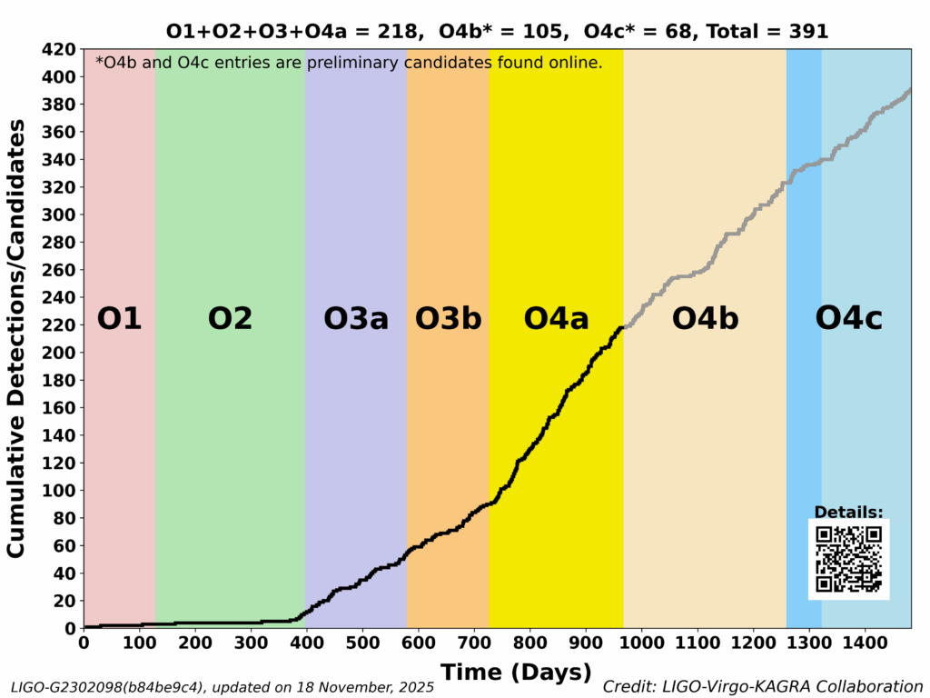
GW in 10 years
12 Sep 2015:
  Advanced Detector Era begins
  (2nd generation instruments)
14 Sep 2015 (pub. 11 Feb 2016):
  Observation of Gravitational Waves from a Binary Black Hole Merger
17 Aug 2017 (pub. 16 Oct 2017):
  GW170817: Observation of Gravitational Waves from a Binary Neutron Star Inspiral
18 Nov 2025:
  O4 ends
To-date:
  2 BNS
  ~3 NSBH
  ~350+ BBH
Credit: Caltech/MIT/LIGO Lab [link]

Slide 3
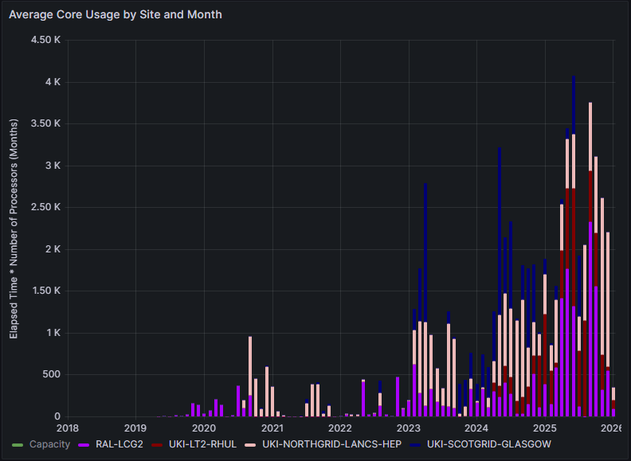
Impact of IRIS
LIGO–Virgo–KAGRA (LVK) science requires highly heterogeneous computing:
  LVK Grid resources operated with OSG/PATh in USA
  IRIS infrastructure (via GridPP) integrates seamlessly* to provide resources for LIGO.
  As a result, UK contributions integrate seamlessly into LVK’s international computing ecosystem, significantly reducing technical and operational overhead.
The IRIS community adds strategic value far beyond raw compute:
  Provides deep, practical insight into operating at scale in multi‑tenant, cross‑disciplinary compute environments.
  Offers access to domain experts across HEP, astronomy, and other large research infrastructures who are solving similar data, workflow, and collaboration challenges.
  Creates opportunities for shared tooling, co‑developed services, and cross‑project discussions that enable LVK to escape from its silo and accelerate adoption of best practices.
  Enables UK LIGO cohort to engage in wider national conversations about compute strategy, security, storage, software packaging, and sustainability.
accounting.iris.ac.uk

