Slide 1
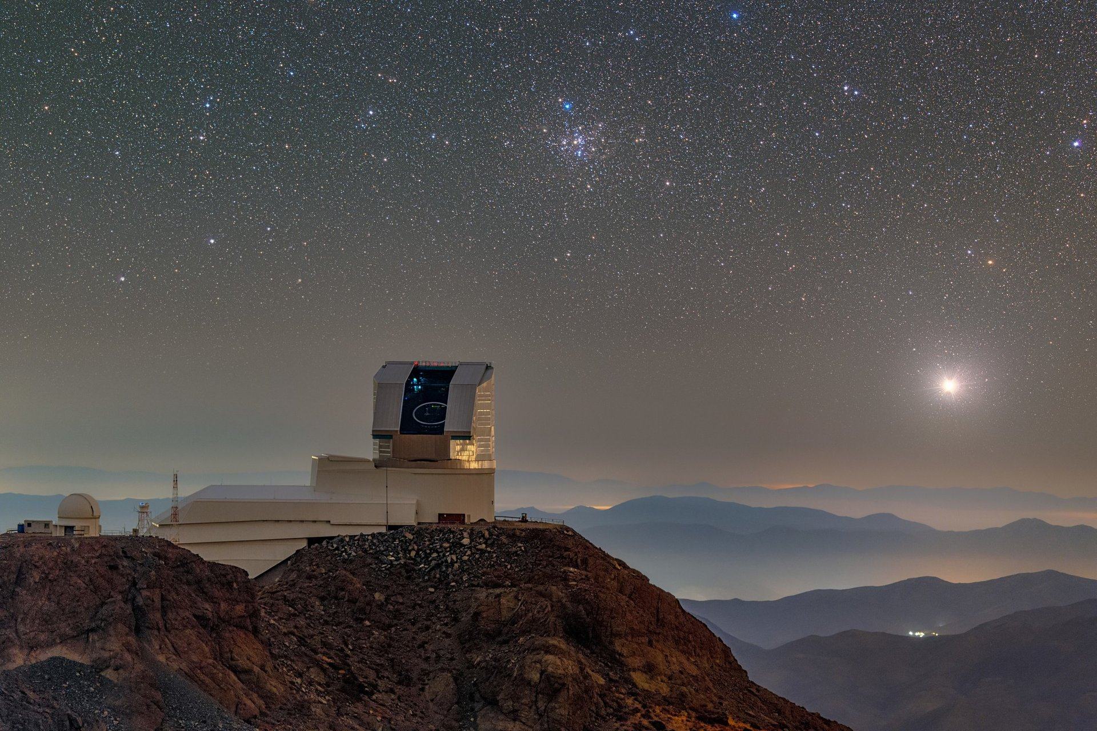

LSST:UK
Benefits and Plans for IRIS
George Beckett
UK Data Facility Liaison/ LSST:UK Project Manager
University of Edinburgh
Acknowledgement: Rubin Obs/NSF/AURA

Slide 2
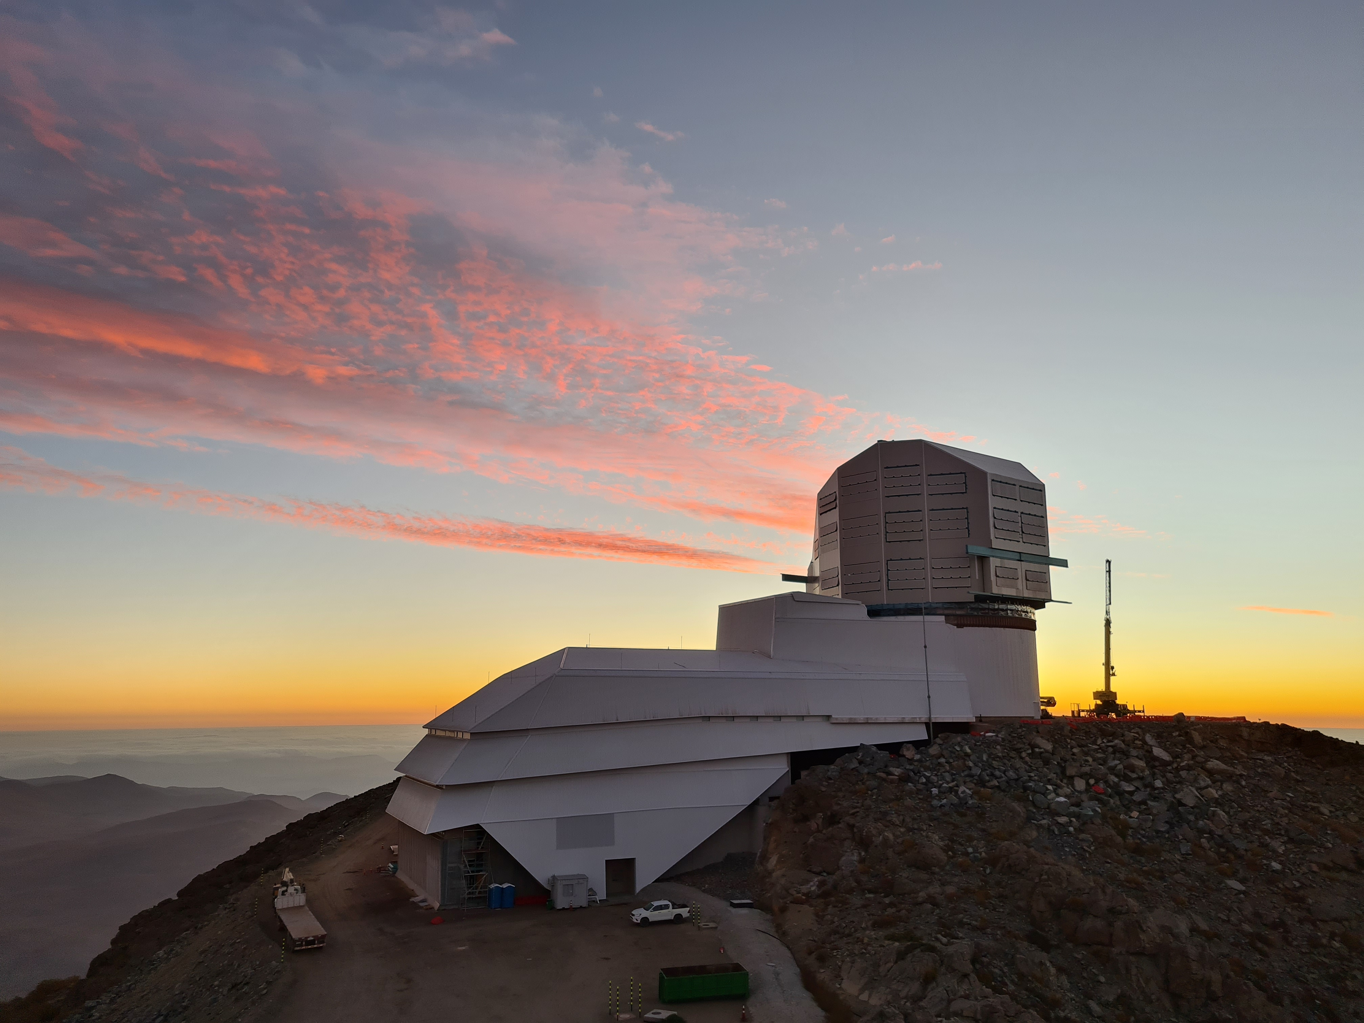
Vera C. Rubin Observatory
New observatory in Chile (Cerro Pachón)
  Hosts 8.4m Simonyi optical telescope
Legacy Survey of Space and Time (LSST)
  10-year survey starting early 2026
Complete survey consists of 400 PB of data
  Images, catalogues, astronomical measurements
  Plus, real-time stream of ~10M alerts
UK is one of largest international contributors
  LSST:UK Consortium represents all UK astronomy depts
  16 distinct in-kind contributions, including four computationally intensive ones
Acknowledgement: Rubin Obs/NSF/AURA

Slide 3
UK involvement in LSST
Four UK contributions involve significant computational resources
  DRP – Contribute to Data Release Processing
    Process 25% of survey data (alongside France and US)
  DAC – Design, deploy, and operate Independent Data Access Centre
    Full set of LSST Data Products w/ computing resources to support analysis and exploitation
  LASAIR – Community Broker to receive and process nightly alert stream
  DEV – Derived data products focused on UK science priorities
Plan to realise computational requirements through IRIS
  IRIS supporting services (IAM, accounting, security advisory)
  Networking critical for all aspects of operation

Slide 4
IRIS Support to date
Access to significant, diverse computing via UKRI service providers
  GridPP – data-release processing (resources from GridPP Other Communities)
  DiRAC – HPC-scale simulations and data analysis (LSST:UK capital and IRIS investment)
  STFC Research Cloud – persistent services (IRIS investment)
Access to trusted expertise on, for example:
  System Administrators/ infrastructure experts
  AAAI, storage technology, networking (also via Jisc)
  (Also, infrastructure costing via GridPP and DiRAC)
Option to exploit shared services => cost savings. For example:
  Security
  IRIS IAM
  Scientific OpenStack and Magnum
Centralised administration
  IRIS RSAP provides single point of contact for range of infrastructure and services
  IRIS Accounting – both the online dashboard and the periodic updates from Deniza

Slide 5
LSST:UK Priorities for future
Greater alignment of service-provider offerings (esp. cloud)
  Options to span multiple clouds
Federation of services
  To support complex workflows and facilitate integration with specialised DRI
Engagement with UK DRI
  Ensuring IRIS remains first-class route for researchers to access large-scale computing
Service resilience – as we move into Operational phase
  Esp IAM
  Functionality of accounting – making easier for PIs to track usage

Slide 6
LSST:UK Priorities for future
Promoting standardisation of development patterns
  Allowing expertise sharing between projects
  Informing skills development for technical staff
  Making operations more robust and predictable
Potential support for procurement
  Combining IRIS buying power to achieve more stable pricing

Slide 7
Exit Costs for LSST:UK
Significant
  LSST:UK has capital budget for key infrastructure, though typically not deployed in isolation
    Cost and time to reimplement low-level services (workflow, storage, etc.) would be serious issue
  UK priorities and user-generated products depend on IRIS infrastructure
  Isolation from DRI community, leading to inefficiencies and reduced choice
IRIS has greater influence on research computing landscape than individual experiments
Stifles ability to exploit whole scope of DRI
  Through loss of trusted RSAP, procurement assessments, accounting, etc.

Slide 8
Thank you

