Slide 1
IRIS Federated Digital Research Infrastructure: Nuclear Physics
Shaun de Witt, UKAEA
IRIS Collaboration Meeting
14th January 2026

Slide 2
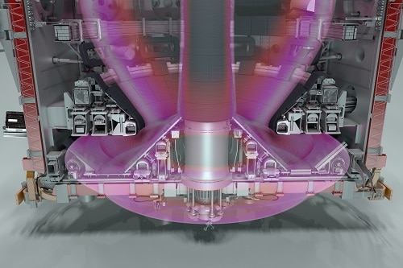
What is “nuclear physics”
Fusion:
  Plasma Physics
  Material Science
  Neutronics
  Mechanical Engineering
  Electrical Engineering
  Thermo-hydraulics
  Health Physics
  Robotics
  Data Science
But it’s more than fusion/fission:
  Astrophysical Plasmas
  Stellar evolution
  Lattice QCD
  …

Slide 3

What is this session really about
Non Traditional Uses of IRIS
Not STFC core missions
Smaller user communities
Making unusual use of IRIS facilties

