Slide 1
IRIS Federated Digital Research Infrastructure: Nuclear Physics
Shaun de Witt, UKAEA
IRIS Collaboration Meeting
14th January 2026

Slide 2
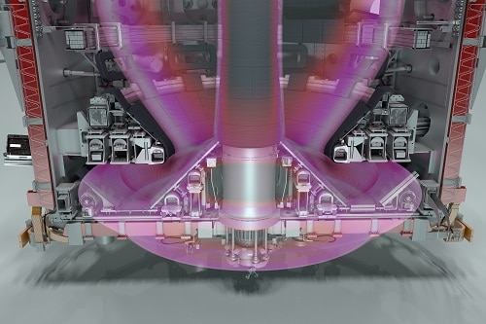
What is “nuclear physics”
Fusion:
Plasma Physics
Material Science
Neutronics
Mechanical Engineering
Electrical Engineering
Thermo-hydraulics
Health Physics
Robotics
Data Science
But it’s more than fusion/fission:
Astrophysical Plasmas
Stellar evolution
Lattice QCD
…

Slide 3

What is this session really about
Non Traditional Uses of IRIS
Not STFC core missions
Smaller user communities
Making unusual use of IRIS facilties

Slide 4
Questions
What are the main barriers currently limiting digital research infrastructure support for non-traditional usage of RIS, and what opportunities should we explore together to address them?
How could we, or should we, encourage more non-traditional use. What would this mean to IRIS?
What deliverable in the next year would be a clear “impact story” that IRIS should enable and help communicate?

