Slide 1
UKAEA
Towards Making Fusion Data Open and FAIR with IRIS Resources
Larisa Dorman-Gajic
Notes:
Hello, I am Larisa and I am a Data Engineer at the UK Atomic Energy Authority working on the FAIR-MAST project which utilises IRIS resources to help make nuclear fusion data from one of our reactors open and accessible to all.

Slide 2
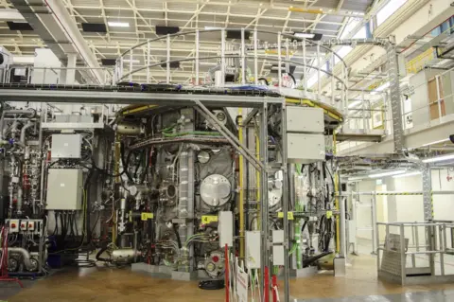
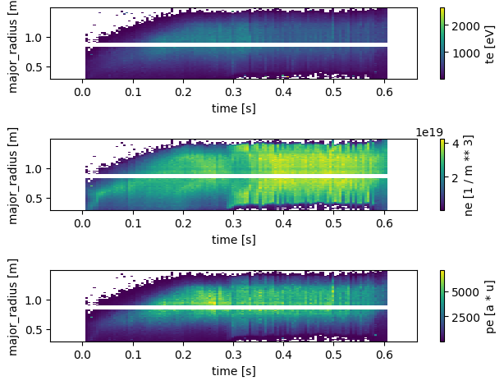
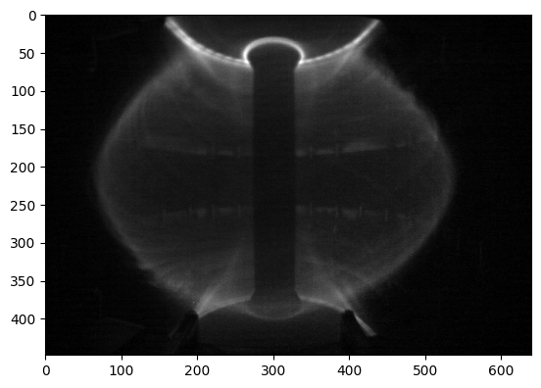
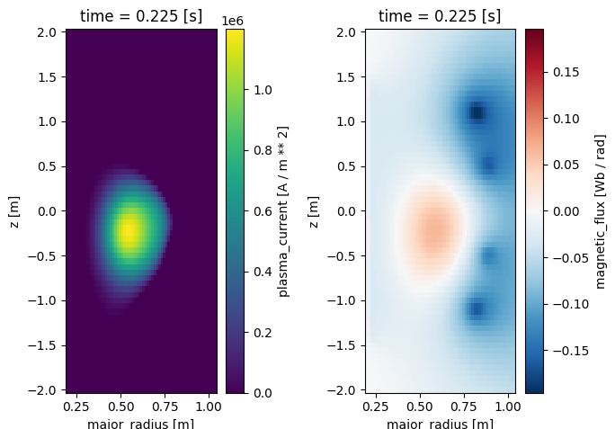
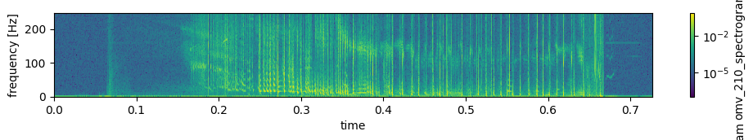
MAST
MAST (Mega Ampere Spherical Tokamak)
Spherical tokamak design commissioned by EURATOM/UKAEA
Built at Culham Centre for Fusion Energy, Oxfordshire, UK
Experiments ran from 1999 through to 2013
Produced ~30,000 shots over its history
Succeeded by MAST Upgrade (MAST-U) in 2020
MAST-U Tokamak
2D Profiles: Thomson Scattering Data
2D+t Video: Centre Column Camera data
3D profiles: Equilibrium Reconstruction Data
2D Spectrogram: Mirnov Coil Spectrograms
2
Notes:
Quick background. MAST is a tokamak, a type of fusion reactor that we have on our site in Culham which ran experiments from 1999 to 2013, it was later upgraded to MAST-U in 2020.
MAST is an experimental fusion reactor which produced around 30,000 shots in its lifetime creating huge amounts of diagnostic data. Here shows a small subsect of some of the data that is generated from a signal shot.
MAST data can be thought of as shot, single experimental shot taken by the machine, each of which has sources, which are the diagnostics, for example mirnov coils and Thomson scattering. Each source then contains multiple recorded quantities, split between signals and images.

Slide 3
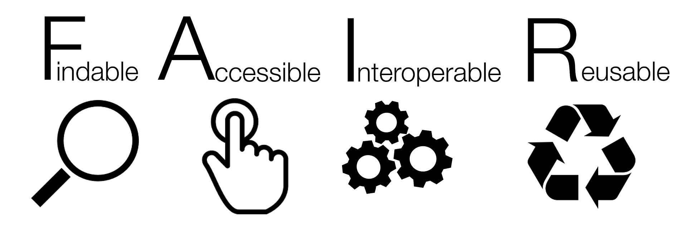
FAIR-MAST Project
Challenges:
Data were only accessible from an internal cluster
Must be on UKAEA network or whitelisted IP
Must have account access to internal cluster
Data were only accessible though domain specific access layer (UDA)
Data had inconsistent naming, dimensions, units
Data had significant amount of redundancy
Data representation not interoperable with common analysis tools
Goal: “To produce a framework for public access to MAST data in a FAIR (Findable, Accessible, Interoperable, and Reusable) manner”.​
​
Data must be easily findable through the metadata​
Data must be in exposed in an interoperable format​
Minimise loading and transferring data​ (lazy loading)
Support data analysis and ML/AI frameworks​
Support larger-than-memory & parallel computation
Be publicly accessible​
​
Findable - Metadata and data should be easy to find for both humans and computers
Accessible - It should be clear how to access the data once found.
Interoperable - Data can be integrated with other data and interoperate with applications or workflows for analysis, storage, and processing.
Reusable - Metadata and data should be well-described so that they can be replicated and/or combined in different settings.
Wilkinson, M., Dumontier, M., Aalbersberg, I. et al. The FAIR Guiding Principles for scientific data management and stewardship. Sci Data 3, 160018 (2016). https://doi.org/10.1038/sdata.2016.18
Notes:
Before this project, MAST data could only be accessed through an internal computing cluster and relied on a custom python library UDA, making it largely inaccessible to the wider scientific community. UDA was developed for analysing individual shots in custom formats that were not well documented outside the experiment. Additionally, inconsistencies in naming conventions, data dimensions, and units meant that substantial data engineering was required before the data could be meaningfully analysed. These barriers significantly limited collaboration with the broader fusion and plasma physics communities.
Hence, the need to make the data FAIR (Findable, Accessible, Interoperable, and Reusable). FAIR is a widely adopted data framework that supports efficient collaboration and reuse in scientific research.

Slide 4
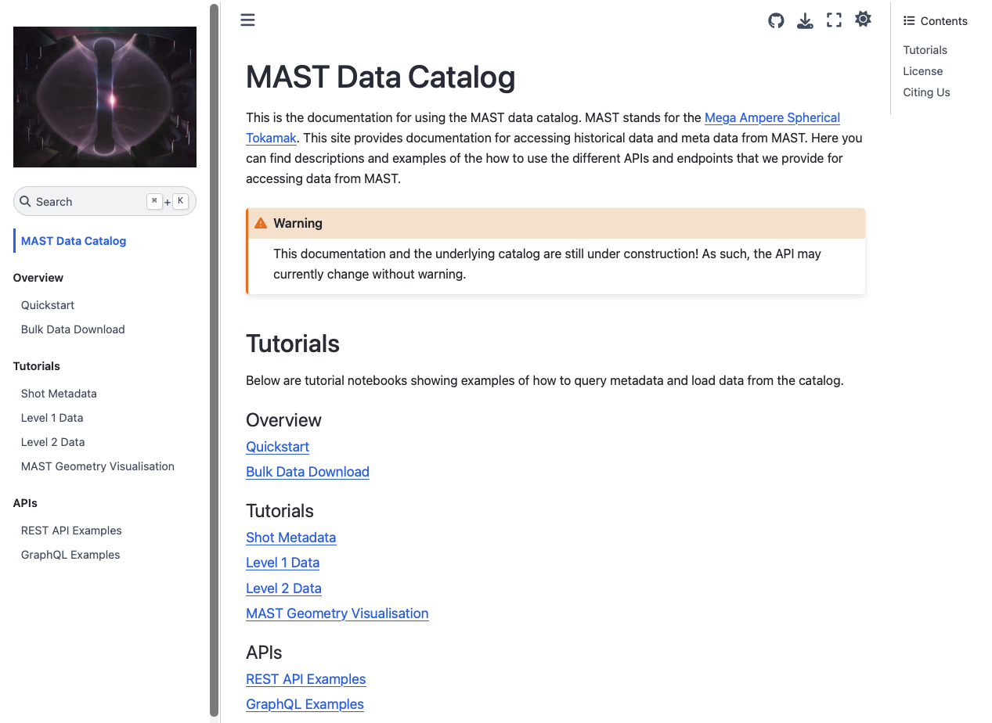
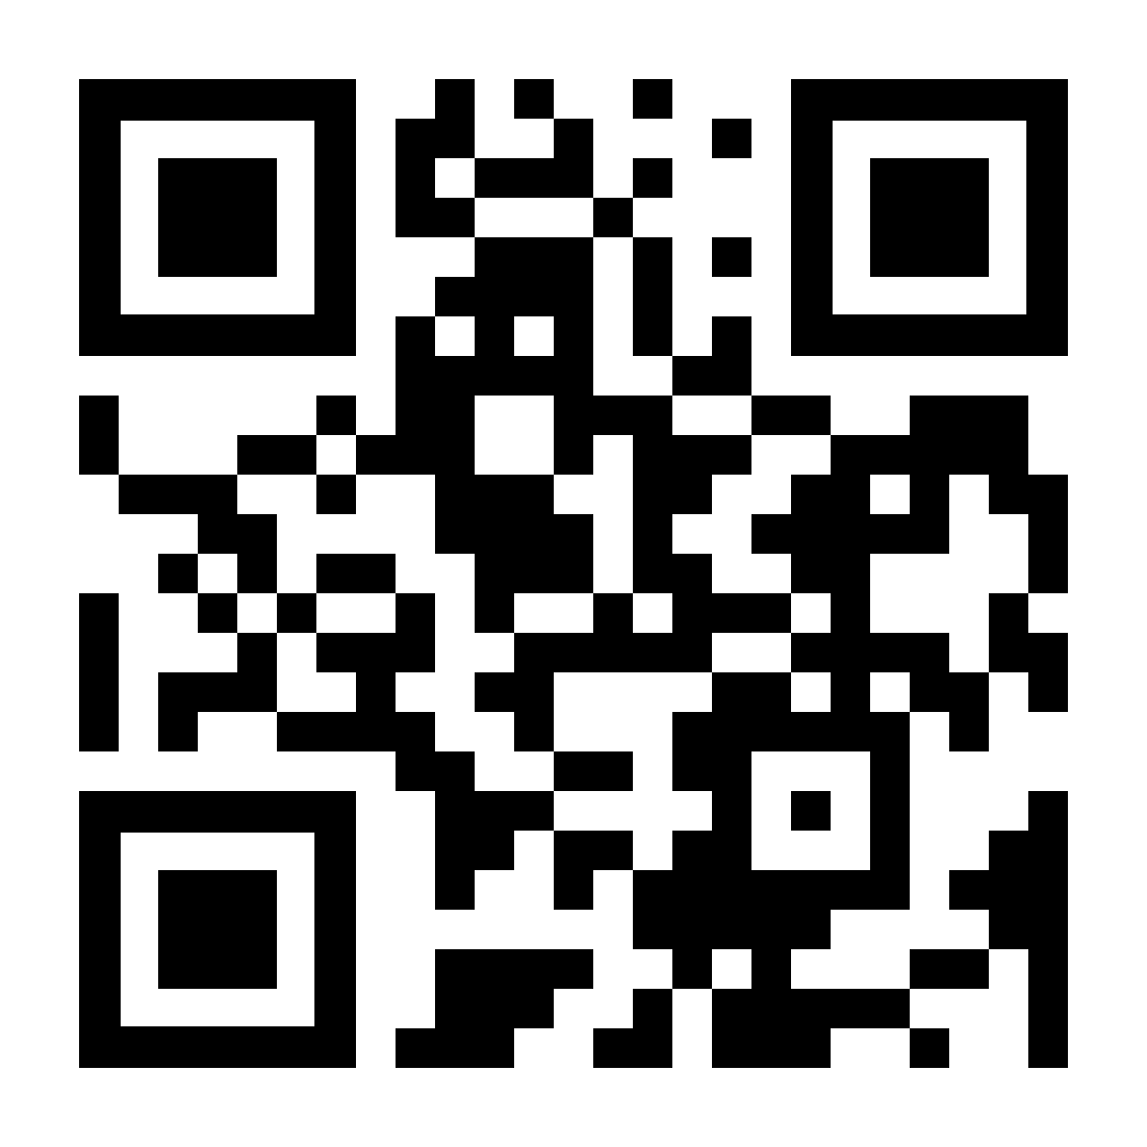

FAIR-MAST Project
https://mastapp.site/
Hosted by IRIS on
STFC Cloud
4
Jackson, Samuel, et al. "FAIR-MAST: A fusion device data management system." SoftwareX 27 (2024): 101869.
S. Jackson et al., "An Open Data Service for Supporting Research in Machine Learning on Tokamak Data,” IEEE (2025): 101109
Notes:
This is where fair-mast comes in. It takes the data from the UDA system and configures it in a way to be accessible to the public. The system provides a publicly searchable metadata index and remote access to shot data via an S3-compatible object store, enabling efficient interactive analysis and AI/ML workflows without unnecessary data transfer. Its generic design allows it to be easily extended to other tokamaks in the future, such as MAST-U, supporting greater collaboration and accelerating scientific discovery in fusion and plasma physics. The documentation using jupyter book that is executable and API for this project can be found at mastapp.site (follow the link of QR code) which is very helpfully hosted by IRIS on STFC Cloud. So, thank you very much.

Slide 5
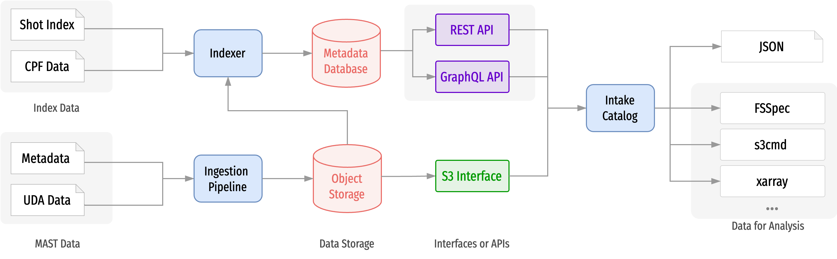

System Architecture
Object storage
Holding shot, source, and signal data in a self-describing, cloud optimised file format.
Accessible by S3 protocol.
Metadata database
Indexing data in the object storage
For searching and finding data in the object storage
Accessible by web APIs
Jackson, Samuel, et al. "FAIR-MAST: A fusion device data management system." SoftwareX 27 (2024): 101869.
S. Jackson et al., "An Open Data Service for Supporting Research in Machine Learning on Tokamak Data,” IEEE (2025): 101109
Notes:
Here shows the system architecture of fair-mast.
At a high level, the system consists of two components: an object store holding the diagnostic data in a self-describing, cloud-optimised format, and a metadata database that indexes this data and exposes it via web APIs for search and discovery.
We choose to use a hierarchical self-describing file format that we implement using zarr. We group the data by shot, and signals roughly by diagnostic. Each group contains metadata and defined coordinate axes.

Slide 6
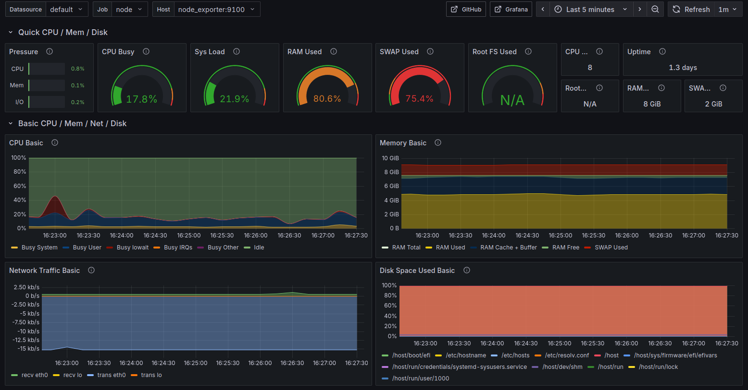

Recent FAIR-MAST Improvements
Further data curation
IMAS naming¹
Filtered shots
Improved dev-ops monitoring
Integration with open-source tools such as Toksearch² and disruption-py³
Inclusion of MAST geometry which was not before included in UDA
Monitoring Dashboard
https://imas-data-dictionary.readthedocs.io/en/latest/
B.S. Sammuli , et al. ”TokSearch: A search engine for fusion experimental data” (2018): 101016
GL Trevisan, et al. (2024), "DisruptionPy: An open-source physics-based scientific framework for disruption analysis of fusion plasmas", 10.5281/zenodo.13935223
Notes:
Since our last update for iris we have: Continued with the curation of mast data with higher levels of processing which has been cropped, interpolated, and calibrated. We have also mapped the data has to follow IMAS naming conventions. IMAS is a data dictionary written by ITER which standardises naming in fusion. Data is also filtered using plasma current to remove shots used for testing, commissioning, and machine calibration for example.
FAIR-MAST has been integrated with other open source tools to increase it’s findablility and usability with researchers. These include, toksearch, a search engine for fusion experimental data, and disruption-py a framework for disruption analysis of fusion plasmas.
We have now included monitoring using graphana which informs us on the traffic to the databases. We are planning on increasing this monitoring to better inform us on what data is being used the mosr.
In the process of improving FAIR-MAST we have also improved UDA, including bug fixes, performance scaling and most notably adding MAST geometry data into UDA.

Slide 7
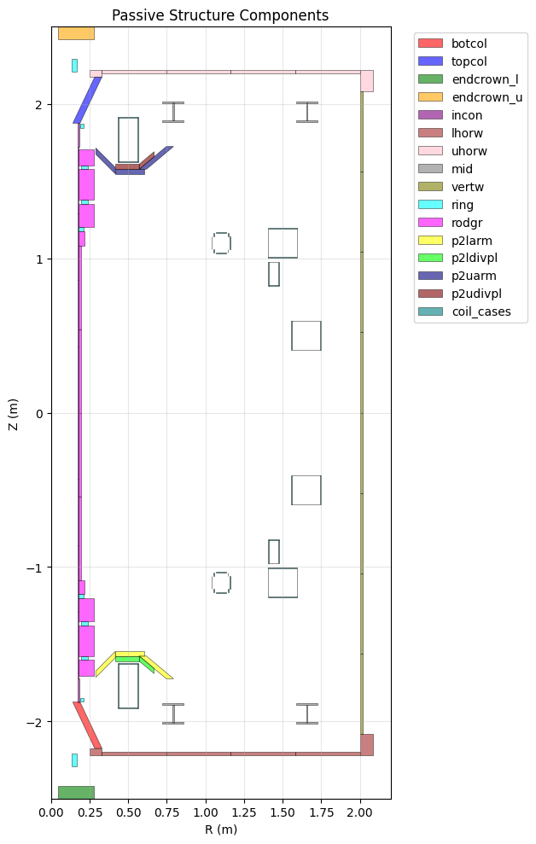
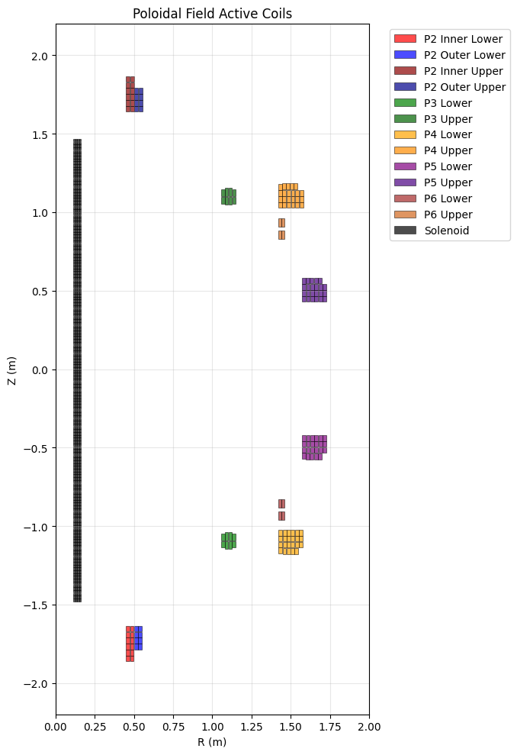
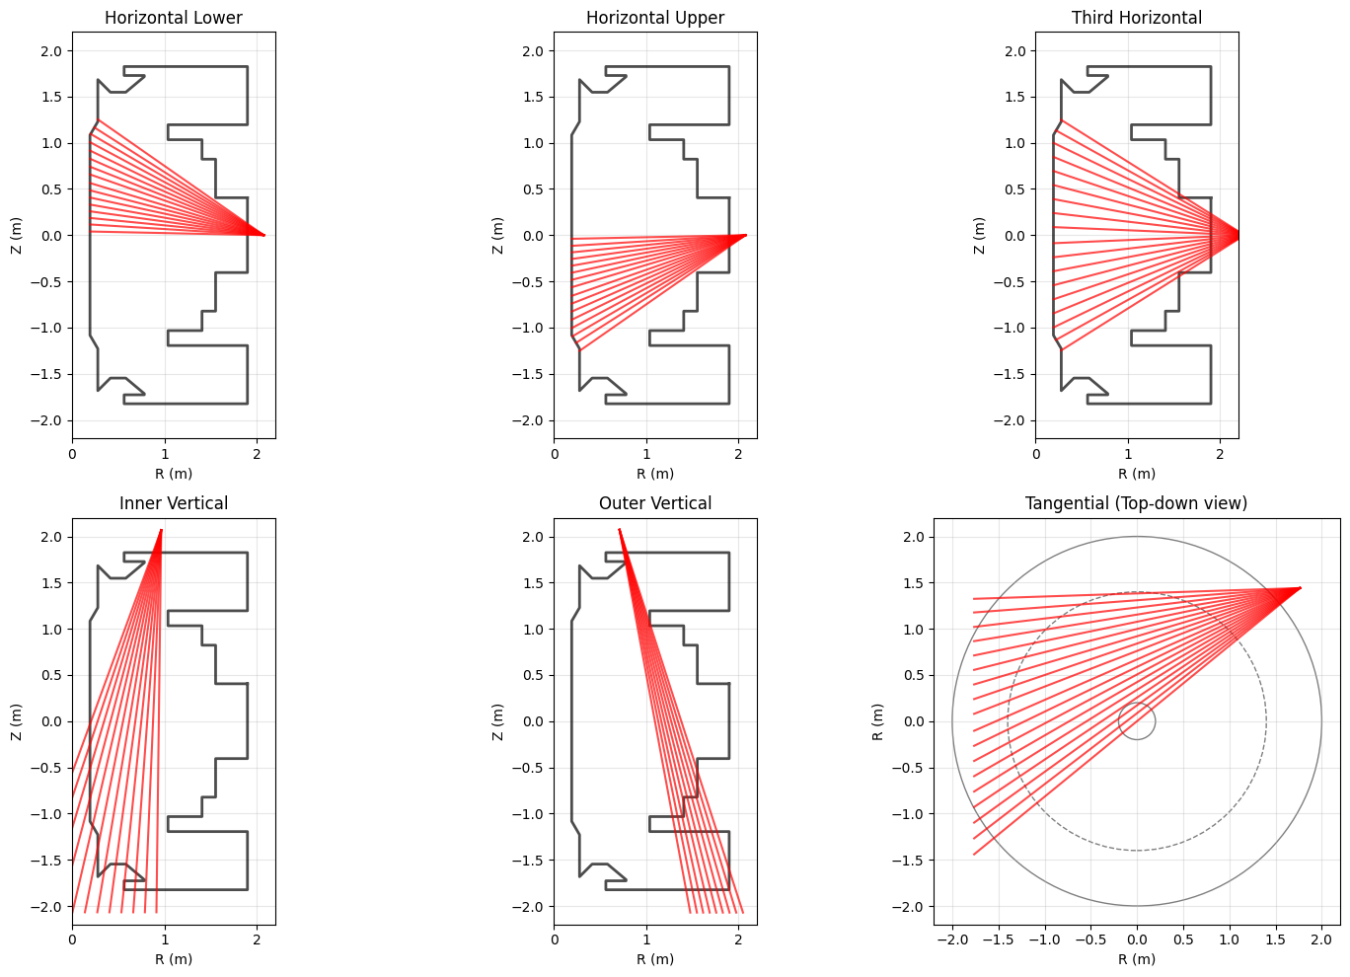
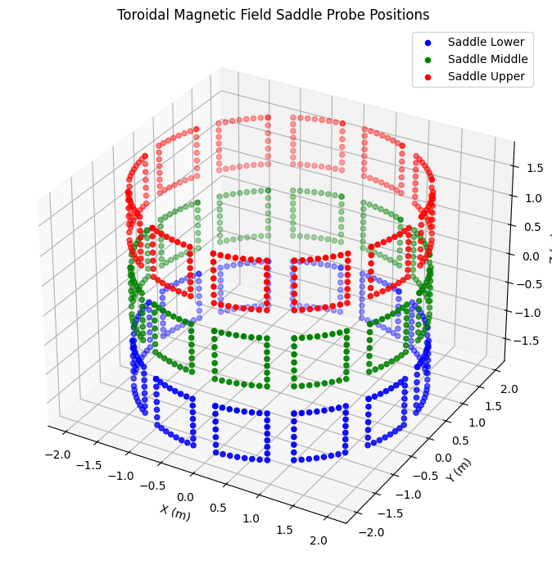
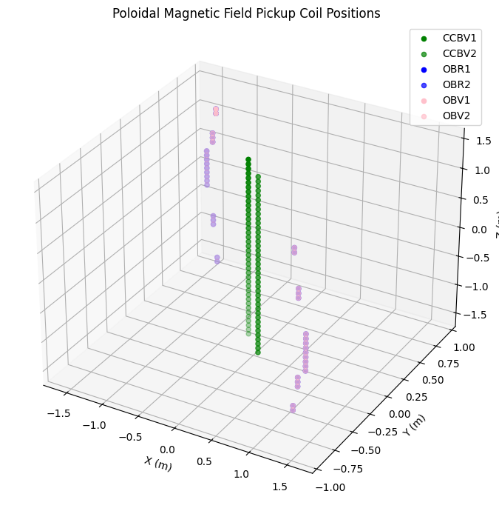
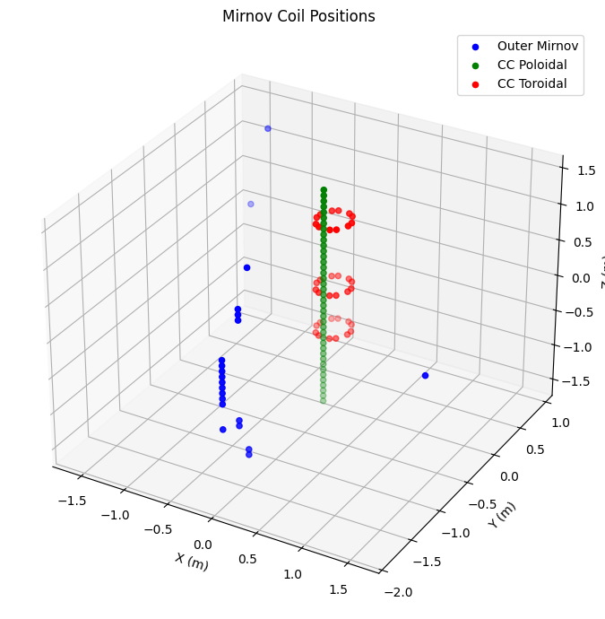
MAST Geometry
Recently Added to both UDA and FAIR MAST.
Geometry data is organised such as:
Magnetics: Magnetic field probes, flux loops, Mirnov coils, saddle coils
PF Active: Poloidal field coil positions
PF Passive: Passive structure (e.g. vessel wall, supports)
Soft X-rays: Camera positions and lines-of-sight
Wall: Limiter and wall geometry
Soft X-Rays
Notes:
Here are some examples of the geometry data that has been added.
This geometry adds to the metadata to inform the diagnostic data giving researchers more context for their analysis.

Slide 8
Summary
We developed a data infrastructure solution for the history of the MAST experiment
We provide a public REST API for the metadata
We provide a publically accessible version of MAST data in cloud object storage
We provide a processed version of the data for optimal use
We provide MAST data with diagnostics mapped to IMAS naming conventions
All developed and hosted on IRIS resources!
Demo site:
https://mastapp.site/
Notes:
In summary, FAIR-MAST provides a public, cloud-based data infrastructure for the full history of the MAST experiment. It offers searchable metadata, remote access to processed diagnostic data, and interoperability with modern analysis tools, all hosted on IRIS resources.
Thank you very much.

Slide 9
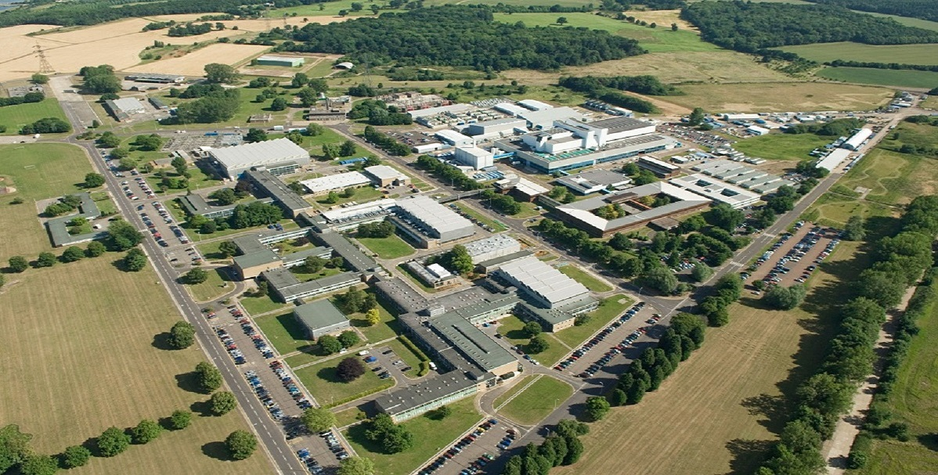
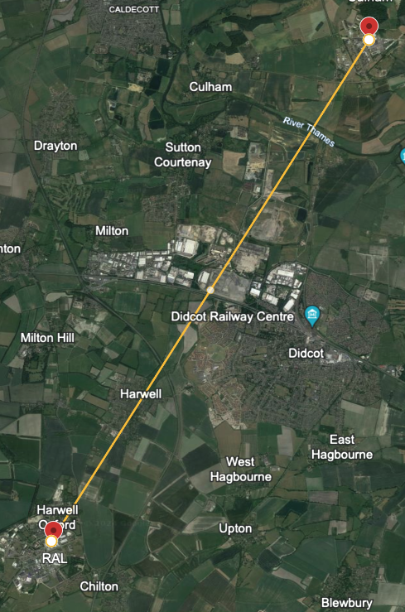
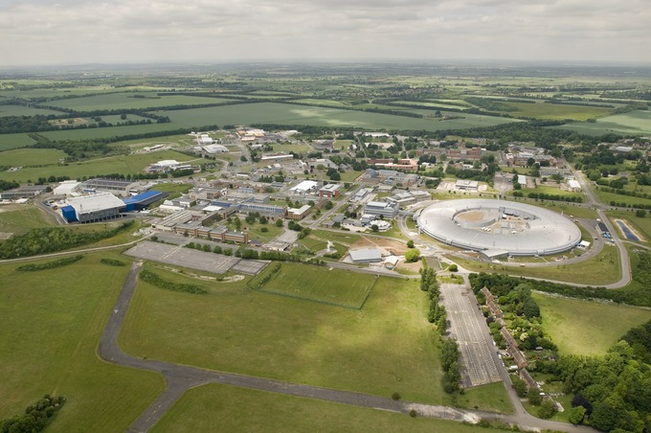
With Thanks
A cross-organisation collaboration between STFC and UKAEA and was funded as part of the Fusion Computing Lab programme.
STFC
Saiful Khan
Jeyan Thiyagalingam
Culham Centre for Fusion Energy
UKAEA
Samuel Jackson
Nathan Cummings
James Hodson
Khalid Lawal
Larisa Dorman-Gajic
Daniel Brennand
Shaun De Witt
Stanislas Pamela
Rob Akers
Rutherford Appleton Laboratory
With special thanks to Jonathan Hollocombe, Stephen Dixon, Jimmy Measures, Lucy Kogan, Adam Parker, Deniza Chekrygina, Alejandra Gonzalez-Beltran, IRIS, the STFC Cloud and STFC Data Services Groups.
(C) Google (2024) Didcot Area, Accessed June 2024

