Slide 1
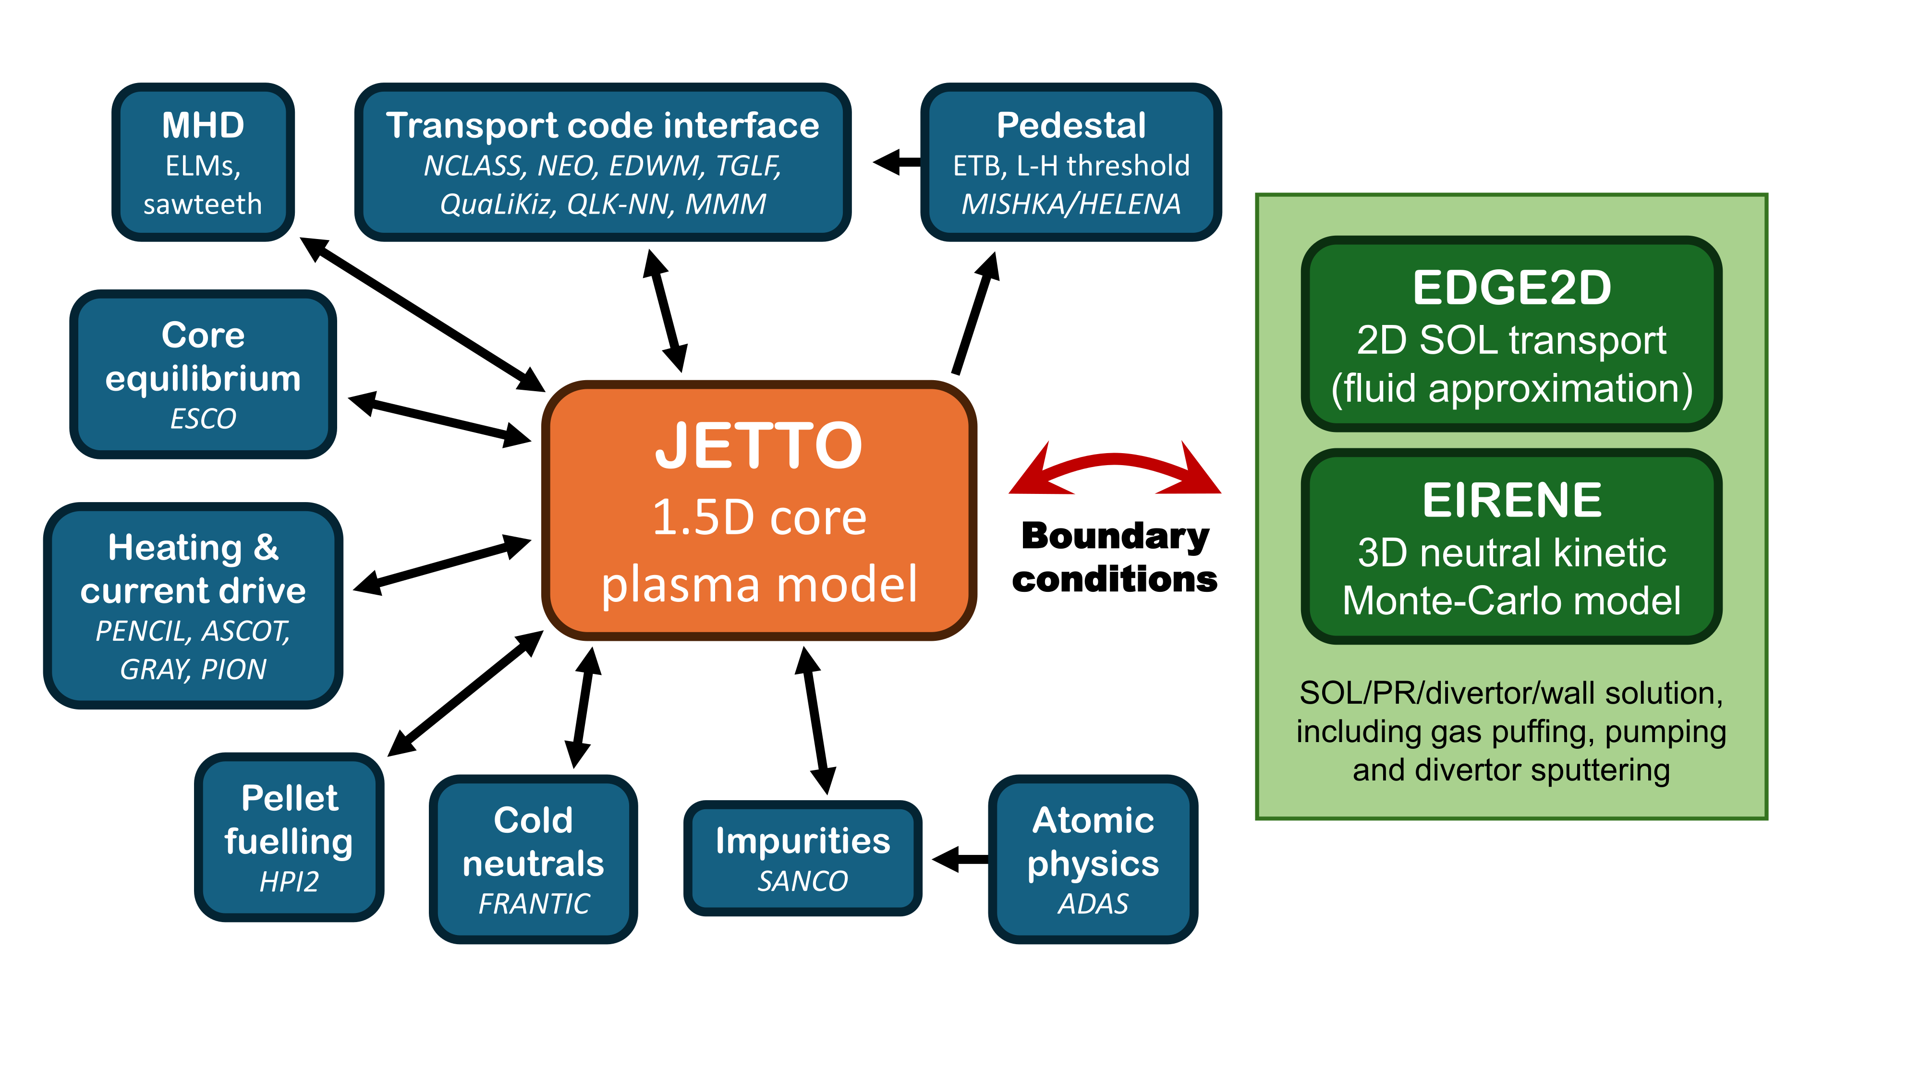
JINTRAC integrated plasma simulations
I work for UK Atomic Energy Authority (UKAEA), running and developing models for integrated simulations of tokamak plasmas (mainly for STEP and ITER)
Primarily work with JINTRAC
IRIS resources are being used routinely in our work, e.g.:
Large parameter scans with simple models (1 processor/simulation)
Advanced transport model simulations (~60 processors, one simulation lasting days or weeks)
Core/SOL-plasma integrated simu- lations, requiring to resolve short time scales (~16 processors, days or weeks of runtime per plasma second)
In the future, we could also use IRIS resources for machine learning of surrogate models
Block diagram of the JINTRAC integrated modelling structure

Slide 2
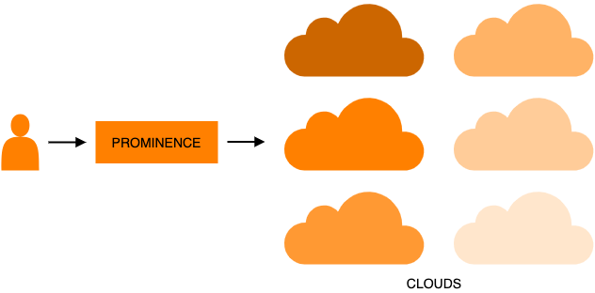
PROMINENCE as interface against IRIS resources
A platform that allows users to exploit cloud resources for running containerised batch workloads
Can be accessed from command line, or programmatically via APIs
Allows submission of groups of jobs organised in workflows – Useful for e.g. parameter scans
GitHub:
https://github.com/prominence-eosc
Documentation:
https://prominence-eosc.github.io/docs/

Slide 3
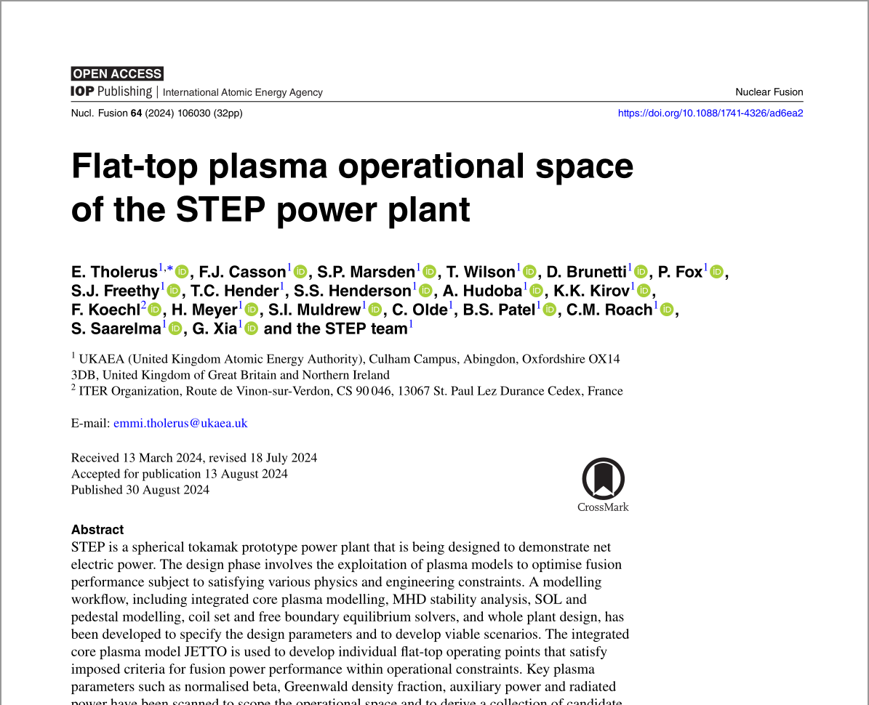
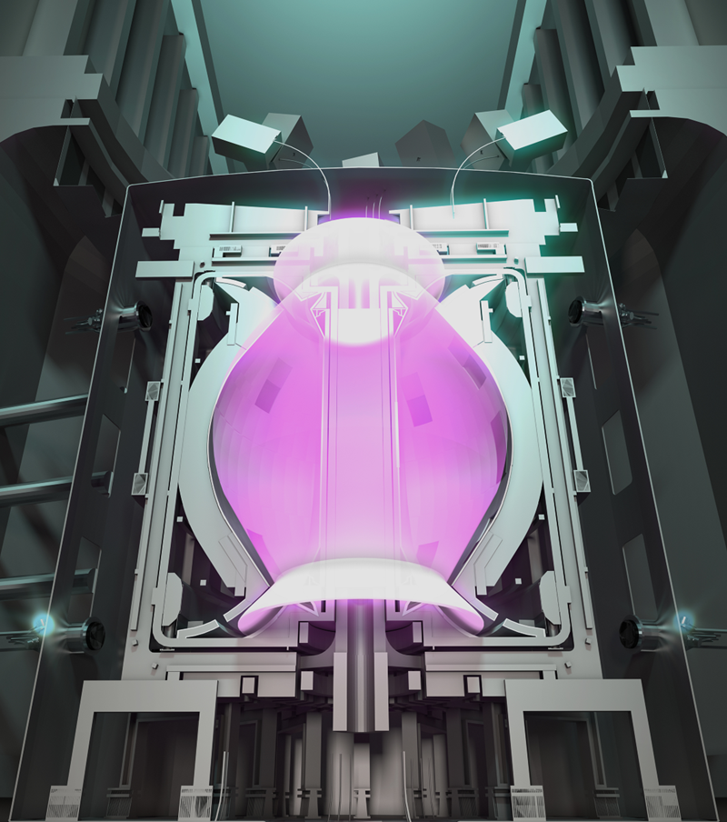
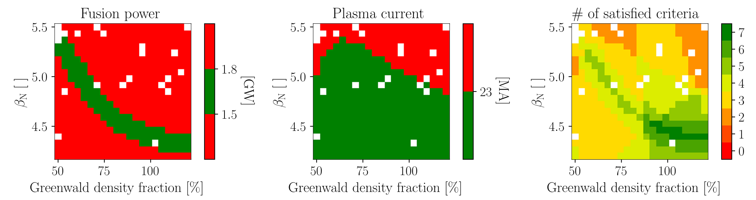
Extensive parameter scans for STEP design and scenario development
STEP (Spherical Tokamak for Energy Production) is a prototype power plant planned to be built in UK, Nottinghamshire
Plasma parameter scans to assess and optimise performance of STEP
Each pixel in the figures below ↓ corresponds to a core plasma simulation with JETTO, run on IRIS resources (several CPU hours per simulation)
Nearly 1,500 simulations in total for this paper alone
Paper published in IOP Nuclear Fusion E. Tholerus et al. 2024 Nucl. Fusion 64 106030

