Slide 1

Paul Quinn
Paul.quinn@stfc.ac.uk
STFC Facilities
Notes:
The abstract pattern can be removed or repositioned if required. Be careful to ‘Send to Back’ so that it does not obscure any important information.

Slide 2
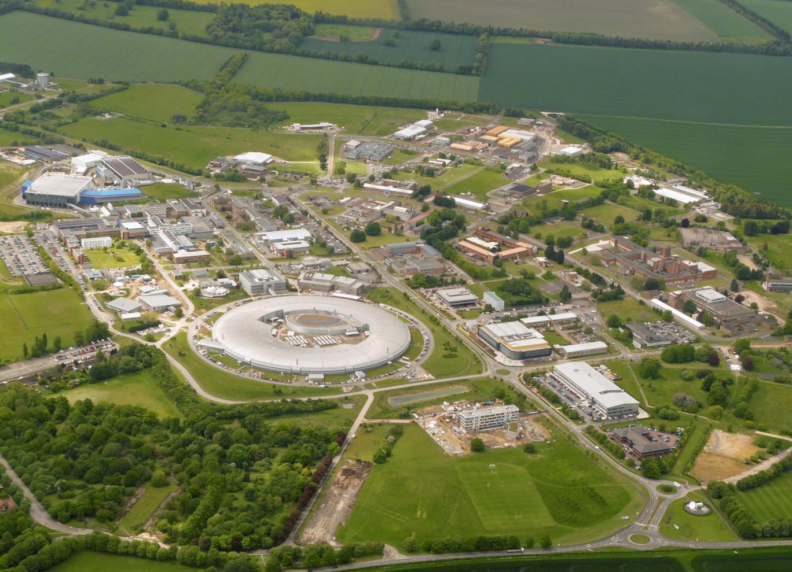
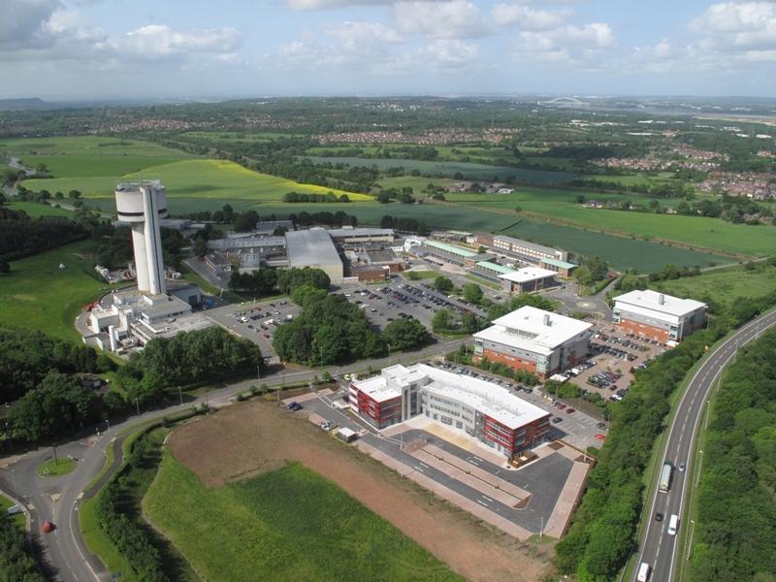
Harwell and Daresbury Campus
The Rosalind
Franklin
Institute
STFC Scientific computing
ISIS
Central
Laser
Facility
National Quantum Computing Centre
Hartree Centre
STFC Scientific computing
RCaH
RAL
Diamond Light Source
RAL Space
Rutherford Appleton Laboratory
ASTeC, REUDI
Notes:
eBIC is the Uks national facility for cryo electron microscopy, and is an associated facility to DLS, which is the Uks national synchotron facility. DLS was opened in 2007, is currently in the third phase of construction with 32 operational beamlines.
DLS has a total of 12,000 registered users, with over 9,000 user visits per year and over 100 industrial users paying for proprietary use of the equipment.
Diamond light source is located on the harwell research complex, which also contains many other national facilities including a neutron source (ISIS), Central laser facility, CCP-4 and CCP-EM, as well as the European Space Agency.

Slide 3








5 laser labs, each with an array of instruments
35 X-ray instruments, 10 electron microscopes
Over 30 neutron and muon instruments
Each focused on a different science areas
Each having different analysis needs
Annual Throughput
2500
experiments
8000
researchers
1500
Publications
18 Pb
stored
30
Countries

Slide 4


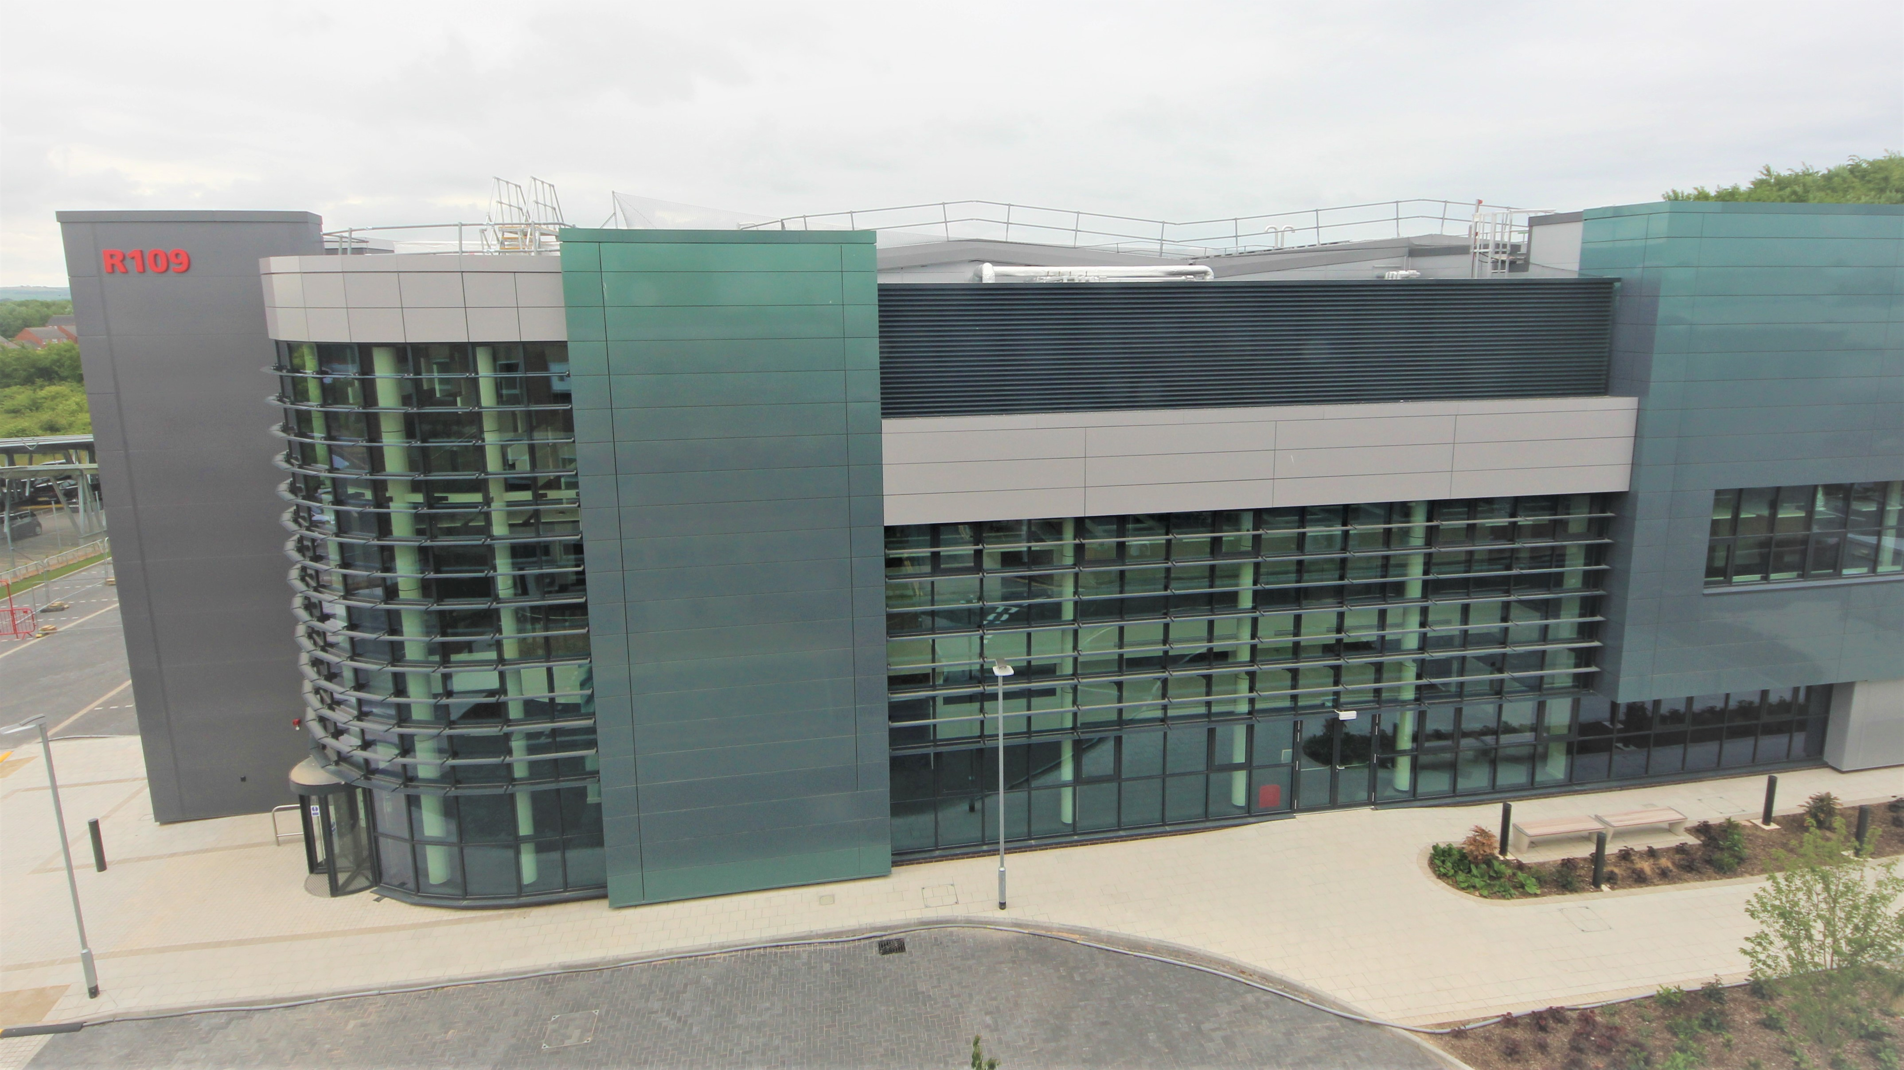
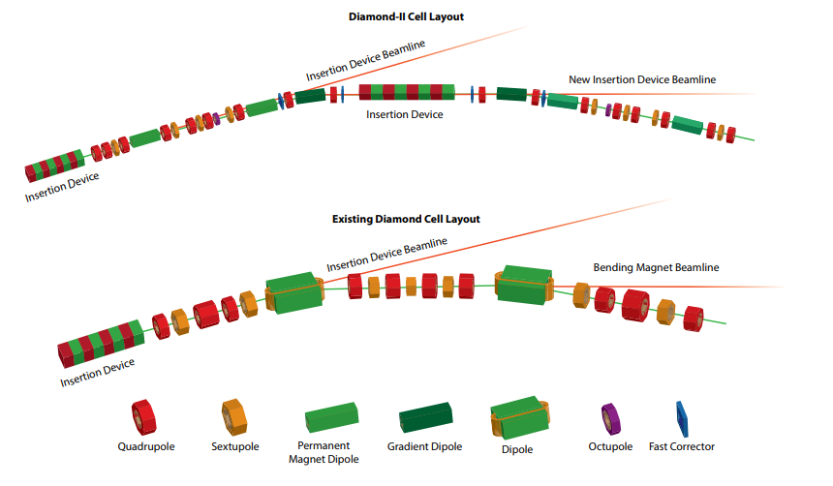
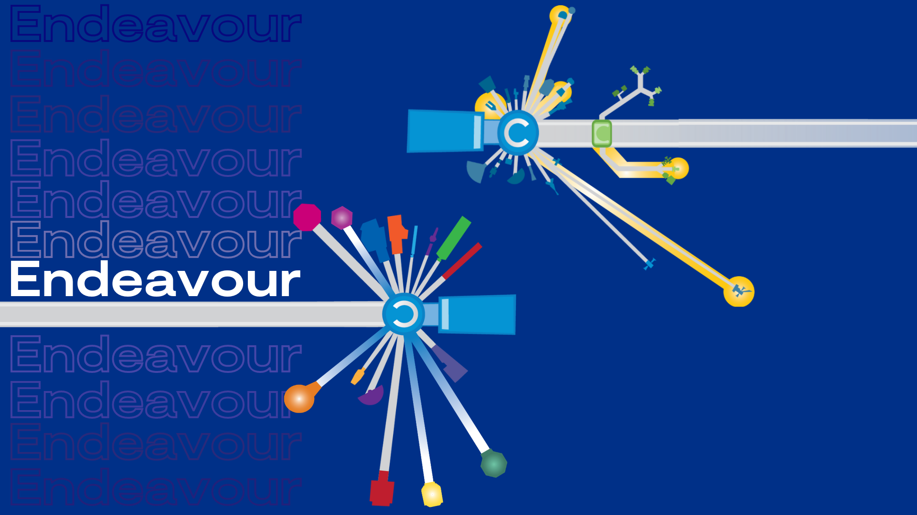

New Facilities and Upgrades
UK XFEL
CLF HiLUX upgrades to Ultra and Artemis
CLF-EPAC
PetaWatt laser and X-ray source
x10-100 fold increases in power, flux, brightness
Diamond “dark period” 2028 – 18 months
Faster Timescales
New instruments/techniques
Diamond-II - - Diamond Light Source
Relatvistic Ultrafast Electron Diffraction & Imaging
ISIS The Endeavour Programme (stfc.ac.uk)
4

Slide 5
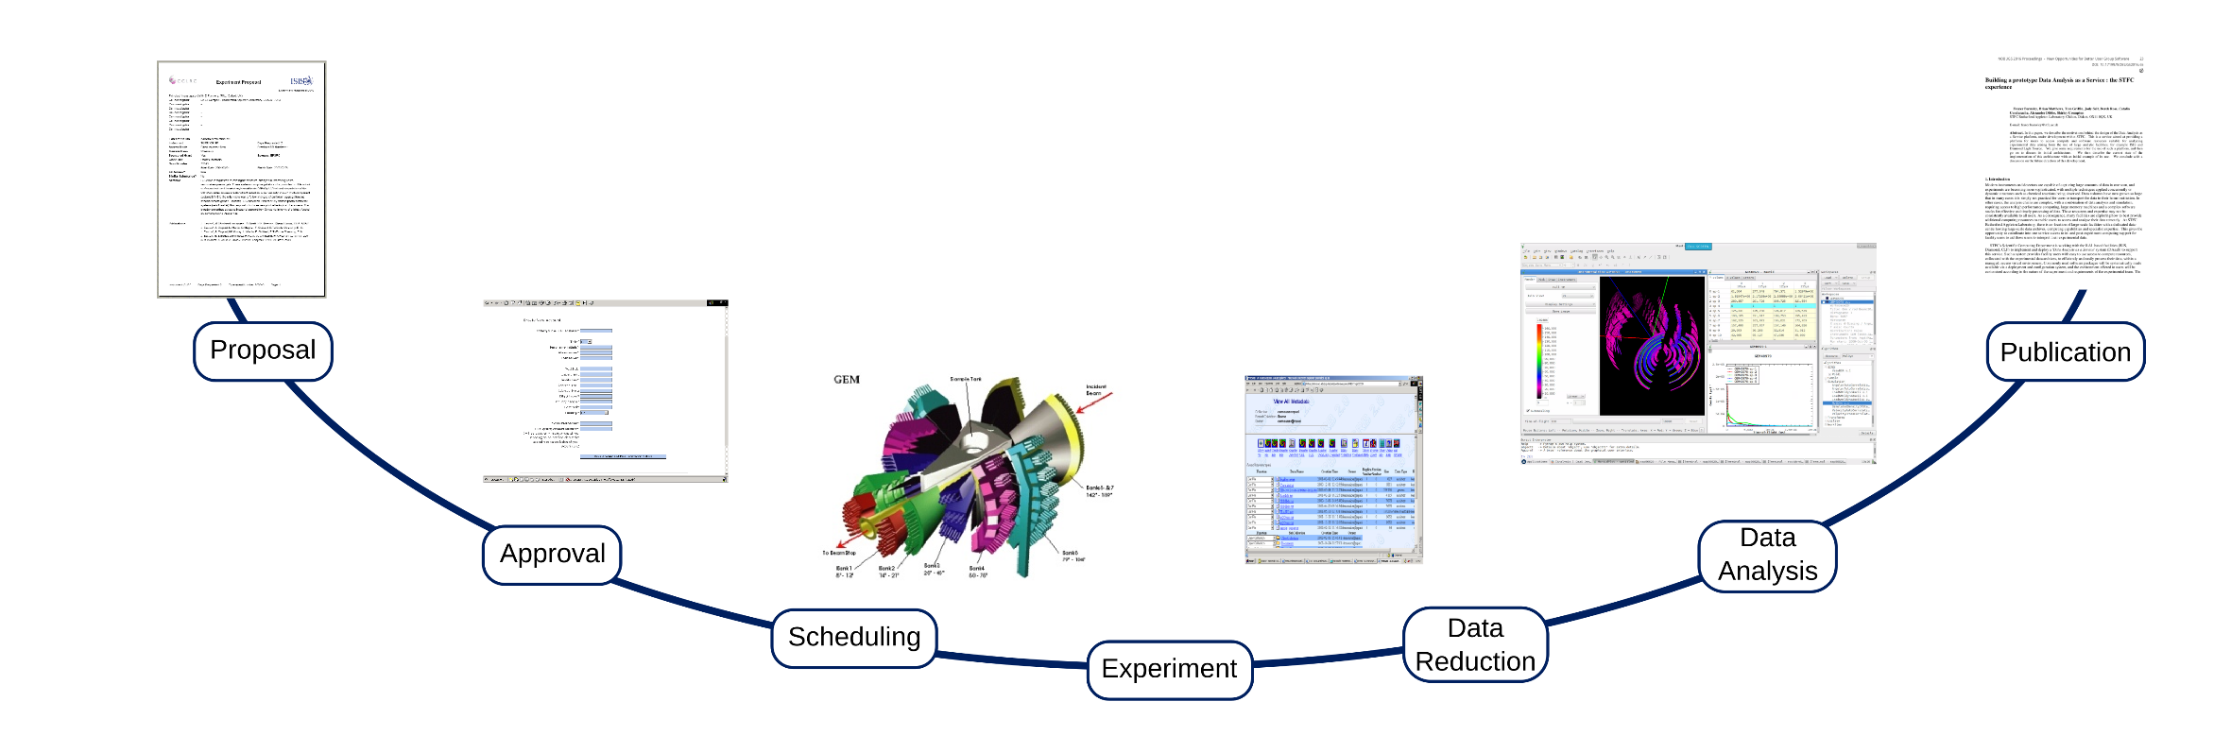
Experiment Life
Average 2.5 years
Production rate varies 30%-95%
6 months
1-5 days
Notes:
Experiment lifecycle: Users will come on site for a short time (maybe 2 days) then never come back.
Lots of people visit the facilities each year, this may be the only big experiment they ever do (PhD students)
Once they leave, they have 3 problems. They need to access their data which is stored at RAL behind the site firewall
They need compute
They need an environment to analyze their data

Slide 6



Activity Streams
Facilities adapting IRIS to their user needs
Supporting researcher projects
Ada Lovelace Centre
To expand use of advanced tools
Increase impact

Slide 7
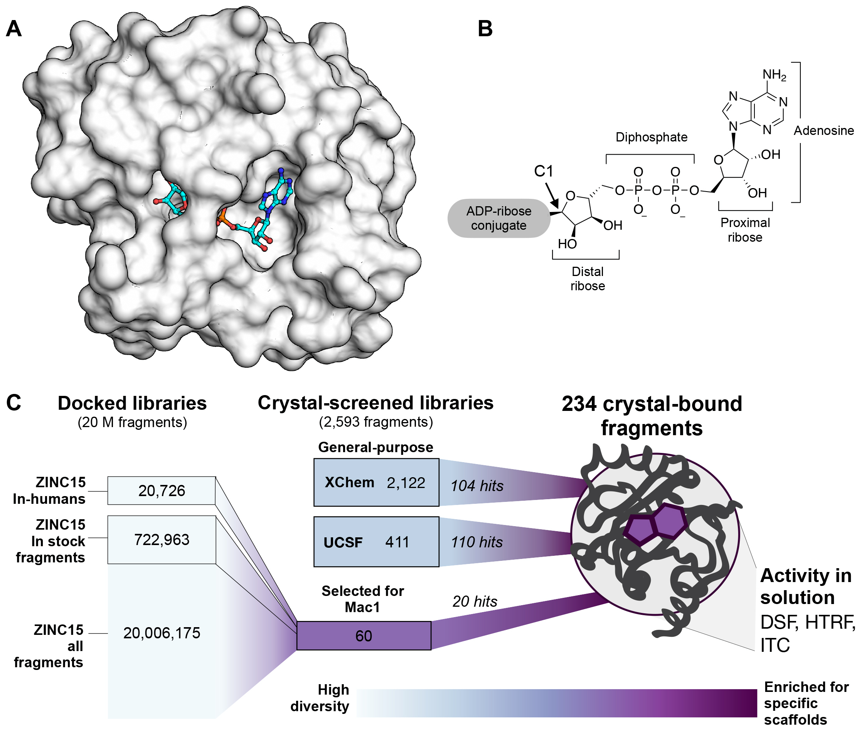

Highlight – IRIS supporting discovery
XChem
Fragalysis platform
Fragment screening for drug discovery
2025 - Openbind
Sovereign AI flagship
Professor Charlotte Deane of the University of Oxford said:
OpenBind realises a major gear-shift for AI in drug discovery by investing in the data that powers it.
Moonshot Project
Covid Moonshot was a global open-science project started in 2020 with the aim to develop a safe, globally accessible and affordable antiviral pill for Covid-19
Science Advances DOI:10.1126/sciadv.abf8711

Slide 8
Outlook
A lot of exciting impact
Refine the platform offering – an integrated discovery platform (moving data, workflow standards, Slurm, VM’s , AI tools, notebooks )
“Next year we need 10x more” – IRIS flexibility is a big plus
Models of how we use data/compute changing
New tools and user communities
Varying role of AI
Positioning, Redundancy and Service level
Experiments are short and access is limited
Drive for automation and in-experiment decisions

Slide 9
Questions
What IRIS enabled you to achieve?
In the next 2-3 years, which capabilities should IRIS prioritise to unlock the biggest step-change for you?
How can we better capture impact of IRIS on your community?

Slide 10
Questions
How do you balance diverse projects with competing priorities, and what allocation/charging/accounting approach best reflects real value?
Which capabilities should be standardised across projects (identity, data management, workflow orchestration, observability), and where is bespoke unavoidable?
How are you measuring and reducing energy/carbon impact without reducing scientific output?

