Slide 1

CLF Octopus Imaging Cluster
Dan Rolfe, Octopus Facility
UKRI STFC Central Laser Facility

Slide 2
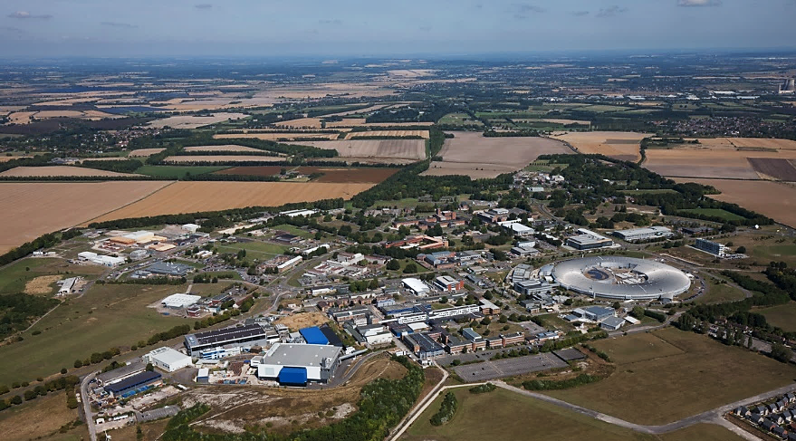
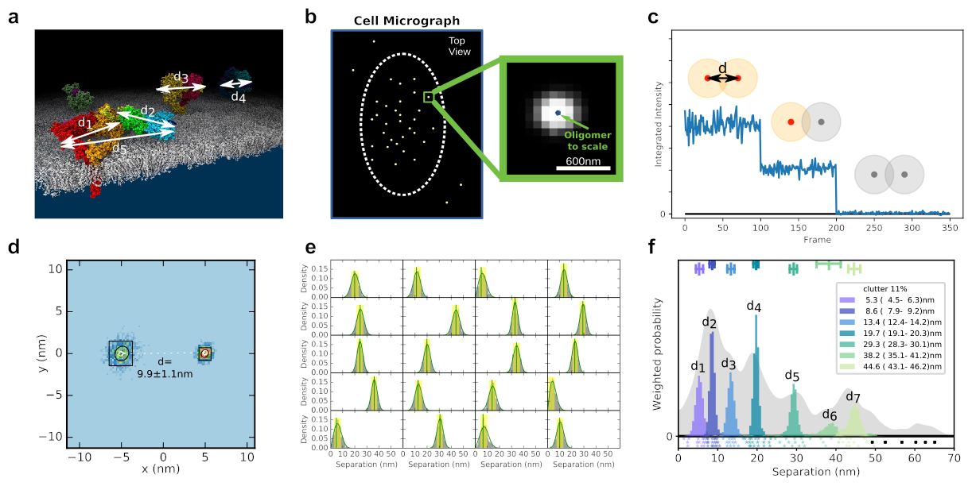
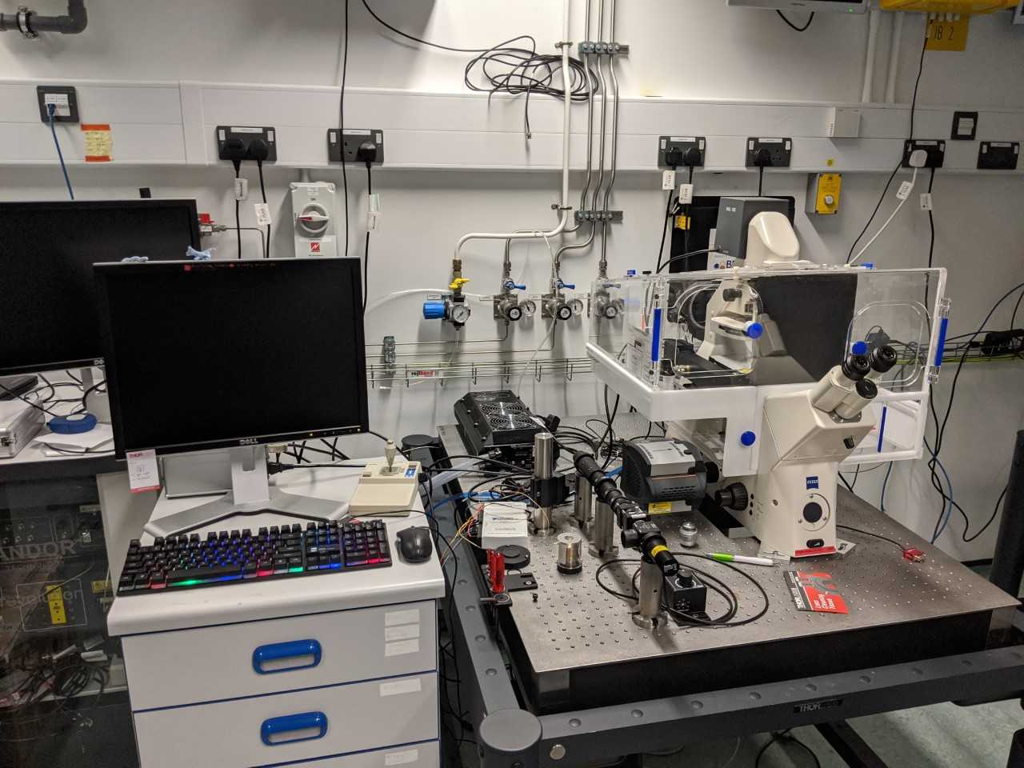
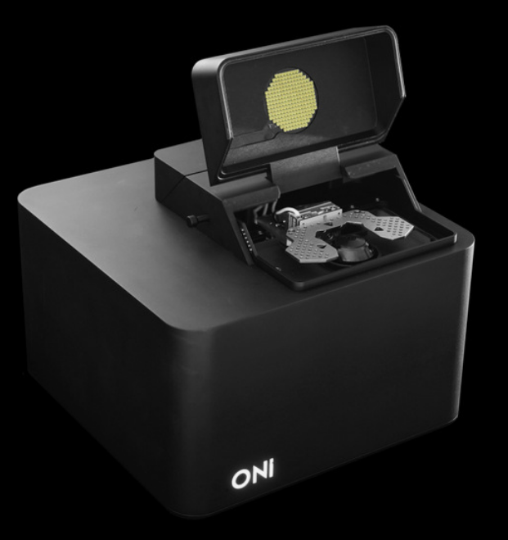
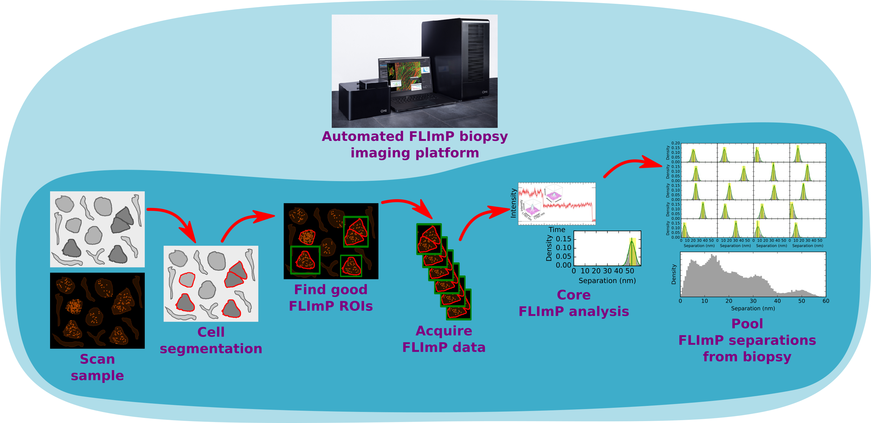
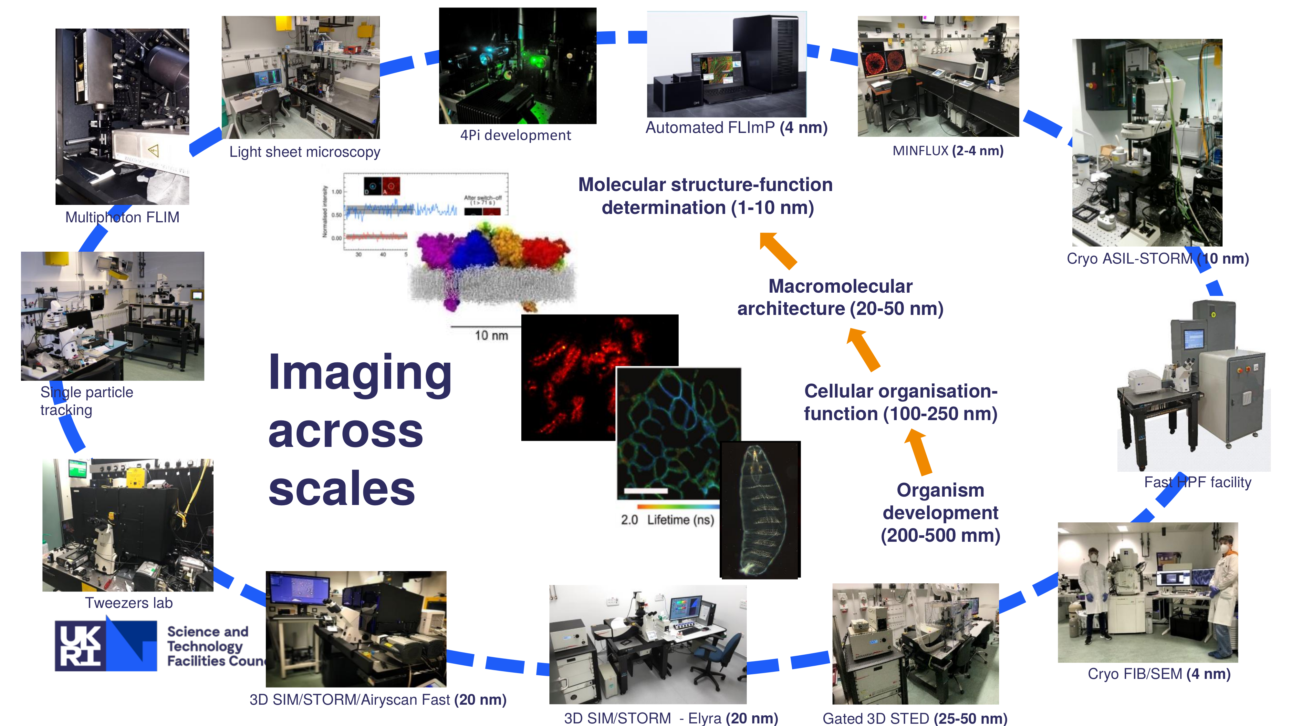
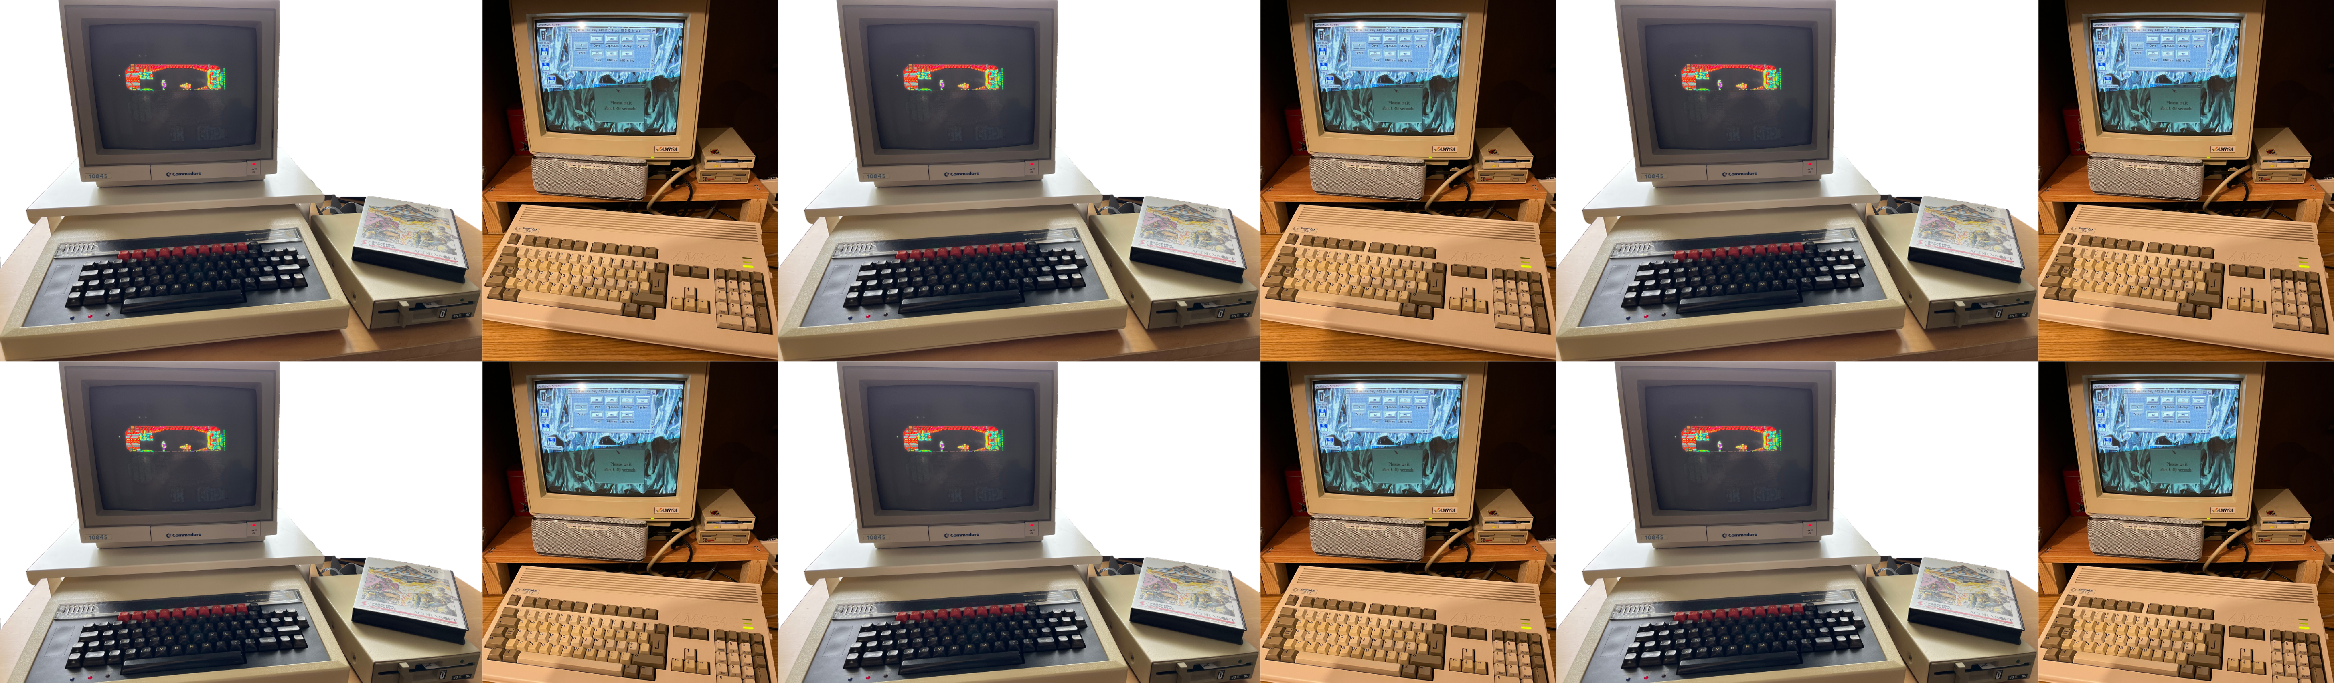
OCTOPUS
FLImP Fluorophore Localisation Imaging with Photobleaching
Cell membrane receptor protein organisation at ~nm resolution
Automation of acquisition -> 30x increase in acquisition rate :o)
30x increase in data processing & storage needs :o|
~1TB/day per microscope
1000s of independent jobs per day per microscope
Drove development of HTC pipeline
To run our workflow and automated analysis pipeline
Optics Clustered To OutPut Unique Solutions
National imaging facility with peer-reviewed, funded access, part of Central Laser Facility at RAL, Harwell
Cluster of microscopes and lasers and expert end-to-end multidisciplinary support – from design of experiment to publication
Single molecule microscopy, super resolution fluorescence microscopy & now superresolution correlative light and electron microscopy (cryoCLEM) at cryogenic temperatures
Method development from instrumentation to analysis and interpretation
Automation for efficiency and throughput and to enable complex studies

Slide 3
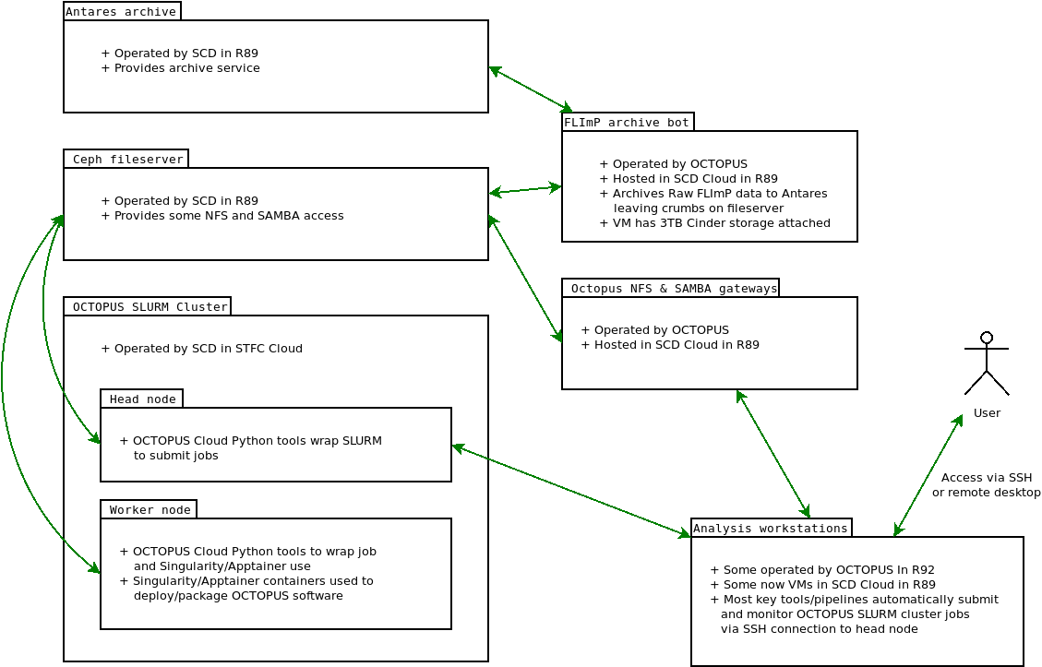

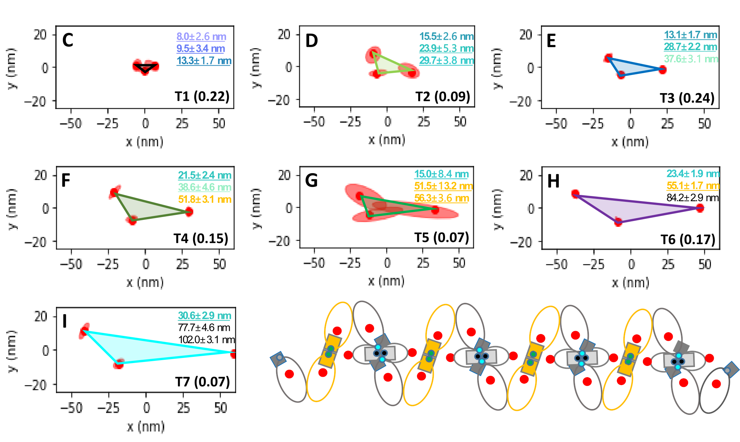
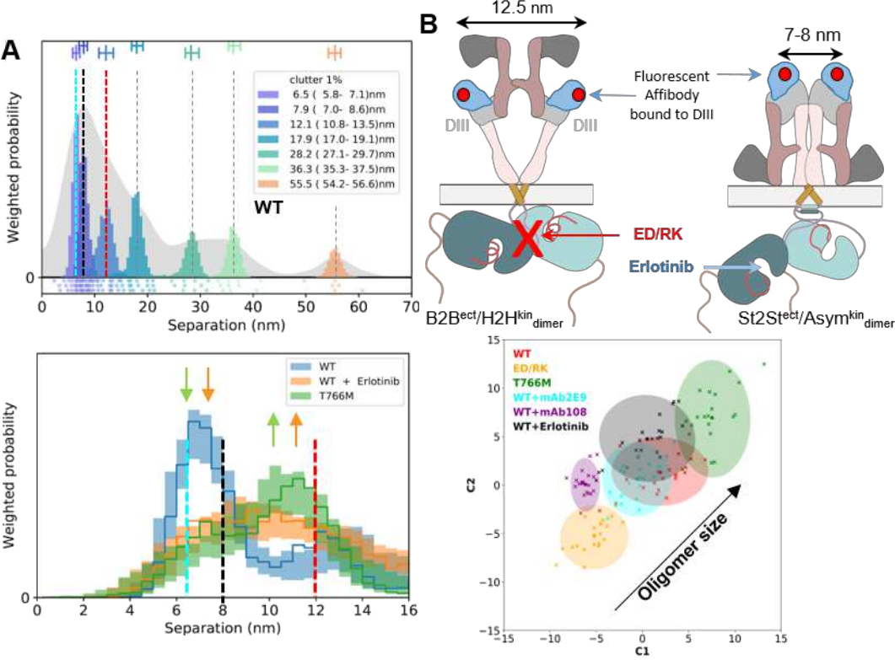
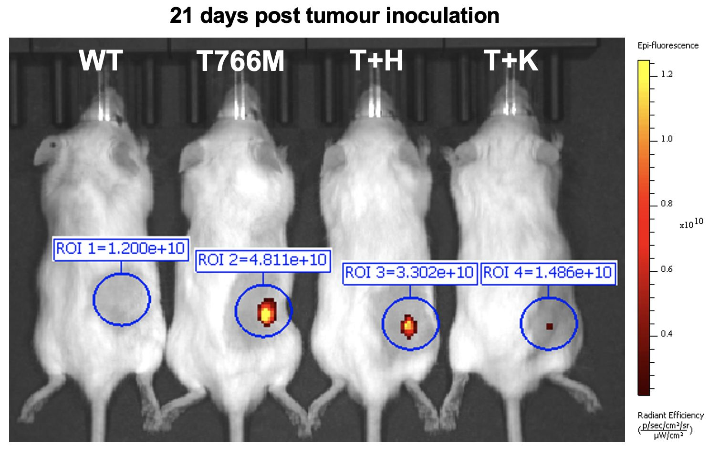
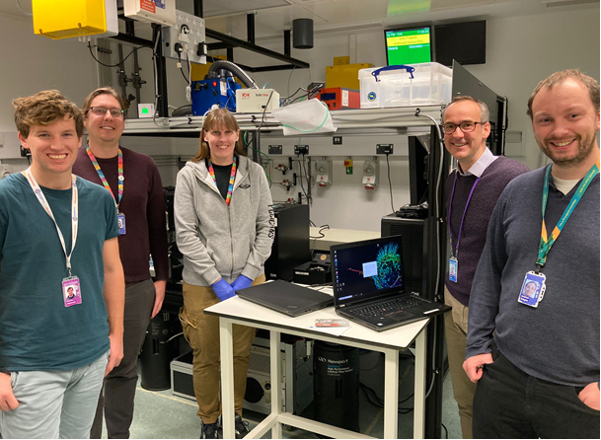
Compute infrastructure
SLURM cluster on STFC Cloud, CephFS fileserver, Antares archiving, services on STFC Cloud VMS
IRIS - STFC Cloud 120 CPU nodes and 50 GPU nodes, CephFS backup and Antares tape storage resources
STFC SCD teams – operating and supporting STFC Cloud SLURM cluster & storage resources
ALC funded development of initial prototypes in Octopus (SCARF, Octopus fileservers, STFC Cloud SLURM)
Will be used in future by additional Octopus workflows, e.g. superresolution cryoCLEM currently in development
FLImP user projects and outputs
Automated FLImP development and first user - Non Small Cell Lung Cancer
Identified new molecular interfaces to target NSCLC with fewer side effects and opening new doors in precise drug design (Nat. Comm., 2024, Iyer et al)
2026 paper in prep – Identified common thread in NSCLC receptor mutations which will enable currently ineffective drugs to work well
Understanding membrane protein arrangements and their function in lung fibrosis
Material science – molecular data storage
Challenges (for a small team)
Swiss army knives or experts in team with external support available (e.g. RSEs)
People to develop and apply methods in facility efficiently (e.g. code optimisation, cloud-optimised pipelines…)
Notes:
ROI detection – UNET
Autofocus - ?
Drift – fiducials, average track, cross validation & bootstrap resampling
Track selection – mulitple filtering steps

