Slide 1
Impact of IRIS in CLF “other” facilities
Rajeev Pattathil
IRIS Collaboration Meeting, January 2026

Slide 2
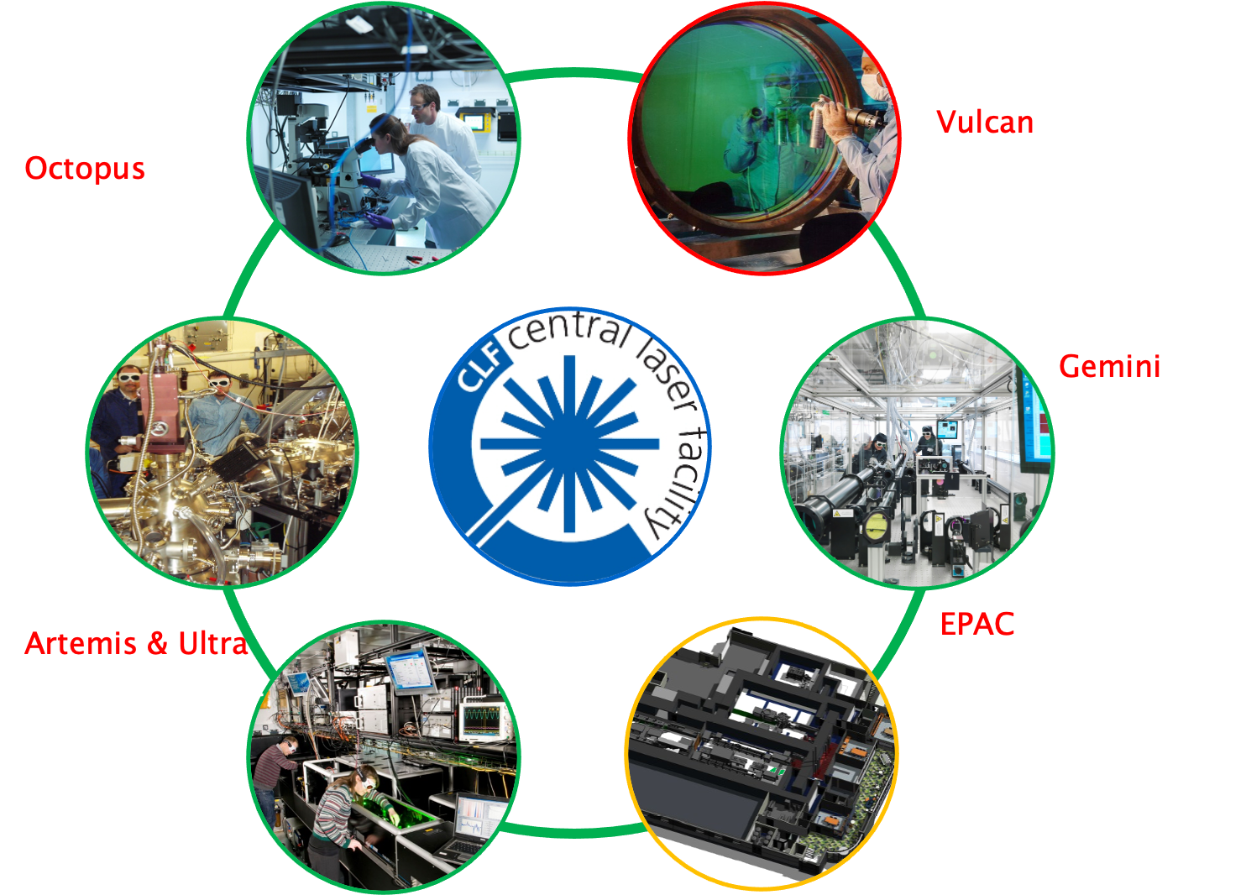
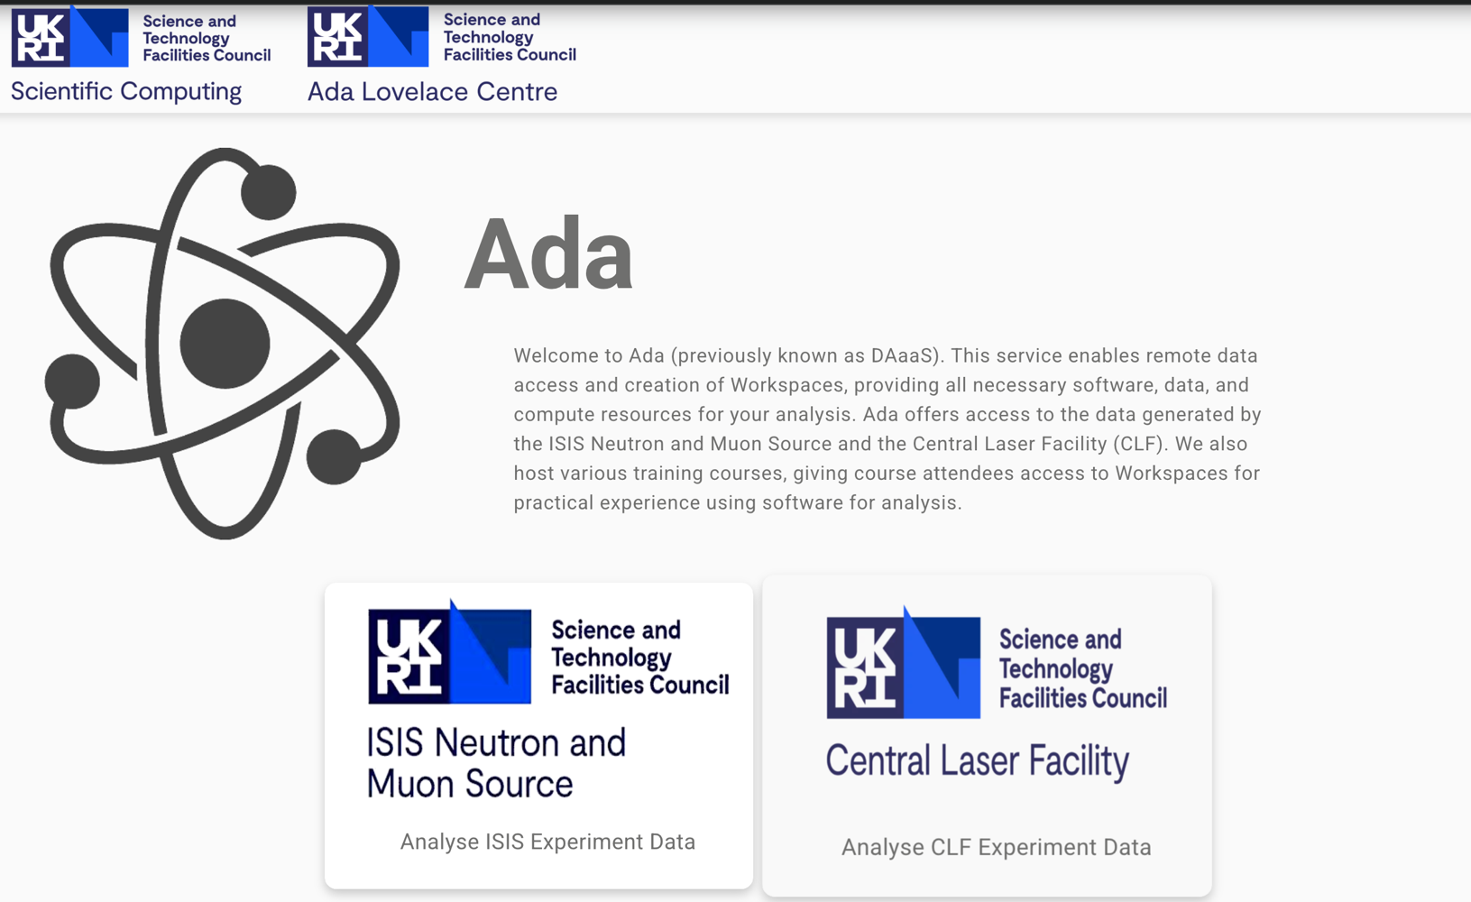
IRIS helped “smarten” existing CLF facilities
Historically low data volumes (except Octopus)
Bespoke data handling solutions – mostly manual
DAaaS (ADA), enabled via IRIS, changed this considerably
Allows academic users to access and analyse experimental data remotely – increasingly being used
CLF science spans from understanding cancer at cellular levels to creating stellar interiors in the lab
> 500 unique users per year

Slide 3
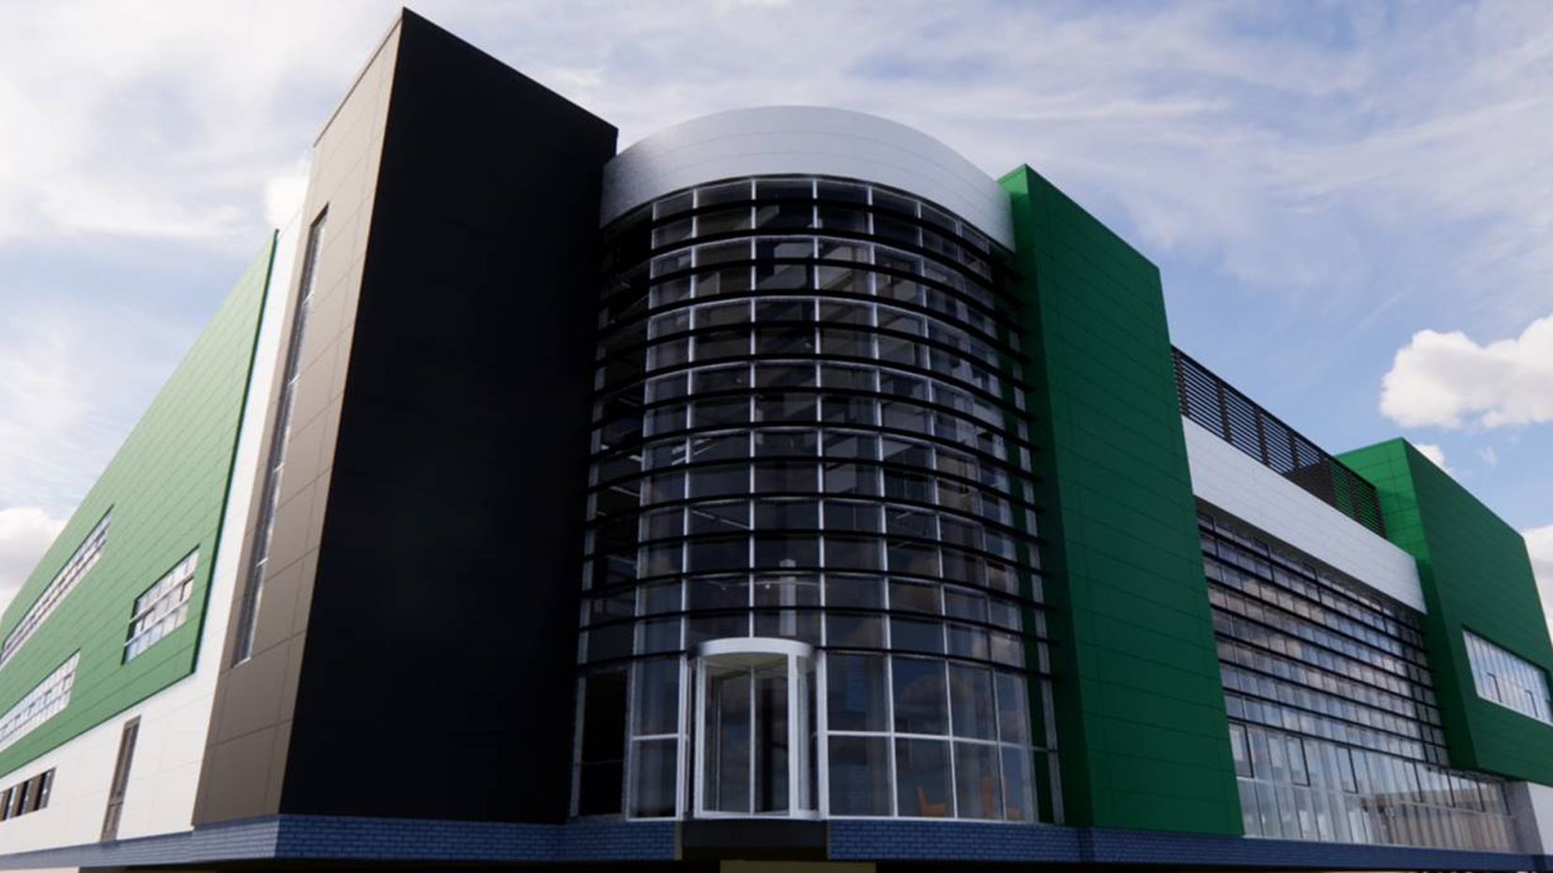
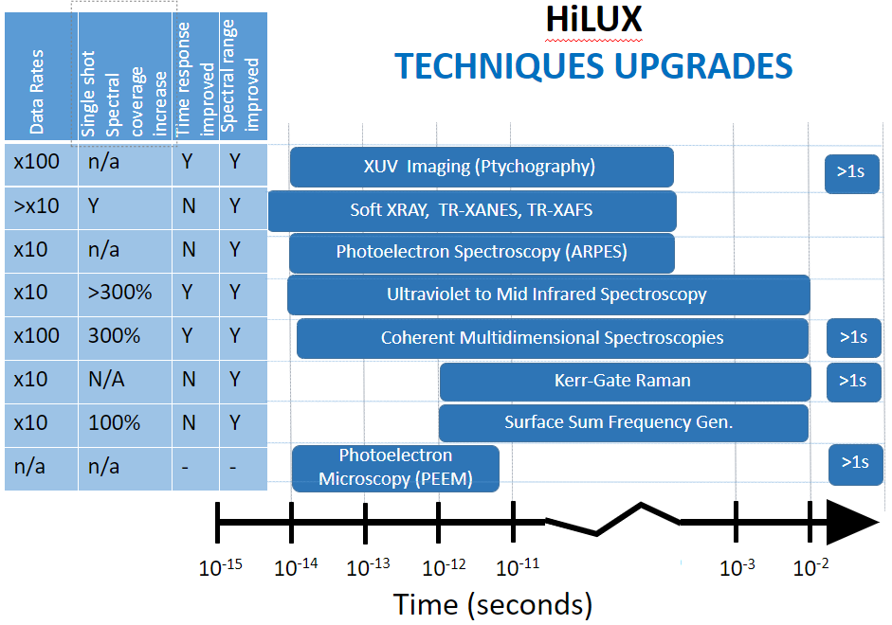
IRIS will be critical for upcoming CLF facilities
EPAC and HiLUX will be very data intensive
EPAC could accumulate ~PB/yr if we save all the data
IRIS supported solutions (ADA, storage etc.) will be critical for successful operation of these facilities
Year | GPU (note type) | CPU | Storage/Disk | Storage/Tape
2027-2028 | 10 – (RTX4000 or similar) 10 - Visualisation | 1600 | RAL – Echo 150 TB RAL – Deneb 2000 TB | RAL – 2000 TB
2028-2029 | 10 – (RTX4000 or similar) 10 - Visualisation | 1700 | RAL – Echo 200 TB RAL – Deneb 2000 TB | 3000TB

