Slide 1
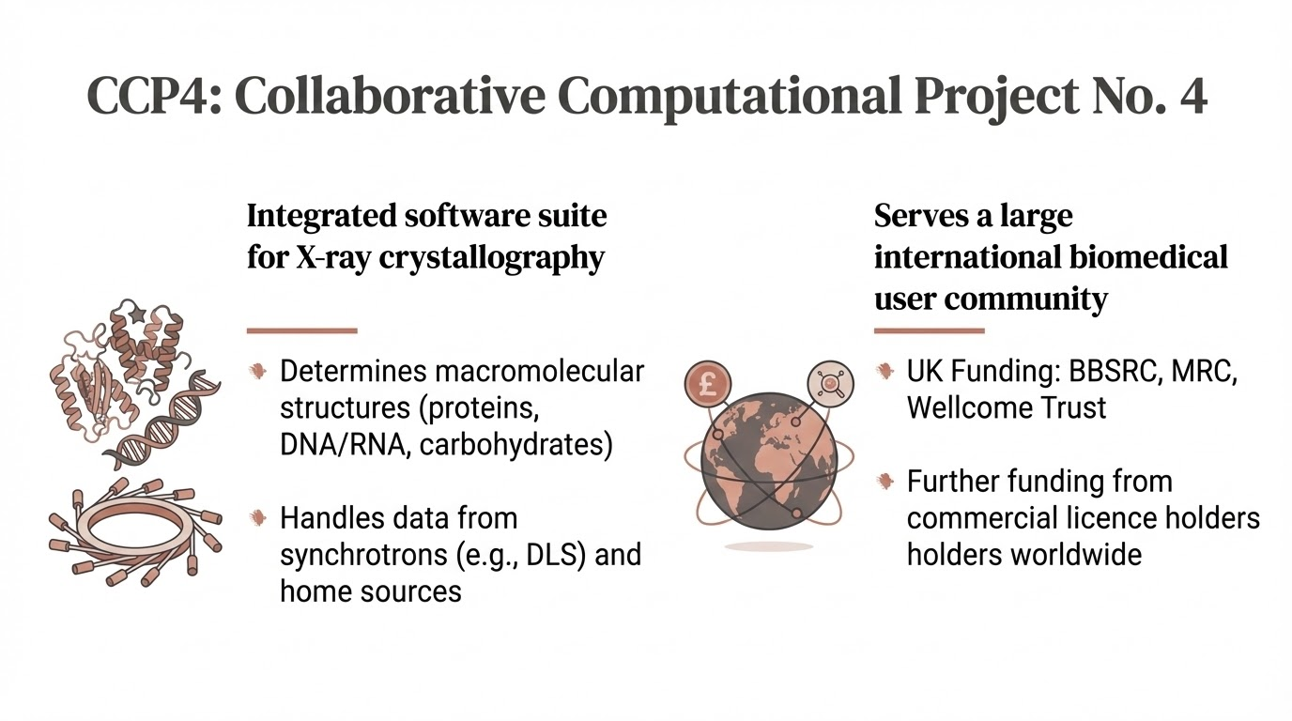
since 1979

Slide 2
