Slide 1

How IRIS Enables Science At
Diamond Light Source
-
Chris Reynolds – Principal Platform Engineer
DLS Scientific Computing
IRIS Collaboration Meeting Jan 2026

Slide 2

Contents
The science Diamond does on IRIS
Some history
Compute and storage architecture
Queue configuration
xChem & eBIC
Summary

Slide 3
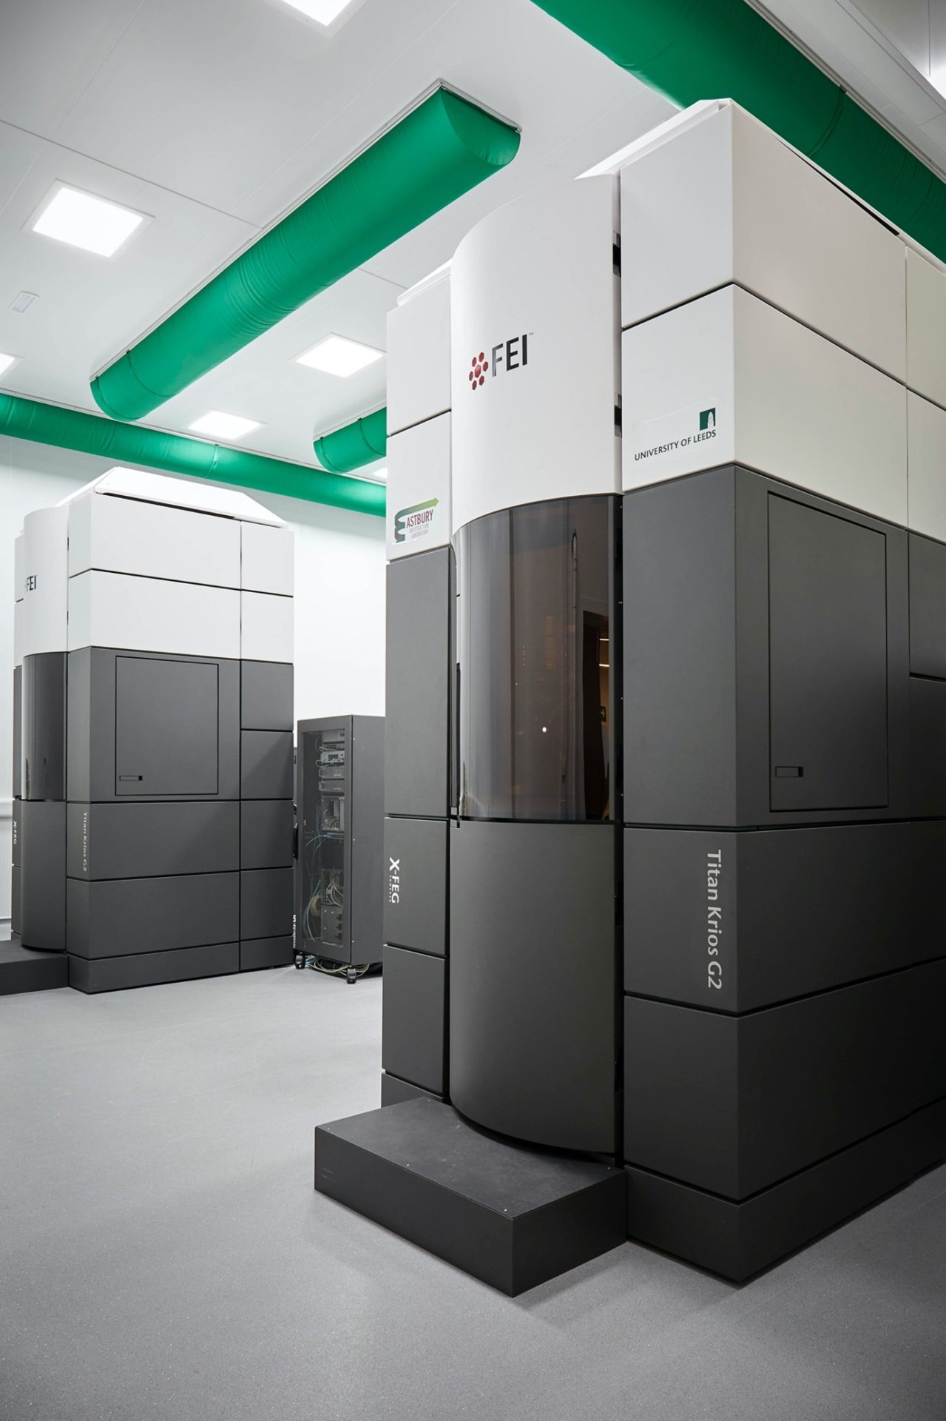
Diamond on IRIS: Science Use Cases
Macromolecular Crystallography (MX) Pipelines *
  Automated, submitted by a workflow engine/middleware
  Electron Density Maps built from beamline X-Ray Data
eBIC (electron Bio-Imaging Centre) *
  Tomogram reconstruction
Spectroscopy
  Pre-visit simulations, prototype application
XChem
  Fragment Screening Web Application:
  https://fragalysis.diamond.ac.uk
eBIC Titan Krios Electron Microscope (EM)
DLS has 8 EMs
* Cloudbursting based on high demand
Notes:
HostPath and Kyverno act together to negate the need for separate Cloud and HPC storage pools. Single biggest factor for K8s adoption.
Training, one to ones, certs and rbac managed

Slide 4
Some History...
Diamond has been using IRIS for approx. 7 years
STFC has been our IRIS provider. They do an awesome job!
Various science use cases have come and gone
Always "opportunistic" or "post-visit-processing"
The compute scheduling infrastructure DLS runs on IRIS has been through several iterations
Much experience gained about how to offer DLS Scientists reliable and performant computing infra based on IRIS components
This experience guides our current choice of tools and architecture

Slide 5
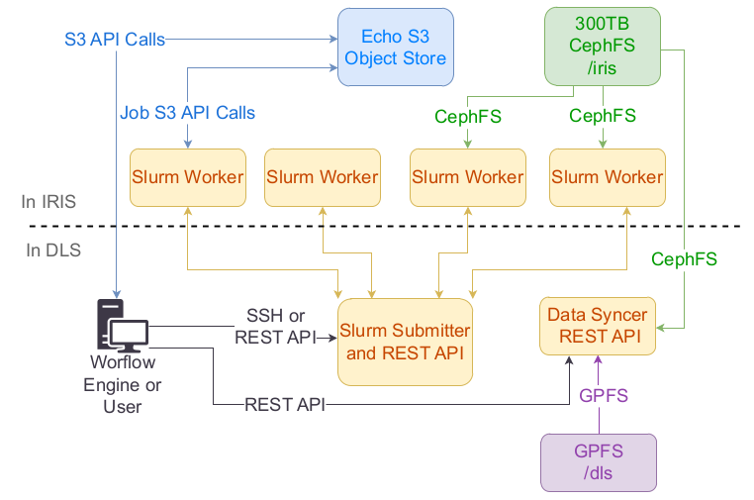
Current Infrastructure
Data syncer REST API moves data from DLS GPFS to Arided Flash CephFS (retains POSIX ACLs)
Some data also held in Echo/S3
Workflow Engine or User interacts with REST API or Slurm CLI to submit
OpenVPN connects Slurm submitter to workers (allows interactive jobs, no direct login)
DLS based AuthN/Z
Singularity/Apptainer only for bins & libs
Bulk of DLS IRIS allocation lives in Slurm (GPUs, ~7000 CPU Cores)

Slide 6
Queue Configurations
A queue (Slurm partition) per science use case
Some science use case partitions/queues only present on some instances
A preemptible main partition/queue that is present on all instances
A separate GPU partition/queue that is first come first served
Effectively guarantees resource for the science use case, but offers the resource to anyone (via main partition/queue) if the science use case is not using it

Slide 7
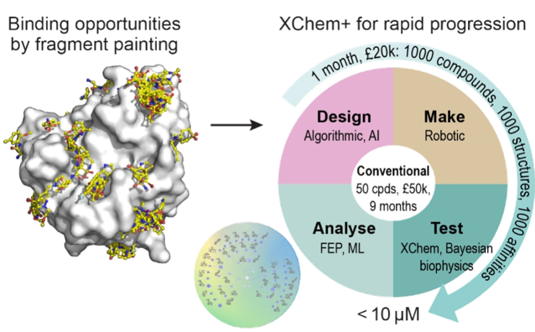

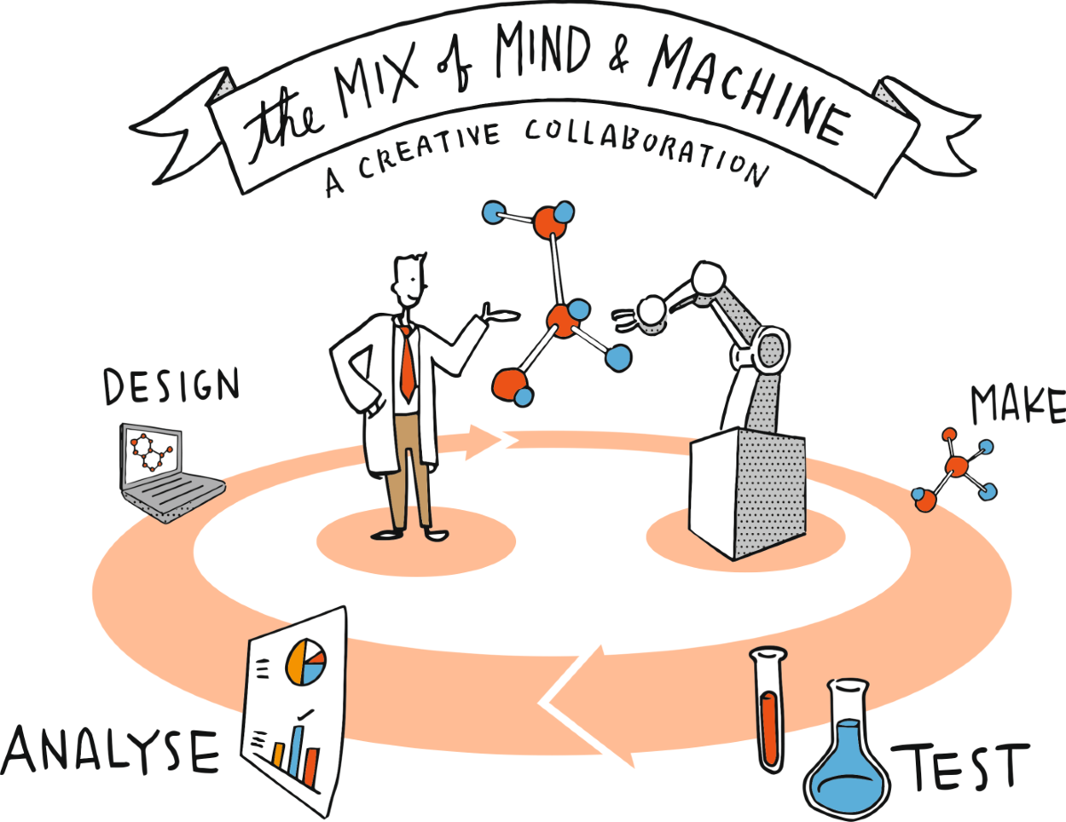

Accelerating Drug Discovery Through Computational Speed – MX/xChem
The Challenge:
Traditional drug discovery: Finding the right molecule = months or years of lab time
We used Fragment Screens to speed up the process to give 'hot starts' on target:drug interactions. Combining Crystallography and chemical data.
Design → Make → Test → Analyze"(the DMTA cycle)
Each step generates massive amounts of data
The IRIS Solution:
1000x Algorithmic Merging: IRIS performed docking to computationally merge fragment hits into larger molecules
1000x Retrosynthetic Elaboration: IRIS ran enumeration of building block combinations to design synthetic routes
Procurement Analysis: IRIS identified which building blocks were actually available for purchase—making designs practical to synthesize
The Impact:
From 10¹ fragment hits → 10³ merges → 10⁶ elaborations → 10³ selected → 10¹ validated hits
Chemists could focus on making only the most promising compounds, not guessing blindly
Entire DMTA cycle compressed from months to weeks
These cycles supported Moonshot and ASAP antiviral discovery projects. Many antiviral targets using IRIS cluster computing for drug discovery

Slide 8
Macromolecular Crystallography – IRIS Driven Protein Structure Determination
Structural biology output is unprecedented:
Structural Biology Core has collected 18,353 datasets as of 1st of April 2024
601 structures deposited in Protein Data Bank by ASAP project in 2023
955 for all of Diamond, 916 for all American synchrotrons
Open Science: 5 preprints, 63 Addgene, 24 protocols.io, 138 assays, 2104 compounds on ChEMBL
http://asapdiscovery.org
https://covid.postera.ai/covid

Slide 9
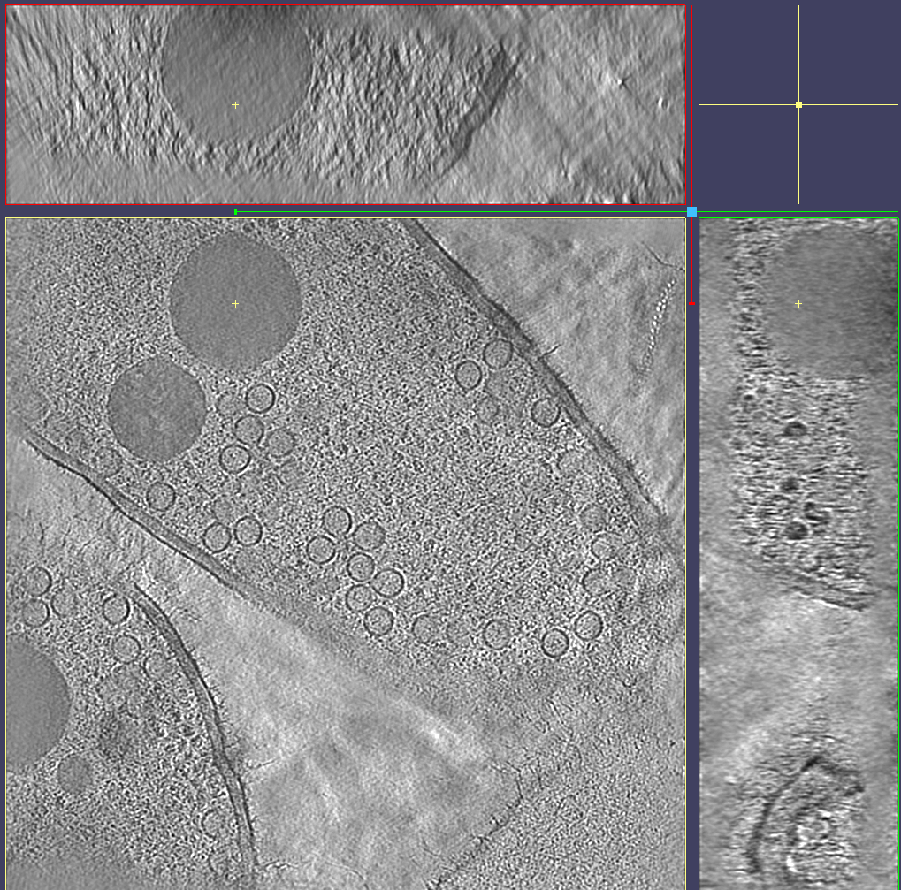
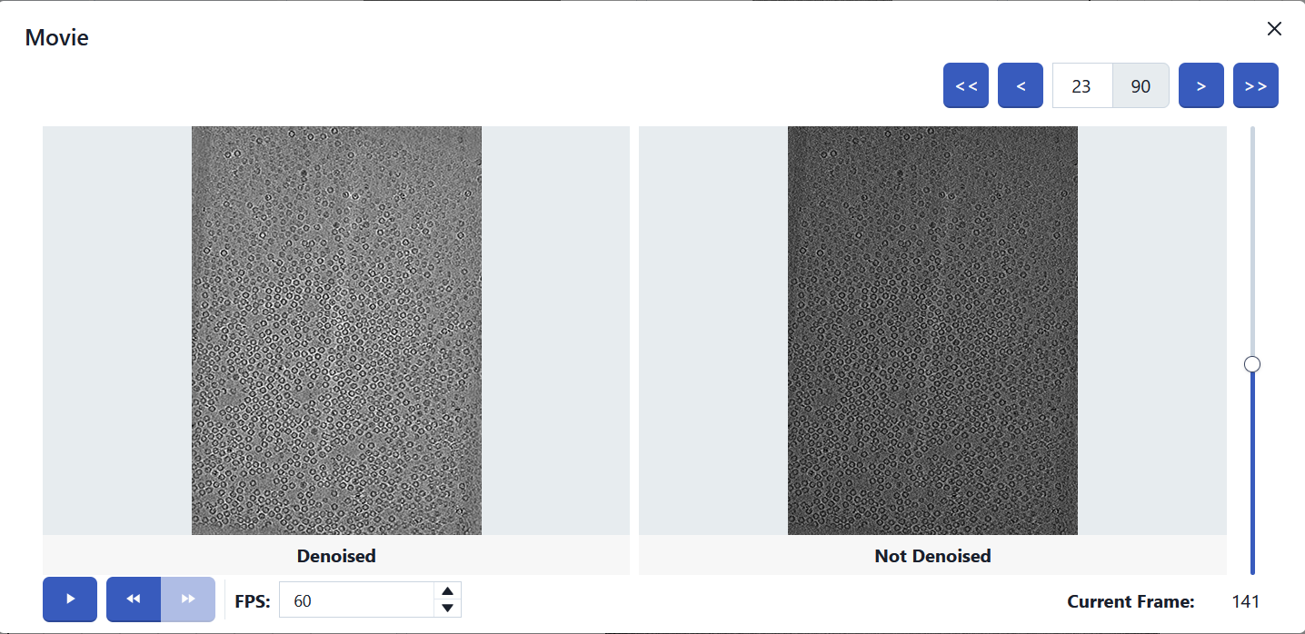
eBIC
We use IRIS to opportunistically reconstruct 3D tomogram volumes and then denoise them
Both tasks are GPU processes taking around 5 minutes each
Data collection of tomograms is completed in bursts, so IRIS allows us to overflow processing from the Argus cluster at times of high demand
This means we give users feedback about the quality of their data quicker
Fast feedback allows users to decide whether to continue collection or make changes to fix any problems

Slide 10
Summary
Slurm + Apptainer built on the IaaS parts of IRIS
Scientists mostly interact with Slurm and a data mover API only (no Openstack access)
Hosts https://fragalysis.diamond.ac.uk web application allowing fragment hit visualisation and investigation
IRIS is driving the "Open Source" contribution of high throughput drug discovery by xChem
Real time experiment steering for eBIC

Slide 11
Thanks! Questions?
Acknowledgements Past and Present:
DLS Cloud Team:
Thomas Hartland, Sachin Gautam, Godson Alex, John Davies, Subin Saji, Richard Parke, Althaf Mohamed-Koya, Sam Diserens
cloud.manager@diamond.ac.uk for future questions

