Slide 1
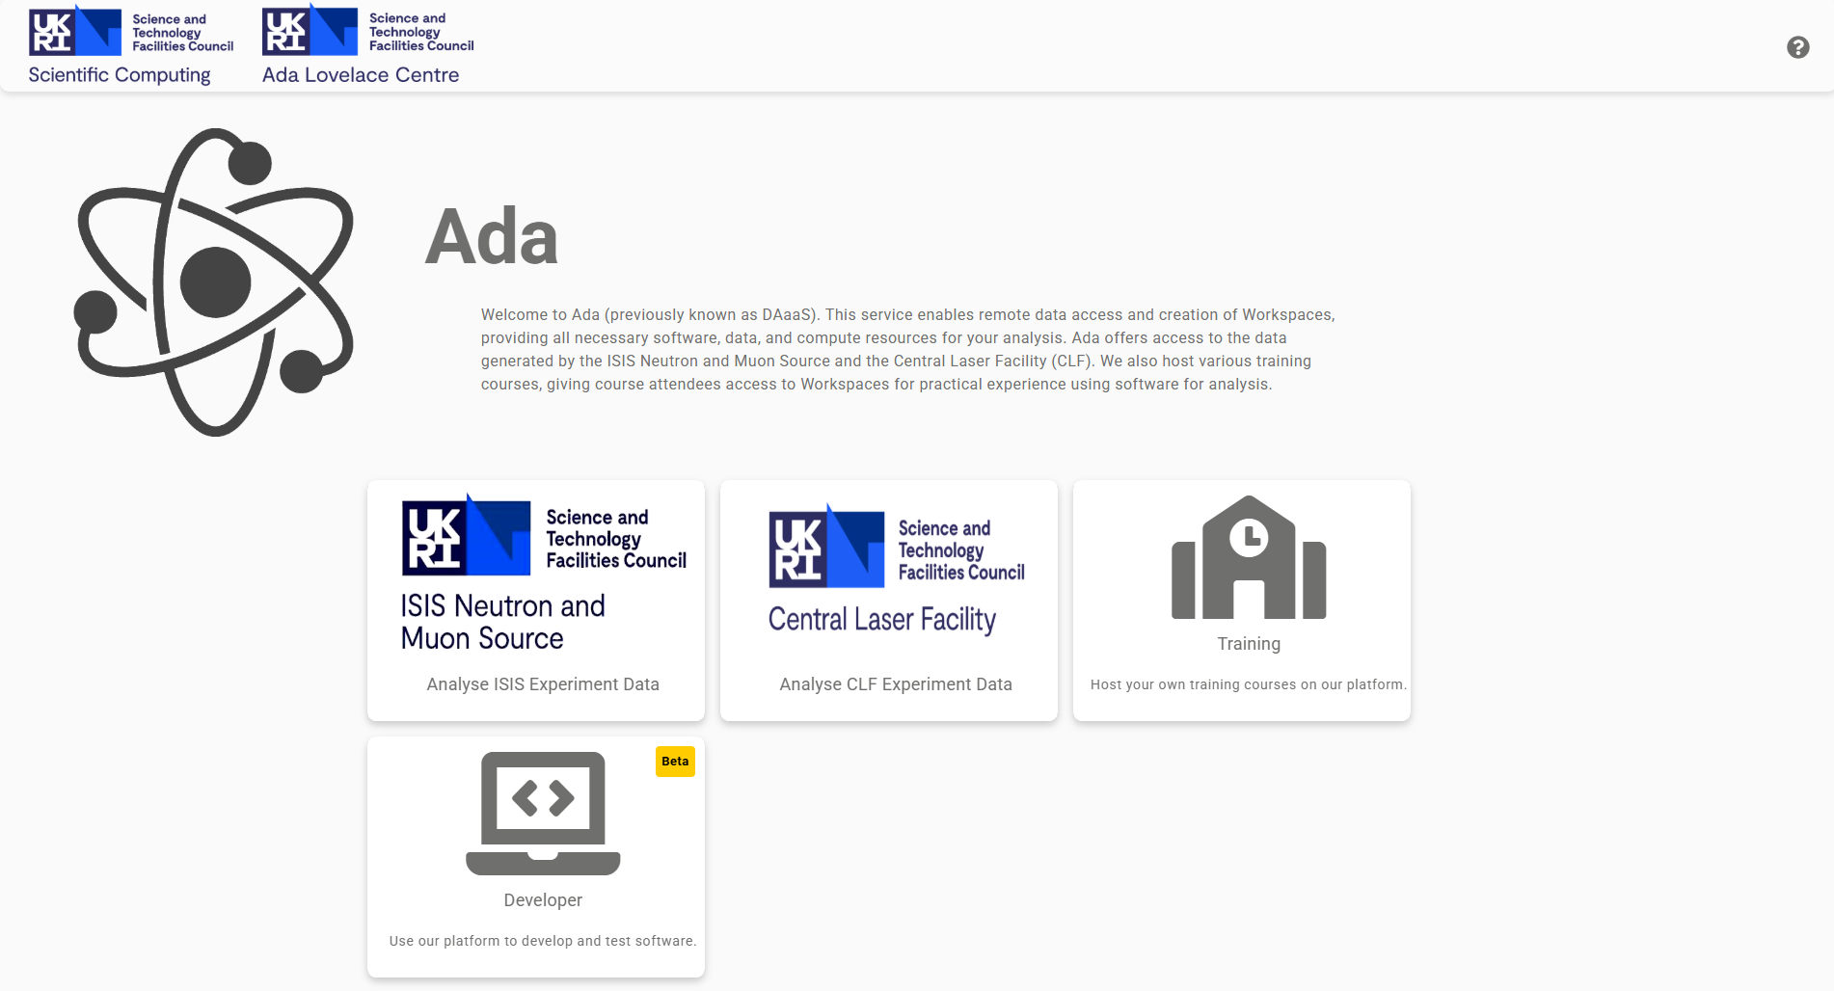
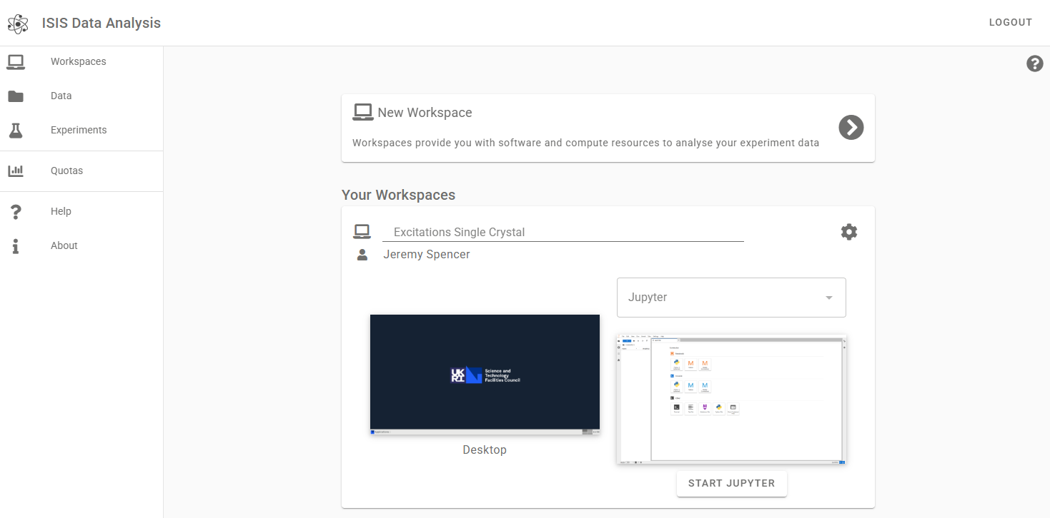
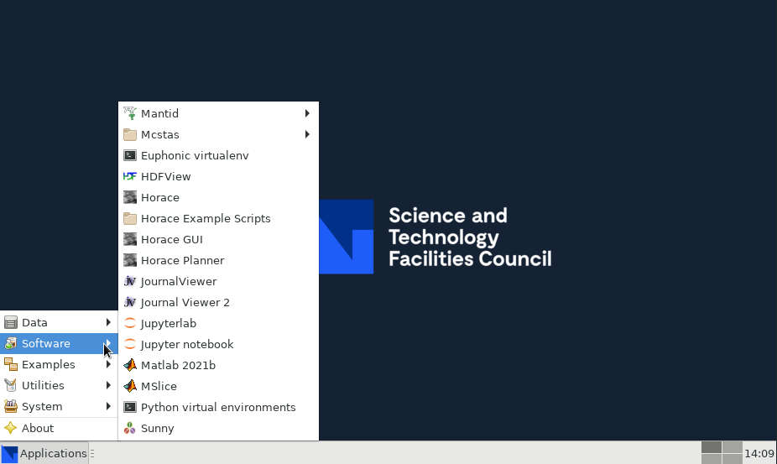


DAaaS - Ada
DAaaS Group (Data Analysis as a Service)
  Provides Ada (called IDAaaS for ISIS)
    https://ada.stfc.ac.uk/
  Part of Platforms & Services in STFC Scientific Computing
  Funded by the Ada Lovelace Centre
Ada
  Interactive remote desktop sessions and notebooks for data analysis
  Brings together data, software and compute resources for a variety of scientific workflows
  Primary focus on STFC Facilities
  Training interface enables interactive sessions, removes setup time on the day
Notes:
DAaaS Group:
The DAaaS group develops and runs Ada (called IDAaaS when used by ISIS).
For more information about Platforms & Services in STFC Scientific Computing, see Tom Dack’s talk in the session five introduction.
The Ada Lovelace Centre funds the staff effort to develop and support Ada for STFC Facilities
Ada – Simple access to:
Interactive workflows
Remote desktop
Web based software (Jupyter, etc)
VMs preconfigured with required software and data access

Slide 2
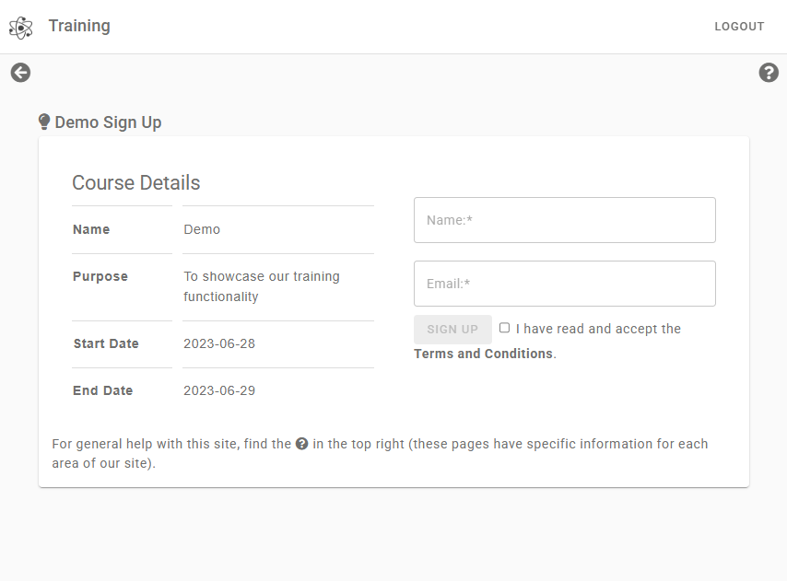
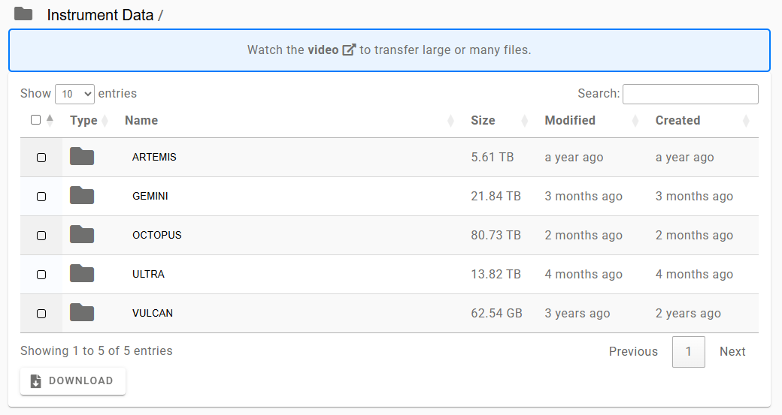
DAaaS - Ada
Timeline
2019
  DAaaS goes into production for two groups in ISIS
  “over 30 VMs in concurrent use”
  50 unique users over the year
2020
  Supporting the rest of the ISIS instruments
2021/2022
  Supporting CLF
2023
  Training platform deployed
2024
  Supporting ePSIC group in Diamond
2025/2026
  Concurrent connections to VMs up to ~200
  1500 unique users over the year
Ada provides access to IRIS hardware for these science cases:
  ISIS
  CLF-Other
  Diamond (a small portion so far)
  SciML
IRIS hardware used through Ada
  RAL Cloud
  Ceph (Deneb, Echo)
  Tape
Notes:
(Hardware related to Ada/IDAaaS)
ISIS – a large portion of their hardware last year came from IRIS, the rest they funded directly
CLF – all the hardware we provide access to for CLF comes from IRIS funding
Diamond – we’re in a prototyping phase and only use a small part of their IRIS funded hardware
SciML – AI for Science Theme is using a different Ada interface to the others, and we’re looking to consolidate that into a single platform
IRIS hardware:
RAL Cloud – VMs which contain our platform and users’ Workspaces.
Ceph (mostly the Deneb cluster) – home directories and experiment data
Tape – We back up raw experiment data from CLF to tape
Timeline:
We went into production in 2019 with just a few ISIS instruments supported, a few users and VMs (prior to IRIS funding).
Over the years we expanded to support all ISIS instruments (except ChipIR), CLF, developed a training platform, and started working with ePSIC in Diamond.
Now over 1500 different people have used the platform in the last year, and over 3000 since 2021.
This growth was made possible or at least much easier due to support and funding from IRIS.

