Slide 1


AI for Automated Facilities and Scientific Discovery at Rutherford Appleton Laboratory
IRIS Collaboration Meeting- IRIS: A Decade of Discovery & Collaboration
January 13 to 14, 2026
Jaehoon Cha

Slide 2
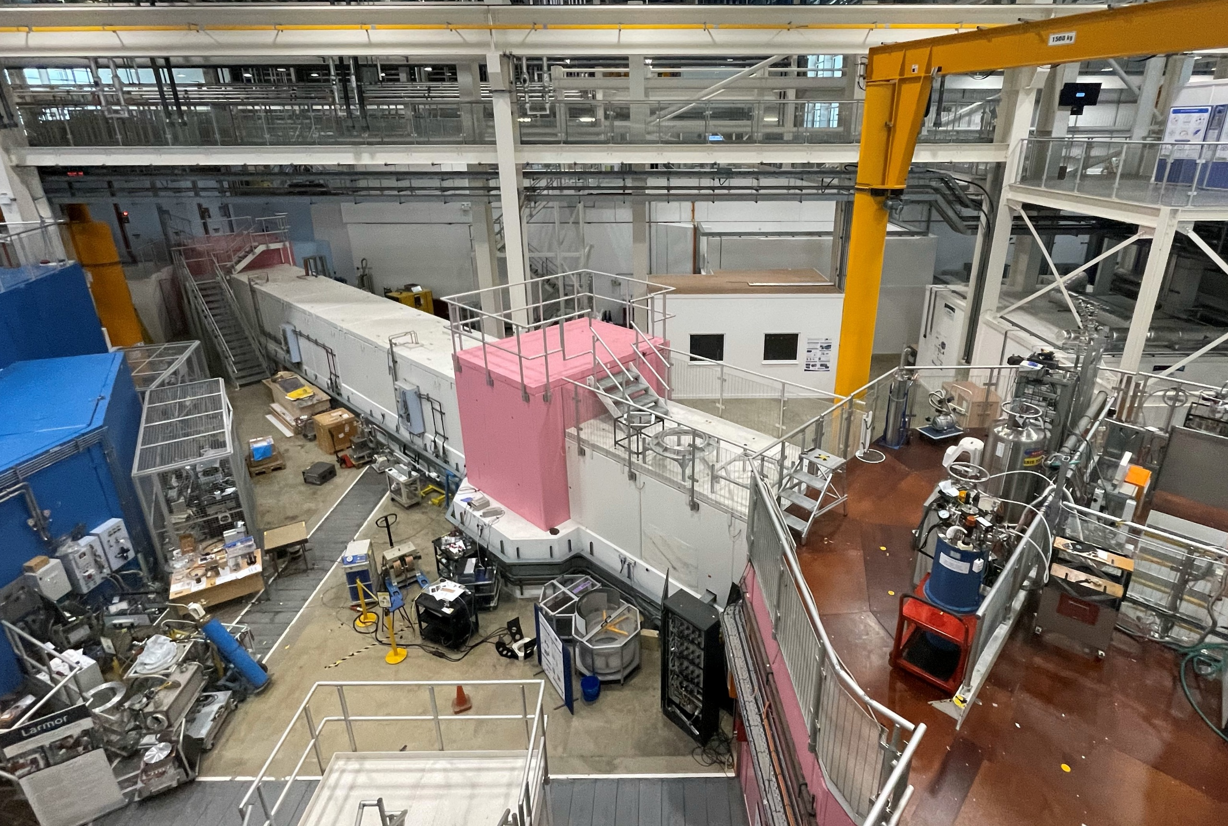
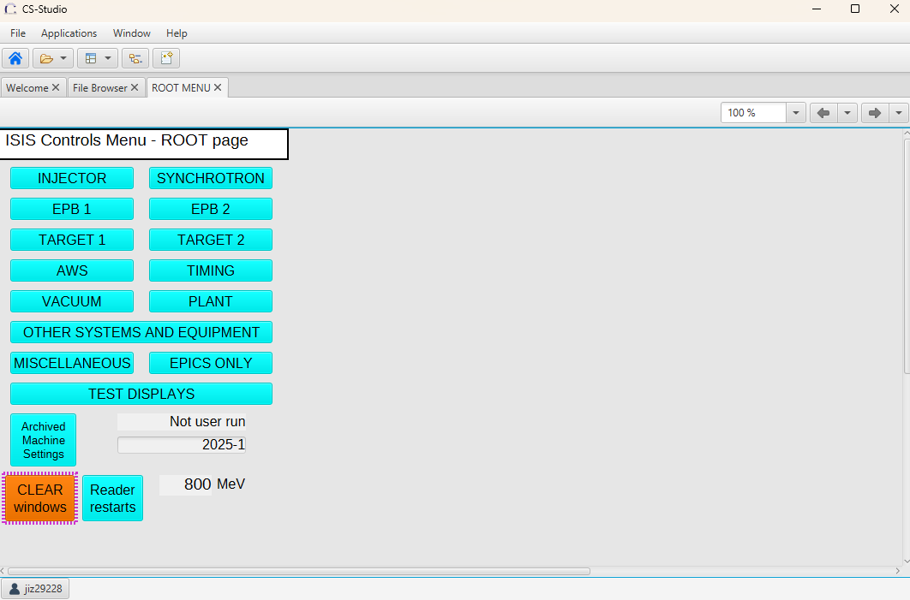

Two Programmes
AI for Accelerators
Uncertainty-Aware Surrogate Modelling
Efficient Optimisation Strategies
Feedback System/Continual Learning
Real Machine
Digital Twin
Automate Scientific Discovery
Data Analysis
Data
Facilities
Preprocessing
Detection
Feature Extraction
Data Collection

Slide 3
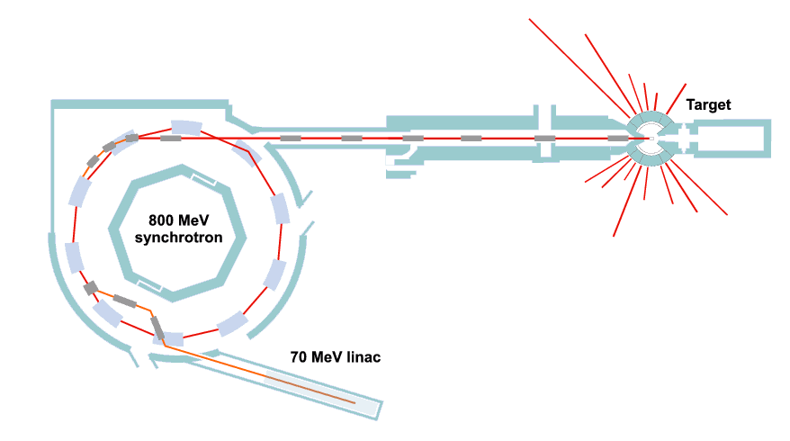
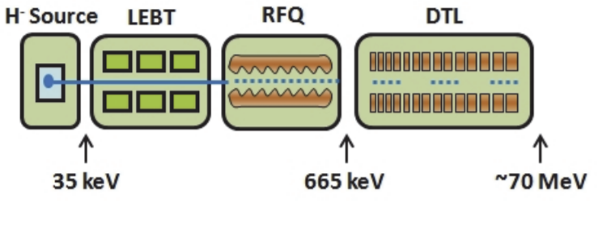
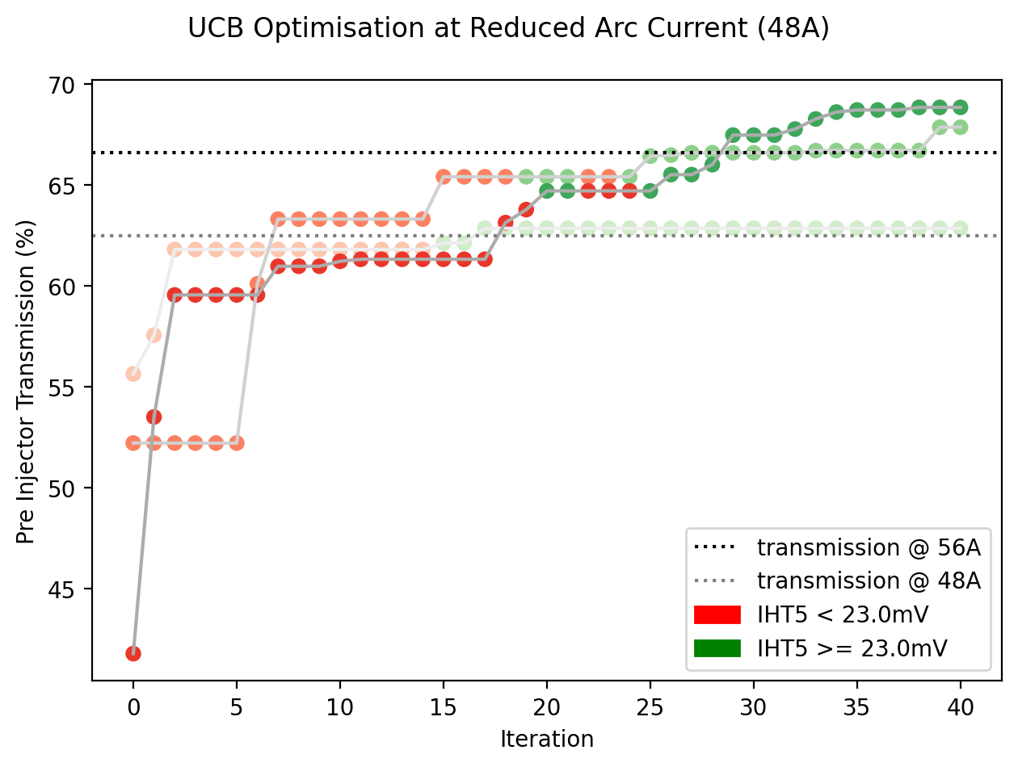
Optimisation for the Low Energy Beam Transport (LEBT)
Objective is to maximise pre-injector Transmission.
Constraint is to keep IHT5 current above a threshold.
Tuning 3 solenoids and 3 dipole magnets.
Surrogates help test safer versions of BO.
Able to achieve ~70% transmission in 20-30 mins.

Slide 4
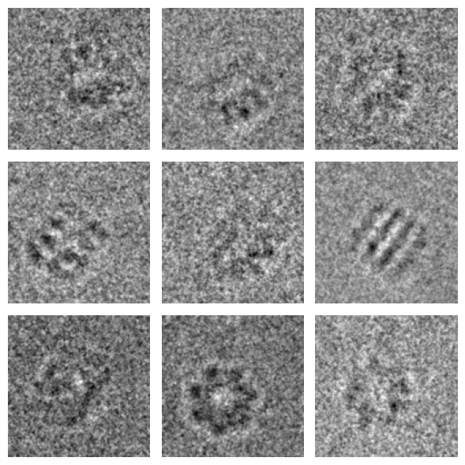
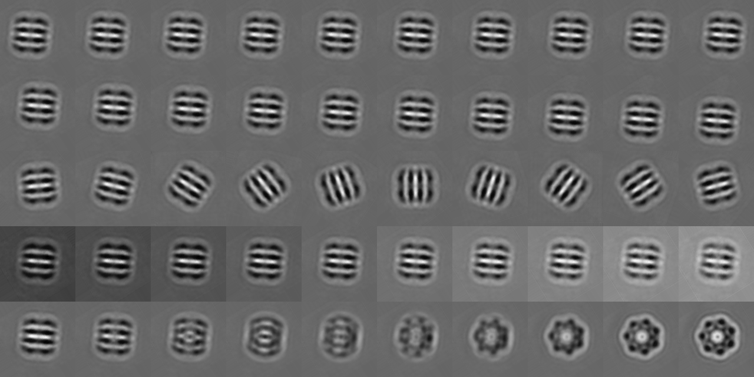
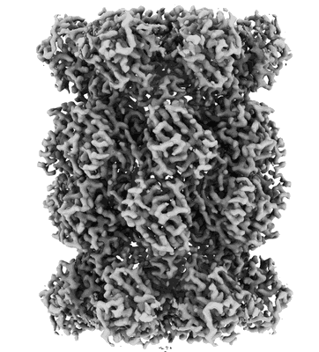


CryoEM single particle analysis
Examples of 2D Protein Projections
The cryoEM single particle analysis method generates 2D projection images with low signal-to-noise ratios.
Grouping 2D projections of the molecule captured from similar viewing angles (or object poses) and aligning them improves the signal-to-noise ratio.
Latent traversals
$x$ position
$y$ position
in-plane orientation
background
out-of-plane orientation

Slide 5
Summary
Advancing UK research through world-leading facilities (ISIS Neutron and Muon Source, Diamond Light Source, and CLF) by developing AI pipelines that accelerate data collection, analysis, and scientific discovery.
Enhancing accelerator performance, reliability, and control using machine learning, including surrogate modelling, optimisations and feedback systems.
Enabling data-driven scientific insight across modalities, through preprocessing and segmentation, and disentangled representation learning methods that uncover physically meaningful features and support more efficient experiment design and data interpretation.

Slide 6



scd.stfc.ac.uk
@SciComp_STFC

