Slide 1


Technology & Service Development Panel Introduction
Tom Dack
Federating Services Group Leader,
STFC Scientific Computing
Notes:
The abstract pattern can be removed or repositioned if required. Be careful to ‘Send to Back’ so that it does not obscure any important information.

Slide 2
Technology Underpins IRIS
To develop cutting-edge Digital Research Infrastructure, IRIS needs to support the development, iteration, and delivery of cutting-edge technology and services
However, IRIS’ investment in supporting and driving these areas in turn enables the growth and development of these activities, increasing the impact and delivered value – not just to IRIS, but to partner communities and organisations too

Slide 3
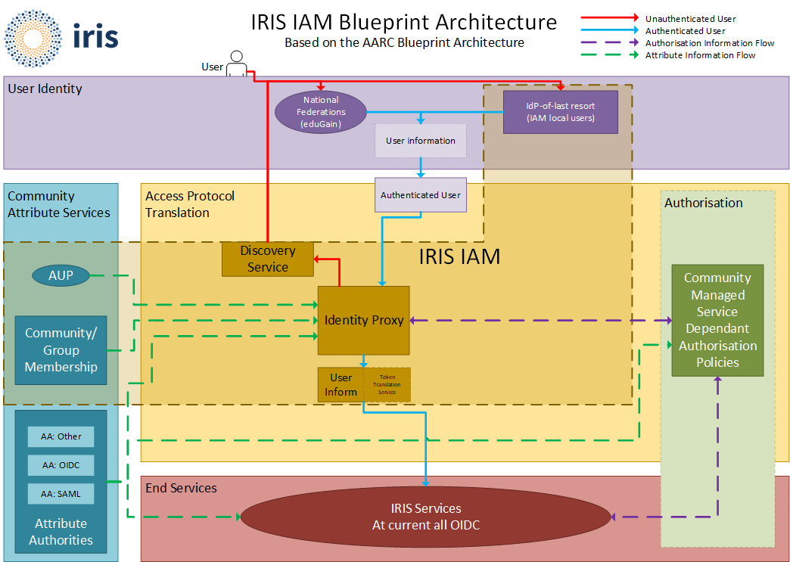
My Experience – IRIS IAM
The development of the service that would become the IAM started in 2018, and has grown alongside the IRIS community
Initially funded via Digital Assets for proof of concept for the value of a federated identity and attribute management platform
Architecture Blueprint for IRIS IAM, ca. 2019

Slide 4
Federation and IRIS
IRIS IAM has grown to a core underpinning service for IRIS, and facilitated the development of federated workflows
The experience and expertise built within IAM and linked activities has provided clear value to both IRIS, and partners
Federated systems and technologies an underpinning concept within the UKRI DRI programme, an initiative to develop a coherent, federated, and world-class national digital research infrastructure

Slide 5
Federation and IRIS
IRIS’s ongoing support of technologies and services have been a major step towards Federation within STFC science
Notable activities and success include:
  Identity management – as mentioned
  Storage and Data Transfer
  Accounting and Grid Topology
As well as Platforms, such as Ada, and Cloud Providers

Slide 6
Platforms & Services
STFC Scientific Computing has taken steps to unify its provision of many of these services through restructuring in 2025
The Platforms & Services theme, led by Alastair Dewhurst, brings together technology and service activities, for more cohesive delivery to communities and customers
  This includes the Tier-1, SCARF, Jasmin, Ada as platforms
  As well as Federation Enabling Services, such as IAM, APEL, FTS, among others.

Slide 7
Panelists
Storage: Ceph - Tom Byrne
Identity Management: IRIS IAM - Donald Chung
Accounting: APEL - Adrian Coveney
Data Movement: FTS - Rose Cooper
Security: Policies and Communities - David Crooks

